Slide 1
MOOD STABILIZING DRUGS

Slide 2
MOOD STABILIZING DRUGS
ILOs
By the end of this lecture you will be able to:
Recognize the possible causes in mood swing in bipolar depression
Classify mood stabilizing drugs
Focus on the mechanism of action of lithium as a mood stabilizer
Expand on its pharmacological actions, kinetics, indications, side effects, contraindications & toxicity

Slide 3
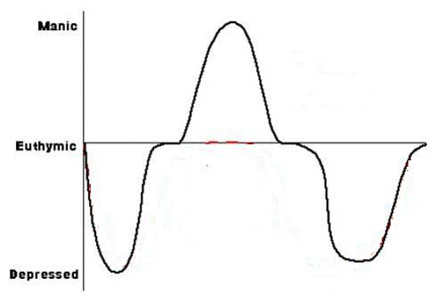
A MOOD STABILIZER
Is a psychiatric medication used for treatment of
mood disorders
characterized by intense & sustained mood shifts
typically in bipolar depression
i.e .
Suppress Swings between
MANIA & DEPRESSION
= depressed energy levels, moods & cognition
= Elevated energy levels, moods & cognition
Separated by periods of "normal“ mood
BIPOLAR DEPRESSION

Slide 4
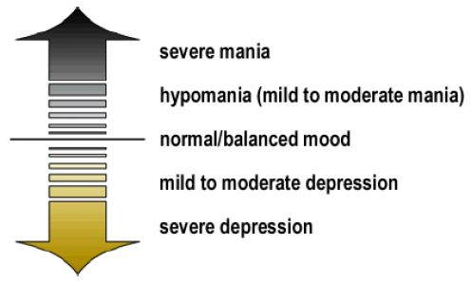
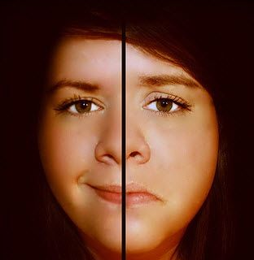
BIPOLAR DEPRESSION [BP]
An affective health disorder, characterized by cycling from depression to mania [hypomania] and back again over time; so there are switch in person’s mood, energy levels and ability to function
a spectrum or
continuous range
CYCLING
Rapid
Cycles back & forth in the course of a day or multiple times a week
Slow
Stuck in one mood or the other for weeks or months at a time

Slide 5
CHARACTERS OF MANIA
Emotional Symptoms
Happy, excited, euophoric
Unwarranted optimism
Irritated with those who do not share same feeling
Thinking Patterns
Behavioral Patterns
Full of new, exciting ideas
Moving quickly from one to another (flight of ideas)
Lack of judgment
Very active, behaving unusually
Less inhibited in general
Plans are grandiose & unrealistic
Excessive rapid talking
Sudden odd decisions, that are mostly of disastrous consequences
Recklessly spending of money
Over-familiar with other people
Sudden irritability, rage or paranoia
Biological Symptoms
Hyperactive & full of energy
Unable or unwilling to sleep
More interested in sex

Slide 6
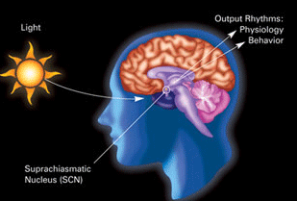
A MOOD STABILIZER
Reset Back the Master Clock
Circadian cycle becomes slower Circadian period becomes longer
-
-
-
-
-
-
-
-
-
-
-
-
-
-
-
-
-
-
-
-
Metabolism, Hormones, Transmitters, Sleep-Wake patterns …. Become Adjusted

Slide 7
MOOD STABILIZER
MOOD STABILIZER
MOOD STABILIZER

Slide 8
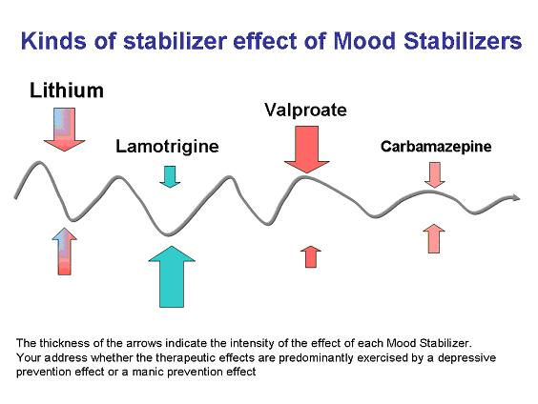
Classification of MOOD STABILIZING DRUGS
Lithium Carbonate
Benzodiazepines
Antiepileptics
Atypical antipsychotics
Valproic acid
Carbamazepine
Gabapentin
Lamotrigine
Topiramate
Olanzapine
Risperidone
Quetiapine
Clozapine
Are used for;
Prophylaxis in bipolar disorder therapeutic effects more predominates, either for prevention of depression or mania
Mono or in combination therapy with lithium in acute mania.

Slide 9
Lithium [ Li⁺]
As salts carbonate or citrate are used as drugs
MANIA
DA
Mechanism
Can substitute ions as Na
alter excitability thresholds, conductivity potentials, ….etc.
Can compete for Mg binding sites that activate many key cellular enzymes that signal the effects of many transmitters i.e altering cAMP, PI turn over & DAG productionspecially myoinositol , PKC…..etc.
◉ glycogen synthase kinase-3 (GSK-3)  affects Circadian Cycle Gene Expression
Implicated in long term modulation of Genes Responsible for Neuroplasticity & Neuroprotection
Circadian cycle becomes slower Circadian period becomes longer
Adjusting neuronal morphology, neurotransmission, synaptogenesis, axonogenesis, survival & apoptosis)
Valproic acid & Lamotrigine

Slide 10
Lithium mechanism of action
Lithium inhibits recycling of inisotol substrates, causing depletion of the second messenger source PIP2
and reduce release of IP3 and DAG.
Lithium has however multiple mechanism of actions.

Slide 11
Pharmacokinetics
Completely absorbed from GIT.
Peak plasma levels within 30 minutes to 2 hours
Long plasma half-life (20 hr).
Not bound to plasma proteins.
Not metabolized in the body.
Distributed in all body fluids
Slow entry into intracellular compartment.
Has a slow onset of action (takes 3-4 days to act, so sedative drugs should be given as haloperidol I.V.).

Slide 12
Pharmacokinetics
Excretion mostly in urine. Lithium clearance is about 20% of creatinine. Less is via, in feces, sweat, breast milk
Has a narrow therapeutic range.
Its concentration can be detected in plasma, saliva, urine.
Monitoring of plasma level is essential.
Target plasma concentration: 0.6–1.4 mEq/L

Slide 13
CLINICAL USES
Treatment of bipolar affective disorders.
Prophylactic of manic-depressive disorders.
Schizoaffective disorders.
Acute mania.
Aggressive behavior in children.
Premenstrual dysphoria.
Leucopenia [ make use of ADRs inducing leukocytosis ]

Slide 14
ADVERSE EFFECTS
Neurologic effects mainly tremors.
Psychotic effect as mental confusion.
Renal effects:
Polydipsia & polyuria (diabetes insipidus) .
Prolonged use cause chronic interstitial nephritis, nephrotic syndrome.
Edema, Hypernatremia, Increase body weight.
Disturbance in thyroid function (>hypothyroidism)
Cardiac effects:
Bradycardia-tachycardia (“sick sinus”) syndrome
T wave flattening in ECG.
Transient acne eruption & folliculitis.
Leucocytosis.
Teratogenic effects.

Slide 15
How (GSK-3) by lithium  can lead to ADRs in kidney
Li⁺
Li⁺

Slide 16
Drug Interactions
Diuretics e.g. thiazides 25% renal clearance of Li
NSAIDs decrease renal clearance of lithium.
Antipsychotic drugs mainly typical drugs causing severe extrapyramidal adverse effects.
Pregnancy   plasma level of lithium
Post partum  plasma level of lithium suddenly
PREGNANCY
NEWBORN
Breast milk ¹/₃ – ½ concentration of serum .
If toxicity  cyanosis, poor suckling & hepato-megaly.

Slide 17
Lithium Toxicity
Therapeutic over dose is more common than accidental
Values over 2 mEq/L  considered as  likely toxicity
Toxicity develops when given in the following cases :
Renal dysfunction
Postpartum
Dehydation or low salt diet
Concomittent drugs; diuretics, NSAIDs…
Treatment of toxicity  Peritoneal or Hemodialysis

Slide 18
MOOD STABILIZING DRUGS
GOOD LUCK

