Slide 1

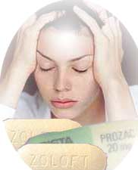
An intense feeling of
sadness hopelessness despair + inability to experience ordinary power to cope with regular life events
E
R
D
P
S
O
S
E
I
N

Slide 2

D E PRESSION
An AFFECTIVE DISORDER
Disturbance in mood rather than of thought or behavior
Yet it affects the way one feels about himself … (emotional changes), the way he person eats, sleeps,… (biological changes), the way one thinks about things….(though changes)
& the way he reacts….(behavioral changes)
Emotional symptoms
Biological symptoms
Abnormal sadness & often
weeping for no reason
Loss of energy & motivation
Loss of self enjoyment, self
confidence and interest in life
Feelings of guilt, useless, hopeless
Recurrent thoughts of death &
suicide
Loss of libido
Difficulty in getting to sleep
Waking earlier than usual
Loss of appetite &weight
but < may be the reverse
Constipation
Irritability / agitation /
restlessness

Slide 3
Thinking Patterns
Behavioral Patterns
Can not think positively or hopefully
Hard to make even simple decisions
Difficulty in concentrating
Difficulty in starting or
completing things
Can sometimes avoid
contact with other people
CLASSIFICATION OF DEPRESSION
Unipolar Depression
Bipolar Depression
Unipolar Depression
Mood swings are always in the same direction
> common (75%) > in elder /associated with stressful life effects
+ symptoms of anxiety and agitation (reactive depression)
The patients are usually inert

Slide 4
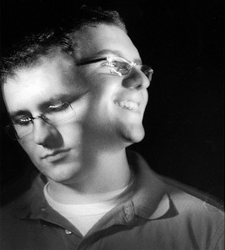

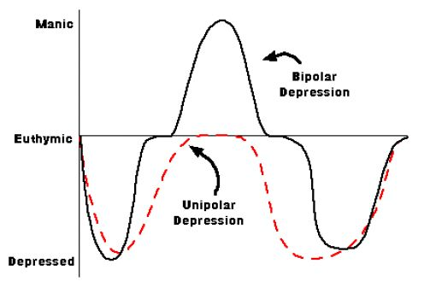
Bipolar Depression
Depression alternates & oscillates with mania
< common (25%), develops early in life, runs in families,
hereditary nature (endogenous depression) i.e related to genes
Episodes can sometimes be provoked by stressful
experiences or physical illness

Slide 5
Depression-symptoms
DSM-IV states that a mood episode is the experience of a strong emotion of
depression, mania, or a mixture of both for a period of at least 2 weeks
– Symptom must be newly present or have clearly worsened over the pre-episode state
– Must be present nearly every day for most of the day for 2 weeks

Slide 6

UNIPOLAR DEPRESSION

Slide 7
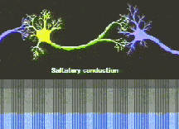
PATHOPHYSIOLOGY OF DEPRESSION
Too little monoaminergic activity
TRANSMITTERS
Alteration in receptor density
RECEPTORS
Abnormal 2nd messenger cascade  gene expression
SIGNAL TRANSDUCTION
NEUROTROPHIC REGULATION
brain-derived neurotrophic factor  hippocampal atrophy &  neurogenesis.
SYNAPTIC TRANSMISSION

Slide 8
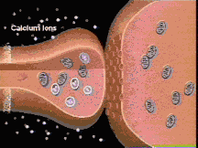
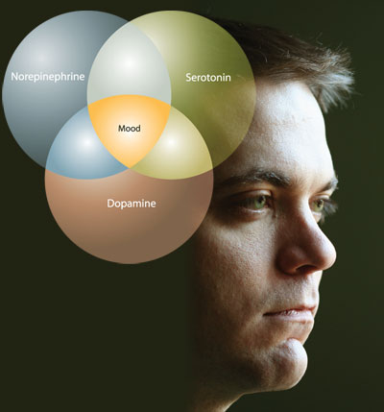
PATHOPHYSIOLOGY OF DEPRESSION
Not distinguished clearly
SYNAPTIC TRANSMISSION
Dopamine; in mesocortical, mesolimbic, nigrostriatal, tuberoinfundibular pathways & motor system
Regulates reward & pleasure, psychomotor activity, cognition, nausea & endocrine systems
NE; in locus coeruleus & lateral tegmental field.
Regulates alertness & arousal, reward & appetite.
5-HT; dorsal (& rostal ) raphe nucleus
Regulates mood, sexual behavior , satiety, temperature, sleep, cognition, sensory perception decreasing nociception, and hormone secretion.
Neurotransmitter Imbalances & Dysregulation
 creates a state of deficiency in monoamines ???

Slide 9
MONOAMINE THEORY OF DEPRESSION
Strengths of the theory
1. CSF studies.
5H1AA HVA (main metabolites of 5H-T and Dopamine) reduced in CSF of Depressed people and suicide victims.
2. Platelet studies:-
Uptake of 5H-T and metabolism of 5H-T is altered in depressed and suicidal people.
3. Pharmacological Evidence: Drugs which are effective against depression (tricyclic and SSRIs) inhibit reuptake of NA and/or 5H-T

Slide 10
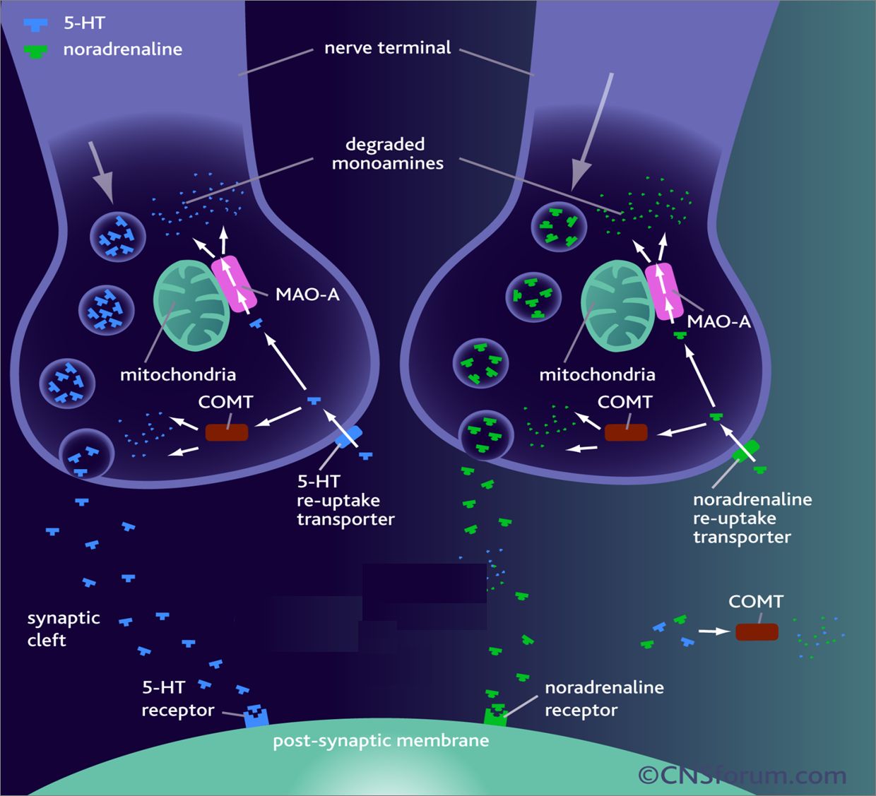
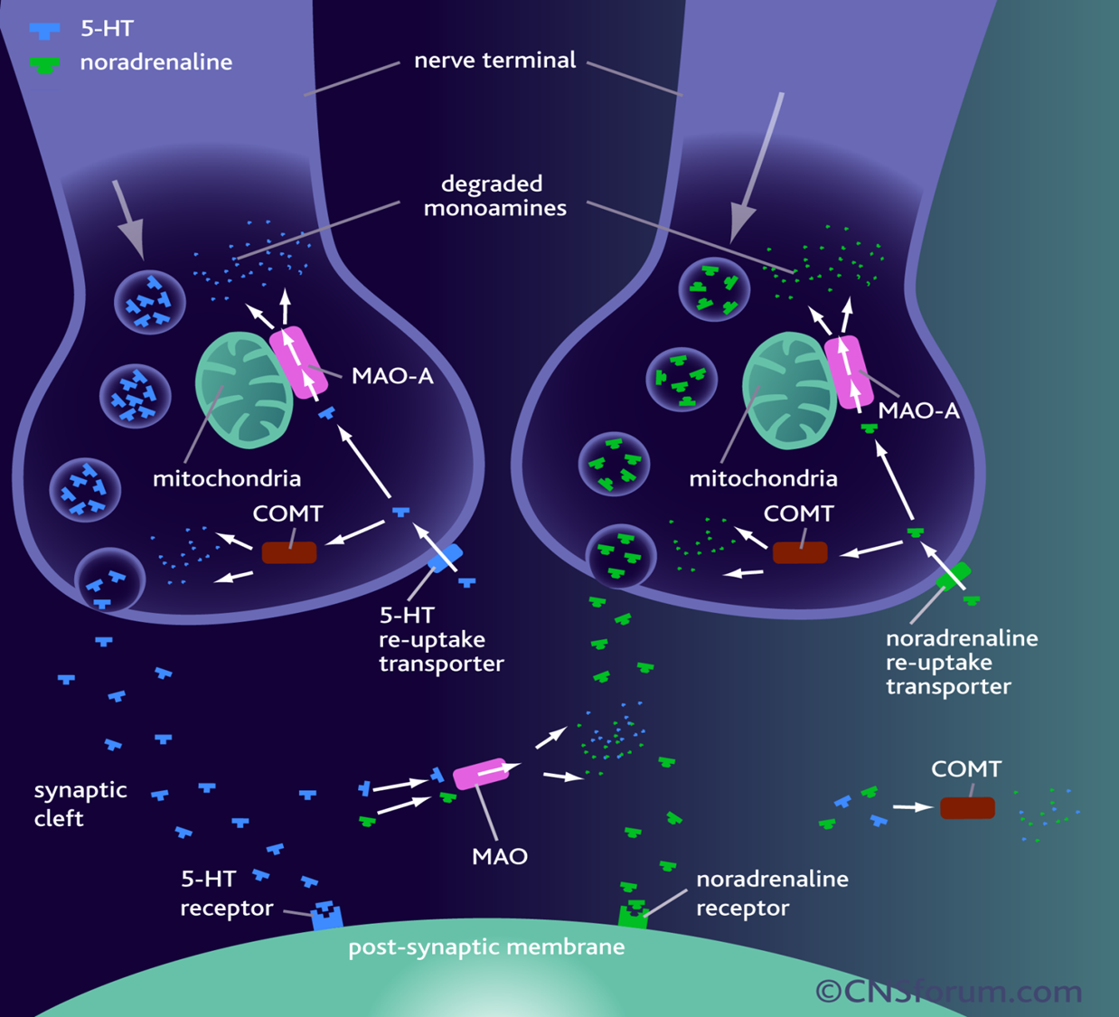
5HT
NE
NET
SERT

Slide 11
ANTIDEPRESSANTS
?
Restore the ability of 5HT to modulate NA, thus restoring the critical balance between transmitters that controls emotional behavior.
?

Slide 12
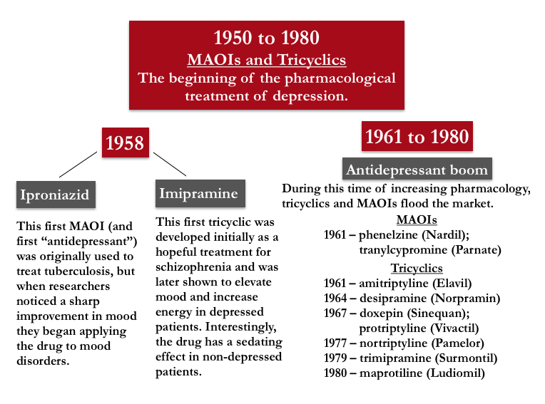
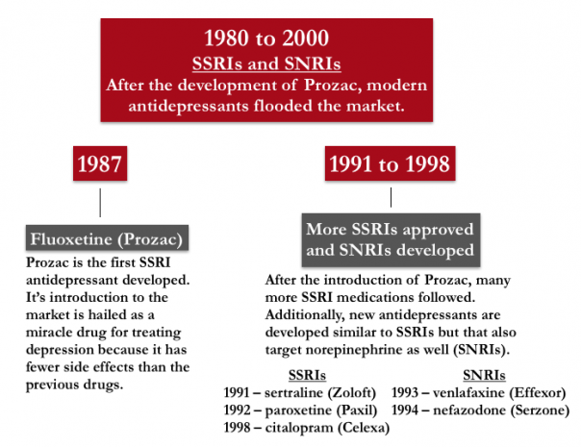
OLD
NEW
NaSSAs
NRIs
After 2000
NDRIs

Slide 13
ANTIDEPRESSANTS
The concept of action of all drugs relay on extracellular biogenic amines in the brain indirectly by blocking their catabolism or directly by preventing their uptake + altering receptor firing.
All drugs take weeks to manifest their clinical effect [to control depressive manifestations], even though their pharmacological actions starts immediately indicating that secondary adaptive changes must occur before the benefit is gained
The delay presents the time needed for the inhibitory somato- dendritic autoregulatory 5HT_{1A} receptors or axonal autoregulatory 5HT_{1D} or also α₂ ADR receptors or β ADR to be sensitized [down regulated] thus permitting greater synthesis & release of trans- mitter at synaptic cleft → i.e. adjusting back normal seretonergic and adrenergic postsynaptic firing → therapeutic effect.

Slide 14
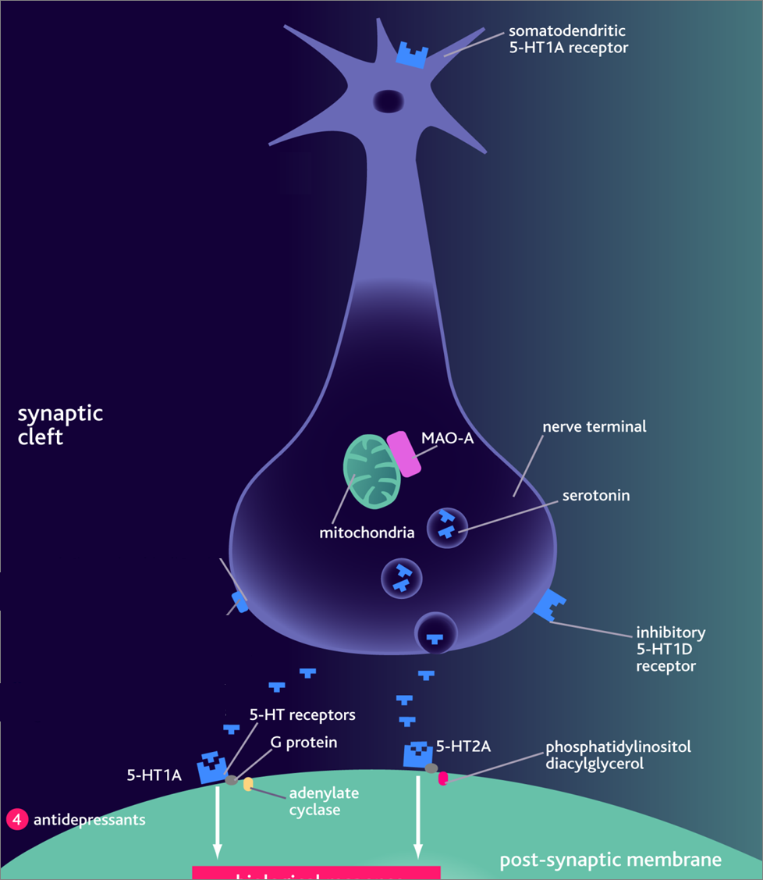
Treatment should continue
6 months at full therapeutic
doses before withdrawal.
Withdrawal of drugs must
be very gradual otherwise
withdrawal symptoms
Agitation
Worsening of the disease
Withdrawal manifestation
They mediate therapeutic effects

Slide 15
Antidepressants-Goals of Therapy
To relieve symptoms of depression
To prevent Suicide
To restore optimal functioning
To prevent recurrence

Slide 16
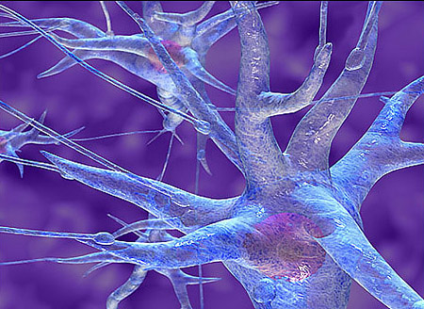
MONOAMINE
OXIDASE
INHIBITORS

Slide 17
MAO is a mitochondrial enzyme found in nearly all tissues
Two forms of monoamine oxidase exist:
  MAO-A is primarily responsible for NE, 5-HT & tyramine metabolism. It is important for catabolism of monamines ingested in food
  MAO-B is more selective for dopamine metabolism
Non Selective Inhibitors (MAO-A & MAO-B)
Irreversible ➔Phenelzine, long acting [persists 2w after
discontinuation]
Reversible ➔ Tranylcypromine, [persists 7 days after
discontinuation]
Selective Reversible Inhibitors
➔ Moclobemide, (MAO-A)
➔ Selegiline, (MAO-B)
Seldom used now because;
➔ADR, Food &Drug Interactions
➔ Low relative antidepressant efficacy
= Low benefit/risk ratio;
All are well absorbed, metabolized & excreted in urine

Slide 18
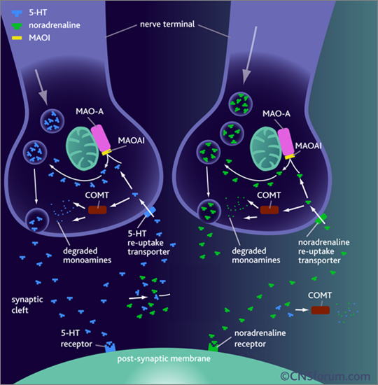
MAOIs ➔⬇ activity of MAO ➔preventing monamine break down ➔⬆ availability indirectly
Possess both α Adrenoceptor & mAch blocking effects
Indications
MAOIs ➔ reserved as a last line of defense in atypical depression and depression resistant to therapy
In treatment of social anxiety (agrophobia)

Slide 19
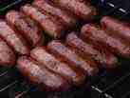

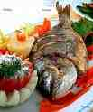

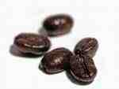
ADRs
1. Antimuscarinic effects.
2- Postural hypotension.
3- Sexual dysfunction mainly with phenelzine.
4- Sedation , sleep disturbance.
5- Weight gain
6- Hepatotoxicity ( phenelzine)
Food interactions
Many foods containing tyramine are normally degraded in the gut by MAO-A
MAOIs inhibit this process  so tyramine is absorbed taken up into adrenergic neurons  converted into octopamine-a false transmitter  replaces NE in the vesicles & massively release it in synapse ➔ may result in hypertensive crisis.
Distribution of 5-HT2 receptors
So avoid foods rich in
Tyramine ; Aged cheese, liver, sausages, fish , some meat & yeast extracts.
Levodopa ; Broad beans, FAVA beans.

Slide 20
Drug interactions
1. With indirect acting sympathmimetic, flue medications, local anesthetics & TCA ➔ severe hypertension ➔ hypertensive crisis
2- With SSRI causing fatal serotonin syndrome [hyperthermia, muscle rigidity, cardiovascular collapse ] so at least 6 weeks space between the two groups of drugs .
3- With pethidine ➔ as MAOIs inhibit its normal demethylation pathway ➔ so ↑ its levels ➔ leads to hyperpyrexia, irritability, hypotension and coma.
Distribution of 5-HT2 receptors

Slide 21
TRICYCLIC ANTIDEPRESSANTS

Slide 22
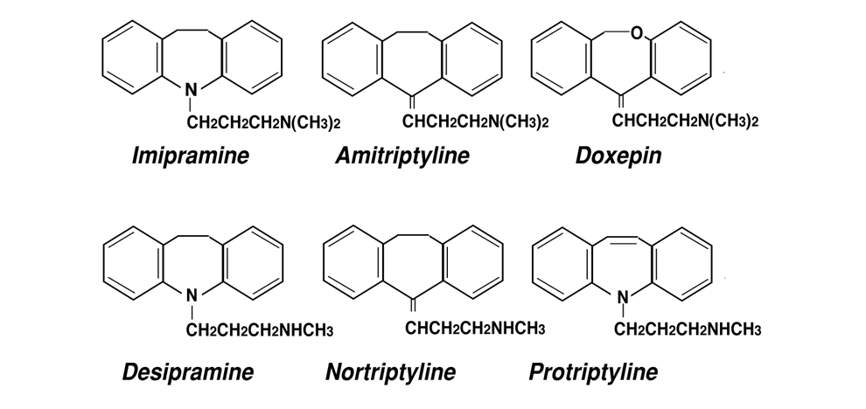
1st Generation Tricyclic Antidepressants
 have three-ring nucleus structure
Tertiary amines
Block 5HT& NE reuptake
More side effects
Imipramine (Tofranil)
Amitriptyline (Elavil)
Secondary amines
More selective to NE
Less side effects
Desipramine (Norpramin)
Nortriptyline (Pamelor)
+ Block ADR (α₁), Histamine (H₁) & Ach (M₁)receptors.

Slide 23
Tricyclic Antidepressants (TCAs)
    / CH₃ / H
N N
\ CH₃ \ CH₃
tertiary amine secondary amine

Slide 24
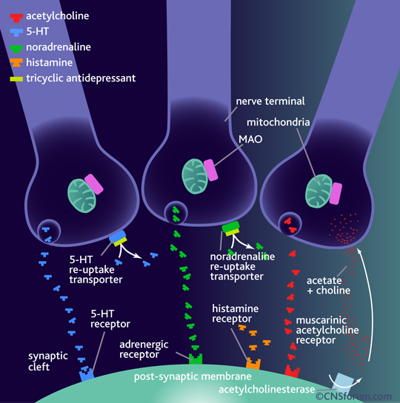
+ block adrenergic (α₁), histamine (H₁) & muscarinic (M₁)receptors.

Slide 25
Given once daily
Most TCA are incompletely absorbed
Undergoes first-pass metabolism.
Highly bound to plasma proteins.
Some of them give active metabolites
  Imipramine  Desipramine
  Amitriptyline Nortriptyline
Pharmacokinetics
Clinical Indications
Used for long duration without loss of effectiveness [preferable to MAOIs]
  Elevate mood
  Improve mental alertness.
  Increase physical activity
1- Treatment of depression;
- Depressed phase of bipolar depression with lithium.
- Treatment resistant depression in failure to other therapy
- Together with antipsychotics in depressed psychotic patients.

Slide 26
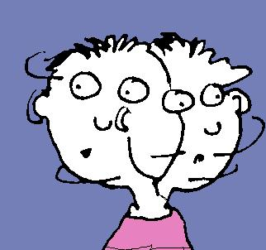
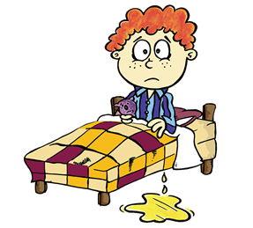
2-Other psychiatric disorders;
Obsessive-compulsive disorders (OCD) when
psychostimulants are ineffective or contraindicated
(OCD;  DA & NE in the brain's prefrontal cortex.)
Generalized anxiety disorders
Panic disorders
Anorexia nervosa
3-Other disorders;
Control bed-wetting in children; Imipramine  contraction of
internal sphincter of bladder . Better desmopressin
Gradually withdrawn / Treatment period do not exceed 3 months.
Neuropathic pain; better Tertiary amines > → modulate endorphins
Their pain relieving properties can typically be felt at  doses than
that prescribed for depression.
Prophylaxis of migraine / vertigo

Slide 27

ADRs
Anti-cholinergic: Dry mouth, blurred vision, constipation & urine
retention, aggravation of glaucoma
Anti-histaminic: Sedation, confusion. Stop sedatives 1-2 w before use
Anti-adrenergic (>α)  C.V.S ; Postural hypotension, arrhythmias
conduction defects ( prolonged Q-T interval - heart block )
Weight gain, sexual dysfunction & impotence
Lower seizure threshold
Aggravation of psychosis
EARLY IN USE  During 1st month  aggravate suicidal thoughts specially in young aged. Can happen less upon change of dose.
DURING USE  narrow therapeutic index  toxicity can develop
Excitement, delirium , convulsions, respiratory depression , coma, atropine like- effects, cardiac arrhythmias, sudden death. DIALYSIS
STOPAGE OF USE  Withdrawal Symptoms; characterized by cholinergic rebound, flu-like symptoms.

Slide 28
Interactions
Being strongly bound to plasma proteins  toxicity enhanced
by aspirin, phenylbutazone, ….etc
Being metabolized by hepatic microsomal enzymes  toxicity
enhanced by enzyme inhibitors.
With MAOIs, SSRIs or any sympathomimetic drugs  cause
hypertensive crisis
Additive to sedatives or other CNS depressants  respiration
Additive to antipsychotics & anti parkinsonisms  anti-
cholinergic effects.
Glaucoma
Heart disease
Liver disease
Seizure disorder
Thyroid disease
Prostate hypertrophy
Pheochromocytoma
Chronic bronchitis
Contraindications

Slide 29
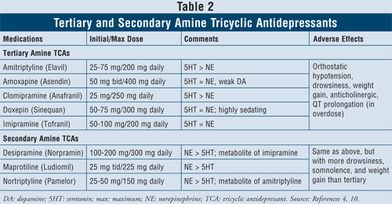
Metabolite of antipsychotic drug  DA antagonism 
> suitable for depression in psychotic patients.
!!!
◉
Parkinsonism
Amenorrhea- galactorrhea Tardive dyskinesia.

Slide 30
ANTIDEPRESSANTS
New Antidepressants
To be Continued

