Slide 1
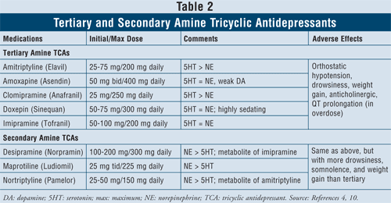
Metabolite of antipsychotic drug  DA antagonism 
> suitable for depression in psychotic patients.
◉
Parkinsonism
Amenorrhea- galactorrhea Tardive dyskinesia.

Slide 2
Side Effects of Tricyclic Antidepressants
Reuptake inhibition |  | Relative Side effects |  |  |  | TCAs
5-HT | NE | Anti - mAch | Hypotension | Cardio Toxicity | Sedation
+++ + +++ +/- + + +++ + + + + | ++ +++ +/- ++++ + + + ++++ +++ ++++ + | +++ ++ ++ ++ ++ ++ +++ + ++ ++ ++ | +++ + ++ + ++ ++ +++ + 0/+ + ++ | +++ + +++ +++ +++ ++ +++ + ++ +++ +++ | +++ ++ ++ + +++ +++ ++ + + - +++ | Amitriptyline Amoxapine Clomipramine Desipramine Dothiepin Doxepin Imipramine Lofepramine Nortriptyline Protriptyline Trimipramine
!!!

Slide 3
TCAs
Which one of the tricyclics is more selective on inhibiting reuptake of NE?
Which one of the tricyclics is more selective on inhibiting reuptake of 5-HT?
Why sedation
Why constipation
Why tachycardia
Why postural hypotension
Why weight gain
SSRIs
Why they are better choice as compared to TCA?
What is the clinical significant of the antagonistic effect on 5-HT2 receptors?
Insomnia and anxiety ( Fluoxetine ; Citalopram; but not with Paroxetine. Importance in selection?
Impotence and sexual dysfunction (in male and female)
How these occur and what are their clinical significant ?
Nausea; vomiting and anorexia. How ? Can SSRIs be used together with TCA ?
Drugs interactions due to their significant inhibitory action at CYP450 (Except Citalopram.)
Which one of SSRIs does produce active metabolite?
Which one has the longest t_{1/2} ?
Mirtazepine
NO N/V why? No Sexual dysfunction Why ? ; sedation.
Venalafaxine
May produce seizure and constipation. Why?
Trazodone
Why , hypotension / sedation / priapism?

Slide 4
Antidepressants when block other postsynaptic receptors can confer side effects. Such receptors include mainly histaminergic [H₁], muscarinic, [a₁]-adrenergic.
Histaminergic antagonism has been associated with sedation and drowsiness. Can contribute to increased appetite & weight gain.
Muscarinic-receptor antagonism is responsible for gastrointestinal disturbances; constipation, dry mouth, tachycardia, blurred vision, urine retention
Block of the [a₁]-adrenergic receptor may be responsible for dizziness and orthostatic hypotension
Antidepressants increase variably the availability of 5HT & NE at synapes
Increased NE transmission tremors, insomnia
Increased 5HT transmission  sedation, and a decrease in sexual drive.
Antidepressants & sexual dysfunction?
Through acting on 5HT₂ → sexual dysfunction (loss of sexual desire and impaired sexual response (ejaculatory delay, erectile dysfunction, anorgasmia)
ADDs with
5HT₂ blocking action as mirtazipine, has minimal action on sexual dysfunction.
With > NE than 5HT as Bupropion , have minimal sexual side effects
Trazodone, nafazodone,
With dual action are better than SSRIs with respect to sexual side effects

Slide 5
Antidepressants & Sedation
 Sedating ADDs are; Amitryptyline, Maprotiline, Amoxiepine, Doxepin, Trazadone, Nafazodone, ……… So better given near bed time
 Less Sedating ADDs are; Bupropion, Venalafoxine , MOA Is, most SSRIs (except Paroxetine). …. So can be given in the morning as some cause insomnia as side effect.
Antidepressants and appetite???
DA is responsible for eating. 5HT action on 5HT₂ halts dopamine release so suppress appetite.
Depression is accompanied more by weight loss.
SSRIs by ↑ 5HT availability to act on 5HT₂  could suppress appetite. At least no weight gain with SSRIs.
Most TCAs have dual reuptake inhibition + sedation + antihistaminic effects  ↑ weight gain
Mertazepine blocks 5HT₂  so cannot shut off dopamine signals  ↑ weight gain
N.B. Antidepressants isn't always a direct cause to cause alteration in weight. Other contributing factors to weight gain during antidepressant therapy are for example: ↑ day time sleep, ↑ craving for food when mood alleviates,
Nausa & Vomiting by SSRIs  ↑ 5HT availability  act on 5HT3  nausea & vomiting

Slide 6
Antidepressants safe combinations;
 Bupropion + Desipramine
 SSRIs + Mertazepine, Reboxetine or any other NRIs / SNRIs/
Antidepressant approved for use in children; fluoxetine
Antidepressants good for elderly are SSRIs because they can be used at lower dosage giving least side effects in this age group
SSRIs use is more than TCAs because they are better tolerated by patients
Antidepressants dangerous combinations;
 MAO Is + SSRIs  Serotonin syndrome
 Paroxetine / Fluoxetine / nefazodone / + Desipramine, Nortryptiline  severe sedation or > toxicity
Enuresis  Imipramine
Chronic pain  TCAs (Tertiary better than 2ndry amines )  Duloxetine
SSRIs not effective
Bulimia  Fluoxetine
Obsessive convulsive disorder SSRIs
Cancer associated depression  Mertazepine
Depression in Adolescence and young adults Bupropion
Depressive phase of bipolar add? Lamotrigine (anticonvulsant) or lithium

Slide 7
Fluoxetine is metabolized to active product norfluoxetine and it has elimination half life three times longer than fluoxetine. So fluoxetine has long lasting effect of all SSRIs.
Drug intercations: combination of SSRIs+ MAOIs or SSRIs+ TCA can cuase serotonic syndrome (excess serotonoin may cuase hypethermia, muscle rigidity, fluctuation in mental status and vital signs).
Most of SSRIs inhibits hepatic enzymes (CYP450) can increase half life and toxicity of other drugs such as warfarin, phenytoin and antipsychotic drugs etc.
TCAs and NE and 5-HT selectivity:
Clomipramine greater effect on 5-HT re-uptake than NE (better choice in OCD)
Imipramine more on 5-HT
Desipramine (metabolite of imipramine) more effect on NE.
Tertiary amine TCAs (Amitriptyline, clomipramine, imipramine) cause greater inhibition of 5-HT re-uptake
Secondary amine TCAs (desipramine, nortriptyline) cause greater inhibition of NE re-uptake.

Slide 8
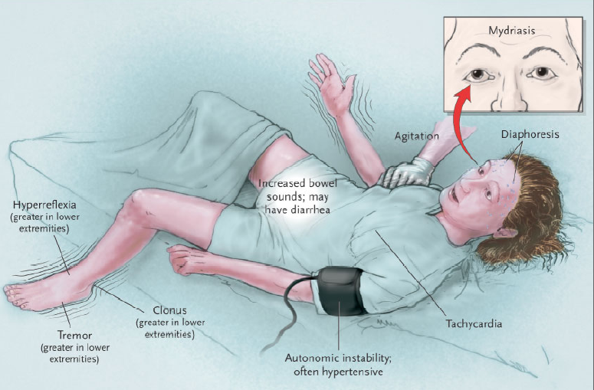

Slide 9
Serotonin involves mood, anxiety, arousal & sleep aggression, impulse control, and thinking abilities body temperature,, human sexuality, appetite, and metabolism, as well as stimulating vomiting. Serotonin is a neurotransmitter which produces a sense of well-being calm and satisfaction.
Excess amounts of serotonin cause relaxation, sedation, and a decrease in sexual drive.
Deficiency in serotonin is associated with low mood, lack of will power, and poor appetite control (eating disorder problems)
Disruption in serotonin system leads to a number of psychiatric conditions, which include anxiety disorders, depression, improper social behavior, and sexual aberrations. Common medical conditions associated with disruption of the serotonin system include disturbance in the sleep-wake cycle, obesity or eating disorders, and chronic pain.
5-HT1 receptors; when serotonin binds its effect is inhibitory  constriction of large intracranial vessels
5-HT2 receptors; when serotonin binds its effect is excitatory, feeding & sexual behavior and susceptibility to seizure . In platelets 5-HT_{2A} receptors elicits a weak aggregation
5-HT3 receptors; when serotonin binds its effect is excitatory in both the gastrointestinal tract and the CNS participate in the emetic response

Slide 10
5-HT₁-receptors are predominantly inhibitory in their effects. 5-HT_{1A}-receptors are expressed as autoreceptors by the 5-HT neurons in the raphe nuclei, and their autoinhibitory effect tends to limit the rate of firing of these cells. They are also widely distributed in the limbic system and are believed to be the main target of drugs used to treat anxiety and depression 5-HT_{1B}- and 5-HT_{1D}-receptors are found mainly as presynaptic inhibitory receptors in the basal ganglia. Agonists acting on peripheral 5-HT_{1D}-receptors are used to treat migraine
5-HT₂-receptors (mostly 5-HT_{2A} in the brain) exert an excitatory postsynaptic effect and are abundant in the cortex and limbic system. They are believed to be the target of various hallucinogenic drugs The use of 5-HT₂-receptor antagonists such as methysergide in treating migraine is discussed in
5-HT₃-receptors are found chiefly in the area postrema (a region of the medulla involved in vomiting; and other parts of the brainstem, extending to the dorsal horn of the spinal cord. They are also widely, but more sparsely, present in certain parts of the cortex. They are excitatory ionotropic receptors, and specific antagonists (e.g. ondansetron,) are used to treat nausea and vomiting. They may also have anxiolytic effects, but this is less clear.
5-HT₄-receptors are important in the gastrointestinal tract (see) and are also expressed in the brain, particularly in the striatum. They exert an presynaptic facilitatory effect, particularly on acetylcholine release, thus enhancing cognitive performance.

Slide 11
Dopamine and norepinephrine, also influence mood and arousal.
Dopamine is associated with pleasurable activity. Released when people do naturally rewarding activities like having sex or enjoying food. Some drugs such as nicotine, cocaine and amphetamines can influence the level of dopamine in the brain.
Dopamine is actually the culprit in many addictions such as drugs, food, and sex addictions. Dopamine also has other functions in the brain, including important roles in behaviour and cognition, motor activity, motivation and reward, inhibition of prolactin production which is involved in lactation, sleep, mood, attention, and learning
Dopamine plays an important role in bulimia and binge eating because these people often dream and think about food. And it is why when a bulimic or binge eater sees food she/he goes on a binge losing all sense of control.

Slide 12
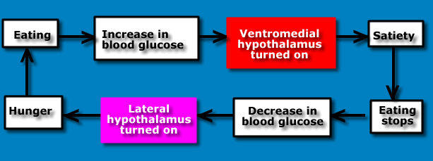
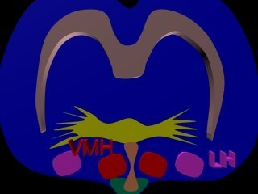
Appetite has 2 components; appetitive & consummatory component.
Dopamine is released to increase appetite
NE, NPY, AgRP, maintains the consummatory response of DA
5-HT shuts down the DA control of appetite; satiety
Area of hypothalamus | Effect of lesioning | Effect of stimulating
Ventromedial hypothalamus | Increases eating | Decreases eating
Lateral hypothalamus | Decreases eating | Increases eating
Serotonin could be involved in bulimia. Serotonin helps control both emotions and appetite. Some scientific studies suggest that people with bulimia don't have the right amount of serotonin.

Slide 13
