Slide 1
ANTIPSYCHOTIC DRUGS

Slide 2
PSYCHOSES
1- Affective Psychoses:
a- Mania
b- Depression
c- Manic-depressive illness
( bipolar affective disorder )
2- Schizophrenia

Slide 3
Schizophrenia
Positive Symptoms
Hallucinations
Delusions
Paranoia

Slide 4
Negative Symptoms
Social withdrawal
Anhedonia ( absence of pleasure )
Emotional blunting

Slide 5
THEORIES OF SCHIZOPHRENIA
5-HT theory
assumes serotonin deficiency
based on the observation that LSD
produces hallucinations.
LSD: (Lysergic Acid Diethyl amide), an ergot derivative synthesized in 1943, which antagonizes some peripheral actions of 5-HT

Slide 6
THEORIES OF SCHIZOPHRENIA
Dopamine theory
❏ Schizophrenia is due to increased
dopaminergic activity in the limbic system
❏ This may be due to:
1- Increased sensitivity or number of
dopamine receptors
2- Increased synthesis or release of
dopamine
3- Reduced enzymatic destruction of
dopamine

Slide 7
Dopamine System
Dopaminergic pathways in the brain :
1- Mesolimbic - mesocortical pathway
(behavior)
2- Nigrostriatal pathway
(co-ordination of voluntary movements)
3- Tuberoinfundibular pathway
(endocrine effects)
4- Medullary - periventricular pathway
(metabolic effects)

Slide 8
Dopamine System
DOPAMINE RECEPTORS
There are at least five subtypes of receptors:
D 1, D 2, D 3, D 4, D 5

Slide 9
Antipsychotic drugs
Classification :
Typical Antipsychotic Drugs
According to chemical structure into :
1-Phenothiazine derivatives :
Chlorpromazine
Thioridazine
2- Butyrophenones
Haloperidol
3- Thioxanthene
Thiothixene

Slide 10
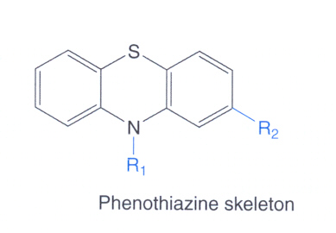

Slide 11
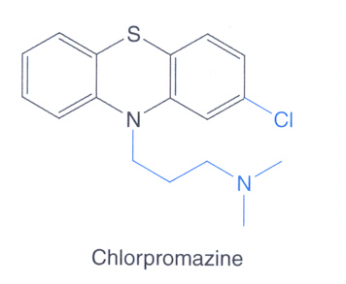

Slide 12
Atypical Antipsychotic Drugs
4- Dibenzodiazepines
Clozapine
5- Benzisoxazoles
Risperidone
6- Thienobenzodiazepines
Olanzapine
7- Dibenzothiazepines
Quetiapine

Slide 13
Pharmacological Actions
C.N.S :
1- Antipsychotic effect :
Produce emotional quieting and psychomotor slowing
Decrease hallucinations, delusions and agitation.
Mechanism:
Blockade of dopamine receptors in the mesolimbic system.

Slide 14
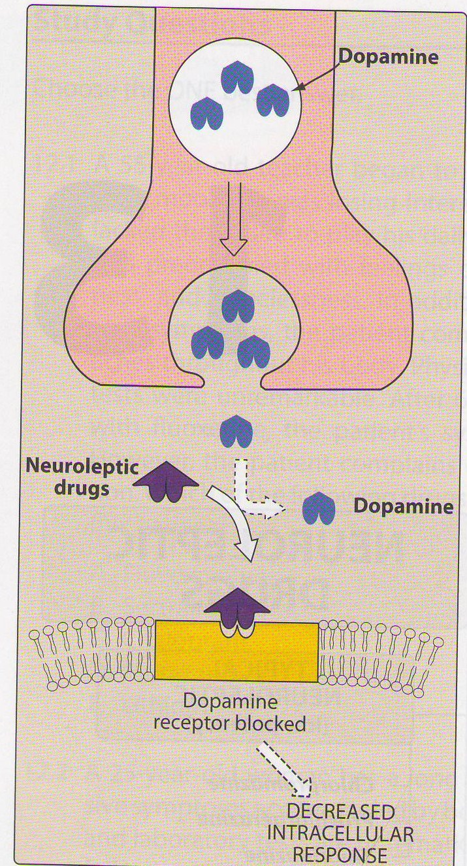
Mechanism of Antipsychotic Action

Slide 15
Atypical drugs exert their antipsychotic action through blocking serotonergic ( 5HT₂) & dopaminergic receptors.

Slide 16
Phrmacological actions ( con.)
2- Extrapyramidal Symptoms :
Abnormal involuntary movements such as tremors, parkinsonism & tardive dyskinesia.
Mechanism :
Blockade of dopamine receptors in the nigrostriatum

Slide 17
3- Endocrine effects
Galactorrhea, amenorrhea, gynecomastia & impotence.
Mechanism :
Prevent dopamine inhibition of prolactin release from pituitry→ Hyperprolactinemia

Slide 18
Pharmacological Actions ( cont.)
4- Metabolic effects :
Changes in eating behavior and weight gain
Mechanism :
Blockade of dopamine receptors in the medullary – periventricular pathway

Slide 19
Pharmacological Actions ( cont.)
5- Anti-emetic effect :
Effective against drug & disease- induced vomiting ( not- motion sickness)
Mechanism :
Blockade of dopamine receptors in the CRTZ
of the medulla

Slide 20
Pharmacological Actions ( con.)
A.N.S
1- Anticholinergic Effects :
- Blurred vision
- Dry mouth
- Urinary retention
- Constipation
Mechanism
Blockade of muscarinic receptors

Slide 21
Pharmacological Actions ( con.)
2- Antiadrenergic Effects :
- Postural hypotension
- Impotence
- Failure of ejaculation
Mechanism :
Blockade of α- adrenergic receptors

Slide 22
Pharmacological Actions ( con.)
Other Actions :
1- Temperature regulation :
May cause lowering of body temperature
Mechanism :
Heat loss as a result of vasodilation
( α- blocking )
Or due to central effect

Slide 23
Other Actions ( con.)
2- ECG changes :
Prolongation of QT interval
Abnormal configuration of ST- segment & T wave.
3- Antihistaminic effect :
Sedation due to H1 receptor blockade
4- Quinidine –like actions

Slide 24
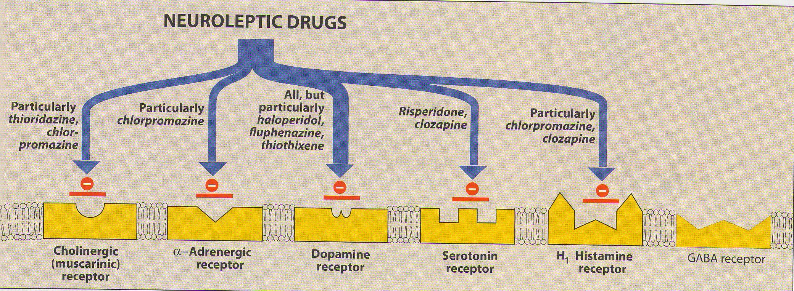

Slide 25
Therapeutic USES
PSYCHIATRIC :
Schizophrenia ( primary indication)
Acute mania
Manic-depressive illness ( bipolar affective disorder ) during the manic phase

Slide 26
THERAPEUTIC USES:
NON-PSYCHIATRIC:
1- Nausea and vomiting
- prochlorperazine and benzquinamide
are only used as antiemetics
2- Pruritis
3- Preoperative sedation

Slide 27
ADVERSE EFFECTS
C.N.S .
1- Sedation, drowsiness, fatigue
( haloperidol , Risperidone )
2- Extrapyramidal symptoms :
Some occurring early in treatment as :
Parkinson,s syndrome

Slide 28
Adverse Effects ( con.)
Other Extrapyramidal Symptoms are late – occurring :
1- Tardive Dyskinesia
(from Latin tardus, slow or late coming)
it is a disorder of involuntary movements
(choreoathetoid movements of lips,
tongue, face, jaws, and of limbs and
sometimes trunk).

Slide 29
Adverse Effects ( con.)
2- Neuroleptic Malignant Syndrome
♦ Rare but life threatening.
♦ Symptoms are muscle rigidity and high
fever ( clinically similar to anaesthetic
malignant hyperthermia ).
♦ The stress leukocytosis and high fever
associated with this syndrome may
wrongly suggest an infection.

Slide 30
Adverse Effects ( con.)
A.N.S.
1- Anticholinergic Effects :
- Blurred vision
- Dry mouth
- Urinary retention
- Constipation
( Clozapine, Chlorpromazine )

Slide 31
Adverse Effects ( con)
2- Antiadrenergic Effects :
- Postural hypotension
- Impotence
- Failure of ejaculation
( Chlopromazine , Thioridazine )

Slide 32
Adverse Effects ( con.)
Endocrine Effects :
- Gynecomastia
- Galactorrhoea
- Amenorrhoea

Slide 33
Adverse Effects ( con.)
Miscellaneous Effects :
Obstrucive jaundice
Granular deposits in cornea
Retinal deposits ( thioridazine)
Weight gain

Slide 34
Adverse Effects ( con.)
- Agranulocytosis
( Clozapine ) about 1-2% usually happen after 6-18 weeks
Weekly WBC is mandatory
- Seizures
( Clozapine )

Slide 35
PHARMACOKINETICS
Incompletely absorbed
Highly lipid soluble
Highly bound to plasma proteins
Undergo extensive first-pass hepatic metabolism.
Excretion by the kidney

Slide 36
❏ Most of drugs have complicated
metabolism
e.g. Chlorpromazine has about 60
metabolites some of which are active
metabolites. These metabolites may
still be excreted in urine after months
of stopping the drug.
Pharmacokinetics

Slide 37
Atypical Antipsychotics
2nd Generation antipsychotics
Are now considered to be first line treatments for schizophrenia
Little or no extrapyramidal side effects
Effective in treatment of resistant schizophrenia

Slide 38
Are effective on both positive & negative symptoms.
Block both dopaminergic & serotonergic receptors.

Slide 39
CLINICAL USES
Refractory cases of schizophrenia.
To reduce the risk of recurrent suicidal behavior in patients with schizophrenia

Slide 40
CLOZAPINE
Blocks both D₄ & 5HT₂ receptors
Main adverse effects
Agranulocytosis
Seizures
Myocarditis
Excessive salivation ( during sleep )

Slide 41
RISPERIDONE
Blocks D₂ & 5HT₂ receptors
Main adverse effects
-Postural hypotension
- QT prolongation
- Weight gain
Contraindicated in patients with long QT interval

Slide 42
OLANZAPINE
Blocks D₁- D₄ & 5HT₂ receptors
Main adverse effects
-Weight gain
- Sedation
- Flatulence , increased salivation & thirst - Postural hypotension
- Joint stiffness & twitching
- Dental pain & flu syndrome

Slide 43
QUETIAPINE
Blocks D₁-D₂ & 5HT₂ receptors
Main adverse effects
-Sedation
-Hypotension
- Leukopenia /neutropenia
- hyperglycemia

Slide 44
Summary
Drugs used in schizophrenia are classified according to chemical structures.
The advantages of atypical drugs includes :
They block both dopaminergic & serotonergic drugs.
They are effective in refractory cases of schizophrenia
They produce few extrapyramidal effects

Slide 45
Summary (con.)
The pharmacological actions of antipsychotic drugs result from :
Blocking dopamine receptors at different areas in the brain.
Blocking antimuscarinic receptors
Blocking α-adrenergic receptors
Blocking H1 receptors
Adverse effects are due to:
Blocking dopamine receptors at areas other than mesolimbic area

Slide 46
Summary ( con.)
Blockade H1, muscarinic & α- adrenergic receptors.
The main clinical use is in schizophrenia
Examples of atypical drugs includes :
Clozapine
Risperidone
Olanzapine
Quetiapine

