Slide 1
Neurotransmitters in the Central Nervous System
By
Prof. A. Alhaider
Dept. of Pharmacology

Slide 2
Neurotransmitters
Exert their effect by binding to specific receptors on the neuronal postsynaptic membranes (see Figure).
They can either excite the neurons → increase their activity or inhibit the neurons → suppressing their activity.
The activity of neurons depends on the balance between the number of excitatory or inhibitory process.

Slide 3
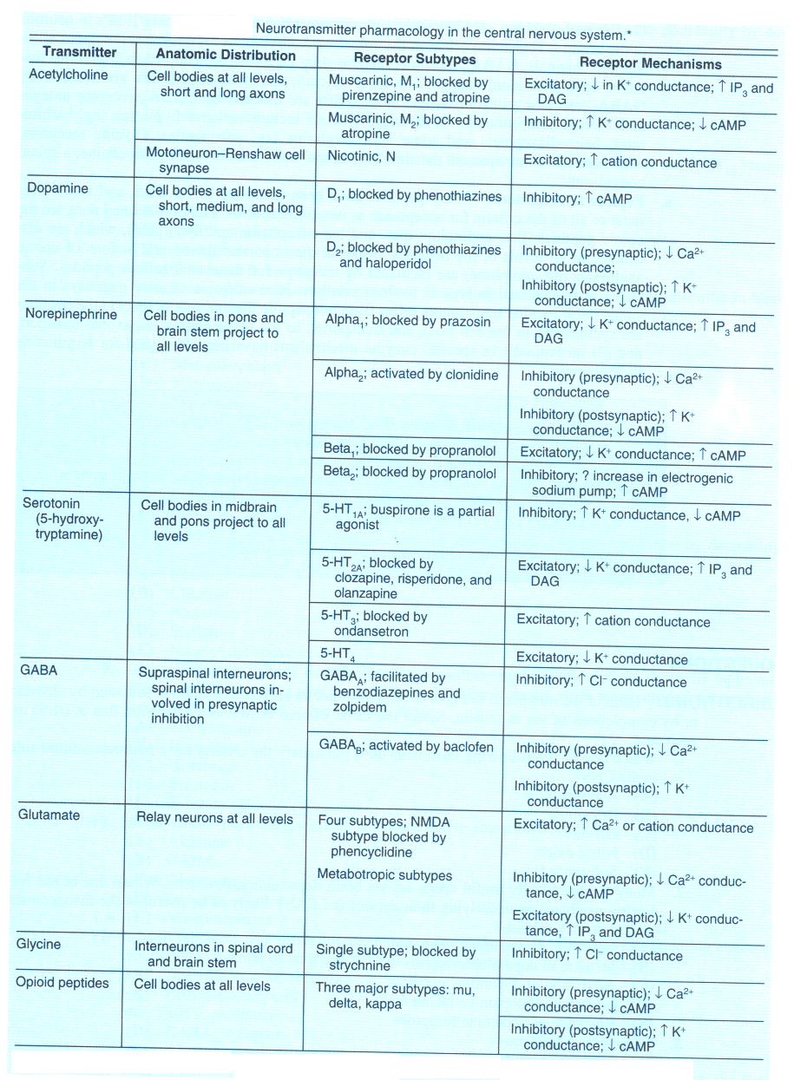

Slide 4
What is the importance of understanding the type of neurotransmitter in the CNS?
- To understand the etiology of diseases.
- To suggest the best drugs to be used.
- To understand the other clinical uses of any particular drug.

Slide 5
Examples of some neurotransmitters & their relation to diseases
Acetylcholine
Type of receptors :
Muscarenic receptors
Nicotinic receptors

Slide 6
Role of Acetylcholine in the CNS
Ach is thought to be involved in cognitive functions such as : memory, arousal and attention. It plays a role in the enhancement of sensory perception when we wake up .
Damage of cholinergic pathways is associated with memory deficits associated with Alzheimer,s disease.

Slide 7
Continue
Treatment of Alzheimer,s disease involved the use of directly & indirectly acting cholinomimetic drugs (e,g:
Donepezil (Aricept)
Rivastigmine (Exelon)
Memantine (Akatinol)
Galantamine (Reminyl)
Outside brain ,Ach is the main neurotransmitter in the parasympathetic system.

Slide 8
What will happen if Cholinergic neurotransmissions increase in CNS?

Slide 9
Quiz 1: Acetylcholine:
Is Acetylcholine an inhibitory or excitatory neurotransmitter?
Does acetylcholine has any role in the CNS?
What are the CNS diseases that linked to ACH derangement?

Slide 10
Epilepsy
It occurs as a result of imbalance between inhibitory (e.g: GABA) and Excitatory Neurotransmitters (Glutamates)

Slide 11
GABA & Glutamate Transmitters
Decrease in GABA levels ( an inhibitory neurotransmitters ) or increase in glutamate (an excitatory neurotransmitters ) Or
Disturbance in brain stabilization predispose to epilepsy
Therefore, antiepileptics act either by stimulating inhibitory neurotratransmissions (e,g: Gababentin) or by inhibition of excitatory ones (eg: Carbamazipine).

Slide 12
Based on the above, what is your simple definition of epilepsy?

Slide 13
Dopamine
Monoamine neurotransmitter, concentrated in very specific groups of neurons called basal ganglia.
Three important pathways throughout the brain :
Nigrostriatal
Mesolimbic
Tuberoinfundibular

Slide 14
What are the consequences of blocking dopaminergic receptors?.
Is it useful or harmful effects?. (See Figure)

Slide 15
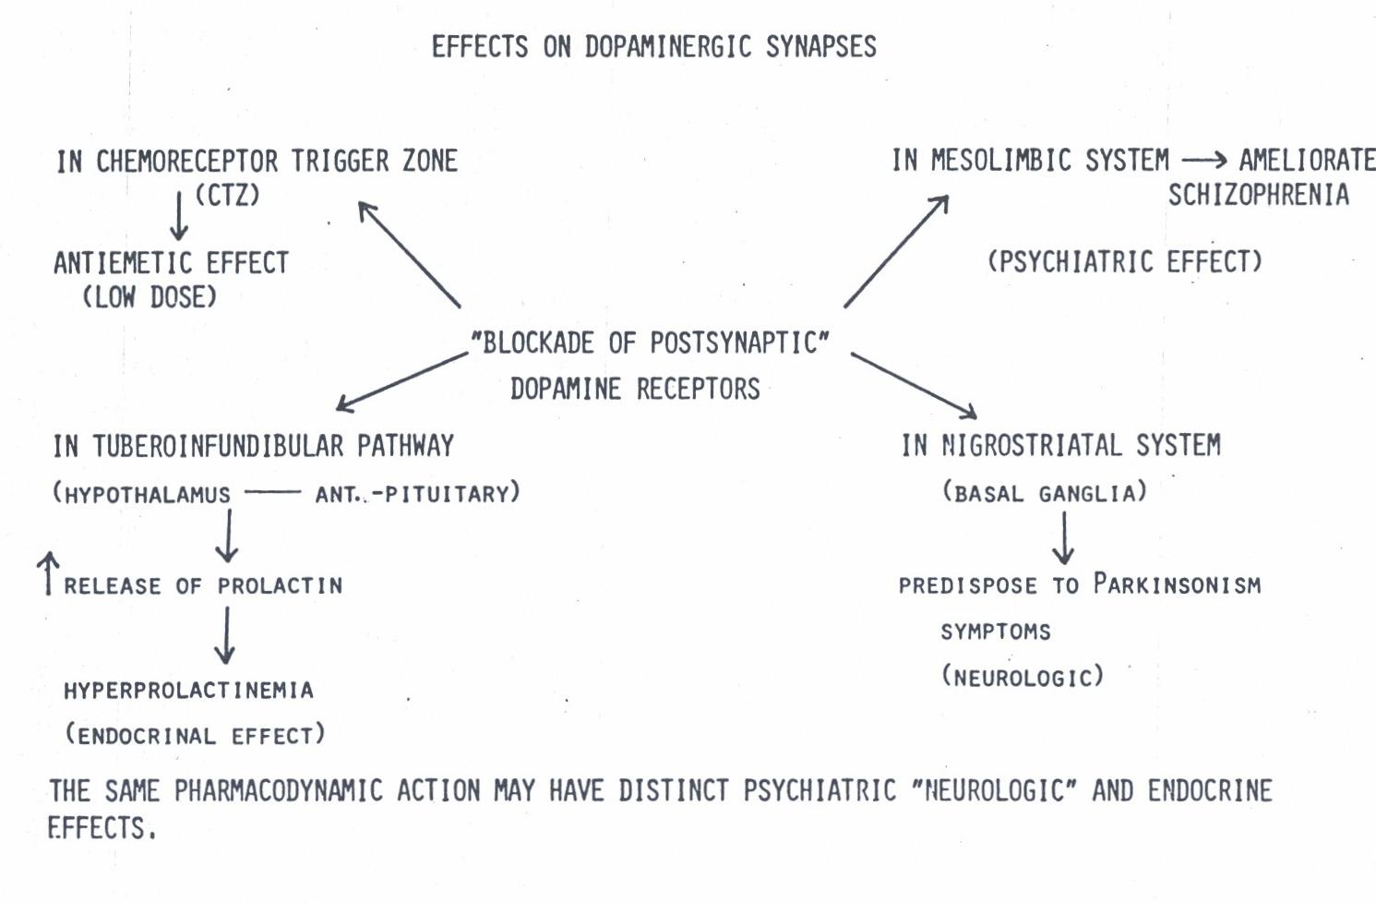

Slide 16
Continue
↑ of dopamine levels in brain has a role in the development of schizophrenia, Therefore, treatment by blocking dopamine receptors by neuroleptic drugs .
↓ of dopamine levels is a contributing factor in parkinson,s disease, thus, treatment by increasing dopamine content (e.g: L-Dopa).

Slide 17
Quiz 2: Biochemical theory of schizophrenia.
What are the evidence of dopamine involvement in Psychosis (Schizophrenia)?.
What are the consequences of blocking dopaminergic receptors? (see Figure)?.
What is the story of MPTP and MPTP neurotoxicity (Parkinson’s Disease?).

Slide 18
Serotonin
Although the CNS contains less than 2% of the total serotonin in the body, serotonin plays a very important role in a range of brain functions including :
Mood control
Regulation of sleep
Pain perception
Body temperature

Slide 19
Mode Disorders and Neurotransmissions
Affective Disorders Serotonin
NE NE
Mania Depression
Rx Drugs that decrease NE Drugs that increase NE
What is the evidence to support this theory?.

Slide 20
Based on the last Figure what are features of drugs that used of affective disorders? See Figure
Obsessive Compulsive Disorders (OCD) and 5-HT!

Slide 21
Diseases that are influenced by derangement of 5-HT:
Affective Disorders (Depression and Manai)
Schizophrenia (5-HT2 antagonists are used for Rx )
OCD
Anxiety (Which drugs ?)
Nausea and Vomiting (5-HT3 antagonists are DOC for N/V)

Slide 22
Conclusion:
Without understanding the involvement of neurotransmitters in the etiology of CNS diseases, Doctors could not select the proper drug for any particular disease.

