Slide 1
Drugs Used in Gastrointestinal System
Prof. : Abdulqader A. ALHAIDER

Slide 2
Drugs Used in Gastrointestinal Disorders
This area will cover the Followings:
a. Peptic Ulcer Diseases
b. Nausea and Vomiting
c. Diarrhea
d. Inflammatory Bowel Diseases
e. Drugs used for gallstones

Slide 3
Drugs Used For Peptic Ulcer
Definition
A peptic ulcer, also known as PUD or peptic ulcer disease, is an ulcer (defined as mucosal erosions equal to or greater than 0.5 cm) of an area of the gastrointestinal tract that is usually acidic and thus extremely painful.
Etiology: Smoking, Caffeine; Heredity; Diet ??; Hypersecretory states; H. pylori infection; Drugs (e.g.)

Slide 4
Signs and Symptoms:
Abdominal pain with a burning or gnawing sensation
Pain 2 - 3 hours after eating
Pain is often made worse by an empty stomach; nighttime pain is common
Pain may be relieved by antacids or milk
Heartburn
Indigestion (dyspepsia)
Belching
Nausea
Vomiting
Poor appetite
Weight loss

Slide 5
3. Pathophysiology of PUD
(see figure 1): Simply it is imbalance between Aggressive factors ( Acid & Pepsin) and Defensive Factors (e.g. )
However, nowadays, it seems that H. pylori theory is important.

Slide 6
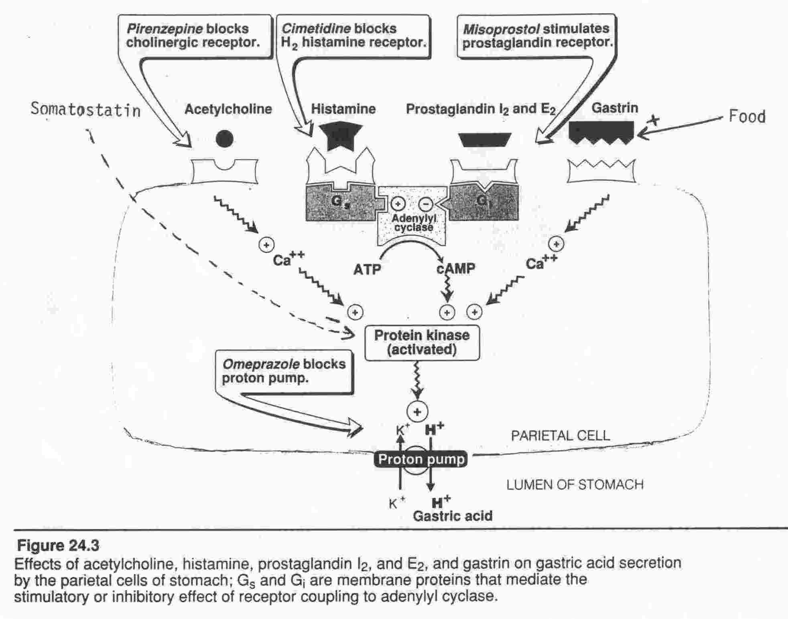

Slide 7
What is the role of gastric emptying on the formation of ulcers?
Treatment
* Objectives ( Relieve pain; healing of ulcer ; prevention of further ulcer recurring)
How the above objectives could be accomplished?
1) Inhibiting the aggressive factors e.g Acid and pepsin
Enhancing mucosal resistance
Eradication of H.pylori (Best).

Slide 8
B. Classification of Drugs used in the treatment of peptic ulcers?
Antacids
These drugs are mainly inorganic salts (e.g.: NaHCO₃; Ca CO₃; Al (OH)₃; Mg (OH)₂
Mechanism of Action (Antagonize acid; May
Indirectly decrease pepsin activity)
What are their side effects ?
Which one (s) produce (s) constipation?
Which one (s) produce (s) diarrhea?
What is the milk-alkali syndrome?
Why their uses have been declined?

Slide 9
What is Gaviscon^{R} (Alginic Acid + NaHCO₃)
How Gastrooesophageal Reflux could be managed?
- Definition
- Treatment:
Decrease gastric acidity
Increase tone of LOS and increase gastric emptying.
Avoid drugs or foods that trigger GEPR.

Slide 10
Table -1 Major constituents of antacids
Adverse Effects | solubility of Salt | Salt Formed in Stomach | Neutralizing Capacity | Constituent
Systemic alkalosis, fluid retention | High | NaCl | High | NaHCO₃
Hypercalcemia, nephrolithiasis, milk-alkali syndrome | Moderate | CaCl₂ | Moderate | CaCO₃
Constipation, hypophosphatemia,drug adsorption reduces bioavailability | Low | AlCl₃ | High | Al(OH)₃
Diarrhea, hypermagnesemia (in patients with renal insufficiency | Low | MgCl₂ | High | Mg(OH)₂

Slide 11
2. Antisecretory Drugs (see figure)
H₂ –receptor antagonists (considered the most important discovery in the seventies)
Examples: ( Cimetidine; Ranitidine; Famotidine; Nizatidine )
MOA:
Potency VS efficacy
Side effects and drug interactions.
What are the differences between cimetidine and Ranitidine?.
d. Dose and formulations?

Slide 12
Anticholinergic ( Pirenzepine ) Why it is not commonly used ?
Proton pump inhibitors
Examples: Omeprazole ; Lansoprazole ; Pentoprazole ; Raperazole
MOA: are potent inhibitors of H⁺,K⁺‑ATPase. This enzyme, located in the apical secretory membrane of the parietal cell, plays a key role in the secretion of H⁺ (protons).
What is the effect of combing H2-Blockers or anti acids with PPIs?

Slide 13
Clinical Uses:
1) Gastric and duodenal ulcer (H.pylori Eradication)
2) Zolinger Elison syndrome.
3) GERD
4) NSADs
Side Effects: Headache; diarrhea; nausea; decrease gastric acid secretion lead to hypergastermeia (How?), and mucosal hyperplasia.
However, gastric carcinoid tumor occurs with large doses in rats.

Slide 14
Agents which protect the mucosa
Sucralfate (contains aluminum and disaccharide)
-MOA : before meal Why?
-Side Effects: Constipation, N/V, Back pain
-Disadvantages
ii) Bismuth subsalicylate (has antibacterial and antidiarrheal activity).
-limitations and drug interactions:
Prostaglandins (Misoprostol)

Slide 15
Clinical Pharmacology of Drugs used in peptic ulcers?
Rx of H,pylori; Prevention of further ulcer recurring.
Rx of hypersecretory states (Zollinger–Ellison syndrome).
Prophylaxis from drug-induced peptic ulcer (NSAIDs.
Rx Gastroesophageal Reflux Disease (GERD).

