Slide 1
MISUSES OF
ANTIBIOTICS

Slide 2
antimicrobials
antibiotics
antiviral
antiparasitics
antifungal

Slide 3
Definition of Antibiotics
Chemical substances produced by various microorganisms (bacteria, fungi, actinomycetes) that have the capacity to inhibit or destroy other microorganisms.
Nowadays, they are mainly chemically synthesized.
They have the capability to either kill bacteria (bactericidal) or to prevent more bacteria from growing (bacteriostatic).
Antibiotics do not cure infections caused by viruses.

Slide 4
HISTORICAL BACKGROUND
Discovery of sulfonamides in 1935 by Domagk
Clinical use of sulfonamides in 1936
Discovery of penicillin in 1928 by A. Fleming
Purification of penicillin by H.Flory&E.chain(1940)\
Production of penicillin in 1941
1960s-1980s Production of Cephalosporins & other antibiotics.
Antibiotics are the 2nd most commonly used drugs after cardiovascular drugs.
25%-40% of hospitalized patients receive one or more courses of antibiotics ( More common in 3rd world countries).
In the west, 30% of total drugs prescribed for out-pts are antibiotics (more in 3rd world countries).
Antibiotics are among the most misused drugs.

Slide 5
Misuses of Antibiotics
Approx 50% of antibiotic are used inappropriately.
7 out of 10 receive antibiotics for common cold.
>90% of Antibiotics are available without prescriptions in 3rd world countries.
Some types of bacteria in Asia are no longer responding to 1st line drugs (WHO).
Resistance rates in several Asian countries are the highest in the world (WHO).
Some physicians are given financial incentives to prescribe certain drugs made by certain companies.
Antibiotics are also used as growth promoters in animals and agriculture.

Slide 6
MISUSES OF ANTIBIOTICS
Is attributed to many factors:
1- Availability of a very wide selection
2- Limitation of physician’s time
3- Physician shortage and expenses
4- Availability without prescription in pharmacies (OTC)
3- Public demand (pressure to prescribe)
4- Patients do not take them according to their doctor’s instructions.
5- Some patients save unused antibiotics for another illness, or pass it along to others.

Slide 7
Cont’d
6. Treatment of untreatable infections e.g. viral infections
7. Improper dosage.
8. Therapy of fever of unknown origin.
9. Reliance on chemotherapy with omission of surgical drainage. Because pus prevent antibiotic to reach to organism
10. Excessive use of prophylactic antibiotics in travellers.
11. Lack of adequate bacteriological information.

Slide 8
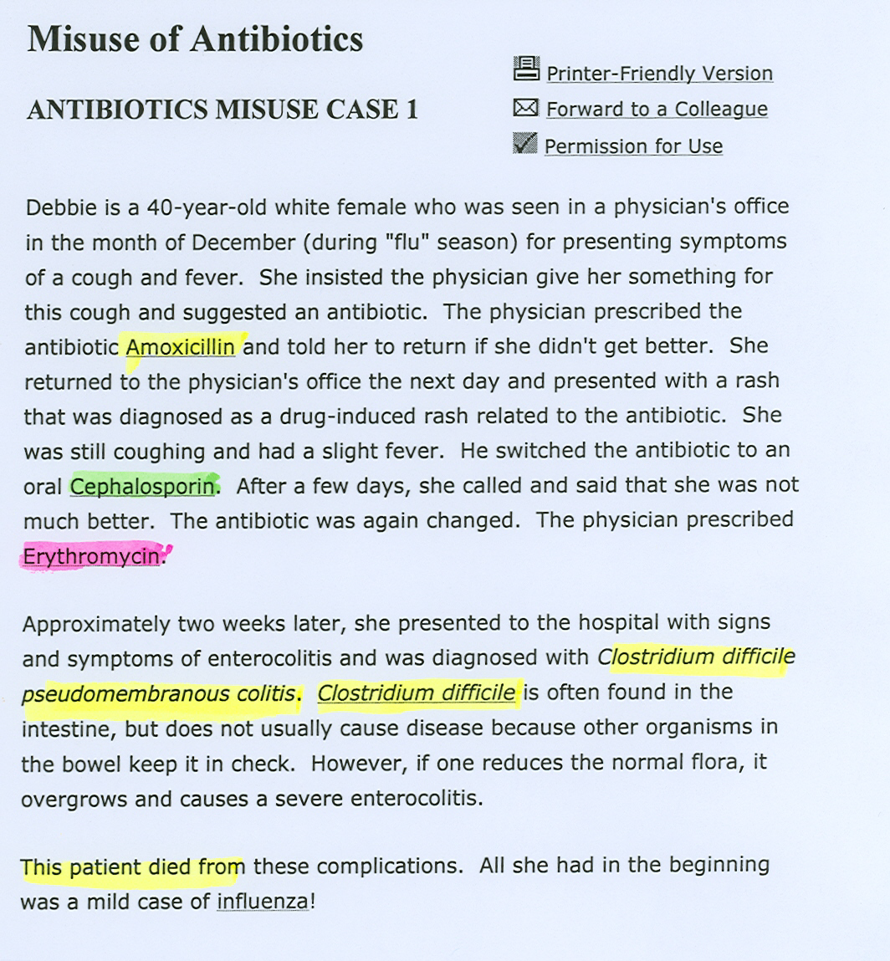

Slide 9
Antibiotic Prescription
Clinical Presentation
Microbiological Information
Pharmacological Consideration

Slide 10
Bacteriological information
Advantages:
1- A known antibiotic for unique clinical presentation, e.g. syphilis (a unique presentation) gets penicillin for treatment.
2- Documented clinical trials of antiobiotcis proved efficient for certain infections as opposed to other antibiotics.
3- The least toxic
4- The cheapest (cost-effective)

Slide 11
Disadvantages
1- Occasionally, clinical trials do not parallel in vitro sensitivity.
2- Site of infection is not taken into consideration in prescribing antibiotics.
3- Some bacteria cannot be cultivated or take time to grow e.g. M. Leprae, M. Tuberculosis.
4. Microbiological services are not always available at all hospitals

Slide 12
BACTERIAL RESISTANCE
Definition:
Concentration of antibiotic required to inhibit or kill the bacteria is greater than the concentration that can safely be achieved in the plasma.
If a microorganism develops resistance to a certain antimicrobial drug, there will be cross resistance to all other antimicrobial drugs that belong to the same group.

Slide 13
Mechanism of Antibiotic Resistance
Examples:
1. Inactivation by an enzyme produced by the bacteria
2. Reduced bacterial permeability to antibiotic
3. Bacteria develops an altered receptor for the drug
4. Bacteria develops an altered metabolic pathway
5. Bacteria develops an altered enzyme

Slide 14
Prevention of Resistance
Use antibiotics only when absolutely required
Use only in adequate dosage for a sufficient period of time.
Not too brief therapy (kills only sensitive bacteria)
Not too prolonged therapy (leads to side effects)
(there are some exceptions e.g. T.B.)
Combination of antibiotics may be required to delay resistance e.g. T.B.

Slide 15
Choice of Antimicrobial Drugs
1.Clinical diagnosis e.g. Syphilis (because syphilis is only sensitive to Penicillin)
2. Bacteriological identification
a) Infectious organism is unidentified e.g. pneumonia, UTI, meningitis.
b) infecting organism is identified but sensitivity to antibiotic isn’t known e.g T.B.
3. Site of infection
4. Empiric therapy: is a medical term referring to the initiation of treatment prior to determination of a firm diagnosis. Only in emergency cases (e.g. acute presentation in ER), in this case use broad-spectrum antibiotics.

Slide 16
(Cont)
4. Host factors
a) Immune system e.g. Alcoholism, diabetes, HIV, malnutrition, advanced age→higher than usual doses or longer courses are required.
b) Genetic factors
e.g. Patients with G-6-PD deficiency treated with sulfonamides and chloramphenicol which are considered to be oxidizing agents → Hemolysis
c) Pregnancy and Lactation
Aminoglycosides and hearing loss in the children
Tetracyclines → discoloration to the developing teeth
Fatal acute fatty necrosis of the liver (pregnant mother*)
d) Age of the patient
e.g. Grey Baby Syndrome caused by chloramphenicol
e) Renal function
eg. Aminoglycosides, Vancomycin in renal failure
f)Liver function
eg. Erythromycin, Chloramphenicol in hepatic failure
g) Poor perfusion
e.g. Lower limbs in diabetics
*In a pregnant women there is ↑↑ in fatty storage in the liver which become even higher when taking tetracyclins

Slide 17
( Cont.)
5. Drug Allergy (penicillin)
6. Potential Side Effects (drug safety)
Chloramphenicol → aplastic anemia
Tetracyclines in children → dental discoloration
Flouroquinolone in children & pregnancy → tendon damage. Thus, avoid using it before 17 years of age.
7. The cost of therapy

Slide 18
General Principles of Chemotherapy
1. Administer drug in full dose at proper intervals and by the best route
2. Apparent cure achieved-continue for about 3 days further to avoid relapse (exception T.B. and bacterial endocarditis )*
3. Skipping doses may decrease effectiveness of treatment & increase the likelihood of bacterial resistance to that antibiotic
4. Two or more antimicrobials should not be used without a good reason, e.g.
Mixed bacterial (polymicrobial) infections
Desperately ill patient of unknown etiology
To prevent emergence of resistance e.g. T.B.
To achieve synergism e.g. piperacillin+gentamicin (in case of infection with p.aeruginosae)
*because symptoms usually disappear long time before eradication of bacteria

Slide 19
(cont)
Disadvantages of multiple antibiotics:
Increased risk of sensitivity or toxicity
Increased risk of colonization with a resistant bacteria
Possibility of antagonism
Higher costs
5. In some infections, bacteriological proof of cure is desirable eg. T.B., UTI
6. Measurement of plasma conc. of antibiotics is seldom (rarely) needed, except for aminoglycosides (to watch out for ototoxicity), you should measure streptomycin in renal TB and gentamycin if you use it I.M.
Notes:
streptomycin in renal T.B., I.M gentamicin)
Can someone put this sentence in a way which we can understand the meaning of it?

Slide 20
Indications for antibiotic prophylaxis:
Surgical prophylaxis
bowel surgery, joint replacement, and some gynecological interventions
to prevent postoperative infections.
A single dose is only needed for surgeries lasting for less than 4 hours & two doses if more than 4 hours.
Immunosuppressed Patients
Very old, very young
Diabetics, Anemic patients, AIDS patients, cancer patients.
Dental extractions (to prevent infections by Strept. viridans)
Patients with total joint replacements
Patients with cardiac abnormalities

Slide 21
Reasons for failure of chemotherapy:
1. Wrong diagnosis
2. Wrong choice of drug
3. Wrong dose
4. Development of resistance
5. Infection with more than one organism
6. Presence of pus

Slide 22
Prof. Muhammad Alhumayyid ANTIBACTERIAL AGENTS
Folate antagonists:
Sulfonamides
trimethoprim
Quinolones:
fluoroquinolones
Protein synthesis inhibitors:
Macrolides
Cloramphenicol
Clindamycin
Aminoglycosides
Spictinomycin
tetracyclins
Miscellaneous:
polymixins
Inhibitors of bacterial wall synthesis
β-Lactam compounds
Other inhibitors
penicillins
cephalosporins
imipenem
monobactams
vancomycin
teicoplannin
bacitracin

Slide 23
SULFONAMIDES
Sulfonamides was first introduced in 1930s.
They are bacteriostatic.
Their usefulness is limited by:
Bacterial resistance
Formation of crystaluria due to its bulky molecular structure which doesn’t dissolve in water.
Development of other better antibiotics.
Sulfonamide alone is not the drug of choice for any bacterial pathogen.
Their activity is poor against anaerobes

Slide 24
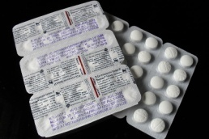
Trimethoprim + Sulfamethoxazole (TMP) (SMX)
Co-trimoxazole (Bactrim, Septra)
Introduced in mid 1970s
Alone, each agent is bacteriostatic
Together they show bactericidal synergism.
The optimal ratio of TMP to SMX in vivo is 1:20
Currently, sulfonamides are used most frequently in this combination.
With combination there is reduction in the formation of crystaluria.

Slide 25
Mechanism of action:

Slide 26
In the previous figure TMP inhibits dihydrofolate reductase, an enzyme which is also present in human beings.
The reason why this enzyme isn’t affected in human beings is because TMP is 50,000 less effective on the human enzyme.
Sulfamethoxazole inhibits dihydropteroate synthetase which only presents in microorganisms.
Remember: if the bacteria has preformed tetrahydrofolate or doesn’t need it the drug will have no effects.

Slide 27
Absorption, Metabolism & Excretion
Sulfonamides:
Mainly given orally
Rapidly absorbed from the stomach and small intestine.
Widely distributed to tissues and body fluids (including CNS and CSF), and to the placenta and fetus.
Absorbed sulfonamides bind to serum protein ( approximately 70% which increases the risk of displacing other drugs).
Metabolized in the liver by acetylation and glucuronidation.
Eliminated in the urine, partly as unchanged and partly as the acetylated form in feces.

Slide 28
Trimethoprim (TMP)
Usually given orally alone or in combined with SMX
Well absorbed from the gut
Widely distributed in body fluids & tissues, including CSF
60% of TMP or its metabolite is excreted in the urine
TMP concentrates in acidic fluids such as the prostatic and vaginal fluids due to:
1-More lipid soluble than SMX.
2-Less protein bound (approximately 40%)

Slide 29
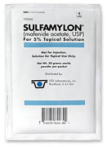
CLINICAL USES
TOPICAL(Local):
1. Opthalmology, in occular infections:
Sulfacetamide 10- 30% (The only one for its neutral pH)
2. Ulcerative colitis
Sulfasalazine (sulfapyridine+ 5-amino salicylate)-(orally, unabsorbed, works locally, can be used with pregnancy)
3. Infected burns
Mafenide acetate (sulfamylon cream) (lead to metabolic acidosis
Silver sulfadiazine → less toxic (preferred)
Effective against p.aeruginosa infection
Less effective against staphylococci
Sulfa carries 5-amino salicylate in the gut.

Slide 30
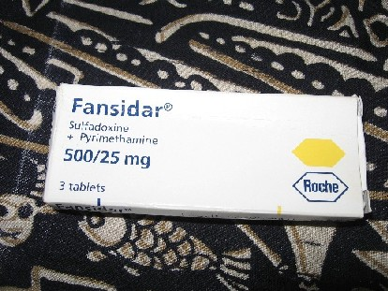
CLINICAL USES ( CONT. )
B. ORAL(Systemic)
1. Pneumocystis carinii (jeroveci) pneumonia **
2. Nocardiosis**
3. Toxoplasmosis** (sulfadiazine + pryimethamine)
4. Prostatitis
5. Falciparum malaria: Fansidar (sulfadoxine + pyrimethamine)

Slide 31
ADVERSE EFFECTS:
GI:
Nausea
Vomiting
Allergy:
Skin rash
Urticaria
Erythema multiforms
Photo sensitivity
Hematological:
Acute hemolytic anemia: A) G6PD deficiency B) hypersensitivity
Megaloblastic anemia, leukopenia, thrombocytopenia (due to TMP)
HIV patients:
Drug induced fever
Rash
diarrhea
Drug interactions:
Displace bilurubin (may lead to kernicterus)
Potentiates warfarin, oral hypoglycemics, methotrexate

Slide 32
CONTRAINDICATIONS
1. Pregnancy because it crosses the placenta
2. Nursing mother
3. Infants under 6 weeks
4. Renal or hepatic failure
5. Blood disorders

Slide 33
Resistance to sulfa compounds
1. impair permeability of sulfa compounds by the bacteria.
2. Increased PABA synthesis by the bacteria. because sulfa competes with PABA
3. Mutation in bacterial dihydropteroate synthetase which results in a decreased affinity for sulfa compounds.

