Slide 1
Gram +ve bacteria
cocci
aerobes
anaerobes
bacilli
Staph and strept
Peptococcus and peptostreptococcus
aerobes
anaerobes
Corynebacterium, listeria, noradia…
clostridium

Slide 2
Gram –ve bacteria
aerobes
Nisseria, psuedomona, salmonella, shigella, E.coli, hemophilus, leptospira
anerobes
Campylobacter, treponema, bacteriodes

Slide 3
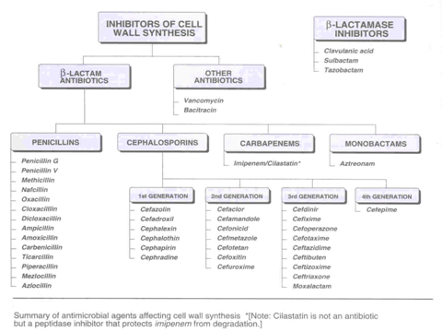

Slide 4
Penicillins
Penicillin G Ampicillin
Penicillin V Amoxicillin
Oxacillin Ticarcillin
Dicloxacillin Piperacillin
Nafcillin
similarities
structure
Mechanism of action
differences
stability
Action on some bacteria

Slide 5
PENICILLINS
Beta-lactam antibiotics
Derivatives of 6- aminopenicillanic acid
Most widely effective antibiotics
Least toxic drugs known

Slide 6
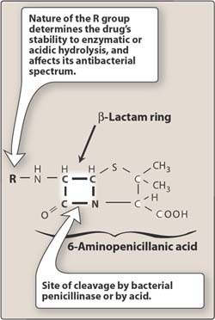
Alteration of the side group results in compounds with:
Great stability in acidic pH
Resistance to penicillinase
Broader spectrum of activity

Slide 7
MECHANISM OF ACTION
They act by inhibiting bacterial cell wall synthesis (by halting peptidoglycan synthesis)
Thus exposing the osmotically less stable membrane
This causes lysis of the bacterial cell wall
These agents are bactericidal
Active against multiplying bacteria which are synthesizing new cell walls and not resting bacteria.
Inactive against mycobacteria, protozoa, fungi and viruses

Slide 8
Classifications of Penicillins
1.Penicillin G (IM, slow IV, or infusion)
Highest activity against Gram+ve organisms, yet is susceptible to β-lactamase.
Effective against :
Gram-positive aerobic cocci - Staph. aureus- not producing β-lactamas
- S.pneumoniae,
- S.pyogenes ( group A )
Gram-negative aerobic cocci - N.meningitidis
N. gonorrhea → is no longer treated with penicillin G
Gram-positive bacilli : Bacillus anthracis
Spirochetes : T. pallidum (drug of choice)
Anaerobes:
Clostridium spp but inactive against B.fragilis
Actinomycetes israelii (actinomycosis)

Slide 9
Repository* penicillins
Developed to prolong duration of penicillin G in the blood.
Penicillin G procaine
Duration 12-24 hrs
It is given IM but not IV (risk of procaine toxicity)
*Drug designed to act over a prolonged period

Slide 10
Repository penicillins (cont)
2. Penicillin G benzathine (IM)
Duration 3-4 weeks
There is pain at the site of injection (limits its use)
if given IV, it will cause heart arrest.
Uses
1. Syphilis
2. Rheumatic fever prophylaxis( inhibits
group A β- hemolytic streptococci)
3. Streptococcal pharyngitis

Slide 11
Disadvantages of Penicillin G:
1. Destroyed by gastric HCl, thus not given orally
2. Inactivated by penicillinase (β-lactamase)
3. Has narrow spectrum of activity

Slide 12
Class. Of penicillins ( cont. )
2. Acid resistant penicillins
Penicillin V, PO (taken orally)
( spectrum of activity is similar to penicillin G )
It overcomes the acid instablity of penicillin G.
Uses:
Group A Streptococcal pharyngitis
Prophylaxis against group A streptococci in patients with a history of rheumatic heart disease.
Disadvantages:
Readily hydrolyzed by β-lactamase

Slide 13
Class. Of penicillins ( cont. )
3. Penicillinase-resistant penicillins
Methicillin Oxacillin
Cloxacillin Dicloxacillin
Floxacillin Nafcillin
Less activity against G+ve compared to Penicllin G but, are the drug of choice for infections caused by penicillinase producing S. aureus.
Listeria and enterococci are resistant
However, MRSA & ORSA have emerged.
Not effective against G-ve aerobes e.g. E.coli, Klebsiella, N. gonorrhea or Pseudomonas spp.
Less active than penicillin G on anaerobes.
High protein and food binders

Slide 14
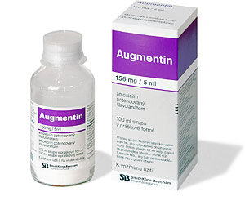
Class. Of penicillins ( cont )
4. Broad- spectrum penicillins
a) Ampicillin, Ampicillin- sulbactam, Amoxicillin, Amoxicillin- clavulanic acid (augmentin).
Less active than penicillin G against G+ cocci.
Active against G- organisms.

Slide 15
Uses of Broad-spectrum penicillins
H. Influenza infections (otitis media, sinusitis, chronic bronchitis, pneumonia, bacterial meningitis).
M.catarrhalis
E. Coli infections (Urinary & biliary infections)
Samonella infections (typhoid fever)
Shigella infections (ampicillin) the unabsorbable form of amp.
Gonococcal infections (alternative for penicillin G in the treatment of gonorrhea )
Prophylaxis for infective endocarditis.
Disadvantages
Amoxicillin & ampicillin alone are readily destroyed by Staph.Penicillinase.
Ineffective against P. aeruginosa

Slide 16
Broad-spectrum penicillins (cont)
b) Extended- spectrum :
Ticarcillin,Ticarcillin-clavulanic acid,
piperacillin, piperacillin-tazobactam (Tazocin)
Uses
Pseud. aeruginosa. For pseud. septicemia, they should be given together with an aminoglycoside
( eg. Gentamicin ).
Disadvantages
Ticarcillin and piperacillin alone are readily destroyed by S. penicillinase.
High dose may lead to hypernatraemia which is due to containing Sodium.
Notes:
. cell wall to allow gentamicin to get in ?
Should we write it?

Slide 17
Absorption, distribution & metabolism
Oral absorption of most penicillins is poor
Exception: Penicillin V
Amoxicillin
Food interfere with absorption (except amoxicillin)
Distribution
Widely distributed
Relatively insoluble in lipid
Hence, have poor penetration into cells and BBB
In special cases such as inflammation of the meninges there is transient permeablity into the CSF.

Slide 18
Absorp., metabolism ( cont. )
Protein binding differs:
Ampicillin and penicillin G 20% bound unchanged
Nafcillin, oxacillin, 90% boundmetabolized
cloxacillin , dicloxacillin
Metabolism and excretion
Not metabolized in human
Excreted mostly unchanged in urine via tubular secretion. An exception to this is nafcillin, oxacillin, cloxacillin, and dicloxacillin.
Probenecid blocks their secretion at the renal tubules.
Normal Half-life of penicillins is 30-60 min, (increased in renal failure)

Slide 19
Adverse effects of penicillins
1.Hypersensitivity reactions ( occur in 1-10% of pts;
fatality occur in 0.002%)
( immediate (min), accelerated (hrs) & late allergic (days to weeks) rxns)
Urticarial rash most common
Fever
Bronchspasm
Hypotention
Serum sickness
Exfoliative dermatitis
Stevens-Johnson syndrome = life-threatening skin reaction where cell necrosis causes separation between the dermis and epidermis.
Anaphylaxis
2. Superinfections (vaginal candidiasis)
3. Diarrhea most antibiotic cause diarrhea
4. May cause convulsions after high doses by IV or in renal failure

Slide 21
Cephalosporins
B-Lactam antibiotics ( similar to penicillins)
Broad spectrum
Act by inhibition of cell wall synthesis
Bactericidal
Inactive against : enterococci, MRSA*, L.monocytogenes
Widely used in surgical procedures to reduce the risk of post operative infections
They are classified to generations depend on time of production and bacterial spectrum.
*Methicillin-resistant Staphylococcus aureus

Slide 22
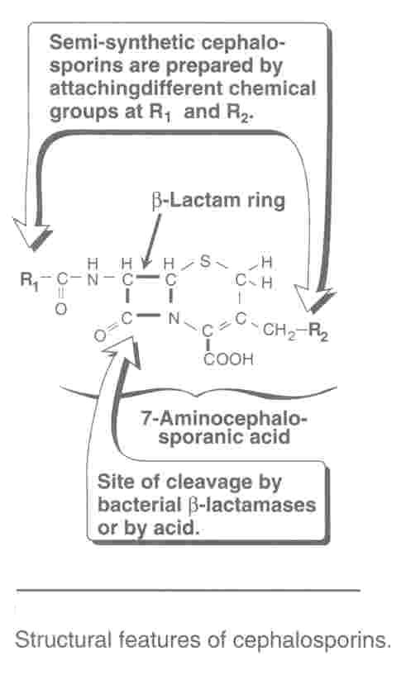

Slide 23
Classifications of cephalosporins
FIRST GENERATION
Cephalexin* , po (orally)
Cefazolin* , (IM, IV)
Cephalothin
Cephradine , po
Active against: G +ve cocci ( except.enterococci & MRSA ):
s.pneumoniae, s.pyogenes,s. aureus, s. epidermidis
Modest activity against G -ve bacteria
Cephalexin indicated for streptococcal pharyngitis
Cefazolin prophylacic for surgical procedures(S.aureus and S. epidermidis). (because it has more t_{1/2} )
Notes:
اذكر ان الدكتور قال ركزوا على أول اثني بس

Slide 24
SECOND GENERATION
Cefoxitin ( mefoxin )
Cefuroxime ( zinacef ) Cef. axetil ( zinnat )
Cefaclor ( ceclor ) Cefprozil ( cefzil )
Mainly effective against G- bacteria
Modest activity against G+ bacteria
Cefoxitin active against bowel anaerobes (B. fragilis )
Cefuroxime (injection) active against, Moraxella catarrhalis,H. influenzae, S. pneumoniae
Cef. Axetil- oral form of cefuroxime
Cefaclor active against H. influenzae, M. catarrhalis &E.coli
Cefprozil- similar to cefaclor, c. axetil and augmentin*- Liked by children (has a cherry flavour)
Avoid I.M administration
They have more t_{1/2} than 1st Gen
Second Generations are used primarily for URTIs & acute otitis media.

Slide 25
THIRD GENERATION
Ceftriaxone ( rocephin )
Cefotaxime ( claforan )
Cetazidime ( fortum )
Cefoperazone ( cefobid )
Cefixime ( suprax ) (the only oral of them)
Enhanced G- activity, H. influenzae, N. meningitidis, N.gonorrhea, P. aeruginosae, M. catarrhalis, E.coli, most Klebsiella
Cefotaxime preferred in neonates .
Ceftazidime & cefoperazone have excellent activity against p. aeruginosae.
Cefixime has similar activity to amoxicillin & cefaclor (URTIs & acute otitis media)
Third G can cross BBB so it can use in N.meningitis

Slide 26
Ceftriaxone has long t_{1/2} (used once daily).
Used in children & adults .
Not advised in neonates (↑ bilirubin).
1st line of treating neisseria
Meningitis in adult Ceftriaxone
Meningitis in neonate Cefotaxime
Fourth Generation
Cefipime (i.v, i.m).
Extended spectrum of activity against both Gm + & Gm - more than 3rd generations.
Enterobacter are resistant to all cephalosporins except cefipime

Slide 27
Pharmacokinetics
Cephalosporins are given parenterally and orally.
Extent of binding to plasma protein vary from one to another.
e.g. Cefazolin is 80% protein bound ( hence, long t_{1/2} )
Cephalexin is 10-15% protein bound
Relatively lipid insoluble ( like penicillins )
Hence,do not penetrate cells or the CNS, except for third generations.
Mostly excreted unchanged by the kidney (glomerular & tubular secretion )*, except, ceftazidime , cefoperazone, and ceftriaxone( biliary tract))
Probenecid slows their elimination and prolong their half-live ( except Ceftazidime & cefoperazone)
Half-life 30-90 min; ceftriaxone 4-7 hr (the longest in cephaslosporins)
*Tubular secretion means it is active secretion
*Glomerular secretion means it is freely secreted

Slide 28
Therapeutic uses
1. Alternative to penicillin in allergic patients
2. URTI and otitis media 2nd G
cefaclor cefuroxime axetil
cefprozil cefixime (3rd G)
3. Septicaemia caused by G- bacteria ( P.aeruginosae)
A penicillin(eg.Piperacillin/ Ticarcillin) +aminoglycoside
OR
A cephalosporin(eg. ceftazidime ) + AG (aminoglycosides)
4. Urinary tract infections (E.coli)
Cefuroxime, Cefixime
. 5. Prophlaxis in surgery:
Appendectomy ( bowel anaerobes ) eg. Cefoxitin
Obstetrical &gynecological, urological, orthopedic procedures, etc
( S. aureus & S. epidermidis ) eg. Cefazoline
6. Meningitis- N. Meningitidis
Ceftriaxone
Cefotaxime( preferred in neonate)
7. Gonococcal infections
Ceftriaxone

Slide 29
Adverse effects
1. Hypersensitivity reactions: most common:
Anaphylaxis, bronchspasm, urticaria
Maculopapular rash, fever, nephritis, anemia
2. Thrombophlebitis ( i.v administration )
3. Superinfections
4. Diarrhea when use oral cephalosporins,
5. cefoperazone may cause:
a) bleeding disorders (hypothrombinemia)
b) Flushing, tachycardia, vomiting with alcohol intake
if there’s a severe allergy to penicillin → don’t use cephalosproins

Slide 30
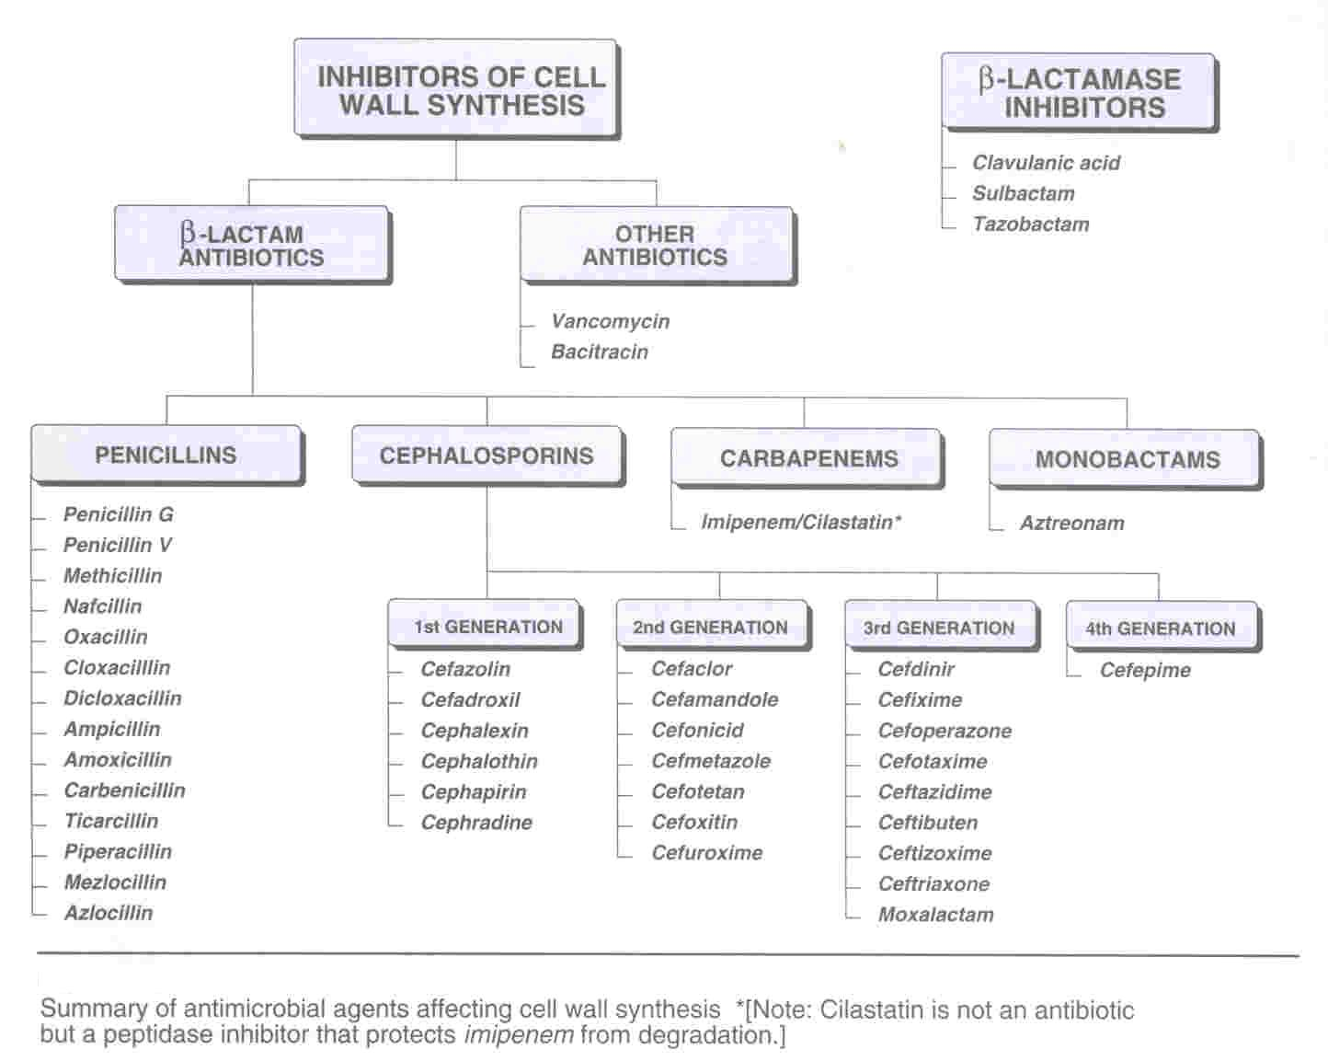

Slide 31
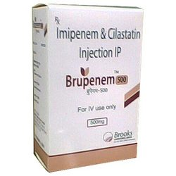
CARBAPENEMS
e.g. (Imipenem + Cilastatin) ,
Meropenem
Imipenem + Cilastatin (I.V.)
Mechanism of action
Similar to other β. lactams
Antibacterial spectrum
Aerobic & anaerobic G+ & G- bacteria, including pseudomonas and most enterobacter.
MRSA is less susceptible

Slide 32
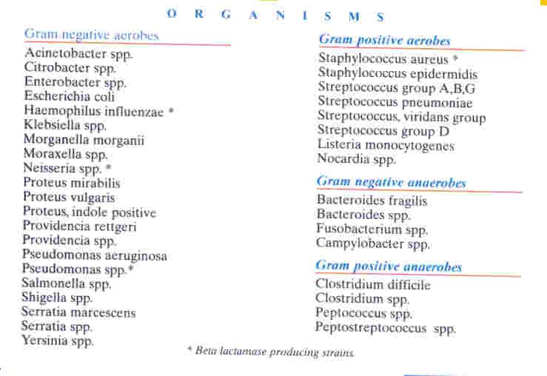

Slide 33
IMIPENEM / CILASTATIN ( CONT. )
Pharmacokinetics
Not absorbed orally ( i.v infusion )
Penetrates body tissues well (including CSF)
Partly broken down by dehydropeptidase in the proximal tubule
given with cilastatin ( dihydropeptidase inhibitor )
Excreted primarily by the kidney
Doses must be reduced in renal failure
Half- life about 1 hr

Slide 34
Clinical uses of imipenem / cilastatin
One of best drugs for emperic therapy
Infections require multiple antibiotics ( useful in nosocomial infections )
Not used alone for serious pseud.infections
Not used for MRSA infections
Beta lactam of choice for enterobacter
Mixed infections
Side effects
Similar to those seen with β- lactams:
Nausea & vomiting are frequent
Excessive levels with renal failure may lead to seizures
Pts allergic to penicillins may be allergic to imipenem

Slide 35
Disadvantages of Imipenem / cilastatin versus Meropenem
High incidence of seizures, whereas meropenem is not.
A 1g of imip./cilas require 200 ml saline to dissolve, whereas
A 1g of meropenem dissolves in only 20 ml saline.
Hence, meropenem can be given either by i.v bolus or i.v infusion
Whereas, Imip./cilas should be given only by i.v infusion, so:
Less suitable for fluid restricted patients
Not suitable for outpatients it needs hospitalization

Slide 37
GLYCOPEPTIDES
E.G. Vancomycin, Daptomycin
Mechanism of action:
Inhibit cell wall synthesis = mechanism of β-lactam antibiotics.
Antibacterial activity:
Restricted only for Gram+ve bacteria
Bactericidal against aerobic G+ bacteria, especially Staphylococci ( including β-lactamase producing MRStaph Aureus & MRStaph Epidermidis) & anaerobic G+ (C.difficile).
Ineffective against aerobic & anaerobic G –ve bacteria.

Slide 38
Cont’d
Pharmacokinetics:
Not absorbed from GIT (only given orally in antibiotic-associated colitis caused by C. difficile)
It is given as slow IV infusion.
Widely distributed (including CSF in inflammation of meninges)
Only 10 % bound to plasma protein
Eliminated mainly unchanged by glomerular filtration
Accumulates in renal impairment
Half-life approximately 8 hours

Slide 40
Cont’d
Uses:
Serious Staphylococcal infections caused by MRSA or MRSE
Prophylaxis for major surgical procedures in hospitals with high rates of infections with MRSA or MRSE
Antibiotic-associated colitis; start with metronidazole, if resistant give vancomycin. Although vancomycin shows greatest efficacy in severe cases of antibiotic-associated colitis.
Vancomycin showed less effectiveness in methicillin-susceptible SA as compared to β-lactam antibiotics.
Vancomycin- resistant staph use Daptomycin

Slide 41
Cont’d
Side effect:
Fever , rashes
Thrombophlebitis at the site of injection
Ototoxicity & nephrotoxicity especially when combined with aminoglycosides
Rapid infusion:
Flushing of upper body red man or red neck syndrome due to release of histamine
Hypotension
Pain & muscle spasm of chest & back

Slide 43
MONOBACTAM

Slide 44
eg, Aztreonam
Unique among B-lactams:
Active only against G-ve aerobes.
It shows low cross-reactivity with antibiodies induced by other β-lactams. Thus, this drug may offer a safe alternative for treating patients who are allergic to penicillins and/or cephalosporins

Slide 45
Cont’d
Mechanism of action:
Similar to other β-lactams
Antibacterial spectrum:
Active only against G-ve aerobic bacteria (pseudomonads, Neisseria, H. influenzae and enterobacteriaceae )
Inactive against G+ve or anaerobic bacteria

Slide 46
Cont’d
Pharmacokinetics:
Poorly absorbed orally( IV/ 8 hr )
Limited penetration into the CSF
Excreted primarily by the kidney
Half- life 2 hrs
resistant to the action of β-lactamase
Side effects:
Similar to other β-lactams

Slide 47
Cont’d
Clinical uses of aztreonam:
Active against G-ve aerobes only
A safe alternative for penicillin (piperacillin) and cephalosporin (ceftazidime) in allergic patients against G-ve infections
A safe alternative for aminoglycosides, especially in elderly and patients with renal impairment

Slide 48
Bacitracin
Active against G+ve
Bacitracin is highly nephrotoxic when administered systemically and is only used topically.
Bacitracin is formulated as an ointment base (often combined with polymyxin or neomycin).
Adverse effects:
Nausea/vomiting and skin rash

