Slide 1
Antiviral Drugs Prof. Alhaider, 1431 H
Definition:
Viral infections depend on the host cells. Therefore, antiviral drugs must block viral entry or exit or the activitiy of the virus inside the cell
Classification of Antiviral Drugs:
Note: To understand the classification of antiviral drugs, students should remember the steps that are involved in viral replication (See next slide). However, most antiviral agents interfere with nucleic acid synthesis or late synthesis of viral proteins.
Furthermore, most of them act as antimetabolites.

Slide 2
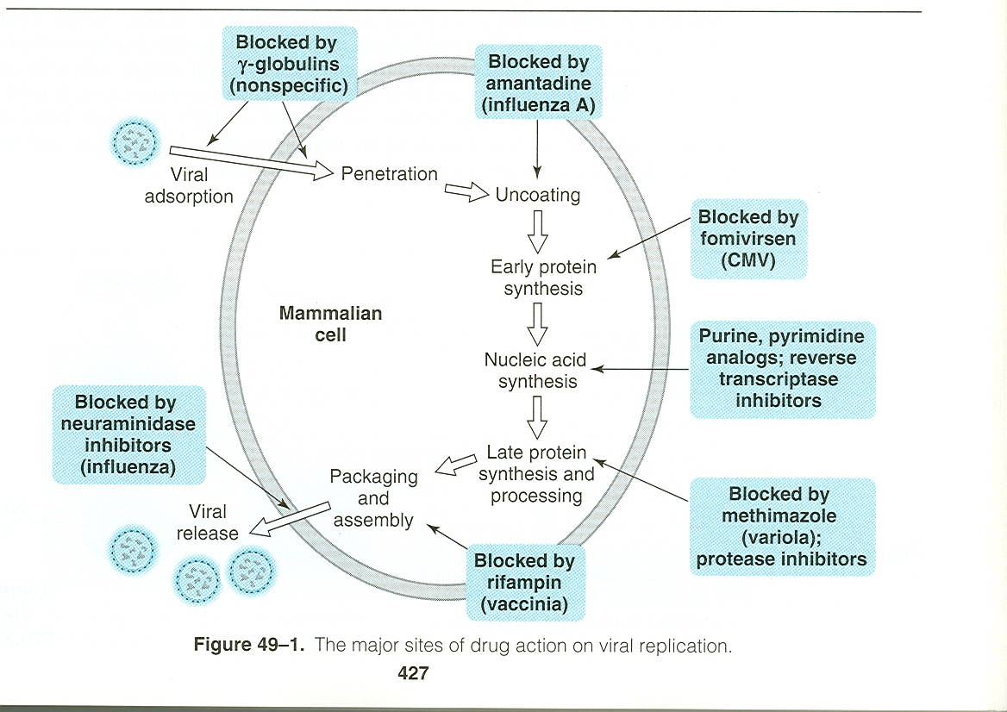
Steps of viral replication
1
3
2
4
5
6
7
8

Slide 3
Classification of Antiviral Drugs
Best Classification Based on 1) Type of Viral Infections (Organisms) or 2) its site:
I. Agents to Treat Herpes Simplex virus (HSV) and Varicella Zoster Virus (VZV) infections.
II. Agents To Treat Cytomegalovirus infection (CMV)
III. Drugs Used for R_{x} of AIDS (Antiretroviral Agents)
IV. Antihepatitis Agents
V. Antiviral Used for Respiratory Tract Infections

Slide 4
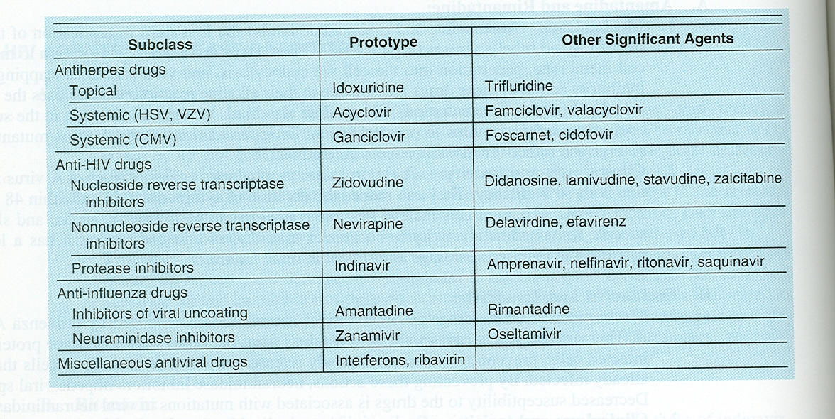
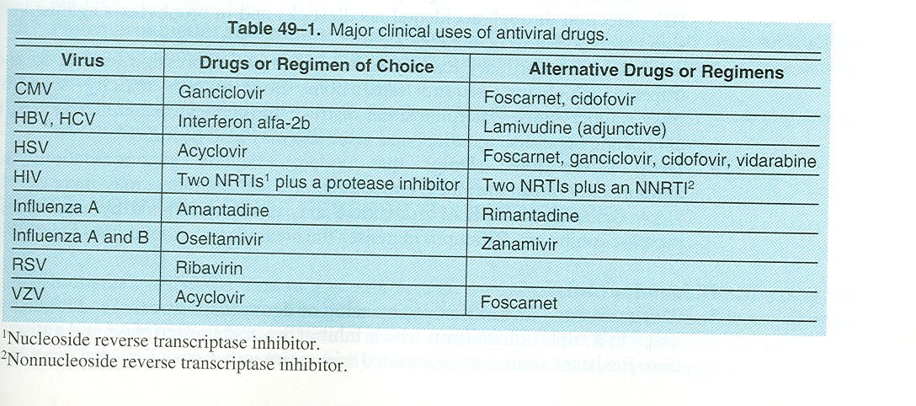
Table 2: Types of Antiviral drugs
1
2
3
4

Slide 5
Agents to Treat Herpes Simplex virus (HSV) and Varicella Zoster Virus (VZV) infections.
Examples: Acyclovir (prototype); Valcyclovir; Famiciclovir; Trifluridine (Topical)
Mechanism of action
Step 1:
three phosphorylation steps are required.
The 1st one needs viral thymidine kinase.
The rest need host thymidine kinase.
Step 2:
The result of step 1 is (acyclo-GTP)
Acyclo-GTP
Incorporation into Viral DNA
Competitive inhibition of viral DNA polymerase
Inhibition of viral DNA synthesis
Chain termination

Slide 6
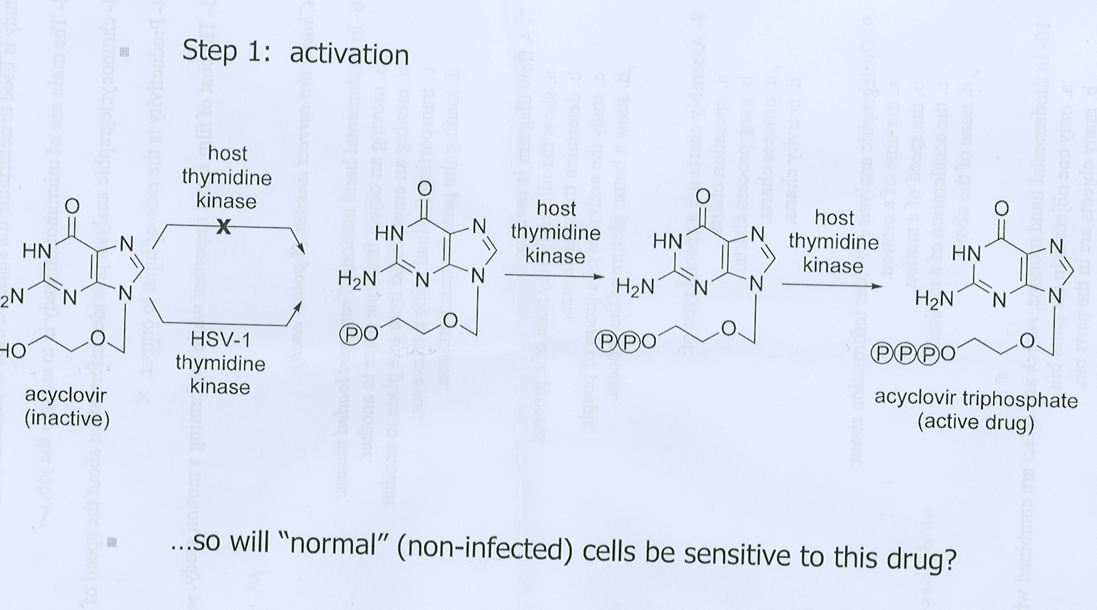
These drugs are guanosine analogs without sugar moiety, so they block DNA elongation of virus
They can’t effect human cells because they need viral enzymes, so they are more effective in infective pt

Slide 8
Resistance:
Can be developed due to deficient or alteration of thymidine kinase and or alteration DNA polymerases.
Cross resistance: to valcyclovir, famiciclovir and gancyclovir
but no cross resistance for cidofovir (because it doesn’t need viral thymidine kinase for action) (see anti-CMV)

Slide 9
PK of Acyclovir :
is available as topical, I.V. and oral (bioavailability:15-20% low) (not affected by food),
Short t_{1l2} 3 hr thus given 4-5 times daily and eliminated mainly by kidney (t_{1l2} prolonged in renal impairment) may reach 20 hr (the main disadvantage)
Distribute in ALL parts of the body, including CNS (e.g: encephalitis). Concentration in the CNS = ½ conc. In serum
Clinical Uses (see Table 49-1)
HSV, Varicella-zoster VZV; Epstein-Barr virus mediated infection; HSV encephalitis; Genital herpes infection.
What is Valacyclovir? It’s the L-valyl ester of acyclovoir.
It given IV if the infection is so sever
How valcyclovir differs from acyclovir?
High oral bioavailability; long duration (almost five times the plasma concentration)
Can replace I.V. acyclovir
Effective even for CMV (but it’s not the drug of choice)
Valcyclovir is a prodrug of acycolvir

Slide 10
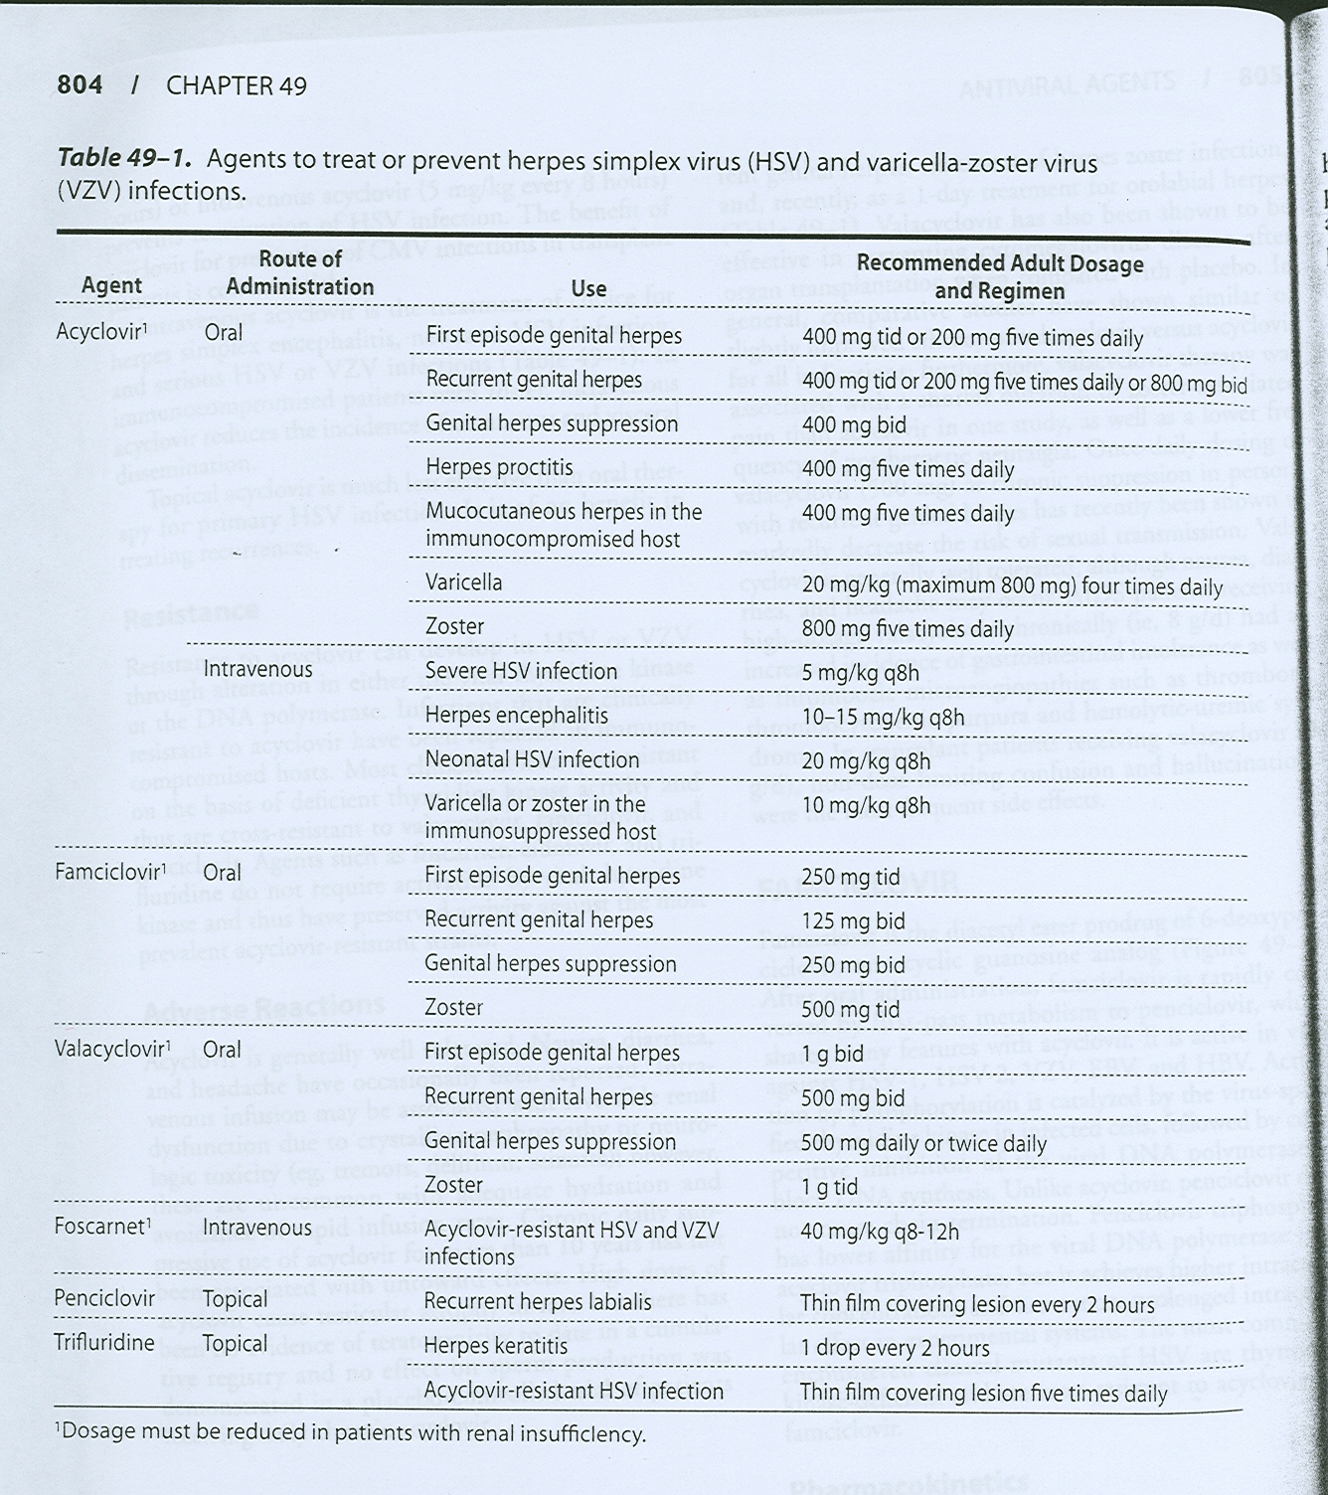

Slide 11
Side Effects of Acyclovir
(Generally speaking, acyclovir considers to be safe drug (remember slide #6) however, it may produce:
1 . Transient Renal dysfunction at high dose or at IV (Crystalline Nephropathy). It’s uncommon with adequate hydration and avoid rapid infusion rates
2. GIT disturbances
Side Effects of Aalacyclovir
Thrombotic thrombocytopenic purpura (TTP) and hemolytic-uremic syndrome in pts with AIDS

Slide 13
II. Agents To Treat Cytomegalovirus infection (CMV)
Ganciclovir: Analog of acyclovir
Why Acyclovir is not active against CMV? Because the affinity of CMV thymidine kinase to acyclovir is very low
MOA: Similar to acyclovir
PK:
Administered I.V. , orally (poor bioavailability), intraocular implant.
T_{1/2} = 4 hr (short)
Kidney clearance
Valganciclovir:
L-valyl ester of ganciclovir.
Oral replacement for IV ganciclovir

Slide 14
Clinical Uses of Ganciclovir:
IV: (commonly used formulation)
- to delay the progression of CMV retinitis in patients with AIDS, 2 weeks followed by oral form)
- for CMV colitis, esophagitis and pneumonitis.
- to prevent CMV before trasplantation.
Oral: (Used for prophylaxis)
- CMV prophylaxis in transplant patients
- prevention of end organ CMV disease in AIDS patients.
- as maintenance therapy for CMV retinitis.
Intraocularly (implant):
R_{x} CMV retinitis.

Slide 15
Adverse Effects of Ganciclovir:
- Myelosuppression (neutropenia 20-30%) and increases if given with Zidovudine, azathioprime, or mycophenolate mofetil)
- Vitreous hemorrhage and retinal detachment with intraocular implant.
- Mitogenicity in mammalian cells and carcinogenic in animals at high dose

Slide 16
Cidofovir:
Differs from acyclovir in its long t_{1/2} 26 hr with active metabolite.and MOA.
MOA: phosophorylation does not depend on viral enzyme, and works as inhibitor and alternative substrate for viral DNA polymerase.
Activity: CMV; HSV; VZV
Used for CMV retinitis, colitis, and esophagitis.
and for Acyclovir-resistant
PK: produce active metabolite, thus it has long t1/2, eliminated in the kidney, Probenicid prolonged its action. but with poor CNS penetration.
Why acycoliver is better than Cidofovir for encephalitis?
Side effects: Dose-dependent nephrotoxicity (53%) and uveitis and decrease IOP (intra ocular pressure)

Slide 17
Note: Normally, DNA → RNA
however,
Reverse transcriptase = RNA-directed DNA polymerase (DNA polymerase that transcribes single- stranded RNA into double-stranded DNA.

Slide 18
III. Drugs Used for Rx of AIDS (Antiretroviral Agents)
AIDS are caused by HIV, and zidovudine was the first drug used (1987).
To understand drugs used for AIDS, the life cycle of HIV should be utilized for drugs combination (See next slide)
Drug combination or the so-called Highly Active Antiretriviral Therapy (HAART) (Figure 38-17) as well as adherence to the regimen, both are very essential.
HIV is always in mutation through it cycle, so combination & adherence is recommended.
Classification of Anti AIDS (Based on life cycle) Table 2 and Figure 38-17):
1) Nucleotide Reverse Transcriptase Inhibitors (NRTIS)
2) Non Nucleotide Reverse Transcriptase Inhibitors (NNRTIS)
3) Protease Inhibitors e.g. Saquinavir; Ritonavir; Indinavir
4) Viral Fusion Inhibitor e.g. Enfuvirtide

Slide 20
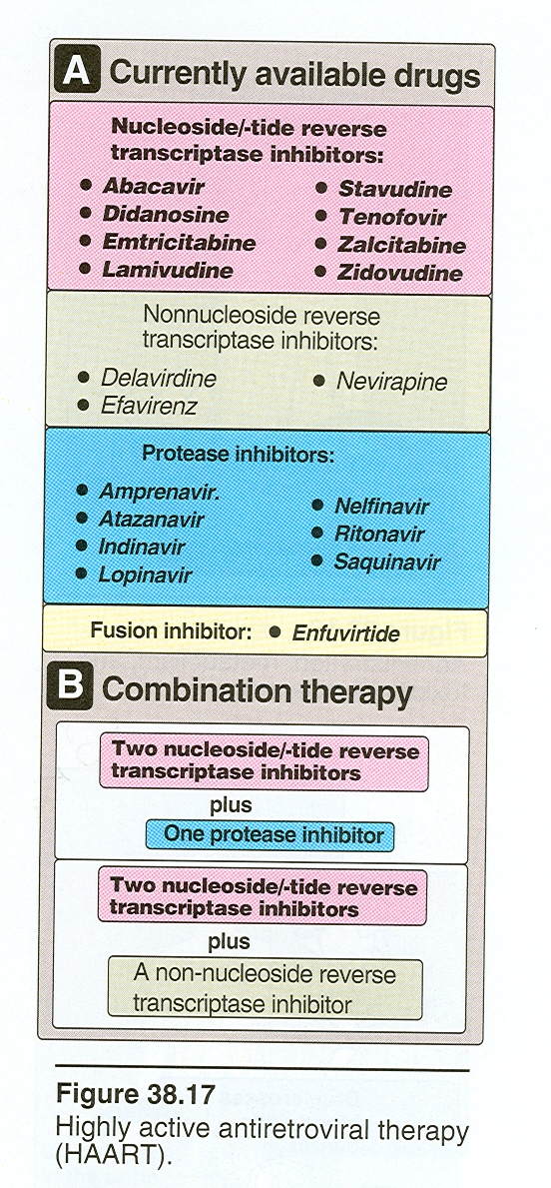

Slide 21
Objectives of HIV Treatment:
Suppression of viral replication (decrease the viral load).
Restoration of a degree of immunocompetency to the host.
Decrease incidence of opportunistic infections.
prolonged survival

