Slide 1
IV. Antihepatitis Agents:
Like in AIDS, they are suppressive rather than curative. Among many hepatitis viruses, HBV and HCV are the most common cause of chronic hepatitis, cirrhosis, and HCC.
Drugs for Hepatitis B (see next slide)
Lamivudine:
MOA: inhibit HBV DNA polymerase and HIV reverse transcriptase, resulting in chain termination.
This safest NRTI antiretroviral drug, shows prolonged intracellular t_{1/2} in HBV cell lines (17-19 Hr), than in HIV-infected cell line.(give lower doses and less frequent administration in HBV)
Effectiveness:
Achieves almost universal HBV DNA suppression, with decrease in viral replication; and decrease progression to liver fibrosis.
Response is more rapid than using interferon alone.
What will happen of lamivudine is stopped?

Slide 2
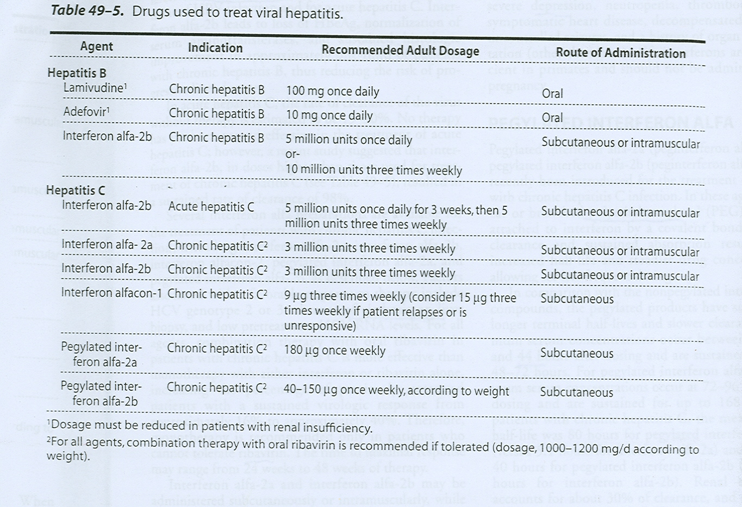

Slide 3
Resistance:
20 % can occur after 8-9 months of therapy.
Resistance: Mutation occur inside virus to decrease efficacy of the lamifvudine against HBV(also occur in HIV)
What is the evidence of resistance? (associated with progressive liver disease)
2. Adefovir:
This nucleotide (NRTIs) analog is also use in HBV infection especially in lamivudine resistance cases.
There is no cross-resistance between lamivudine and adefovir

Slide 4
MOA: inhibition of HBDNA polymerase and chain termination
Side effects:
Eliminated by glomerular filtration and tubular secretion, thus it is nephrotoxic.
Lactic acidosis and hepatomegaly with steatosis may occur.

Slide 5
3. Interferon Alfa:
Endogenous glycoprotein or cytokine that produced by human leukocytes and exert
1- anitviral,
2-immunomodulatory (immunostimulants) and
3-antiproliferative activities.
Commercially available as:
Interferon alfa-2b: Licensed for Rx of HBV and acute hepatitis C.
Interferon alfa-2a: can be used for HCV (Either alone or better with oral Ribaverin
Note: Both types can be used for HCV
MOA:
Unclear but may be via the induction of host cell enzymes that inhibit viral penetration, translation, transcription, maturation, release. Thus degrading viral mRNA and tRNA.

Slide 6
PK of interferons:
Both types could be administered either S.C or I.M. with short t_{1/2}.(4-7 hrs)
Filtered unchanged in the glomeruli and undergo proteolytic degradation during tubular reabsorption
(not contraindicated in renal impairment)
What are the differences between interferon and pegylated interferon Alfa?
1) Structure: Peg Interferon alfa-2a and 2b represent the corresponding interferons with branched polyethylene moiety is attached by covalent bond. Thus,
2) Peg has longer t_{1/2} as compared to normal interferon. (80 Hr VS 5.1 for alfa-2b) and increase in renal impairment.
3) Efficacy is superior to non-pegylated interferon.

Slide 7
In CONCLUSION
Pt with renal impairment, the dose of pegylated interferon & non-pegylated interferon should be reduced according to severity of the impairment
despite pegylated interferon have long t_{1/2} ,it’s not contraindicated in renal impairment
Notes:
لقيت هذا الكلام في احد البحوث

Slide 8
Other Uses of Interferon:
1) Cancers such as hairy-cell leukemia and Kaposi sarcoma related to AIDS.
2) Multiple Sclerosis
3) topically for genital warts.
4) prevent dissemination of herpes zoster in cancer patients or immunocompromised patients
5) Multiple myeloma
Side Effects of interferons:
-Since they are endogenous types of proteins, they may produce Flu-like symptoms within 6 hr in more than 30% of patients, with N/V(nausea and vomiting) and anorexia; fatigue; rash; alopecia.
- Cough, tinnitus, retinopathy, pneumonitis
- Thrombocytopenia: granulocytopenia and elevation in aminotransferase level mainly in responders. Induction of autoantibodies.
- Mental depression and Neurotoxicity (somnolence)

Slide 9
Contraindications
Hepatic decompensation, autoimmune disease, history of cardiac arrhythmia
Caution of using IFN in:
Psychiatric disease, epilepsy, thyroid disease, cytopenia, sever renal insufficency
Drug-drug interaction:
Increase theophylline and methadone
Combinations:
IFN + NRTI agents = hepatic failure
IFN + didanosine = not recommended
IFN+ zidovudine = exacerbate cytopenia

Slide 10
Ribavirin:
Guanosine analog requires phosporylation; and inhibits the replication of wide range of DNA and RNA viruses, including HCV; HIV; influenza A & B and respiratory syncytial virus (RSV).
Uses:
Orally: together with interferons for HCV.
Inhaled: For (RSV).
side effect:
Hemolytic anemia (thus, it’s not given with AZT & didanosine)

Slide 11
V. Antiviral Used for Respiratory Tract Infections:
1) Inhibitors of viral coating (e,g: Amantadine* and Rimantadine:
MOA: will Inhibit uncoating of viral RNA of influenza to the infected host cell, via blocking the viral membrane matrix M2 protein, thus it inhibits the replication of viral RNA.
Note: M2 protein only present in Influenza A (active against A only)
PK:
Amantadine eliminated unchanged in kidney, while rimantadine is metabolized in the liver. Amantadine can pass BBB and available in Tablet forms. Amantadine is dopamine enhancer (dopaminergic activity)
Which one is preferred in a patient with renal failure? وش رايك عزيزي الطالب؟؟
contraindications:
Uncorrected anemia, ischemic vascular disease, renal failure, pregnancy

Slide 12
Uses:
For prophylactic and treatment of Influenza A
(Influenza B has different protein in the membrane).
Side Effects:
CNS (by amantadine only): Nervousness, difficulty in concentration, lightheadness
GIT: nausea and anorexia
((They are not effective as antiviral because of rapid resistance & side effect))
Peripheral edema
* Note: Amantadine is also used for management of Parkinson disease.

Slide 13
2. Neuraminidase Inhibitors:
Viruses that cause infuenza like orthomyxovirus contain the neuraminidase; which can be selectively inhibited by Zanamavir (inhaled) and Oseltamivir(oral).
MOA:
- Via inhibition of neuraminidase these drugs inhibit the release of new virions (Influenza viruses employ specific neuroaminidase that is inserted into the host cell membrane for the purpose of releasing newly formed virions. Thus virions accumulate at the internal infected cell surface. .
- Active against both Influenza A and B.
They are alternative for amantadine & rimantadine in RTI
What is the difference between Amantadine and Zanamavir?
Zanamavir → bronchospasm (contraindicated in asthma)
3. Ribaverin: (see the above)

Slide 14
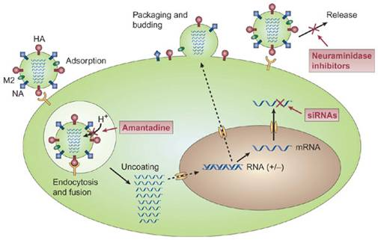

Slide 15
4. Palivizumab:
Huminized monoclonal antibody directed against the F glycoprotein on the surface of RSV
Uses: only for prevention of high- risk infants

