Slide 1
DRUGS USED FOR TREATMENT OF EPILEPSY
Prof. Mohammad Saad AL-Humayyd

Slide 2
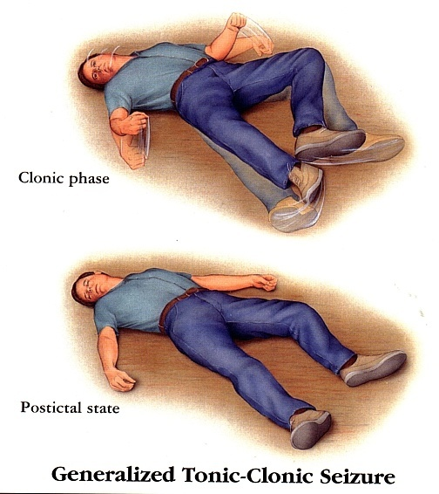
Definition
Epilepsy is a chronic medical condition characterized by 2 or more unprovoked seizures.
It is not a disease, it is a syndrome
What is the difference between seizure & epileptic syndrome?
Seizure: limited, provoked
Epilepsy: chronic, recurring, unprovoked

Slide 4
Etiology
Congenital defects, head injuries, trauma, hypoxia
Infection (bacterial or viral) e.g. meningitis, brain abscess, viral encephalitis.
Concussion, depressed skull, fractures.
Brain tumors (including tuberculoma), vascular occlusion, stroke.
Drug withdrawal, e.g. CNS depressants, alcohol, or drug abuse or drug overdose,e.g. penicillin.
A poison, like lead
Fever in children (febrile convulsion).
Hypoglycemia
PKU (phenylketonuria)
Photoepilepsy

Slide 5
Triggers
Fatigue
Stress
Sleep deprivation
Poor nutrition
Alcohol

Slide 6
Classification of Epilepsy
a)Partial (focal) Arise in one cerebral hemisphere
[1] Simple | consciousness is retained
[2] Complex (psychomotor) | Altered consciousness

Slide 7
b)Primary Generalized Both hemispheres + loss of consciousness.
 | Tonic-clonic (Grand mal epilepsy) | Stiffness (15-30 sec) followed by violent contractions & relaxation (1-2 minute)
 | Tonic | Muscle stiffness
 | Clonic | Spasms of contraction & relaxation
 | Atonic (akinetic) | Pt’s legs give under him & drops down
 | Myoclonic Absence (Petit mal epilepsy) Status epilepticus | Jerking movement of the body Brief loss of consciousness with minor muscle twitches eye blinking Re-occuring seizure

Slide 8
[c] Secondarily generalized seizure
Begins as partial (simple or complex) and progresses into grand mal seizure

Slide 9
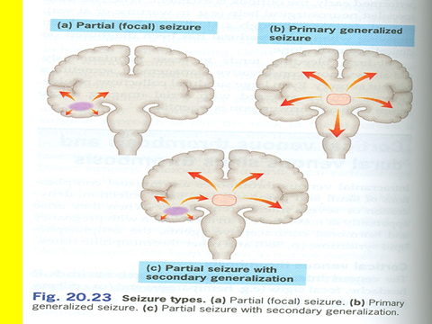

Slide 10
General rules for treatment of epilepsy
Epilepsy is usually controlled but not cured with medication.
Up to 80% of patients can expect partial or complete control of seizures with appropriate treatment.
20% no response to treatment → non pharmacological approach e.g. surgry, etc
Antiepileptic drugs are indicated when there is two or more seizures occurring in short interval ( 6 - 12 months)
An initial therapeutic aim is to use only one drug, monotherapy, with the least dose and increasing gradually.

Slide 11
Drugs are usually administered orally
Monitoring plasma drug level is useful
Triggering factors can affect seizure which could be controlled by drugs.
Sudden withdrawal of drugs should be avoided

Slide 12
Withdrawal considered
Seizure –free period of 2-5 yrs or longer
Normal IQ
Normal EEG prior to withdrawal
NO juvenile myoclonic epilepsy
Relapse rate when antiepileptic drugs are
withdrawn is 20% in chdildren and 40% adults

Slide 13
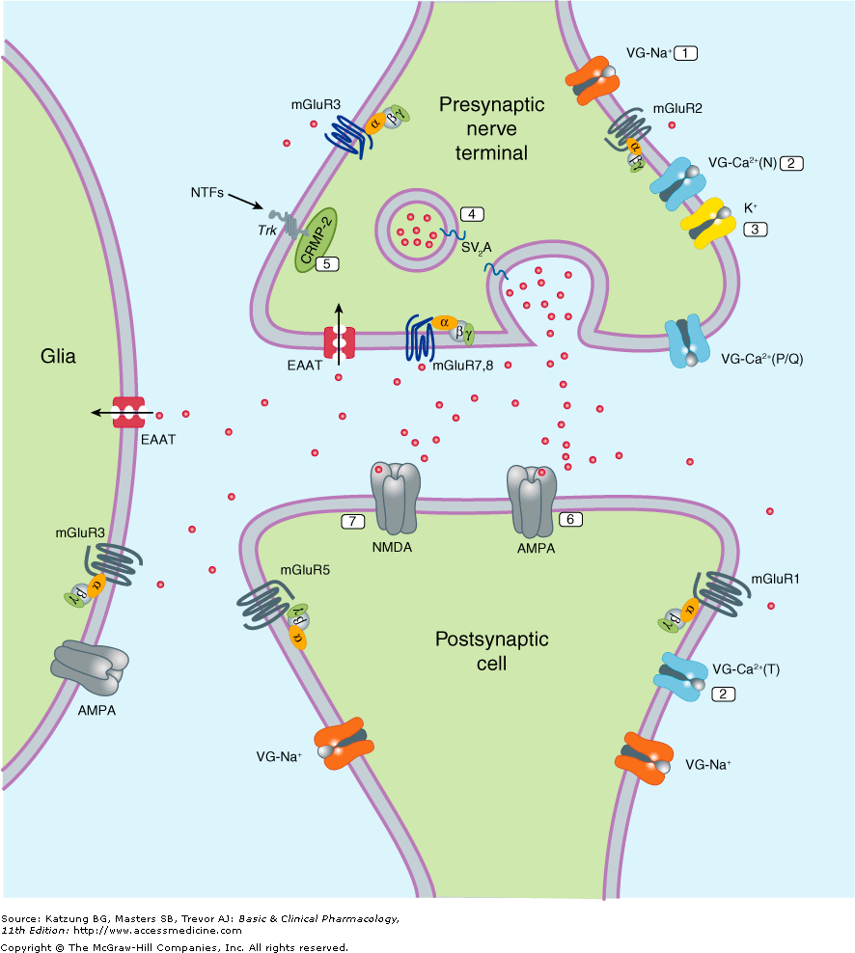
Pathophysiology of Epilepsy
How Drugs Act?
Blockade of voltage –gated channels (Na⁺ or Ca⁺)
Enhancement of GABA
Or interference with
Glutamate transmission (citatory)
(inhibitory)

Slide 14
Classification of antiepileptic drugs
First-generation
Phenytoin**
Carbamazepine**
Valproate**
Phenobarbital and Primidone
Benzodiazepines (e.g.Clonazepam, lorazepam and diazepam)
Second- generation
Lamotrigine**
Levetiracetam**
Topiramate **
Gabapentin
Vigabatrin
Felbamate
Zonisamide
2nd generation used alone (doctor said used as adjunct therapy to 1st G. this note for leader)
2nd generation: less interaction with other drugs, expensive, we have limited experience with them (they’re new so we know less about them)
Increased in PK profile

Slide 15
Phenytoin
Pharmacokinetics :
Well absorbed orally
A prodrug of phenytoin (fosphenytoin) available as IV administration (but may cause cardiac arrest)
Enzyme inducer (decrease other drugs)
Metabolized by the liver to inactive metabolites
Excreted in urine
At low blood levels metabolism follows 1st order kinetics
When the dose is increased → very large changes of phenytoin concentration

Slide 16
Phenytoin
Mechanism of action
Blockade of Na⁺ & Ca⁺⁺ influx into neuronal axon.
Inhibit the release of excitatory transmitters
Potentiate the action of GABA
Therapeutic uses:
Partial and generalized tonic-clonic seizures
Not in absence seizure.
In status epilepticus, IV .

Slide 17
Drug interactions
Phenylbutazone and sulfonamides displace phenytoin from its binding site.
Decrease in protein binding (as in hypoalbuminemia) → decrease in total plasma concentration but not free concentration.
Renal disease → ↓ protein binding
The drug has an affinity for thyroid-binding globulin which may confuse thryoid function test
Phenobarbital and carbamazepine → decrease concentration of phenytoin.
Isoniazid inhibits metabolism of phenytoin

Slide 18
Side effects
Nausea or vomiting
Neurological like headache, vertigo, ataxia, diplopia , nystagmus
Sedation
Gum hyperplasia (especially with decreased level of oral hygiene)
Hirsutism
Acne
Megaloblastic anemia
Osteomalcia
Teratogenic effect
vertigo. Diplopia, nystagmus, ataxia, & CNS depression like sedation are common symptom of all antiepileptic drugs
Ataxia occur in chronic treatment

Slide 19
Carbamazepine
Pharmacokinetics :
Available only orally
Well absorbed
Strong enzyme inducer including its own metabolism
Metabolized by the liver to active & inactive metabolites
Excreted in urine

Slide 20
Carbamazepine
Mechanism of action
Blockade of Na⁺ & Ca⁺⁺ influx into neuronal axon.
Inhibit the release of excitatory transmitters
Potentiate the action of GABA
Therapeutic uses:
Drug of choice in partial seizures.
Tonic-clonic seizures (1ry & 2ry generalized) but Not in absence seizures.
It is the most favorable antiepileptic drug

Slide 21
Side effects
GIT upset.
Hypersensitivity reactions
Drowziness , ataxia, headache & diplopia
Blood dyscrasis
Hyponatremia & water intoxication
Teratogenicity

Slide 22
What make Carbamazepine differ from phenytoin
Only use orally
Increase it’s own metabolism
Metabolized into active and inactive metabolite

Slide 23
Sodium Valproate Broad spectrum antiepileptic
Pharmacokinetics :
Available as capsules, Syrup , IV
80% bioavailability
Food delay absorption
90% protein binding
Metabolized by the liver ( inactive )
Stronge enzyme inhibitor
Excreted in urine

Slide 24
Sodium valproate
Mechanism of action
Blockade of Na⁺ channels.
Inhibits GABA –transaminase*
Suppress glutamate action.
Blockade of NMDA receptor mediated excitation.
Inhibit the action of GABA transporter GAT-1.
Inhibit histone deacetylase → change the transcription of many genes
Therapeutic Uses
[I] Epilepsy:
It is effective for all forms of epilepsy e.g.
Generalized tonic-clonic seizures (1^{ry} or 2^{ry} ).
Absence seizures
Complex partial seizures
Myoclonic
Atonic
photosensitive epilepsy
* GABA transaminase: an enzyme which inhibits the action of GABA

Slide 25
Side effects:
Drug interaction:
Weight gain(↑appetite ).
Transient hair loss with re-growth of curly hair
Thrombocytopenia
Hepatotoxicity .IMP (LFT)
Teratogenicity
GI disturbance
It displaces phenytoin.
Inhibits the metabolism of: phenobarbital, phenytoin, carbamazepine.
Note: all three drugs of 1st G are teratogenic

Slide 26
Lamotrigine (2nd G)
Mechanism of action
Blockade of Na⁺ channels
Inhibits excitatory amino acid release ( glutamate & aspartate )
It has an action on Ca⁺⁺ channels.
Therapeutic Use
As add-on therapy or as monotherapy in partial seizures
Lennox-Gastaut syndrome (not important)

Slide 27
Pharmacokinetics
Available as oral tablets
Well absorbed from GIT
55% protein binding
Metabolized primarily by glucuronidation not CP450
Does not induce or inhibit C. P-450 isozymes. IMP

Slide 28
Side effects
Influenza-like symptoms.
Skin rashes (may progress to Steven –Johnson syndrome )
Somnolence
Blurred vision
Diplopia
Ataxia

Slide 29
Levetiracetam
Pharmacokinetics :
Taken orally ( tablets or solutions)
Not metabolized & excreted unchanged in urine only drug excreted unchange
Does not affect liver enzymes
Drug interactions are minimal

Slide 30
Levetiracetam
Mechanism of action
Unknown
Therapeutic Uses
Adjunctive therapy in :
Partial seizures
Generalized tonic-clonic seizures
monotherapy therapy in
Myoclonic seizures

Slide 31
Side effects
Ataxia
Dizziness
Somnolence
Pin & needles sensation in extremities(glavs and socks)
Blurred vision
asthenia

Slide 32
Topiramate
Pharmacological Effects:
Well absorbed orally ( 80 % )
Food has no effect on absorption
Has no effect on microsomal enzymes
9-17 % protein bound ( minimal )
Mostly excreted unchanged in urine
Plasma t_{1/2} 18-24 hrs
Mechanism of Action:
Blocks sodium channels (membrane stabilization), potentiates the inhibitory effect of GABA, and depresses the excitatory action of kainate on glutamate receptors.

Slide 33
Topiramate ( Cont. )
Clinical Uses:
Can be used alone for partial, generalized tonic-clonic, and absence seizures.
Lennox- Gastaut syndrome ( or lamotrigine, or valproate ) and West syndrome
Side effects:
Psychological or cognitive dysfunction
Weight loss ( can be desirable side effect)
Sedation
Dizziness
Fatigue
Urolithiasis
Paresthesias (abnormal sensation )
Teratogenecity (in animal but not in human)
Myopia or glaucoma

Slide 34
All the above drugs have long t_{1/2}
Type of seizure | Choice among drugs
Partial seizures: Carbamazepine or phenytoin or valproate or lamotrigine.
Generalized seizures:
Tonic-clonic (grand mal) | Valproate or carbamazepine or phenytoin or lamotrigine
Myoclonic | Valproate, clonazepam
Absence | Valproate or ethosuximide
Atonic | Valproate

Slide 35
Drugs used for treatment of Status Epilepticus
Most seizures stop within 5 minutes. When seizures follow one another without recovery of consciousness, it is called “status epilepticus”. It has a high mortality rate . Death is from cardiorespiratory failure.

Slide 36
Intravenous injection of :
Lorazepam is the drug of choice
Diazepam: safe drug, also used in febrile convulsion by rectal administration
Phenytoin
Fosphenytoin
Phenobarbital .

Slide 37
Vagal nerve stimulation
It is an alternative for patients who have been refractory to multiple drugs .
Who are sensitive to the many adverse effects of anti epileptic drugs
It is an expensive procedure

Slide 39
Pregnancy & antiepileptics
Seizure is very harmful for pregnant woman.
NO antiepileptic drug is safe in pregnancy.
Monotherapy usually better than drug combination.
Valproate & phenytoin are contraindicated during pregnancy.
Patient has to continue therapy.
If follow up of pregnancy reveals teratogenic effect, terminate pregnancy.

