Slide 1
ANTI FUNGAL DRUGS Nov.2010
PHARMA TEAM 428
Be patient !!

Slide 2
Do you remember this ??

Slide 3
Introductions
Fungal infections are called as mycoses, and they are often chronic in nature.
All Eukaryotic organisms
Heterotrophic – do not have chlorophyll
The cell is surrounded by rigid cell wall made up of chitin & complex polysaccharides.
Have simple structure
Most of them are microscopic
Fungal cell membrane contains ergosterol as the main cell membrane sterol, human cell membrane sterol is composed of cholesterol predominantly.

Slide 4
Groups of fungal infection
Superficial Mycoses
Subcutaneous Mycoses
Systemic Mycoses
Actinomycetous Infections
Cutaneous Mycoses
Opportunistic Mycoses

Slide 5
Superficial Mycoses
Dermatophytosis
The dermatophytes are subgrouped into 3 genera:
Trichophyton: Infect skin + hair + nail
Microsporum: Infect skin + hair
Epidermophyton floccosum in human: infect skin + nail.

Slide 6
Cont’d
2. Candidiasis (commonly normal flora of mouth, skin, intestines and vagina) infection caused by genus candida affecting skin, mucous membrane of mouth or G.I.T or female genital tract

Slide 7
Systemic mycosis causing agents:
Candidiasis ,Cryptococcal meningitis , endocarditis, pulmonary Aspergillosis, Rhinocerebral mucormycosis, Blastomycosis, Histoplasmosis, Coccidioidomycosis, Paracoccidioidomycosis and others

Slide 8
Classification of drugs
disrupt cell membrane
inhibits mitosis
Miscllaneous
inhibits DNA synthesis

Slide 9
A) Drugs that disrupt fungal cell membrane
i) Polyenes
Amphotericin-B , Nystatin
ii) Azoles depending on the number of nitrogen groups attached to the 5 ring azole:
a) Imidazole
Ketoconazole Clotrimazole
Econazole Miconazole Oxiconazole
Sulconazole
b) Triazole
Itraconazole, Fluconazole, Voriconazole, &Posaconazole
iii) Allylamines
Terbinafine, naftifine , & butenafine
vi) Echinocandins
Caspofungin, micafungin, & anidulafungin,

Slide 10
B) Drugs that inhibits mitosis
Penicillin derivatives
Griseofulvin
C) Drugs that inhibits DNA synthesis
Flucytosine
D) Miscllaneous
Haloprogi
Tolnaftate
Whitefield's ointment
Ciclopirox olamine

Slide 11
A) Dermatophyte infections (ring worm (tinea), Tinea barbae, T. capitis, T.cruris , T. pedis and others)
Benzoic acid ointment for mild infection.
Topical imidazoles (like miconazole, clotrimazole) are preferred now a days
Tioconazole for nail infection
Griseofulvin orally for extensive scalp or nail tinea infection.

Slide 12
B) Candidaiasis
Cutaneous infection:
Treat by topical amphotericin B, clotrimazole econazole, miconazole, or nystatin
Candidiasis of elementary tract mucosa
Amphotericin B, fluconazole, ketoconazole,
miconazole or nystatin.
Vaginal candidiasis: Clotrimazole, econazole, ketoconazole, miconazole or nystatin

Slide 13
C) Systemically
1-POLYENE ANTIBIOTICS: e.g. amphotericin B

Slide 14
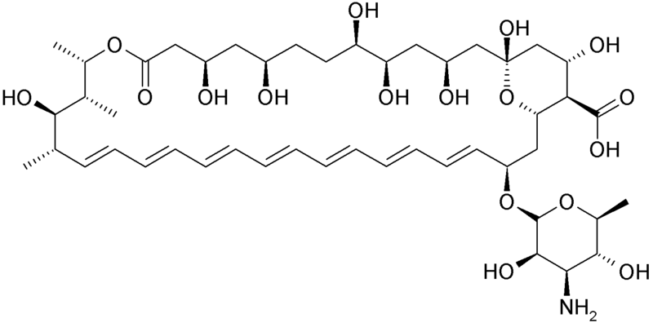
AMPHOTERICIN B
It is amphoteric polyene macrolide. (polyene= contains many double bond. Macrolide= contains a large lactone ring of 12 or more atoms)
Insoluble in water
Poorly absorbed orally, useful for fungal infection of gastrointestinal tract.
Notice the multiple double bonds (lipophillic) which aids in attaching to the fungal cell wall

Slide 15
Highly protein bound
Penetration through BBB is poor but increases in inflamed meninges.
Excreted slowly via kidneys, traces found in urine for months after cessation of drugs.
Half life 15 days
Remains in the body for weeks after stopping the drug.
No dose adjustment in hepatic or renal impairment
Course of treatment lasts 6-12 weeks.

Slide 16
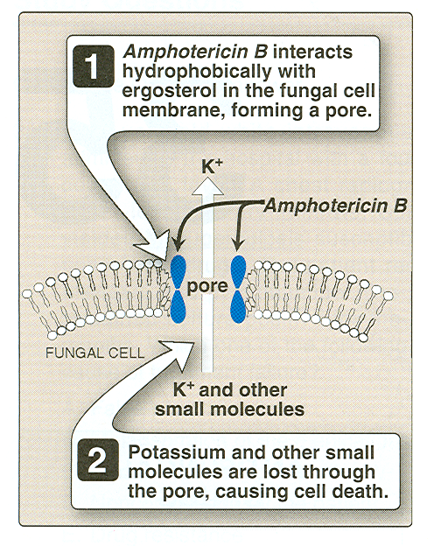
Mechanism of action and resistance
Resistance occurs because of:
1-↓ the membrane concentration of ergosterol
2-Modify the target molcule → ↓ affinity of the drug

Slide 17
Clinical uses
Locally used in corneal ulcers, candidial bladder irrigation, which proved to be nontoxic, and arthritis by local joint injections
For systemic infections given as slow I/V infusion.
Drug of choice for most systemic infections, except for using it in cryptococcal meningitis due to the diminished penetration of the BBB
Empiric therapy for pt. with high risk for systemic fungal infection
Course of treatment lasts for 6-12 weeks.

Slide 18
Adverse reactions:
Has a low therapeutic index
Most serious is renal toxicity which occurs in 80% of patients.
It may cause decrease in glomerular filtration, and tubular acidosis, drop in creatinine clearance, and loss of potassium and magnesium, nephrotoxcity may be potentiated by sodium depletion and decreased by saline infusion.
Hypokalaemia in 25% of patients, requiring potassium supplementation.

Slide 19
Cont’d
Anemia, of the normochromic normocytic type due to the decreased erythropoieting secreted by damaged renal tubules,
Thrombocytopenia
Impaired hepatic function
Anaphylactic shock
Anorexia, nausea, vomiting, abdominal, joint and muscle pain, loss of weight, and fever.
Aspirin, antihistamines (H1), antiemetics can be used to reduce these adverse effects
Febrile reactions can be reduced by hydrocortisone infusion.

Slide 21
Liposomal preparations of amphotericin B.
To reduce the toxicity of amphotericin B ,several new formulations have been developed in which amphotericin B is packaged in a lipid-associated delivery system, to assume that they will less bind to mammalian cell. Lipid vehicle act as a reservoir, reducing binding to human cell. In this way it permits a larger doses, even five times more than normal colloidal preparation, they also have better clearance .
Clinically they have more efficacy, less nephrotoxicity, and less infusion toxicity.
But these are very expensive.

Slide 22
NYSTATIN
It is polyene macrolide, similar in structure to amphotericin B and with the same mechanism of action.
Too toxic for systemic use
Only used topically
Not absorbed from GIT, skin or vagina, therefore administered orally to prevent or treat superficial candidiasis of the mouth, esophagus, or intestinal tract.
It has little toxicity
For vaginal candidiasis in the form of pessaries used for 2 weeks

Slide 23
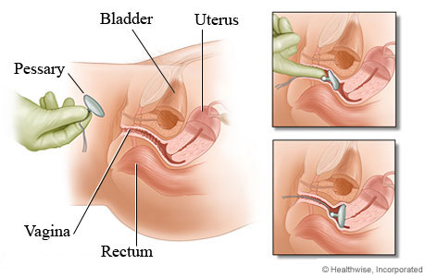
Pessaries: small plastic or silicone medical device inserted into the vagina or rectum and held in place by the pelvic floor musculature.
In Cutaneous infection it’s available in cream, ointment or powder form and applied 2-3 times a day
Can be used in combination with antibacterial agents and corticosteroids

Slide 24
Flucytosine
Has useful activity against Candida and Cryptococcus.
It is often used in combination with amphotericin B
it is fungistatic, effective in combination with itraconazole for treating chromoblastomycosis and with amphotericin B for treating cryptococcosis.

Slide 25
PK:
Flucytosine
Absorbed rapidly and well from GIT
Widely distributed in body and penetrates well into CSF.
Minimally bound to plasma protein
Peak plasma con. reaches in 1-2 hours.
80% dose is excreted unchanged in urine.
t _{1/2} 3-6 hours in renal failures it may be 200 hours

Slide 26
MOA
Flucytosine is converted to the antimetabolite 5-fluorouracil (5-FU) by the fungus, not human. 5-FU is subsequently converted to 5- fluorodeoxyuridine monophosphate (5-FdUMP) which inhibits thymidylate synthetase enzyme and thus DNA synthesis. Resistant mutants may occur. Thus, is not used alone.

Slide 27
Uses:
Generally used in combination with amphotericin
For cryptococcal meningitis in AIDS patients.
Used with itraconazole for chromoblastomycosis
Side effects:
Reversible neutropenia, anemia, thrombocytopenia and occasional bone marrow depression due to the effect of the drug being metabolized by the microflora to the antineoplastic drug 5-fluorouracil.
Nausea ,vomiting ,diarrhea, severe enterocolitis
Hepatic enzyme elevation in 5% of patients and is reversible.

Slide 28
AZOLES
Broad-spectrum of activity. This group of drugs possess antibacterial, antiprotozoal, anthelminthic, and antifungal effects.
These are synthetic, fungistatic agents
They produce their effect by inhibiting the fungal cytochrome P450 enzyme , spcifically the enzyme lanosine 14 α-desmethylase,which is responsible for converting lanosterol to ergosterol, the main sterol in the fungal cell membrane.

Slide 29
classification
azoles
imidazoles
ketoconazole
clotrimazole
triazole
itraconazole
miconazole
fluconazole
voriconazole
posaconazole

Slide 30
A. Imidazoles
Inhibit the formation of ergosterol
They lack selectivity, and also inhibits human gonadal and adrenal steroid synthesis leading to decreased testosterone and cortisol production. they also inhibit cytochrome P450 –dependant hepatic drug –metabolizing enzyme thus leading to the increase in concentration of CYP-450 dependent drugs, check figure the slide below.

Slide 31
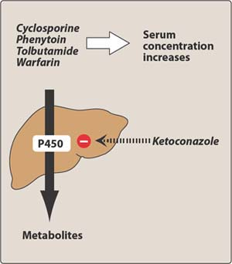
contraindicated

Slide 32
KETOCONAZOLE (Imidazoles ):
Well absorbed orally and acidic environment favors its dissolution.
Only administered orally
Bioavailability is decreased with Rifampin, H₂ (histamine) blocking drugs, proton pump inhibitors and antacids and is impaired with food.
Cola drinks improve its absorption in patients with achlorhydria (absent gastric acid in stomach)
Half life increases with dose and it is 7-8 hrs
84 % is bound to plasma proteins.
It does not enter CSF.

Slide 33
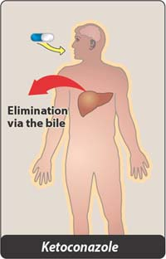
MOA and pharmacokinetics

Slide 34
Metabolized extensively in liver and inactive products appear in feces.
Moderate hepatic dysfunction has no effect on drug concentration = amphotericin B (for the hepatic part).
Induction of microsomal enzymes by other drugs reduces its concentration.
Contraindicated in pregnancy

Slide 35
Side effects:
It inhibits adrenal and gonadal steroids. which leads to menstrual irregularities, loss of libido, impotency and gynecomastia in males.
Its efficacy is poor in immunosuppressed patients and in meningitis.
Dose dependant nausea, anorexia ,vomiting
Liver toxicity is rare but may prove fatal
Hair loss
Fluid retention and hypertension

Slide 36
triazole 1/ ITRACONAZOLE
It is a new drug
It lacks endocrine side effects of ketoconazole.
It has broad-spectrum activity
Administered orally and IV
Food and low gastric pH increase its absorption
It is well distributed to body tissues including bone, sputum, and adipose tissue.
Highly bound to plasma protein
Does not penetrate CSF adequately (just like ketaconazole), not used for meningeal infections.
Metabolized in the liver extensively
It doesn’t affect mammalian steroid synthesis
Reduced bioavailability when taken with rifamycins (rifampin, rifabutin, rifapentine)

Slide 37
Half life is 30-40 hours
Steady state reaches in 4 days, so loading doses are recommended for deep mycosis.
Side effects:
Nausea, vomiting
Increased liver enzymes, hepatotoxicty, and rash which leads to drug discontinuation.
Hypertriglyceridemia
Hypokalaemia

Slide 38
2/FLUCONAZOLE
Completely absorbed from GIT
Concentration in plasma is same by oral or IV route.
Bioavailability is not altered by food or gastric acidity (high oral bioavailability)
It has the least effect on hepatic microsomal enzymes→ low drug interaction
Widest therapeutic index of azoles thus allowing it to be given in massive doses.
It easily penetrates CSF and is the drug of choice in and coccidioidal mycosis and the drug of choice for treatment and prophylaxis in Cryptococcal meningitis.

Slide 39
It can be safely administered prophylactically in patients receiving bone marrow transplants.
Resistance is not a problem except in patients with HIV
Renal excretion 90%,dose is readjusted in compromised renal function
t_{1/2} 25-30 hours.
Uses:
Candidiasis, Cryptococcosis.
In AIDS for life-threatening cases
Not effective for invasive aspergillosis (voriconazole is used instead)

Slide 40
Side effects
Nausea, vomiting, headache, skin rash, abdominal pain, diarrhea, reversible alopecia.
Hepatic failure may lead to death→ rare
It is teratogenic like other azoles.

Slide 41
3/Voriconazole
A new drug ,with wider spectrum
Drug of choice in for invasive aspergillosis
Available in IV and oral formulations.
High bioavailability when given orally
Predominant hepatic metabolism
Reversible visual disturbances, photosensitivity dermatitis occuring within 30 minutes of taking the drug. This phenomenon is unique to voriconazole.
It is similar to itraconazole but more potent.

Slide 42
4/Posaconazole
Newest triazole
Available only in liquid formulation
Better absorption with fatty meal
It has the broadest-spectrum among the azoles
It is the only azole with significant activity against zygomycosis and mucormycosis

Slide 44
Echinocandins: Caspofungin
It interferes with the synthesis of fungal cell wall by inhibiting synthesis of β (1-3) glucan.
Available IV only
It is water soluble and highly bound to serum proteins
Has half life of 9-11 hours
Slowly metabolized by hydrolysis and N-acetylation
Dose adjustment in severe hepatic insufficency
Eliminated equally by urinary and fecal route

Slide 45
Adverse effects:
Clinical uses
Particularly useful for aspergillus and candida.
Replaced amphoreicin B for Empirical therapy for febrile neutropenia
vomiting, flushing and elevated liver enzymes
It is very expensive!!

Slide 46
Mechanism of action of different anti fungal durgs:

Slide 47
Topical Anti fungal Drugs Used For Topical Fungal Infections
azole
Nystatin and Amphotericin
tolnaftate
Terbinafine
Naftifine
Butenafine
Ciclopirox olamine

Slide 48
Oral Anti Fungal Drugs Used For Topical Infections
Griseofulvin
Terbinafine
oral azoles

Slide 49
First, topical
In superficial fungal infections drugs confined to thestratum corneum are preferred, squamous mucosa, or cornea.
Such disease includes dermatophytosis (ring worm), candidiasis tinea and fungal keratitis.
Topical administration of antifungal agents is usually not successful in mycoses of the nails and hair and has no place in the treatment of subcutaneous mycoses.
The efficacy of topical agents in the superficial mycoses depends not only on the type of lesion and the mechanism of the drug action but also on the viscosity, hydrophobicity and acidity of the formulation.
The preferred formulation for cutaneous application usually is a cream or solution.

Slide 50
IMIDAZOLE AND TRIAZOLES FOR TOPICAL INFECTION
These are synthetic azoles and used both topically and systemically
Selection depends on cost and availability
Should be applied twice a day for 2-3 weeks.
Vaginal creams, suppositories and tablets for vaginal candidiasis used once a day preferably at bed time.

Slide 51
CLOTRIMAZOLE
Absorption less than 0.5 % from intact skin, 3-10 % from vagina and activity in vagina remains for 3 days.
Its efficacy in cutaneous candidiasis is 80-100% &
In vulvovaginal candidiasis is 80%.
Stigma, erythma, edema, vesication, pruritus, urticaria mild vaginal burning sensation may occur.

Slide 52
ITRACONAZOLE
Systemic drug for topical infection.
Itraconazole is effective for treatment of onychomycosis* after meal for 3 months
Should not be given in patients with ventricular dysfunction
Routine evaluation of hepatic function is recommended.
should not be used concurrently with midazolam, triazolam, quinidine and HMG-CoA reductase inhibitors.
* fungal infection of the nail

Slide 53
TOLNAFTATE
Effective in most cutaneous mycosis.
It is ineffective against Candida.
In tinea pedis cure rate is around 80%.
Available in 1% cream,gel,powder and topical solution.
Applied locally twice a day.
Rarely causes irritation or allergic contact sensitization

Slide 54
TERBINAFINE & Naftifine (topical usage)
It is synthetic allylamine
It is broad spectrum, fungicidal.
Available as 1% cream or gel
It is a drug of choice for treating dermatophytes especially onychomycosis
It is better tolerated, requires shorter duration of therapy
It inhibits fungal squalene epoxidase ,decreases synthesis of ergosterol
Also accumulation of toxic amounts of squalene causes cell death.
It is fungicidal but activity is limited to C.albicans and dermatophytes.
Metabolites are excreted in urine
Adverse effects: irritation, burning sensation, erythema
Avoid contact with mucous membrane.

Slide 55
TERBINAFINE (systemic usage)
Quite effective for the treatment of onychomycosis for 6 weeks for finger nail infection and for 12 weeks in toe nail infection
Well absorbed orally, bioavailability decreases due to first pass metabolism in liver.
Protein binding more than 99% in plasma.
Drug accumulates in skin, nails and fat.
severely hepatotoxic , liver failure even death.

Slide 56
Initial half life 12 hrs but extends to 200-400 hrs ,which reflects it slow release from the tissues
Can be found in plasma for 4- 8 weeks after prolong therapy.
Clearance is reduced in moderate and hepatic impairment.
Not recommended in azotemia or hepatic failure.
Dose 250 mg for 3 months/for local infection applied twice
daily.
Side effects
GIT disturbance ,Taste and visual disturbance ,transient rise in serum liver enzymes.
Rifampicin decreases its blood levels and cimetidine increases it.

Slide 57
GRISEOFULVIN
It has been largely replaced by terbinafine for treatment of dermatophytosis of the nails.
Insoluble
It is fungistatic for species of dermatophytes. it has narrow spectrum as opposed to terbinafine which is fungicidal.
It interacts with microtubules and interferes with mitosis.

Slide 58
Inhibition of mitosis by Griseofulvin

Slide 59
PK
Absorption increases with fatty meal
It is ineffective topically.
Barbiturates decreases the absorption from GIT.
Extensively metabolized in liver.
Drug is deposited in keratin, nail, and hair are 1st to get rid of disease.

Slide 60
Induction of P-450 cytochromes

Slide 61
Uses:
Mycotic diseases of the skin, hair (particularly of the scalp), nail
It is also highly effective in athlete's foot
Treatment required is 1 month for scalp and hair ringworm, 6-9 months for finger nails, and at least 1 year for toe nails.
Not effective in subcutaneous or deep mycoses.

Slide 62
Adverse effects:
Headache
Peripheral neuritis , lethargy , mental confusion, impairment in performance of routine task, fatigue, vertigo ,syncope, blurred vision.
Hepatitis
Serum sickness syndrome
Leukopenia and proteinuria
Interacts with warfarin and phenobarbital
Cross-reactivity with penicillin
Contraindicated in: porphyria, hepatic failure, and in case of hypersensitivity reactions.

Slide 63
Thank You
It’s time for a cup of….

