Slide 1
Alcohol (Pharmacology and neurobiology)
By: Dr Alia Alshanawani
Dr. Ishfaq A. Bukhari
Dep of Medical Pharmacology, KSU

Slide 2
introduction
Currently Alcohol ( ethyl alcohol or ethanol) is the most commonly abused drug in the world.
Alcohol in low-moderate amounts relieves anxiety and fosters a feeling of well-being/euphoria.
Alcohol abuse and alcoholism cause severe detrimental health effects such as alcoholic liver and heart disease, increased risk for stroke, chronic diarrhea and alcohol dementia
Alcoholism: a person who continues to drink alcohol in spite of adverse medical or social consequences related directly to their habit of alcohol consumption.

Slide 3
Pharmacokinetics of Alcohol
Water soluble molecule, completely absorbed from the GIT.
Peak blood ethanol concentration after oral doses: 30 -75 min.
absorption is delayed by food .
Volume of distribution = Total Body Water (0.5 – 0.7 L/kg)
Metabolism (in gastric mucosa & liver).
1- Oxidation of ethanol to acetaldehyde via
A- alcohol dehydrogenase (ADH): reduction of NAD⁺ to NADH. Mainly in the liver. OR
B- microsomal ethanol oxidizing system (MEOS)
2- Acetaldehyde is converted to acetate via aldehyde dehydrogenase (ALDH) which also reduce NAD⁺ to NADH.
Acetate ultimately is converted to CO₂ + water.
90% of alcohol is metabolized in the liver. The remainder is excreted through the lung and urine

Slide 4
Hepatic Ethanol Metabolism (ADH)
ADH
RATE-LIMITING STEP
Alcohol
Acetaldehyde
NAD⁺
NADH
NAD⁺
Chronic intake→ induction of CYP2E1
ALDH
NADH
NB: If Alcohol increase acetylCoA will increase then increase progression of fatty liver
Acetyl CoA
Acetate
Citric Acid Cycle
Energy
Fatty Acid synthesis
Fatty liver

Slide 5
Acetaldehyde is more toxic than ethanol
B. Metabolism of alcohol by microsomal ethanol oxidizing system (MEOS)
Use NADPH as a cofactor.
When the concentration of alcohol rises above 100 mg/dl, there is increased contribution of MEOS.
2- Acetaldehyde metabolism:
Oxidation of acetaldehyde is inhibited by disulfriam.
There are genetic variation of ALDH (see next slide)
The rate of oxidation follows zero-order kinetics

Slide 6
Metabolism: Genetic Variation
Genetic variation in alcohol metabolizing enzyme Aldehyde Dehydrogenase (ALDH)
Acute acetaldehyde toxicity in individuals with an inactive form of the ALDH2*2 (mitochondrial aldehyde dehydrogenase 2). So decreased level of ALDH cause increased level of acetaldehyde and then more toxicities.
Associated with the ‘flushing reaction’
immediately following alcohol intake (due to increased acetaldehyde).
Mostly Asian populations have ALDH2*2 allele .

Slide 7
Hepatic Cellular Processing
EtOH
Peroxisome
Cytosol
H₂O₂
O₂
ER
NAD⁺
CAT
NADPH
MEOS
ADH
Aminotriazole
P450
H₂O
NADH
NADP⁺
Pyrazole
Acetaldehyde
NAD⁺
Mitochondrion
ALDH
Disulfriam
Chlorpropamide
Metronidazole
Trimethoprim
NADH
Acetate
Extra-hepatic tissue
Thiamine is consumed during hepatic metabolism of ethanol
Hypothalamus responds to thiamine deficiency by increasing the hepatic ADH activity which gives enhanced ethanol degradation.

Slide 8
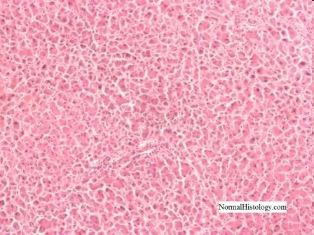
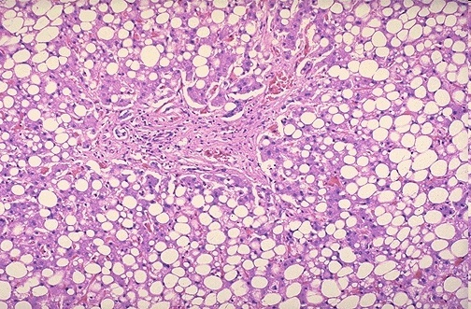
Healthy Liver vs Fatty Liver
Alcohol converted to Acetaldehyde which is more toxic than alcohol →
causing mild inflammation and fat cell proliferation.

Slide 9
Effect of alcohol
Ethanol consumption at first inhibits the CYP450 microenzymes, but with chronic use and increase of dose it will induce the isoform CYP450 2E1. Therefore, the induction of hepatic enzymes will increase leading the decrease in the number of the NAD enzyme which leads to hpoxia and the generation of reactive oxygen species.
Chronic ethanol use thus leads to ↓NAD & ↑NADH by the liver.
All of these biochemical changes have been proposed to contribute to DNA damage, hepatocyte injury, and liver disease.
Pyruvate is reduced to lactate to regenerate NAD (replenishing its stores) which causes metabolic acidosis
This will cause hypoglycemia in malnourished alcoholics
Lactate, also, inhibits uric acid excretion → hyperuricemia.

Slide 10
Cont’d
Hyperlipidemia and fat deposition are common in chronic alcohol use because of excess acetate and fatty acid (FA) synthesis + direct oxidation of ethanol for energy instead of using body fat stores.

Slide 11
Effects of alcohol greatly depends on the dose and frequency of alcohol consumption.
Increasing alcohol consumption gives the following dose-effect in order, alcohol acts as an anxiolytic → mood enhancement→ sedative→ slows reaction time→ produces motor incoordination→ impairs judgment (making it dangerous and illegal to drive a car).
At very high doses alcohol produces loss of consciousness.

Slide 12
Effect of chornic alcoholism on liver
Liver disease: most common medical complication. Accumulated acetaldehyde: hepatotoxicity.
Fatty liver/alcoholic steatosis (common, reversible, hepatomegaly, slight elevation in liver enzyme)
Followed by: steatohepatitis (fat, inflammation, and injury),
Then hepatic cirrhosis (jaundice, ascites, bleeding & encephalopathy) &
liver failure & death within 10 yrs.

Slide 13
Etiology:
Metabolic repercussions of ethanol oxidation in the liver
Dysregulation of fatty acid oxidation and synthesis
Activation of the innate immune system by effect of ethanol and bacterial toxins
Tumor necrosis factor –α plays a pivotal role.
Alcoholic liver disease
Steatosis
Normal liver
cirrhosis
steatohepatitis

Slide 14
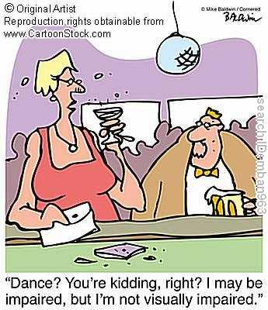
Alcohol and electrolyte imbalance
Alcoholics with chronic liver disease have disorders of fluid and electrolyte balance, including ascites, edema, and effusions.
Loss of K⁺ (by vomiting and diarrhea) contributes to muscle weakness.
Alcoholics develop hypoglycemia as a result of impaired hepatic gluconeogenesis.
Alcoholics develop ketosis, caused by excessive lipolytic factors (cortisol and growth hormone)

Slide 15
Hematological complication:
Iron deficiency anemia results from inadequate dietary intake( malnutrition in most of alcoholism) & GI blood loss
Hemolytic anemia results from liver damage(↑free radical)
Megaloblastic anemia results from folate deficiency in chronic alcoholism
Thrombocytopenia & prolong bleeding time because of suppressing platelet formation
Alcohol can diminish the production of Vit-K dependent clotting factors due to hepatotoxic action

Slide 16
Alcohol effects on Central neurotransmitters(NTs):
Alcohol causes inhibition of NMDA (Glutamate)
& activation of GABA_{A} receptors in brain this will lead to:
- Sedative effect & CNS depression
Disruption in memory, consciousness, alertness & learning
Blackouts: periods of memory loss that occur with high levels of alcohol may result from inhibition of NMDA receptors.

Slide 17
Alcohol effects on Central NTs
Chronic use of alcohol leads to the UP-REGULATION of NMDA receptors & voltage-sensitive Ca Channels to compensate the inhibition which leads to
1- Increased NMDA activity significantly ↑Ca influx to nerve cells, Ca excess can lead to cell toxicity & death. (Ca related brain damage).
2- This also contributes to alcohol tolerance & withdrawal symptoms (tremors, exaggerated response, seizures, the delirium tremens).

Slide 18
Ethanol interactions e NTs release
Ethanol enhances Dopamine (DA) release in “pharmacological reward” pathway
Ethanol appears to release DA from Ventral tegmental area (VTA) & nucleus accumbens (NAC) via interactions with multiple NT receptors
Ethanol has direct excitatory actions on DA containing neurons in the VTA
Dopamine is the one responsible for happiness/euphoria
Ventral Tegmental Area (VTA)
Nucleus accumbens (NAC)
Control
Dopamine
Ethanol
+
+
Dopamine

Slide 19
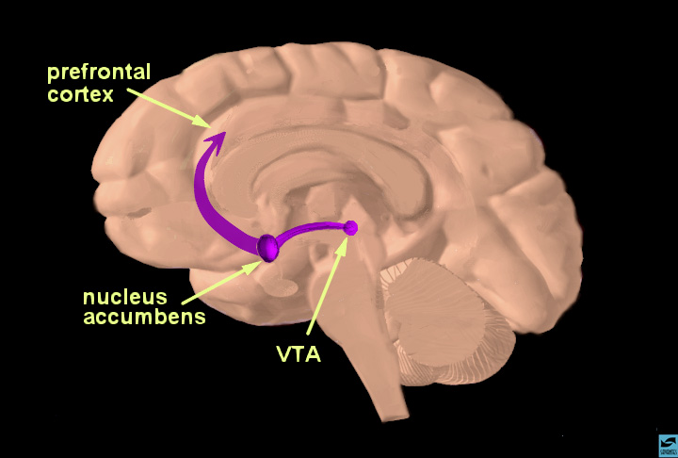
Alcohol as a Reinforcer: Neural Systems
Alcohol effects:
Acute → ↑DA in NAC
Chronic → ↓DA in NAC → tolerance (need more alcohol to exert the effect.
Activation of the VTA results in the release of DA in the nucleus accumbens, limbic system, and the prefrontal cortex. This is associated with rewarding/reinforcing effects, not only for alcohol but for almost all abused drugs.
Activation of mesocorticolimbic system

Slide 20
(Cont’d)
Alcohol increases the release of:
-- Serotonin: alcohol rewarding effects, tolerance, and withdrawal
5-HT system modulates the dopaminergic activity of the VTA and the NAC.
-- Opioid peptides; feeling of euphoria and increase rewarding effect of alcohol.

Slide 21
Wernicke-Korsakoff syndrome
Is a manifestation of thiamine (NAD) deficiency, usually as a secondary effect of alcohol abuse (severe alcoholism).
Result from: (inadequate nutritional intake; ↓uptake of thiamine from GIT, liver thiamine stores are decreased due to hepatic steatosis or fibrosis).
Syndrome is a combined manifestation of two disorders:
wernicke’s encephalopathy is acute neurologic disorder & is characterized by CNS depression (mental sluggishness, confusion, Coma), ocular disorder (impairment of visual acuity & retinal hemorrhage), ataxia & polyneuropathy.
Korsakoff’s psychosis main symptoms are amnesia & executive dysfunction
Rx: thiamine + dextrose-containing IV fluids.

Slide 22
Alcoholism Tolerance
A person increases the amount of alcohol drinking to obtain the given effect on brain function
Tolerance develops gradually to alcohol intake by:
Metabolic tolerance, hepatic enzyme induction
Functional tolerance, change in CNS sensitivity (Neuro-adaptation )
Faster alcohol absorption
Tolerance appears to involve the NMDA receptor, GABA receptor, 5-HT, DA in brain reward and reinforcement.

Slide 23
Cardiovascular:
Heavy alcohol consumption of long durations is associated with dilated cardiomyopathy presenting as ventricular hypertrophy and fibrosis.
The pathogenesis of cardiomyopathy in chronic alcoholism occurs as the result of:
Alterations in contractile functions of heart
Cell membrane disruption
Up-regulation of voltage-dependent Ca²⁺ channels
Depressed function of mitochondia & sarcoplsmic reticulum
Intracellular accumulation of phospholipids and FA

Slide 24
Arrhythmia: premature ventricular/atrial contractions, atrial and ventricular tachycardia, atrial fibrillation and flutter resulting from: abnormalities of K⁺ or Mg⁺⁺ metabolism as well as the enhanced release of catecholamines.
CHD:
Moderate alcohol consumption: prevents chronic heart disease by slightly increasing the level of HDL
Excess drinking is associated with higher mortality risk from chronic heart disease.
HTN: by the effect of ↑Ca and ↑sympathetic activitation

Slide 25
Fetal Alcoholic Syndrome: IRREVERSIBLE
Ethanol rapidly crosses the placenta
Prenatal exposure to alcohol causes:
- intrauterine growth retardation, congenital malformation (wide-set eyes, microcephaly, impaired facial development) & teratogenicity
- ↓fetal growth by inducing hypoxia.
- More severe cases include congenital heart defects & physical and mental retardation.
- Minor joint anomalies

Slide 26
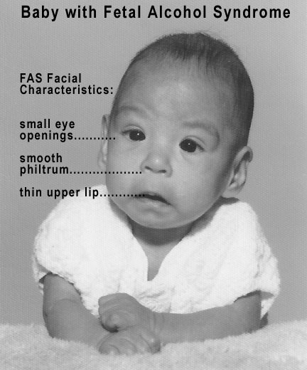
Fetal Alcohol Syndrome ( FAS )

Slide 27
Gastritis and ulcer diseases. Alcohol also causes:
Malabsorption of water-soluble vitamins
Acute/chronic hemorrhagic gastritis
Gastroesophageal reflux disease, esophageal bleeding (reversible).
Cancer
Excessive consumption of alcohol increases the risk of developing cancers (tongue, mouth, oropharynx, esophagus, liver, and breast) because of:
Acetaldahyde and reactive oxygen species damage DNA.
Changes in folate metabolism and the growth-promoting effects of chronic inflammation

Slide 28
Pancreatitis:
Occurs in heavy drinkers
Presents as severe epigastric pain + elevated amylase and lipase levels
Pancreatitis also occurs by the raised level of hypertriacylglycerolemia
Rx: parenteral analgesics, hydration, and nutrition.

Slide 29
Endocrine: hypogonadism
In women: amenorrhea, anovulation, luteal phase dysfunction, hyperprolactinemia, ovarian dysfunction, infertility, and spontaneous abortion as well as an impairment in fetal growth.
In men: hypogonadism, loss of facial hair, gynecomastia, decrease in muscle and bone mass, testicular atrophy, and sexual impotence.
Also, alcohol may decrease the level of testosterone and inhibit the release of LH from the pituitary gland.

Slide 30
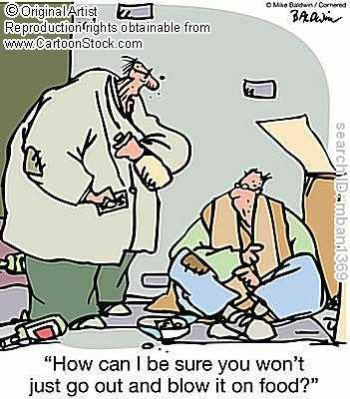
Effect of alcohol on immune system
It inhibits the immune response in the lung increasing the mortality of pneumonia in chronic alcoholics. In contrast, alcohol increases the immune response in the liver and pancreas.
Induces inflammatory damage to the liver and pancreas.

Slide 31
Acute Ethanol Intoxication:
CNS depression: sedation, relief of anxiety, higher concentration, slurred speech, ataxia, and impaired judgment.
Respiratory depression leading to respiratory acidosis and coma. In certain cases, acute intoxication may lead to respiratory failure.
Death can occur from respiratory depression plus aspiration of vomitus.

Slide 32
Significant depression of myocardial contractility
Vasodilation due to depression of vasomotor center & direct smooth muscle relaxation caused by acetaldehyde.
Volume depletion, hypothermia, hypotension
Hypoglycemia occurs in conjunction with reduced carbohydrates intake and malnutrition.

Slide 33
Acute Ethanol Intoxication
Ethanol level | Intoxication
<500 mg/L (0.05%) | Mild signs
≤ 1000 mg/L (0.1%) | Frequent psychomotor impairment
1500 mg/L(0.15%) | Psychomotor impairment in ordinary persons
2500 mg/L (0.25%) | Severe/anesthe-sia & coma
5000 mg/L (0.5%) | Death (respiratory depression)
Supportive therapy is implemented until the metabolism of ethanol is complete.
Supportive therapy includes for the following:
IV fluids for hypotension/hypovolemia
Artificial respiration
IV glucose for hypoglycmia
Gastric lavage, naloxone (opioid antagonist) for coma

Slide 34
Elevated acetaldehyde during ethanol intoxication causes:
Nausea and headache
Hypersensitivity reactions, vasodilation, and facial flushing
Increase skin temperature
Low BP
Sensation of dry mouth and throat
Bronchial constriction and allergic-type rxs
Euphoric effects that may reinforce alcohol consumption
Increase incidence of GI and upper airway cancers
Liver cirrhosis.

Slide 35
ALCOHOL withdrawal
Alcohol withdrawal occurs in > 2/3 alcohol-dependent patients.
Symptoms:
Autonomic hyperactivity and craving for alcohol
Hand tremor
Insomnia, anxiety, agitation
Vomiting and thirst
Transient visual/auditory hallucination
Grand-mal seizures (after 7-48 hour from alcohol cessation)
Rebound supersensitivity of glutamate receptors and decreased responsiveness of GABAergic receptors are possibly involved in the symptoms occurring in alcohol withdrawal.

Slide 36
Alcoholism withdrawal
Chronic alcohol intake followed by abrupt stop leads to two-stage severe withdrawal:
Stage1: in few hours, the symptoms in the last slide occur
After ≥2 days delirium tremens stage starts fatal; profuse sweating, delirium & hallucinations, intense Vasodilation, fever, severe tachycardia
Possible causes:
rebound β-adrenoceptor super-sensitivity
hyperactivity of neural adaptive mechanism (neuroadaptation) no longer balance by inhibitory effect of alcohol & upregulation of NMDA Rs .

Slide 37
Alcohol withdrawal symptoms
Withdrawal symptoms depend upon the rate and duration of the preceding drinking period
In mild cases: hyperexcitability
In severe cases: seizures, toxic psychosis & delirium tremens.
Begin after 8 hours, Peak at day 2, Diminish at day 5, Disappear 3 - 6 months.

Slide 38
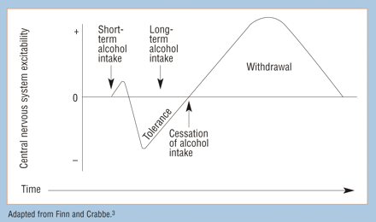
Schematic representation of the effects of alcohol consumption and withdrawal.

Slide 39
In the figure, zero line represents the degree of brain excitability
Short-term alcohol intake produces a depression of inhibitory centers of cerebral cortex, which results in initial symptoms of intoxication (euphoria, exaggerated feelings of well-being, & loss of self-control followed by sedation).
Long-term alcohol intake causes initial decrease in tolerance that occurs during continued exposure to alcohol.
Removal of alcohol causes a rebound stimulatory effect, increasing excitability in the nervous system.

Slide 40
Management of alcoholism withdrawal
Substituting alcohol with a long-acting sedative-hypnotic drug and tapering the dose.
Benzodiaziepins such as chlordiazepoxide and diazepam are commonly used, yet short-acting benzodiazepines (eg, lorazepam) are preferred.
Uses: IV or PO BZ are used to manage withdrawal symptoms prevent irritability, insomnia, agitation, and seizures.
The dose of BZ should be carefully adjusted to provide efficacy and avoid excessive doses that cause respiratory depression and hypotension.

Slide 41
Cont’d
Clonidine, a central α2 agonist, inhibits the release of sympathetic neurotransmitters.
Propranolol, inhibits the exaggerated sympathetic activity.
Naltrexone, an opioid antagonist given PO, reduces the psychic craving for alcohol in abstinent patients. Naltrexone is used with caution in mild increase of aminotransferase enzyme. Naltrexone should not be combined together with disulfiram.

Slide 42
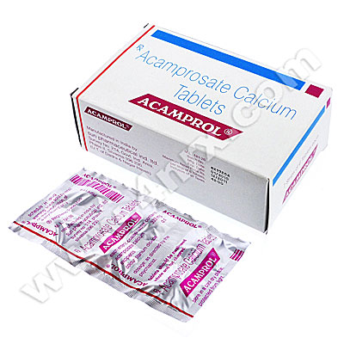
Acamprosate:
Weak NMDA receptor antagonist and GABA receptor activator.
Reduces psychic craving.
Poorly absorbed and food reduces its absorption.
Widely distributed and is eliminated renally.
Does not participate in drug-drug interaction.
Adverse effects: GI disturbance and rash
Contraindicated in patients with severe renal impairment

Slide 43
Fluoxetine in Alcoholics
Transient reduction in drinking
Reduction in drinking in alcoholics with a
family history of alcohol dependence.
5-HT and alcohol consumption reduces the 5-Hydroxyindoleacetic acid (5-HIAA) levels.

Slide 44
Disulfriam and alcholics
For adjunctive treatment of alcohol dependence: Disulfiram
Disulfiram blocks hepatic ALDH, this will increase blood acetaldehyde conc.
If alcohol + disulfiram = extreme discomfort & disulfiram ethanol rx: vasodilation, flushing, hotness, cyanosis, tachycardia, dyspnea, palpitations & throbbing headache.
Disulfiram-induced symptoms render alcoholics afraid from drinking alcohol.
Has rapid and complete absorption from GI tract.
Inhibits metabolism of phenytoin, oral anticoagulant, and isoniazid.
Should not be administered with medication that contain alcohol.
No longer commonly used

Slide 45
Alcohol and drug interactions
Chronic uses of alcohol induces liver enzymes and increases the metabolism of drugs such as propranolol, warfarin, etc.
Acute alcohol intoxication causes inhibition of liver enzyme and an increase in drug toxicity of some drugs such as warfarin, phenothiazines, tricyclic antidepressents, and sedative-hypnotics.

Slide 46
Alcohol and drug interactions
Increases the risk of developing major GI bleed or ulcers with current use of NSAIDs.
Increases acetaminophen-induced hepatotoxicity with chronic alcoholism.
Alcohol increases the risk of respiratory and CNS depression effects of barbiturates and narcotics (eg, codeine, methadone).

