Slide 1
Local Anesthetics
LA

Slide 2
LA: Reversibly block impulse conduction along nerve axons & other excitable membrane that utilize Na⁺ channels for Action Potential generation.
Uses: block pain sensation (nociception) from specific area of the body or block sympathetic vasoconstricor impulses to this area.
Cocaine was the 1st LA isolated from Coca plant as an ophthalmic anesthetic.
Cocaine chronic use → psychological dependence (addiction).

Slide 3
Followed by procaine and Lidocaine which are the most widely used LA.
What characteristics of LAs make them ideal agents for anesthesia?
1- Rapid onset
2- Long Duration of Action
3- Reversible & selective blockade of sensory nerves without motor blockade
4- Minimal local tissue irritation & no systemic toxicities.

Slide 4
Chemistry of LA
LA are weak bases & available as salts to increase solubility & stability.
A local anesthetic consists of:
Lipophilic group eg, aromatic rings
Intermediate chain (amide or ester)
Ionizable group (eg, Tertiary amine)
Esters usually have short duration of action
LA exist in the body as two forms:
Cation (charged): most active form.
Uncharged: important for rapid penetration of cell membrane.

Slide 6
Medium
Short
long
Medium
medium
Long
Medium
Long

Slide 8
pharmacokinetics
• systemic absorption of LA depends on
Dosage.
Site of injection: ↑ vascularity → ↑ absorption.
High vascular areas: tracheal mucosa and intercostal area.
Low vascular areas: tendon, dermis, and SC fat.
Comparing absorption in other areas:
Paracervical > epidural > brachial plexus > sciatic nerve
IV administration has the highest systemic absorption

Slide 9
Drug tissue binding.
Local blood flow
Use of vasoconstrictors (eg, epinepherine):
Vasoconstrictors reduce blood flow → ↓ systemic absorption.
Works for drugs with short or intermediatre duration (procaine, lidocaine, and mepivacaine) but not prilocaine
Vasoconstricors enhance neuronal uptake of LA → prolong action
Also, they reduce systemic toxic effects of LA.
They don’t work with long-acting drugs (bupivacaine and ropivacaine).
Physiochemical property of the drug

Slide 10
Distribution
Amide LA are widely distributed after IV bolus injection
Distribution has 2 phases
Initial rapid phase into highly perfused organs (brain, live, kidney)
slower phase to moderately perfused organs.
(muscle and GI)

Slide 11
Metabolism & Excretion
Ester-type hydrolyzed rapidly in blood(by pseudocholinesterase) to inactive metabolite. Therefore, they have short plasma t_{1/2} (< 1 min).
amide linkage is hydrolyzed by liver CYP₄₅₀ with different rates (prilocaine (fastest) > Lidocaine > mepivacaine > ropivacaine > bupivacaine (slowest).
Hepatic diseases → ↑ toxicity of amide type.
Example: elimination t_{1/2} of Lidocaine from 1.6 hr in normal pt. to ↑6 hr in liver disease pt.
Amide LA also affected by enzyme inhibitors.
Reduced hepatic blood flow →decreases their elimination.

Slide 12
cont’d
All are converted to water-soluble metabolites & excreted in urine.
Acidification of urine → ↑ionization & excretion of LA

Slide 13
MOA
Primary action is by blocking voltage-gated Na⁺ channels.
Alkaline PH → ↑ activity of drugs.
Inflamed tissues are acidic thus changing the LA (weak bases) to the charged form becoming less lipophillic and less absorbable by tissues.
They bind to activated and inactivated channels. (rested channels are resistant)

Slide 14
↑ extracellular Ca⁺ → ↑ rested channels → ↓ activity of LA.
K⁺ → ↑ inactivated channels.
Structure-activity characteristics of LA
Smaller & more lipophilic LA → Faster rate of interaction with Na⁺ channels
Lidocaine, procaine, and mepivacaine are more water-solube than tetracaine, bupivacaine and ropivacaine. The latter agents are more potent and have long duration of action (DOA)
These long acting LA also bind more extensively to plasma proteins & can be displaced by other drugs.

Slide 15
Other actions on nerves
1- Motor paralysis during surgery
2- Autonomic nerve blockade
Disadvantages
In Spinal anesthesia, motor paralysis → impairs respiratory activity &
autonomic blockade → hypotension & urinary retention (requires catheterization).

Slide 16
Nerve fibers differ in their susceptibility to LA
1- Effect of fiber diameter:
Small fibers are blocked 1st . (e.g. C fibers which transmit slow pain).
Large and thick fibers (motor neurons) are relatively resistance because the LA takes a longer time in penetrating the full diameter of the nerve.
Myelinated fibers are blocked earlier than unmyelinated fibers of the same size.
Preganglionic B fibers (myelinated) are blocked before C fibers (unmyelinated)
So the chronological order is: 1st small B and C fibers 2nd other sensory fibers 3rd motor neurons

Slide 17
2- Effect of firing frequency
Blockade by LA is increased at higher frequencies of depolarization.
Sensory (pain) fibers have high firing rate & long AP duration, while motor fibers fire at a slower rate & have shorter AP duration.
3- Effect of fiber position in nerve bundle
In large nerve trunks, motor nerves are located in the outer portion of the trunk. Thus, they are the 1st to be exposed to LA.
In the extremities, proximal sensory fibers are located in the outer portion. So the drug acts 1st proximally then distally.

Slide 18
Properties of LAs
drug | onset | duration | Plasma t_{1/2} | Side effects | notes
cocaine | M | M | 1 hr | CVS & CNS | Rarely used only as spray in UR
procaine | M | Short | <1 hr | Restlessness, shivering, anxiety, bradycardia, ↓ CO | No longer Used

Slide 19
Lidocaine | Rapid | M | 2 hr | As procaine but < tendency to CNS | Widely used + IV in ventricular arrhythmia. Mepivacaine is similar
Amethoc- (tetrac | V. Slow | Long | 1 hr | As Lidocaine | spinal & corneal anesthesia.
Bupivacaine | Slow | Long | 2 hr | As Lid but > CVS | Widely used (long DOA). Ropivacine is similar, with less cardioTox.
Prilocaine | M | M | 2 hr | No VD? MetHgemia | Widely used, not for obstetric (neonatal metHgemia.

Slide 20
Clinical pharmacology
Effective analgesia in specific regions of the body.
Route of administration:
1- Topical application (nasal mucosa, wound margins)
2-Injection in the vicinity of peripheral nerve endings (infiltration) & major nerve trunks (blocks)
3- Injection into the epidural such as in labor or subarachnoid spaces (spinal) surrounding the spinal cord for operations done below the level of the umbilicus for example in area L3, L4 for lower limb operations. This method might cause direct neurotoxicity.
4- IV regional anesthesia (Bier block) for surgery < 60 min in limbs.

Slide 21
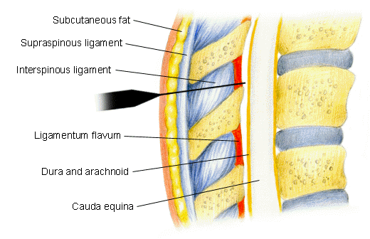
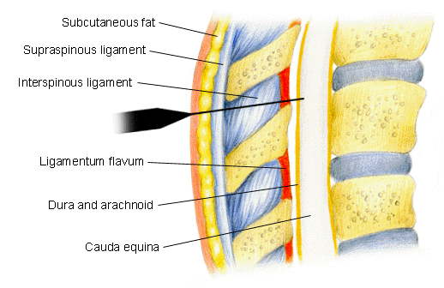
Epidural
Spinal

Slide 23
DOA
Local Infiltration:
Extravascular placement of LA in the region to be anesthetized
Peripheral Nerve Block:
LA injection into tissues around individual nerves or nerve plexuses (e.g. brachial plexus).
Short: proc- & chloropro- caine
Intermediate: Lid, mepiva- & prilo- caine
Long-acting: tetra-, bupiva-, & ropiva- caine.
DOA can be prolonged by increasing the Dose + adding vasoconstrictor agent.

Slide 24
To increase the onset of LA: add NaHCO3 to LA solution which enhances the buffering media for LA at the site of injection.
Repeated injection of LA →extracellular acidosis → tachyphylaxis
Pregnancy increases sensitivity to LA→ toxicity of LA.
Topical LA: eye, ENT & for cosmetic surgery. LA should be able to:
1- rapidly penetrate across the skin or mucosa
2- little tendency to diffuse away from the site of application.

Slide 25
Cocaine because of its excellent penetration & local vasoconstrictor effect is used for ENT procedures. Has irritating effect and, therefore, not used for ophthalmic procedure.
Other topical: Lidocaine + Vasoconstrictor, tetracaine, pramoxine, dibucaine, benzocaine, & dyclonine.

Slide 26
OTHER USES:
LAs have membrane-stabilizing effects so Both IV Lidocaine & oral (mexiletine, tocainide) used to treat pt. with neuropathic pain syndrome.
Systemic LA: as adjuncts to tricyclic antidepressant (amitriptyline) & anticonvulsant (carbamazepine) combination.

Slide 27
Toxicity
A- CNS:
1- All LA at low concentration: sleepiness, light headiness, visual & auditory disturbances & restlessness.
Early symptoms: tongue numbness + metallic taste.
Rare, but High plasma conc. : nystagmus & muscular twitching, then tonic-clonic convulsions. Followed by generalized CNS depression (apnea).
You can avoid convulsion by:
Giving the smallest dose
Avoid inadvertent intravasulcar injection

Slide 28
If large dose of LA is required: premedication with benzodiazipine provides prophylaxis
2- Cocaine: widely abuse drug, severe CV toxicity; HTN, arrhythmia, & myocardial Failure.
B- Neurotoxicity:
direct neuronal toxicity with excessive high concentration
Chloroprocaine & Lidocaine are > neurotoxic than others in spinal anesthesia and are avoided for this use.
They produce transient radicular irritation (or transient symptoms).

Slide 29
C- CVS: direct effect on the heart & smooth muscle & indirect effect on autonomic nervous system(ANS).
Depress strength of contraction and cause arteriolar dilatation → hypotension
Cocaine blocks Norepinephrine uptake: vasoconstriction & HTN + cardiac arrhythmia & ischemia.
Bupivacaine is > cardiotoxic than other long-acting LA.
Ropivaciane: has CVS & CNS toxicity but less than Bupivacaine.

Slide 30
D- Hematologic effects:
Large dose of prilocaine: accumulation of Oxidizing Agent (o- toluidine) that convert Hb to metHb.
Signs: cyanosis & chocolate-colored.
Not recommended in infants.
(Benzocaine can also cause metHb).
R_{x} of metHb: IV methylene blue or ascorbic acid.
E- Allergic reactions: (only in ester type)
Ester-type LAs are metabolized to P-ABA derivatives → allergic reactions.

