Slide 1
(Drugs Used for Nausea and vomiting)
Antiemetic drugs
Prof. Alhaider
Pharma Team 428

Slide 2
Nausea and vomiting may be a manifestations of many conditions. However, a useful abbreviation for remembering causes of nausea and vomiting is VOMIT.
Vestibular
Obstruction or drugs like opiates)
Mind (dysmotility)
Infection (irritation of gut)
Toxins (taste and other senses)

Slide 3
Causes of Vomiting
1.CTZ stimulation (Dopamine and 5-HT):
Drugs: morphine, apomorphine, digitalis, L-dopa (How? By activating the D2 receptor present richly in the CTZ), bromocriptine, estrogen, and emetine.
Chemicals
Radiation.
Uremia (very important).

Slide 4
2. The periphery via sensory nerves (DA;5-HT3)
GIT irritation, myocardial infarction, and renal or biliary stones.
3. Disturbance of vestibular system; by Ach and Histamine (H₁ receptors)
4. Higher cortical centers stimulation; emotional factors and nauseating smells or sights.
Note: It is very important to know the underlying cause of N/V to select the proper drug and to have the right diagnosis.

Slide 5
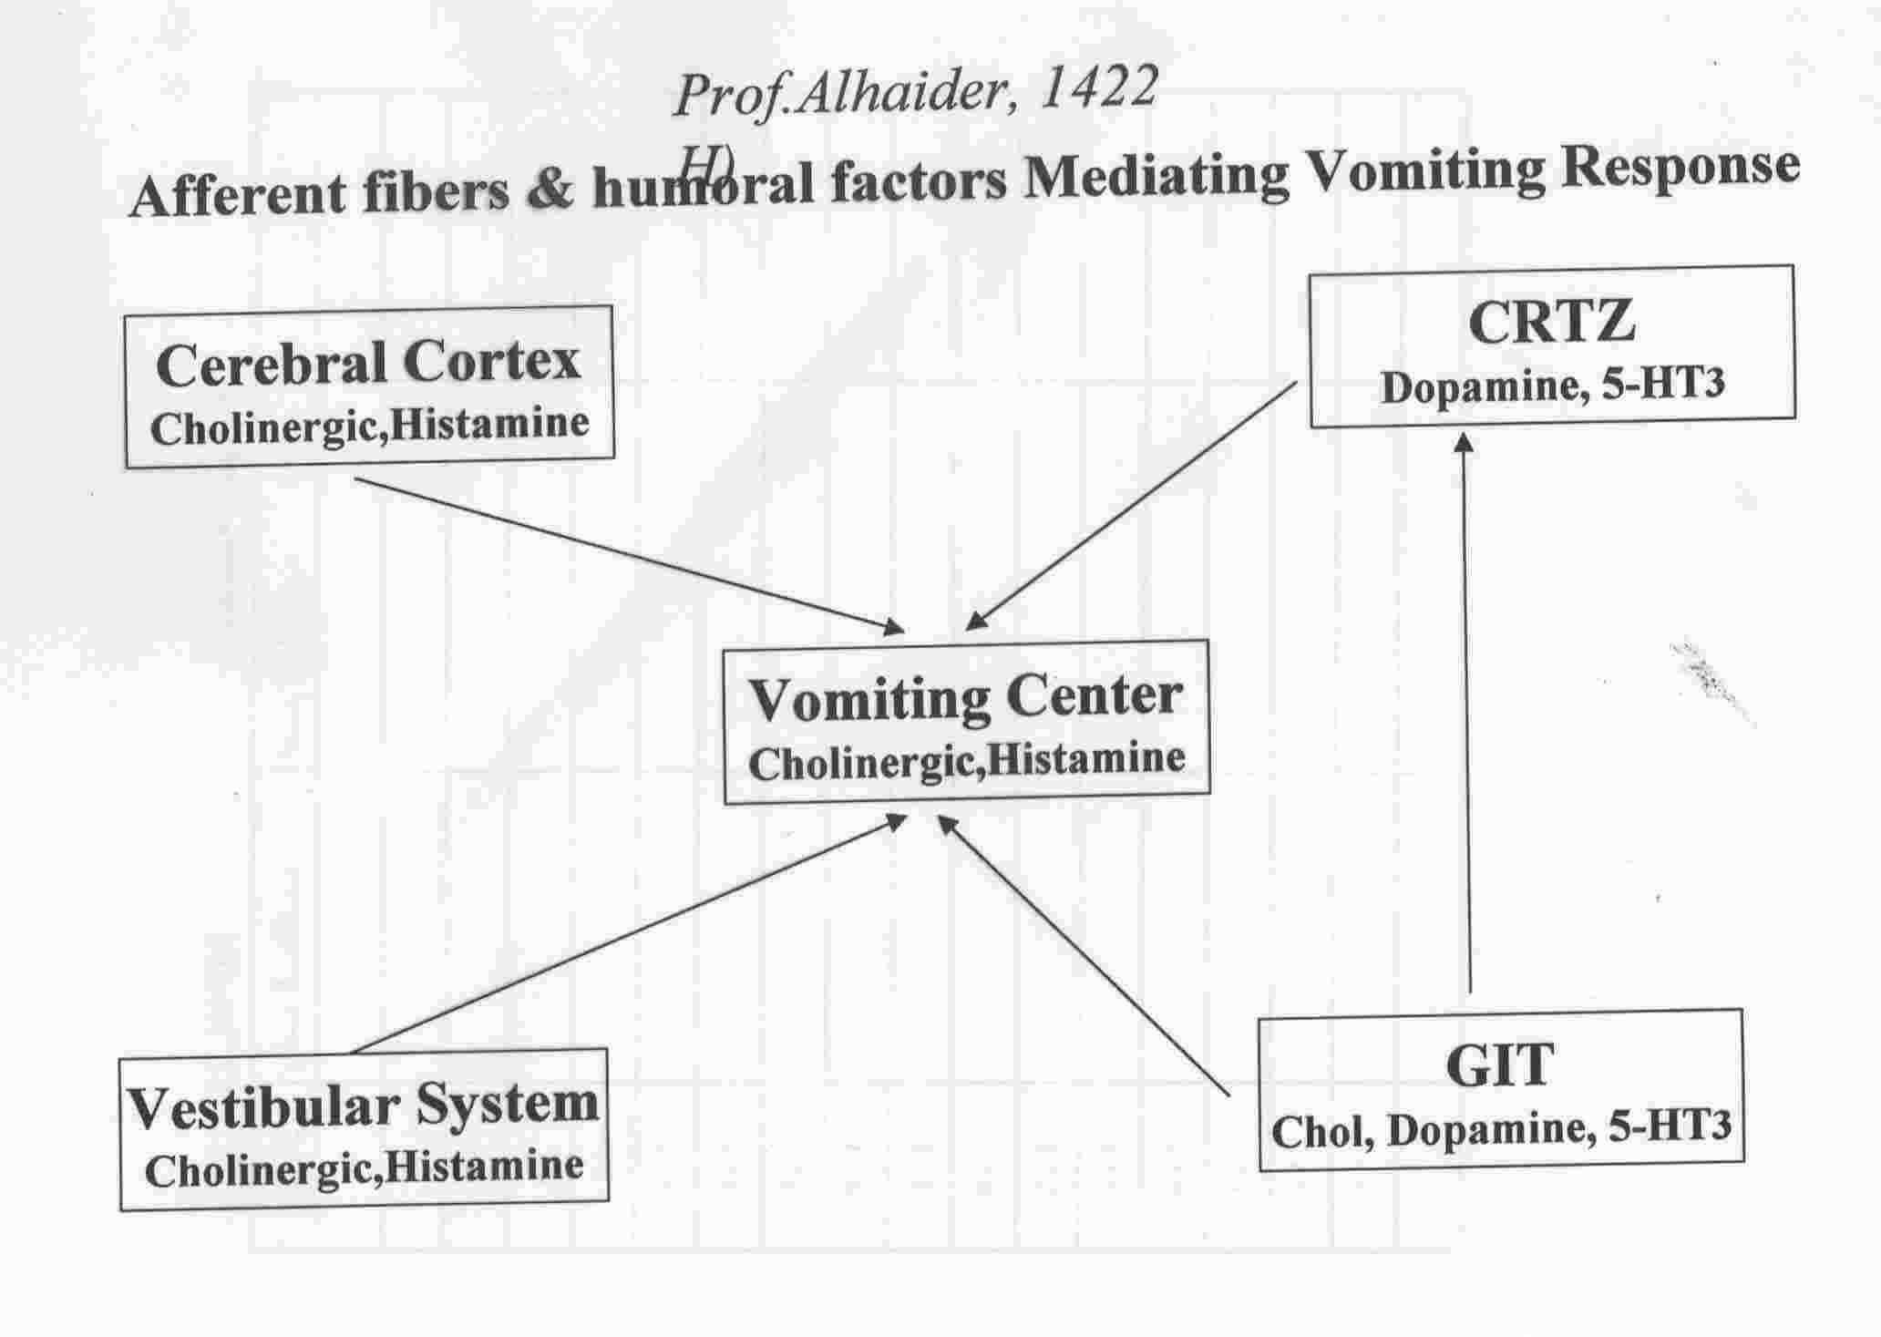

Slide 6
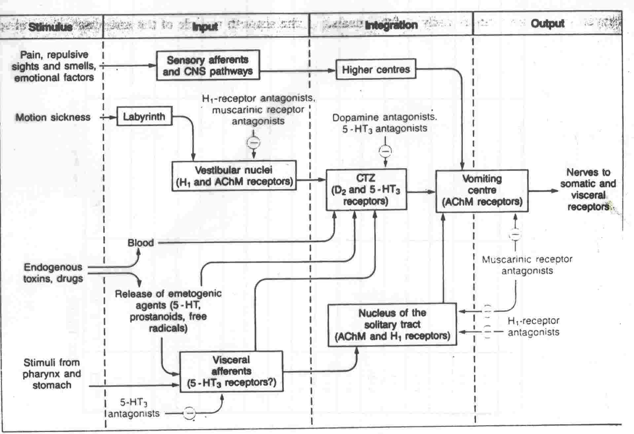

Slide 7
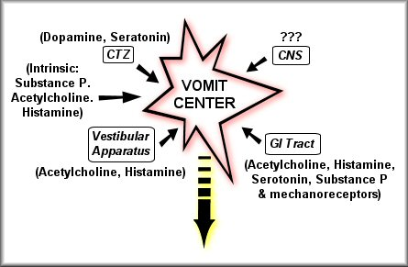
Receptors Associated with Nausea and Vomiting

Slide 8
Example of drugs commonly used for the treatment of N/V.
a. Antihistamines (promethazine; cyclizine; meclozine (Navidoxine^{R}). Dimenhydrinate (Dramamine^{R}), an H1 blocker which is very effective for long journeys in cases of motion sickness.
b. Anticholinergics, e.g. Hyoscine, an anti M1 blocker)
c. Antidopaminergics
Metoclopramide; Domperidone; Phenothiazines e.g. promethazine
5-HT3 receptor antagonists (new approach): Metoclopramide (a D2 receptor antagonist with mixed 5-HT3 receptor antagonism)
Pure 5-HT3 receptor antagonists: Ondansetron,Granisetron; Tropisetron

Slide 9
A) H1-receptor antagonists:
_ Dimenhydrinate; Cyclizine and promethazine (also acts as D2 antagonist):
Uses:
motion sickness in long journeys
Vestibular disorders (e.g. Meniere's disease) Betahistine, betaserc, and meclizine.
Severe morning sickness of pregnancy (but only if absolutely essential).
ADRs
Drowsiness, sedation, confusion, blurred vision, dry mouth, and urinary
Retention. These adverse effects are considered mild in comparison to anticholinergics.

Slide 10
B) Muscarinic receptor antagonists
-Hyoscine: motion sickness as the drug of choice for short journey due to the atropine-like side effects.
Better tolerated as transdermal patch

Slide 11
C) D2-receptor antagonists:
1) Phenothiazines (e.g.thiethylperazine; promethazine):
vomiting caused by uremia, radiation, viral gastroenteritis; severe morning sickness of pregnancy. These drugs are only used in special cases due to their side effects profile.
2) Metoclopramide (Plasil^{R}):
It is a prokinetic agent and commonly used for vomiting caused by uremia, radiation, gastrointestinal disorders, cytotoxic drugs. Not used in pregnancy induced N/V.
what are the side effects of dopamine antagonists:
Answer: Extrapyremidal symptoms or Parkinsonism
3) Domperidone (MOtilium^{R})
Block D₂₊₃ receptors

Slide 12
D) 5-HT3-receptor antagonists (e.g. Ondansetron; Granisetron; Tropisetron; Dolasetron):
1) They are mainly used for nausea and vomiting caused by cytotoxic anticancer drugs where they are considered drugs of choice.
2) Postoperative vomiting; radiation-induced vomiting.
Side Effects: Constipation
Does metoclopromide antagonize 5-HT3 receptors? Yes, that is why it surpassed promethazines.
E) Cannabinoids (e.g. nabilone) for vomiting caused by cytotoxic anticancer drugs.

Slide 13
F. Glucocorticoids
- Dexamethasone and methylprednisolone
- Highly effective in acute emesis
- Mechanism in treating N/V is unknown.
-Side Effects: same as cushing’s syndrome symptoms
G. Vitamin B6 (Pyridoxine)
Aprepitant belongs to a class of drugs called substance P antagonists (SPA). It acts by blocking the neurokinin 1 (NK₁) receptor. Used for N/V due to cancer chemotherapy and radiation. Also, apretipant is used in pregnancy.

Slide 14
Therapeutic Choice of Antiemetics
Vomiting with pregnancy
Avoid all drugs in the first trimester
Pyridoxine (B6)
Promethazine but not metoclopromide

Slide 15
CENTRAL ACTIONS OF ANTIEMETICS
Antagonist
5-HT₃ RAs
Promethazine
Atropine
Domperidol
NK-₁ RA
Agonist
5-HT₃
H₁
M
D₂
Substance P
Receptor Site
Chemoreceptor
Trigger Zone (CTZ)
Area
Postrema
BLOOD BORN EMETICS
Solitary Tract
Nucleus
Parvicellular
Reticular
Formation
Vestibular Nuclei
Emetic
Center

Slide 16
ANTIEMETICS
General rules on use of antiemetics
Should only be used when the cause of nausea or vomiting is known i.e cause of vomiting should be diagnosed.
Otherwise, the symptomatic relief produced could delay diagnosis of a remediable and serious cause.
Treat the cause (e.g. diabetic ketoacidosis, intestinal obstruction, intracerebral space-occupying lesion) usually cures the vomiting.
The choice of drug depends on the etiology
Indications of antiemetics
1- Chemotherapy-induced
vomiting
2- Post-irradiation vomiting
3- Postoperative vomiting
4- Vomiting of pregnancy
5- Motion (travel) sickness

Slide 17
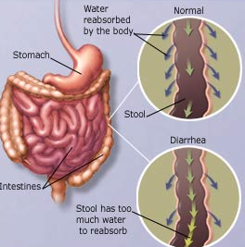
Antidiarrheal drugs
Diarrhea:
Is the condition of having 3 or more loose or liquid bowel movements per day, or having more stools than normal for a set person.
The accompanying loss of fluid causes dehydration and electrolyte imbalance which can be severe enough to be a direct cause of death. Diarrhea related death is considered to be the second cause of mortality in infancy.

Slide 18
ANTIDIARRHEAL DRUGS
Definition of Diarrhea
Simply diarrhoea is defined as ↑ in motility &↓ water absorption.
How to Rx Diarrhea ?
a. Oral Rehydration Therapy (ORT):
Why glucose is important for any rehydration ? It is important in replenishing blood sugar as well as in the assisting of electrolyte absorption.
b. Antidiarrheal Agents:
1. Drugs that increase 2. Drugs that slow the
the viscosity of luminal passage of gut
contents (adsorbants) contents (antimotility)

Slide 19
General Lines of Therapy
Maintenance of fluid and electrolyte balance, particularly in children and in the elderly by compensating lost fluid by oral or parenteral rehydrating therapy. Furthermore, the addition of zinc tablets for more than 6 months, in addition to oral rehydration therapy, is considered to be the 1st line treatment in most cases.
In non-pathogenic diarrhea or viral gastroenteritis, antibiotics and antidiarrheal drugs are better avoided.
Initial therapy should be with oral rehydration preparations which contain electrolytes and glucose.
Antibiotic treatment is indicated for patients with systemic illness with evidence of bacterial infection.

Slide 20
1-Adsorbants:
a) Kaolin (naturally occurring hydrated aluminum silicate) + Pectin (a complex carbohydrate)= Kaopectin^{R});
MOA: Adsorbs bacterial toxins. Therefore, it is preferred for diarrhea associated with diverticular diseases or ileostomy and colostomy.
b) Bismuth subsalicylate (Pepto-Bismol)
It retards the expulsive excretion of fluids into the digestive system by irritated GI mucosa by coating it and protecting it from further irritation.
Killing some bacteria that cause diarrhea, an action related to salicylate action.
Uses: Travelers’ diarrhea
Side Effects: Blackening of the tongue and stools
Contraindication: In viral infection to avoid Reye’s syndrome

Slide 21
2. Antimotility Drugs:
a. Opioid-like: (Codeine sulfate),(Diphenoxylate ( e.g. Lomotil )) & (Loperamide ( e.g. imodium ) )
MOA: They antagonize peristalsis by activating presynaptic opioid receptors in the enteric nervous system with subsequent inhibition of Ach release in the intramural nervous plexus of the gut. Non-cholinergic effects may also be involved.
Why low concentration of atropine is present in Lomotil Tablets?
To decrease the probability of addiction to opioid drugs by presenting the adverse effects of atropine
Loperamide is prescribed more often due to its limited peripheral action. Should not be given to children under 4 yr.
b. Anticholinergics (antispasmodic agents) work by relaxing the smooth muscle layer of the GI tract:
e.g: Propantheline; dicyclomine; Mebeverine (IBS)

Slide 22
OCTEROTIDE (Somatostatin)
Peptide secreted from D cells of pancreas, enteric nerves and hypothalamus.
Secretion of gastrin, CCK, glucagon, secretin, GH, 5HT, VIP
◉ Intestinal fluid secretion
Slows down GIT motility
Enhances vascular smooth muscle contraction
Inhibits the action of anterior pituitary hormones
Uses: Treatment of diarrhea (at high doses) particularly those attributed to carcinoid and vasoactive intestinal peptides (VIP) tumors
Side effects:
Blocks the secretion of pancreatic digestive enzymes resulting in steatorrhea
Nausea, vomiting, and abdominal pain
Alters fat absorption resulting in the formation of gall bladder sludge and stones
Hyper or hypoglycemia (insulin-glucagon disturbance)
Hypothyroidism
Bradycardia

Slide 23
Irritable Bowel Syndrome (IBS)
It is a functional bowel disorder associated with characteristic clustering of symptoms in the absence of detectable structural abnormalities. However, it is a condition of diverse pathophysiology associated with abnormalities in GIT motility (either diarrhea or constipation). The prevalence of IBS is around 15% of the population. Recent work concentrated on the important role serotonin plays in this syndrome. Therefore, many drugs which are used for the treatment of IBS may act on serotonergic mechanisms (see Table).

Slide 24
1) 5-HT3 receptor antagonists (Alosetron, Cilanestron) are used for IBS associated diarrhea.
Slows intestinal motility decreasing the urge to defecate
Decreases intestinal secretions
Decreases the water content of stool
Diminishes colonic pain in IBS attacks
Dose: 1 mg bid. Its use is restricted to women with unsatisfactory response to other causes (check the table)
Side Effects: Constipation and ischemic colitis
2) 5-HT4 partial agonist (Tegaserod): This is used for constipation-predominant IBS in women, and is also recommended for the treatment of chronic constipation by increasing peristalsis.
MOA: Stimulation of the 5-HT4 receptor enhances the release of Ach.
Side Effects: Diarrhea and headache
Limitation: Has no effect on the pain associated with IBS

Slide 26
Drug used in the treatment of IBS
For Pain Antispasmodic  Mebeverine, Otilonium bromide, Roceverine, Dicycloverine, Oxyphenonium,
Anticholinergic  Hyoscine
Antidepressant  TCA (amitryptaline) > SSRIs
For Diarrhea Antidiarrheals Loperamide, Diphenoxylate
 Bulking agents  Ispaghula
 5HT₃- Antagonist  Alosetron, Cilansetron
For Constipation  Laxatives  Fibers
 5HT₄- Agonist  Tegaserod, Prucalopride, Renzaprid
 Cl Channel Activators  Lubiprostone
For Bloating  Probiotics Non-pathogenic live microbial food supplements or capsules improve the intestinal microbial balance decreasing bacterial metabolism of food
 Antiobiotics  Rifaximin–luminal nonabsorbable antibiotic

Slide 27
