Slide 1
CONTROLLERS
PREVENT FUTURE ATTACKS
Reduce bronchial hyper-reactivity
LONG TERM CONTROL
Induce anti-inflammatory actions
REDUCE AIRWAY REMODELLING
Halt partial irriversibility
WHICH DRUGS ARE USED
DRUGS THAT DECREASE AIRWAY INFLAMMATION
To prevent airway remodeling
PREVENT RECUR OF ACUTE SYMPTOMS
Abort exacerbations
USED TOGETHER
Glucocorticoids.
Leukotrienes Modifiers
Leukotriene Synthesis Inhibitors Leukotriene Receptor Antagonists
Anti IgE monoclonal antibodies
Antiallergics; Mast cell stabilizers
Bronchodilators;
Long-acting β₂-AR agonists (LABA)
Long acting Anticholinergics
PDE Inhibitors;
Non-Selective & PDE-4 Selective

Slide 2
CONTROLLERS
DRUGS THAT DECREASE AIRWAY INFLAMMATION

Slide 3
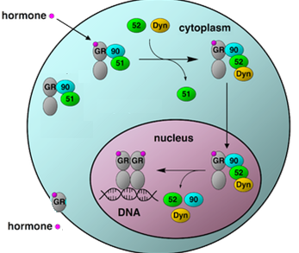
1. CORTICOSTEROIDS [GC]
Mechanism of action
Like all other steroids, GC acts on;
Cytosolic GC R  mediates GENOMIC Action 
Expression of proteins (anti-inflammatory effects)
Repression of proteins (pro-inflammatory effects)
slow process needs hours - days
2. Membranous GC R  mediates NON-GENOMIC Action: alter Ca⁺⁺, cAMP, PKC & PKA rapidly exert anti-inflammatory effects & shut down proinflammatory effects
(rapid process needs minutes-hrs)
PKA
cAMP
PKC
GCRE
Ca
mRNA
Protein

Slide 4
Pharmacological Effects
Suppress inflammation & immune reactions:
◉ release & synthesis of inflammatory mediators
◉ antigen antibody reaction mast cell degranulation, infiltration & activity of inflammatory cells by  cytokines & chemokine production
vascular permeability; so  ↓edema of the airway mucosa
airway mucus production
◉ Formation of myofibroblasts, collagen deposition, subepithelial fibrosis & airway remodeling
Benefits of Use
Effective in exercise, allergic & irritant-induced asthma most types
Though it can never be given as monotherapy to induce relief of symptoms, yet its use EARLY with relievers, help to stop the pool of mediators contributing to bronchoconstriction by its RAPID NON-GENOMIC ACTION

Slide 5
CORTICOSTEROIDS
 it is the MAINSTAY OF ASTHMA THERAPY. It takes 7-14 days to built its full anti-inflammatory effects & six weeks for achieving maximum benefits specially in halting remodeling by its GENOMIC ACTION
Indications
Used alone or with other drugs, depending on asthma frequency & severity
For mild persistent asthma  low dose inhalational monotherapy
For moderate persistent asthma  low-moderate doses inhalational + long-acting ß-AD agonist
For severe persistent asthma  high doses inhalational + long-acting
ß-AR agonist + oral steroids (if needed)
For status asthmaticus  IV drip infusion has life-saving effects  decreasing edema, local leukotriene generation, inflammatory cell recruitment & reversal of ß2-AR downregulation.
Method of administration & preparations
INHALATIONAL or Systemic (oral or IV)

Slide 6
INHALATIONAL STEROIDS
i.e. Beclomethasone, Budesonide & Fluticasone
Inhalational therapy guarantees that therapeutic levels are rapidly reached with least systemic side effects (even if high doses are given).
Fluticasone is the best in use as it;
 first-pass clearance by the liver systemic availability
effective in control at 50% the dose of others
No pituitary adrenal axis suppression
Local (Topical) ADRs
Cough
Dysphonia (hoarseness)
Candidiasis of the mouth or throat (Thrush)
N.B. to limit local ADRs, instruct patient to rinse mouth, gargle & spit out, use spacer to  particle deposition in the oral-pharynx & larynx & tend to dose needed by adding LABA & giving it prior to steroids to open airways
SYSTEMIC STEROIDS
Oral; Prednisone Chronicity, repeated acute exacerbations & hospitalization
Parenteral; Methylprednisolone, Dexamethasone  severe attacks and status asthmaticus

Slide 7
SYSTEMIC STEROIDS
If given for more than one week, no abrupt withdraw should be done but tapper the doses gradually to prevent adreno-pituitary suppression fear of adrenal insufficiency
Systemic ADRs are dose & time dependent and include;
Adrenal suppression
Growth retardation premature fusion of epiphysis
Osteoporosis
Susceptibility to infections &  immunosuppresion
Salt & water retention  Hypertension and edema
Increased appetite & weight gain
Hyperglycemia & poor glycemic control(care in diabetics)
Altered fat metabolism & distribution
Protein catabolism
Muscle wasting
Mood disturbances / psychosis
Cataract & Glaucoma

Slide 9
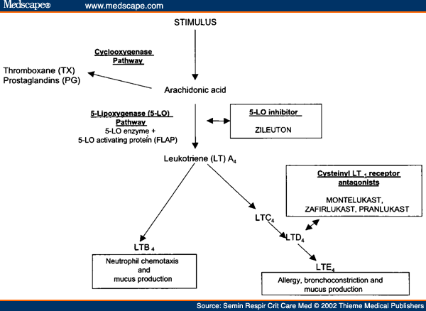
Leukotrienes

Slide 10
Actions of leukotrienes
LTD4
Eosinophill recruitment
Increase blood flow and permeability
Hyperreactivity
Smooth muscle cells proliferation

Slide 11
Leukotriene Modifiers
Synthesis Inhibitors; Zileuton Its use has declined considerably, with increased efficacy of Receptor Antagonists; Montelukast, Zafirlukast
Pharmacological Effects
Anti-inflammatory action < corticosteroids, but they ↓requirement for glucocorticosteroid Corticosteroid Sparing Action
Mild, slow-onset bronchodilatation
Kinetics
Montelukast
Rapidly absorbed from GIT.
t_{1/2} is 2.7–5.5 hours
Undergoes hepatic metabolism by CYP 3A and 2C9
Mainly excreted in the bile.
Individual responses vary “responders & nonresponders”
Benefits of Use
Used prophylactically to  frequency, nocturnal attacks & severity of attacks
Not indicated for monotherapy & not used as reliever in in acute attacks (bronchodilation = 1/3 of salbutamol)

Slide 12
Used in;
Prevention of Aspirin induced asthma more efficient
Exercise induced asthma
Decrease both early and late responses to allergen induced asthma
Maintenance (Long Term) Therapy of
Mild chronic persistent asthma as 2nd line or as add on therapy to LABA, to  lung function /need of short-acting beta₂-agonists if exacerbations
Interactions & ADRs
Restlessness & headache
GI disturbances
Hypersensitivity reactions, arthritis
Respiratory tract infections
Reversible hepatitis & hyperbilirubinemia ( Zileutin)
Acute vasculitis, eosinophilia &  of pulmonary symptoms (Zafirlukast)
All are avoided in pregnancy & breast-feeding
Zileuton metabolism of theophylline, warfarin, terfenadine, propranolol
Zafirlukast warfarin / theophylline & erythromycin concentration
Montelukast; is the safest, well tolerated, least reported ADRs & interactions.

Slide 13
3. Anti- IgE Monoclonal Antibody
Omalizumab
Is a Recombinant MAb directed against human IgE  given subcutaneous
Mechanism
It binds to Fc region of free IgE molecules  prevent its binding to cell-surface receptors on inflammatory cells.
Pharmacological effects
early & late responses to antigen challenge
Indications
Given as SC every 2-4 weeks
frequency of allergen induced asthma
In moderate-sever persistent asthma (adults or children >12 ys.), not controlled by inhaled CS to frequency of attacks
◉ need for GC in maintenance & allows its safe withdrawal by exacerbation rate during this transition

Slide 14
4. Anti-Allergics
Cromolyn (weaker) & Nedocromil
Mechanism
Block Ca influx, alter function of delayed Cl⁻ channel
 stabilize antigen-sensitized mast cells
Pharmacological Effects
Can control early & late phases of asthmatic reaction
Control early phase by
Mast cell stabilization   histamine, LTs, PGs, chemokines,
◉ neuronal reflexes involving C-fibres & sensory neurons.
Control the late phase by
-ve accumulation & activation of inflammatory cells
Preserves mucocliliary function &  airway vascular leak
Kinetics
Poor oral absorption; being acidic & almost exclusively ionized
By inhalation; deposits & is retained at bronchial mucosa  topical effect

Slide 15
Indication
 For Asthma
Only as an alternative for prophylactic prevention of mild to moderate attacks particularly allergen > exercise > irritant induced asthma. In allergen induced asthma  start 2-4 weeks before allergy season
Useful > in children (safe) & in patients where ADRs to other drugs is a problem
Their regular use > 3 months may reduce bronchial hyperreactivity.
 For allergic rhinitis &/or conjunctivitis
Methods of administration
Inhalational; as powder by dry powder inhaler, as aerosols by metered dose inhalers & also by nebulizers
As eye drops or nasal sprays
ADRs
Generally well tolerated & if occur  are minor & localized (no systemic absorption).
Bitter taste, throat irritation, cough & dry mouth .
Reversible dermatitis, myositis, gastroenteritis & joint swellings
Nasal congestion, but pulmonary eosinophil infiltration, anaphylaxis  rare
Respiratory side effect can be minimized by taking ß-AD agonist first

Slide 16
CONTROLLERS
PREVENT RECUR OF ACUTE SYMPTOMS
Abort exacerbations
LONG ACTING BRONCHODILATORS
Long-acting β₂-AR agonists (LABA)
Long acting Anticholinergics; Tiotropium
PDE Inhibitors;
Non-Selective & PDE-4 Selective ; Cilomilast

Slide 17
1. Long Acting β₂-AR Agonists (LABA)
Salmeterol & Formoterol
Mechanism:
In submucosa  Improve mucociliary function → ↓vascular leak
On mast cell   mediators & cytokine release
In B epithelium   NO release
On presynaptic cholinergic  Ach release
1st dose will act as bronchodilator, but using it regularly → anti-inflammatory action
N.B. β₂ AR downregulation & desensitization
LABA; Never give alone as controller
Repression of pro-inflammtory molecules
Expression of ant-inflammatory molecules
Suppression of BSMC proliferation & remodeling
PRIMING of GC RECEPTORS (Cross-talk between GC & LABA)
GC  expression of bronchial β₂ AR & their responsiveness to β₂ AR

Slide 18
Kinetics & Dynamic Character;
Duration: 12 hrs
Salmeterol
Lipophilic
Long duration
Slow onset
Less potent
> selective
Formoterol
Intermediate lipophilicity
Long duration
Rapid onset (may used as a rescuer
More potent
< selective
Indications
Never as rescue in acute attacks.
Never given as controller alone but must be with anti-inflammatory
Only as add on, to asthma treatment plan, if other medications do not totally control symptoms, specially if not adequately controlled with inhaled corticosteroids
Is particularly useful in treating nocturnal asthma
Administration
Inhalation unless inability to use inhalers → Oral use

Slide 19
CLINICAL APPROACH TO ASTHMA THERAPY
A.
Presence of one feature of severity is sufficient to place patient in that category

Slide 20
B. Step-WISE APPROACH TO ASTHMA MANEGEMENT
Mild Intermittent
Use: Albuterol (as needed)
Mild Persistent
Use: Albuterol & Controllers (low dose inhaled steroids, aniallergics, montelukast)
Moderate Persistent
Use: Albuterol & Combination Controllers (medium dose steroid + LABA &/or montelukast)
Severe Persistent
Use: Albuterol & Combination Controllers (High dose inhaled steroids + LABA &/or montelukast + oral steroids
Depending on judgment, it can be applied either by beginning;
1. At high level to achieve quick control & then decrease “STEP DOWN” the medication; starting the “step down”, once persistent asthma
patient has been sustained well controlled for about 3 months
N.B.  inhaled steroid by about 25% every 2 months until the lowest dose required to maintain control is obtained

Slide 21
2. At low level then increase “STEP UP” the medications ; starting the
“step up” if control is lost, when:
Exacerbations are more than 3 times a week.
Increased symptoms at night or early in the morning.
Increased frequency of inhaled short-acting β2-AD agonist.
Rescue course of prednisolone may be needed, at any time, at any step.
Anti-muscarinic, are alternatives if patient is intolerant to β₂ AD agonists
PDE Is, could be alternative to β₂ AD agonists only if persistent asthma is moderate (oral sustained release) or sever ( parenteral/ in hospital)
C. CAUSAL Treatment
1. Avoidance (environmental control):
Useful if allergic or irritant precipitating cause is known & can be avoidable. It produces a dramatic improvement.
2. Immunotherapy: is exposure to  doses of antigenic substances, at varying intervals, in an attempt to  allergic response to it.
Must be used for at least two yrs in order to maintain benefit.
Immunotherapy is efficient for insect venom but not for food.

Slide 22
D.TREATMENT OF STATUS ASTHMATICUS
Dyspnea at rest
Cannot walk
Difficult or cannot speak
Cyanosis, confusion, drowsiness, incontinencence
Impending respiratory arrest
In ICU
Subcutaneous β₂-agonist (epinephrine)
IV aminophylline for maintainance
IV corticosteroid, to be repeated
Oxygen inhalation
Antibiotics may be used if there is bacterial infection
Repeated β₂-agonist inhalation by nebulizer
Consider artificial ventilation with intra-tracheal intubation in case of worsening of dyspnea
Consider bronchial lavage

Slide 23
COPD
COPD
COPD
COPD is a lung-destruction disease.

Slide 24
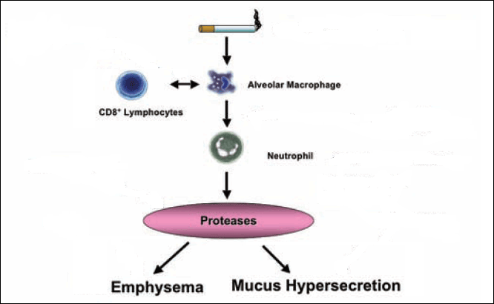
Lung-destruction Disease
 Goal is: slow loss of lung function
SMOKING Cessation
Chemokine Antagonists
Immunosuppressants
Oxidants
Anti-inflammatory
PDE-4 Inhibitors
Protease Inhibitors
Surgery
Mucoregulators
But in view of lack of efficacy of pharmaceutical agents that can alter such progression of COPD (disease-modifying)  treatment is driven by the need to REDUCE SYMPTOMS.
Bronchodilators
Immunomodulators & Anti-inflammatory

Slide 25
Bronchodilators for COPD
Short-acting
Long-acting
Fixed Combination
β₂-agonists:
Albuterol
Terbutaline
β-agonists:
Salmeterol
Formoterol
Albuterol + ipratropium
Budesonide + formoterol
Fluticasone + salmeterol
Anticholinergic:
Ipratropium
Anticholinergic:
Tiotropium (more selective on M₃ receptors)
Methylxanthine:
Theophylline
Cilomalist
TIOTROPIUM
Anticholinergic
Acts for 24 hrs
Relax bronchospasm caused by irritant stimuli (irritants initiate a vagal reflex that liberates ACh)
Decrease mucus secretion

Slide 26
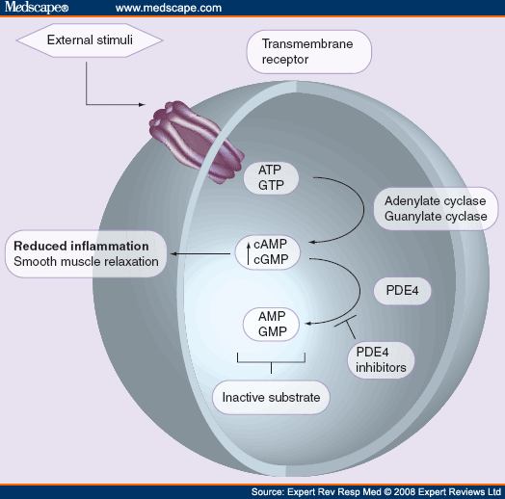
CILOMALIST
Is a SELECTIVE PDE-4 Inhibitor
PDE ₄ exists predominantly in pro-inflammatory & immune cells
Effects
◉ (macrophages & CD8+ lymphocytes); cells considered central in etiopathogenesis of COPD
Kinetics
Orally active
Completely absorbed
Negligible first-pass metabolism
Protein bound
t_{1/2} 6.5 hours
BenefitsImproves FEV1
ADRs
GI toxicity nausea & emesis
No cardiac side effects
No CNS side effects like theophylline . Selective on the lungs
Lymphocyte

