Slide 1
DRUGS USED
IN TREATMENT OF COUGH

Slide 2
Protective mechanisms of respiratory tract are:
1. MUCOCILIARY CLEARANCE  Competent mechanisms ensuring optimum tracheobronchial clearance by forming sputum (in optimum quantity & viscosity ) that is exhaled out by the movement of the ciliated epithelium.
2. COUGH REFLEX  that is meant to exhale sputum out, if not optimally removed by the mucociliary clearance mechanisms
MUCOCILIARY CLEARANCE
Mucous; 95% water
2% glycoproteins
Gel layer: high viscosity from goblet cells
Sol layer : low viscosity from submucosal bronchial glands

Slide 3
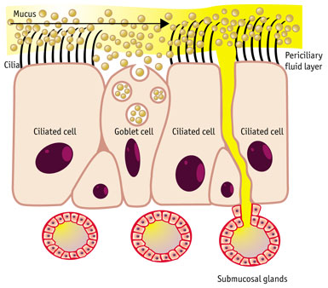
The more viscid part of mucus is secreted from the goblet cells & the less viscid from submucosal glands.
Mucociliary clearance is the primary mechanism of clearance of mucus.
Under normal conditions, the cilia beat in a coordinated fashion in the periciliary fluid layer propelling the mucus towards the mouth.
When irritated, these glands excrete excessive sputum.
When mucociliary clearance fails to clear it, cough becomes the secondary mechanism for clearance of mucus.
Afferent C-fibres
Efferent Symp & Parasymp

Slide 4
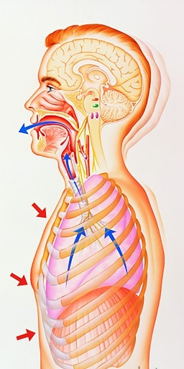
COUGH
Coughing is a sudden expulsion of air from the lungs through the epiglottis at an amazingly fast speed (~100 miles/ hr) to rid the breathing passageways of unwanted irritants.
So as abdominal & muscles contract, against the closed epiglottis  pressure   air is forcefully expelled to dislodge the triggering irritant.
Cough is a protective REFLEX;
Meant to be useful with intention to help the clear of respiratory airway from foreign material & excess secretions
“wet or productive”
But may not be useful occurring 2ndry to exposure to irritant vapors, gases, infections, cancer,… it becomes annoying  “dry or irritant”

Slide 5
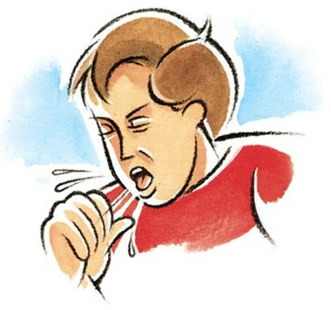
Cough can be divided according to;
Etiopathogenic Perspective
Productive
Non-productive (dry)
Clinical Perspective
Acute
Chronic
(Not lasting longer than 2 -3 weeks)
(Lasting longer than 4 weeks)
COUGH
Is provoked by:
Common cold
Pneumonia & pulmonary embolism
Asthma
Bronchitis
Gastroesophageal reflux
Smoking
Drugs ; ACE inhibitors

Slide 6
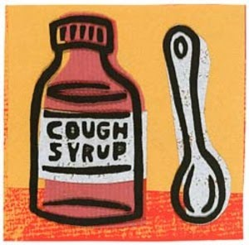
COUGH
Can be treated by:
EXPECTORANTS
For Productive
MUCOLYTICS
ANTITUSSIVE AGENTS
For Non-productive (dry)
Cough preparations may contain a mixture of both for treatment i.e cough mixtures for common cold
Cough preparations are available either
As OTC
By prescription.

Slide 7
EXPECTORANTS
&
MUCOLYTICS

Slide 8
EXPECTORANTS
DEFINITION
Drugs that aid in the expectoration i.e removal of mucus. This is achieved by accelerating natural clearance mechanisms
Mechanism of Expectoration
Reflex stimulation
Agent causes irritation of the GI tract  stimulating gastropulmonary vagal reflex “expectorant action”  leads to loosening & thinning of respiratory tract secretions in response to this irritation  Guaifenesin
Direct stimulation
Stimulation of secretory glands  respiratory fluids production  Iodinated glycerol, Na or K iodide / acetate , Ammonium chloride, Ipecacuahna
The final outcome is that cough is indirectly diminished

Slide 9
INDICATIONS
Used for the relief of productive cough associated with:
Common cold
Bronchitis
Laryngitis
Pharyngitis
Influenza
Measles
Chronic paranasal sinusitis
Pertussis
ADRs
Guaifenesin
Dry mouth, chapped lips, risk of kidney stones(uric acid excretion)
Iodide preparations
Unpleasant metallic taste, hypersensitivity, hypothyroidism, swollen of salivary glands( overstimulation of salivary secretion), & flare of old TB.

Slide 10
MUCOLYTICS
DEFINITION
Drugs that alter the biophysical quality of sputum so that it can be easily exhaled by mucociliary clearance or by less intense coughing
Mechanism of Mucolytic Actions
Mucolysis occurs by one or more of the following;
◉ Viscoelasticity by water content; Hypertonic Saline & NaHCO₃
◉ Adhesivness; Steam inhalation
Splitting disulfide bond less viscid mucous; N-Acetyl Cysteine
Synthesize serous mucus (sialomucins of smaller-size) so it is secretolytic + activate ciliary clearance & transport; Bromohexine & Ambroxol
Cleavage of extracellular bacterial DNA, that contributes to viscosity of sputum in case of infection; rhDNAase (Pulmozyme)

Slide 11
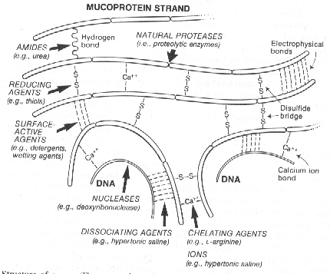
Action of various Mucolytics

Slide 12
INDICATIONS
1. Most mucolytics are used as adjuvant therapy in respiratory conditions with excessive and/or thick mucus production specially in COPD, asthma, bronchitis, …etc.
In COPD  exacerbations, rate of hospitalization, cough severity & chest discomfort but do not show improvement in lung functions
In bronchiectasis, pneumonia & TB  are of partial benefit
In cystic fibrosis  they are of little benefit, as mucus accumulates in lower airways & thinning of secretions may not always be beneficial, since it may negatively affect certain aspects of mucus transport such as cough clearance.
2. rhDNAase in particular is used in cystic fibrosis (CF) & is also of benefit if respiratory infection is severe. This is because the viscosity of infected sputum then, is more due to nucleic acids of bacterial infection rather than mucopolysaccharides
In CF  it  pulmonary exacerbations & rate of deterioration of lung function  is currently the only mucolytic with proven efficacy in CF

Slide 13
1. Acetylcysteine
Aerosol
Orally
As mucolytic
Also, has potential anti-inflammatory action & improves immune defense mechanisms
As a free radical scavenger  used in acetominophin overdose to prevent hepatotoxicity
Kinetics
Bioavailability  6-10% (oral) <3% (topical)
t ½ 5-6 hrs (adults) 11 hours (neonates)
Hepatic metabolism / Renal excretion
ADRs
Bronchospasm; with 20% solution / give salbutamol
Stomatitis, Rhinorrhea, Rash
Nausea & vomiting
Precautions
Turns mucous pink
Good for short term / long term can become irritating; smells bad
Notes:
13

Slide 14
2. Bromhexine & its metabolite Ambroxol
Derived from alkaloid vasicine
Given as tablet Or as solution for nebulization during exacerbation
As mucolytic
sputum concentration of IgA  better immuno defence mechanism   duration of disease.
Long-term use   in antibiotics used for treatment of exacerbation.
Ambroxsol is also  very potent inhibitor of neuronal Na channels   pain in acute sore throat (fast onset & long duration)
Kinetics
Bioavailability  75 – 80 %
t ½ 12 hrs
ADRs
Rhinorrhea and lacrymation
Gastric irritation
Hypersensitivity

Slide 15
3. Pulmozyme (Dornase Alpha or DNAse)
 Is a phosphorylated glycosylated recombinant human deoxyribo-nuclease-1 enzyme.
Kinetics
Administered twice daily, by inhalation via neubilizers,
Safe  detectable serum levels are minimal
Full benefit appears within 3-7 days
ADRs
Voice changes
Pharyngitis, laryngitis, rhinitis.
Chest pain
Fever, Rash
Precautions
Stored in the refrigerator at 2-8°C
Not to be diluted or mixed with other drugs in the nebulizer.

Slide 16
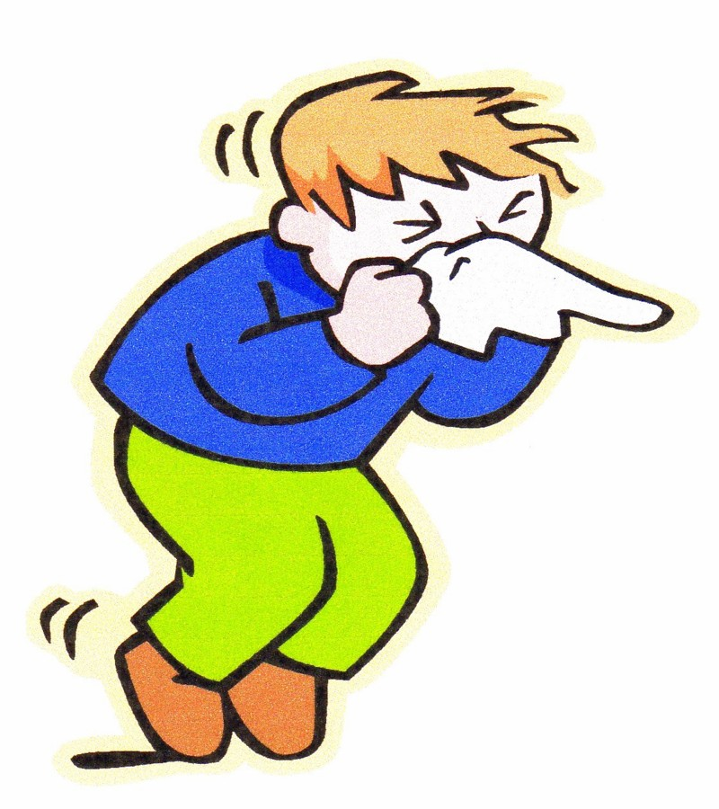
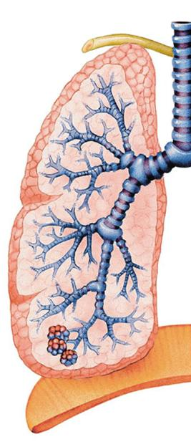
ANTITUSSIVE AGENTS

Slide 17
Definition
Antitussives are drugs used to stop or reduce cough by acting either primarily on the peripheral or the central nervous system components of the cough reflex.
COUGH REFLEX
Irritation to bronchial mucosa  bronchoconstriction  specialized stretch receptors in tracheobronchial airways  fire afferent conduction via fibres in the vagus nerve  relay at cough center in medulla  coordinate signals with other autonomic & somatic reflexes  leading to the act of cough
The drugs that can affect this complex mechanism, directly or indirectly, are quite diverse.
Antitussives can be classified as ;
Peripherally acting  suppress different stretch receptors
Opioid & nonopioid (narcotic & nonnarcotic)  suppress the cough centers

Slide 18
PERIPHERALLY ACTING ANTITUSSIVES
A. Inhibitors of airway stretch receptors
In Pharynx  Use Demulcents  form a protective coating
Given as soothing pastilles, lozenges, gargles & syrups of acacia, licorice, glycerin, honey, and wild cherry syrups
In Larynx  Use Emollients  form a protective coating
Given as syrup or as soothing spray of menthol & eucalyptus.
In Tracheobronchial Airway Use aerosols or inhalational hot steam alone or medicated with tincture benzoin compound & eucalyptol
During bronchoscopy or bronchography  Use local anaesthetic aerosols, as lidocaine, benzocaine, and tetracaine
B. Inhibitors of pulmonary stretch receptors in alveoli
Benzonatate “tessalone”  sensitivity (numbing) of receptors by local anesthetic action. Also has a central inhibitory effect
Given orally as softgel capsules / 3 times a day. Capsules must be swallowed intact in order to allow slower release of the medication being potent & toxic .
ADRS; drowsiness, dizziness, dysphagia, allergic reactions
Overdose  mental confusion, hallucination, restlessness & tremors

Slide 19
CENTRALLY ACTING ANTITUSSIVES
A. OPIOIDS
Those used, have less addicting, more antitussive & less analgesic effects
They act directly on cough centre in the medulla by inhibiting release of excitatory neuropeptides via activating µ opioid receptors
e.g. Codeine (methyl-morphine) & Pholcodine
Morphine , only in bronchogenic carcinoma, because of its many side effects
ADRs
1- Constipation.
2- Inhibition of mucociliary clearance (thick sputum ).
4- Drowsiness & mild respiratory depression
5- Dependence.
6- Dry mouth
B. NON-OPIOIDS
Dextromethorphan
Or
H₁-blockers (better the sedating) as;
Diphenhydramine,Triprolidine, Chlorphenaramine

Slide 20
Dextromethorphan
Mechanism
Multiple non-selective mechanisms; 5HT reuptake inhibition, σ receptor agonist & NMDA receptor antagonist.
As antitussive; it  threshold for coughing centrally & has benefits of being;
1. As potent as codeine.
2- But no drowsiness.
3- Less constipating
4- No respiratory depression.
5- No inhibition of mucociliary clearance.
6- No addiction.
Kinetics
Good oral absorption but bioavailability 11%
t ½ up to 4 hrs
Metabolized by many of the P450 isoenzymes, its metabolite dextrorphan, is 10 times more active & mediates its dissociative effects (on high doses).
ADRs
Nausea, vomiting, dizziness, rash & pruritis in normal doses
In high doses, hallucinations + opiate like side effects on respiration & GIT

