Slide 1
CONGENITAL HAND ANOMALIES
By Dr.
Jamaleldin Hassanain

Slide 2
Hand function
is an important feature in humans over other primates who lack fine control and precision

Slide 3
EMBRYOLOGY
Limb development and differentiation is a rapid process occurring between 3-8 wk

Slide 4
EMBRYOLOGY OF THE UPPER LIMB
Limb buds first appear as small elevations on ventro lateral body end of fourth week.

Slide 5
Each limb bud :
Mesenchyme derived from somatic mesoderm which is covered by a layer of ectoderm

Slide 6
Distal end of bud form flipper like limbs.
Later bones develop and myoblast aggregate to develop muscle mass .

Slide 7
Upper limb rotates laterally 90 degrees
Specific dermatone ( which is skin area supplied by a single spinal nerve )

Slide 8
ANATOMY
Bony skeleton
Muscles and soft tissues
Vessels and nerves

Slide 9
Proximal row of carpal bone (radial to ulnar) scafoid , lunate , traquetral , pisiform
Distal row trapezium , trapazoid , capitate , hamate

Slide 10
BONES OF THE HAND
5 Metacarpals
Thumb is no. 1
Little finger is no. 5

Slide 11
BONY SKELETON
Wrist joint composed of multiple carpal bone articulating with the radius proximally and five metacarpals distally

Slide 12
PHALANGES
All fingers have 3 phalanges proximal middle distal
Except thumb has 2 proximal distal

Slide 13
Embryological failure are related to malformations
Causes
Teratogen
Chromosomal abnormality
Viruses
Toxic agent
Vascular events
trauma

Slide 14
Most anomalies occur between 25th –50th day.
Any anomalies occurring after 7th week occur as a result of extrinsic compression upon uterine wall eg.
ischemic events.
mechanical influences (amniotic constriction band syndrome ).

Slide 15
INCIDENCE
1 : 4000 Live births (Birch – Jensen 1944)
1 : 625 live births (Conway & Bowe 1956)

Slide 16
Congenital : something present at birth
Malformation : gross structural anomalies

Slide 17
TYPES
SYNDROMIC : Combination of anomalies ( 3- 4 )
Single gene
Multiple genes
Sex linked

Slide 18
MALFORMATION SEQUENCE
Poor formation of tissue within the fetus e.g.. Radial dysplasia

Slide 19
DEFORMATION SEQUENCE
There is no intrinsic problem with fetus but abnormal external mechanical or structural forces e.g.. Leaking of amniotic fluid
Bicornate uterus e.g.. Amniotic constriction band syndrome

Slide 20
CLASSIFICATION

Slide 21
FAILURE OF FORMATION
( A) Transverse arrest i -shoulder e.g. amelia ii –upper arm -long above elbow -short above elbow iii – elbow Iv – forearm -long below elbow -short below elbow v- wrist (acheira ) vi –metacarpal (adactyly) vii -phalanges

Slide 22
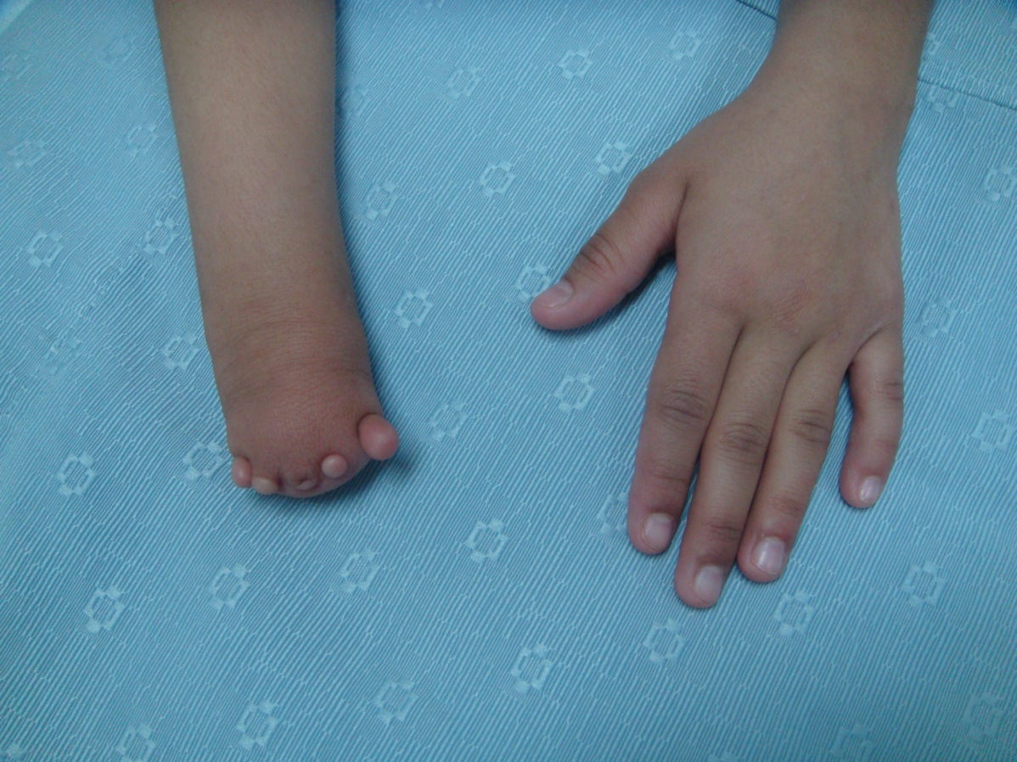

Slide 23
B – LONGITUDINAL ARREST
Radial ray ( pre-axial )
Ulner ray ( post-axial )
Central ray ( cleft hand )

Slide 24
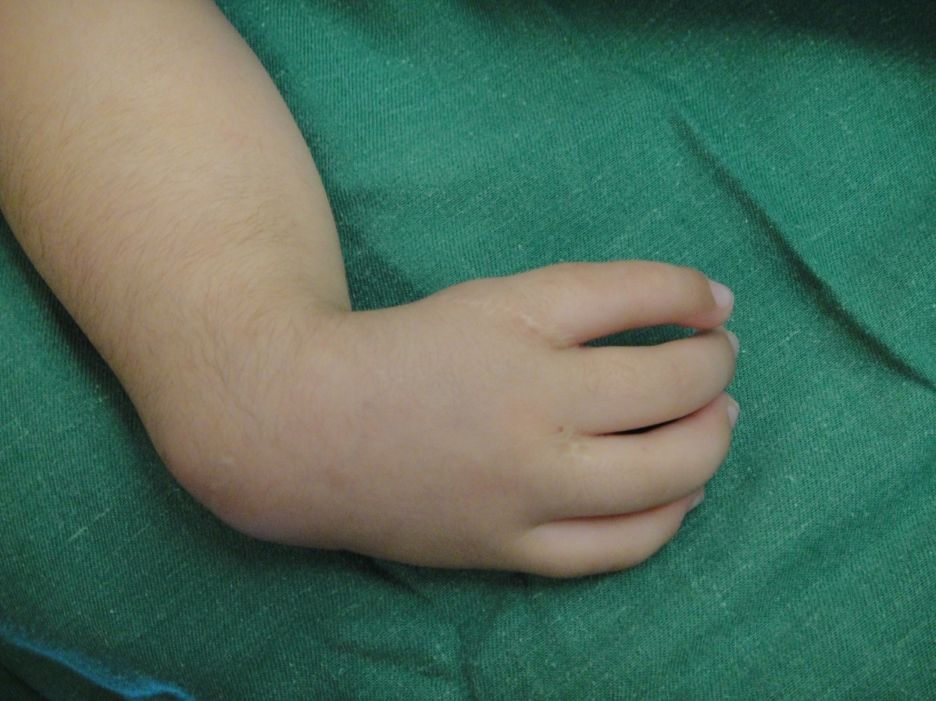

Slide 25
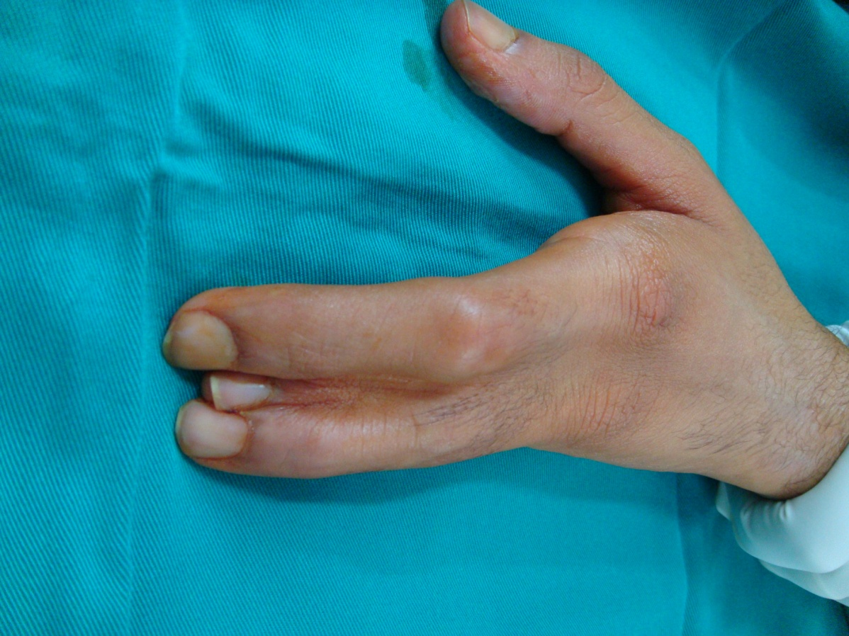

Slide 26
II – FAILURE OF DIFFERENTIATION
(a)- Soft tissues e.g.. Cutaneous syndactyly
(b)- skeletal involvement e.g.. Osseous syndactyly

Slide 27
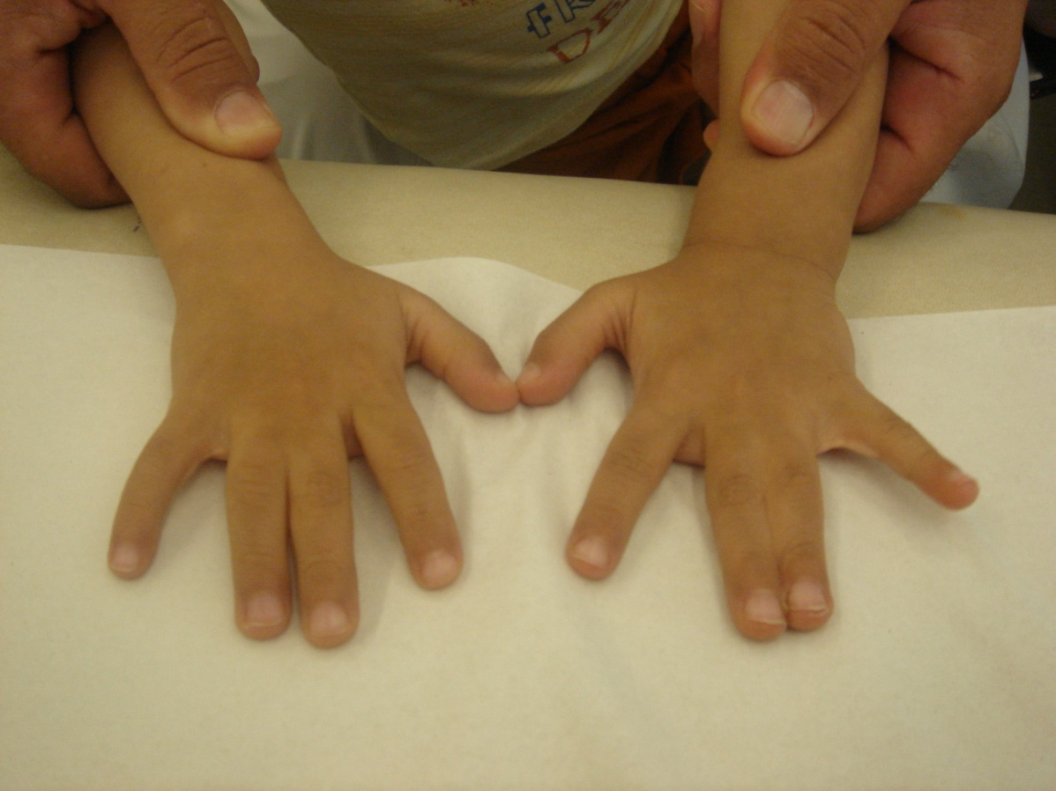

Slide 28
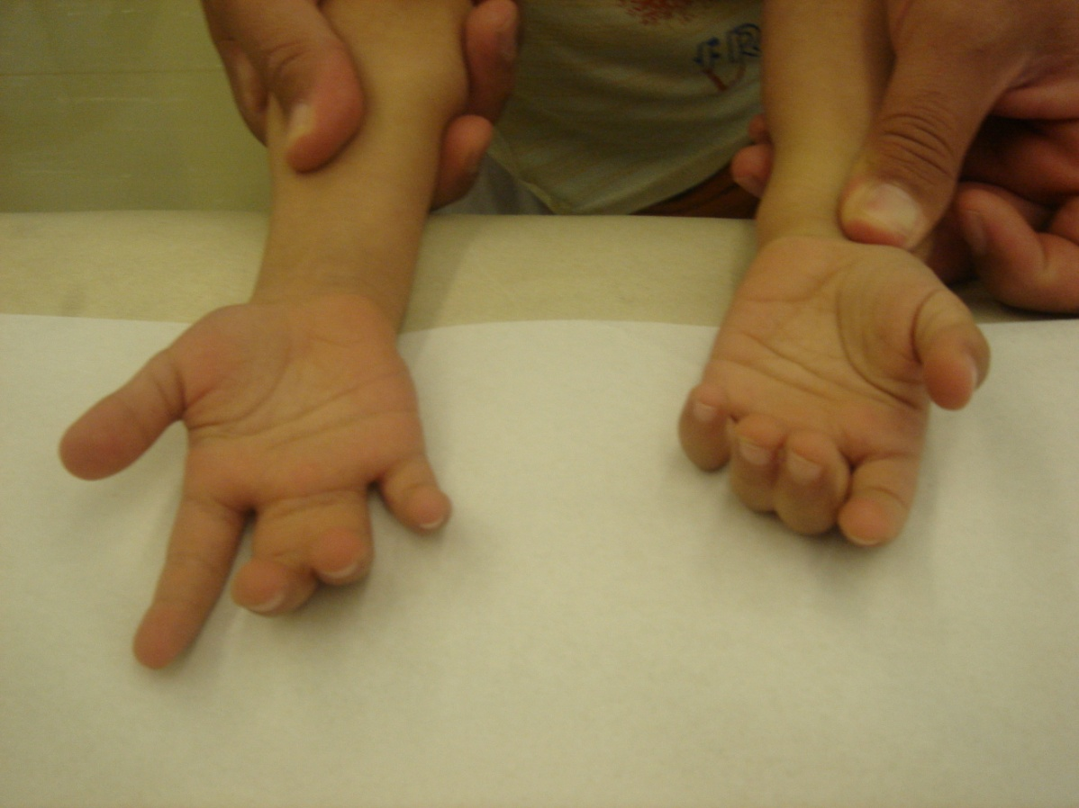

Slide 29
Congenital tumorous condition
Vascular e.g. heamongiomas portwine stain
Neurological e.g. neurofibromas
Connective tissues e.g. juvenile aponeurotic fibroma
Skeletal e.g. osteochondromes

Slide 30
DUPLICATION
Whole limb
Humerus
Radus
Ulna
Digit

Slide 31
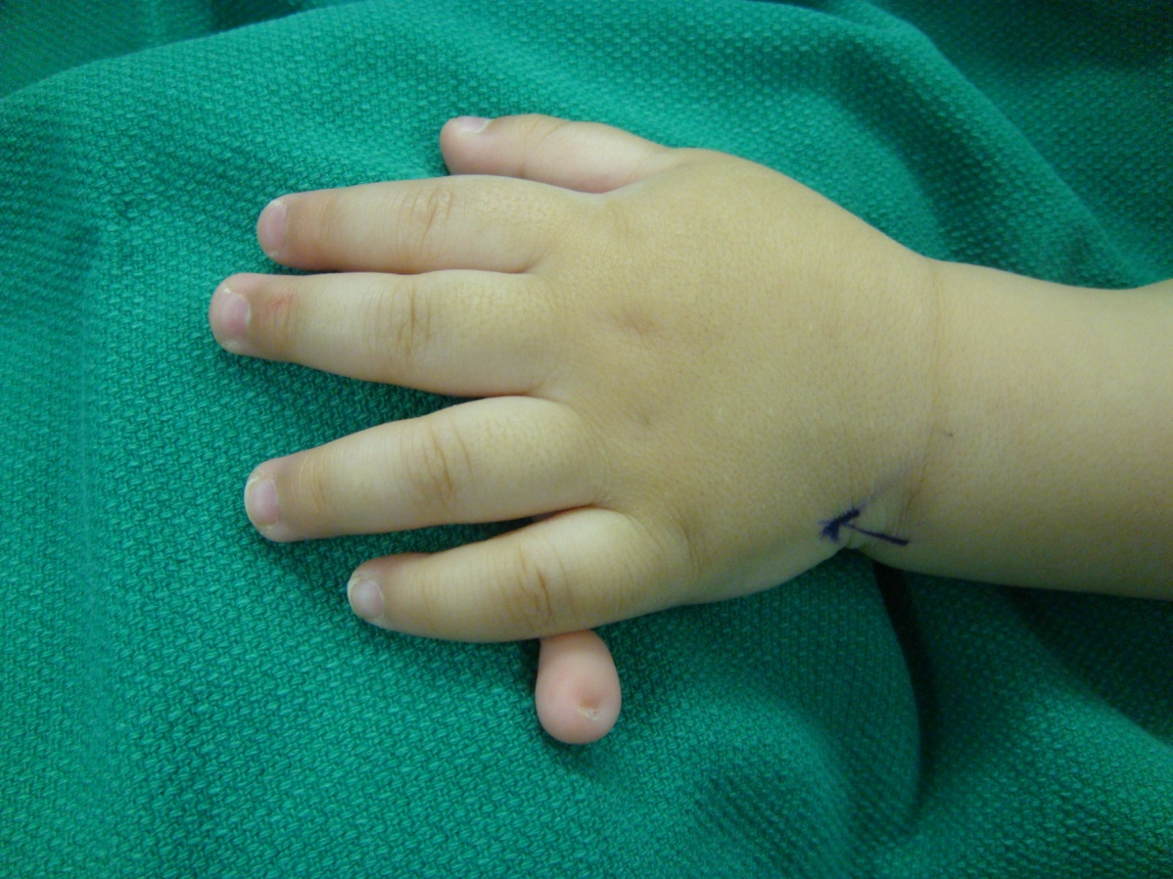

Slide 32
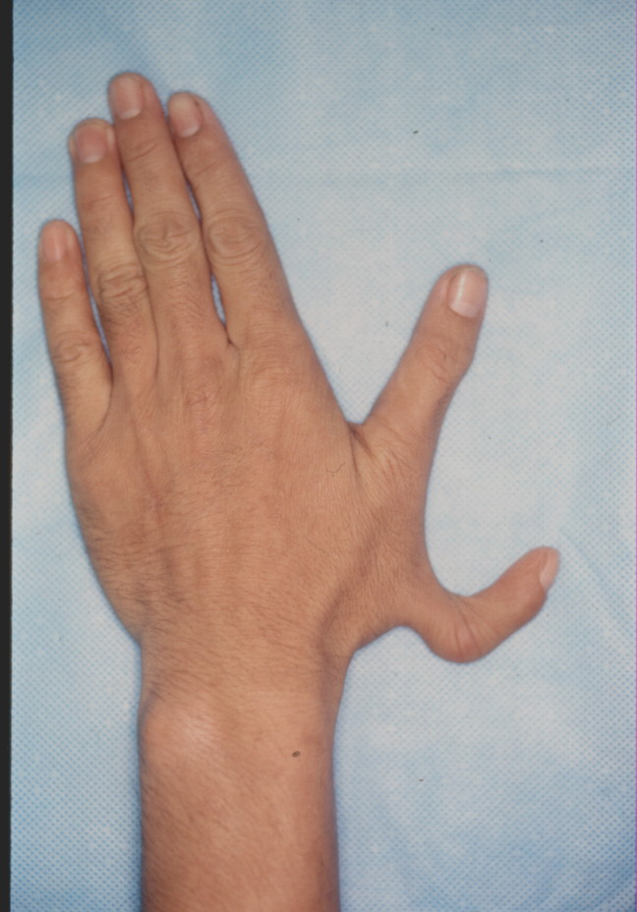

Slide 33
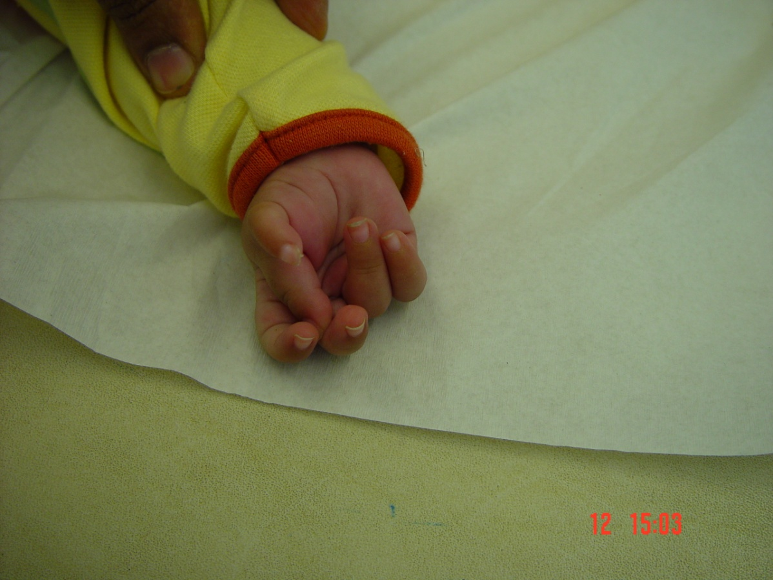

Slide 34
OVERGROWTH
Whole limb e.g. hemi hypertrophy
Partial limb e.g. associated vascular malformation
Digit macrodactyly

Slide 36
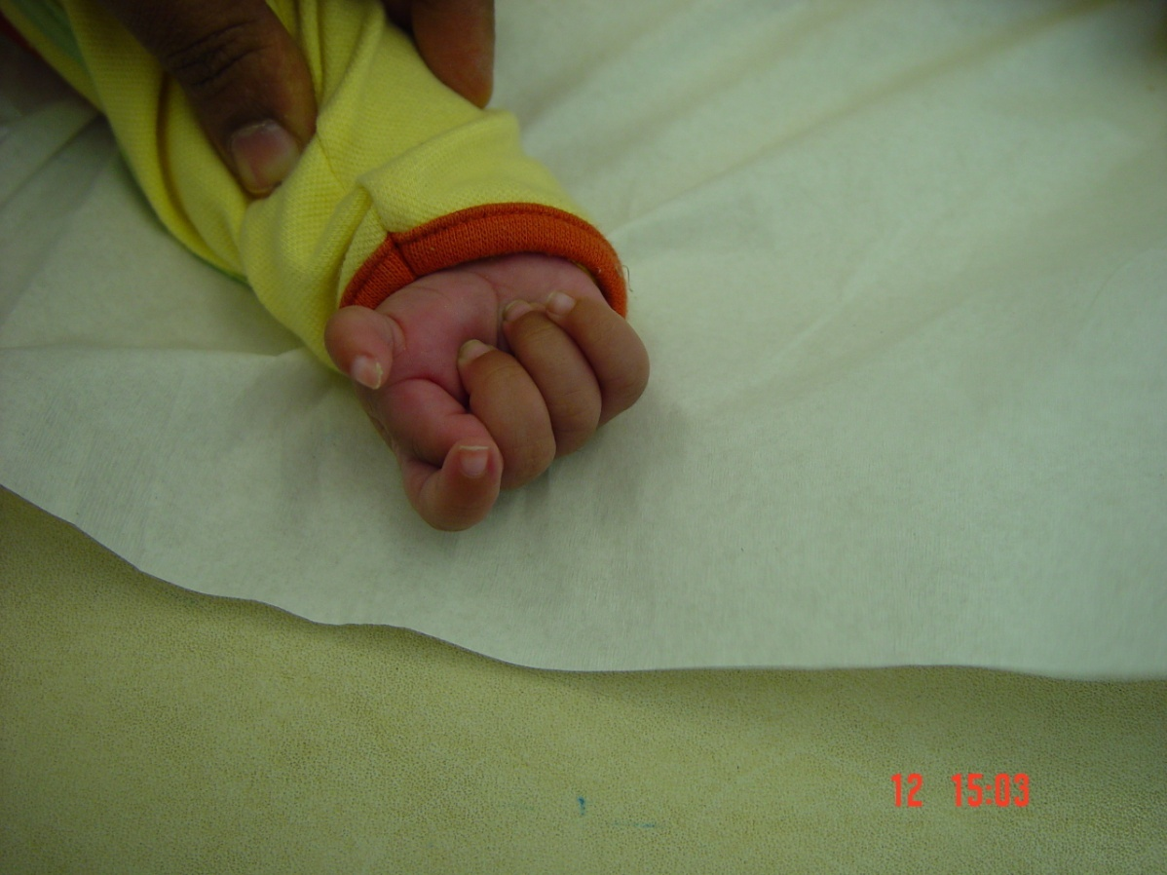

Slide 37
UNDERGROWTH
Whole limb
Forearm & Hand
Hand alone
Digit

Slide 39
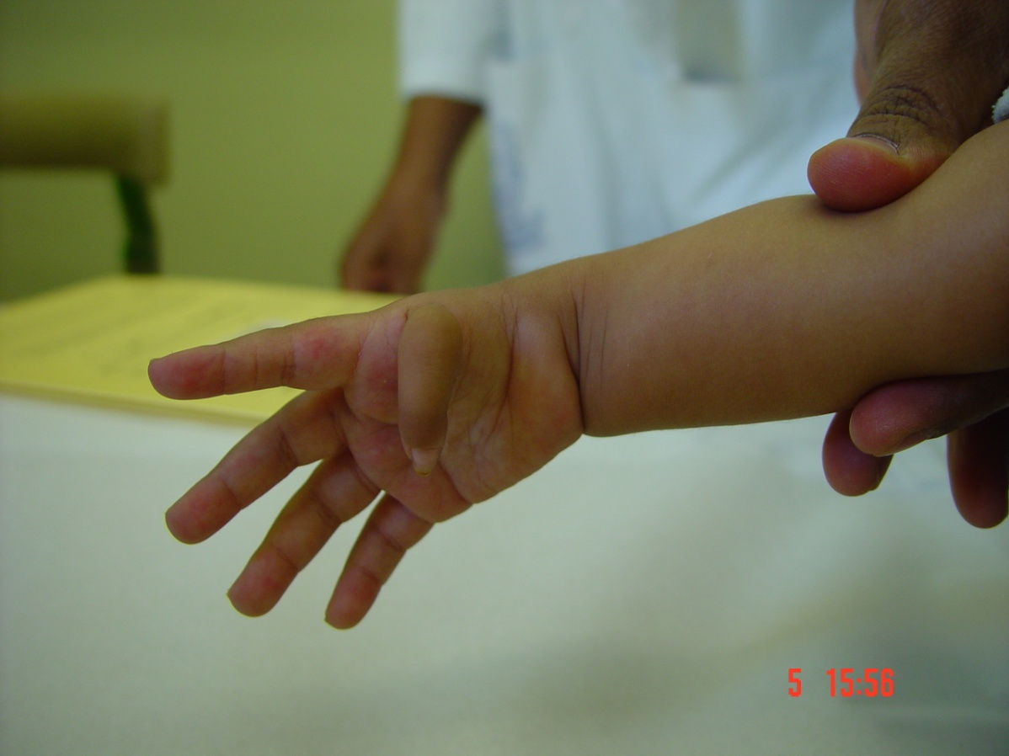

Slide 40
CONSTRICTION RING SYNDROME
Focal necrosis e.g. constriction band syndrome
Amputation intra uterine

Slide 42
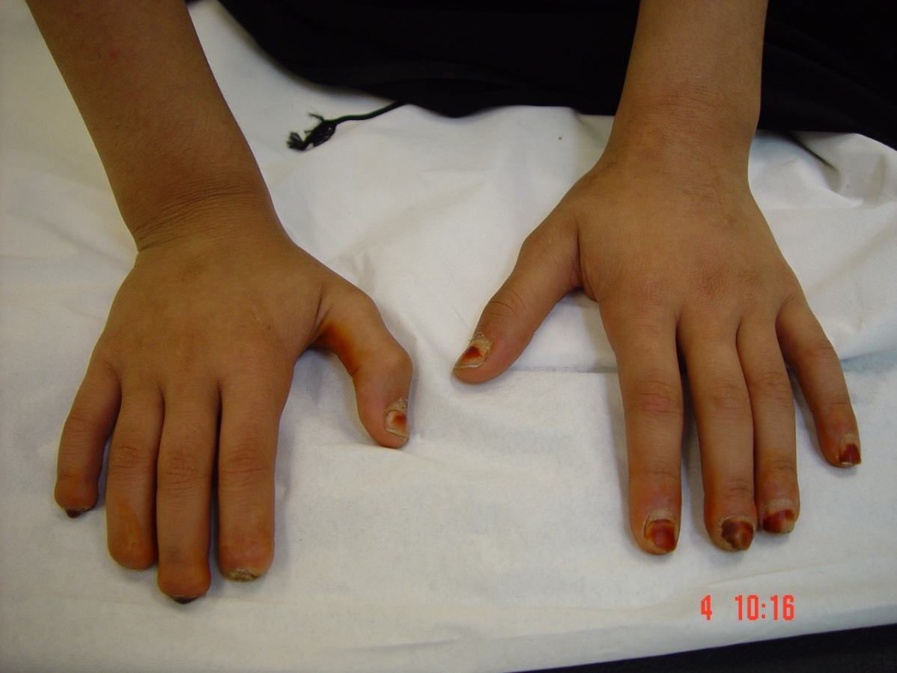

Slide 43
GENERALIZED ABNORMALITIES AND SYNDROMES

Slide 44
THANK YOU FOR YOUR ATTENTION

