Slide 1
Introduction to Abdominal Emergencies in Pediatric
بسم الله الرحمن الرحيم

Slide 2
Presentations History
Ages
Children < 3 years → difficult to Dx
Atypical Presentation
Don’t complain of pain (cry, irritable, poor feeding)
Late → septic (lethargic, Non-responsive, vomiting)
Children > 3
Similar to adult Symptom &Signs
Girls 12-16
DDX ovarian pathology (rupture cyst, torsion)
U/S is helpful

Slide 3
Appendicitis
Most common cause of abdominal surgical emergencies in children
> 3 years, diagnosis is mainly clinical
Hx, P/E and CBC+diff
< 3 years esp. Infant, difficult Dx
Early rupture = (elderly group)
Sepsis (fever, ↑ WBC)
Vomiting (ileus or abscess)

Slide 4
Investigation
Not needed if the clinical picture is clear
Mainly used in difficult Dx
Age < 3 years
Atypical symptoms
Girls > 12 years → R/O ovarian causes
Abdominal XR
R/O perforation
Might show
Fecolith
Localised Ileus

Slide 5
Investigation
U/S
Available
No sedation needed
No radiation
Children have thin abdominal wall → can see better
U/S is operator dependent (need a good radiologist)
Good for
Ovarian cysts
Intussusception
Free fluid
Stones
Not very good for
Appendicitis
Meckle’s diverticulitis
Volvulus

Slide 6
Investigation
CT scan
Problems:
Radiation → future risk of malignancies
Young children need sedation (Not to move)
Need IV contrast
Allergies
Renal failure
Good for
Abscess (late appendicitis)
Tumors
Sometime it is used to Dx Appendicitis

Slide 7
Investigation
If H&P is doesn’t suggest AP
Low probability → observation + re-evaluation
Observation NPO, No analgesia, repeat (Exam + CBC)
If AP → it will become clear (worse inflammation)
Higher probability
Laparoscopy or open appendicectomy
5-10% can be normal
When normal
Look for other ddx
Do appendicectomy (even if it’s normal)

Slide 8
Appendicitis
Late presentation (ruptured)
Contained → abscess
Percutaneous drain + antibiotics
> 6 wks if no abscess → appendicectomy
Diffuse peritonitis
Laparotomy or laparoscopy
Abdominal washout
Appendicectomy

Slide 9
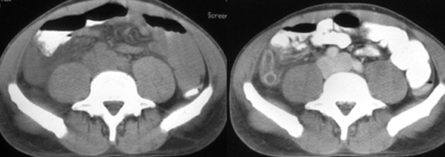

Slide 10
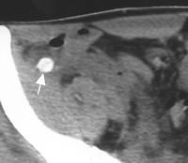

Slide 11
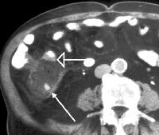

Slide 12
Intussusception
Telescoping of bowel
Proximal (inside) distal
Caused usually by:
Hypertrophied Peyer Patches (submucosal lymphoid tissue) due to viral infection
PLP (Pathological Lead Point)
Meckle's diverticulum
Tumors eg. Intestinal lymphoma
CF
Most common site (ileo-cecal)

Slide 13
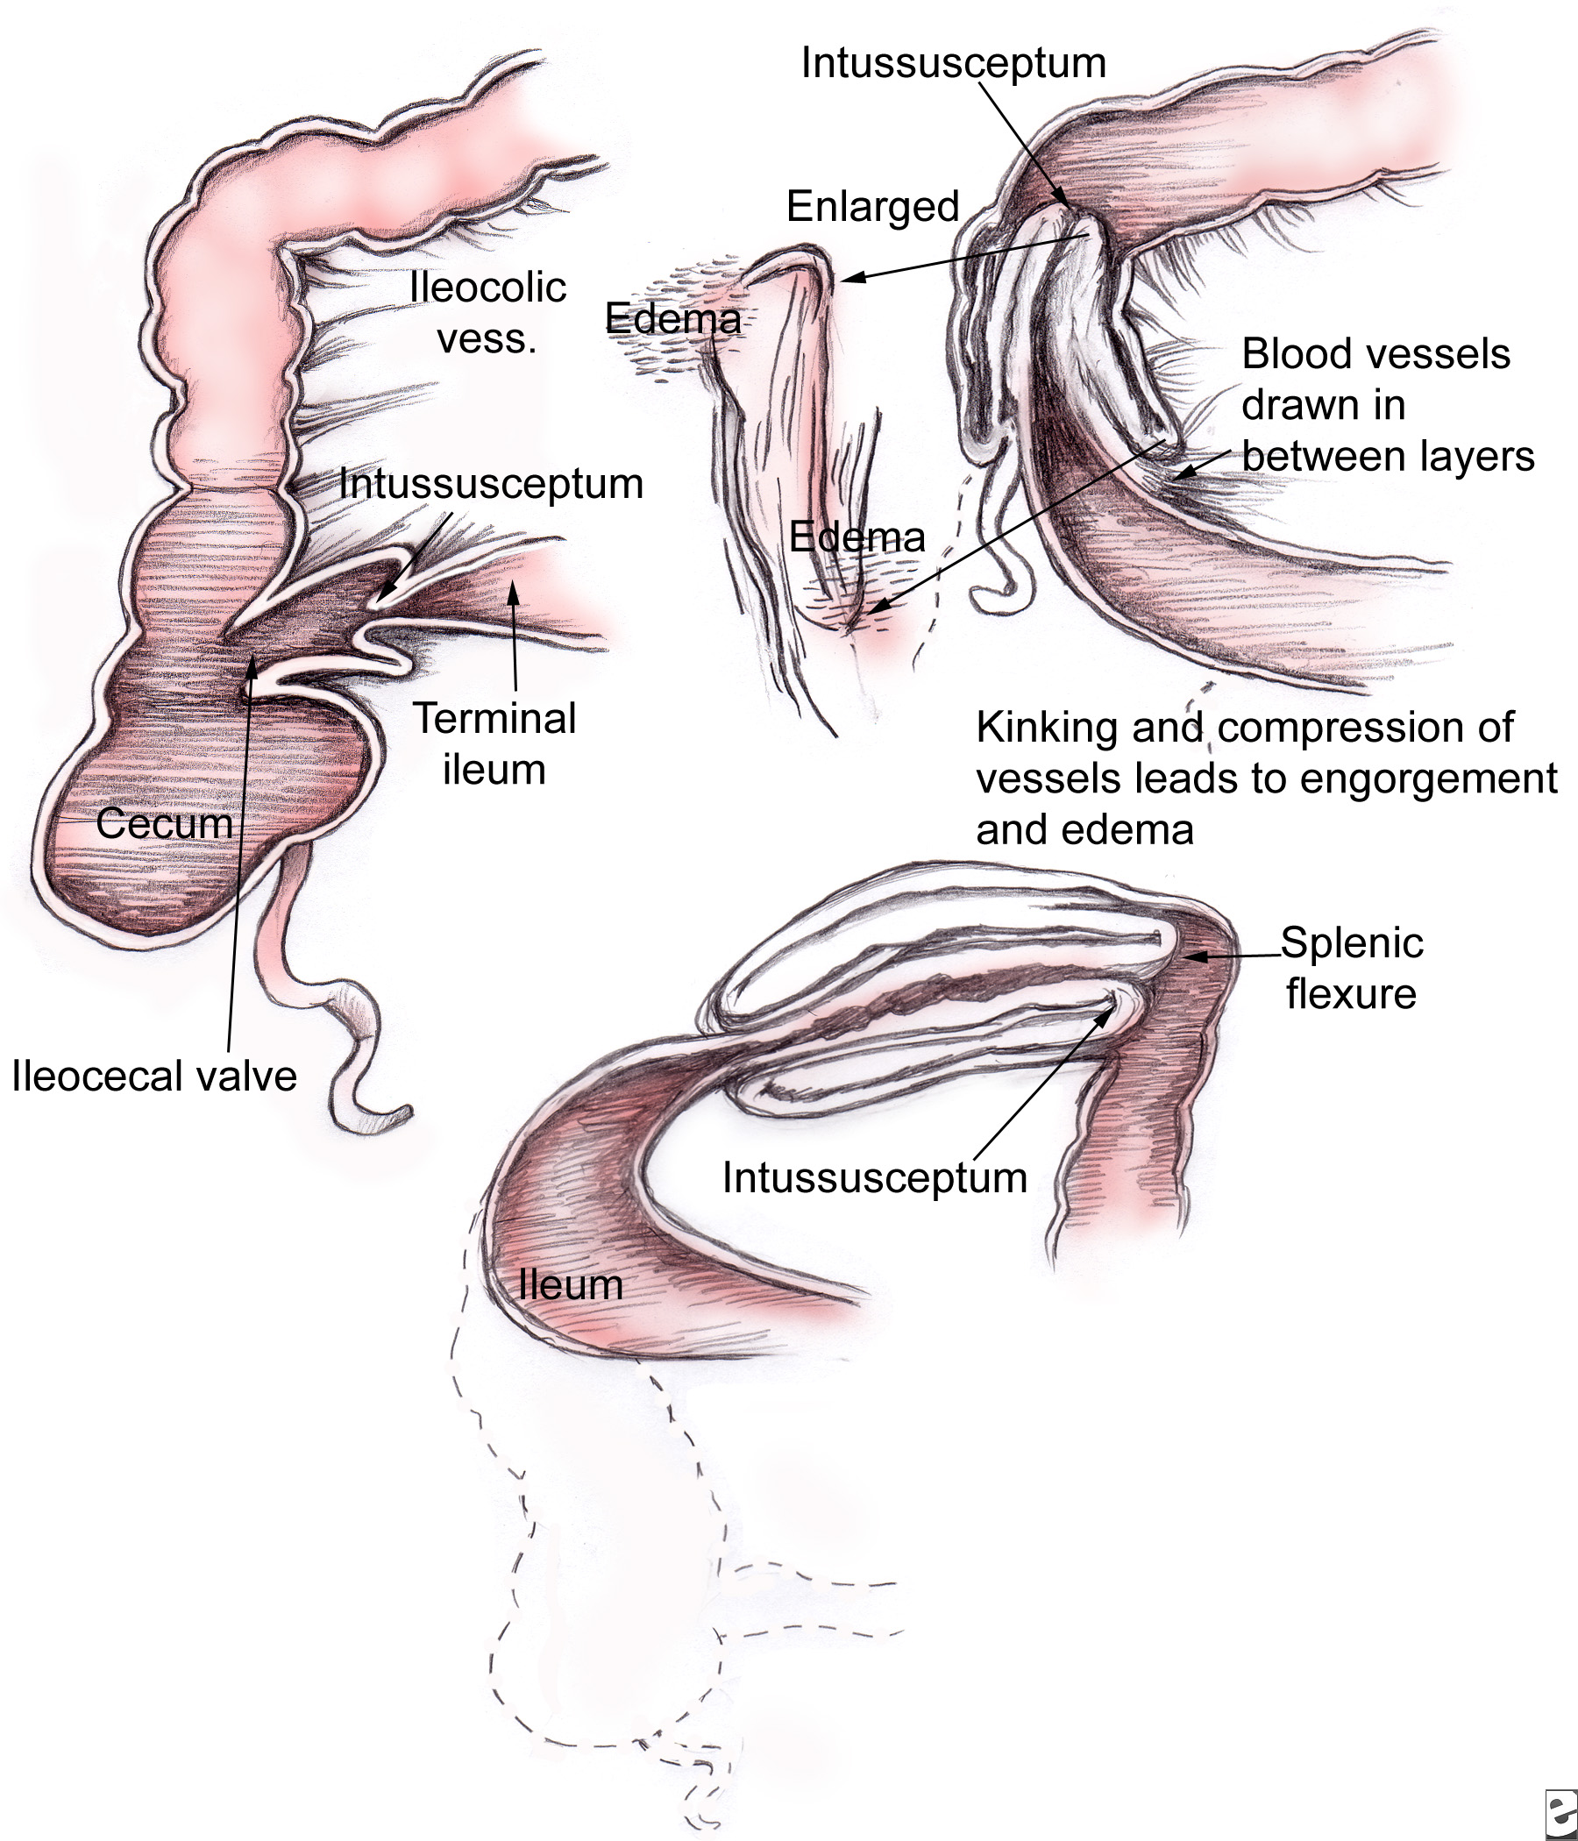

Slide 14
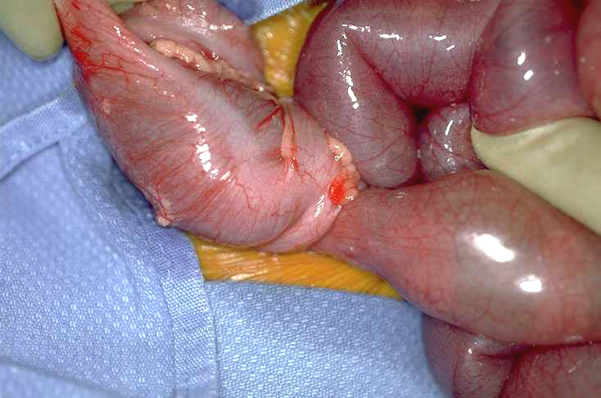

Slide 15
Intussusception
Age 6-18 months
If present later in age → likely to find PLP
Presentation
Hx of URTI
Colicky (on&off) abdominal pain
Infant is calm between attacks
Current Jelly stool (blood PR)
+/- Vomiting (intestinal obstruction is late)

Slide 16
Intussusception
Dx
Best by U/S
Target sign, Donut sign.
95% accurate
Contrast Enema
Dx and treatment
Rx
Pressure reduction
Barium
Water
Air is most common (less complications)

Slide 17
Intussusception
Failed pressure reduction
Only few patients (15%)
Next is surgical reduction → if can’t → resection
Likely PLP

Slide 18
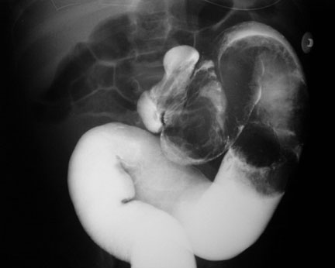

Slide 19
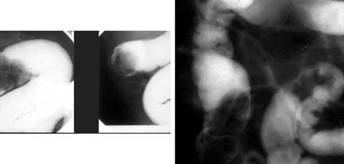

Slide 20
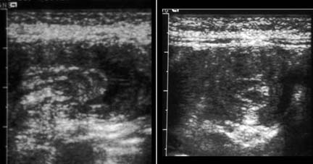

Slide 21
Volvulus
75% First month of life, 90% first year
Malrotation is the risk for volvulus
Small and large bowel are not fixed
Narrow mesentery
→ more likely to turn around itself
Malrotation can cause or present with:
Volvulus is dangerous
Acute obstruction
Chronic intermittent obstruction

Slide 22
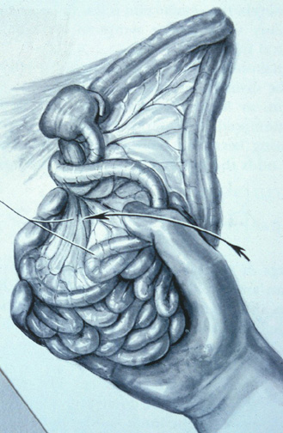

Slide 23
Volvulus is lethal
Malrotation → midgut volvulus → midgut intestinal death → surgery (resected) → short-gut syndrome → death
C/F
Most in infant (1st year of life)
Bilious vomiting
+/- pain
if +pain (irritable) → likely volvulus +ischemia
- pain (calm) → malrotation+obstruction

Slide 24
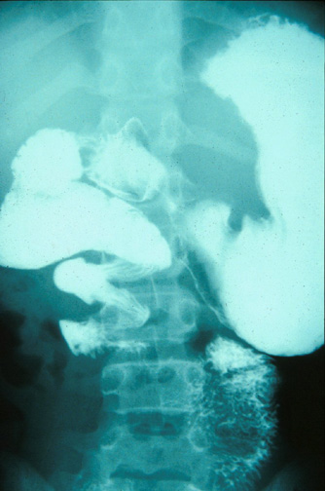

Slide 25
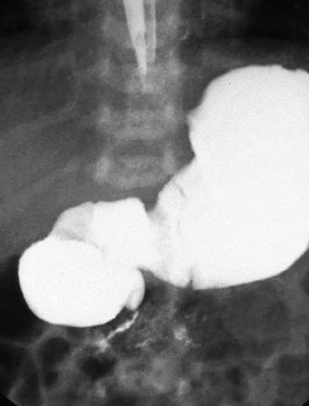
Malrotation, obstruction

Slide 26
midgut volvulus
Infant + Bilious vomiting is EMERGENCY
Investigate (if infant is not sick)
Upper GI series (look for malrotation)
No duodenal C-loop
Duodeno-jejunal junction (ligament of Treitz) to the right of Vertebral col.
Duodenal obstruction
Whirlpool or corkscrew sign (volvulus)
U/S
Can’t R/O volvulus
Can Dx volvulus → Inversion of mesenteric vessels

Slide 27
midgut volvulus
Pt should go directly for surgery if:
If can’t do investigation immediately
Pt is sick + bilious vomiting
Time = $ = bowel
Surgery:
Untwist (counter clock wise) → assess viability
If extensive ischemia → close 2nd look 24-48 hrs
Viable SB → close and observe
Ladd’s procedure
Cut Ladd’s band
Broaden midgut mesentery
Place SB→ Rt and Colon→ LT
Appendicectomy

Slide 28
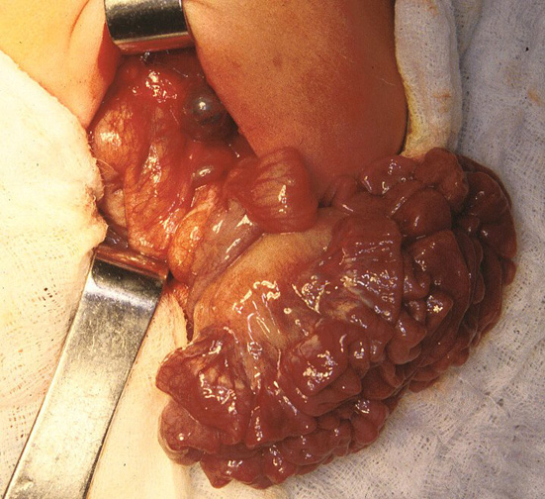

Slide 29
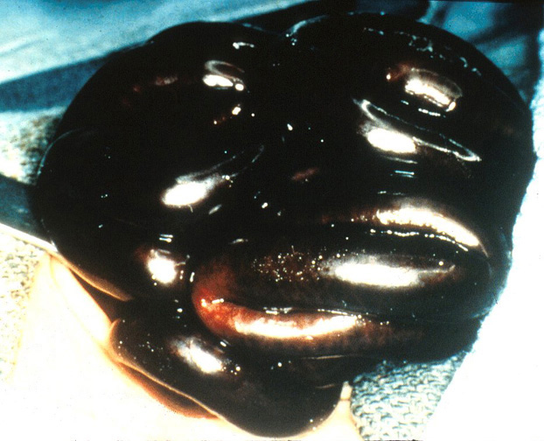

Slide 30
Meckel's Diverticulum
2 roles………….?
Remnant of …………….?
Present as:
Lower GI bleeding
ulcer from ectopic gastric mucosa
Can cause sever bleeding
Diverticulitis
like appendicitis (non-shifting pain)
Intussusception (PLP)
Obstruction
Fibrous band remnant
Hernia called ………………..?

Slide 31
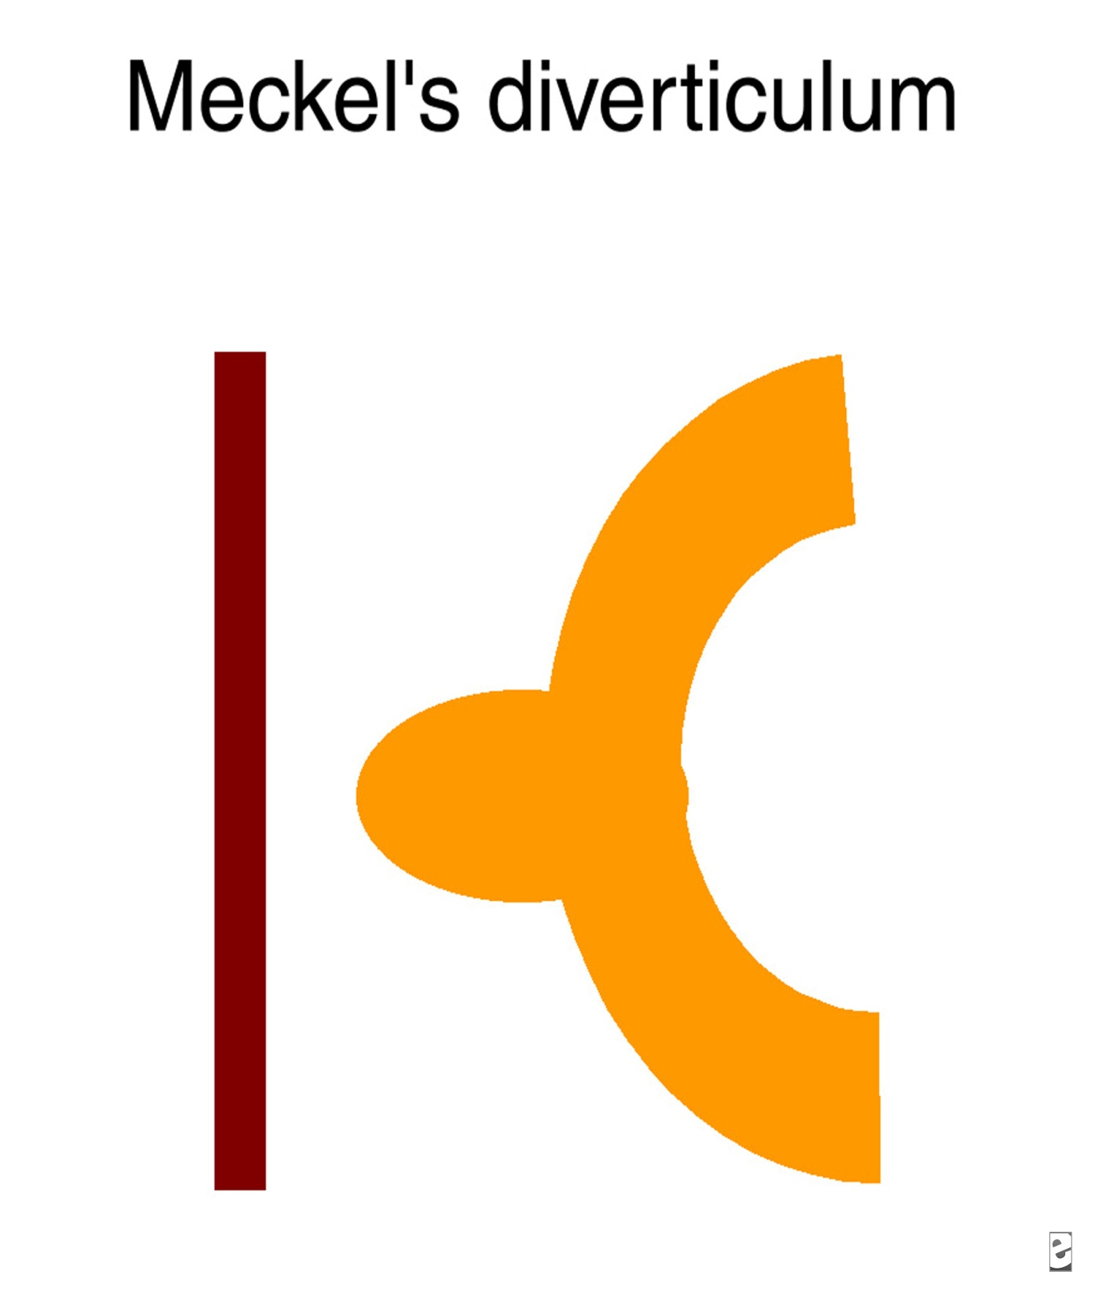

Slide 32
Meckel's Diverticulum
Investigation
Bleeding GI
Meckle’s Scan Tc99
Uptake by gastric mucosa in Meckle’s
Laparoscopy or laparotomy
Diverticulum
= AP → during OR for AP → AP is normal → look for Meckle's → if found → remove

Slide 33
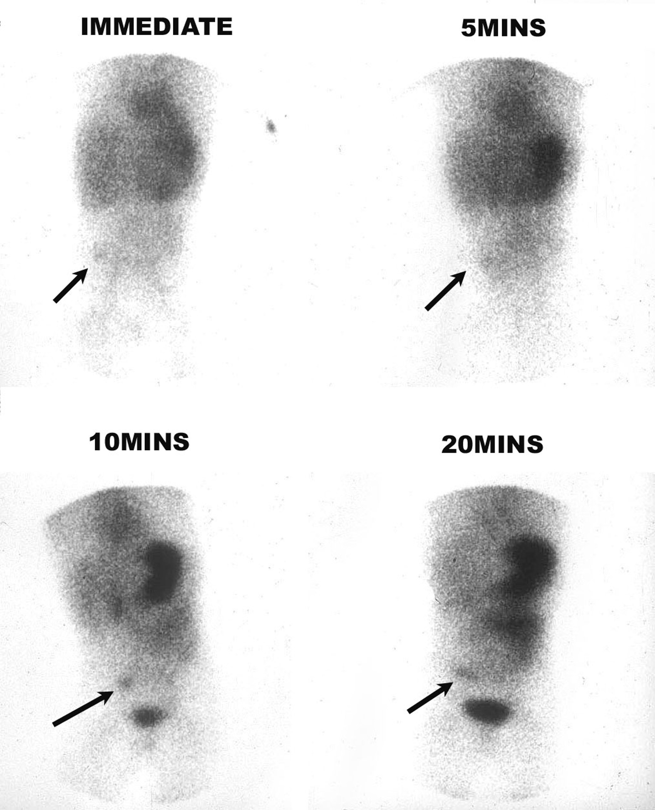

Slide 34
Ovarian torsion
Adolescent girls
Acute sever abdominal pain Lt or Rt
U/S confirm Dx
Or
Laparoscopy or laparotomy
De-rotate
Assess viability
If necrotic remove
Dark → leave it
Fix both sides

Slide 35
Other DDX of abdominal pain
Pleas read your book
Thank you

