Slide 1
Adrenals

Slide 2
Objectives:
History.
Embryology.
Anatomy.
Physiology.
Imaging.
Surgical Diseases:
  Incidentaloma
  Conn’s Syndrome.
  Pheochromocytoma/ Paraganglioma.
  Cushing disease VS Cushing Syndrome.
  Adrenocortical carcinoma.
Operative approaches.

Slide 3
History
1563 anatomy
1855 Addison described clinical features of the syndrome named after him.
1912 Cushing described hypercortisolism.
1934 the role of adrenal tumors in hypercortisolism understood.
1955 pheochromocytoma was first described by frankel.

Slide 4
Embryology
Paired gland
Cortex (coelomic epithelium).
  Zona glomerulus➔ Mineralocorticoid
  Zona fasciculate➔Glucocorticoid
  Zona reticularis.(3rd year)➔Sex hormones
Medulla( ectoderm) neural crest.
  Ectopic tissue.

Slide 5
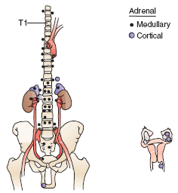
Ectopic Tissues

Slide 6
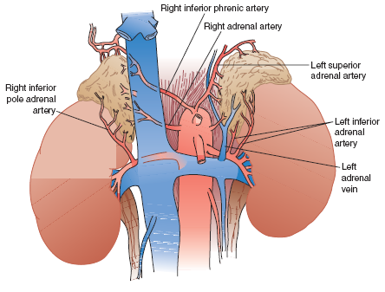
Anatomy

Slide 7
Physiology:
Adrenal cortex
  Aldosterone
  Cortisol
  Sex steroids
Adrenal medulla:
  Noradrenaline (20%).
  Adrenaline (80%).

Slide 8
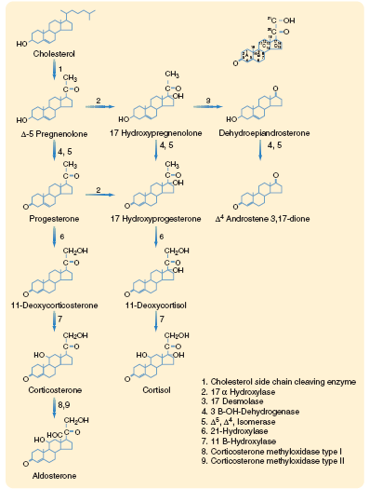
Hormonal Pathway

Slide 9
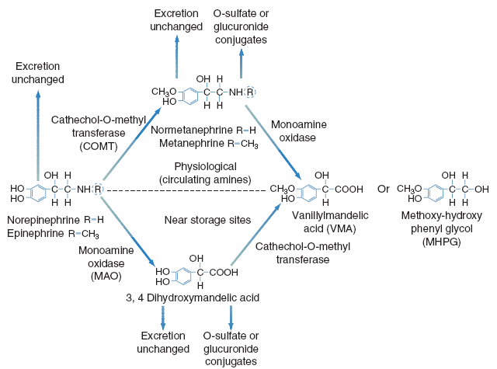
Cont:

Slide 10
Adrenal Imaging:
CT scan:
  Benign
    Intensity similar to liver
    Low attenuation
    Homogeneous
    Smooth border
    Smooth contour
    < 4 cm in greatest dimension

Slide 11
Cont CT scan
Malignant lesions:
  High attenuation (>30 HU).
  Heterogeneous.
  Irregular borders.
  Local/ vascular invasion.
  Lymphadenopathy.
  Metastases.
  Large size (>6cm).

Slide 12
Radiology:
MRI.
Nuclear scan.
PET scan.

Slide 13
Incidentaloma
Found in 1-4 % of CT scans.
Increases with age.
Small nonfunctioning adrenal tumors.
some with subclinical secretions of hormones.
Adrenocortical carcinoma.
Metastases.

Slide 14
Incidentaloma:
Nonfunctioning adenoma 82%
Subclinical Cushing 5%
Pheochromocytoma 5%
Adrenocortical ca 5%
Metastatic carcinoma 2%
Conn’s 1%

Slide 15
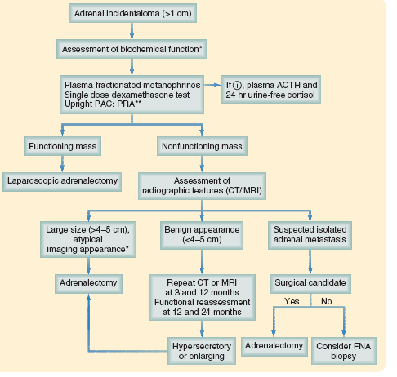
Clinical Pathway

Slide 16
Clinical presentation
Biochemical Dx
positive
equivocal
Suppression tests
negative
Seek other causes of HTN
positive
negative
CT scan
Unilateral adenoma
Bilateral normal
Bilateral nodules
Unilateral nodule <1 cm or >2 cm
Selective venous sampling
unilateral
Laparoscopic adrenalectomy
bilateral
Medical ttt
normal

Slide 17
Diseases of The Adrenals
1- hyperaldosteronism
  Causes:
    Primary
      Adenoma.
      Idiopathic bilateral adrenal hyperplasia.
      Unilateral adrenal hyperplasia.
      Adrenocortical carcinoma.
      Familial
    Secondary
      Renal artery stenosis.
      CHF.
      Liver cirrhosis.
      Pregnancy.

Slide 18
Primary hyperaldosteronism:
Age 30-50 years
Female> male, 2:1
Prevalence 5-13%
HPT with or without hypokalemia.
Weakness, polyuria, paresthesis, tetany, cramps.
Metabolic alkalosis, relative hypernatremia.
Elevated aldosterone secretion and suppressed plasma renin activity.

Slide 19
Cont:
Screening tests:
  PAC (ng/dl) / PRA (ng /ml)>20.
  Plasma aldosterone >15 ng/dl.
Confirmatory tests:
  Sodium suppression test
    Urinary aldosterone excretion >14 ug/ 24hr.

Slide 20
Treatment:
Pre-operative preparation:
  Spironolactone:
  Competitive aldosterone antagonist
    Promote K retention.
    Reduce extracellular volume .
    Reactivate the renin-angio-aldosterone syst.
  Amiloride:
  K sparing diuretics

Slide 21
Cont.
Surgery:
  Laparoscopic adrenalectomy.
  Open surgery.
Medical treatment:
  Unfit patients.
  Bilateral ald.

Slide 22
Prognosis:
1/3 persistent hypertension.
K level will be restored.

Slide 23
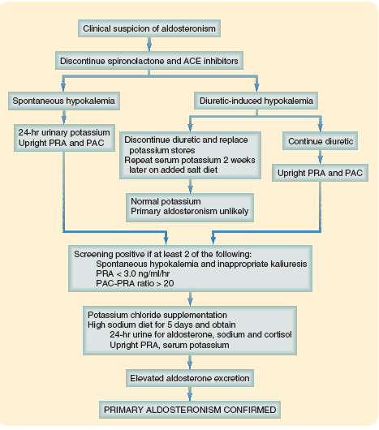
Clinical Pathway

Slide 24
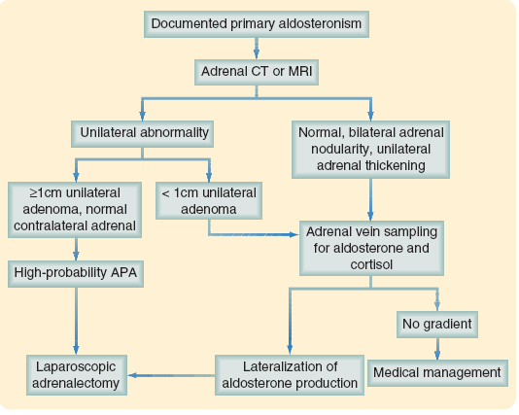

Slide 25
Pheochromocytoma:
EPIDEMIOLOGY:
Less than < 0.1% of patients with hypertension
5% of tumors discovered incidentally on CT scan
Most occur sporadically
•Associated with familial syndromes, such as:
_Multiple endocrine neoplasia type 2A (MEN 2A)
–MEN 2B

Slide 26
Cont.
–Recklinghausen disease
–von Hippel-Lindau disease
Pheochromocytomas are present in 40% of patients with MEN 2
90% of patients with pheochromocytoma are hypertensive
• Hypertension less common in children
• In children, 50% of patients have multiple or extra-adrenal tumors

Slide 27
Symptoms and signs:
Clinical findings are variable
Episodic or sustained hypertension
Triad of palpitation, headache, and diaphoresis
Anxiety, tremors and Weight loss.
Dizziness, nausea, and vomiting
Abdominal discomfort, constipation, diarrhea.

Slide 28
Cont:
• Visual blurring
• Tachycardia, postural hypotension
• Hypertensive retinopathy

Slide 29
Cont:
ESSENTIAL FEATURES
Episodic headache, excessive sweating, palpitations, and visual blurring
Hypertension, frequently sustained, with or without paroxysms
Postural tachycardia and hypotension
• Elevated urinary catecholamines or their metabolites, hyper metabolism, hyperglycemia

Slide 30
Cont.
• Rule of 10s:
– 10% malignant
–10% familial
–10% bilateral
–10% multiple tumors
–10% extra-adrenal

Slide 31
Cont.
Extra-adrenal pheochromocytomas:
–Abdomen (75%)
–Bladder (10%)
–Chest (10%)
–Pelvis (2%)
–Head and neck (3%)

Slide 32
LABORATORY FINDINGS
Hyperglycemia
Elevated plasma metanephrines
Elevated 24-hour urine metanephrines and free catecholamines
Elevated urinary vanillylmandelic acid (VMA)
Elevated plasma catecholamines

Slide 33
IMAGING FINDINGS
Adrenal mass seen on CT or MRI
Characteristic bright appearance on T2-weighted MRI
Asymmetric uptake on MIBG scan. Particularly useful for extra-adrenal, multiple, or malignant pheochromocytomas.
MIBG Not useful for sporadic biochemical syndrome with unilateral mass

Slide 34
DIAGNOSTIC CONSIDERATIONS:
Avoid arteriography or fine-needle aspiration as they can precipitate a hypertensive crisis
Early recognition during pregnancy is key because if left untreated, half of fetuses and nearly half of the mothers will die

Slide 35
RULE OUT:
Other causes of hypertension
Hyperthyroidism
Anxiety disorder
Carcinoid syndrome

Slide 36
WORK-UP:
History and physical exam
Suspect pheochromocytoma based on symptoms
CT, MRI, or other scans
Plasma and urine studies (metanephrines, catecholamines, VMA)
Begin treatment with a-blockers
Possible MIBG scan
• Operative excision of tumor

Slide 37
WHEN TO admit:
Hypertensive crisis (can develop multisystem organ failure, mimicking severe sepsis

Slide 38
TREATMENT AND MANAGEMENT:
a-Adrenergic blocking agents should be started as soon as the biochemical diagnosis is established to restore blood volume, to prevent a severe crisis, and to allow recovery from the cardiomyopathy
SURGERY:
Indications:
• All pheochromocytoma should be excised
Contraindications:
• Metastatic disease
• Inadequate medical preparation (a- blockade)

Slide 39
Cushing disease VS Syndrome
Cushing disease secondary to pituitary adenoma.
Cushing syndrome secondary to anything else.

Slide 40
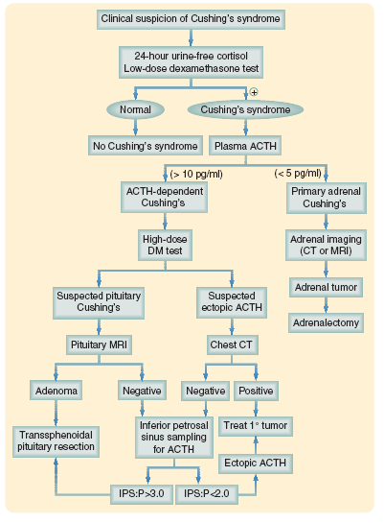
Clinical Pathway:

Slide 41
Adrenocortical carcinoma functioning VS non functioning:
ESSENTIAL FEATURES :
Variety of clinical symptoms through excess production of adrenal hormones
Complete surgical removal of the primary lesion and any respectable metastatic sites has been the mainstay of treatment

Slide 42
EPIDEMIOLOGY:
These tumors are rare; 1—2 cases per million persons in the United States
Less than 0.05% of newly diagnosed cancers per year
Bimodal occurrence, with tumors developing in children < 5 years of age and in adults in their fifth through seventh decade of life
• Male:female ratio is 2:1, with functional tumors being more common in women

Slide 43
Cont:
• Left adrenal involved slightly more often than the right (53% vs 47%); bilateral tumors are rare (2%)
• 50—60% of patients have symptoms related to hypersecretion of hormones (most commonly Cushing syndrome and virilization)
• Feminizing and purely aldosterone-secreting carcinomas are rare
• 50% of patients have metastases at the time of diagnosis

Slide 44
SYMPTOMS AND SIGNS:
Symptoms of specific hormone excess (cortisol excess, virilization, feminization)
Palpable abdominal mass
Abdominal pain
Fatigue, weight loss, fever, hematuria

Slide 45
LABORATORY FINDINGS:
All laboratory abnormalities depend on hormonal status of tumor
Elevated urinary free cortisol or steroid precursors
Loss of normal circadian rhythm for serum cortisol
Low serum adrenocorticotropic hormone (ACTH)
Abnormal dexamethasone suppression test
Elevated serum testosterone, estradiol, or aldosterone levels

Slide 46
IMAGING FINDINGS:
Evaluation of adrenal glands with CT or MRI (adrenocortical carcinomas are typically isodense to liver on T1-weighted MRI, and hyperdense relative to liver on T2-weighted MRI images)
MRI more accurately gauges the extent of any intracaval tumor thrombus

Slide 47
DIAGNOSTIC CONSIDERATIONS:
Mean diameter of adrenal carcinoma at diagnosis is 12 cm
Radiographic evaluation of suspected metastatic sites for purposes of staging should be undertaken prior to thought of any surgery
RULE OUT
Pheochromocytoma

Slide 48
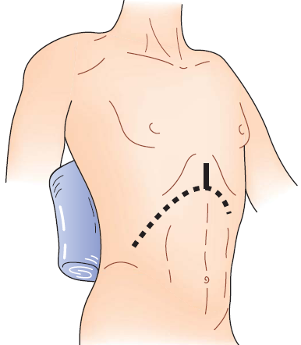
Operative approaches:

Slide 49
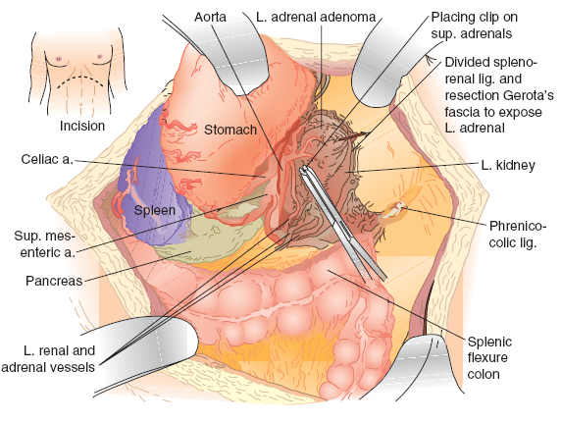

Slide 50
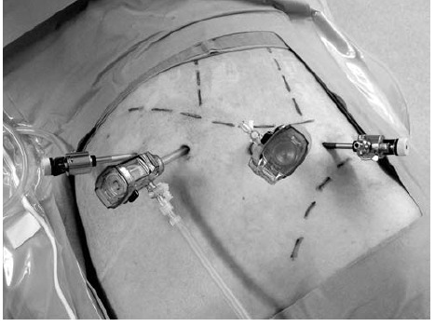
Lap left adrenalectomy:

Slide 51
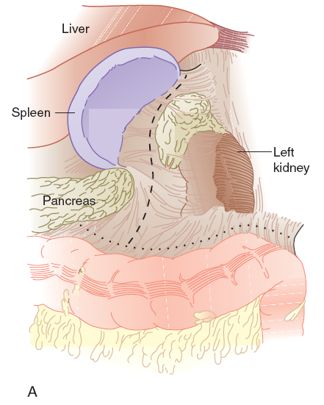

Slide 52
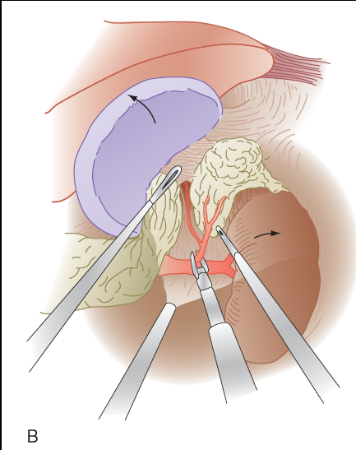

Slide 53
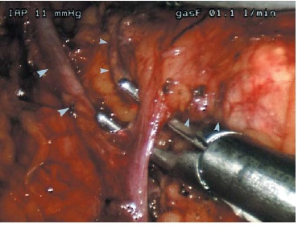

Slide 54
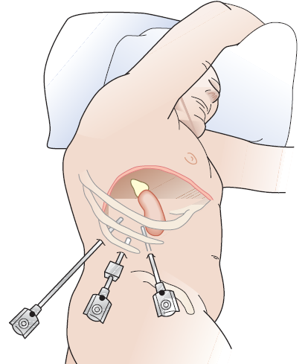
Lap right adrenalectomy:

Slide 55
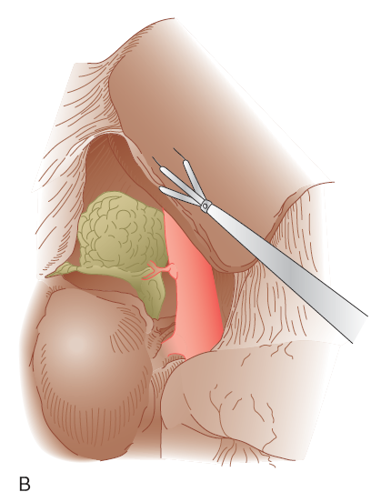

Slide 56
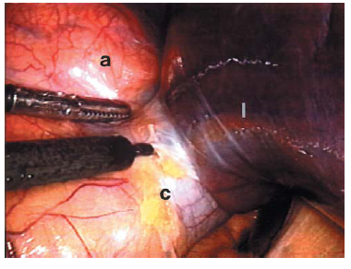

Slide 57
??
Adrenals

