Slide 1
Principles of Surgical Oncology
Done by : 428 surgery team

Slide 2
Types of Tumors
Benign
Malignant
    Carcinoma : arise from parenchymal tissue ( liver cells or renal cells ) e.g. Hepatocellular carcinoma
    Sarcoma : arise from mesenchymal tissue ( connective tissue ) e.g. liposarcoma

Slide 3
Teratoma :
1- is the presence of tissues which are “not usually present” in an organ
2- derived from more than one germ-cell layer
3- and they are arranged like a tumor
E.g. presence of hair and bone in an ovary ( dermoid cyst )
Hamartoma :
1- a collection of tissues which are “normally present” in an organ
2- arranged “haphazardly”,
3- and form a swelling ( tumor )
e.g. presence of hepatic cells + blood vessels + bile duct within the liver ( all these things form a disorganized mass ).

Slide 4
Important Differences
Benign
- you excise the tumor only not the whole organ
Encapsulated
No invasion
- can compress the surrounding tissues as they grow
No metastasis
Malignant
- you excise the tumor plus the whole organ
Non encapsulated
Usually invade
- “surrounding” tissues
Metastasis
- is the development of secondary implants discontinuous with the primary tumor in remote tissues.

Slide 5
Tumor Grading & Differentiation
Grading: Describes the histologic characteristics of cancer cells mainly talk about cell layers. Does not talk about metastasis or invasion.
e.g. grade I, II, III.
Differentiation: Describes the characteristics of cancer cells in reference to their resemblance to the cell of origin.
e.g. well differentiated
moderately differentiated
poorly differentiated
anaplastic.
Both describe the histological features of the tumor

Slide 6
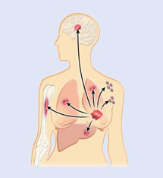
Spread of Malignant Tumor
Local invasion :
    within the organ
    adjacent organs
Metastasis :
    - the most common routes are lymphatic and haematogenous.
    Lymphatic : Regional & distant lymph nodes.
    Haematogenous e.g. liver, lung, bones.
    Transcoelomic e.g peritoneal & pleural cavity.
    Implantation e.g. needle tracks, wounds.

Slide 7
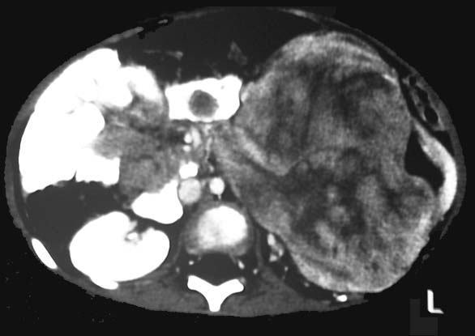
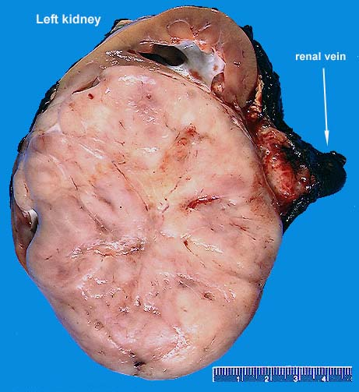
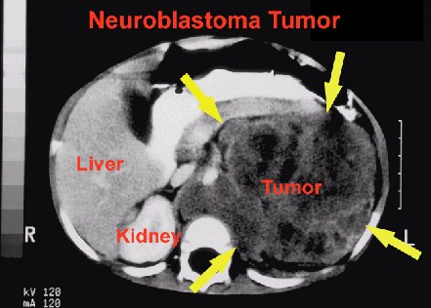
Local Invasion

Slide 8
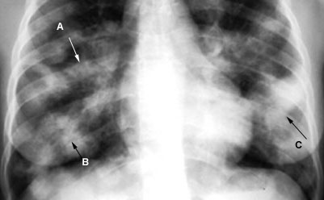
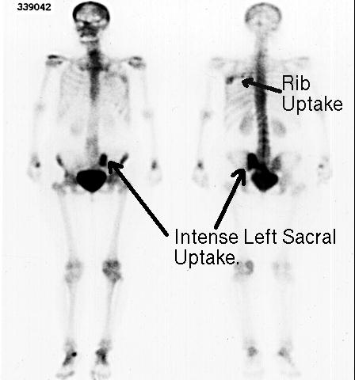
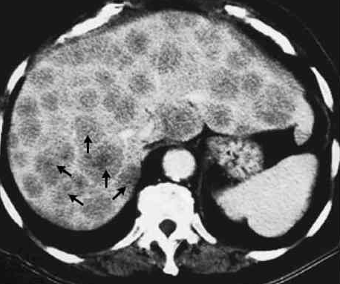
Distant Metastasis tumors have the potential to metastasize to any organ in the body but they usually go to the liver, lung, or bone because of the high blood supply to those organs

Slide 9
Tumor Staging
Staging
describes the primary tumor, the relation of the primary tumor with the organ of origin, with the adjacent organs and with the distant organs.
Types of Staging
TNM Classification : a new system which is specific and detailed
e.g. T1, No, Mo
T – Tumor : describes the primary tumor only T1,2,3…., Tis, Ta, Tb….
N – Node : N0, 1, 2, 3 ….
M – Metastasis : M0,1,2,3…
Classical staging : is not specific and less detailed
e.g. stage I, II, III, IV

Slide 10
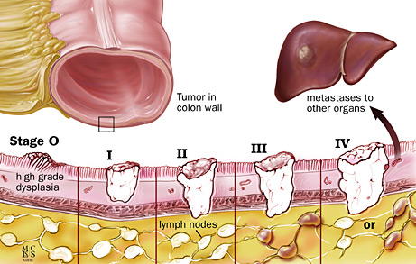
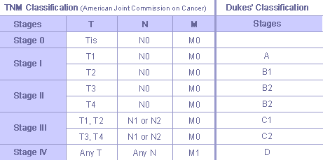
Tumor Staging

Slide 11
Why Do We Stage Malignant Tumors?
To decide the treatment
To plan the treatment
To assess the prognosis

Slide 12
A patient might present with symptoms related to the primary tumor only, secondary tumor only, or both. In some cases a patient may present with symptoms related to the secondary tumor only.
For example, a patient with renal cell carcinoma
* might present with hematuria and other symptoms related to the primary tumor only .
* or may present symptoms related only to a secondary implant in the lungs like hemoptysis ( no hematuria or any sign of renal cell carcinoma )
* or may present with symptoms of the primary and secondary tumors like hematuria and hemoptysis , respectfully,
So whenever you deal with malignant tumor, always remember that there is primary tumor & there may be secondaries.

Slide 13
Presentation of Malignant Tumors
Asymptomatic
Symptoms related to the primary
Symptoms related to the secondaries
Incidental finding
Weight loss and Cachaxia are late manifestations of most malignant tumors except GI and Lung cancer

Slide 14
Investigation of Malignant Tumors
Investigate for the primary
  Depends on the site
  Define the histology
  Define the local extension
Investigate for the secondaries
  Look for metastasis
  Usually liver, lung and bones
Both will define the diagnosis & stage

Slide 15
How we define the histology
Cytology : gives an idea about the morphology of individual cells.
  Exfoliative (urine,sputum,….)
  Fluid aspiration (ascitic fluid,pleural fluid, cyst)
  Fine needle aspiration (FNA) : is aspirating individual cells from solid tumors
Biopsy : gives an idea about the histological (tissue) characteristics
  Incisional biopsy (open, needle, forceps..)
  you only take a sample of the tumor and send it to pathology lab
  Excisional biopsy
  you remove the whole tumor and send it to pathology lab

Slide 16
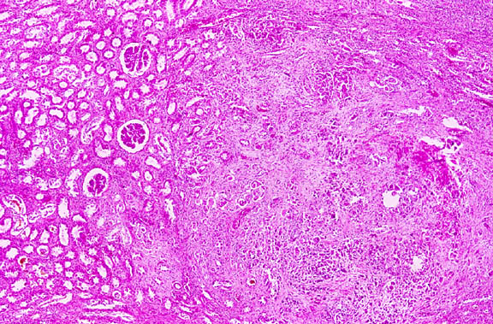
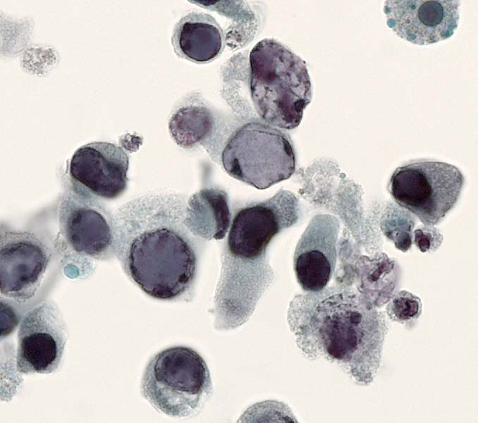
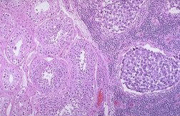
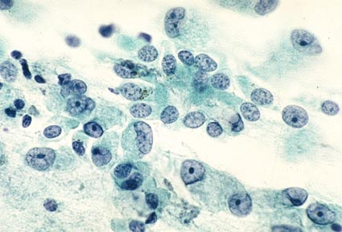
Cytology & Biopsy
One of the main differences between normal and malignant cells is the presence of mitotic figures.
If they are present, this means these cells are rapidly growing and developing

Slide 17
Tumor Markers
Substances which if present in the blood or tissue fluid may indicate malignancy.
The concept is very important
Most are non-specific
Important in diagnosis
Important in follow up
Important for screening
Examples: CEA, PSA, α -fetoprotein, HCG

Slide 18
Hormones & Cancer
Hormones related to tumor growth:
  Usually sex hormones (testosterone,estrogen)
  They may have a relation to tumor growth
  Hormone receptors
  The concept can be used in treatment
Hormones may be produced by tumors:
  Originally hormone producing organ : a hormone-secreting tumor may arise from an organ that originally secretes hormones e.g. a tumor in the adrenal glands
  Originally non hormone producing organ : in this case, a hormone-secreting tumor arises from an organ that originally doesn’t secretes hormones e.g. a tumor in the lung ( small cell carcinoma )

