Slide 1
CONGENITAL HAND ANOMALIES
By Dr.
Jamaleldin Hassanain
Done by : 428 surgery team

Slide 2
Hand function
is an important feature in humans over other primates who lack fine control and precision

Slide 3
EMBRYOLOGY
Limb development and differentiation is a rapid process occurring between 3-8 wk

Slide 4
EMBRYOLOGY OF THE UPPER LIMB
Limb buds first appear as small elevations on ventro lateral body end of fourth week.

Slide 5
Each limb bud :
Mesenchyme derived from somatic mesoderm which is covered by a layer of ectoderm

Slide 6
Distal end of bud form flipper like limbs. ( to form fingers )
Later bones develop and myoblast aggregate to develop muscle mass .

Slide 7
Upper limb rotates laterally 90 degrees
Specific dermatone ( which is skin area supplied by a single spinal nerve )

Slide 8
ANATOMY
Bony skeleton
Muscles and soft tissues
Vessels and nerves

Slide 9
Proximal row of carpal bone (radial to ulnar) scafoid , lunate , traquetral , pisiform
سلمى لازم تلعب بوكر
Distal row trapezium , trapazoid , capitate , hamate

Slide 10
BONES OF THE HAND
5 Metacarpals
Thumb is no. 1
Little finger is no. 5

Slide 11
BONY SKELETON
Wrist joint composed of multiple carpal bone articulating with the radius proximally and five metacarpals distally
Wrist is radio-carbal joint
Ulnar is not playing role

Slide 12
PHALANGES
All fingers have 3 phalanges proximal middle distal
Except thumb has 2 proximal distal

Slide 13
Role of fingers percentage
Thumb alone 10% ( function is go up & down )
Thumb + other finger :
50 (thumb) + 20 (any other finger) +10+10+10

Slide 14
Embryological failure are related to malformations
Causes
Teratogen (any agent that cause birth defect)
Chromosomal abnormality (sex link ,single or multible gene)
Viruses
Toxic agent
Vascular events (haemangioma , lymphangioma)
Trauma (tight band)

Slide 15
Most anomalies occur between 25th –50th day. Coz it’s the time for limbs formation
Any anomalies occurring after 7th week occur as a result of extrinsic compression upon uterine wall eg.
ischemic events.
mechanical influences (amniotic constriction band syndrome ).

Slide 16
INCIDENCE
1 : 4000 Live births (Birch – Jensen 1944)
1 : 625 live births (Conway & Bowe 1956) due to better awareness

Slide 17
Congenital : something present at birth
Malformation : gross structural anomalies

Slide 18
Types of congenital anomalies
SYNDROMIC : Combination of anomalies ( 3- 4 )
Single gene
Multiple genes
Sex linked

Slide 19
MALFORMATION SEQUENCE
Poor formation of tissue within the fetus e.g.. Radial dysplasia
Dysplasia: one tissue changed from one form to another

Slide 20
DEFORMATION SEQUENCE
There is no intrinsic problem with fetus but abnormal external mechanical or structural forces e.g.. Leaking of amniotic fluid
Bicornate uterus e.g.. Amniotic constriction band syndrome
Deformation is not a genetic problem

Slide 21
CLASSIFICATION

Slide 22
FAILURE OF FORMATION
( A) Transverse arrest i -shoulder e.g. amelia the whole limb is absent
ii –upper arm -long above elbow -short above elbow iii – elbow Iv – forearm -long below elbow -short below elbow v- wrist (acheira ) no wrist
vi –metacarpal (adactyly) no finger vii -phalanges

Slide 23
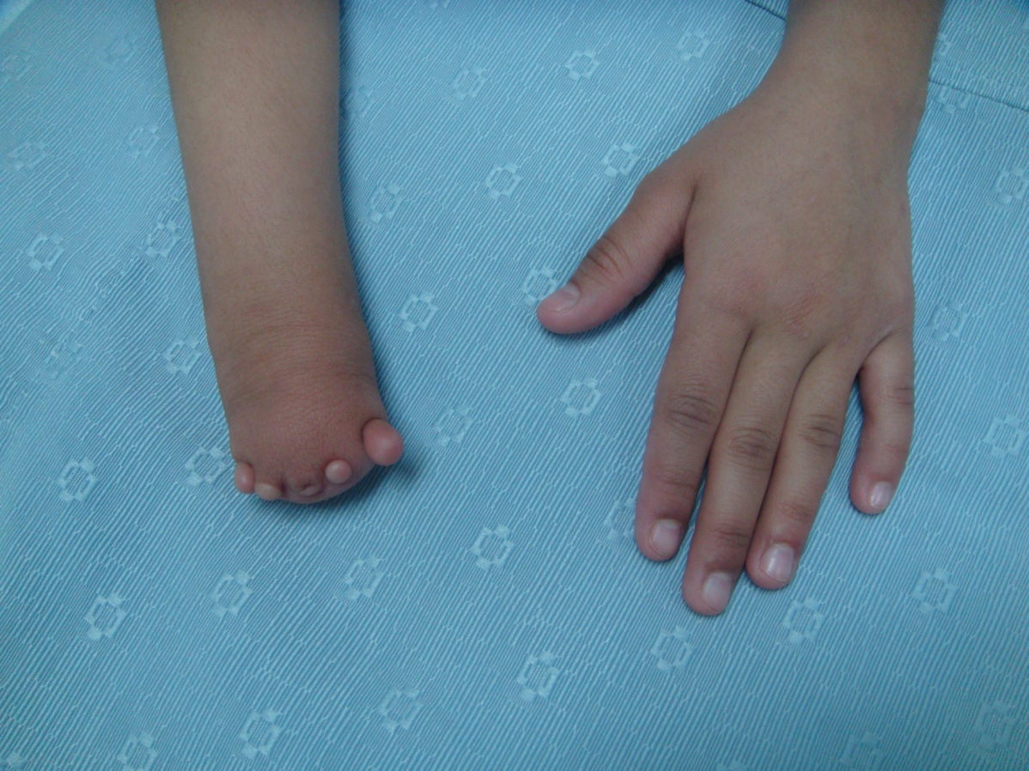
WHAT IS CALLED ?
It is acheira

Slide 24
B – LONGITUDINAL ARREST
Radial ray ( pre-axial ) no radius and no thumb
Ulner ray ( post-axial ) elbow joint is affected but wrist joint is ok
Central ray ( cleft hand )

Slide 25
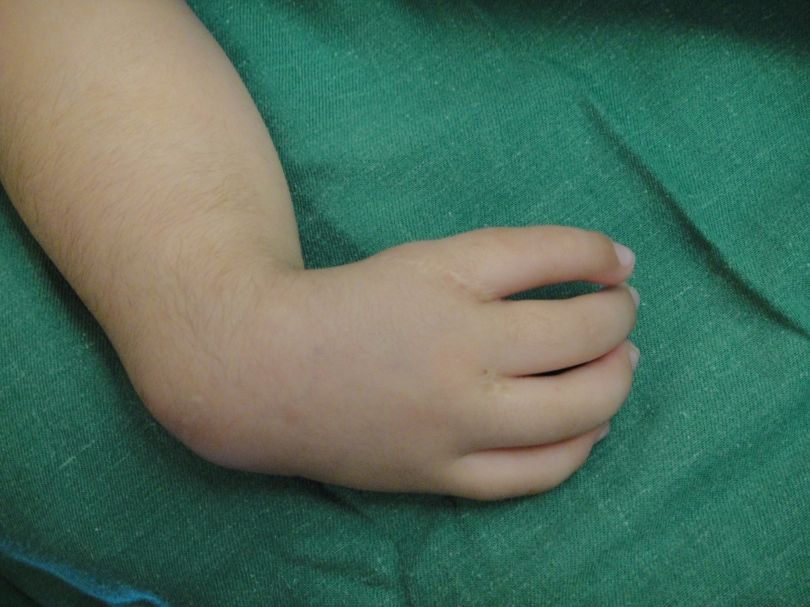
WHAT IS CALLED ?
It’s radial ray

Slide 26
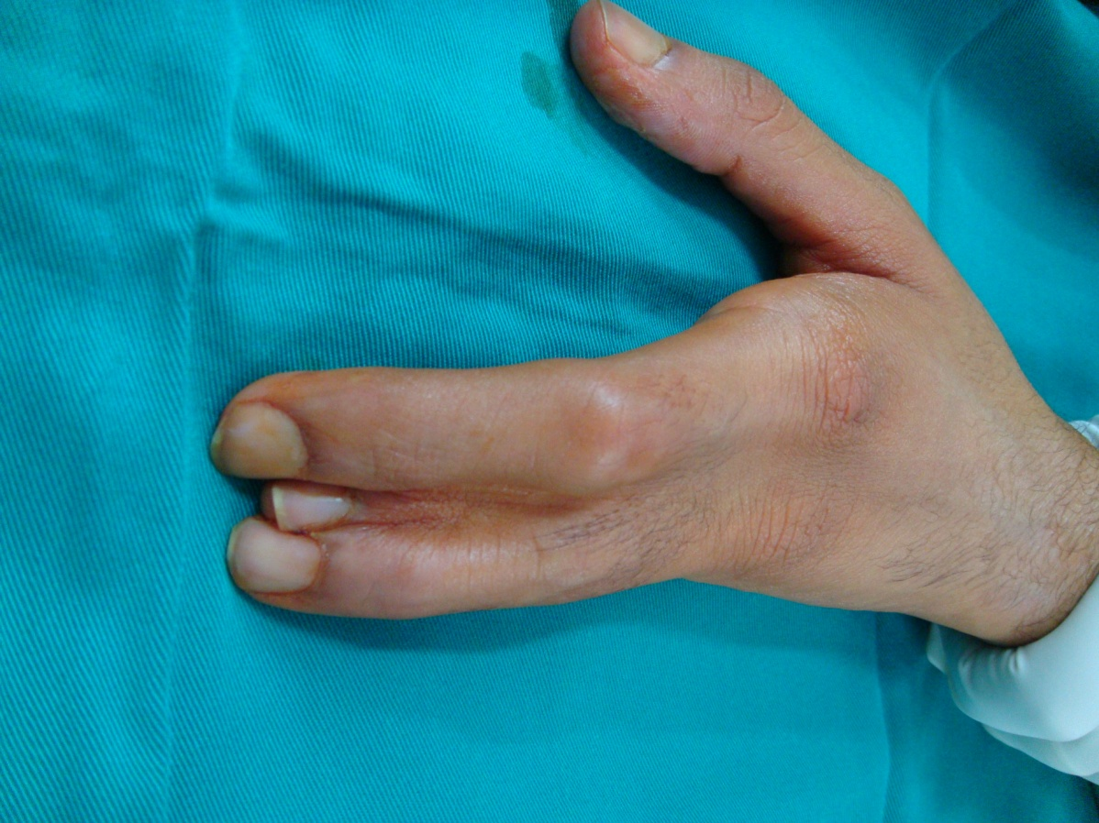
WHAT IS CALLED ?
It’s central ray

Slide 27
II – FAILURE OF DIFFERENTIATION
(a)- Soft tissues e.g.. Cutaneous syndactyly skin is fused together
(b)- skeletal involvement e.g.. Osseous syndactyly bones are fused together
U have to take x-ray to differentiate between them

Slide 28
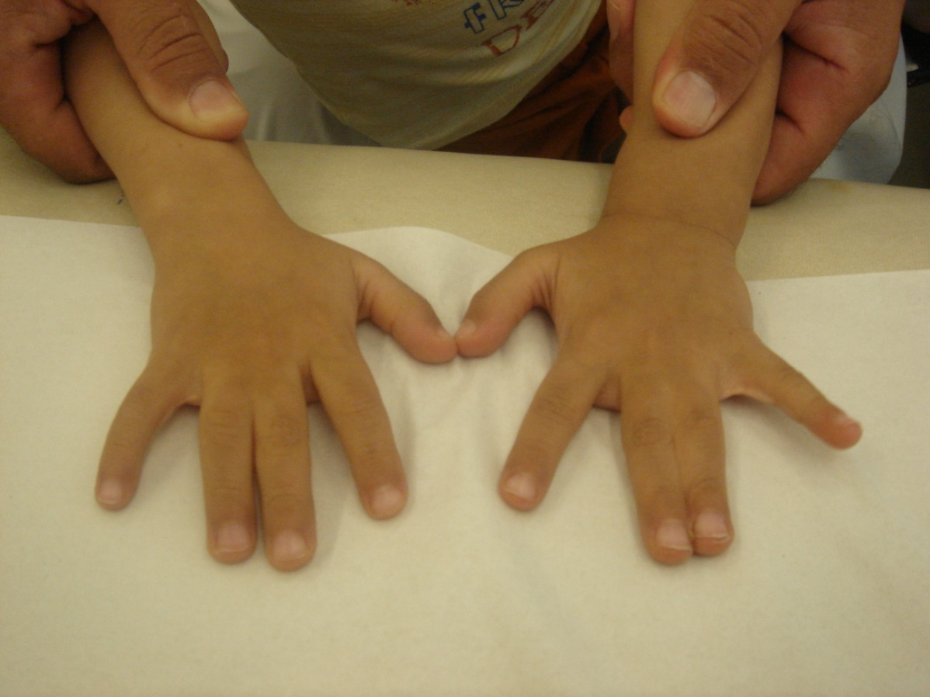

Slide 29
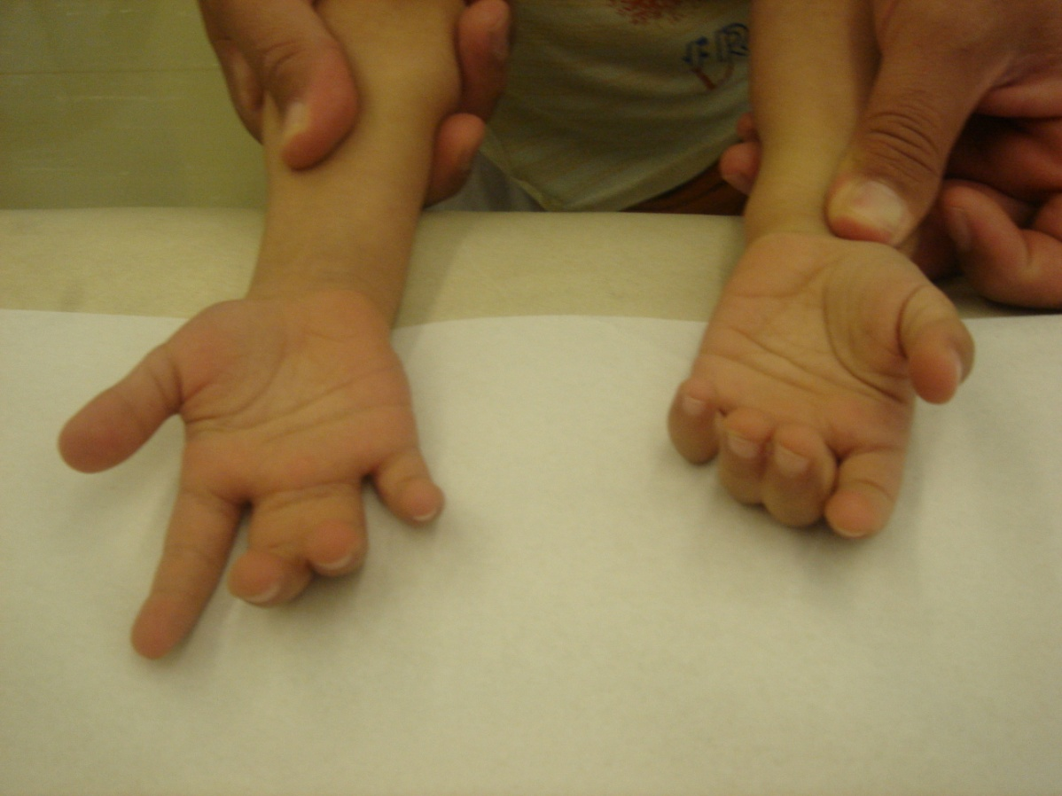

Slide 30
Congenital tumorous condition
Vascular e.g. heamongiomas portwine stain
Neurological e.g. neurofibromas
Connective tissues e.g. juvenile aponeurotic fibroma
Skeletal e.g. osteochondromes

Slide 31
DUPLICATION
Whole limb
Humerus
Radus
Ulna
Digit

Slide 32
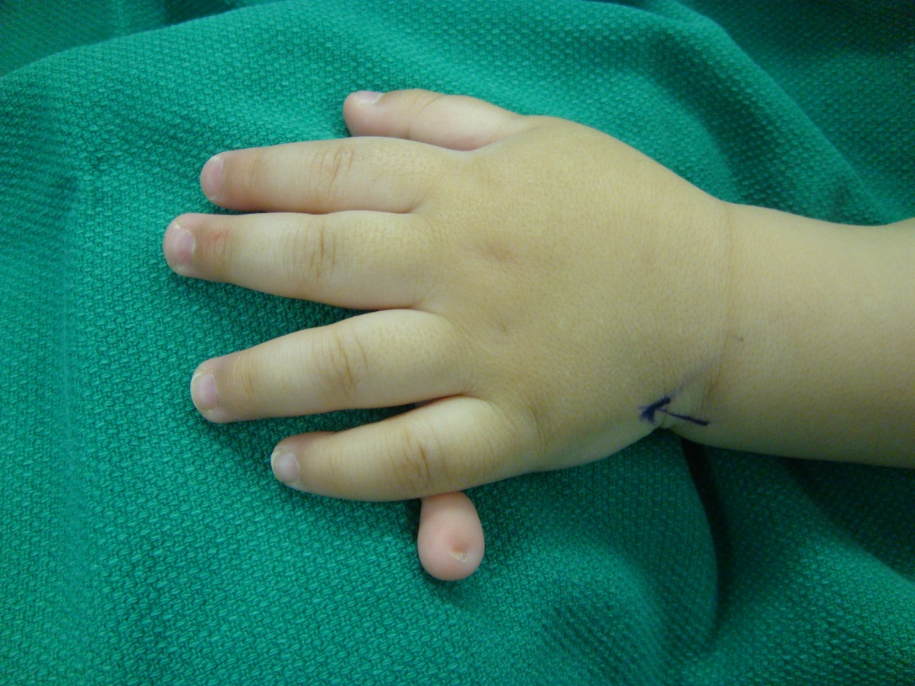
WHAT IS CALLED ?
Ulnar duplication

Slide 33
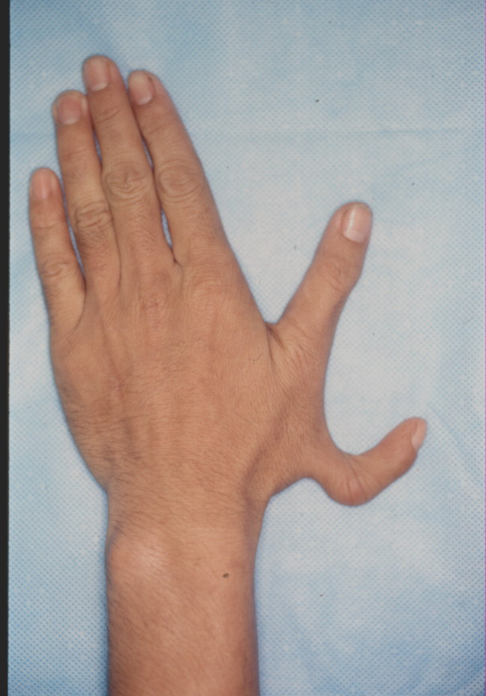

Slide 34
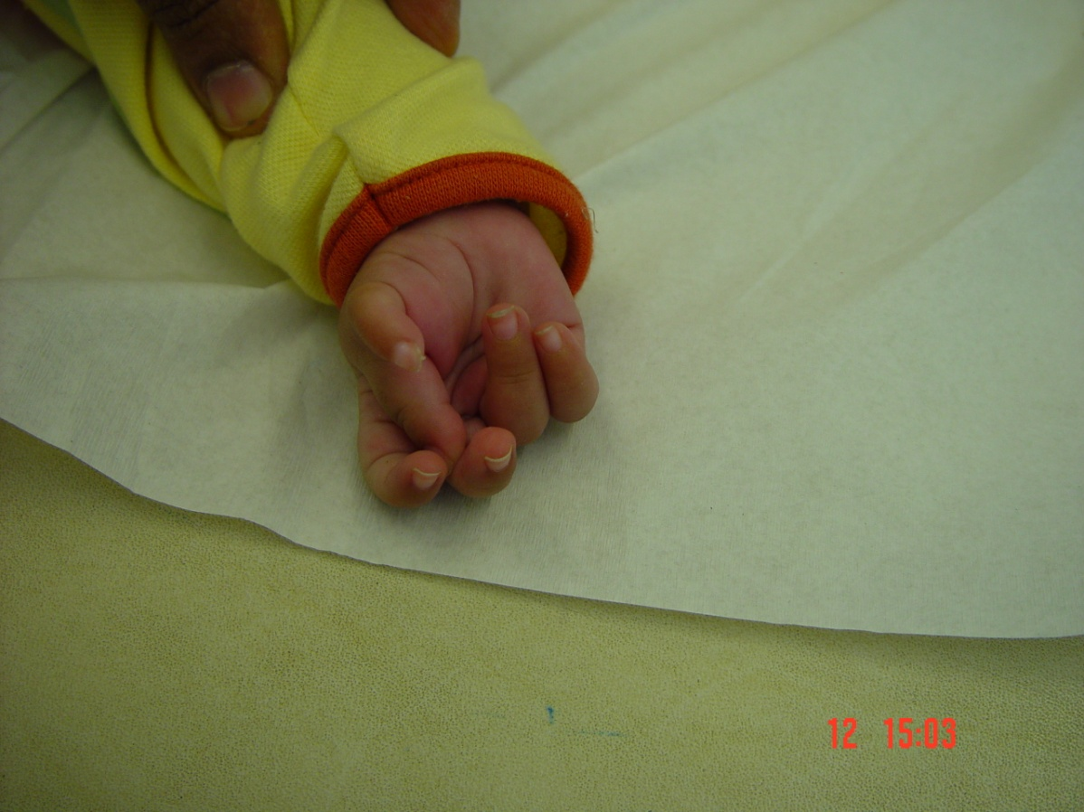
WHAT IS CALLED ?
Thumb dublication

Slide 35
OVERGROWTH
Whole limb e.g. hemi hypertrophy
Partial limb e.g. associated vascular malformation
Digit macrodactyly

Slide 36
UNDERGROWTH
Whole limb
Forearm & Hand
Hand alone
Digit

Slide 37
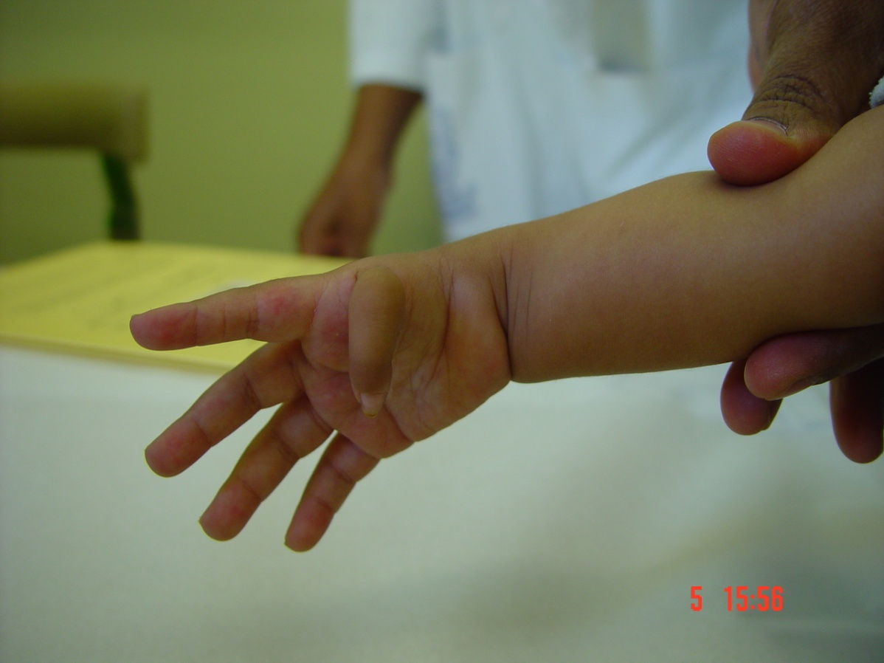
WHAT IS CALLED ?
Digit macrodactylt

Slide 38
CONSTRICTION RING SYNDROME
Focal necrosis e.g. constriction band syndrome
Amputation intra uterine due to fingers ischemia

Slide 40
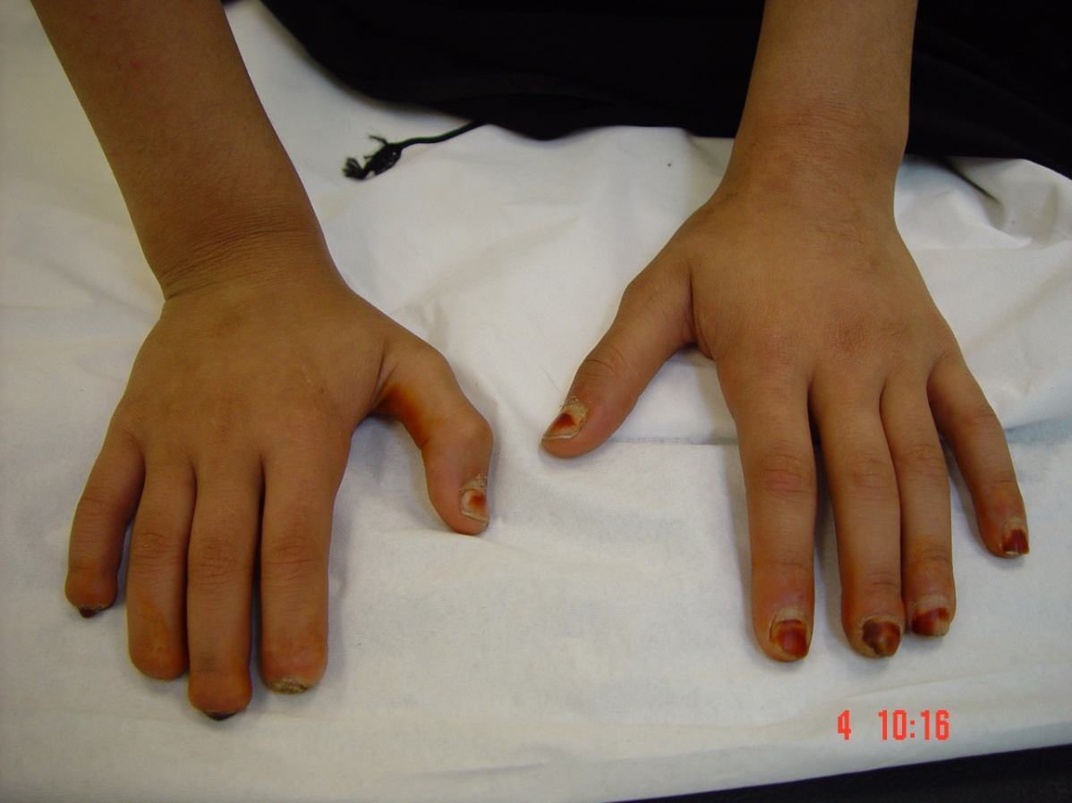
WHAT IS CALLED ?
Auto amputation

Slide 41
GENERALIZED ABNORMALITIES AND SYNDROMES

Slide 42
THANK YOU FOR YOUR ATTENTION

