Slide 1
Epidemiology of DM
Prof. Ashry Gad Mohamed

Slide 2
Diabetes Mellitus
Definition
A metabolic disorder of multiple aetiology characterized by chronic hyperglycaemia with disturbances of carbohydrate, fat and protein metabolism resulting from defects in insulin secretion, insulin action or both
Associated with a risk of developing late diabetic complications including
Microvascular (retinopathy, nephropathy)
Macrovascular (atherosclerosis)
Neuropathy

Slide 3
Types of diabetes
Type 1 (5-10%) – sudden onset absolute deficiency in insulin. Usually affects younger age group (not always)
Type 2 (90 - 95%) – gradual onset of relative insulin insensitivity. Usually older age group (not always)
Pre-diabetes – T2DM
Impaired glucose tolerance
May remain undiagnosed for years; risk of complications same as for T2DM

Slide 4
Diagnosis of diabetes
Symptoms
Thirst
Passing lots of urine
Malaise
Infections (thrush)
Weight loss
BUT – many years of pre-diabetes (type 2) before these symptoms appear!
Biochemical tests
Random plasma glucose
Fasting plasma glucose
Oral glucose tolerance test – 2h glucose
WHO criteria
ADA criteria

Slide 5
DIAGNOSIS
A symptomatic patient plus casual plasma glucose ≥ 11.1 mmol/L or FPG ≥ 7.0 mmol/L.
During an OGTT 2-hr post 75 gm-glucose
≥ 11.1 mmol/L.
● In the absence of symptoms suggestive of DM, these criteria should be confirmed by repeat testing on a different day.

Slide 6
DIAGNOSIS
FPG ≤ 5.5 mmol/L = normal
FPG ≥ 5.6 mmol/L to 6.9 mmol/L= IFG
FPG ≥ 7.0 mmol/L = provisional diagnosis of DM and must be confirmed
in asymptomatic person.

Slide 7
Diagnosis based on: Glucose Tolerance Test
2 hr post 75 gm glucose
If < 7.8 mmol/L = normal GTT
If ≥ 7.8 mmol/L and < 11.1 mmol/L =
Impaired GTT
If ≥ 11.1 mmol/L = provisional diagnosis of
Diabetes

Slide 8
Epidemiology of diabetes
Prevalence worldwide is increasing*
2.8% in 2000; 4.4% in 2030 worldwide.
171 million in 2000; 366 million in 2030.
Greatest rise in developing world
*Wild S et al; Diabetes Care, May 2004. Vol 24, pg 1047-53

Slide 9
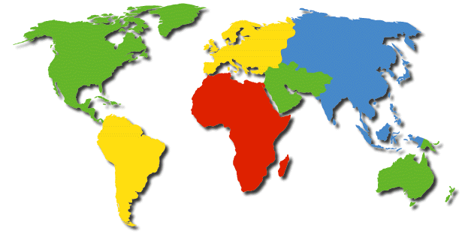
Global Projections for the Diabetes Epidemic: 2000-2030 (in millions)
EU
17.8
25.1
41%
NA
19.7
33.9
72%
China
20.8
42.3
204%
MEC
20.1
52.8
263%
LAC
13.3
33.0
248%
SSA
7.1
18.6
261%
India
31.7
79.4
251%
A+NZ
1.2
2.0
65%
World
2000 = 171 million
2030 = 366 million
Increase 213%
Wild, S et al.: Global prevalence of diabetes:
Estimates for 2000 and projections for 2030
Diabetes Care 2004 In press

Slide 10
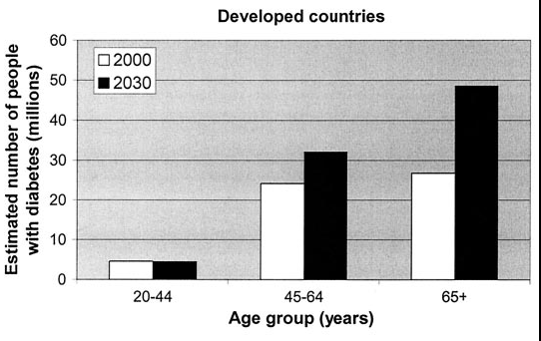

Slide 11
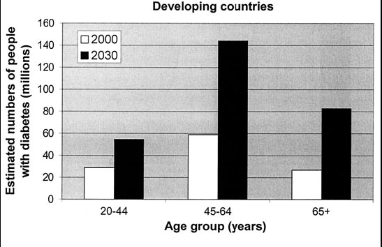

Slide 12
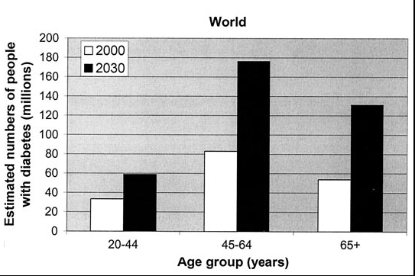

Slide 13
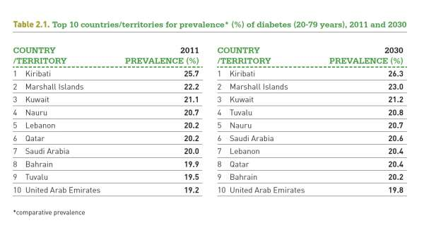

Slide 14
Notes:
Dr. Ossama AlKhatib

Slide 15
Prevalence of diabetes based on stepwise surveys
Jordan: 12%
Iraq: 10.4%
Syria: 20.5%
Saudi Arabia: 17.9%
Iran: 10.3%
No available data from other EM countries

Slide 16
Prevalence of Diabetes in EMR
Notes:
Dr. Ossama AlKhatib (modified

Slide 17
Type 1 diabetes epidemiology
Very big variation in incidence and prevalence
Variation in growth-rate
Disease process relatively well described
Genetic markers known
Weak risk factors

Slide 18
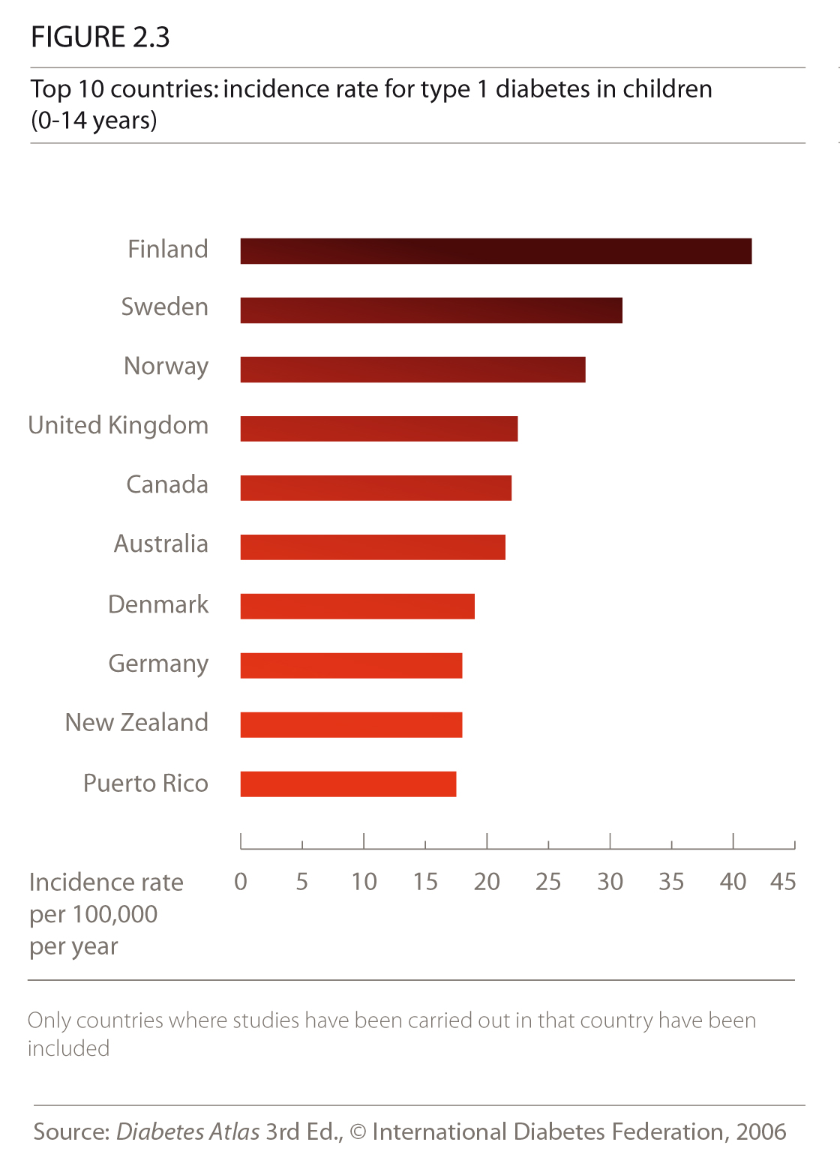

Slide 19
Incidence of type 1 diabetes Age 0-14 years
IDF Diabetes Atlas 2003
Notes:
incidence geographically variation between continents and within continents.
The highest incidence in the developed countries.

Slide 20
Type 1 diabetes Increase in incidence/year

Slide 21
The Global burden of diabetes
Diabetes accounts for more than 5% of the global deaths, which are mostly due to CVD.
Diabetes is responsible for over one third of end-stage renal disease requiring dialysis.
Amputations are at least 10 times more common in people with diabetes.
A leading cause of blindness and visual impairment. Diabetics are 20 times more likely to develop blindness than nondiabetics.

Slide 22
Diabetes Mellitus Prevalence
Diabetes Mellitus
an Epidemic Disease in the
Gulf Countries
Kuwait
14.8
Bahrain
11.0
UAE
15.7
Qatar
15.0
Epidemiological
Data
Saudi Arabia
12.3
Oman
10.0

Slide 23
Impaired Glucose Tolerance Prevalence
Diabetes Mellitus
an Epidemic Disease in the
Gulf Countries
Kuwait
12.8
Bahrain
11.0
UAE
13.2
Qatar
11.0
Epidemiological
Data
Saudi Arabia
11.9
Oman
10.0

Slide 24
Diabetes Complications in the Gulf Countries
Prevalence of microvascular complications:
Comparing data from Arab
countries with data of the
highest & lowest prevalence
world wide in the year 2000.
The major complications will
be soon the highest in Arab
countries due to the lack of
prevention programs.
WHO report 2000.
Retinopathy
Neuropathy
Nephropathy

Slide 25
Diabetes Complications in the Gulf Countries
%
NIDDM
NEUROPATHY WITH DURATION
IDDM
Years
Diabetes Care 1, 168-188 1978

Slide 26
Diabetes Complications in the Gulf Countries
%
BLINDNESS BY DURATION OF DIABETES
Age at diagnosis 60 years old
Age at diagnosis 20 years old
Years
ADA 1993 Vital Statistic

Slide 27
Diabetes Complications in the Gulf Countries
Retinopathy
Retinopathy:
Number of persons with
diabetic retinopathy in different countries and according to the time.
WHO report 2000

Slide 28
Diabetes Complications in the Gulf Countries
Prevalence of Retinopathy in
Saudi diabetic patients
31.5%
IDDM 42.5%
NIDDM 25.3%
Risk factors for Retinopathy in
Saudi diabetic patients
✰ Duration > 10 years.
• Presence of nephropathy.
 Older than 60 years.
 Poor diabetes control.
 Use of insulin.

Slide 29
Diabetes Complications in the Gulf Countries
Diabetes in the Gulf countries
Diabetes is the leading cause for Blindness
Diabetes is the leading cause for ESRF
Diabetes is the leading cause for IHD
Diabetes is the leading cause for CVA
Diabetes is the leading cause for Amputation

Slide 30
Risk factors:
Risk factors for Type 2 DM are complex including obesity, genetic and life style factors (overfeeding and sedentary life). There is patho- physiological changes (weight gain insulin resistance and reduction of insulin secretion) may lead to glucose intolerance and diabetes

Slide 31
Obesity: contributes to the resistance to endogenous insulin.
Obesity
RR risk of DM in females (ref. BMI < 22)
22-23 3.0
24-25 5.0
> 31 40
(Colditz & al, Ann Int Med, 1995, 122; 481-6)

Slide 32
Physiologic or emotional stress: causes prolonged elevation of stress hormone levels (cortisol, epinephrine, glucagon and growth hormone), which raises blood glucose levels, placing increased demands on the pancreas.

Slide 33
Prevalence of Smoking according to STEPwise Survey in EM countries
%

Slide 34
Exercise
Vigorous exercise > 1/week, 25% risk reduction
(Manson & al, Lancet 1991, 338; 774-8., JAMA, 1992, 268,63-7)
Looking TV 2-10 hours per week: RR 1.66 of having DM compared with 0-1 hour per week
( HU et al; Arch Intern Med 2001;161: 1542-1548)
Notes:
Øverste Nurses health study
Nederste Health proffesional folloiw up study (HPFS) began in 1986 and followed up until 1996, only men 40 – 75 years.

Slide 35
Genetic factors may play a part in development of all types; autoimmune disease and viral infections may be risk factors in Type I DM.

Slide 36
Pregnancy: causes weight gain and increases levels of estrogen and placental hormones, which antagonize insulin.
Medications that are known to antagonize the effects of insulin: thiazide diuretics, adrenal corticosteroids, oral contraceptives.

Slide 37
Infection or illness. A range of relatively rare infections and illnesses can damage the pancreas and cause type 1 diabetes.
e.g. Mumps, CMV, EPV.

