Slide 1
Epidemiology of Obesity
Ashry Gad Mohamed
Prof. of Epidemiology
College of Medicine & KKUH

Slide 2

No body is exempted from obesity . It can be you.

Slide 3
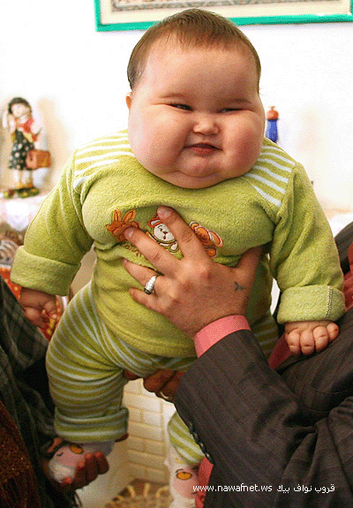

Slide 4
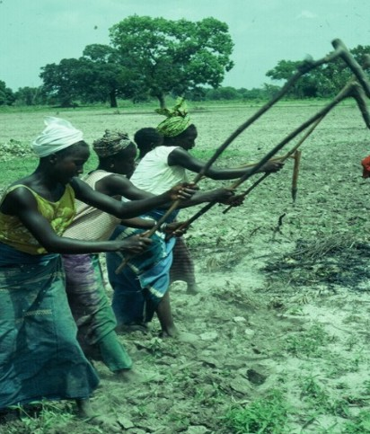
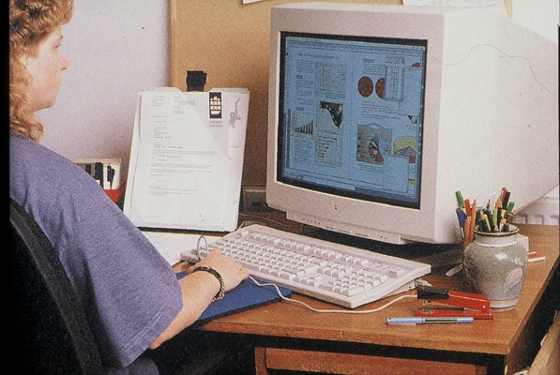
From Ancient to Modern ..…
Work

Slide 5
Today's obese child -- tomorrow's diabetic patient?

Slide 6
Obesity classification.
Obesity is further divided into three separate classes, with Class III obesity being the most extreme of the three.
Obesity class | BMI (kg/m²)
Class I | 30.0- 34.9
Class II | 35.0-39.9
Class III (Extreme Obesity) | ≥ 40.0
With a BMI of: | You are considered:
Below 18.5 | Underweight
18.5 - 24.9 | Healthy Weight
25.0 - 29.9 | Overweight
30 or higher | Obese
CDC, NHLBI

Slide 7
Prevalence of Obesity
40
All data 1991 or later
Men
30
Women
20
% population with BMI ≥30kg/m²
10
0
France
UK
Russia
Finland
Canada
Netherlands
E Germany
USA–white
USA–blacks
Australia
W Germany
USA–hispanics
SAUDI ARABIA

Slide 8
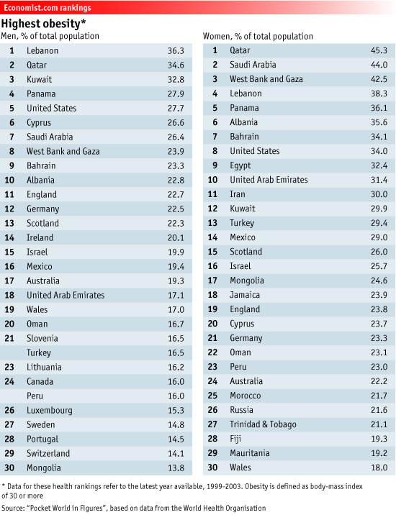

Slide 9
Global Prevalence of Obesity in Adult Males
With examples of the top 5 Countries in each Region
European Region
Croatia 31%
Cyprus 27%
Czech Republic 25%
Albania (urban) 23%
England 23%
Eastern Mediterranean
Lebanon 36%
Qatar 35%
Jordan 33%
Kuwait 28%
Saudi Arabia 26%
North America
USA 31%
Mexico 19%
Canada (self report) 17%
Guyana 14%
Bahamas 14%
Africa
South Africa 10% Seychelles 9%
Cameroon (urban) 5% Ghana 5%
Tanzania (urban) 5%
% Obese
 | 0-9.9%
 | 10-14.9%
 | 15-19.9%
 | 20-24.9%
 | 25-29.9%
 | ≥30%
 | Self Reported data
South Central America
Panama 28%
Paraguay 23%
Argentina (urban) 20%
Uruguay (self report) 17%
Dominican Republic 16%
South East Asia & Pacific Region
Nauru 80%
Tonga 47%
Cook Island 41%
French Polynesia 36% Samoa 33%
With the limited data available, prevalence's are not age standardised. Self reported surveys may underestimate true prevalence. Sources and references are available from the IOTF. © International Obesity TaskForce, London –January 2007

Slide 10
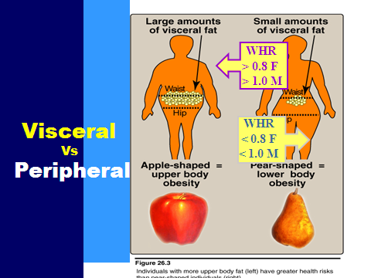
Global Prevalence of Obesity in Adult Females
With examples of the top 5 Countries in each Region
European Region
Albania 36%
Malta 35%
Turkey 29%
Slovakia 28%
Czech Republic 26%
Eastern Mediterranean
Jordan 60%
Qatar 45%
Saudi Arabia 44%
Palestine 43%
Lebanon 38%
North America
USA 33%
Barbados 31%
Mexico 29%
St Lucia 28%
Bahamas 28%
Africa
Seychelles 28%
South Africa 28%
Ghana 20%
Mauritania 19%
Cameroon (urban) 14%
% Obese
 | 0-9.9%
 | 10-14.9%
 | 15-19.9%
 | 20-24.9%
 | 25-29.9%
 | ≥30%
 | Self Reported data
South Central America
Panama 36%
Paraguay 36%
Peru (urban) 23%
Chile (urban) 23%
Dominican Republic 18%
South East Asia & Pacific Region
Nauru 78%
Tonga 70%
Samoa 63%
Niue 46%
French Polynesia 44%
With the limited data available, prevalence's are not age standardised. Self reported surveys may underestimate true prevalence. Sources and references are available from the IOTF. © International Obesity TaskForce, London –January 2007

Slide 11
Regional (local) studies showing the prevlanece of obesity and overweight
Author , and place of study
Age group
No of subjects
Criteria used
Prevalence among male %
Prevalence among
Female%
Khashoggi et al (1994)Attendees at PHC jedahh
11-70 years
Mean
age 32.2
852 female
Obese BMI >30
----
64.3
Overweight
BMI 25-29.9
----
26.8
AL- Shammati et al (1994b) Attendees at PHC, Riyadh
Mean male = 34 Female 32
733 With back pain
Obese BMI >30
47.0
Obese BMI >30
51.6
AL- Jassir et al (1998) Emploees of M.O.H Riyadh
20 and above
1238 males
Overweight
BMI 25-29.9
40.3
----
Obese BMI >30
18.4
…..

Slide 12
A Global Epidemic
Why is obesity accelerating in developing countries?
Increased consumption of energy dense, nutrient poor foods combined with reduced physical activity.

Slide 13
Abdominal body fat increases health risks
Degree of abdominal fat accumulation is
correlated with increased risk of:
Cardiovascular disease¹
Type 2 diabetes^{2,3}
Premature death⁴
Some types of malignancies⁵
¹Hubert HB et al. Circulation 1996; 93: 1372–9
²Colditz GA et al. Am J Epidemiol 1990; 132: 501–13
³Chan JM et al. Diabetes Care 1994; 17: 961–9
⁴Soloman CG, Manson JE. Am J Clin Nutr 1997; 66 (Suppl. 4): 1055S–50S
⁵Schapira DV et al. Cancer 1994; 74: 632–9

Slide 14
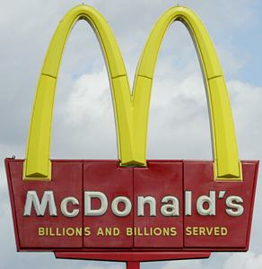
“The biggest problem we face in America is not terrorism. The biggest health problem we’re facing is obesity.”
Dr. Julie Gerberding
Head of the Centers for Disease Control & Prevention

Slide 15
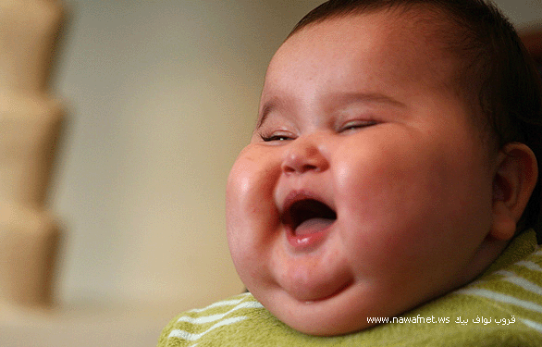

Slide 16
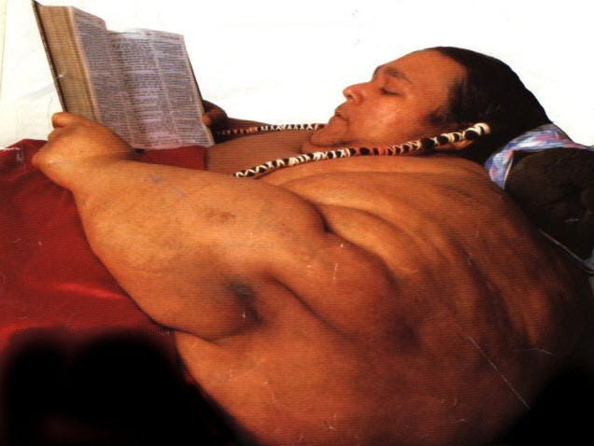

Slide 18
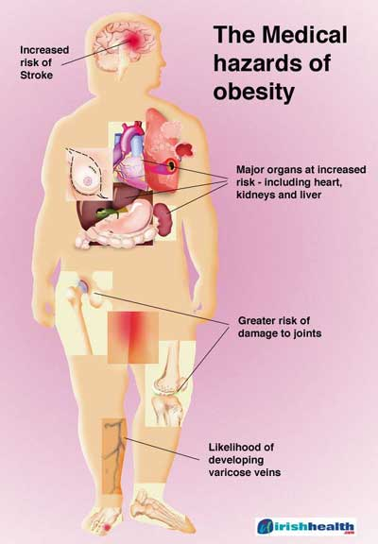
Obese Syndrome Components
Glucose intolerance
Insulin resistance
Dyslipidemia
Type 2 diabetes
Hypertenision
Elevated plasma leptin concentration
Increased visceral adipose tissue
Increased risk of CHD & some cancers

Slide 19
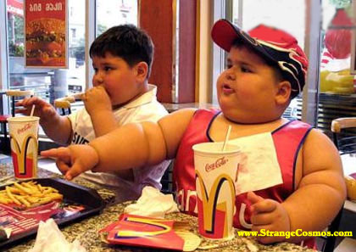
Causes of Obesity
Obesity is a long term process.
Obesity frequently begins in childhood. Obese parents likely have overweight children.
Regardless of final body weight as adults, overweight children exhibit more illnesses as adults than normal kids.
“You gonna finish that?”

Slide 20
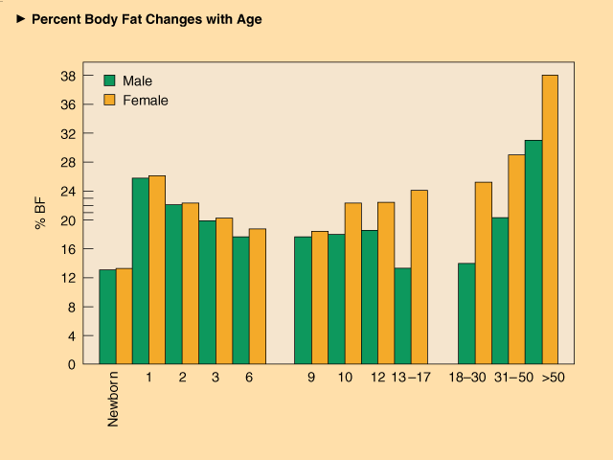
Causes of Obesity
Excessive fatness also develops slowly through adulthood, most weight gain occurring between ages 25 to 44 yrs.
Typical American man & woman gain .5 to 1.8 lb/year until 60.

Slide 21
Causes of Obesity
Not necessarily overeating.
Factors that predispose a person to gain excessive weight gain.
  Eating patterns Eating environment
  Food packaging Food availability
  Body image Physical inactivity
  Basal body temp Dietary thermogenesis
  Fidgeting Biochemical differences
  Quantity & sensitivity to satiety hormones

Slide 22

Causes of Obesity
Characteristics of fast food linked to increased adiposity:
  Higher energy density
  Greater saturated fat
  Reduced complex carbohydrates & fiber
  Reduced fruits and vegetables.

Slide 23
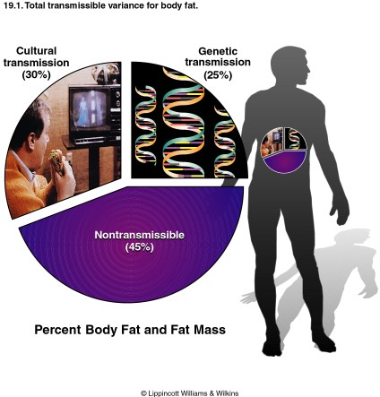
Causes of Obesity
Genetics plays a role.
  How much variation in weight gain among individuals can be accounted for by genetic factors?
  Largest transmissible variation is cultural.

Slide 24
Causes of Obesity
A Mutant Gene?
What is leptin?
  A satiety hormone that influences the appetite control in the hypothalamus.
  Describe the role of the mutant “obese” gene in obesity development.

Slide 25
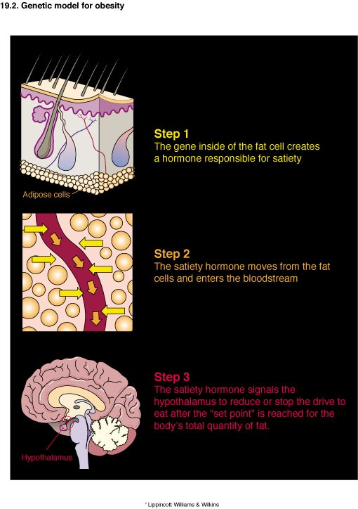
Causes of Obesity

Slide 26
Causes of Obesity
A defective ob gene causes inadequate leptin production. Thus, the brain receives an under assessment of body’s adipose stores and urge to eat.
In addition to deficient leptin production, scientists also propose the possibility of defective receptor action (via a leptin receptor molecule on brain cells), which increases a person’s resistance to satiety.

Slide 27
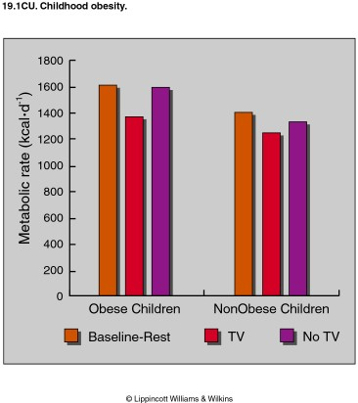
Causes of Obesity
Physical Activity: an important component
For young & middle aged men, physical activity relates inversely to body fat levels.
No relationship between caloric intake and body fat levels.
Notes:
Estimates children 6-11 average 26 hours TV weekly; adolescents spend about 22 hours TV weekly.
Each hour increase TV by adolescents 2% increase obesity prevalence.

Slide 28
10kg Weight Loss in 100kg Patient With Obesity Related Co-morbidities
Mortality 20-25% fall in total mortality
30-40% fall in diabetes related deaths
40-50% fall in obesity related cancer deaths
Blood pressure fall of approximately 10mm/Hg in both systolic and diastolic
values
Reduces the risk of developing diabetes by >50%
Fall of 30-50% F. glucose
Fall of 15% HbAIC
Lipids: Fall of 10% in total cholesterol
Fall of 15% LDL
Fall of 30% triglycerides
Increase of 8% in HDL

Slide 29
References
Park K. Nutrition and health. In: Preventive and social Medicine. Editor. 21th edition. 2011 pages 366-370.
WHO. Obesity and overweight. http://www.who.int/mediacentre/factsheets/fs311/en/

