Slide 1
HIV/AIDS EPIDEMIOLOGY
Prof. Ahmed Mandil
Dr. Hafsa Raheel
KSU Dept of Family & Community Medicine
October 2012

Slide 2
Objectives
At the end of this lecture, the student should be able to:
Describe the current estimates of HIV / AIDS infection
Understand how people get infected with HIV
Appreciate the features which characterize the pandemic in the Eastern Mediterranean Region
Differentiate what could work best, as far as prevention & control efforts are concerned, in our Region

Slide 3
What is AIDS ?
Acquired Immuno-Deficiency Syndrome (AIDS) is a severe life-threatening clinical condition, first recognized as a distinct syndrome in 1981.
This syndrome represents the late stage of infection with the Human Immuno-deficiency Virus (HIV), which often results in progressive damage of the immune and other organ systems, especially the central nervous system (CNS)

Slide 4
HIV/AIDS PANDEMIC: OVERALL FEATURES
- Pandemic: all continents, all nations
HIV has been isolated from ALL body fluids
- There are only three modes of transmission

Slide 5
HIV/AIDS PANDEMIC: OVERALL FEATURES
(Continued)
- Incubation & communicability: long
- Asymptomatic infected (incubating carriers)
are capable of transmission of the infection
Impacts of infection: health, social, productivity,
life expectancy, economic, overall development

Slide 6
HIV Epidemiologic Update -1

Slide 7
HIV Epidemiologic Update -3

Slide 11
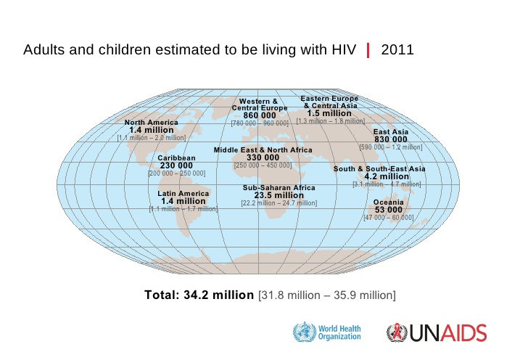

Slide 12
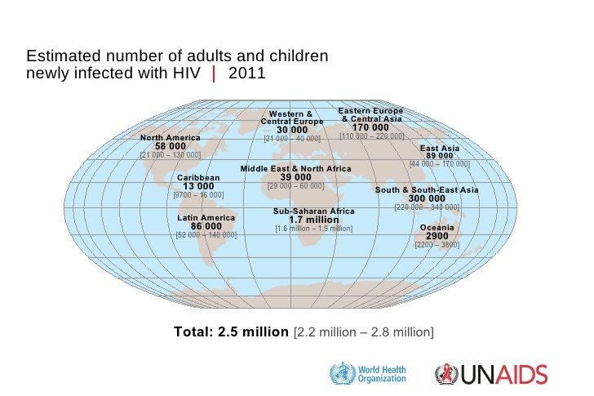

Slide 13
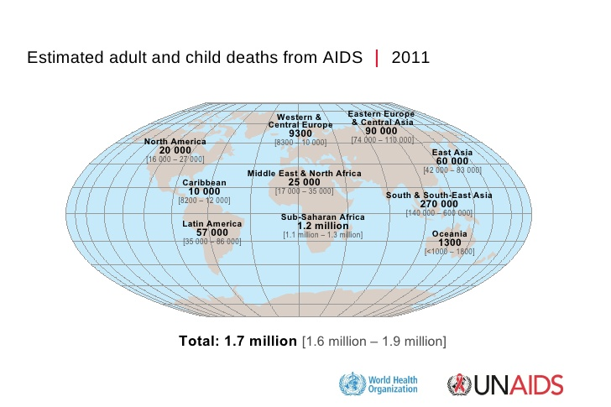

Slide 14
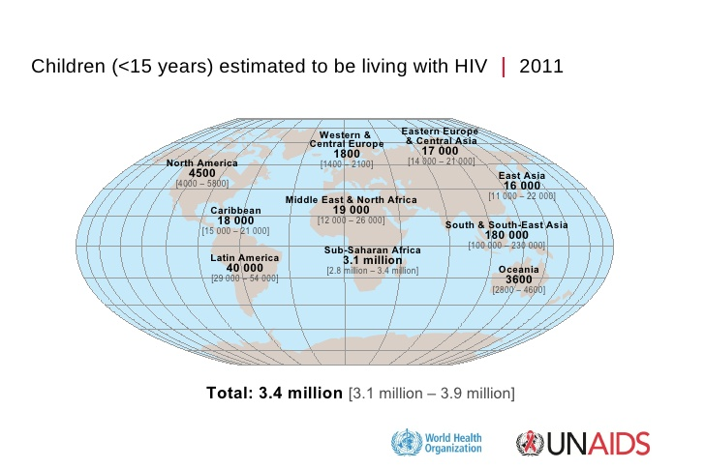

Slide 15
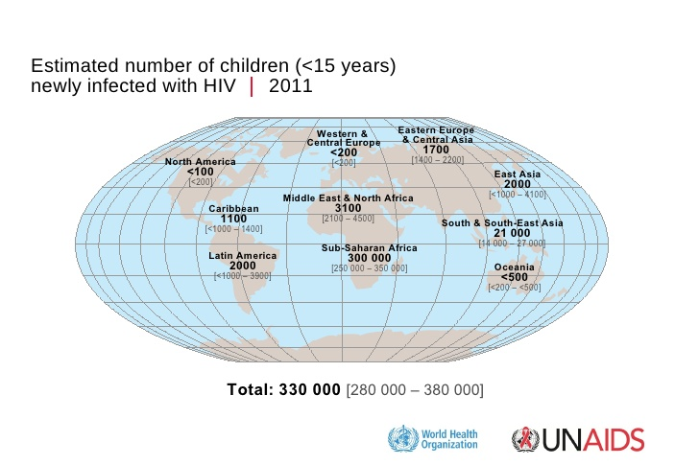

Slide 16
Estimated global distribution of HIV/AIDS infections, by sex (1970s - 2001)
1,000,000
1,000,000
560,000
9.4 Million
440,000
6.1 million
28.1 million
1.82 million
15,000
UNAIDS
WHO

Slide 17
HIV / AIDS Infectious Cycle

Slide 18
HIV/AIDS INFECTIOUS CYCLE -1
Agent: HIV retrovirus, target cell: T4 lymphocyte
Reservoir: humans (cases, carriers)
Communicability increases with: STI, TB, addiction, repeated contaminated injections / transfusions, sexual promiscuity (frequency, multiple partners)
Portal(s) of outlet: semen, vaginal secretions,
blood, skin

Slide 19
HIV/AIDS INFECTIOUS CYCLE -2
Modes of transmission:
Sexual (90 %): hetero- , homo- , bi sexually.
Parenteral (5 %): blood, IDU, skin-piercing
Perinatal (4 %): during pregnancy, labor, milk
Portal of inlet: according to transmission
Susceptibility: general, more among high risk groups especially: TB & STI patients

Slide 20
HIV Transmission by Efficiency & Global Distribution
Exposure Transmission Global
Efficiency % Distribution
Blood Transfusion > 90 < 1
Perinatal 20 - 45 4
Sexual 0.1 - 1.0 90
IV Drug Abuse 0.5 - 1.0 5
Needle-prick < 0.5 < 1

Slide 21
MODES OF HIV TRANSMISSION
(Continued)
There is no current evidence to suggest that HIV is transmitted by:
Casual contact
Respiratory route
Enteric route
Insects
Food/water
Toilets
Swimming pools
Seats, door-knobs
Tears
Sharing eating utensils

Slide 22
HIV / AIDS in the EMR

Slide 23
HIV/AIDS PANDEMIC: EMR FEATURES -1
Late introduction ( late 1980s), slow progression
By end of 2007, reported low overall prevalence of 0.2 % in EMR nations
Generalized epidemic (> 1 %): in Djibouti, Sudan, some parts of Somalia
Concentrated epidemic (> 5 %): among IDU in Iran, Libya, Pakistan
Age-gender distribution: predominantly affecting adult (91 %) males (71 %)
Modes: mainly heterosexual (77 %); IDU (11 %); blood transfusion (5 %), mother to child (2 %)

Slide 24
HIV/AIDS PANDEMIC: EMR FEATURES -2
Current indigenous transmission among high risk groups: IDU, STI patients, T.B. patients, blood recipients, dialyzed patients, prostitutes, imprisoned people, homosexuals (some of whom are underground groups with social / legal difficulties to deal with)
- Serious current limitation in deeply needed surveillance activities.

Slide 25
HIV/AIDS PANDEMIC: EMR FEATURES -3
HIV SEROPOSITIVES (2010)
Estimate: 470 000 [350 000–570 000] up from 320 000 [190 000–450 000] in 2001
New infections: 59 000 [40 000–73 000] up from 43 000 [31 000–57 000]
AIDS related deaths: 35 000 [25 000–42 000] up from 22 000 [9700–38 000] in 2001
STI CASES (2009) (sexually-transmitted infections)
Estimate: 10,000,000 cases
PROBLEMS: late reporting, under reporting, under diagnosis, conflicts, denial (few states)

Slide 26
HIV/AIDS PANDEMIC: EMR FEATURES -4

Slide 27
Middle East and North Africa estimates 1990–2008
Number of people living with HIV
Adult (15–49) HIV prevalence (%)
400
0.4
Number (thousands)
300
0.3
200
%
0.2
100
0.1
0
1990
1993
1996
1999
2002
2005
2008
0
1990
1993
1996
1999
2002
2005
2008
Number of people newly infected with HIV
Number of adult and child deaths due to AIDS
50
50
Number (thousands)
40
Number (thousands)
40
30
30
20
20
10
10
0
1990
1993
1996
1999
2002
2005
2008
0
1990
1993
1996
1999
2002
2005
2008
Estimate
High and low estimates
Source: UNAIDS/WHO
Figure 24

Slide 28
Distribution of cumulative AIDS cases by age and by sex
WHO / EMR, 1999–2002

Slide 29
Mode of Transmission of Reported Cases,
EMR , 2007
Heterosexual
77 %
Homosexual
5 %
Perinatal
2 %
Blood
5 %
IV Drug Abuse
11 %

Slide 30
HIV in Saudi Arabia-1
According to information from the National AIDS Control Program (May 2009) the following estimates are provided:
HIV prevalence in adult population: 0.01%
Prevalence among TB patients: Riyadh: 0.30%, (Surveillance reports from 2007)
Prevalence among STI: Riyadh: 2.80%, Jeddah: 1.20%, Dammam: 0.30%

Slide 31
HIV in Saudi Arabia-2

Slide 32
HIV / AIDS Prevention & Control

Slide 33
HIV/AIDS Control Bodies
Globally: UNAIDS (includes 10 UN agencies); IHRA (International Harm Reduction Association)
Nationally: MoH- National AIDS Program (NAP), Multi-sectoral National AIDS Committee (NAC) including: health, education, higher education, information, Islamic Affairs, Sports & Youth Welfare, planning, finance, labor, defense, interior
Non-governmental (civil service) organizations

Slide 34
Global initiative

Slide 35
MoH - National AIDS Control Program, KSA
Established back in 1986, in response to the emergence of HIV pandemic
Responsible for defining and implementing strategies for preventive and control of HIV/AIDS/STI activities in KSA
Supported by different committees of experts in related aspects
Such program activities are integrated in existing national health system

Slide 36
To unify the strategy among the GCC countries that combat HIV/AIDS and motivate these countries to deal with HIV/AIDS in a way that goes in line with the global trend of HIV/AIDS prevention and control

Slide 38
HIV/AIDS Preventive Measures
Primary: Health education, preventing transmission
Secondary: health education, counseling, health care, support (avoid stigmatization, discrimination), protect society (public health measures)
Tertiary: care for the terminally ill, managing complications and associated conditions

Slide 39
AIDS management
Anti retroviral treatment (ART)
zidovudine + lamivudine
abacavir + zidovudine + lamivudine
lopinavir + ritonavir
abacavir + lamivudine
tenofovir/emtricitabine
efavirenz + tenofovir/emtricitabine
rilpivirine + tenofovir/emtricitabine
elvitegravir + cobicistat + tenofovir/emtricitabine

Slide 40
Target Groups for HIV/AIDS Preventive Measures
Vulnerable groups: youngsters & women (in general) but IDU, prisoners, TB & STI patients, homosexuals, prostitutes (in specific)
Other groups: migrant workers, refugees and displaced persons, transport workers, & tourists

Slide 41
HIV/AIDS Preventive Measures
PREVENTION OF SEXUAL TRANSMISSION
Global recommendations:
abstinence, condom use
EMR Recommendations:
fostering religion, health education (curricula, information, skills, behavior) dealing with the problem as a social/health issue, use of mass media (advertisements, plays, dialogues)

Slide 42
HIV/AIDS Preventive Measures
PREVENTION OF BLOOD TRANSMISSION
Safety measures & screening at every stage
Voluntary un-paid donors only
Transfusion, only when needed
Careful history-taking and physical examination

Slide 43
HIV/AIDS Preventive Measures
PREVENTION OF PERINATAL TRANSMISSION
Pre-marital counseling
Infected women are advised not to conceive
Use of AZT ( reduces transmission risk by 2/3 )
In general, breast feeding should be continued
Case-management: compulsory notification

Slide 44
AIDS must not be allowed to join the long list of problems, like poverty, hunger and ignorance, that the world has learnt to live with, because the powerful have lost interest, and the powerless have no choice.

Slide 45
References
UNAIDS Report on the global AIDS epidemic. 2011.
UNAIDS Global Report Fact Sheet for Middle East and North AfricA. 2011.
WHO EMRO: AIDS and Sexually Transmitted Diseases: http://www.emro.who.int/asd/index.htm
WHO: HIV/AIDS: http://www.who.int/hiv/en/
United Nation Development Program: Kingdom of Saudi Arabia: http://www.undp.org.sa/sa/
National AIDS Control Program: Saudi Arabia. www.unicef.org/gao/Saudi_1.ppt
Saudi Charity Association For AIDS Patients: http://www.saca.org.sa/Action1.htm
Raheel H et al. Sexual practices of young educated men: implications for further research and health education in Kingdom of Saudi Arabia (KSA). Journal of Public Health, 2012, pp. 1–6
Raheel H. Stigma among youth towards People Living with AIDS. Paper presented at XIX International AIDS conference 2012, Washington DC.

