Slide 1

Epidemiology of Viral Hepatitis
Prof. Ashry Gad Mohamed & Dr. Salwa Tayel
Depart. Family & Community Medicine
College of Medicine
October, 2013

Slide 2
Objectives
At the end of the lecture students should:
Understand Classification of viral hepatitis.
Recognize the magnitude of viral hepatitis infections.
Understand modes of transmission of different serotypes.
Understand measures of prevention and control of different serotypes of viral hepatitis.

Slide 3
Viral Hepatitis – Classification &Historical Perspective
Enterically
transmitted
“Infectious”
A
E
Viral hepatitis
“NANB”
C
Parenterally
transmitted
“Serum”
B
D
other

Slide 4
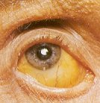
Hepatitis A
Clinical presentation:
Abrupt onset.
Fever
Malaise
Anorexia
Abdominal discomfort
Jaundice

Slide 5
Hepatitis A
More than 90% are asymptomatic
Seroprevalence increases with age.
At age 15, 95% are seropositive.
Case fatality rate (CFR)= 0.3%.
If age > 40 years CFR=2%.
Studies in KSA:
1997 25%
1999 25% Taif
10-82% Jazan (1-12 years)

Slide 6
Agent: RNA virus
Reservior : Human (Clinical & subclinical
cases)
Incubation period: 15-45 days ( median
one month).

Slide 7
Period of communicability : Last two weeks of I.P. + one week of illness.
Modes of transmission:
Fecal-oral route.
Common source outbreaks.
Blood transfusion (rare).

Slide 8
Prevention and Control
Good sanitation & personal hygiene.
“Careful hand washing”
Day- Care centers
Hand washing after every diaper
change and before eating.
Shellfish
heat 85-90C 4 minutes.
steam 90 seconds.

Slide 9
Prevention and Control
Inactivated hepatitis A vaccine
Schedule 2 doses after 6 months interval.
Intramuscularly.
Protection after one month.
Lasting immunity at least 10 years.
Hepatitis A patient:
Enteric precaution for the Period of communicability

Slide 10
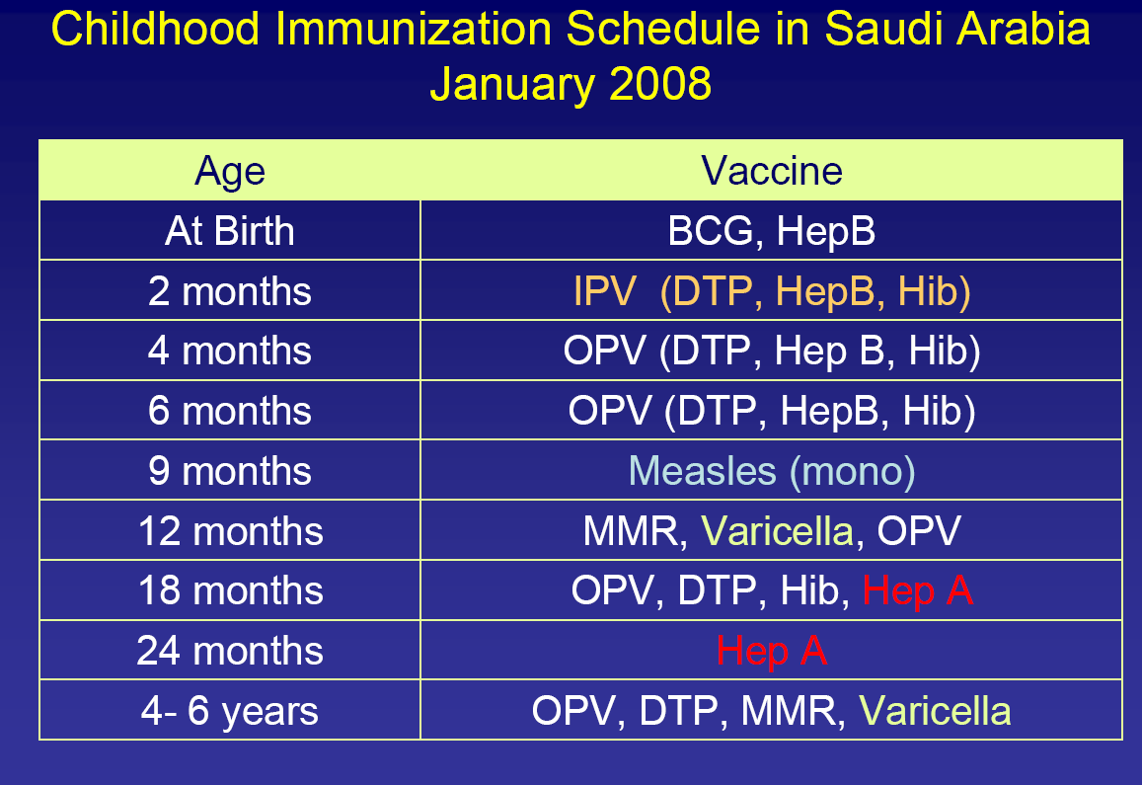

Slide 11
Hepatitis B
Clinical presentation:
Insidious onset.
Anorexia.
Abdominal discomfort.
Nausea.
Vomiting.
Arthralgia.
Jaundice.

Slide 12
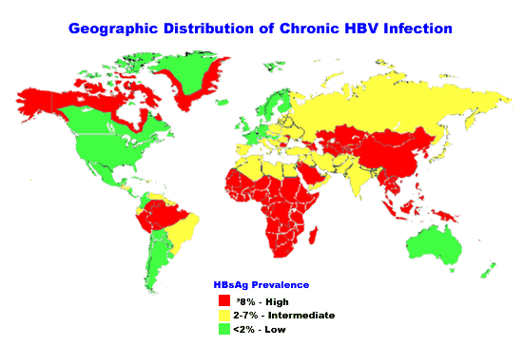
More than 500,000 death/year
2 billion people infected
360 million CHB

Slide 13
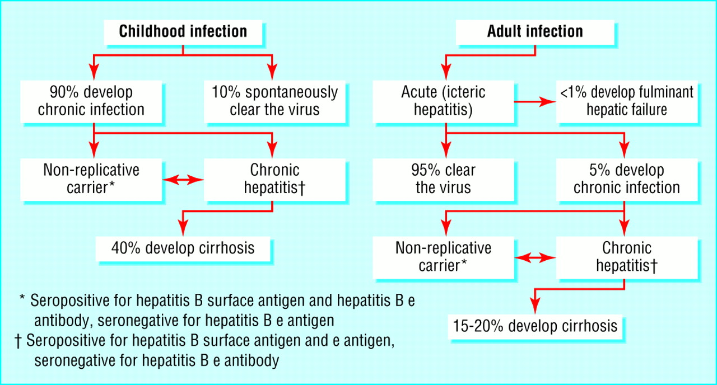
Natural History
  Gow, BMJ 2001

Slide 14
Hepatitis B Virus
HBsAg
Double-Stranded
DNA
HBcAg
HBeAg
The presence of HBsAg indicates active infection or chronic carrier.
Antibody to HBsAg, from either disease or vaccine, indicates immunity.

Slide 15
Hepatitis B
Agent: Double strand DNA.
Serotypes adw, ayw, adr, ayr.
Reservior: Human (case + carrier).
I.P. 2-3 months.
P.C. One week of I.P. + illness period + carriage.
Carriage depends on age at infection;
    <5 yrs, 30%-90% chronicity
    >5 yrs, 2%-10% chronicity

Slide 16
Risk of Chronic HBV Carriage by Age of Infection

Slide 19
Modes of transmission:
Percutaneous and permucosal exposure to: infective body fluids.
Blood transfusion.
Organs transplants.
Sharing needles.
Haemodialysis.
Needlestick.
Tattooing.
Razors & toothbrushes.

Slide 20
Modes of transmission:
Sexual transmission.
Perinatal transmission especially when HBs Ag carrier mothers are also HBe Ag positive.

Slide 21
Prevention and control
Hepatitis B Vaccine
Subunit recombinant HBs Ag IM in the deltoid region.
3 dose series, typical schedule 0, 1, 6 months - no maximum time between doses (no need to repeat missed doses or restart)
Wide scale immunization of infants (revise compulsory vaccination schedule).
Immunization of high risk persons.
Haemodialysis patients.
Bleeding disorders.
Susceptible households.
Health care personnel.

Slide 22
Prevention and control
Blood banks:
Avoid donors from risky groups.
Education & history taking.
Testing for HBs Ag.
Discourage:
Tattooing, Drug abuse,
Extramarital sexual relations.
Needle stick
Single dose of HBIG (24 hours).
Vaccine series.

Slide 23
Prevention and control
Sexual exposure
Single dose of HBIG (14 days).
Vaccination.
Infants to HBsAg +ve mothers.
0.5 ml HBIG (IM).
First dose of the vaccine.
2nd & 3rd doses at 1 & 6 months later.
Health care personnel.
Universal precautions

Slide 24
Hepatitis C

Slide 25
Hepatitis C
WESTERN
EUROPE
9 M
FAR EAST/ASIA
60 M
EASTERN
MEDITERRANEAN
20M
USA
4 M
SOUTH EAST ASIA
30 M
AFRICA
32 M
SOUTH
AMERICA
10 M
AUSTRALIA
0.2 M
170 Million Hepatitis C virus (HCV) carriers
3-4 MM new cases / year
WHO, 1999
Notes:
WHO estimates that 170 million persons or 3 % of the world’s population are infected with hepatitis C and 3 to 4 million persons are newly infected each year. The prevalence of HCV in some countries in Africa, the Eastern Mediterranean, South East Asia and Western Pacific is high compared to some countries in Europe and North America.
According to the National Health and Nutrition Examination Survey of 1988 to 1994, the NHANES survey, and other population-based surveys, nearly 2% of Americans test positive for the hepatitis C antibody. This prevalence corresponds to an estimated 4 million Americans infected with HCV.

Slide 26
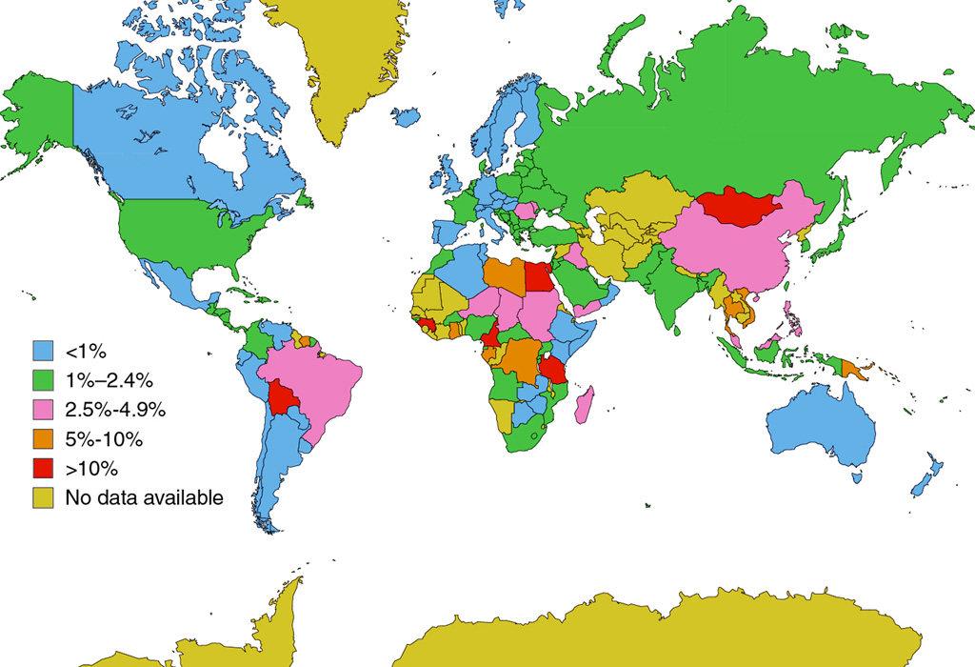
Hepatitis C

Slide 27
AGE SPECIFIC PREVALENCE OF ANTIBODY TO HCV/ANTI-HCV AMONG HEALTHY SAUDIS
Age Group (years) | Community Based Study
 | No. tested | Anti-HCV Pos. (%) | Location
1 – 10 | 1214 490 677 1096 1019 | 0.6 0.0 0.4 0.9 1,9 | Central Province Eastern Province North-Western Province South-Western Province Southern Province
10 – 19 | 504 | 6 (1.2) | Gizan
20 – 29 | 361 | 4 (1.1) | Gizan
30 - 39 | 290 | 6 (2.1) | Gizan
40 – 49 | 183 | 6 (3.3) | Gizan
> 50 | 144 | 5 (3.5) | Gizan
Total | 1482 | 27 (1.8) | Gizan
Al-Faleh et al, Hepatology Vol. 14(2), 1991

Slide 28
PREVALENCE OF ANTIBODY TO HCV TO SAUDI HIGH RISK GROUPS
High Risk Group | No. Tested | No. Pos. | % | Location
Hemophiliacs | 28 | 22 | 78.6 | KKUH, Riyadh
Thalassaemia and sickle cell disease | 78 | 26 | 33.3 | KKUH, Riyadh
β-thalassaemia major | 20 | 14 | 70.0 | KKUH, Riyadh*
Sickle cell anaemia | 55 | 10 | 18.2 | KKUH, Riyadh*
Patients with sexually transmitted diseases | 220 | 35 | 15.9 | KKUH, Riyadh*
2nd-generation anti-HCV tests and confirmation were only done
in this study.

Slide 29
ANTI-HCV IN HAEMODYLYSIS PATIENTS IN SAUDI POPULATION
Author | No. of Persons | Type of Test | %
Fakunle et al | 895 | ELISA I | 53.7
Al-Mugeriren et al | 20 Children | ELISA I | 45.0
Ayoola et al | 74 | ELISA I | 41.9
Huraib et al | 22 HD Centre 1147 Persons | ELISA II | 68.8

Slide 30
Hepatitis C Virus Genotypes
11( 6 major) with many subtypes and quasispecies
The predominate genotype in Saudi is Genotype 4 (62.9% )
Europe & America Genotype 1→ 75 (24.8) %
→ severe disease
Genotype 2 = 10.8 (7.4) %
Genotype 3 = 5.8 (5.9) %
Genotype 1 & 4 → Poor response to therapy

Slide 31
Natural History of HCV Infection
Exposure
(Acute phase)
15% (15)
85% (85)
HIV and
Alcohol
Resolved
Chronic
80% (68)
20% (17)
Stable
Cirrhosis
75% (13)
25% (4)
Slowly
Progressive
HCC
Transplant
Death
MJ Semin Liver Dis 1995; 15:
Management of Hepatitis C NIH Consensus Statement 1997; March 24-26:15(3).
Notes:
Natural history of HCV Infection
The natural history of hepatitis C evolves over the course of decades and can be considered to have three distinct stages. The first is the stage of resolution of recovery. This is seen in approximately 15% of patient with viremia and acute hepatitis followed by resolution of viremia with the persistence of antibody. The second stage is the stable chronic course in which patients have viremia and acute hepatitis with subsequent decrease in ALT. The patient may experience periodic elevations of liver enzymes and persistent viremia for several years. This is the most common stage and is seen in approximately 80% of the patients. During this stage it is believed that patients may experience the emergence of quasispecies and relative ineffectiveness of neutralizing antibodies. The last stage is that of severe progression of the disease and occurs in approximately 20% of the patients. The patient will experience more persistent elevation of liver enzymes, persistent viremia, and a more rapid progression to cirrhosis and possibly even hepatocellular carcinoma.
HIV and alcohol should be considered as important cofactors in hepatitis C and the progression to cirrhosis. There is evidence to suggest a greater than 15 fold increase in the incidence of cirrhosis in alcoholic patients and a >5 fold increase with HIV.
References:
1. Alter MJ. Epidemiology of Hepatitis C in the West. Semin Liver Dis. 1995; 15: 5-14
2. Management of Hepatitis C. NIH Consensus Statement. 1997; March 24-26: 15(3).

Slide 32
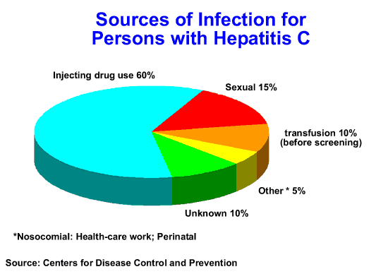

Slide 33

Important HCV Transmission Modes
Blood transfusion
IV drug abuse
80% infected in first year
1:100,000 in US

Slide 34


Un-common HCV Transmission Modes
Household transmission
?
Vertical transmission mother - Child
1-5%
Needle stick injury
3%

Slide 36
Features of Hepatitis C Virus Infection
Incubation periodAverage 6-7 weeks
Range 2-26 weeks
Acute illness (jaundice) Mild (<20%)
Case fatality rate Low
Chronic infection 60%-85%
Chronic hepatitis 10%-70%
Cirrhosis <5%-20%
Mortality from CLD 1%-5%
Age-
related

Slide 37
Chronic Hepatitis C
Factors Promoting Progression or Severity
Increased alcohol intake
Age > 40 years at time of infection
HIV co-infection
Other
  Male gender
  Chronic HBV co-infection

Slide 38
Serologic Pattern of Acute HCV Infection with Progression to Chronic Infection
anti-HCV
Symptoms +/-
HCV RNA
Titer
ALT
Normal
0
1
2
3
4
5
6
1
2
3
4
Months
Years
Time after Exposure

Slide 39
Perinatal Transmission of HCV
Transmission only from women HCV-RNA positive at delivery
  Average rate of infection 6%
  Higher (17%) if woman co-infected with HIV
  Role of viral titer unclear
No association with
  Delivery method
  Breastfeeding
Infected infants do well
  Severe hepatitis is rare

Slide 40
Sexual Transmission of HCV
Case-control, cross sectional studies
  Infected partner, multiple partners, early sex, non-use of condoms, other STDs, sex with trauma, Partner studies
  Low prevalence (1.5%) among long-term partners
    infections might be due to common percutaneous exposures (e.g., drug use), BUT
  Male to female transmission more efficient
    more indicative of sexual transmission

Slide 41
Household Transmission of HCV
Rare but not absent
Could occur through percutaneous/mucosal exposures to blood
  Contaminated equipment used for home therapies
    IV therapy, injections
  Theoretically through sharing of contaminated personal articles (razors, toothbrushes)

Slide 42

Public Health Service Guidelines for
Anti-HCV-Positive Persons
Anti-HCV-positive persons should:
Be considered potentially infectious
Keep cuts and skin lesions covered
Be informed of the potential for sexual transmission
Be informed of the potential for perinatal transmission
  no evidence to advise against pregnancy or breastfeeding
Anti-HCV-positive persons should not:
Donate blood, organs, tissue, or semen
Share household articles (e.g., toothbrushes, razors)
Notes:
[SLIDE 64] Public Health Service Recommendations for Counseling Anti‑HCV‑Positive Persons
Anti‑HCV‑positive persons should:
Be considered potentially infectious.
Keep cuts or skin lesions covered to prevent the spread of infectious secretions or blood.
Be informed of the potential for sexual transmission of HCV. HCV transmission by sex contact appears to occur, but this route of transmission appears to be much less efficient than for other bloodborne sexually transmitted diseases (e.g., HBV, HIV). For persons with a steady sex partner, data are insufficient to recommend changes in sex practices. However, to prevent many sexually transmitted diseases, including hepatitis and HIV infection, persons with multiple sex partners should follow safer sex practices, including reducing the number of sex partners and using barriers (e.g., latex condoms) to prevent contact with body fluids.
Be informed of the potential for perinatal transmission of HCV. The risk of perinatal transmission appears to be low (<10%). At the present time, there is no evidence to support advising against pregnancy or breastfeeding based on anti‑HCV status alone, or to advise any special treatments or precautions for pregnant women or their offspring.
Anti‑HCV‑positive persons should not:
Donate blood, body organs, other tissue, or semen.
Share personal articles such as toothbrushes and razors that could be contaminated with blood.

Slide 43
Hepatitis D

Slide 44
Hepatitis D (Delta) Virus
δ antigen
HBsAg
RNA
HDV is a defective single‑stranded RNA virus (delta Ag)
It requires HBV for synthesis of envelope protein composed of HBsAg

Slide 45
Hepatitis D - Clinical Features
Coinfection with HBV
  severe acute disease
  low risk of chronic infection
Superinfection on top of chronic HBV
  usually develop chronic HDV infection
  high risk of severe chronic liver disease
Notes:
20
20
20

Slide 46
Hepatitis D Virus
Modes of Transmission
Percutanous exposures
  injecting drug use
Permucosal exposures
  sex contact
Notes:
21
21
21

Slide 47
Hepatitis D - Prevention
HBV-HDV Coinfection
  Pre or postexposure prophylaxis to prevent HBV infection (HBIG and/or Hepatitis B vaccine)
HBV-HDV Superinfection
  Education to reduce risk behaviors among persons with chronic HBV infection
Notes:
25
25
25

Slide 48
Hepatitis E

Slide 49
Hepatitis E - Clinical Features
Incubation period: Average 40 days
Range 15-60 days
Case-fatality rate: Overall, 1%-3%
Pregnant women, 15%-25%
Illness severity: Increased with age
Chronic sequelae: None identified
Notes:
27
27
27

Slide 50
Hepatitis E - Epidemiologic Features
Most outbreaks associated with
fecally contaminated drinking water
Minimal person-to-person transmission
Notes:
29
29
29

Slide 51
Geographic Distribution of Hepatitis E
Outbreaks or Confirmed Infection in >25% of Sporadic Non-ABC Hepatitis
Notes:
30
30
30

Slide 53

References
1-Nelson KE, Thomas L. Viral hepatitis. In: Infectious disease Epidemiology, theory and Practice. 2nd edition . Edited by Nelson KE and Williams CM 2007. Published by Jones & Bartlett. Toronto Pages895-939.

