Slide 1

Immunization and vaccination
Prof Awatif Alam
KSU Department of Family & Community Medicine
(October, 2013)

Slide 2
Objectives of the session
By the end of the session the students should be able to;
Mention types of immunity
List important immunizable diseases
Describe the compulsory childhood vaccination schedule practiced in KSA
Understand the importance of maintenance of the Cold Chain

Slide 3
CONCEPTS
Why immunize ?
Types of immunity
Classes of vaccines
KSA Compulsory immunization schedule
Female adult immunization
Immunization for special occupations
The Cold Chain

Slide 4
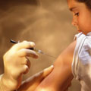
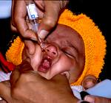
Why to Immunize?
Immunization has helped reduce the impact of communicable disease on health and wellbeing
Some diseases have been well controlled and other eliminated from some parts of the world because of vaccination
Stopping vaccination may again lead to epidemic

Slide 5
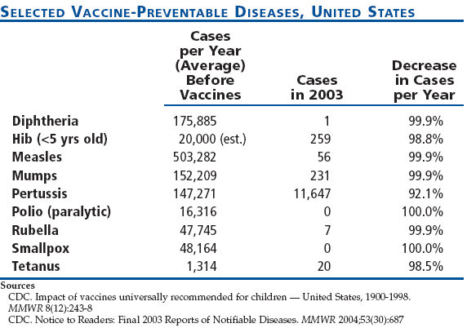

Slide 6
Acquired immunity
Immunity
Artificial
Active
(Post-vaccination)
Live attenuated Vaccine
Killed/
Inactivated
Passive
(Immune serum)
Homologous
Heterologous
Natural
Active
Subclinical
Infection
Clinical
Infection
Passive
Trans-
placental
Subunit

Slide 7
The immune system

Slide 8
Types of Immunity 2
Immunity
The ability of the human body to tolerate the presence of
material indigenous to the body (“self”), and to
eliminate foreign (“non self”) material.
Active Immunity
Protection of persons by their immune system
Usually life-long
Passive immunity
Immuno globulins and immune sera
Temporary protection,
Wanes with time

Slide 9
Vaccination
A method of giving antigens to stimulate the immune response through active immunization.
A vaccine is an immuno-biological substance designed to produce specific protection against a given disease.
A vaccine is “antigenic” but not “pathogenic”.

Slide 10
Antigens & Antibodies
Antigen
A live or inactivated substance (e.g., protein, polysaccharide) capable of producing an immune response
Protein molecules (immunoglobulins) produced by B lymphocytes to help eliminate an antigen
Antibody

Slide 11
Immunotherapy – preformed Ab
Immune serum globulin – (gamma-globulin) contains immunoglobulin extracted from the pooled blood of human donors.
Treatment of choice for preventing measles, hepatitis A and replacing Ab in the immune deficient.
Lasts 2-3 months.

Slide 12
Immunotherapy – preformed Ab
Specific immune globulin- prepared from convalescent patients in a hyperimmune state
Contains high titer of specific Ab.
Pertussis, Tetanus, Chickenpox, Hepatitis B.
Sera produced in horses are available for Diphtheria, Botulism, Spider and Snake bites.
Act immediately and can protect patients for whom no other useful medication exists.

Slide 13
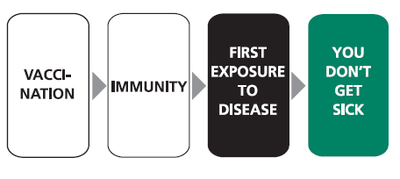
How vaccines work?

Slide 14
Classification of types of Vaccines
  Live attenuated
    Viral
    Bacterial
  Inactivated
    Whole
      Viral
      Bacterial
    Fractional
      protein-based
        toxoid
        subunit
      polysaccharide-based
        pure
        conjugate

Slide 15
Live Attenuated Vaccines
Attenuated (weakened) form of the "wild" virus or bacterium
Must replicate to be effective
Immune response similar to natural infection
Usually effective with one dose*
Severe reactions are possible
Interference from circulating antibodies are possible
Fragile – must be stored and handled carefully
*except those administered orally

Slide 16
Examples of Live Attenuated Vaccines
Viral e.g. measles, mumps,
rubella, yellow fever, influenza, oral polio
Bacterial BCG, oral typhoid

Slide 17
Inactivated Vaccines
Cannot replicate
Less interference from circulating antibody than live vaccines
Generally require 3-5 doses
Immune response mostly humoral
Antibody titer diminishes with time

Slide 18
Examples of Inactivated Vaccines
Viral
  Inactivated polio vaccine (IPV), Hepatitis A, Influenza, Rabies
Bacterial
  Pertussis, Typhoid, Cholera, Plague
Subunit
  Hepatitis B
Toxoid
  Tetanus, Diphtheria

Slide 19
Cellular fraction (Polysaccharide) vaccines
They are prepared from extracted cellular fractions e.g. N. meningitidis (A,C,Y,W-135); meningococcal vaccine from the polysaccharide antigen of the cell wall
Strept. Pneumoniae; pneumococcal vaccine from the polysaccharide contained in the capsule of the organism
Their efficacy and safety appear to be high.

Slide 20
Conjugate vaccine
Haemophilus influenza B (Hib) vaccine; gives long-term protection from Haemophilus influenza type B the leading cause of meningitis in children under 5 years.

Slide 21
Surface antigen (recombinant) vaccines
It is prepared by cloning HBsAg gene in yeast cells where it is expressed. HBsAg produced is then used for vaccine preparations.
Their efficacy and safety also appear to be high.

Slide 22
Toxoids
Prepared by detoxifying the exotoxins of some bacteria rendering them antigenic but not pathogenic.
Adjuvant (e.g. alum precipitation) is used to increase the potency of vaccine.
The antibodies produced in the body neutralize the toxic part produced during infection rather than act upon the organism itself.
In general toxoids are highly efficacious and safe immunizing agents.

Slide 23
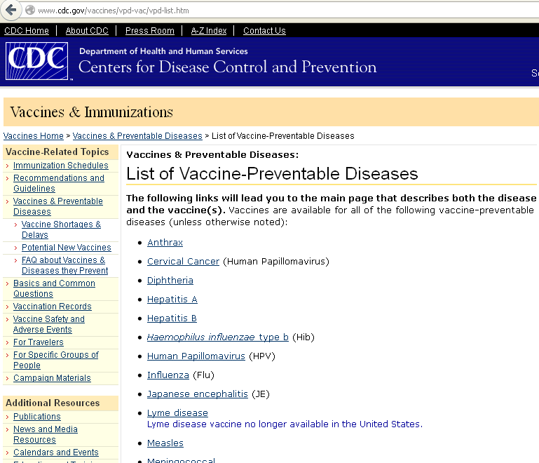

Slide 24
Childhood Immunization Schedule in KSA - 2013
Age: | Vaccines:
At birth | BCG / Hepatitis B
2 Months | IPV /DTaP / Hepatitis B/ Hib/Pneumococcal Conjugate (PCV)/Rota
4 Months | IPV /DTaP / Hepatitis B/ Hib/Pneumococcal Conjugate (PCV)/Rota
6 Months | OPV/IPV /DTaP/ Hepatitis B/ Hib/Pneumococcal Conjugate (PCV)
9 Months | Measles / Meningococcal Conjugate quadrivalent (MCV4)
12 Months | OPV/ MMR/ Pneumococcal Conjugate (PCV)/Meningococcal Conjugate quadrivalent (MCV4)
18 Months | OPV/DTaP/Hib/ MMR/ Varicella/ Hepatitis A
24 Months | Hepatitis A
First class Primary School age | OPV/ DTaP(Td) / MMR/Varicella

Slide 25
Doses & Routes of administration
Vaccine | Dose | Route
BCG | 0.05 ml | ID or SC (left arm)
DPT | 0.5 ml | IM (right or left side of thigh)
Hepatitis B (HBV) | 0.5 ml | IM
Haemophilus Influenza b (Hib) | 0.5 ml | IM
MMR | 0.5 ml | SC
OPV | 2 drops | Oral
BCG = Bacillus Calmette – Guerin vaccine (tuberculosis).
DPT = Diphtheria, pertussis and tetanus vaccine.
MMR = Live measles, mumps and rubella viruses in a combined vaccine.
OPV = Oral Poliovirus vaccines containing attenuated poliovirus types 1,2 and 3
Intradermal = ID Subcutaneous= SC Intramuscular= IM

Slide 26
Factors influencing recommendations concerning the age of vaccination
Age-specific risks of diseases
Age-specific risks of complications
Ability of persons of a given age to respond to the vaccine(s)
Potential interference with the immune response by passively transferred maternal antibody (e.g., measles vaccine)

Slide 27
Active immunization for adult females
MMR vaccine is given in adolescence before or after marriage, but not during pregnancy and has to be at least 3 months before conception,
Tetanus toxoid in indicated during pregnancy to prevent tetanus neonatorum in the newborn, or puerperal sepsis of the mother.
The first dose is given on the third month and after 1 month. The third dose in the second pregnancy, and the fourth on the third pregnancy with a maximum of 5 doses.
If 10 years elapse, and then pregnancy occurs, the doses are given from the start.
Live attenuated vaccines are contraindicated during pregnancy.

Slide 28
Vaccination for special occupations
Health care workers: hepatitis B, influenza, MMR, polio
Public safety personnel (police, fire fighters) and staff of institutions for the developmentally disabled: hepatitis B, influenza
Vetenerarians and animal handlers: rabies, plague and anthrax
Sewage workers: DT, hepatitis A, polio, TAB (Typhoid vaccine)
Food handlers: TAB
Military troops and camp dwellers: pneumococcal, meningococcal, influenza, BCG (for non reactors), tetanus

Slide 29
Invalid Contraindications to Vaccination
Mild illness
Mild/moderate local reaction or fever following prior dose
Antibiotic therapy
Disease exposure or convalescence
Pregnancy in the household
Premature birth
Breast feeding
Allergies to products not in vaccine
Family history not related to immuno-suppression

Slide 30
Vaccine potency
All vaccines are thermo-sensitive and need to be properly stored and distributed within an efficient cold chain system

Slide 31
The cold chain system
Refers to the system (personnel, equipment & procedure) used for keeping and distributing vaccines in good condition.
When implemented properly, can help overcome the challenge of the delivery of quality vaccines.
Can enhance the on-going quality, safety and efficacy of an immunization programme.

Slide 32
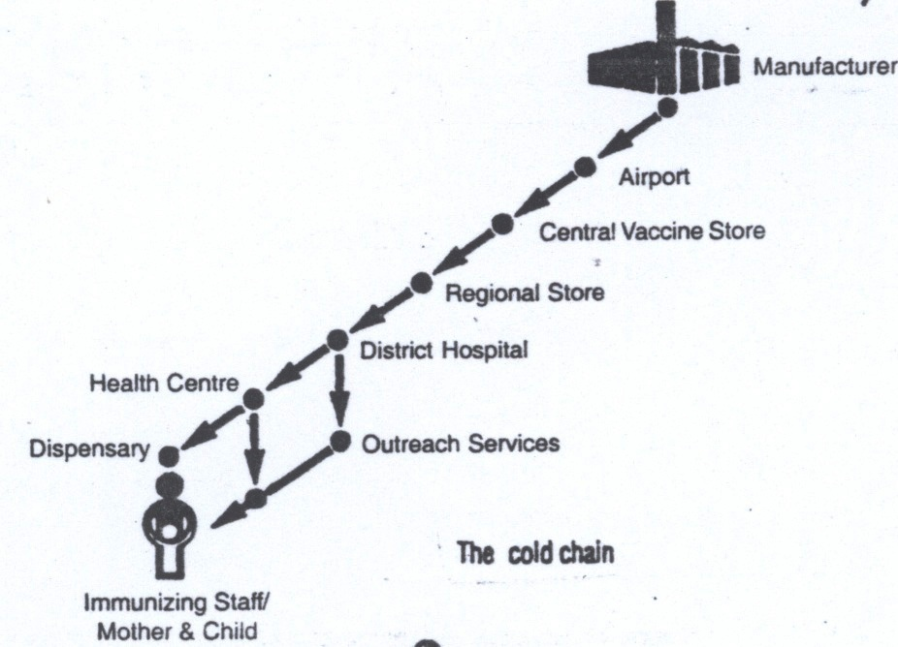

Slide 33
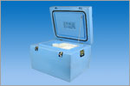
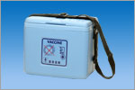
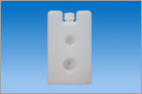
Examples of Cold Chain Instruments

Slide 34
Guidelines for Maintaining and Managing the Vaccine Cold Chain
http://www.cdc.gov/mmwr/preview/mmwrhtml/mm5242a6.htm#tab1

Slide 35
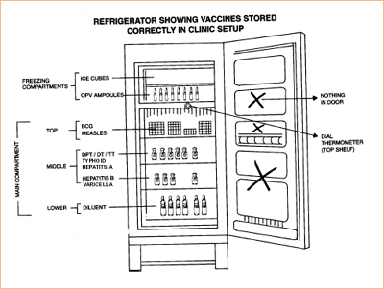
The proper temperature to keep vaccines at the health center level is (+2 to +8)

Slide 36
Heat Sensitivity of vaccines
Live oral polio vaccine (OPV)
BCG (Lyophilized) *
Measles (Lyophilized) *
Rubella and Mumps (Lyophilized)
Adsorbed Diphtheria-Pertussis-Tetanus vaccine (DPT)
Adsorbed Diphtheria-Tetanus vaccine (DT, Td)
Tetanus Toxoid (TT)
Hepatitis A
Hepatitis B
* Note: These vaccines become much more heat sensitive after they have been reconstituted with diluents.
Most sensitive
Least sensitive
Notes:
All vaccines are thermo-sensitive and need to be properly stored and distributed within an efficient cold chain system.
The stability of vaccines varies considerably (Galazka et al. 1998):
Diphtheria and tetanus toxoids and hepatitis B vaccine showing the highest thermostability,
Freeze-dried measles, yellow fever and BCG vaccines occupying the middle position and
Oral poliomyelitis vaccine being the most fragile.

Slide 37
Conclusions about Immunizations
Why to immunize
Diseases that childhood vaccines prevent
Number of immunization doses /schedule in the country
Like any medicine, there may be minor side effects
It's extremely rare, but vaccines can cause serious reactions -- weigh the risks!
What to do in case of a serious reaction
Why you should not wait to vaccinate
Be sure to track the shots via a health record

