Slide 1
Outbreak investigation Tutorial
Dr. Hafsa Raheel

Slide 2
Objectives
Understanding the steps to outbreak investigation
Discussing new terminology
Interpretation of epidemic curves
Understanding different determinants of infectious disease (human, agent, environment)

Slide 3
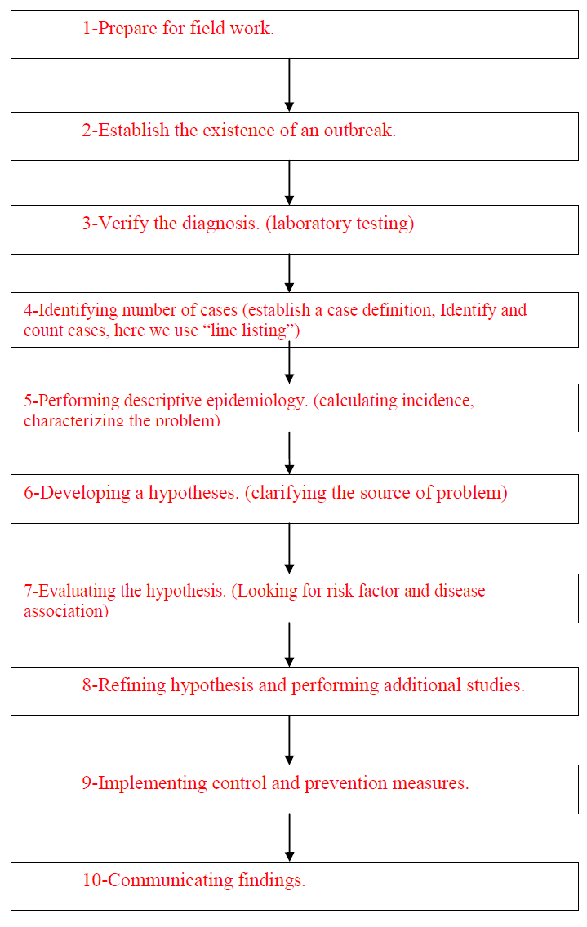
Steps for outbreak investigation

Slide 4
What is meant by “cross-contamination”?
Terminology
It is the transfer of micro-organisms or toxins from foods, hands, utensils or food preparation surfaces to a food.
(e.g. Transfer of micro-organisms from dirty hands of a food handler to food, transfer of micro-organisms from raw meat to food, transfer of micro-organisms from contaminated water to food.)

Slide 5
Terminology cont.
What is meant by “infectious dose”?
It is number of organisms that must be consumed in order to give rise to symptoms of a food-borne illness.

Slide 6
Terminology cont.
In order to detect the number of cases in an outbreak investigation, one must first identify a case definition.
What does “case definition” mean?
It is a group of criteria that helps us decide whether a person has a particular health-related condition or not. These criteria are usually specified by time, person and place.
Notes:
e.g. A group of students studying at KSU campus, who ate at the college of science cafeteria experienced diarrheal illness between the months of January and February. In this example our case definition must fulfill all the following criteria:
1-students who ate at the KSU college of science cafeteria
2-during a time period from January to February
3-students experiencing symptoms of vomiting, diarrhea, abdominal pain or fever.

Slide 7
Terminology cont.
In the Salmonella outbreak example, health care workers identified cases in “report cards” and then forwarded them to the local healthcare department. This helped the local health department to form a “line list” of cases.
What is “Line listing”?
It is a table that helps identify number of diagnosed cases and information relevant to disease outbreak. The columns represent specific patient information and the rows represent each case.

Slide 8
Line listing
What information would you like to include in the line list?
Identifying information: name, address, contact information.
Demographic information: Age, sex, date of birth, current status(dead or alive)
Clinical information: date of report, date of onset of symptoms, presenting symptoms, diagnosis, laboratory findings.
Relevant risk factor information: last meal eaten (what and where), contact with animal, ingestion of undercooked meat, ingestion of water from contaminated source.

Slide 9
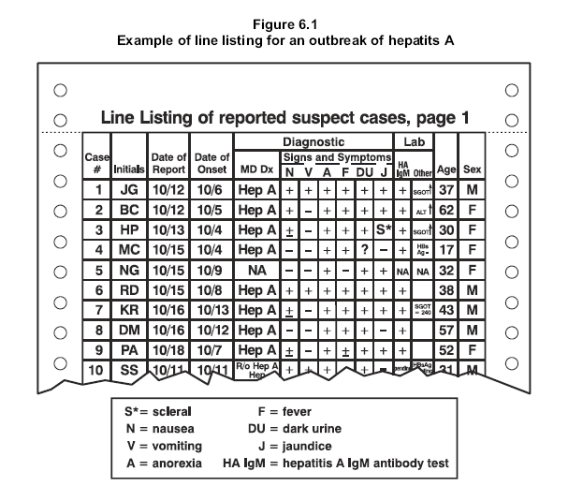
Line list

Slide 10
In the Salmonella outbreak example, after surveillance of reported cases, they found that cases reported in the country were actually LOWER than what was expected in the Caribbean region. Why is that?
This is because of 2 reasons:
There might be a problem in the reporting system (under-reporting, delay in reporting)
There might be a problem in disease diagnosis and detection (lack of accurate microbiology techniques)

Slide 11
Figure 1. Laboratory confirmed cases of Salmonella by year of diagnosis in Trinidad and Tobago, Years 1989-1997.
What is missing in figure 1? Do you think it is a proper epidemic curve?

Slide 12
What would you label the Y axis and what would you label the X axis?
What do you notice about the number of cases between 1992 and 1996?
What could be reasons for that?
1-Increase in the number of reporting, because of improved methods of reporting.
2-Improved method of diagnosis.
3-Improved surveillance that detects number of cases better.

Slide 13
Figure 1. Laboratory confirmed cases of Salmonella by year of diagnosis in Trinidad and Tobago, Years 1989-1997.
In what year were the reported confirmed cases the most?
In what year were the reported confirmed cases the least?

Slide 14
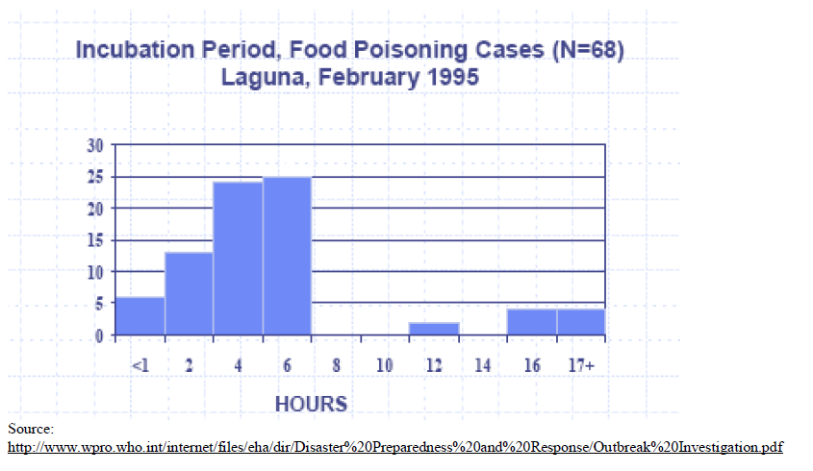
68 residents of Laguna presented with symptoms of vomiting, diarrhea and abdominal pain, over a time period of 17 hours. After thorough surveillance, the investigators came up with the following epidemic curve.
What type of outbreak is this? Why?
Notes:
This is a point source (common source) outbreak:
The number of cases rose up rapidly to a peak (after 6 hours) and
the majority of cases occurred within one incubation period (6 hours). This means that all victims acquired the infection from the same source.

Slide 15
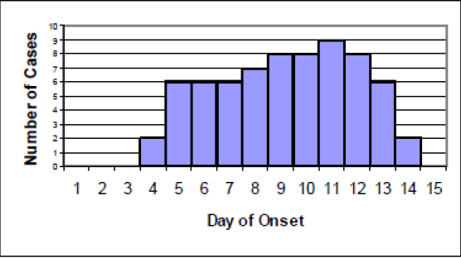
Epidemic curve that shows the number of cases detected with Hepatitis A infection.
What type of outbreak is this? Why?

Slide 16
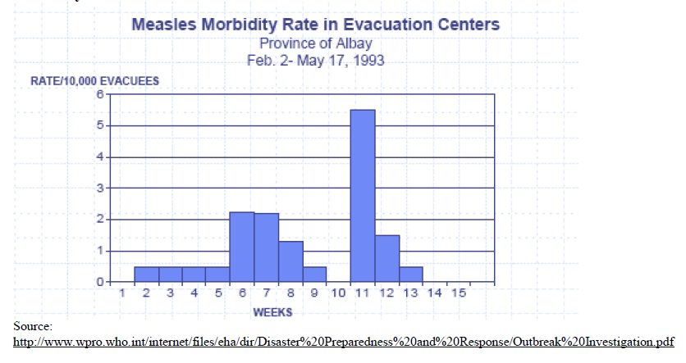
The following figure was drawn from an outbreak of measles in evacuation centers in Albay, 1993.
What type of outbreak is this? Why?

Slide 17
Please complete the table bellow about Non- typhoidal Salmonellosis:
Item | Explanation
Signs and symptoms
Risk factors
Mode of transmission
Diagnosis
Prevention and control measures

Slide 18
Thank you!

