Slide 1

Disabilities & Impairments:
An Overview
Prof.Awatif Alam & Ahmed Mandil
KSU
Dept of Family & Community Medicine

Slide 2
Objectives
At the end of this lecture, the student should be able to:
Describe the concepts of disabilities
Understand how people get disabled in their daily lives
Describe the different types of disabilities
Understand principles of injury prevention and control

Slide 3
Etiology:
Intrinsic vs Extrinsic,
Primary vs Secondary.
Classification:
Physical,
Mental,
Social.

Slide 4
CONCEPTS & DEFINTIONS

Slide 5
Definition of “Health”
Health was defined by the WHO as:
‘‘a state of complete physical, mental and social well being and not merely the absence of disease or infirmity’’.
More recently, the concept has been extended to
include health-related quality of life.
Today, the International classification of impairments, disabilities and handicaps (ICIDH) provides indicators that allow a more structured approach to health disorders.

Slide 6
Quality of life:
In 1993, WHO put forward a definition of
quality of life linked to health:
“ The perception by individuals of their position in life, in the context of the culture and value systems in which they live and in relation to their goals, expectations, standards and concerns” .

Slide 7
Scheme for Assessing Non-fatal
Health Outcomes
Disease Impairment
Polio Paralyzed legs
Brain Mild mental
injury retardation
Disability Handicap
Inability Unemployed
to walk
Difficulty Social
learning isolation

Slide 8
Definitions
Impairment: loss or abnormality of psychological, physiological, or anatomical structure or function.
Disability: any restriction or lack of ability to perform an activity in the manner or within the range considered normal.
Handicap: disadvantage resulting from impairment or disability that limits or prevents the fulfillment of a role that is normal (depending on age, sex, social, and cultural factors).

Slide 9
International Classification (ICIDH) :
An impairment:
“ any temporary or permanent loss or abnormality of a body structure or function , whether physiological or psychological“.
An Impairment is a disturbance affecting functions that are essentially :
Mental (memory, consciousness) or
Sensory, or
Internal organs(heart, kidney),
The head,
The trunk or the limbs..

Slide 10
Commonly reported Impairment indicators
General impairment, movement-related impairment
Major mental impairment
Severe hearing impairment ,blindness, amblyopia
Autism, psychosis, cervical column pain
Vertebral column pain
Unspecified pains, self-perceived chronic health disorders, ‘‘Do you suffer from a chronic disease?’’,
Musculoskeletal, sensory, digestive ,
Cardio- pulmonary, or
Psychoaffective impairments

Slide 11
Problems with Human Functioning (I): Impairments (ICF)
Problems in body function or alterations in body structure – for example, paralysis or blindness.
Any loss or abnormality of psychological, physiological or anatomic structure or function
Permanent impairment: impairment that has become static or well stabilized with or without medical treatment, not likely to remit despite medical treatment

Slide 12
International Classification of Functioning, Disability and Health (ICF)
ICF is a classification of health and health-related domains.
These domains are classified from body, individual and societal perspectives by means of two lists:
a list of body functions and structure, and
a list of domains of activity and participation.
Since an individual’s functioning and disability occurs in a context, the ICF also includes a list of environmental factors.

Slide 13
ICF
ICF was endorsed for use in Member States as the international standard to describe and measure health and disability.
ICF acknowledges that every human being can experience a decrement in health and thereby experience some degree of disability and recognizes it as a universal human experience.
ICF takes into account the social aspects of disability and does not see disability only as a 'medical' or 'biological' dysfunction.
ICF allows to records the impact of the environment on the person's functioning .

Slide 14
Source of Concepts for Measurement: ICF Model
Health Condition
(disorder or disease)
Body Functions & Structure
Activity
Participation
Environmental Factors
Personal Factors
Source: ICIDH-2, 1999

Slide 15
Disability Concepts for the Model of Public Health
Life course
  Life long disability
  Age (or other) transition into & out of disability
Environment
  Built, social, policy, think *ADA
Community
  Where we live
  disability culture
Individual
  Impairment & other intrinsic & acquired experiences e.g., education
Policy & programs
  Centers for Independent Living
  UCEDDs
  *the ADA is an "equal opportunity" law for people with disabilities

Slide 16
ICIDH:
A disability:
“any restriction or inability to perform an activity in the manner or within the range considered normal for a human being, mostly resulting from impairment”.
The term reflects the consequences of impairment in terms of functional performance and activity by the individual disability thus represents disturbances at the level of the person.

Slide 17
Commonly used disability indicators
Functional limitation indicators assessed movement-related disorders; sleep disturbances ;
(Disability in the sphere of physical self-care, defined as involving at least one difficulty in eating, dressing, washing, using the toilet or cutting one’s toenails) ;
( Mobility-related disability, defined as involving at least one difficulty in walking on a flat surface or going up or down stairs) .
Activities of daily living (ADLs).
A general indicator, referring to unspecified
disability, related to a rheumatic or chronic impairment.

Slide 18
Disability I
Disability is complex, dynamic, multidimensional, and contested.
The role of social and physical barriers in disability have been identified.
The transition from an individual medical perspective to a structural social perspective has been described as the shift from a “medical model” to a “social model” in which people are viewed as being disabled by society rather than by their bodies.
A balanced approach is needed, giving appropriate weight to the different aspects of disability.

Slide 19
Disability - II
Disability results from the interaction
between persons with impairments and
attitudinal and environmental barriers that hinder their full and effective participation in society on an equal basis with others
Disability is the umbrella term for impairments, activity limitations and participation restrictions, referring to the negative aspects of the interaction between an individual (with a health condition) and that individual’s contextual factors (environmental and personal factors)

Slide 20
Handicap:
“ Reduction in person’s capacity to fulfill a social role as a consequence of an impairment, inadequate training for the role, or other circumstances”.
Applied to children, the term usually refers to: “the presence of an impairment or other circumstances that are likely to interfere with normal growth and development or with the capacity to learn.”

Slide 21
Physical handicap:
Broad causative categories include:
Birth defects,
Infections, and
Accidents.
Examples include the blind, deaf, and mute, cleft palate ,telipes and the “crippled”
eg. resulting from polio, CP, CHD,RTA’s, burns ,injuries, etc.

Slide 22
Domains of Human Functioning
Mobility: moving around, vigorous activity
Self-care: appearance, grooming
Pain: bodily aches, discomfort
Cognition: remembering, learning
Interpersonal relationships: community participation, dealing with conflicts
Vision: distance vision, near vision
Sleep and energy: falling asleep, feeling rested
Affect: feeling depressed, worry, anxiety

Slide 23
Problems with Human Functioning (II)
Activity limitations (ICF): difficulties in executing activities – for example, walking or eating
Participation restrictions (ICF): problems with involvement in any area of life – for example, facing discrimination in employment or transportation

Slide 24
Mental handicap:
Represents mental retardation.
A sub average intellectual function combined with deficits in adaptive behavior.
Causes: (congenital or acquired)
Genetic.
Antenatal.
Perinatal.
Postnatal.
Miscellaneous.

Slide 25
Genetic causes of mental retardation:
Down’s syndrome,
Klinefelter syndrome,
PKU,
Tay-Sach disease,
Galactosaemia,
Microcephaly,
Congenital hypothyroidism,
Chromosomal abnormalities.

Slide 26
Mental handicaps:
Antenatal factors :
Neural tube defects,
Rh incompatibility,
Infections eg rubella,CMV, TP, Syphilis,
Drugs
Irradiation .
Perinatal factors :
Birth injuries,
Hypoxia,
Cerebral palsy.

Slide 27
Mental handicaps:
Postnatal factors:
Head injuries,
Accidents,
Encephalitis,
Physical agents,
Chemical agents ( lead & mercury poisoning).
Miscellaneous factors :
Maternal malnutrition,
Protein-energy malnutrition,
Iodine deficiency(endemic goiter),
Consanguineous marriages,
Pregnancy after age of 40.

Slide 28
LEARNING DISABILITIES

Slide 29
Warning Signs
Spoken Language
  Delays, disorders, deviations in listening and speaking
Written Language
  Difficulties with reading, writing, and spelling
Arithmetic
  Difficulties in performing arithmetic operations or in understanding basic concepts
Reasoning
  Difficulties in organizing and integrating thoughts
Memory
  Difficulty in remembering information and instructions

Slide 30
What is a learning disability?
Difficulties with academic achievement and progress; discrepancies exist between a person’s potential for learning and what s/he actually learns.
They show an uneven pattern of development (language, physical, academic)

Slide 31
Causes of learning disabilities
Some children develop and mature at a slower rate than others in the same age group (Maturational lag)
Some children with normal vision and hearing may misinterpret everyday sights and sounds (unexplained CNS disorder)
Injury before birth or in early childhood
Premature birth and children who had medical problems soon after birth
Inheritance
More common in boys (later maturation)

Slide 32
Magnitude & Causes

Slide 33
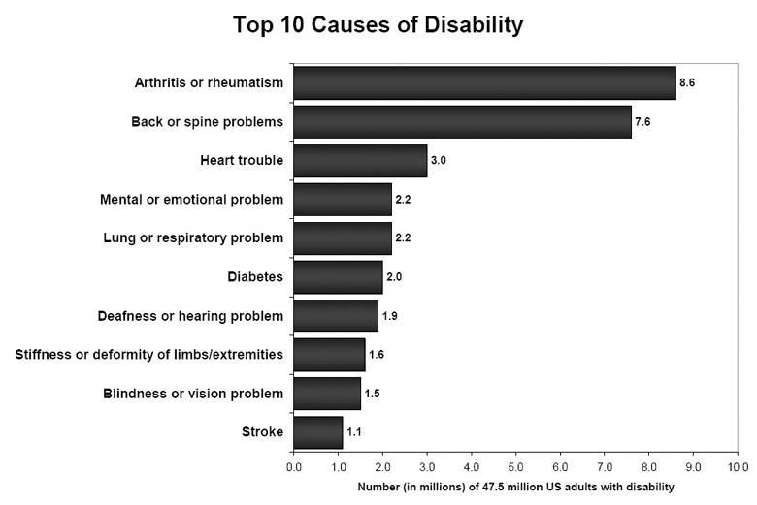

Slide 34
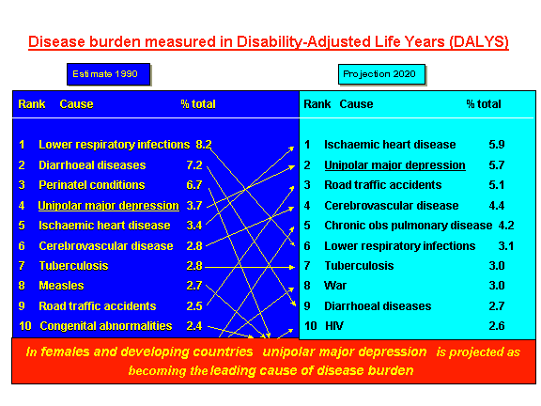

Slide 35
USA Estimates (1)
A CDC study in 2005 showed that 47.5 million US adults (21.8%) reported a disability, an increase of 3.4 million from 1999.
Arthritis or rheumatism continued to be the most common cause of disability, while back or spine problems and heart trouble round out the top three causes.
The number of people identifying the top two musculoskeletal conditions as the cause of their disability is increasing, but the number of people identifying heart disease as the cause of their disability is decreasing.

Slide 36
USA Estimates (2)
The number of people reporting a disability increases with age, and women have a higher prevalence of disability than men at all ages.
There are approximately as many "baby boomers" (ages 45–64; 17.3 million) affected now as older adults (age 65+, 18.1 million).
Given the size of the baby-boom generation, the number of adults with disability is likely to increase dramatically as the baby boomers enter into higher risk age groups over the next 20 years.

Slide 37
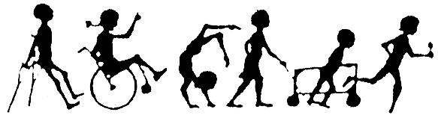

The Magnitude of Disability in the Eastern Mediterranean Region:

Slide 38
G. Fujiura – HD Learning Days
Epidemiology of Disablement:
Proportion of Lives Lived with Chronic Conditions
*Global burden of disease (GBD) Analysis suggests significantly higher rates of disablement and impact in underdeveloped regions of the world
Murray, C.J.L. & Lopez, A.D. (1996). The global burden of disease: A comprehensive assessment of mortality and disability from diseases, injuries, and risk factors in 1990 and projected to 2020. Cambridge, MA: Harvard University Press.

Slide 39
KSA Estimates (1)

Slide 40
KSA Estimates (2)

Slide 41
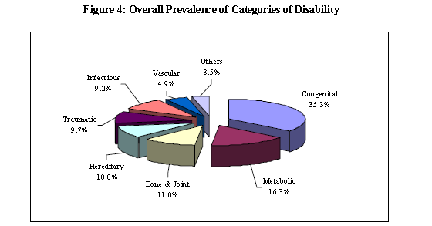

Causes of Disability, KSA

Slide 42
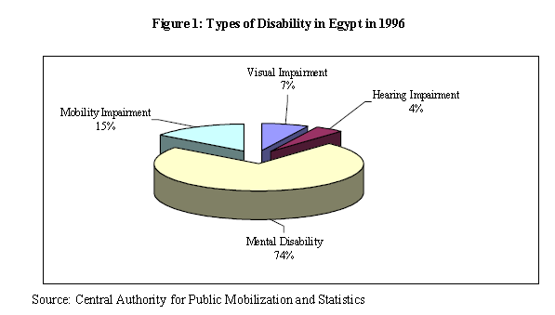
Egypt Estimates

Slide 43
Syria Estimates

Slide 44
PREVENTION & CONTROL

Slide 45
Primary Prevention
Secondary Prevention
Tertiary Prevention

Slide 46
Levels of Prevention
Primary: actions to avoid or remove the cause of a health problem in an individual or a population before it arises.
It includes health promotion and specific protection (for example, HIV education)

Slide 47
Primary Prevention:
Genetic counseling.
At-risk approach:
Identifying people with chromosomal or sex-linked diseases,
Offering the best available investigations,
Provision of competent advice regarding future risks.
Immunization.
Nutrition.

Slide 48
Levels of Prevention
Secondary: actions include:
Early detection of the health,
facilitating cure, or reducing or preventing spread, or reducing or preventing its long-term effects (for example, supporting women with intellectual disability to access breast cancer screening.

Slide 49
Secondary Prevention:
“ The broad objective is to bring people as close to normality as possible in their physical, mental and social dimensions”.
This involves:
Early diagnosis of handicap( through MCH services, or school health programs).
Treatment( PT, OT, ST, prosthetics, recreation)
Training and education ( vocational guidance).
“Physical Medicine and Rehabilitation”

Slide 50
Levels of Prevention
Tertiary: actions to reduce the impact of an already established disease by restoring function and reducing disease related complications (e.g. rehabilitation for children with musculoskeletal impairment)

Slide 51
COMMUNITY-BASED REHABILITATION

Slide 52
Community Based Rehabilitation 1 CBR
A strategy within general community development for rehabilitation which is currently implemented in over 90 countries throughout the world to address the needs of people with disabilities and their family members.
CBR aims to provide rehabilitation, reduce poverty, equalize opportunities and promote the inclusion of persons with disabilities in their communities.
CBR is implemented through the combined efforts of people with disabilities themselves, their families, organizations, and communities, and the relevant governmental and non-governmental sectors to provide health, education, vocational, social, and other services.

Slide 53
Community-Based Rehabilitation 2
Community-based rehabilitation (CBR) programs can challenge negative attitudes in rural communities, leading to greater visibility and participation by people with disabilities.
A three-year project in a disadvantaged community near Allahabad, India, resulted in children with disabilities attending school for the first time, more people with disabilities participating in community forums, and more people bringing their children with disabilities for vaccination and rehabilitation.

Slide 54
CBR
The new WHO/UNESCO/ILO/IDDC CBR guidelines were launched on 27 October 2010 in Abuja, Nigeria.
These guidelines focus on four key development areas:
health, education,
livelihood and social
promote mainstreaming and
empowerment of persons with disabilities and their family members.
CBR has become a flexible and dynamic strategy which can be adapted to suit different contexts, and where properly funded and supported, can make a contribution towards the implementation and achievement of the MDGs.
Link: http://www.who.int/disabilities/cbr/en/

Slide 55
“ Changing our attitudes and the environment, instead of trying to change people with disabilities, must be our mission if we ever hope to create a society where everyone is valued and everyone belongs”..

Slide 56
Can we reach public health?

Slide 57
Harvard Burden of Disease Unit
http://www.hsph.harvard.edu/organizations/bdu/
SF Burden of Disease and Injury Study
http://www.medepi.org/sfbdi/
World Health Report – 2002
http://www.who.int/whr/
WHO Comparative Risk Assessment Methods
http://www.ctru.auckland.ac.nz/CRA/
Thank you.

Slide 58
References (I)
Albrich GL. Encylopedia of Disability. Thousand Oaks, London, New Delhi: Sage Publications, 2006.
Seelman KD. Disability and public policy in the United States. School of Health and Rehabilitation Science, University of Pittsburgh
Lollar D. People with disabilities. In: Detels R, Beaglehole R, Lansang MA, Gulliford M (editors). Oxford Textbook of Public Health. 5th edition. The practice of public health. Oxford: Oxford University Press, 2009.

Slide 59
References (II)
Shahrour G. Regional Conference on: “Sharing Experience Best Practices in ICT Services for Persons With Disabilities”. Cairo: WHO/EMRO, 13-15 November, 2007
Economic Bureau - KSA. Profile on welfare and disability in the Kingdom of Saudi Arabia, 2000.
CDC. Prevalence and Most Common Causes of Disability Among Adults - United States, 2005. MMWR. 2009;58(16);421-426.

Slide 60
Other Resources
CDC Disability & Health web site. http://www.cdc.gov/ncbddd/disabilityandhealth/index.html
OHSU Institute on Development & Disability. www.ohsuidd.org
  Oregon Office on Disability & Health. www.oodh.org
My favorite disability video: Pepsi, 2008 Super Bowl portrays men who are deaf looking for “Bob’s House.” http://www.youtube.com/watch?v=ffrq6cUoE5A
Blog: Harriet McBryde Johnson http://julsland22.blogspot.com/2010/08/unspeakable-conversation-harriet.html
Institute of Medicine. The future of disability in America. Washington, D.C.: National Academies Press, 2007.
Global:
  Disabled Persons International. http://v1.dpi.org/lang-en/index
  Inclusion International. Inclusive communities = stronger communities. Global report on Article 19: The right to live & be included in the community. London: Inclusion International. http://www.inclusion-international.org/wp-content/uploads/Global-Report-Living-Colour-dr2-2.pdf
  World Health Organization disability model http://www.who.int/classifications/icf/en/
Textbooks:
  Lollar D, Andresen EM (Eds). Public health perspectives on disability: epidemiology to ethics & beyond. New York: Springer, 2010.
  Drum CE, Krahn GL, Bersani H (Eds). Disability & public health. Washington DC: APHA, 2009.

