Slide 1

Natural History & Spectrum of Diseases
Dr. Salwa A. Tayel & Dr. Mohammad Afzal Mahmood
KSU Department of Family & Community Medicine
September, 2013

Slide 2
OBJECTIVES OF THE LECTURE
By the end of this lecture students will be able to:
Describe natural history of diseases and their implications for public health.
Describe spectrum of diseases and their implications for public health.
2

Slide 3
Natural History of Disease

Slide 4
Natural history of disease
Natural history of disease refers to the progress of a disease process in an individual over time, in the absence of intervention.
The natural history of a disease describes the course of the disease in an individual starting from the moment of exposure to the causal agents till one of the possible outcomes occurs.
4
4

Slide 5
Natural history Phenomena
  Induction : time to disease initiation
  Incubation:– time to symptoms (infectious disease)
  Latency: time to detection (for non-infectious disease) or to infectiousness
Notes:
Several important landmarks in natural history are the initiation of the disease itself (however we are defining it), the onset of symptoms, the point where a disease can be and/or is usually detected, and for communicable diseases, the point when the disease becomes transmissible.
Epidemiology is still working on standardizing its terminology. The terms presented here are used by a major epidemiology textbook (Rothman and Greenland, Modern Epidemiology) to represent these four stages:
Rothman applies the term induction period to the period of time between exposure to a causal agent and the initiation of the disease. Since the etiology of many diseases involves a combination of factors, Rothman considers each causal agent as having its own induction period. The beginning of actual disease, even if it can be defined, is often unobservable. Nevertheless, the concept of the induction period is a useful one.

Slide 6
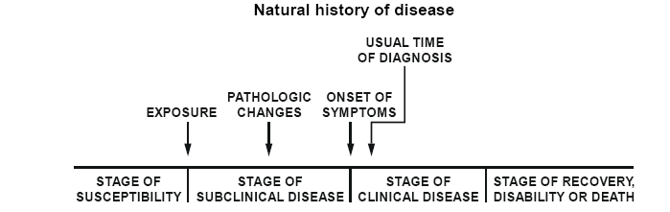
Natural history of disease
6
6

Slide 7
Natural history of disease
7
Notes:
19/2/2007
Dr. Salwa Tayel
7

Slide 8
Natural History of Disease
Detectable subclinical disease
Susceptible Host
Subclinical Disease
Clinical Disease
Outcome:
Stage of Recovery, Complications, Disability, or Death
Diagnosis sought
Point of Exposure
Onset of symptoms
Screening

Slide 9
The problem
The problem is that we might know about disease onset when symptoms occur but most likely we will only know about the disease when a person seeks care for the symptoms.
In some situations an investigator will only become aware of a case after a diagnosis is made.

Slide 10
Importance of studying
Natural history of disease
The understanding of this progression from disease onset to cure or death is important for epidemiologists.
Natural history is as important as causal understanding for the prevention and control of disease.
The earlier you can become aware of the attack the more likely you will be able to intervene and save lives.

Slide 11
Spectrum of disease
The idea that an exposure can lead to varying signs, symptoms and severity of the same disease in the population is the spectrum of disease.
Why do we have varying degrees of severity or outcome?
The outcome will depend on the interactions of host, agent and environmental factors.
11
11

Slide 12
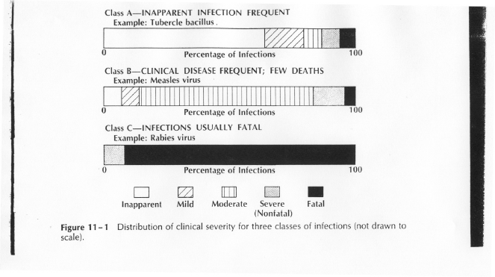
Classification of diseases according to clinical severity (spectrum of disease)
12
12

Slide 13
Class A: Inapparent infection
Examples: Tuberculosis, Polio, Hepatitis A, Meningitis, AIDS
13
13

Slide 14
Class B: Classic cases
Examples: Measles, Chickenpox
14
14

Slide 15
Class C: Severe or Fatal infections
Examples: Rabies, Hemorrhagic fevers caused by Ebola and Murberg viruses.
15
15

Slide 16
Implications for public health
16
16

Slide 17
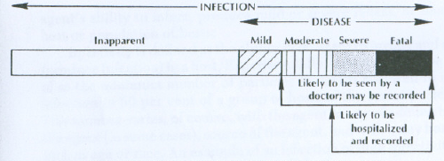
The relation of severity of illness to disease statistics.
17
17

Slide 18
The pyramid and iceberg of disease
1 Diseased, diagnosed & controlled
2 Diagnosed, uncontrolled
3 Undiagnosed or wrongly
diagnosed disease
4 Risk factors for disease
5 Free of risk factors
Diagnosed disease
Undiagnosed or
wrongly diagnosed disease
18
18

Slide 19
Iceberg Phenomenon
Cases of illness correctly diagnosed by clinicians in the community often represent only the “tip of the iceberg.”
Many additional cases may be too early to diagnose or may remain asymptomatic.
Examples: Tuberculosis, meningitis, polio, hepatitis A, AIDS.
The risk is that persons with in-apparent or undiagnosed infections may be able to transmit infection to others.
19
19

Slide 20
Implications of the concepts of natural history and spectrum of disease
Persons with in-apparent or undiagnosed infections can transmit infections to others.
Control measures must be directed toward all infections capable of being transmitted to others;
  both clinically apparent cases and
  those with in-apparent or undiagnosed infections.
20
20

Slide 21
Reference books
Principles of Epidemiology in Public Health Practice. Third Edition. An Introduction to Applied Epidemiology and Biostatistics. Centers for Disease Control and Prevention (CDC)
Gordis L. Epidemiology. 2009

