Slide 1
EPIDEMIOLOGY AND PREVENTION OF INFLUENZA

Slide 2
Introduction
Unique epidemiology:
Seasonal attack rates of 10% to 30%
Global pandemics
Influenza viruses are epizootic in
avian
animal
The influenza continue to cause widespread epidemics (unpredictable antigenic changes)

Slide 3
Clinical Features of Influenza
Fever with respiratory symptoms
Myalgia and headache
GI symptoms
Primary influenza viral pneumonia
Secondary bacterial pneumonia

Slide 4
Transmission
Aerosols secretions (coughing, sneezing, and talking)
Direct or indirect
IP 1- 4 days
Infectivity: shortly before the appearance of the symptoms up to the 4th or 5th day of the symptoms

Slide 5
Diagnosis
Viral culture
Serology
Rapid test
PCR

Slide 6
The Virus
First isolated 1933
Technique of culture in hens’ eggs first described in 1936
Influenza virus B first isolated in 1940
Influenza virus C first isolated in 1947

Slide 7
The virus
3 types (A, B, and C)
A and B contain 8 segments of single-straded RNA
That code for 10 proteins
The most important 2 glycoproteins are HA and NA. Their importance are in the pathogenesis and immune protection.

Slide 8
The Genes of Influenza A Virus and Their Protein Products
RNA Segment Number | Gene Product | Protein | Proposed Functions of Protein
1 | PBI | Polymerase | RNA transcriptase
2 | PB2 | Polymerase | RNA transcriptase (host range determinant)
3 | PA | Polymerase | RNA transcriptase
4 | HA | Hemagglutinin | Viral attachment to cell membranes; major antigenic and virulence determinant
5 | NA | Neuraminidase | Release from membranes; major antigenic determinant
6 | NP | Nucleoprotein | Encapsidates RNA, type-specific antigen
7 | MI | Matrix | Surrounds viral core; involved in assembly and budding
 | M2 | Ion channel
8 | NS1 | Nonstructural | RNA binding, anti-interferon
 | NS2 | Nonstructural | Unknown

Slide 9
The Virus
HA function
It serves as an attachment protein
It also serves as a virulence determinant
NA function
NA cleaves sialic acid residues to allow virus release from the host epithelial cell
The subtypes of influenza A viruts are determined by these two surface antigens

Slide 10
Epidemics and Pandemics
Annual epidemics
Global Pandemics

Slide 11
Characteristic pattern of an influenza pandemic
Starts from a single geographic focus
Rapidly spread along routes of travel
High attack rate of all age groups
Case fatality isn’t increased substanically
Multiple waves

Slide 12
Pandemics and Epidemics
The 1918 Spanish influenza pandemic
AR = 20% - 30% (in adults) and 30% - 45% (in children)
CF 15% - 50% (mostly in young adult)
Annual local epidemics characteristics:
Follow predictable pattern
Usually occur between November and March in the northern hemisphere
High attack rates among schoolchildren
Increased pneumonia and influenza hospital admission
Increased number of deaths from pneumonic and influenza
Usually starts abruptly and reaches the peak within 3wks and ends by the 8th wk
2 strains may coexist
Usually occur between May and September in the southern hemisphere
Virus survives better in environments of lower temperature and humidity
Rates of infection in infants and children are higher than those of adults
Rates of hospitalization are highest in infants followed by elderly

Slide 13
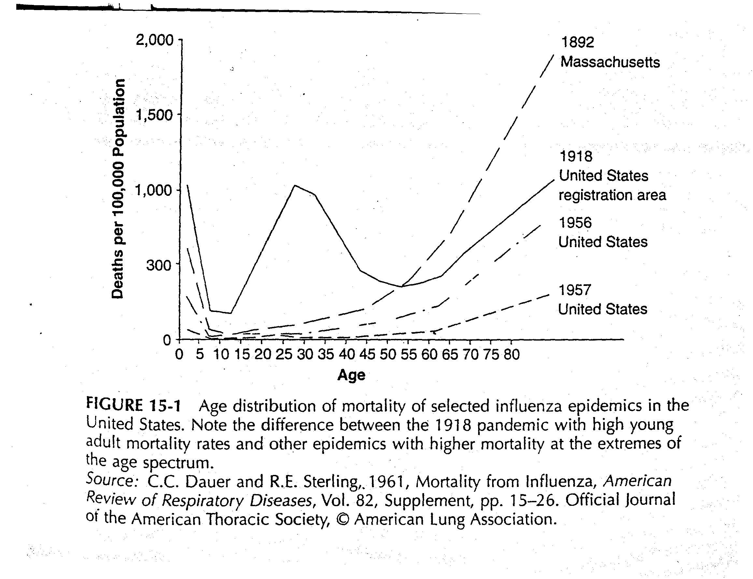

Slide 14
Factors affecting the size and impact of an influenza epidemics
Degree of the antigenic variation of the new virus
Virus virulence
Existing protective immunity

Slide 15
Epidemics in North America
AR 10%-20%
AR in certain population group ranges between 40%-50%
Influenza associated deaths range between 20,000 and 40,000 annually
Persons aged more than 65 years account for 90% of influenza associated deaths
The cumulative deaths during successive annual epidemics of an interpandemic period often exceed the death in the pandemic period
Example: In the 1968-69 H3N2 pandemic, total deaths estimated to be 34,000, but the virus caused more than 300,000 deaths in the annual epidemics in the subsequent 21 years
Annual influenza has been associated with an average of 226,000 hospitalizations per year in the United States
Most epidemic and all 20th-century pandemic infections by influenza virus are type A

Slide 16
Surveillance of Influanza
Necessary to track epidemic
To detect pandemics
To determine virus serotypes for vaccine policy

Slide 17
Mechanisms of Antigenic Variation
Antigenic drift
Minor antigenic changes
Antigenic shift
Major antigenic changes
Mixing vessel
Pandemic may occur when:
If a shift variant:
Retains the ability to replicate well in humans
Is efficiently transmissible between humans
And has new surface HA or NA determinants that evade existing influenza antibody profiles in the human population
3 antigenic shifts occurred during the 20th century

Slide 18
Thank you

