Slide 1
Epidemiology of Diabetes mellitus
Ashry Gad Mohamed, Hafsa Raheel
Department of Family & Community Medicine
KSU

Slide 2
Learning Objectives
At the end of the presentation the participant will be able to :
  Discuss the Global prevalence of diabetes
  Discuss the state of diabetes in KSA.
  Know risk factors of diabetes.
  Discuss the magnitude of complications of diabetes.

Slide 3


Slide 4
Diabetes Mellitus
Definition
  A metabolic disorder of multiple aetiology characterized by chronic hyperglycaemia with disturbances of carbohydrate, fat and protein metabolism resulting from defects in insulin secretion, insulin action or both

Slide 5


Types of diabetes
Type 1 (5-10%) – sudden onset absolute deficiency in insulin. Usually affects younger age group (not always)
Type 2 (90 - 95%) – gradual onset of relative insulin insensitivity. Usually older age group (not always)
Gestational diabetes
Secondary diabetes
Pre-diabetes
Impaired glucose tolerance
  May remain undiagnosed for years; risk of complications same as for T2DM

Slide 6

Diagnosis of diabetes
Symptoms
    Thirst
    Passing lots of urine
    Malaise
    Infections (thrush)
    Weight loss
BUT – many years of pre-diabetes (type 2) before these symptoms appear!
Biochemical tests
  Random plasma glucose
  Fasting plasma glucose
  Oral glucose tolerance test – 2h glucose

Slide 7
Fasting Blood sugar
Non diabetic: FBS< 110 mg/dl (6.1m mol/dl).
Glucose Intolerance: FBS 110 -125 mg/dl (6.1-6.9 m mol/dl).
Diabetic: FBS >126 mg/dl (>7 m mol/dl)
OR Random BS >200 mg/dl (>11.1m mol/dl) .

Slide 8
Diagnosis based on:
Glucose Tolerance Test 2 hr post 75 gm glucose
If < 7.8 mmol/L = normal GTT
If ≥ 7.8 mmol/L and < 11.1 mmol/L = GTT
If ≥ 11.1 mmol/L = provisional diagnosis of Diabetes

Slide 9
Why is diabetes so important?
The burden to patients, carers, NHS
  Complications
    Cardiovascular
    Eyes
    Renal - Hypertension, renal failure
    Feet
    Skin, infections, sexual, psycho-sexual, depression
    Quality of life
    Premature mortality
  Cost

Slide 10
Epidemiology of diabetes
Prevalence worldwide is increasing
    2.8% in 2000;
    4.4% in 2030 worldwide.
    171 million in 2000; 366 million in 2030
    Greatest rise in developing world

Slide 11
Diabetes in the world
Millions

Slide 12
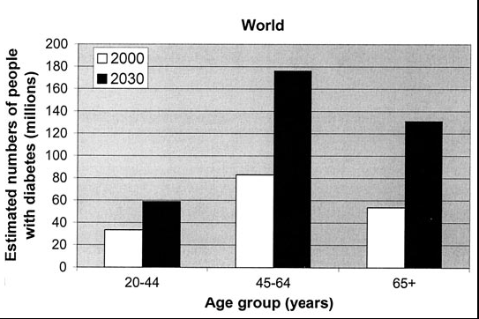

Slide 13
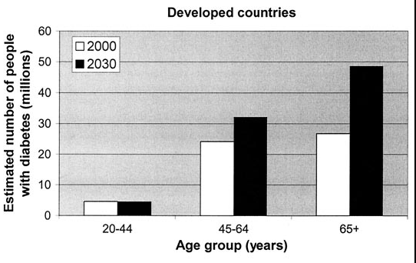

Slide 14
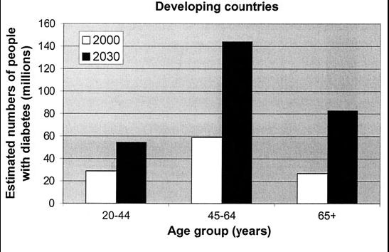

Slide 15
Diagnosed and Undiagnosed Prevalence of Diabetes by Age in the US (NHANES III)
Harris et al., Diabetes Care, 1998

Slide 16
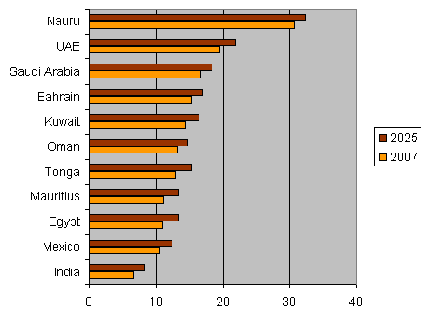
Top 10 Countries with the highest prevalence of diabetes in 2007 and 2025
(SA figure is based on FPG of 7 mmol and over)

Slide 17
Prevalence of diabetes based on stepwise surveys
Jordan: 12%
Iraq: 10.4%
Syria: 20.5%
Saudi Arabia: 17.9%
Iran: 10.3%

Slide 18
Prevalence of Diabetes in EMR
Notes:
Dr. Ossama AlKhatib (modified

Slide 19
Notes:
Dr. Ossama AlKhatib

Slide 20
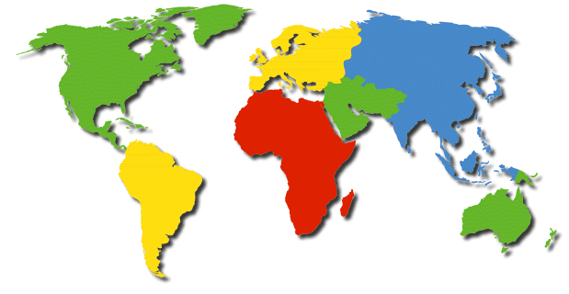
Global Projections for the Diabetes Epidemic: 2000-2030 (in millions)
EU
17.8
25.1
41%
NA
19.7
33.9
72%
China
20.8
42.3
204%
MEC
20.1
52.8
263%
LAC
13.3
33.0
248%
SSA
7.1
18.6
261%
India
31.7
79.4
251%
A+NZ
1.2
2.0
65%
World
2000 = 171 million
2030 = 366 million
Increase 213%
Wild, S et al.: Global prevalence of diabetes:
Estimates for 2000 and projections for 2030
Diabetes Care 2004 In press

Slide 21
Diabetes mellitus and age distribution in KSA

Slide 22
Types of DM and age in KSA

Slide 23
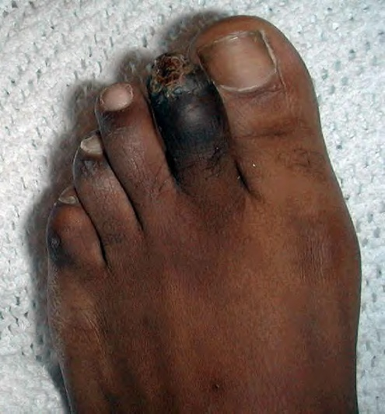
Diabetic complications

Slide 24
Diabetes accounts for more than 5% of the global deaths, which are mostly due to CVD.
Diabetes is responsible for over one third of end-stage renal disease requiring dialysis.
Amputations are at least 10 times more common in people with diabetes.
A leading cause of blindness and visual impairment. Diabetics are 20 times more likely to develop blindness than nondiabetics.

Slide 25
Diabetes Complications in the Gulf Countries
Prevalence of microvascular complications:
Comparing data from Arab
countries with data of the
highest & lowest prevalence
world wide in the year 2000.
The major complications will
be soon the highest in Arab
countries due to the lack of
prevention programs.
WHO report 2000.
Retinopathy
Neuropathy
Nephropathy

Slide 26
Diabetes Complications in the Gulf Countries
Retinopathy
Retinopathy:
Number of persons with
diabetic retinopathy in different countries and according to the time.
WHO report 2000

Slide 27
Diabetes Complications in the Gulf Countries
Prevalence of Retinopathy in
Saudi diabetic patients
31.5%
IDDM 42.5%
NIDDM 25.3%
Risk factors for Retinopathy in
Saudi diabetic patients
✰ Duration > 10 years.
• Presence of nephropathy.
 Older than 60 years.
 Poor diabetes control.
 Use of insulin.

Slide 28
Diabetes Complications in the Gulf Countries
Diabetes in the Gulf countries
Diabetes is the leading cause for Blindness
Diabetes is the leading cause for ESRF
Diabetes is the leading cause for IHD
Diabetes is the leading cause for CVA
Diabetes is the leading cause for Amputation

Slide 29
Increasing mortality from diabetes mellitus
J. Olefsky, JAMA 2001:285:628-632
Notes:
Why is it interesting to do research in diabeets

Slide 30
Risk factors

Slide 31
Genetic factors
May play a part in development of all types; autoimmune disease and viral infections may be risk factors in Type I DM.
Twin studies

Slide 32
Family history
Compared with individuals without a family history of type 2 diabetes, individuals with a family history in any first degree relative have a two to three-fold increased risk of developing diabetes.
The risk of type 2 diabetes is higher (five- to six fold) in those with both a maternal and paternal history of type 2 diabetes .
The risk is likely mediated through genetic, anthropometric (body mass index, waist circumference), and lifestyle (diet, physical activity, smoking) factors.

Slide 33

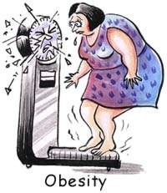
Obesity
Contributes to the resistance to endogenous insulin.
  RR risk of DM in females (ref. BMI < 22)
    22-23 3.0
    24-25 5.0
    > 31 40
    (Colditz & al, Ann Int Med, 1995, 122; 481-6)

Slide 34
The risk of impaired glucose tolerance (IGT) or type 2 diabetes rises with increasing body weight.
The Nurses’ Health Study demonstrated an approximately 100-fold increased risk of incident diabetes over 14 years in nurses whose baseline body mass index was >35 kg/m² compared with those with BMI <22 .
The risk of diabetes associated with body weight appears to be modified by age.
Obesity acts at least in part by inducing resistance to insulin-mediated peripheral glucose uptake, which is an important component of type 2 diabetes

Slide 35
Fat distribution
The distribution of excess adipose tissue is another important determinant of the risk of insulin resistance and type 2 diabetes.
The incidence of type 2 diabetes are highest in those subjects with central or abdominal obesity, as measured by waist circumference or waist-to-hip circumference ratio.
Intra-abdominal (visceral) fat rather than subcutaneous or retroperitoneal fat appears to be of primary importance.

Slide 36

Physical inactivity.
prolonged TV watching is associated with a significantly increased risk of type 2 diabetes. Men who watched TV more than 40 h per week had a nearly threefold increase in the risk of type 2 diabetes compared with those who spent less than 1 h per week watching TV.

Slide 37

Diet.

Slide 38
A number of dietary factors have been linked to an increased risk of type 1 diabetes, such as low vitamin D consumption; early exposure to cow's milk or cow's milk formula; or exposure to cereals before 4 months of age. However, none of these factors has been shown to cause type 1 diabetes.
Consumption of red meat, processed meat, and sugar sweetened beverages is associated with an increased risk of diabetes

Slide 39
Fruits, vegetables, nuts, whole grains, and olive oil is associated with a reduced risk.
It is important to recognize that most studies have used food frequency questionnaires to capture dietary patterns and that none of the food stuffs examined can be considered in isolation. For example, higher meat intake always means more saturated fat intake, relatively lower fruit and vegetable intake, and frequently, higher BMI (body mass index).

Slide 40
Smoking .
Several large prospective studies have raised the possibility that cigarette smoking increases the risk of type 2 diabetes. In a meta-analysis of 25 prospective cohort studies, current smokers had an increased risk of developing type 2 diabetes compared with nonsmokers (pooled adjusted RR 1.4, 95% CI 1.3-1.6).
A definitive causal association has not been established, a relationship between cigarette smoking and diabetes mellitus is biologically possible based upon a number of observations:
●Smoking increases the blood glucose concentration after an oral glucose challenge.
●Smoking may impair insulin sensitivity.
●Cigarette smoking has been linked to increased abdominal fat distribution and greater waist-to-hip ratio that may have an impact upon glucose tolerance.

Slide 41
Infections
A range of relatively rare infections and illnesses can damage the pancreas and cause type 1 diabetes.

Slide 42
Pregnancy
Pregnancy causes weight gain and increases levels of estrogen and placental hormones, which antagonize insulin

Slide 43
Medications
Drugs that are known to antagonize the effects of insulin:
Thiazide diuretics,
Adrenal corticosteroids,
Oral contraceptives.

Slide 44
Physiologic or emotional stress
Causes prolonged elevation of stress hormone levels (cortisol, epinephrine, glucagon and growth hormone), which raises blood glucose levels, placing increased demands on the pancreas.

Slide 45
References
http://www.diabetesatlas.org/content/global-burden.
Al-Madani A. Diabetes Complications in the Gulf Countries. Presentation.
Ibtihal Fadhil. RA/ NCD/ Health promotion and Protection /EMRO/WHO Diabetes and Other Non-Communicable Diseases / EM Regional Perspective. First BA Regional Workshop on the Epidemiology of Diabetes and Other Non-Communicable Diseases , Bibliotheca Alexandrina. 5-13 January 2009.
WILD S, ROGLIC G, GREEN A, SICREE R, KING R. Global Prevalence of Diabetes. Estimates for the year 2000 and projections for 2030. DIABETES CARE 2004; 27 (5):1047-53.

Slide 46
NT, Nguyen XM, Lane J, Wang P. Relationship between obesity and diabetes in a US adult population: findings from the National Health and Nutrition Examination Survey, 1999-2006. Obes Surg 2011; 21:351.
Colditz GA, Willett WC, Rotnitzky A, Manson JE. Weight gain as a risk factor for clinical diabetes mellitus in women. Ann Intern Med 1995; 122:481.
Biggs ML, Mukamal KJ, Luchsinger JA, et al. Association between adiposity in midlife and older age and risk of diabetes in older adults. JAMA 2010; 303:2504.
DeFronzo RA, Ferrannini E. Insulin resistance. A multifaceted syndrome responsible for NIDDM, obesity, hypertension, dyslipidemia, and atherosclerotic cardiovascular disease. Diabetes Care 1991; 14:173.
Friedman JE, Dohm GL, Leggett-Frazier N, et al. Restoration of insulin responsiveness in skeletal muscle of morbidly obese patients after weight loss. Effect on muscle glucose transport and glucose transporter GLUT4. J Clin Invest 1992; 89:701. Mokdad AH, Ford ES, Bowman BA, et al. Prevalence of obesity, diabetes, and obesity-related health risk factors, 2001. JAMA 2003; 289:76.
Helmrich SP, Ragland DR, Leung RW, Paffenbarger RS Jr. Physical activity and reduced occurrence of non-insulin-dependent diabetes mellitus. N Engl J Med 1991; 325:147.
Nguyen
Del Prato S, Bonadonna RC, Bonora E, et al. Characterization of cellular defects of insulin action in type 2 (non-insulin-dependent) diabetes mellitus. J Clin Invest 1993; 91:484.

Slide 47
Thank You

