Slide 1
International & GLOBAL Health CONCEPTS & Current Issues
Dr. Mohammad Afzal Mahmood, Prof Ahmed Mandil, Dr. Salwa Tayel
Department of Family & Community Medicine, KSU, 2014

Slide 2
Objectives of the session
By the end of the session the students should be able to:
List concepts of international health
Understand the scope & applications of IH
Describe current global problems, as well as problems affecting countries at different stages of development

Slide 3
Concepts
Definitions
International Health, Global Health
Scope
Current global problems
Future challenges

Slide 4
Definitions
Inter-national
provision of care from one to the other nation, collective measures by neighbouring nations to control regional epidemics
not necessarily at the government levels, and not necessarily at the whole country level, as International Health actions could be initiated by NGOs as well
e.g. Safe Motherhood Project in East Timor, Health Management Capacity Development Project in East Kalimantan, Indonesia, and Primary Care Research with Shandong PR China
Cross-national
about public health issues affecting region or a group of nations, and measures about prevention, control, assistance
e.g. bird flu epidemic control measures by regional countries
Global
processes and factors influencing health across the world because of flow of people, goods and services across the world, global environmental and climatic conditions
e.g. global pandemics of infectious diseases, influences of biomedical technology,

Slide 5
Global & International Health
Involvement of countries – government and international organizations
International health – is about transboundary and transdisciplinary factors that affect health. International defined in terms of ‘between/among two or more countries’ whereas global health encompasses the entire world.
Collective Health: “A articulated set of technical, ideological, political and economic practices developed in the academic scope, health’s institutions, civil society organizations, institutes of investigation” Mario Estrada et al
Global Public Health: It is about actions for management and control of global disease outbreaks and pandemics; requires International/global agreements and cooperation
Global and International Health is also concerned about Mass Gatherings & International Travel:
MASS Gathering: people often arrive from many countris with different levels of health and health care and different morbidity patterns.
International Travel is important because of its potential association with introducint of a disease from one region to the other, regional epidemics and pandemics

Slide 6
Global Health
Health Issues that go beyond national boundaries, affecting or have the potential to affect many countries/region/globe
From a global and International Health considers health as a human right, with considers health care and public health for all as a key for equity, sustainability, security.
Therefore, Global Health is concerned about finding solutions as well to these issues. In identifying solutions countries learn from each other’s experiences
Global health: not about a single health problem such as malaria, TB, or AIDS, regardless of the severity of that single issue for one or two countries. Global Health is about issues that transcends boundaries and regions

Slide 7
IMPORTANCE of Global and International Health
Perceived and actual threat to health and welfare across nations (SARS in Asia 2003, Flu worldwide 2009 ......)
Collective epidemic, pandemic control measures (Global Alert & Response, UN)
Regional & global security: Vicious cycle of poverty, oppression, food insecurity, poor health, social consequences, unrest, conflicts, infectious diseases)
Humanitarian needs: 36 million people under UNHCR responsibility
Health issues affecting mass gathering and international travellers
International/multinational global funding (multiple motives):
Influence of global pharmaceuticals – the issue of need and profitability

Slide 8
International/global health STAKEHOLDERS
Bilateral & multilateral government aid
International NGOs, charitable organisation
UN institutions: for technical support, health regulations, infrastructure for monitoring/surveillance - to help the international community prevent and respond to acute public health risks that have the potential to cross borders and threaten people worldwide. require countries to report certain disease outbreaks and public health events to WHO
Research across countries/regions by education & development institutions
Pharmaceutical industry
Academic and research institutions

Slide 9
Factors influencing International & Global Health
Different MORBIDITY patterns across countries
Countries are at different stages of EPIDEMIOLOGICAL & DEMOGRAPHICH transition
Different MORTALITY & DALY
Differences in the CAPACITY OF HEALTH SYSTEM in addressing the local problems and in addressing the threats of epidemics

Slide 10
Global Health Current Issues:
COMMUNICABLE, MATERNAL & CHILD HEALTH, & NUTRITIOAL: Mainly Developing Counties
NON COMMUNICABLE DISEASES: Both Developed and Developing Countries
INJURIES: Epidemic in some countries, in both developed and developing

Slide 11
Global & International challenges
Epidemiological transition: health issues affecting rich and poor
Burden of disease – triple burden (Chronic, Infectious, Injuries0
Threat of epidemics
e.g. H1N1 2009 , new infections, drug resistant microbes
Global health inequality across rich & poor
infant, maternal deaths
premature adult mortality
across rich and poor
between countries
Demographic Transition
Re-emergence of infections

Slide 12
Rich Countries with well developed Public Health and Health Care Systems
Health
Longer life expectancy
Ageing populations, Different shapes of Population Pyramid
Low prevalence of infectious diseases
Health System
Comprehensive range of services
Expensive health and medical care system
Rapidly growing Private Health Sector (in fact in both developed and developing countries)

Slide 13
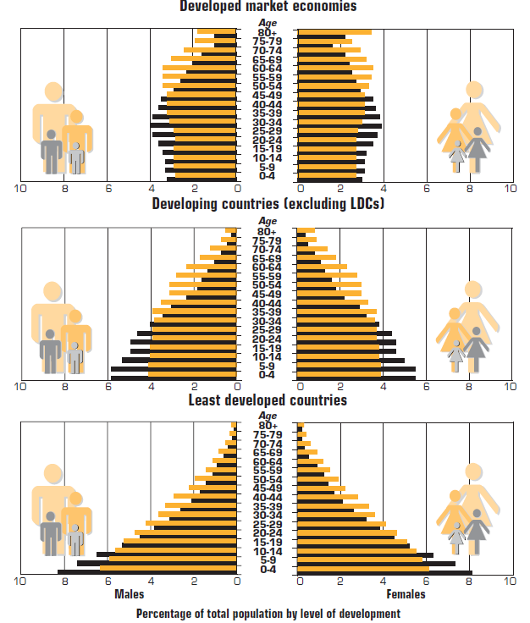
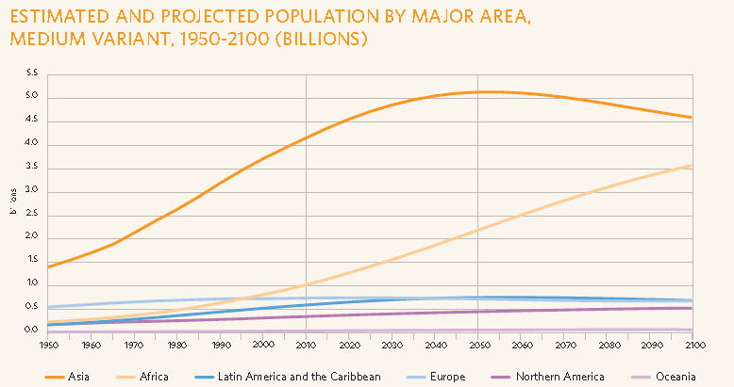
Demographic transition across the globe
WHR 1998, Population 1995, 2025
SOWP Report 2012

Slide 14
Leading Global health problems
Maternal & Child Health
Lower respiratory infections
Road Traffic Injuries
Diarrhoeal diseases
Ischemic Heart Disease, COPD
Mental Health Issues
Malaria
TB
HIV-AIDS
Congenital anomalies

Slide 15
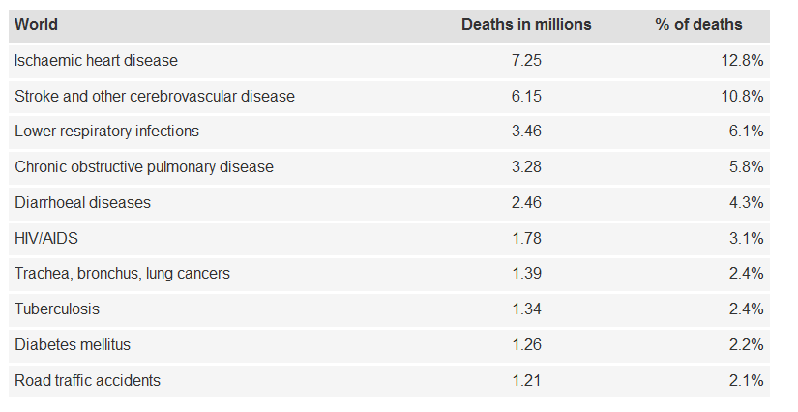
Top ten causes of death
http://www.who.int/mediacentre/factsheets/fs310/en/index.html
http://www.gapminder.org/
WHO

Slide 16
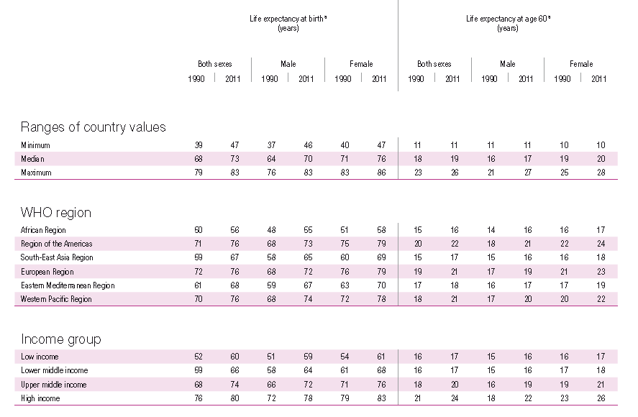
Life expectancy- global comparison (Ref: Table from ‘WHO World Health Statistics 2013)

Slide 17
Leading causes of attributable global mortality and burden of disease, 2004
Attributable Mortality
Attributable DALYs
%
High blood pressure 12.8
Tobacco use 8.7
High blood glucose 5.8
Physical inactivity 5.5
Overweight and obesity 4.8
High cholesterol 4.5
Unsafe sex 4.0
Alcohol use 3.8
Childhood underweight 3.8
Indoor smoke from solid fuels 3.3
59 million total global deaths in 2004
%
Childhood underweight 5.9
Unsafe sex 4.6
Alcohol use 4.5
Unsafe water, sanitation, hygiene 4.2
High blood pressure 3.7
Tobacco use 3.7
Suboptimal breastfeeding 2.9
High blood glucose 2.7
Indoor smoke from solid fuels 2.7
Overweight and obesity 2.3
1.5 billion total global DALYs in 2004
Ref: This slide is by WHO Health Statistics and Informatics Department – Global Health Risks

Slide 18
Poor Countries’ Health Situation
Relatively shorter life expectancy – in fact fallen in many African countries due to health issues such as HIV-AIDS, TB and the poor state of health services and inadequate public health programs
Difficult access to even the most basic services for many in these countries
Many of the poor have to pay a large amount of personal expenditures for health care causing further economic hardship

Slide 19
Poor Countries Health Situation
Predominant pattern is still infectious diseases
Poor physical environment and lack of sanitation contributing to issues such as malaria, tuberculosis, GIT problems
AIDS (Africa in particular), TB (in some of the countries such as India, Indonesia)
High Maternal Mortality
Non communicable diseases are also beginning to plague these regions

Slide 20
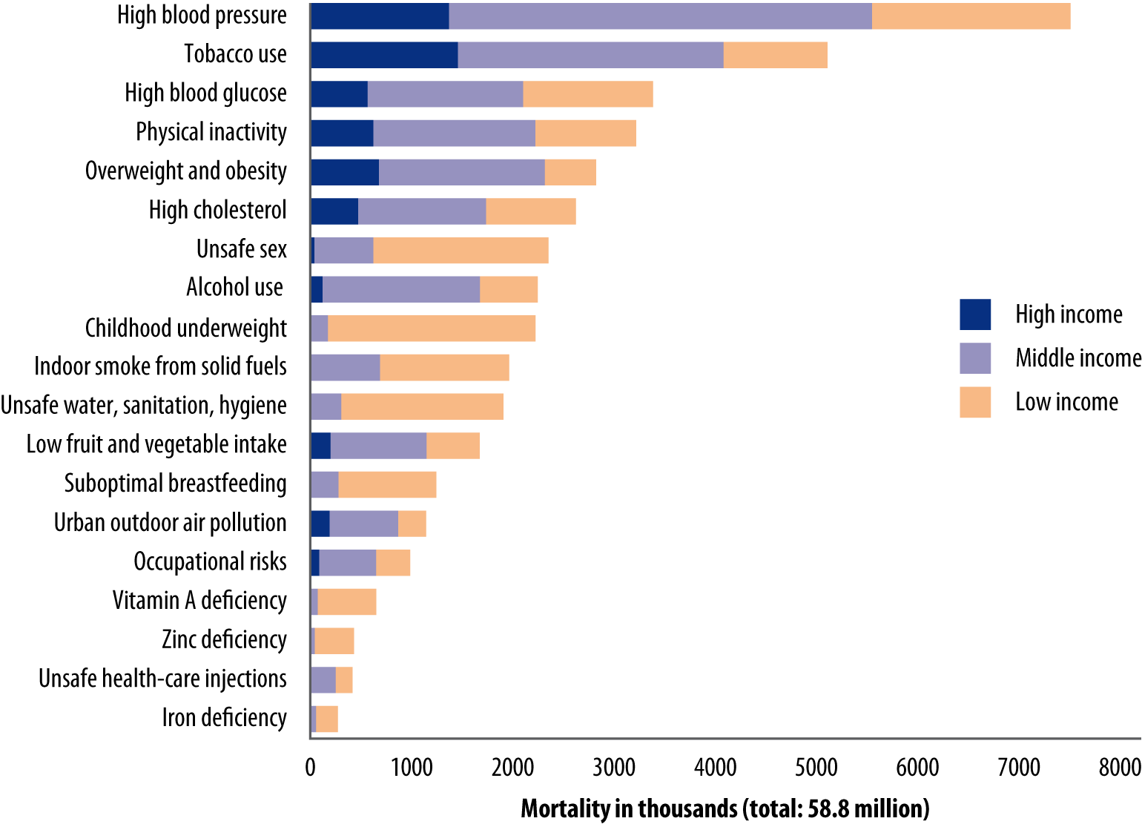
Deaths attributed to 19 leading factors, by country income level, 2004
Ref: This slide is by WHO Health Statistics and Informatics Department – Global Health Risks

Slide 21
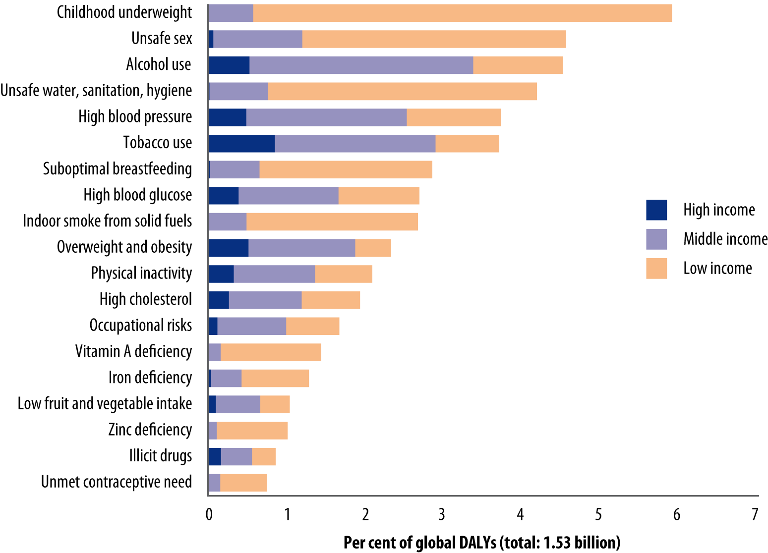
Percentage of DALYs attributed to 19 leading risk factors, 2004
Ref: This slide is by WHO Health Statistics and Informatics Department – Global Health Risks

Slide 22
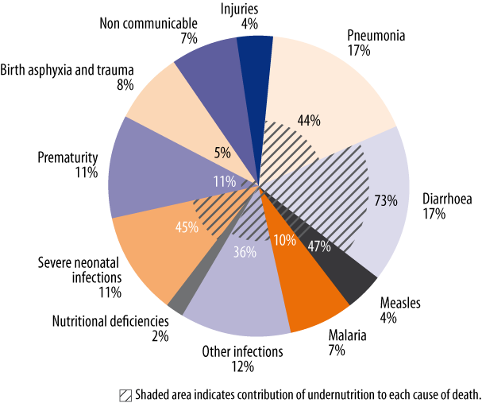
Major causes of deaths in children under 5 with disease-specific contribution of undernutrition, 2004
Ref: This slide is by WHO Health Statistics and Informatics Department – Global Health Risks

Slide 23
Global situation with regard to MDGs
Hunger & Poverty: The proportion of underweight children in developing countries has declined from 28% to 17% between 1990 and 2011.
Child Mortality: <5 Age, 6.9 million deaths in 2011, 12 million in 1990. 41% decline from 87 deaths per 1000 live births to 51.
Maternal Mortality: 543000 deaths in 1990 to 287000 in 2010. Larger majority in poor developing countries
HIV/AIDS: 3.1 million new infections 2001, 2.5 Million in 2011. Number of People Living With HIV increased to 34 million
Malaria: in 2010 216 Million cases, 655000 deaths, >80% of children<5
TB: 8.7 Million new cases in 2011, Mortality declined by 40% in two decades
Ref: WHO Millennium Development Goals
http://www.who.int/mediacentre/factsheets/fs290/en/index.html

