Slide 1
Introduction to Medical Search Using Medline
Dr. Ahmed AlBarrak
Associate Prof. of Medical Informatics, College of Medicine
King Saud University
albarrak@ksu.edu.sa
@draalbarrak2
faculty.ksu.edu.sa/albarrak

Slide 2
Outline
Objectives of literature search
Methods of finding relevant literature?
Electronic Journals
Features/Advantages
Database management
University library
Saudi Digital Library

Slide 3
Literature Search
Objectives
What has been published in the area?
Is my question novel?
How have similar questions been addressed?

Slide 4
Literature Methods
Several approaches
Medline/databases
Abstracts of proceedings
Bibliographic searches
Review articles

Slide 5
Litreature Search
Answering these questions allow you to determine the following:
What has been published in the area?
what is the context of my specific question?
Is my question novel?
how important is my question?
How have similar questions been addressed?
is my approach appropriate?
to what extent can comparisons be made?

Slide 6
Litreature Search
What do we know?
What don’t we know?
What’s the best approach?

Slide 7
Journals Online
Most journals have print & Electronic formats
HTML or PDF
Personal or library subscription gives you access to both (usually)
Some journals are free
Many journals make back issues available for free
Abstracts are free in most cases
Wealth of accessible information on line

Slide 8
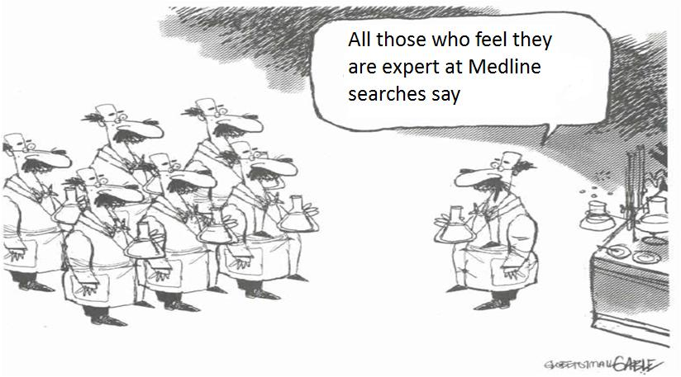
Litreature Search

Slide 9
Medline Search
Good for:
Comprehensive search
Latest publications
State of the art approaches

Slide 10
What is Medical Search?
Medical Search
Helps in collecting medical information needed in the medical researches.
Helps physicians maintain the level of their clinical skills, which tend to decline with time.
Helps in learning more quickly about advances in medical diagnosis and therapy.

Slide 11
Medical Search
The World Wide Web is triggering a large growth in the amount of medical information that is potentially freely available to practicing physicians quickly.
Medical information is often difficult to find on the World Wide Web.
The Major problem while searching for medical information on the World Wide Web is the presence of much noise, resulting from the varying values of the published information.

Slide 12
Biological Database
A Biological database is a large, organized body of persistent biological data, usually associated with computerized software designed to update, query, and retrieve components of the data stored within the system.
A simple database might be a single file containing many records, each of which includes the same set of information.

Slide 13
MEDLINES
MEDLINE, the National Library of Medicine's premier bibliographic database, standing in contrast with the potentially larger usefulness of the Web, given that it presents full-text information instead of just abstracts.
The primary source in the U.S for information from biomedical literature.
The single most important research tool for physicians, nurses and health personnel.

Slide 14
Scope of MEDLINE
It has Most of the citations published in English language.
All references appearing in:
Index Medicos
Index to Dental Literature and
International Nursing.

Slide 15
Biological Database
For researchers to benefit from the data stored in a database, two additional requirements must be met:
easy access to the information
a method for extracting only that information needed to answer a specific biological question
There are many databases available in the internet some have free articles
E.g. www.Diabetes.org/diabetes
some of have ordered articles, and most have only the abstracts:

Slide 16
Database
Database name | URL | Information | User name | Password
UMI | http://www.proquest.com/proquest | ABI/ INFORM Global PQ Computing PQ Medical Library PQ Biology Journals | 004xstw79q | Welcome
EBSCO | http://search.epnet.com |  | S3287673 | Password
Gale Group | http://Infotrac.galegroup.com/itweb/ksuni | Health and wellness Resource Center and Alternative Health module Infotrac One file |  | tryinfomarks
Omnifile Mega Full Text Web | http://hwwilsonweb.com |  | Awx74 | Unsa225407

Slide 17
Databases
Database name | URL | Information | User name | Password
 | http://www.alkhazindar.com.sa/onlinejournals/ksu.asp | For journals in college of medicine library | Kingsaud | Univlibrary
 | http://findarticles.com
 | http://highwire.standford.edu
 | http://www.emedicine.com
Science Direct | www.sciencedirect.com |  | Kingsaud1 Kingsaud2 Kingsaud13 | University1 University2 University13
Blackwell | http://www.blackwell-synergy.com |  | Sauduniversity | University
 | http://ww.nlm.nih.gov

Slide 18
Search Strategy
Developing a Search Strategy:
Before you can search for any information, you should first develop a search strategy.
What is a Search Strategy?
A search strategy is a plan that helps you look for the information you need.

Slide 19
Search Strategy Tips
Determine your goal from this search.
Determine the scope of the search.
Identify the key concepts.
Key words
Determine the name of the database you need to search in.
Determine alternative terms for these concepts, if needed.

Slide 20
Search Strategy Tips
Refine your search to dates, study groups, etc., as appropriate.
Practice helps. Strategies and styles will differ according to personal choice and professional discipline.
Specify the field of the search even the author, Journal name, or certain topic.

Slide 21
Search Tips
Truncation:
Truncation can be used when you want to find all terms that begin with a given text string.
Truncation is represented by the asterisk (*), sometimes referred to as a "wildcard."
For example, let's say you are trying to search all terms that have the root, mimic.
If you search mimic* you will retrieve words such as mimic, mimics, mimicing, etc. PubMed has no single character truncation symbol.

Slide 22
Limitation Result
To limit the search result you can use the following tools:
Boolean operators with combination words
Specify date
Specify the journal
Specify the author.

Slide 23
Introduction to Boolean Logic
Boolean logic symbolically represents relationships between entities.
Boolean operators allow you to combine terms (or text strings) in your search.
These operators can be used within individual fields, or as a tool to combine terms across more than one field.

Slide 24
Boolean Operators
Boolean Operators:
Boolean operators:
And
Or
Not
Lets see their functions

Slide 25
Boolean Operators
AND The default operator is and -- if an operator is not specified by the user, and will automatically be used by the system. Records retrieved must contain all search terms surrounding the and operator.
Example: typing: Pediatric AIDS treatment -- searches for records containing “Pediatric" and "AIDS" and "treatment" (i.e. all the terms must be present).
Example: typing pediatric and AIDS and treatment -- is the same search as above.

Slide 26
Boolean Operators
OR
Use the OR operator to retrieve documents that contain at least one of the specified search terms.
Use OR when you want to pull together articles on similar subjects. The or operator tells the system to search for records that contain either of the search terms entered into the field (or to combine the fields on either side of it
Example: cancer or oncology -- searches for records containing either "cancer" or "oncology."

Slide 27
Boolean Operators
NOT
Use the NOT operator to exclude the retrieval of terms from your search.
The not operator tells the system to eliminate any records from the search that contain a given term.
Example: pediatric not AIDS -- searches for records which contain "pediatric" but not "AIDS."

Slide 28
Precedence
You can tell the search engine to execute search commands in a particular order by using parentheses.
This works like the rules for math problems. For example, in the equation (4+3) x 2, you first add 4 and 3 to get 7, and then multiply 7 by 2.
Example: ((AIDS or HIV) and Microbiology) not Tropical -- will search for records with either “AIDS" or “HIV" and containing the term “Microbiology," and then will limit this set of records to those that do not contain the term “Tropical."

Slide 29
Name Searching
The methods by which to search on author names are as follows:
Using only a last name:
Example: ruiz -- searches for all records by "ruiz" with any first name.
When a first name or initial is available, also use the Initial(s) field.
Example: typing ruiz in the Last Name box and m in the Initial(s) box -- searches for all records by "Ruiz" with a first name beginning with m.
Multiple authors names can be searched (using the Advanced Search option only) in the following ways:

Slide 30
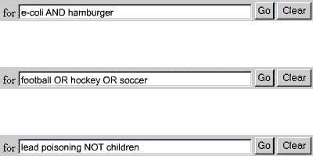
Name Searching
A word of caution about NOT: Be careful when using this operator as you may eliminate relevant articles. In this search, we have eliminated the citations about this condition in children but may have also eliminated citations that discuss both children and other age groups.

Slide 31
Boolean Logic
Boolean logic search rules and syntax :
Boolean operators: AND, OR, and NOT, must be entered in UPPERCASE.
Boolean connectors processed in a left-to-right sequence.
the order of search statement can be changed by enclosing, that is nesting, an individual concept in parentheses.
The terms inside the parentheses will be processed as a unit and then incorporated into the overall strategy.

Slide 32
Truncation (*)
This search method is also called a wild card or root word search.
If you type an asterisk after the root of the word you want to search, the search engine will find all records containing words beginning with that root.
Use this tool if you are unsure of spelling or if you want to include plural forms of search terms.
Example: chem* -- searches for "chemical," "chemicals," "chemistry," "chemotherapy," etc.
Please note that left and internal truncation cannot be used -- the system ignores all letters to the right of the truncation symbol (*).

Slide 33
Result Fields
Title [ ti ]: Article title
Author [au ]: Author name
Journal Name [ jn ]:
Volume [vi ] Page [ pg ], and Year.
example, page 552 of volume 120 in the Journal of Endocrinology.
Abstract [ AB ]: The AB field contains abstracts, or summaries taken directly from the published article.

Slide 34
Getting the Result
After searching the Medline and get the result you can either:
Download the article text (Free or paid).
Print it (If available in the site).
Order it by mail.
Some sites give you only the abstract of the articles then you have to search for it in the University or Hospitals Libraries.

Slide 35
Searching the Libraries
Using the result fields you can search for the full article in the library:
First, you have to check if the journal available in the library through searching the library index.
Second, check the year and the volume of the journal.
Third, check the place of the journal in the library (Row and Shelf)
Fourth, if you get the journal check the page numbers you have and check the title of the article then copy it.

Slide 36
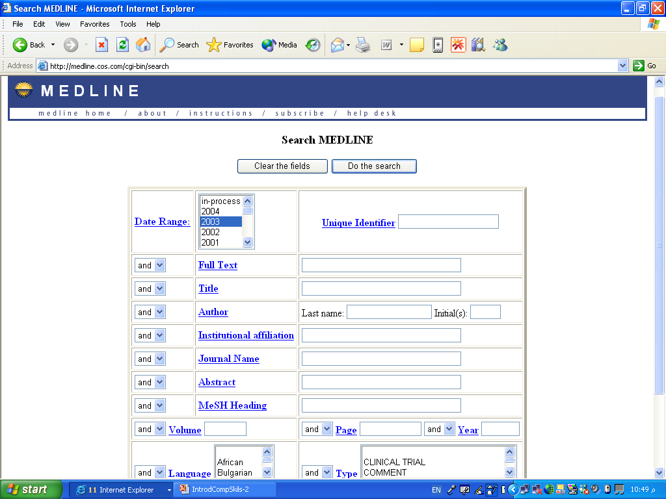
http://medline.cos.com/ Search Screen

Slide 37
Required Bibliographic Information
Journal Article
Authors (add all author names)
Article title
Journal title
Year of publication
Volume (plus issue if available)
Start and end pages
Conference Proceedings
Authors (add all author names)
Title of paper
Editors or proceedings (add all editor names)
Conference title
Date of conference
Place of publication
Publisher name
Year of publication
Start and end pages

Slide 38
Required Bibliographic Information
Book
Authors or editors (add all names)
Book title
Year of publication
Publisher name
Place of publication
Edition (if not first edition)
Book chapter
Authors or editors of chapter (add all names)
Title of chapter
Authors or editors of book (add all names)
Title of book
Year of publication
Publisher name
Place of publication
Edition (if not first edition)
Start and end pages of chapter

Slide 39
Thanking you
Dr. Ahmed AlBarrak
albarrak@ksu.edu.sa
Website: faculty.ksu.edu.sa/albarrak

