Slide 1
Electronic Health (medical) Record
Amr Jamal, MD, SBFM, ABFM, MRCGP, GCMI
Assistant professor and consultant Family physician and clinical informatician
Head of medical informatics and e-learning unit
King Saud university, School of medicine

Slide 2
History and perspective of the medical record
Data can be organized as
Physician‐centered
Patient‐centered
Orientations (not mutually exclusive) include
Time‐oriented –organized chronologically
Department‐oriented –organized by department
Problem oriented organized by focus on problems

Slide 3
History and perspective (cont.)
Earliest medical records were physician‐oriented
Hippocrates said over 2,500 years ago that the medical record should
Accurately reflect course of disease
Indicate possible causes of disease
Before era of widespread medical diagnostic testing, record consisted mostly of observations

Slide 4
Terminology of the medical record
Electronic health record (EHR) – subsumes:
Electronic medical record (EMR)
Computer‐based patient record (CPR)
Other terms of note:
Medical records system / Chart management
Hospital information System (HIS)
Practice management system (PMS)
Patient registry
Personal health record (PHR)
Problem‐oriented medical record (POMR)

Slide 5
Problem‐oriented medical record
Proposed by Weed (1969)
All entries grouped under particular problems
An encounter for each problem is organized under four headings
Subjective –what patient reports
Objective –what clinician observes or measures
Assessment –what clinicians assesses
Plan – what clinician plans to do
Most common usage is to have entire encounter organized by SOAP format, not individual problems

Slide 6
The modern‐day medical record
Mixture of patient‐and problem‐oriented approaches
In general, each provider or institution maintains its own record
The creator of the medical record is assumed to be its “owner”
It is still predominantly paper‐based
Or even worse, it is “hybrid,” with some data on paper, some electronic, and some on both media

Slide 7
Flow of information in primary care practice (Bates, 2002)

Slide 8
Some limitations of the paper‐based record
Single user –one person at a time
Disorganized – especially for complex patients
Incomplete –reports missing or lost, some providers not sharing their reports with the rest
Insecure –no audit trail, easily copied or stolen
Source of infection transmission
Handwriting ambiguity

Slide 9
Can you decipher these orders?

Slide 10
Can you decipher these orders?
Coumadin vs. Avandia
25 U/hr vs. 25 cc/hr vs. ???

Slide 11
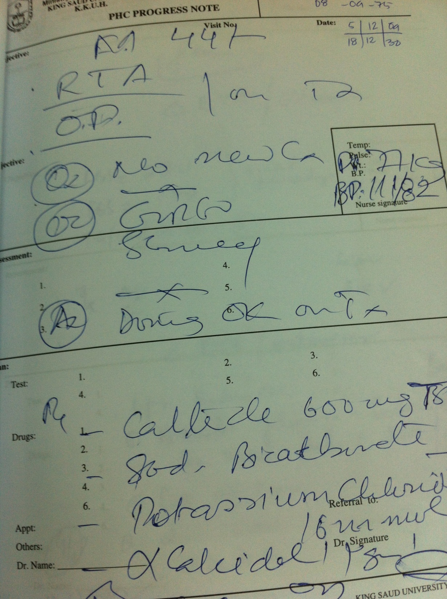

Slide 13
Go from Paper to Digital
Have patient information at your fingertips.

Slide 14
What are Electronic Health Records?
The IOM 2003 Patient Safety Report describes an EHR as encompassing:
“a longitudinal collection of electronic health information for and about persons
Immediate electronic access to person- and population-level information by authorized users;
Provision of knowledge and decision-support systems that enhance the quality, safety, and efficiency of patient care and
Support for efficient processes for health care delivery.”

Slide 15
HIT Functionality Measures
Eligible Professionals (EPs) must report on 20 of 25 Meaningful Use (MU) objectives with associated measures
Core set of 15
Menu set of 10
An EP must successfully meet the measure for each objective in the core set and all but five in the menu set
Some MU objectives are not applicable to every provider’s clinical practice. In this case, the EP would be excluded from having to meet that measure.
e.g., Dentists who do not perform immunizations and chiropractors who do not have prescribing authority

Slide 16
Meaningful Use: Core Set Objectives
15 Core Objectives
Record demographics
Record and chart changes in vital signs
Computerized physician order entry (CPOE)
E-Prescribing (eRx)
Report ambulatory clinical quality measures
Implement one clinical decision support rule
Provide patients with an electronic copy of their health information, upon request
Provide clinical summaries for patients for each office visit
Drug-drug and drug-allergy interaction checks
Maintain an up-to-date problem list of current and active diagnoses
Maintain active medication list
Maintain active medication allergy list
Record smoking status for patients 13 years or older
Capability to exchange key clinical information among providers of care and patient-authorized entities electronically
Protect electronic health information

Slide 17
Meaningful Use: Menu Set Objectives
10 Menu Objectives
Drug-formulary checks
Incorporate clinical lab test results as structured data
Generate lists of patients by specific conditions
Send reminders to patients per patient preference for preventive/follow up care
Provide patients with timely electronic access to their health information
Use certified EHR technology to identify patient-specific education resources and provide to patient, if appropriate
Medication reconciliation
Summary of care record for each transition of care/referrals
Capability to submit electronic data to immunization registries/systems*
Capability to provide electronic syndromic surveillance data to public health agencies*

Slide 18
HIT Resources
http://www.healthit.gov/providers-professionals/how-attain-meaningful-use
https://www.cms.gov/Regulations-and-Guidance/Legislation/EHRIncentivePrograms/downloads/EP-MU-TOC.pdf

Slide 19
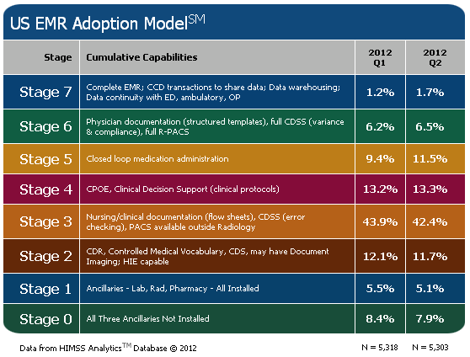

Slide 20
CDR: Clinical Data Repository
CMV: Controlled Medical Vocabulary (e.g. MeSH)
CDO: Care Delivery Organizations;
SEHR: Shared EHR (= EMR)
ICEHR: Integrated Care EHR (= EHR)
LIS: Laboratory Information System
RIS: Radiology I S
PIS: Pharmacy I S
PACS: Picture Archiving and Communication System
CDSS: Clinical Decision Support System
CPOE: Computerized Physician Order Entry
MAR: Medication Administration Record
HCO: Health Care Organization
eMAR: Electronic Medication Administration Record

Slide 21
Stages of EMR complexity
CDR is the central pivot
3
2
eMAR
1
0
Notes:
CDR: Clinical Data Repository; CMV: Controlled Medical Vocabulary (e.g. MeSH); CDO: Care Delivery Organizations; SEHR: Shared EHR (= EMR); ICEHR: Integrated Care EHR (= EHR); LIS: Laboratory Information System; RIS: Radiology I S; PIS: Pharmacy I S; PACS: Picture Archiving and Communication System; CDSS: Clinical Decision Support System; CPOE: Computerized Physician Order Entry; MAR: Medication Administration Record; HCO: Health Care Organization; eMAR: Electronic Medication Administration Record
Stage 0: Some clinical automation may be present, but all three of the major ancillary department systems for laboratory, pharmacy, and radiology are not implemented.
Stage 1: All three of the major ancillary clinical systems (pharmacy, laboratory, radiology) are installed.
Stage 2: Major ancillary clinical systems feed data to a CDR that provides physician access for retrieving and reviewing results. The CDR contains a controlled medical vocabulary, and the clinical decision support/rules engine for rudimentary conflict checking. Information from document imaging systems may be linked to the CDR at this stage.
Stage 3: Clinical documentation (e.g. vital signs, flow sheets) is required; nursing notes, care plan charting, and/or the electronic medication administration record (eMAR) system are scored with extra points, and are implemented and integrated with the CDR for at least one service or one unit in the hospital. The first level of clinical decision support is implemented to conduct error checking with order entry (i.e., drug/drug, drug/food, drug/lab conflict checking normally found in the pharmacy). Some level of medical image access from picture archive and communication systems (PACS) is available for access by physicians via the organization’s intranet or other secure networks outside of the radiology department confines.
Stage 4: Computerized Practitioner/Physician Order Entry (CPOE) for use by any clinician is added to the nursing and CDR environment along with the second level of clinical decision support capabilities related to evidence based medicine protocols. If one patient service area has implemented CPOE and completed the previous stages, then this stage has been achieved.
Stage 5: The closed loop medication administration environment is fully implemented in at least one patient care service area. The data flows of the CPOE, pharmacy, and the eMAR applications are tightly coupled and integrated with bar coding technology (or RFID technology) for the nurse, patient and medication to support the five rights of medication administration, thereby maximizing point of care patient safety processes.
Stage 6: Full physician documentation/charting (using structured templates) is implemented for at least one patient care service area. Level three of clinical decision support provides guidance for all clinician activities related to protocols and outcomes in the form of variance and compliance alerts. A full complement of radiology PACS systems provides medical images to physicians via an intranet and displaces all film-based images.
Stage 7: The hospital has a paperless SEHR environment with a mixture of discreet data, document images, and medical images. Clinical information can be readily shared via electronic transactions or exchange of electronic records with all entities within a regional health information network (i.e., other hospitals, ambulatory clinics, sub-acute environments, employers, payers and patients). This stage allows the health care organization (HCO) to support the true ICEHR as envisioned in the ideal model.

Slide 22
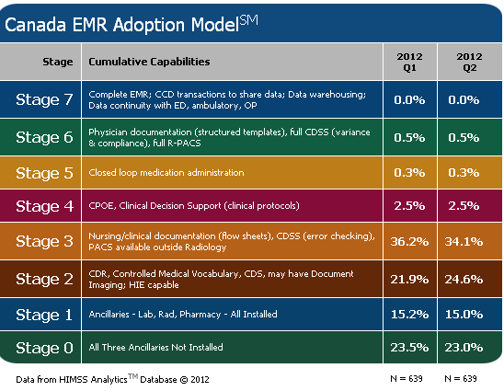

Slide 23
UK HealthCare Information Technology Services
2010
Guiding Principles
RHIO
Accountability- Based
Practice
Access to Data at the Point of
Service
Service Oriented Culture
Patient Centric Care
Innovation is Rewarded
2009
Patient
Health
Record
Electronic
Health Record
2008
Data Repository
Data Warehouse
Clinical
Decision
Support
Physician Referral
Secure Health
Messaging
2007
CPOE
Interdisciplinary
Documentation
Ambulatory
Care
EMAR
Portals
Web
Enablers
Pre 2007
ED Tracking
(ED Manager)
ICU Predictor
Apache
Barcode
Medication
Administration
OR Management
PICIS
Capacity
Command
Center
Patient Tracking
Scanning
Electronic
EKG
Results
TraceMaster
OB QS Fetal
Monitoring
System
Endoscopy
Provation
Cardiology
(Witt,
Phillips)
Other
Ancillary
Services
PACS
Registry’s
(Trauma, cancer,
OTTR, Tumor)
Radiology
Siemens
Pathology
Cerner
CoPathPlus
Laboratory
Mysis
Pharmacy
Mediware
Worx
Sunrise Clinical
Viewer
Pharmacy
Pyxis
CBORD
Diet Office
Management
Dictation/
Transcription
Soft Med
Single Sign On
Sentillion
Citrix
Device
Integration
Remedy
Support Center
RFID
Bar-Coding
Patient
Identification
Mobile Devices
(Hand held)
(wireless)
Server
Based
Infrastructure
Registration
(PM)
McKesson
Patient
Accounts
McKesson
Medical
Records
Soft Med
Scheduling
RSS
Financial
Decision
Support
(SDMS)
ERP/
Inventory
Mgt.
SAP
KMSF
Physician
Billing
(SMS)
Case
Management
Soft Med
Utilization
Review
McKesson
Claims/
Billing
SSI
Notes:
(1)Core Financial Systems – Business strategies (2) technical infrastructure (3) core lab systems (4) Niche Ancillary Systems (5) Niche ancillary systems (5) core integrated clinical systems (6) integrated network systems (7) strategic initiatives (8) regional network

Slide 24
Why the reluctance by clinicians to adopt IT systems
Main reason, they were not involved in the decision of implementation
May partially be a generational issue
Main reason may be that so far EMR has not delivered time savings for physicians and nurses, in fact, in many circumstances when not fully deployed, costs time
Main justification may be in addressing cost, quality and safety issues

Slide 25
Conclusion
EMR is ultimately geared towards reducing errors, improving safety and care and cutting costs of healthcare

Slide 26
Conclusion
"We can't solve problems by using the same kind of thinking we used when we created them."
-Albert Einstein

