Slide 1
Medical Informatics as a discipline for physicians
Dr. Osama Alswailem MD MA
Director of Medical Informatics,
King Faisal Specialist Hospital
Medical Informatics Course, KSU College of Medical

Slide 2
Current issues in clinical care
The improvement is clinical research made it so much that published literature each week can literally rake decades for the results of clinical trails to translate into changes in clinical practice.
Heart Failure and Beta Blocker, past and current
The speed and accuracy with which medical information is conveyed can be the difference between life and death.

Slide 3
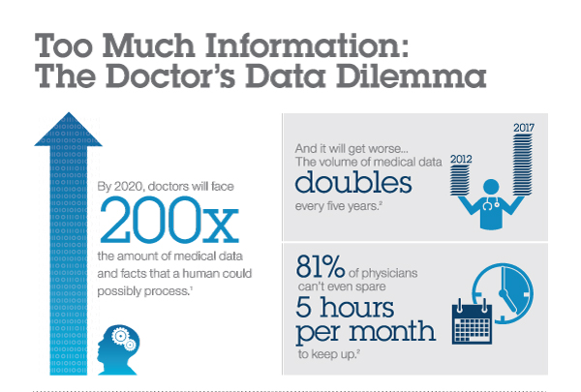
¹ William Stead, IOM Meeting, October 8, 2007. Growth in facts affecting provider decisions versus human cognitive capacity
²University of Oulu, Finland January 15, 2009
Adopted from IBM

Slide 4
Current issues in clinical care
Cost
Accessibility of health care
Coordinating care and setting policy
Acquisition and retrieval of data (eg across inst.)
Acquisition and sharing of knowledge (eg specialist)

Slide 5
Life Magazine
Approx 120 people in picture
$63,589 bill
64 year old male

Slide 6
Today
Waiters access their need information is faster than MDs
You can transfer money by few clicks any where
YET
You can’t figure out your appointments, you medication list..
Hospital records doesn’t talk to each other; No Continuum of care, duplicate of services
Management relays on instinct > objective data
Notes:
Right hand doesn’t know what left hand do

Slide 7
What do we need
Right information on right format to right person to make the right decision
Predictive model of knowledge representation.
CDSS
We need to reduce waste in workflows, to improve healthcare.
Notes:
Right hand doesn’t know what left hand do

Slide 8
Three global Healthcare trend
Rise of the Rest
Globalization of healthcare & Education
Bioclusters
New Business Model
Healthcare = IT
New eHealth context

Slide 10
Medical practice Using EMRs
Patient information available, accessible, legible.
Adopt EMR
Incident reports, M&M reports addressed efficiently
Communication; CPOE
TAT; radiology requests, ROI
Quality of care; child abuse case
Productivity; RVU

Slide 11
Patient engagement for better outcomes
Eroding confidence in provider community; increasing reliance on the web—66% of patients getting evidence online vs. 15% from their physicians.

Slide 12
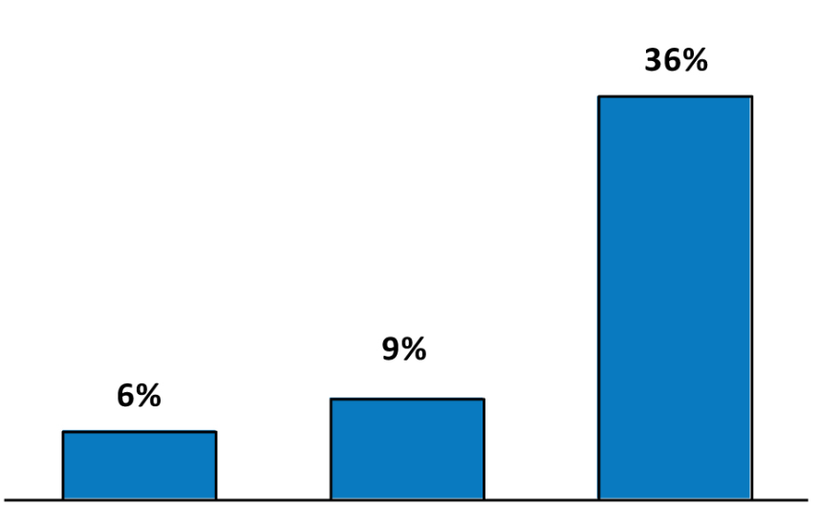
The trends and pressures shaping the health care industry
Job Listing Growth 2007 - 2011
All Jobs Health Care Jobs Health Informatics Jobs
Burning Glass Technologies, a leader in labor market analytics
Notes:
Health informatics is realizing its promise as the connective tissue between medicine and information science.

Slide 13
Fast Growing Health informatics titles

Slide 14
إعطاء الأولولية للتدريب وبناء الكوارد المتخصصة في مجال المعلوماتية الصحية القادرة على مواكبة التطور في مجال تقنية المعلومات، وإيفاد البعثات الداخلية والخارجية للدراسات العليا،
التأكيد على ضرورة وجود مركز معلومات رئيسي لكل قطاع صحي بالمملكة، ويكون الهدف من كل مركز العمل على توحيد أنظمة المعلومات الطبية والإدارية،
إنشاء مركز وطني للمعلومات الصحية يتشكل من مدراء المراكز الرئيسية للمعلومات بالقطاعات الصحية ومصلحة الإحصائات العامة بالإضافة إلى ممثلين للقطاع الخاص، وتكون مرجعية هذا المركز مجلس الخدمات الصحية،
تعمل وزارة الصحة بالتنسيق مع القطاعات الصحية على إنشاء سجلات وطنية تهتم بالأمراض الشائعة والمزمنة والأورام والأمراض الوبائية، وسجل للحوادث والإعاقات وربطها

Slide 17
Who is in
MOH 3bil. SAR
UAE
Qatar
Q8
USA, According to the Bureau of Labor Statistics, employment in medical and health informatics is expected to increase by 18 percent through the year 2016. That’s faster than the average for all occupations in the United States.

Slide 18
Medical informatics role
Develop implementation strategies for integrating Electronic Health Record systems into organizations
Analyze current stat of practice and invent smarter solutions
Possess the technical skills and leadership experience necessary to lead and manage change and transform health care industry using IT.
Create innovative applications for Electronic Health Records
Provide information management consulting services to health care organizations

Slide 19
Quality and characteristics of Informatician
Respected clinician, ie at least Board certified
Strong buy-in to informatics and to interest to do wide scale changes and transformation
Communication & writing skills
Understanding the business workflow

Slide 20
Some physicians informatics titles
Chief Information Officer | Chief Medical Information Officer
Director of Clinical Information System | Clinical Data Manager
Health information Application Analyst | Performance Improvement consultant
Knowledge management consultant | Academic Faculty / Researcher
Consultant Medical Informatics | Director of medical informatics

Slide 21
MI organizations and journals
Organizations:
AMIA
SAHI Saudi Association of Health Informatics
HIMSS
Journals:
JAMIA
Methods of Information in Medicine
Computers and Biomedical Research
Medical Decision Making

Slide 22
Major academic research centers
King Saud bin Abdulaziz University
Columbia University
Stanford University
Harvard University
Vanderbilt University
Duke University
Indiana University

Slide 23
Medical Informatics Physician
Large scale effect on patient care
Evolving, challenging
Excel fast, as MI is a new discipline with growing needs
Oncall and weekends are far less.
The graduates of today's degree programs in medical informatics will be the pioneers of the field.
Medicine field is lead by MDs, MI is not different

Slide 24
Nothing happens unless first a dream

