Slide 1
Arrhythmia 341
Ahmad Hersi
Associate Professor
KSU

Slide 2
Objectives
Identify mechanism of AF
Recognize EKG of AF
Discuss treatment options of AF
Identify other forms of Arrhythmia

Slide 3
Atrial fibrillation accounts for 1/3 of all patient discharges with arrhythmia as principal diagnosis.
  6%
  PSVT
  6%
  PVCs
  18%
  Unspecified
  4%
  Atrial
  Flutter
  9% SSS
  34%
  Atrial
  Fibrillation
  8%
  Conduction
  Disease
  10% VT
  3% SCD
  2% VF

Slide 4
Epidemiology
2.3 million people in North America
4.5 million in EU
In the 20 year AF admission have increased by 66%.
$ 15.7 billion annually in EU
Estimated prevalence of AF is 0.4% to 1% in the general pop. 8% in pt. >80 years

Slide 5
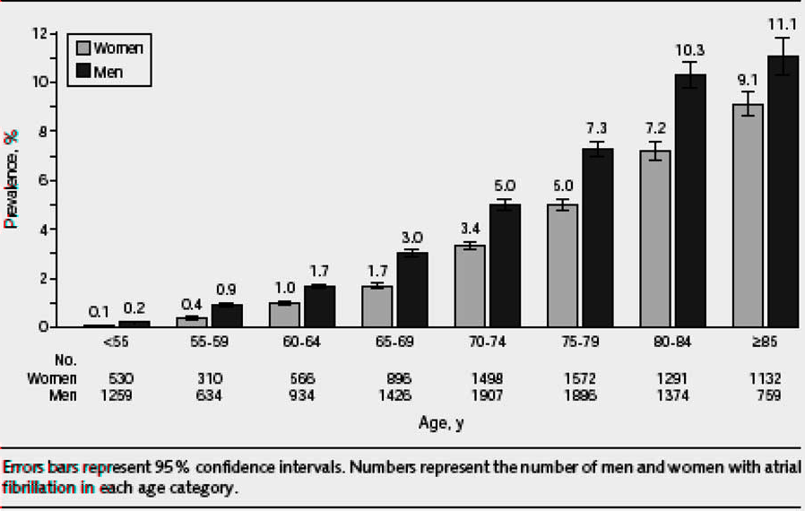
AF Prevalence in US Population

Slide 6
Pathophysiology of Atrial Fibrillation and associated Stroke

Slide 7
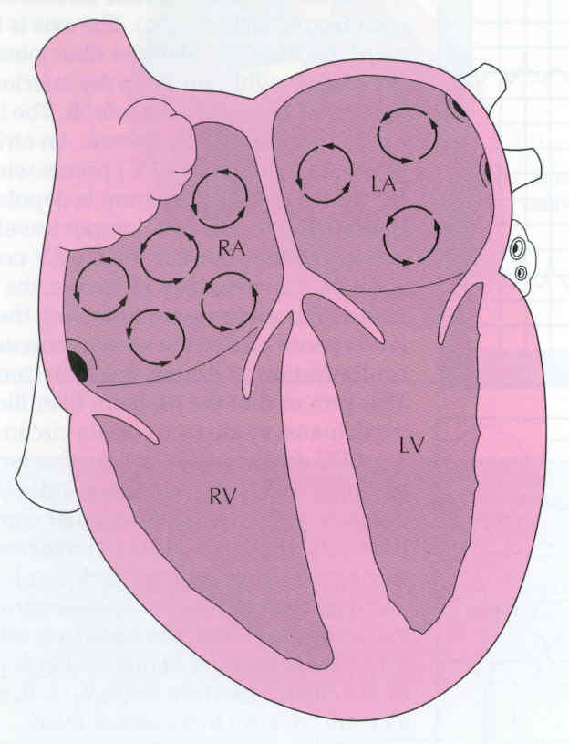
Normal regulation of heart rate and rhythm
Contraction is controlled by the sinoatrial (SA) node

Slide 8
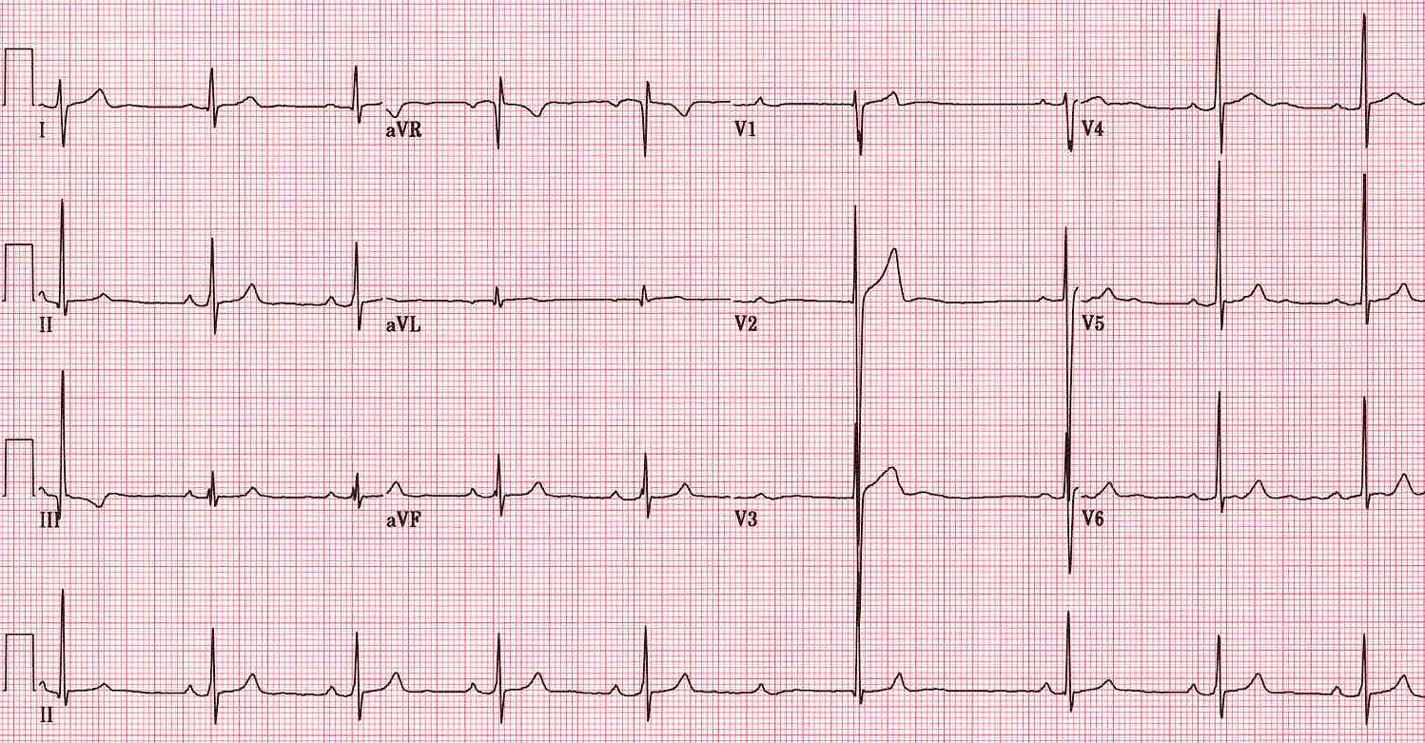
Normal EKG

Slide 9
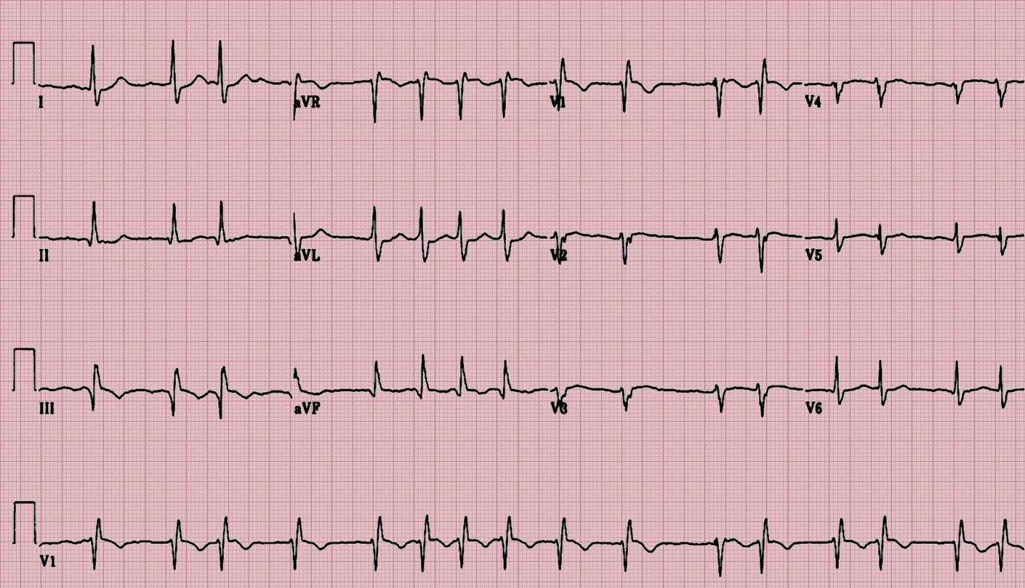

Slide 10
Normal heart rhythm is disrupted in AF
AF is characterized by:
  Rapid (350–600 beats/min) and irregular atrial rhythm
  Reduced filling of the left and right ventricles
Conduction of most impulses from the atria to ventricles is blocked at the AV node
Contraction of the ventricles can be:
  Irregular and rapid (110–180 beats/min; tachycardia)
  Irregular and slow (<50 beats/min; bradycardia)
  Normal
Cardiac output can be reduced

Slide 11
AF begets AF
AF causes remodelling:
  Electrical: shortening of refractory period
  Structural: enlargement of atrial cavities
Many episodes of AF resolve spontaneously
Over time AF tends to become persistent or permanent.
Wijffels MC et al. Circulation 195;92:1954–68

Slide 12
Consequences of AF
Formation of blood clots (thrombosis) on the walls of the atria that can dislodge (embolize), leading to stroke and systemic embolism
Reduction in cardiac output can precipitate heart failure leading to:
  Peripheral oedema
  Pulmonary oedema

Slide 13
Diagnosis of Atrial Fibrillation

Slide 14
Atrial Fibrillation: Cardiac Causes
Hypertensive heart disease
Ischemic heart disease
Valvular heart disease
  Rheumatic: mitral stenosis
  Non-rheumatic: aortic stenosis, mitral regurgitation
Pericarditis
Cardiac tumors: atrial myxoma
Sick sinus syndrome
Cardiomyopathy
  Hypertrophic
  Idiopathic dilated (? cause vs. effect)
Post-coronary bypass surgery

Slide 15
Atrial Fibrillation: Non-Cardiac Causes
Pulmonary
  COPD
  Pneumonia
  Pulmonary embolism
Metabolic
  Thyroid disease: hyperthyroidism
  Electrolyte disorder
Toxic: alcohol (‘holiday heart’ syndrome)

Slide 16
Diagnosis of AF
Signs and symptoms
Electrocardiography
Transthoracic echocardiography
Laboratory tests
Holter monitoring
Transoesophageal echocardiography
Exercise testing
Chest radiography

Slide 17
Heterogeneous clinical presentation of AF
With or without detectable heart disease
Episodic
  Symptoms may be absent or intermittent
  Up to 90% of episodes may not cause symptoms
Symptoms vary according to
  Irregularity and rate of ventricular response
  Functional status
  AF duration
  Patient factors
  Co-morbidities
Fuster V et al. Circulation 2006;114:e257–e354;
Page RL et al. Circulation 1994;89:224–7

Slide 18

Signs and symptoms
Cause | Sign/symptom
Irregular heart beat | Irregularly irregular pulse Palpitations
Decreased cardiac output | Fatigue Diminished exercise capacity Breathlessness (dyspnoea) Weakness (asthenia)
Hypotension | Dizziness and fainting (syncope)
Cardiac ischaemia | Chest pain (angina)
Increased risk of clot formation | Thromboembolic TIA, stroke
Fuster V et al. Circulation 2006;114:e257–354

Slide 19
Clinical evaluation of patients with AF
All patients
  History
  Physical examination
  Electrocardiogram (ECG)
  Transthoracic echocardiogram (TTE)
  Blood tests
  Holter monitor
  Chest x-ray
Selected patients
  Transesophageal echocardiogram (TEE)
Adapted from Fuster V et al. Circulation 2006;114:e257–354

Slide 20
History and physical examination
Clinical conditions associated with AF
  Underlying heart conditions (e.g. valvular heart disease,
  heart failure, coronary artery disease, hypertension)
  Other reversible conditions
Family history
  Familial AF (lone AF in a family)
  AF secondary to other genetic conditions
  (familial cardiomyopathies)
Type of AF
  First episode, paroxysmal, persistent, permanent
  Triggers – e.g. emotional stress, alcohol, physical exercise, gastroesophageal disease
  Specific symptoms
  Response to any treatments administered
Fuster V et al. Circulation 2006;114:e257–354;
de Vos CB et al. Eur Heart J 2008;29:632–9

Slide 21
Electrocardiogram
Assesses the electrical activity of the heart
Essential for all patients with suspected AF, to identify
  Abnormal heart rhythm (verify AF)
  Left ventricular hypertrophy
  Pre-excitation
  Bundle-branch block
  Prior MI
  Differential diagnosis of other atrial arrhythmias
Fuster V et al. Circulation 2006;114:e257–354

Slide 22
Eletrocardiogram: normal sinus rhythm
Impulse from sinoatrial (SA) node stimulates myocardium
to contract
P-wave:
atrial depolarization
QRS complex:
ventricular depolarization
T-wave:
ventricular repolarization

Slide 23
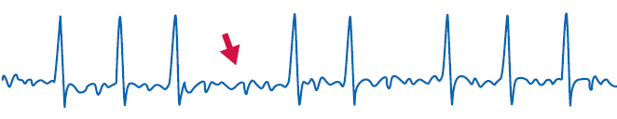
Electrocardiogram: loss of P wave in AF
Normal sinus rhythm
  Normal heart rate
  Regular rhythm
  P Waves
  Steady baseline
AF
  Heart rate increased (tachyarrhythmia)*
  Irregular rhythm
  No P wave
  Irregular baseline
P
No P
  *Reduced heart rate (bradyarrythmia) may also be observed

Slide 24
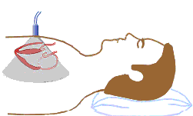
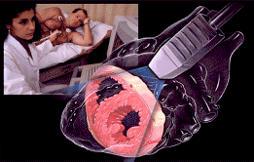
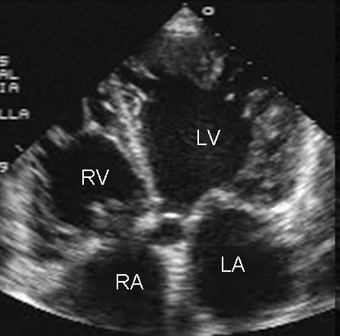
Transthoracic echocardiography (TTE)
Non-invasive
Used to identify
  Size and functioning of atria and ventricles
  Ventricle hypertrophy
  Pericardial disease
  Valvular heart disease

Slide 25
Laboratory tests
Routine blood tests should be carried out at least once
in patients with AF
Important parameters to assess include:
  Thyroid function
  Renal function
  Hepatic function
  Serum electrolytes
  Complete blood count

Slide 26
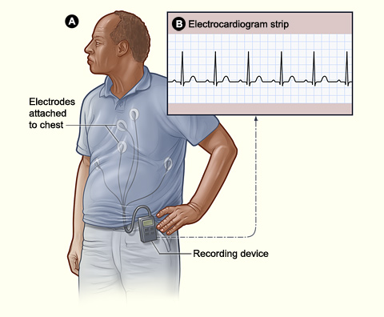
Holter monitor
Portable ECG device
Continuous monitoring for a short period of time (typically 24 hours)
Useful for
  Detecting asymptomatic AF
  Evaluating patients with paroxysmal AF
  Associating symptoms with heart rhythm disturbance
  Assessing response to treatment

Slide 27
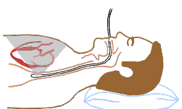
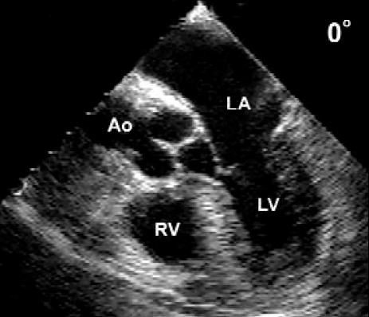
Transoesophageal echocardiogram (TEE)
Ultrasound transducer positioned close to the heart using an endoscope-like device
High quality images of cardiac structure and function
  Particularly the left atrial appendage, the most common site of thrombi in patients
  with AF
Not routinely used but useful for:
  Accurate assessment of risk of stroke
  Detection of low flow velocity (‘smoke’ effect)
  Sensitive detection of atrial thrombi

Slide 28
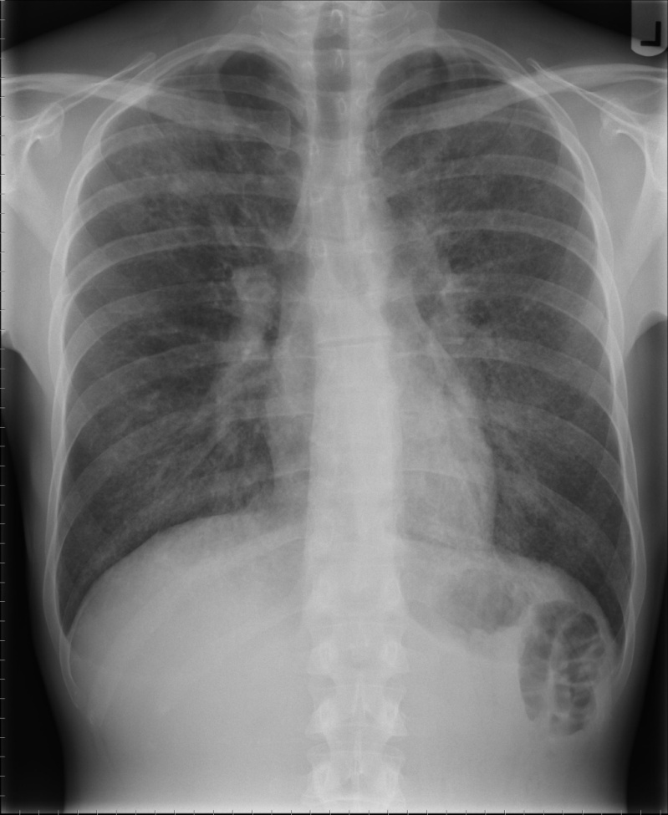
Chest Radiography
When clinical findings suggest an abnormality chest radiography may be used to
  Evaluate pulmonary pathology and vasculature
  Detect congestive heart failure
  Assess enlargement of the cardiac chambers

Slide 29
Classification of atrial fibrillation

Slide 30
Classification of AF: joint guidelines of the ACC, AHA and ESC (1)
Classification | Definition
First-detected | First recognised episode of AF
Recurrent Paroxysmal Persistent | ≥2 episodes of arrhythmia AF that terminates spontaneously AF than persists for >7 days but can be converted with cardioversion
Permanent | AF that cannot be terminated by cardioversion, and long-standing AF (>1 year) where cardioversion not indicated/not attempted

Slide 31
Classification of AF: joint guidelines of the ACC, AHA and ESC (2)
Classification | Definition
Lone or primary | AF without clinical/ECG evidence of cardiopulmonary disease
Secondary | AF associated with cardiopulmonary disease (e.g. myocardial infarction or pneumonia)
Non-valvular | AF that is not associated with damage to the heart valves (e.g. rheumatic mitral valve disease, prosthetic heart valve or mitral valve repair)

Slide 32
Treatment Atrial Fibrillation

Slide 33
3 Strategies
Prevention of thromboembolism
Rate control
Restoration and maintenance of sinus rhythm

Slide 34
Treatment options for AF
STROKE PREVENTION
CONTROL OF HEART RATE
MAINTENANCE OF
SINUS RHYTHM
PHARMACOLOGIC
PHARMACOLOGIC
PHARMACOLOGIC
Warfarin
Aspirin
Dabigatran
Apixaban
Rivaroxaban
Rivaroxaban
Ca²⁺-channel blockers
β-blockers
Digoxin
Antiarrhythmic drugs
– Class IA
– Class IC
– Class III: e.g. amiodarone, dronedarone
NON-PHARMACOLOGIC
NON-PHARMACOLOGIC
NON-PHARMACOLOGIC
Removal/isolation of
left atrial appendage,
e.g. WATCHMAN® device
or surgery
Ablate/pace
Ablation
Surgery (MAZE)
ACE = angiotensin-converting enzyme
Notes:
34

Slide 35
Prevention of Thromboembolism

Slide 36
The CHADS₂ Index
Stroke Risk Score for Atrial Fibrillation
Score (points)
Prevalence (%)*
Congestive Heart failure 1 32
Hypertension 1 65
Age >75 years 1 28
Diabetes mellitus 1 18
Stroke or TIA 2 10
Moderate-High risk >2 50-60
Low risk 0-1 40-50
VanWalraven C, et al. Arch Intern Med 2003; 163:936.
* Nieuwlaat R, et al. (EuroHeart survey) Eur Heart J 2006 (E-published).

Slide 37
The CHA₂DS₂VASc Index
Stroke Risk Score for Atrial Fibrillation
Weight (points)
Congestive heart failure or LVEF < 35% 1
Hypertension 1
Age >75 years 2
Diabetes mellitus 1
Stroke/TIA/systemic embolism 2
Vascular Disease (MI/PAD/Aortic plaque) 1
Age 65-74 years 1
Sex category (female) 1
Moderate-High risk > 2
Low risk 0-1
Lip GYH, Halperin JL. Am J Med 2010; 123: 484.

Slide 38
Restoration of Sinus Rhythm

Slide 39
Rhythm-control therapies
The objective of rhythm-control therapy is to restore (cardioversion) and maintain normal sinus rhythm
Cardioversion can be achieved by:
  Pharmacotherapy with antiarrhythmic agents
  Electrical shocks (direct-current cardioversion)
Direct-current cardioversion is generally more effective than pharmacotherapy
Likelihood of successful cardioversion decreases with the duration of AF
  Pharmacological cardioversion is most effective when initiated within 7 days of AF onset
Cardioversion can dislodge thrombi in the atria, increasing the risk of stroke
  Thromboprophylaxis is recommended for ≥3 wk before and for at least
  4 wks after cardioversion in patients with AF that has persisted for ≥48 h
39
Fuster V et al. Circulation 2006; 114:e257–354
Notes:
39

Slide 40
TEE-guided cardioversion: ACUTE study design
AF >2 d duration
Direct-current cardioversion prescribed
TEE-guided cardioversion
Conventional cardioversion
Therapeutic anticoagulation
with heparin or warfarin
Thrombus
No thrombus
No cardioversion
Cardioversion
Warfarin for 3 wk
Warfarin for 3 wk
Repeated TEE
Warfarin for 4 wk
Cardioversion
No thrombus
Thrombus
Cardioversion
No cardioversion
Warfarin for 4 wk
Warfarin for 4 wk
Warfarin for 4 wk
Follow-up (8 wk)
DC = direct-current; TEE = transoesophageal echocardiography
Klein AL et al. N Engl J Med 2001;344:1411–20

Slide 41
Atrial Flutter

Slide 42
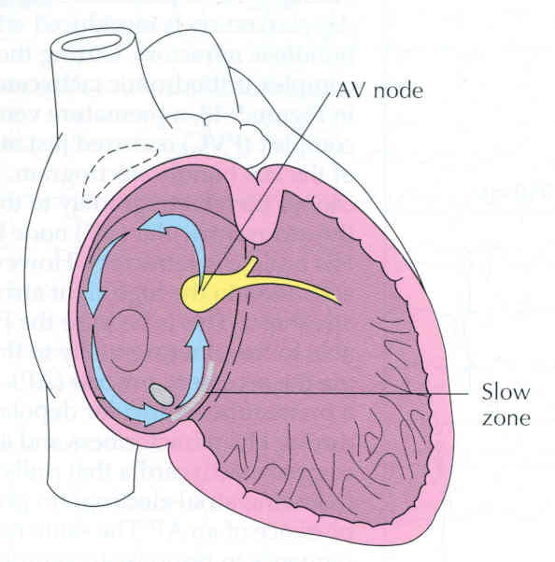

Slide 43
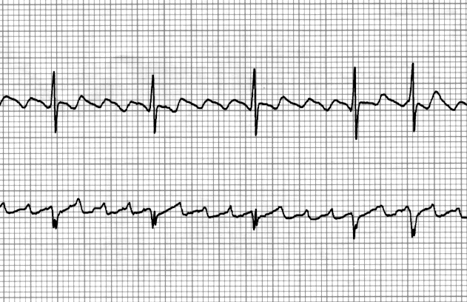

Slide 44
Rx – Atrial Flutter
Unstable pt (i.e. low BP / CP / AMS):
    Synchronized cardioversion as per ACLS
    50J → 100J → 200J → 300J → 360J
Stable pt:
    Rate control - just like atrial fibrillation (AFib)
    Elective cardioversion - just like AFib
    Anti-coagulation – just like AFib
    Refer for Ablation

Slide 45
SVT

Slide 46
AVRT-Narrow complex

Slide 47
So What Is Actually Meant By Supraventricular Tachycardia?
Arrhythmias of supraventricular origin using a re-entrant mechanism with abrupt onset & termination
AVNRT (60%)
AVRT (30%)
Atrial tachycardia (10%)

Slide 48
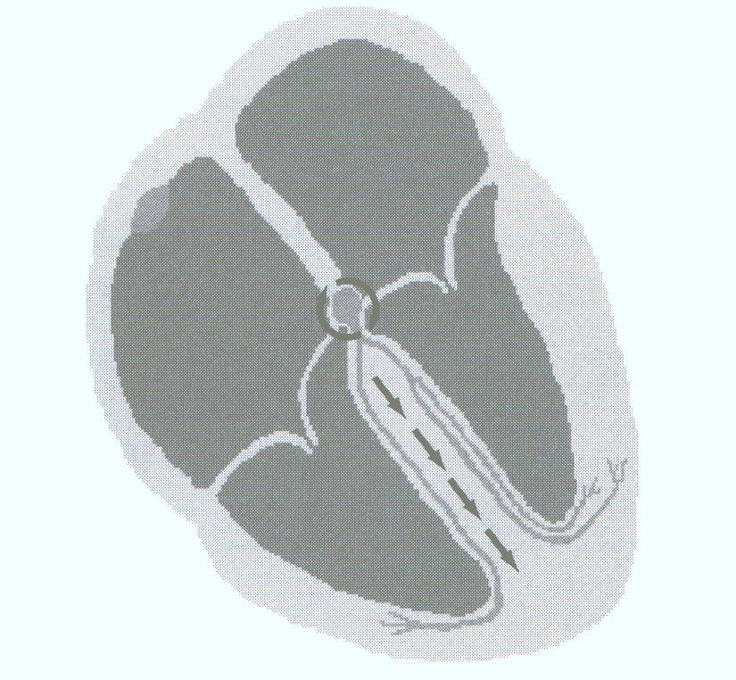
Atrioventricular Nodal Re-entrant Tachycardia (AVNRT)

Slide 49
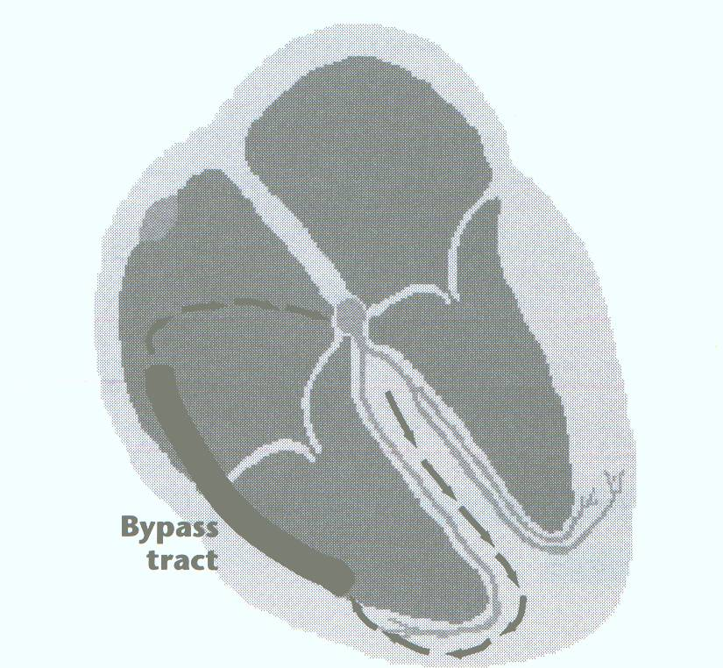
Atrioventricular Re-entrant Tachycardia (AVRT)

Slide 50
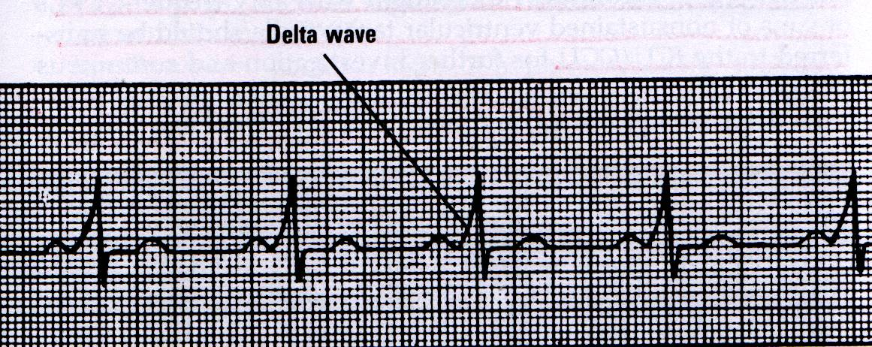
Wolf-Parkinson-White (WPW) Syndrome

Slide 51
Treatment options
Medical therapy
Radio Frequency Ablation

Slide 52
Other Arrhythmias
Ventricular Tachycardia
Ventricular Fibrillation

Slide 53
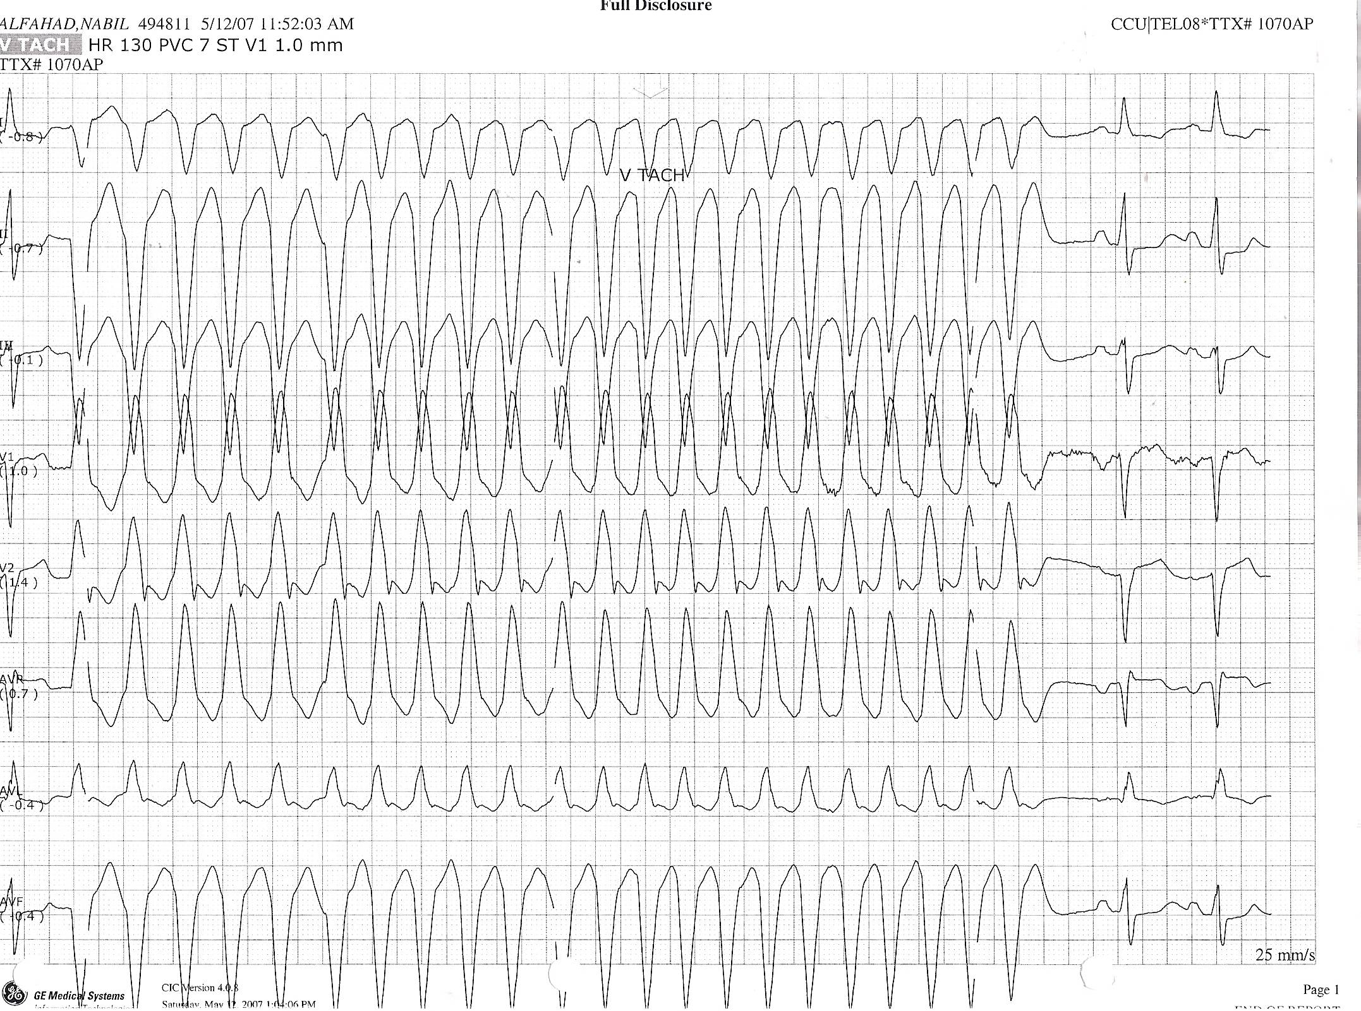

Slide 54
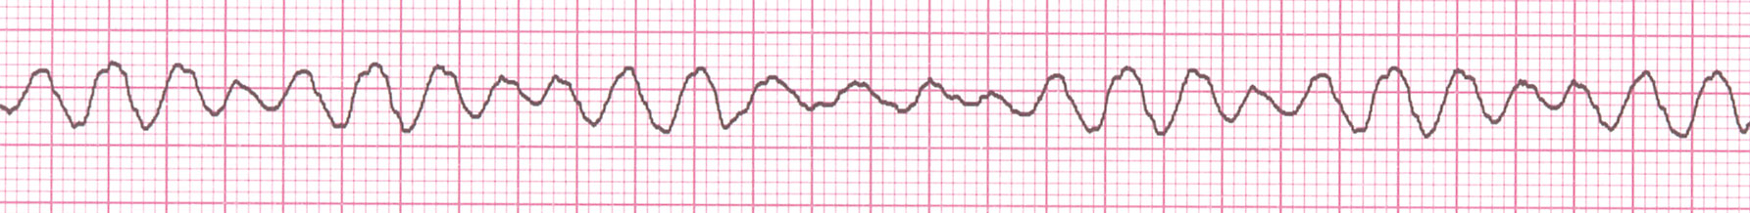
VF

Slide 55
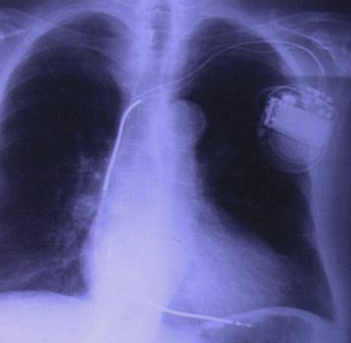
Treatment options
Treat the underlying cause
Automatic Implantable defibrillators

Slide 56
Thank You

