Slide 1
Pulmonary Embolism
Prof. Ahmed BaHammam, FRCP, FCCP
Professor of Medicine
College of Medicine
King Saud University

Slide 2
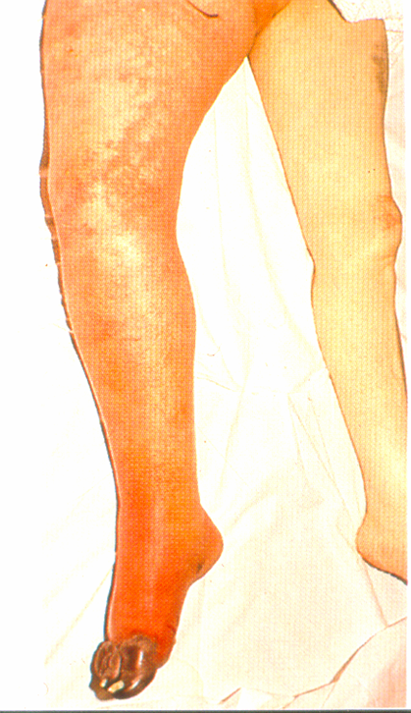
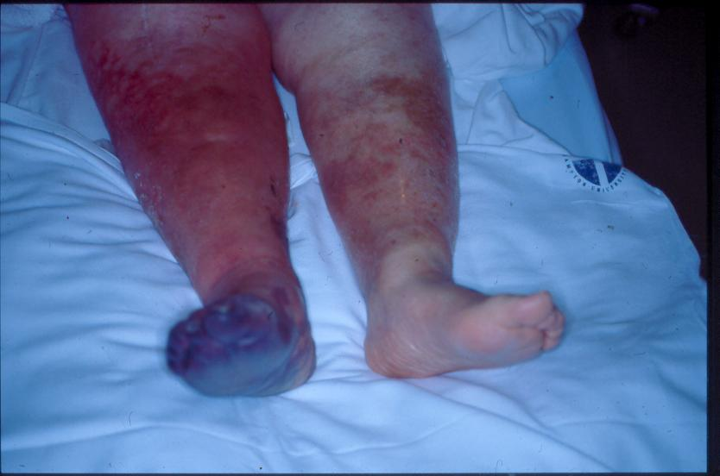
Phlegmasia cerulea dolens
Venous gangrene

Slide 3
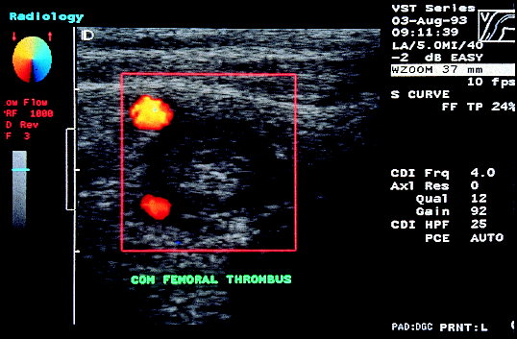
Color duplex scan of DVT

Slide 4
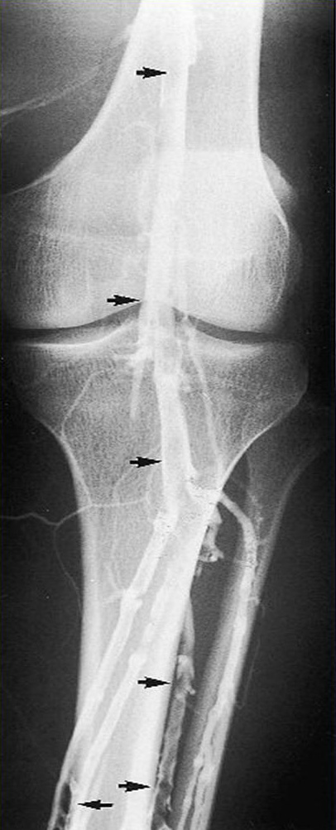
Venogram shows DVT

Slide 5
Patient with suspect symptomatic
Acute lower extremity DVT
Venous duplex scan
negative
Low clinical probability
observe
positive
High clinical probability
negative
Evaluate coagulogram /thrombophilia/ malignancy
Repeat scan /
Venography
Anticoagulant therapy
contraindication
yes
IVC filter
No
pregnancy
LMWH
OPD
LMWH
+ warfarin
hospitalisation
UFH
Compression treatment

Slide 6
Thrombophilia screening
Factor V leiden, Prot C/S deficiency
Antithrombin III deficiency
Idiopathic DVT < 50 years
Family history of DVT
Thrombosis in an unusual site
Recurrent DVT

Slide 7
Recommendation for duration of warfarin
3-6 months first DVT with reversible risk factors
At least 6 months for first idiopathic DVT
12 months to lifelong for recurrent DVT or first DVT with irreversible risk factors
malignancy or thrombophilic state

Slide 8
Catheter directed-thrombolysis
Consider in: Acute< 10 days iliofemoral DVT.
Long-term benefit in preventing post-phebitic syndrome is unknown.

Slide 9
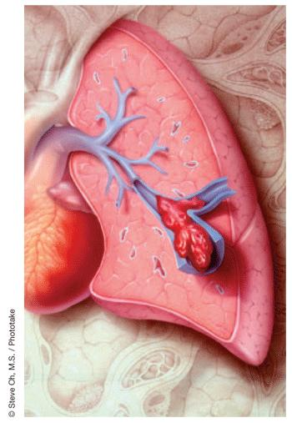

Slide 10
50,000 individuals die from PE each year in USA
The incidence of PE in USA is 500,000 per year

Slide 11
Incidence of Pulmonary Embolism Per Year in the United States*
Total Incidence 630,000
89%
11%
Survival >1hr
563,000
Death within 1 hr
67,000
71%
29%
Dx not made
400,000
Dx made, therapy
instituted 163,000
*Progress in Cardiovascular Diseases, Vol. XVII, No. 4 (Jan/Feb 1975)
70%
30%
92%
8%
Survival
280,000
Death
120,000
Survival
150,000
Death
120,000

Slide 12
Risk factor for venous thrombosis
Stasis
Injury to venous intima
Alterations in the coagulation-fibrinolytic system

Slide 13
Source of emboli
Deep venous thrombosis (>95%)
Other veins:
  Renal
  Uterine
  Right cardiac chambers

Slide 14
Risk factors for DVT
General anesthesia
Lower limb or pelvic injury or surgery
Congestive heart failure
Prolonged immobility
Pregnancy
Postpartum
Oral contraceptive pills
Malignancy
Obesity
Advanced age
Coagulation problems

Slide 15
Clinical features
Sudden onset dyspnea
Pleuritic chest pain
Hemoptysis
Clinical clues cannot make the diagnosis of PE; their main value lies in suggesting the diagnosis

Slide 16
Signs or symptoms observed in patients with thromboembolism
 |  | Study
 |  | Stein et al., % (n= 117) | Anderson et al., % (n= 131)
Pulmonary embolism | Dyspnea | 73 | 77
 | Tachypnea | 70 | 70
 | Chest pain | 66 | 55
 | Cough | 37 | —
 | Tachycardia | 30 | 43
 | Cyanosis | 1 | 18
 | Hemoptysis | 13 | 13
 | Wheezing | 9 | —
 | Hypotension | — | 10

Slide 17
Signs or symptoms observed in patients with thromboembolism
 |  | Study
 |  | Stein et al., % (n= 117) | Anderson et al., % (n= 131)
Pulmonary Embolism | Syncope | — | 10
 | Elevated jugular venous pulse | — | 8
 | Temperature >38.5°C | 7 | —
 | S-3 gallop | 3 | 5
 | Pleural friction rub | 3 | 2

Slide 18
Signs or symptoms observed in patients with thromboembolism
 |  | Study
 |  | Stein et al., % (n= 117) | Anderson et al., % (n= 131)
Deep vein thrombosis | Swelling | 28 | 88*
 | Pain | 26 | 56
 | Tenderness | — | 55
 | Warmth | — | 42
 | Redness | — | 34
 | Homan’s sign | 4 | 13
 | Palpable cord | — | 6

Slide 19
Massive Pulmonary Embolism
It is a catastrophic entity which often results in acute right ventricular failure and death
Frequently undiscovered until autopsy
Fatal PE typically leads to death within one to two hours of the event

Slide 20
Pathophysiology
Massive PE causes an increase in PVR → right ventricular outflow obstruction → decrease left ventricular preload → Decrease CO
In patients without cardiopulmonary disease, occlusion of 25-30 % of the vascular bed → increase in Pulmonary artery pressure (PAP)
Hypoxemia ensues → stimulating vasoconstriction → increase in PAP

Slide 21
Pathophysiology
More than 50% of the vascular bed has to be occluded before PAP becomes substantially elevated
When obstruction approaches 75%, the RV must generate systolic pressure in excess of 50mmHg to preserve pulmonary circulation
The normal RV is unable to accomplish this acutely and eventually fails

Slide 22
Diagnosis
CXR
ABG:
ECG
V/Q
Spiral CT
Echo
Angio
Fibrin Split Products/D-dimer

Slide 23
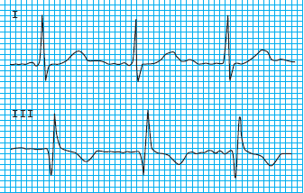
S1 Q3 T3 Pattern

Slide 24
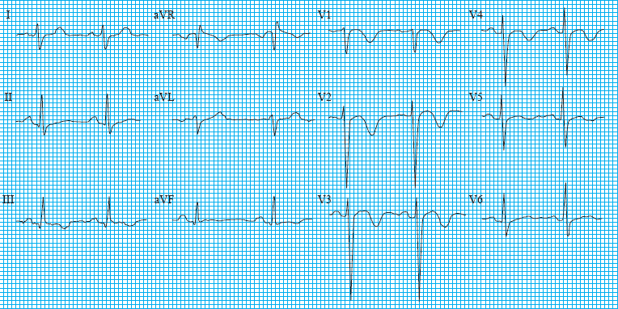
T-wave inversion

Slide 25
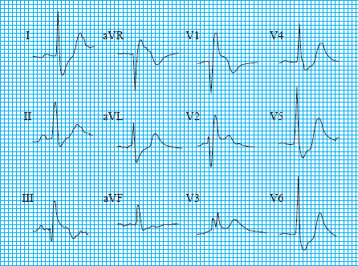
Rt. Bundle Branch Block

Slide 26
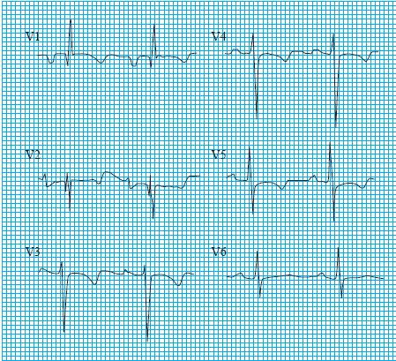
Rt. Ventricular Strain

Slide 27
Diagnosis
The diagnosis of massive PE should be explored whenever oxygenation or hemodynamic parameters are severely compromised without explanation
CXR
ABG:
    Significant hypoxemia is almost uniformly present when there is a hemodynamically significant PE
V/Q
Spiral CT
Echo
Angio

Slide 28
Diagnosis
D-Dimer
BNP
Troponin

Slide 29
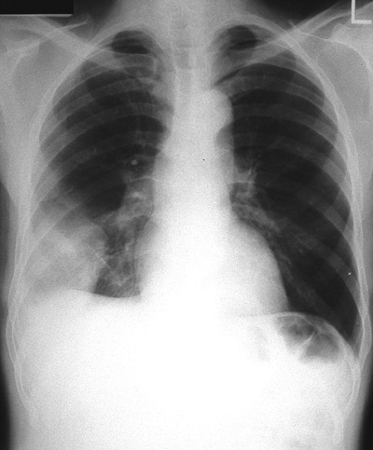
Chest radiograph showing pulmonary infarct in right lower lobe
Notes:
Figure 21-5. Chest radiograph showing pulmonary infarct in the right lower lobe. This patient had low-grade fever, hemoptysis, and pleuritic chest pain. The ventilation-perfusion scan was read as high probability for pulmonary embolism. A pleural-based density in the lower lobe with the convexity directed toward the hilum signifies pulmonary infarction. This sign is also known as ?Hampton’s hump.”

Slide 30
Chest radiographic findings in patients with pulmonary embolism
 | COPD, % (n= 21) | No prior cardiopulmonary disease, % (n= 117)
Atelectasis or pulmonary parenchymal abnormality | 76 | 68
Pleural effusion | 52 | 48
Pleural-based opacity | 33 | 35
Elevated diaphragm | 14 | 24
Decreased pulmonary vascularity | 38 | 21
Prominent central pulmonary artery | 29 | 15
Cardiomegaly | 19 | 12
Westermark’s sign* | 5 | 7
Pulmonary edema | 14 | 4
Notes:
Figure 21-6. Chest radiographic findings in patients with pulmonary embolism. Although frequently abnormal, the chest radiograph is nonspecific for the diagnosis of pulmonary embolism and cannot be used to confirm the diagnosis. The existence of underlying lung disease may also influence the chest radiographic appearance of pulmonary embolism. (Data from Stein [7].)

Slide 31
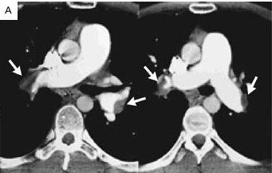
Spiral CT

Slide 32
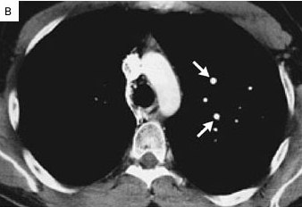
Spiral CT

Slide 33
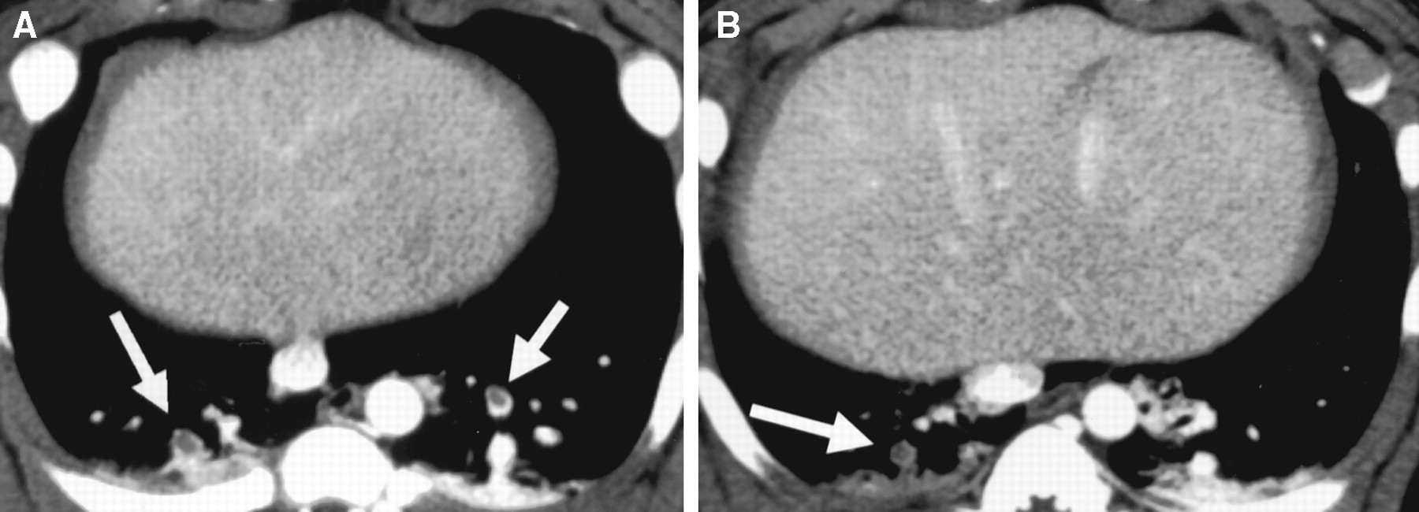
Spiral CT

Slide 34
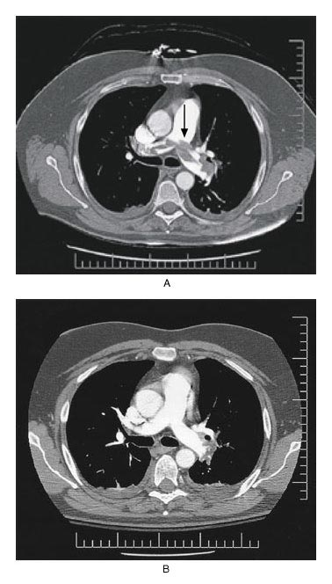
Before
After

Slide 35
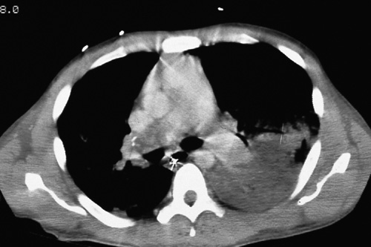
Tomographic scan showing infarcted left lung, large clot in right main pulmonary artery
Notes:
Figure 21-30. A, Computed tomographic scan demonstrating infarcted lung on left and large clot in the right main pulmonary artery. B, Autopsy specimen from same patient demonstrating organized clot in right main pulmonary artery. The patient presented with chronic dyspnea and hemoptysis and later died from complications of severe pulmonary hypertension. Patients with moderate to severe pulmonary hypertension may be considered for thromboendarterectomy. The operative mortality has decreased to approximately 5% with improvement in technique. Patients may experience dramatic relief of symptoms. Life-long anticoagulation is required to prevent recurrence.

Slide 36
The use of ventilation perfusion scan in diagnosing pulmonary embolism
High probability
=2 large segmental (>75% of a segment) perfusion defects without corresponding ventilation or radiographic abnormalities or substantially larger than matching ventilation or radiologic abnormalities
OR
=2 moderate segmental (>25% and <75% of a segment) perfusion defects without matching ventilation or chest radiographic abnormalities plus one large unmatched segmental defect
OR
=4 moderate segmental perfusion defects without matching ventilation or chest radiologic abnormalities
Notes:
Figure 21-8. The use of ventilation-perfusion scan in diagnosing pulmonary embolism. The criteria used for interpreting ventilation-perfusion scans are listed in the figure. In patients suspected to have pulmonary embolism, this study is ordered routinely. The perfusion scan is usually performed first. Macroaggregates of albumin labeled with technetium-99m are injected, and images are obtained in anterior, posterior, and right and left lateral and oblique views. If the perfusion scan is normal, there is no need to perform a ventilation scan. Defects in perfusion are assessed and quantified. The ventilation scan is performed by inhalation of a radioactive gas, usually 133 Xe is mixed with air. The patient breathes this radioactive mixture until a state of equilibrium has been reached between the spirometer and lungs, then the patientbreathes room air. Images taken in this wash-out phase are useful in detecting ventilation abnormalities. (Adapted from the PIOPEDInvestigators [14].)

Slide 37
The use of ventilation perfusion scan in diagnosing pulmonary embolism
Intermediate probability
Scans that do not fall into normal, very low, low, or high probability categories
Notes:
Figure 21-8. The use of ventilation-perfusion scan in diagnosing pulmonary embolism. The criteria used for interpreting ventilation-perfusion scans are listed in the figure. In patients suspected to have pulmonary embolism, this study is ordered routinely. The perfusion scan is usually performed first. Macroaggregates of albumin labeled with technetium-99m are injected, and images are obtained in anterior, posterior, and right and left lateral and oblique views. If the perfusion scan is normal, there is no need to perform a ventilation scan. Defects in perfusion are assessed and quantified. The ventilation scan is performed by inhalation of a radioactive gas, usually 133 Xe is mixed with air. The patient breathes this radioactive mixture until a state of equilibrium has been reached between the spirometer and lungs, then the patientbreathes room air. Images taken in this wash-out phase are useful in detecting ventilation abnormalities. (Adapted from the PIOPEDInvestigators [14].)

Slide 38
The use of ventilation perfusion scan in diagnosing pulmonary embolism
Low probability
Nonsegmental perfusion defects
OR
Single moderate mismatched segmental perfusion defect with normal chest radiograph
OR
Any perfusion defect with a substantially larger abnormality on chest radiograph
OR
Large or moderate segmental perfusion defects involving no more than four segments in one lung and no more than three segments in one lung region with matching or larger ventilation/radiographic abnormalities
OR
More than three small segmental perfusion defects (<25% of a segment) with a normal chest radiograph
Very low probability
Three or fewer small segmental perfusion defects with a normal chest radiograph
Normal
No perfusion defects present
Notes:
Figure 21-8. The use of ventilation-perfusion scan in diagnosing pulmonary embolism. The criteria used for interpreting ventilation-perfusion scans are listed in the figure. In patients suspected to have pulmonary embolism, this study is ordered routinely. The perfusion scan is usually performed first. Macroaggregates of albumin labeled with technetium-99m are injected, and images are obtained in anterior, posterior, and right and left lateral and oblique views. If the perfusion scan is normal, there is no need to perform a ventilation scan. Defects in perfusion are assessed and quantified. The ventilation scan is performed by inhalation of a radioactive gas, usually 133 Xe is mixed with air. The patient breathes this radioactive mixture until a state of equilibrium has been reached between the spirometer and lungs, then the patientbreathes room air. Images taken in this wash-out phase are useful in detecting ventilation abnormalities. (Adapted from the PIOPEDInvestigators [14].)

Slide 39
The use of ventilation perfusion scan in diagnosing pulmonary embolism
Very low probability
Three or fewer small segmental perfusion defects with a normal chest radiograph
Normal
No perfusion defects present
Notes:
Figure 21-8. The use of ventilation-perfusion scan in diagnosing pulmonary embolism. The criteria used for interpreting ventilation-perfusion scans are listed in the figure. In patients suspected to have pulmonary embolism, this study is ordered routinely. The perfusion scan is usually performed first. Macroaggregates of albumin labeled with technetium-99m are injected, and images are obtained in anterior, posterior, and right and left lateral and oblique views. If the perfusion scan is normal, there is no need to perform a ventilation scan. Defects in perfusion are assessed and quantified. The ventilation scan is performed by inhalation of a radioactive gas, usually 133 Xe is mixed with air. The patient breathes this radioactive mixture until a state of equilibrium has been reached between the spirometer and lungs, then the patientbreathes room air. Images taken in this wash-out phase are useful in detecting ventilation abnormalities. (Adapted from the PIOPEDInvestigators [14].)

Slide 40
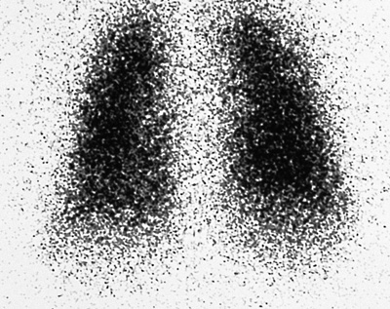
High-probability ventilation-perfusion scan
Notes:
Figure 21-9. High-probability ventilation-perfusion scan. A and B, Multiple large segmental and subsegmental perfusion defects are seen bilaterally. C, The corresponding ventilation image was normal. The patient was treated for pulmonary embolism.

Slide 41
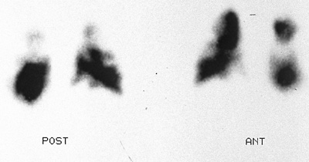
High-probability ventilation-perfusion scan
Notes:
Figure 21-9. High-probability ventilation-perfusion scan. A and B, Multiple large segmental and subsegmental perfusion defects are seen bilaterally. C, The corresponding ventilation image was normal. The patient was treated for pulmonary embolism.

Slide 42
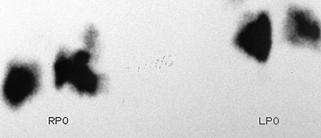
High-probability ventilation-perfusion scan
Notes:
Figure 21-9. High-probability ventilation-perfusion scan. A and B, Multiple large segmental and subsegmental perfusion defects are seen bilaterally. C, The corresponding ventilation image was normal. The patient was treated for pulmonary embolism.

Slide 43
Prospective Investigation of Pulmonary
Embolism Diagnosis (PIOPED) results
Prospective investigation of pulmonary embolism diagnosis results
Scan category | PE present | PE absent | PE uncertain | No angiogram | Total
High probability | 102 | 14 | 1 | 7 | 124
Intermediate probability | 105 | 217 | 9 | 33 | 364
Low probability | 39 | 199 | 12 | 62 | 312
Near normal or normal | 5 | 50 | 2 | 74 | 131
Total | 251 | 480 | 24 | 176 | 931
Notes:
Figure 21-10. Prospective Investigation of Pulmonary Embolism Diagnosis (PIOPED) results. This prospective study was designed to study the accuracy of ventilation-perfusion (õ/õ) scan in the diagnosis of pulmonary embolism. Results of õ/õ scan were compared with pulmonary angiography, which was used as a gold standard. From the results it is obvious that more than two thirds of patients have scans of low or intermediate probability that are nondiagnostic. Although a high-probability scan usually indicates pulmonary embolism, only a minority of patients with pulmonary embolism have a high-probability scan. Near-normal lung scans make the diagnosis of pulmonary embolism very unlikely. (Data from the PIOPED Investigators [14].)

Slide 44
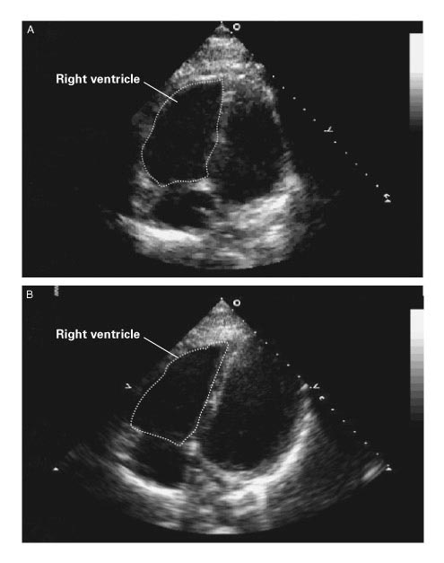
Before
After

Slide 45
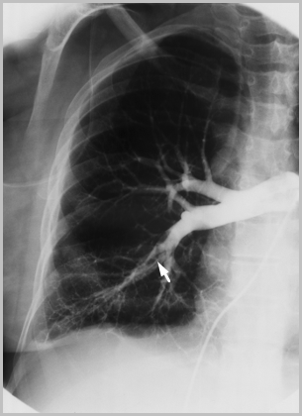
Pulmonary angiogram
Notes:
Figure 21-11. Pulmonary angiogram showing pulmonary embolism. Pulmonary angiography remains the diagnostic gold standard for pulmonary embolism. Access to the pulmonary artery is obtained via transvenous catheter placement. The diagnosis is confirmed by persistent filling defect or abrupt cut-off of flow. Abrupt cut-off of flow to the right and left upper lobe vessels is seen in this patient.

Slide 46
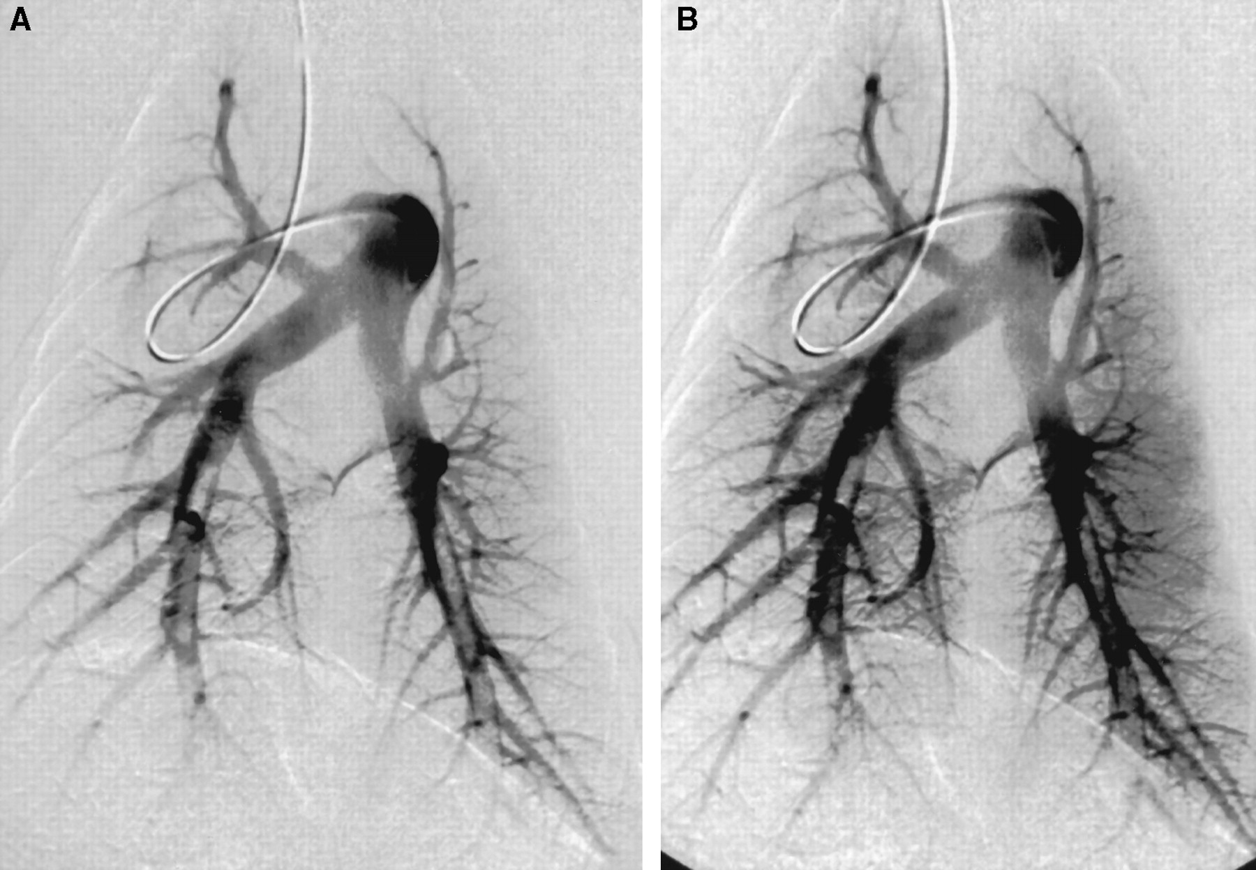
Pulmonary Angiogram

Slide 47
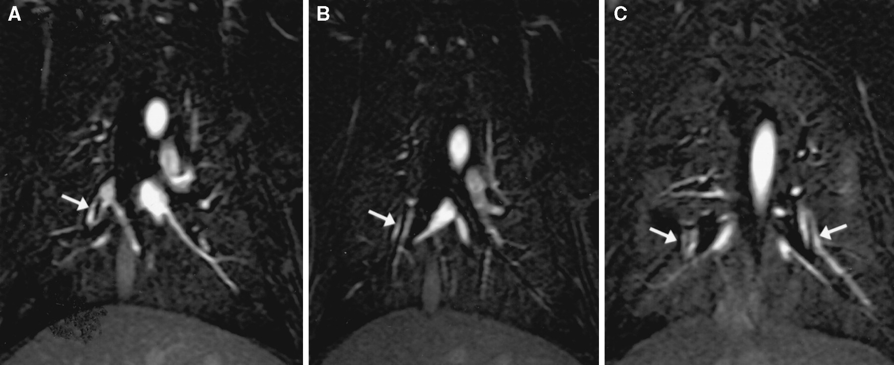
MRA with contrast

Slide 48
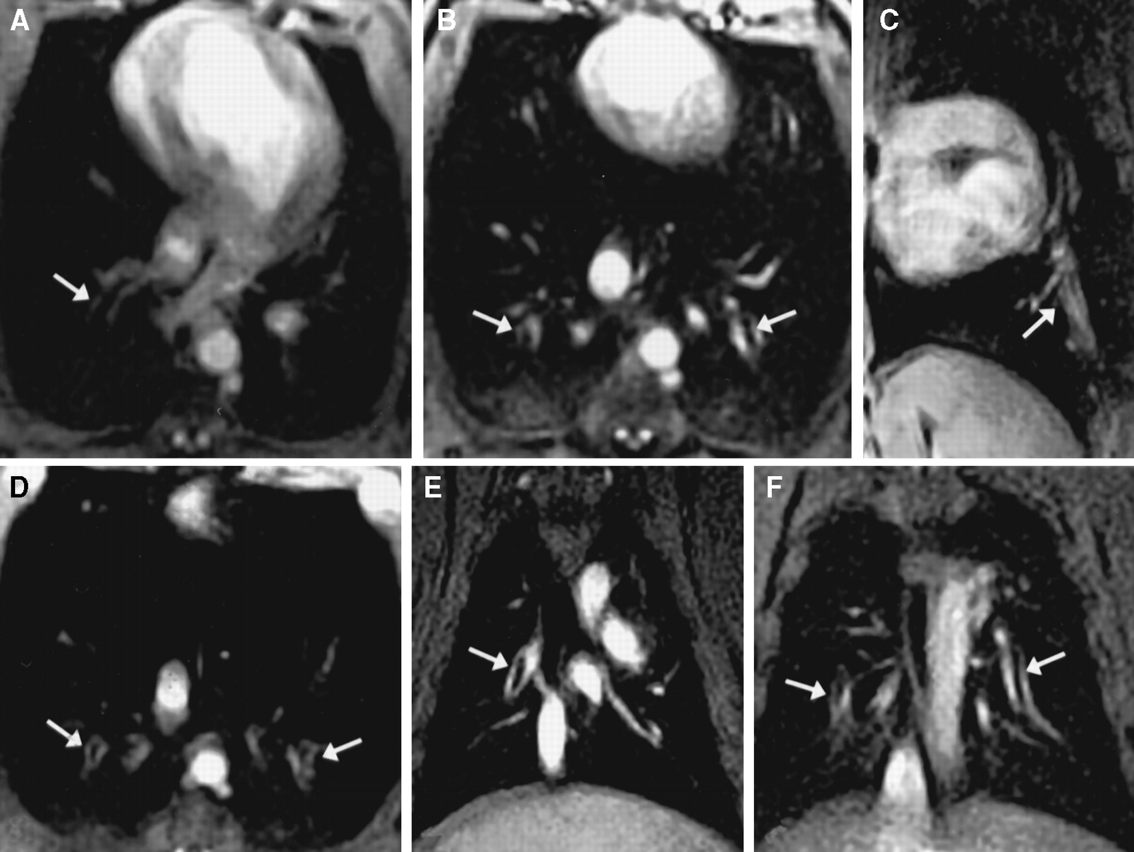
MRA Real Time

Slide 49
PULMONARY EMBOLISM
Notes:
23

Slide 50
Sensitivity of spiral computed tomography, magnetic resonance angiography, and real-time magnetic resonance angiography, for detecting pulmonary emboli
Reader
1
2
Mean
K
CT
72.1
69.8
71.0
0.86
MRA
79.1
81.4
80.3
0.84
RT-MRA
97.7
97.7
97.7
1
Am J Respir Crit Care Med 2003

Slide 51
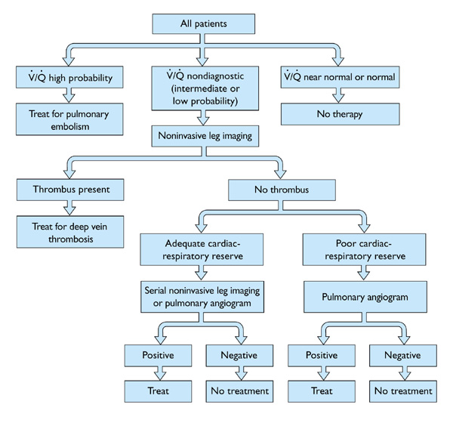
Suggested diagnostic strategy for venous thromboembolism
Spiral CT Scan
Notes:
Figure 21-12. Suggested diagnostic strategy for venous thromboembolism. The PIOPED study revealed that results of ventilation-perfusion (õ/õ) scans are nondiagnostic in more than 70% of the cases. The diagnostic strategy proposed in the figure provides a rational approach to work up patients with suspected thromboembolic disease. The role of spiral CT scan in the diagnosis of pulmonary embolism remains controversial with a wide range of reported sensitivities (53%–100%) and specificities (81%–100%) [15]. (Adapted from Stein et al.[16].)

Slide 52
Suggested diagnostic strategy for venous thromboembolism
Notes:
Figure 21-12. Suggested diagnostic strategy for venous thromboembolism. The PIOPED study revealed that results of ventilation-perfusion (õ/õ) scans are nondiagnostic in more than 70% of the cases. The diagnostic strategy proposed in the figure provides a rational approach to work up patients with suspected thromboembolic disease. The role of spiral CT scan in the diagnosis of pulmonary embolism remains controversial with a wide range of reported sensitivities (53%–100%) and specificities (81%–100%) [15]. (Adapted from Stein et al.[16].)

Slide 53
Treatment
Respiratory support
Hemodynamic Support
Anticoagulation

Slide 54
Dosage and monitoring of anticoagulant therapy
Dosage and monitoring of anticoagulant therapy
After initiating heparin therapy, repeat APTT every 6 h for first 24 h and then every 24 h when therapeutic APTT is achieved
Warfarin 5 mg/d can be started on day 1 of therapy; there is no benefit from higher starting doses
Platelet count should be monitored at least every 3 d during initial heparin therapy
Therapeutic APTT should correspond to plasma heparin level of 0.2–0.4 IU/mL
Heparin is usually continued for 5–7 d
Heparin can be stopped after 4–5 d of warfarin therapy when INR is in 2.0–3.0 range
Notes:
Figure 21-15. Dosage and monitoring of anticoagulant therapy [22],[23]. An activated partial thromboplastin time ratio of 1.5 to 2.5 has traditionally been used to define the boundaries of therapeutic heparin effects. The actual therapeutic range may vary according to the thromboplastin reagent used by a particular laboratory. Warfarin acts by inhibiting the synthesis of vitamin K-dependent coagulation factors in the liver (II, VII, IX, and X). The half-lives of these factors are relatively long (60, 6, 24, and 40 hours, respectively), thus the onset of action of warfarin is slow—3 or more days may be required to achieve a therapeutic response. Traditionally, warfarin therapy has been monitored by measuring the prothrombin time (PT). To standardize themonitoring of therapy, the INR is used by many laboratories. The PT of the patient is compared with a normal control PT value; this ratio is thenplotted against the International Sensitivity Index (ISI) to calculate the INR (INR = PT ratioisi). The ISI is obtained by comparing the local thromboplastin reagent used for testing with a standardized international reagent [24].

Slide 55
Important drug interactions with warfarin
Drugs that decrease warfarin requirement | Drugs that increase warfarin requirement
Phenylbutazone | Barbiturates
Metronidazole | Carbamazepine
Trimethoprim-sulfamethoxazole | Rifampin
Amiodarone | Penicillin
Second- and third-generation cephalosporins | Griseofulvin
Clofibrate | Cholestyramine
Erythromycin
Anabolic steroids
Thyroxine
Notes:
Figure 21-18. Important drug interactions with warfarin. The figure includes only a short list of commonly used agents that are known to have clinically significant interactions with warfarin; several other drugs have pharmacokinetic and pharmacodynamic interactions with warfarin. Careful review of medications, alcohol consumption, and dietary factors is mandatory in patients who are on warfarin therapy.

Slide 56
Complications of anticoagulation
 | Complication | Management
Heparin | Bleeding | Stop heparin infusion. For severe bleeding, the anticoagulant effect of heparin can be reversed with intravenous protamine sulfate 1 mg/100 units of heparin bolus or 0.5 mg for the number of units given by constant infusion over the past hour; provide supportive care including transfusion and clot evacuation from closed body cavities as needed.
Notes:
Figure 21-22. Complications of anticoagulation. Major bleeding episodes with the use of heparin are much more likely to occur in patients with identifiable risks for bleeding rather than an excessively long activated partial thromboplastin time per se. LMWH does not affect the APTT to a significant degree; therefore, the APTT need not be routinely measured. Many factors influence the prothrombin time during warfarin therapy. Weekly or biweekly measurements are necessary until the prothrombin time stabilizes. Thereafter, monthly measurements of the prothrombin time may be sufficient.

Slide 57
Complications of anticoagulation
 | Complication | Management
Heparin | Heparin-induced thrombocytopenia and thrombosis | Carefully monitor platelet count during therapy. Stop-heparin for platelet counts <75,000. Replace heparin with direct inhibitors of thrombin-like desirudin if necessary. These agents do not cause heparin-induced thrombocytopenia. Avoid platelet transfusion because of the risk for thrombosis.
Notes:
Figure 21-22. Complications of anticoagulation. Major bleeding episodes with the use of heparin are much more likely to occur in patients with identifiable risks for bleeding rather than an excessively long activated partial thromboplastin time per se. LMWH does not affect the APTT to a significant degree; therefore, the APTT need not be routinely measured. Many factors influence the prothrombin time during warfarin therapy. Weekly or biweekly measurements are necessary until the prothrombin time stabilizes. Thereafter, monthly measurements of the prothrombin time may be sufficient.

Slide 58
Complications of anticoagulation
 | Complication | Management
Heparin | Heparin-induced osteoporosis (therapy >1 mo) | LMWHs may have lower propensity to cause osteoporosis as compared with unfractionated heparin; consider LMWH if prolonged heparin therapy is necessary.
Notes:
Figure 21-22. Complications of anticoagulation. Major bleeding episodes with the use of heparin are much more likely to occur in patients with identifiable risks for bleeding rather than an excessively long activated partial thromboplastin time per se. LMWH does not affect the APTT to a significant degree; therefore, the APTT need not be routinely measured. Many factors influence the prothrombin time during warfarin therapy. Weekly or biweekly measurements are necessary until the prothrombin time stabilizes. Thereafter, monthly measurements of the prothrombin time may be sufficient.

Slide 59
Complications of anticoagulation
 | Complication | Management
Warfarin | Bleeding | Stop therapy. Administer vitamin K and fresh-frozen plasma for severe bleeding; provide supportive care including transfusion and clot evacuation from closed body cavities as needed
 | Skin necrosis (rare) | Supportive care.
 | Teratogenicity | Do not use in pregnancy or in patients planning to become pregnant.
Notes:
Figure 21-22. Complications of anticoagulation. Major bleeding episodes with the use of heparin are much more likely to occur in patients with identifiable risks for bleeding rather than an excessively long activated partial thromboplastin time per se. LMWH does not affect the APTT to a significant degree; therefore, the APTT need not be routinely measured. Many factors influence the prothrombin time during warfarin therapy. Weekly or biweekly measurements are necessary until the prothrombin time stabilizes. Thereafter, monthly measurements of the prothrombin time may be sufficient.

Slide 60
Risks and benefits of thrombolytics vs heparin therapy for pulmonary embolism
 | Thrombolytic therapy | No difference | Heparin
Improved resolution at 2-4 h after onset of therapy
Angiography | + | - | -
Pulmonary artery pressure | + | - | -
Echocardiography | + | - | -
Resolution at 24 h
Lung scan | + | - | -
Angiography | + | - | -
Notes:
Figure 21-23. Risks and benefits of thrombolytics versus heparin therapy for pulmonary embolism. The role of thrombolytic therapy in the management of acute thromboembolic disease is unclear. Improvement in hemodynamic parameters and reduction in clot burden have been demonstrated after thrombolysis; however, no improvement in mortality has been demonstrated when compared with conventional anticoagulation. Nonetheless, in selected patients with acute pulmonary embolism and hemodynamic instability, thrombolytics may prove to be life saving. (Adapted from Dalen et al.[18].)

Slide 61
Risks and benefits of thrombolytics vs heparin therapy for pulmonary embolism
 | Thrombolytic therapy | No difference | Heparin
Echocardiography | + | - | -
Pulmonary artery pressure | + | - | -
Resolution at 1 wk and 30 d (lung scan) | - | + | -
Rate of confirmed recurrent pulmonary embolism | - | + | -
Notes:
Figure 21-23. Risks and benefits of thrombolytics versus heparin therapy for pulmonary embolism. The role of thrombolytic therapy in the management of acute thromboembolic disease is unclear. Improvement in hemodynamic parameters and reduction in clot burden have been demonstrated after thrombolysis; however, no improvement in mortality has been demonstrated when compared with conventional anticoagulation. Nonetheless, in selected patients with acute pulmonary embolism and hemodynamic instability, thrombolytics may prove to be life saving. (Adapted from Dalen et al.[18].)

Slide 62
Risks and benefits of thrombolytics vs heparin therapy for pulmonary embolism
 | Thrombolytic therapy | No difference | Heparin
Hospital mortality | - | + | -
Late mortality | - | + | -
Less severe bleeding | - | - | +
Less intracranial hemorrhage | - | - | +
Lower cost | - | - | +
Notes:
Figure 21-23. Risks and benefits of thrombolytics versus heparin therapy for pulmonary embolism. The role of thrombolytic therapy in the management of acute thromboembolic disease is unclear. Improvement in hemodynamic parameters and reduction in clot burden have been demonstrated after thrombolysis; however, no improvement in mortality has been demonstrated when compared with conventional anticoagulation. Nonetheless, in selected patients with acute pulmonary embolism and hemodynamic instability, thrombolytics may prove to be life saving. (Adapted from Dalen et al.[18].)

Slide 63
Approved thrombolytics for pulmonary embolism
Approved thrombolytics for pulmonary embolism
Streptokinase
250,000 IU as loading dose over 30 min, followed by 100,000 U/h for 24 h
Urokinase
4400 IU/kg as a loading dose over 10 min, followed by 4400 IU/kg/h for 12-24 h
Recombinant tissue-plasminogen activator
100 mg as a continuous peripheral intravenous infusion administered over 2 h
Notes:
Figure 21-24. Approved thrombolytics for pulmonary embolism. All three US Food and Drug Administration–approved regimens used fixed or weight-adjusted doses. No further dosage adjustments are made. Heparin is resumed after the thrombolytic infusion when the activated partial thromboplastin time is less than 2.5 × control.

Slide 64
Indications and contraindications for thrombolytic therapy in pulmonary embolism
Indications
Hemodynamic instability
Hypoxia on 100% oxygen
Right ventricular dysfunction by echocardiography
Notes:
Figure 21-25. Indications and contraindications for thrombolytic therapy in pulmonary embolism. Thrombolytics may also be used to treat extensive ileofemoral venous thrombosis in selected patients with a low risk of bleeding. Some evidence exists that the incidence of postthrombotic syndrome is reduced if complete thrombolysis is achieved. Often the decision to administer thrombolytic therapy has to be individualized after careful review of potential risks and benefits.

Slide 65
Contraindications
Relative
Recent surgery within last 10 d Previous arterial punctures within 10 d
Neurosurgery within 6 mo Bleeding disorder (thrombocytopenia, renal failure, liver failure)
Ophthalmologic surgery within 6 wk
Hypertension >200 mm Hg systolic or 110 mm Hg diastolic Placement of central venous catheter within 48 h
Hypertensive retinopathy with hemorrhages or exudates Intracerebral aneurysm or malignancy
Cardiopulmonary resuscitation within 2 wk
Cerebrovascular disease
Major internal bleeding within the last 6 mo Pregnancy and the 1st 10 d postpartum
Infectious endocarditis Severe trauma within 2 mo
Pericarditis
Absolute
Active internal bleeding

Slide 66
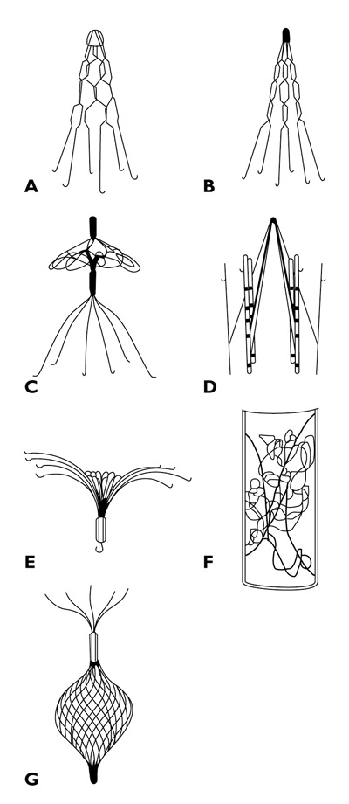
Various inferior vena caval filters
Notes:
Figure 21-26. Various inferior vena caval filters. A, Greenfield filter; B, Titanium Greenfield filter; C, Simon-Nitinol filter; D, LGM or Vena Tech filter; E, Amplatz filter; F, Bird’s Nest filter; G, Günther filter. Surgical interruption of the inferior vena cava was first practiced more than 100 years ago. The practice is percutaneous insertion of a filter device in the inferior vena cava under fluoroscopy to prevent pulmonary embolism. (Adapted from Becker et al.[38].)

Slide 67
Indications for inferior vena caval (IVC) filters
Absolute contraindication to anticoagulation (eg, active bleeding)
Recurrent PE despite adequate anticoagulant therapy
Complication of anticoagulation (eg, severe bleeding)
Hemodynamic or respiratory compromise that is severe enough that another PE may be lethal
Notes:
Figure 21-27. Indications for inferior vena caval (IVC) filters. IVC filters are widely used, but randomized controlled trials assessing their efficacy are lacking. The procedure is not difficult to perform in experienced hands; mortality from filter placement is less than 1%[38]. Nonfatal complications that have been reported include misplacement, cellulitis, hematoma, and venous thrombosis. Proximal or distal migration of the device may also occur. Erosion of the filter into the vena cava wall has been reported; it usually occurs slowly with very few clinical complications. IVC obstruction and lower extremity venous insufficiency may occur in some patients [38],[39].If possible, anticoagulation should be used after filter placement to prevent morbidity from deep vein thrombosis in the legs and to prevent clot formation on the filter[40]. Note that IVC filters may lose their effectiveness within a few months due to the development of collateral venous circulation.

Slide 68
EMBOLECTOMY
Embolectomy (ie, removal of the emboli) can be performed using catheters or surgically.
It should be considered when a patient's presentation is severe enough to warrant thrombolysis (eg, persistent hypotension due to PE), but this approach either fails or is contraindicated.

Slide 69
Conclusions
PE is common and under-recognized serious medical problem
Early diagnosis and treatment is essential for good outcome
High index of suspicion is needed in high risk patients

Slide 70
http://faculty.ksu.edu.sa/ahmedbahammam

