Slide 1
INVESTIGATIONS OF LUNG DISEASE
Esam Alhamad, MD,FCCP, FACP
Division of Pulmonary Medicine
College of Medicine

Slide 2
Objectives
Type of pulmonary diagnostic procedures
Role of various specialized pulmonary procedures in diagnosing lung diseases
When to apply specific tests

Slide 3
Pulmonary Diagnostic Procedures
Thoracentesis
Chest tube
Pleural biopsy
Bronchoscopy
Pulmonary function tests
Computed tomography
Lung Scans: V/Q

Slide 4
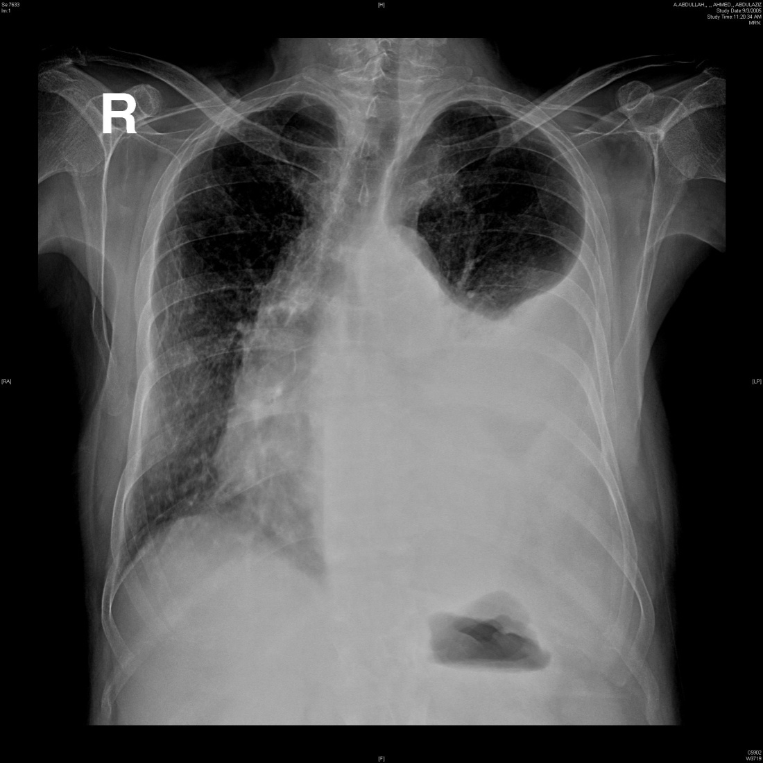

Slide 5
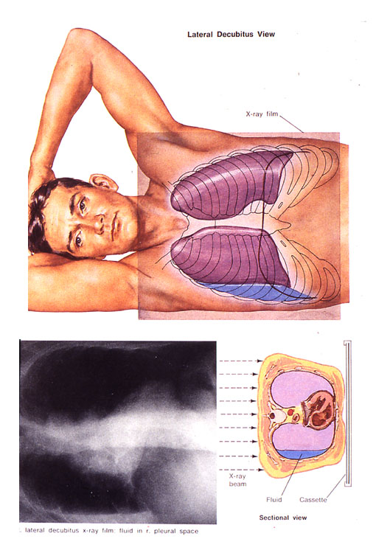

Slide 6
Thoracentesis
Appearance
Gram stain, and cultures
pH
Chemistry (glucose, amylase, LDH, protein)
Cytology

Slide 7
Separation of Transudates from Exudates
Pleural fluid protein divided by the serum protein greater than 0.5
Pleural fluid LDH divided by the serum LDH greater than 0.6
Pleural fluid LDH greater than two-thirds of the upper limit of normal for the serum LDH

Slide 8
Gross appearance is pus
or
Gram stain positive
or
pH below 7.20

Slide 9
Chest tube
Indication for chest tube insertion
Empyema
Complicated parapneumonic effusion
Symptomatic pleural effusion
Hemothorax
Pneumothorax

Slide 10
Complication of Thoracentesis
Pneumothorax
Bleeding
Infection
Hypotension
Hypoxemia
Air embolism
Splenic laceration

Slide 11
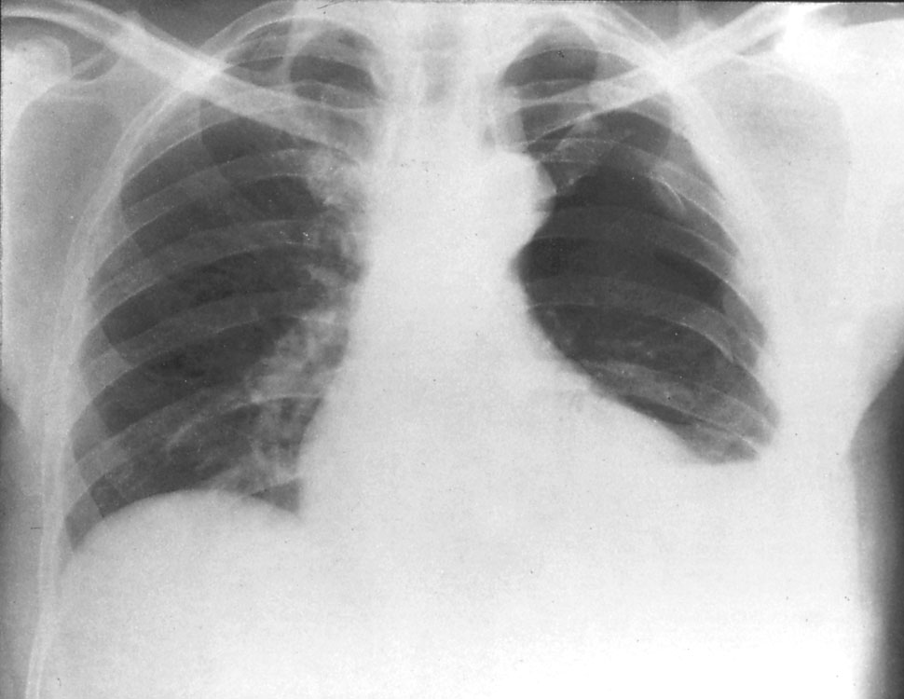

Slide 12
Pleural biopsy
Granulomatous disease
Malignanancy

Slide 13
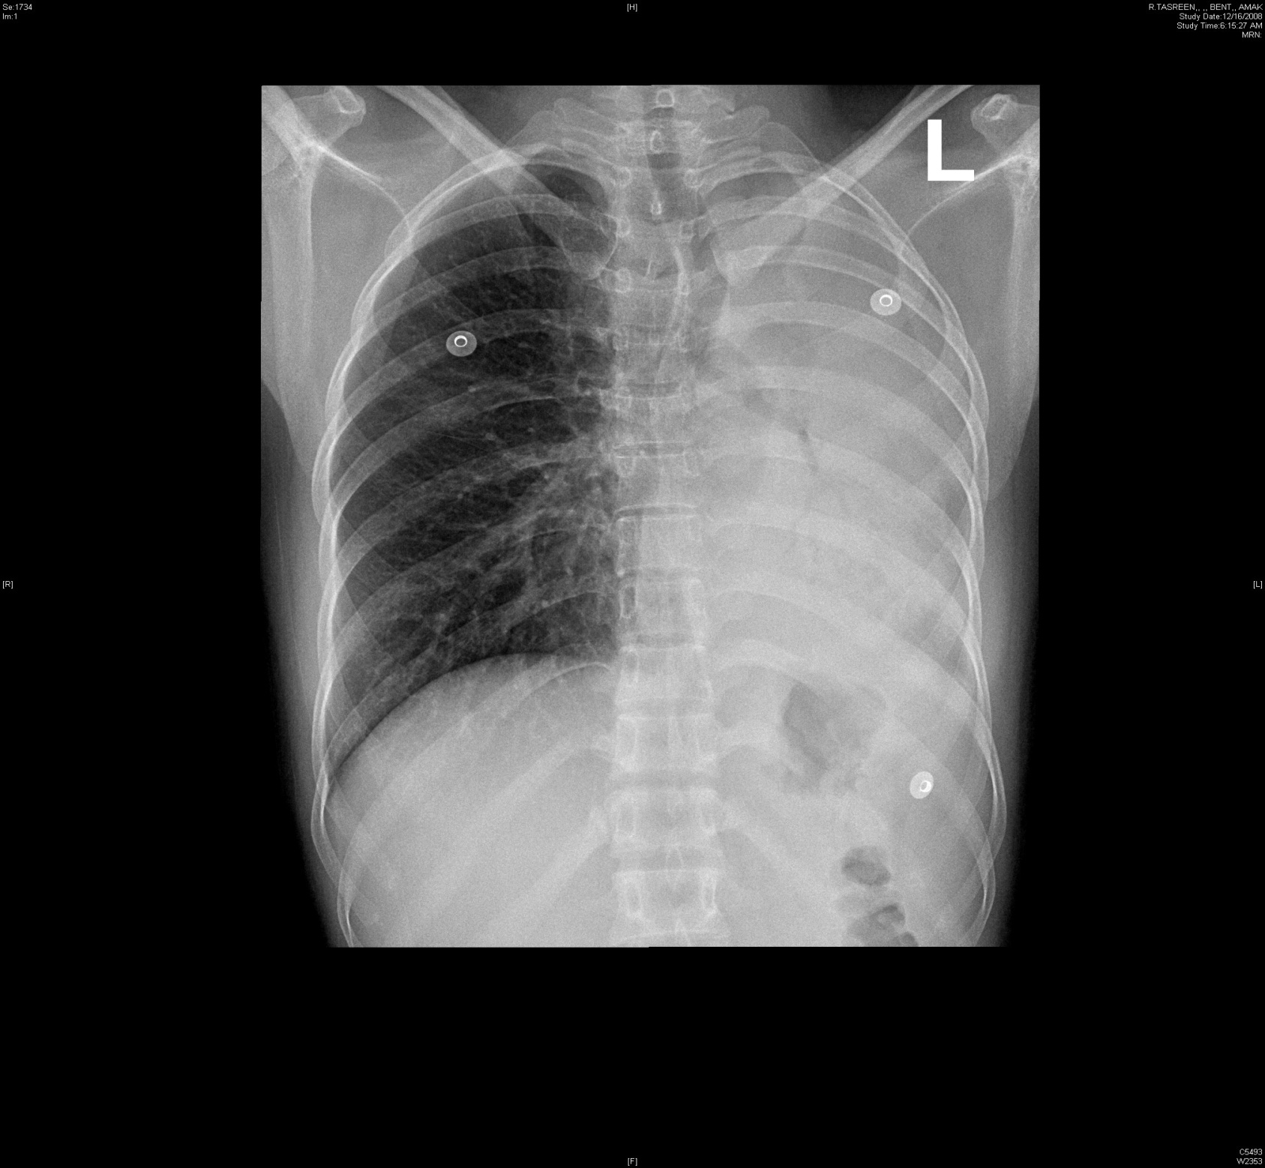

Slide 14
Bronchoscopy
Suspected lung cancer
Abnormal CXR
Hemoptysis
Unexplained cough
Localized wheeze
Positive sputum cytology
Notes:
diagnostic

Slide 15
Bronchoscopy
Mediastinal lymph nodes
Hemoptysis
Refractory cough
Unexplained pleural effusion
Lung abscess
Staging of lung cancer
Obtain culture material
Airway trauma
Tracheoesophageal fistula
Diffuse lung disease

Slide 17
Bronchoscopy
Therapeutic
Remove foreign bodies
Remove abnormal endobronchial tissue
Difficult endotracheal tube intubation
Endobronchial stent placement

Slide 19
Pulmonary function tests
Spirometry
Lung volumes
Diffusion capacity
Respiratory muscle strength

Slide 20
Spirometry
FVC (L) predicted >90%
FEV1 (L) predicted >90%
FEV1/FVC >75
Diagnose obstructive lung disease
Suggest restrictive lung disease

Slide 21
Lung volumes
TLC (L) >90% predicted
RV (L) > 90% predicted
Diagnose restrictive lung disease
Diagnose air trapping

Slide 22
Diffusing capacity (DL)
Measure the ability of gases to diffuse from the alveoli into the pulmonary capillary blood
CO not normally present in lungs or blood
More soluble in blood than lung tissues
Dlco

Slide 23
DLco
Reflect loss or damage to the gas exchanging surface of the lung
Emphysema
Distinguish emphysema from chronic bronchitis or chronic asthma
Interstitial lung disease
Pulmonary vascular disease

Slide 24
Respiratory muscle strength
PImax, Pemax
Measured by pressure transducer at the mouth when subject make a maximal inspiratory effort from full expiration or maximal expiratory effort from full inspiration
PI reflect inspiratory muscles (diaphragm)
PE expiratory muscles including abdominal
Motor neuron disease, Guillian Barre syndrom

Slide 26
50 yr old male with SOB and cough >3yrs
Exam: clubbing and bilat insp crackles
CXR: reticulation bilateral
ABG: hypoxic respiratory failure
PFT: restrictive defect with significant impairment in DLco

Slide 27
HRCT
Designed for detailed evaluation of interstitial structures of the lung
Use narrow slice thickness (1-2 mm) compared with 5-10 mm for routine scans

Slide 28
HRCT
Principle indications
Suspected interstitial lung disease
Characterization of interstitial lung disease
Characterization of solitary pulmonary nodules
Diagnosis of bronchiectasis

Slide 29
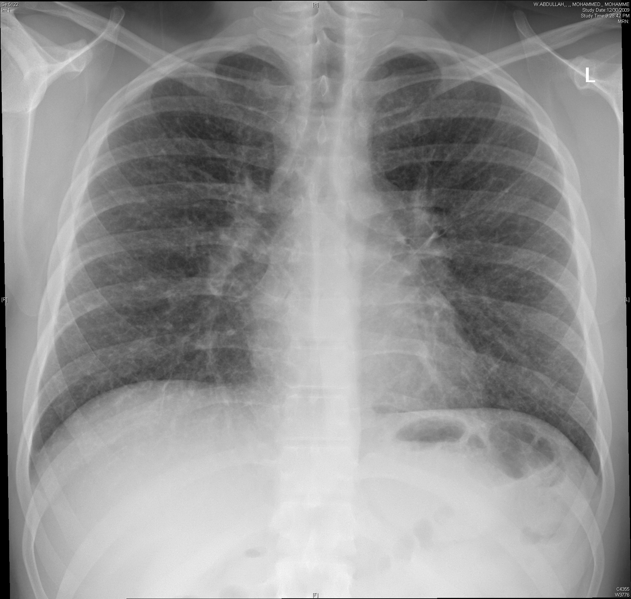

Slide 30
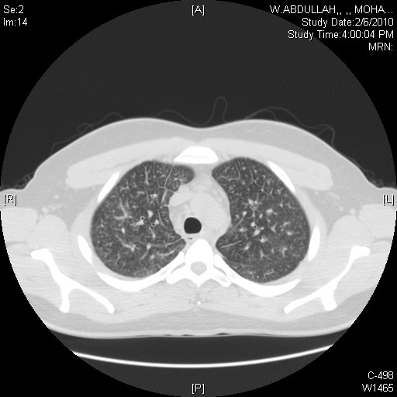
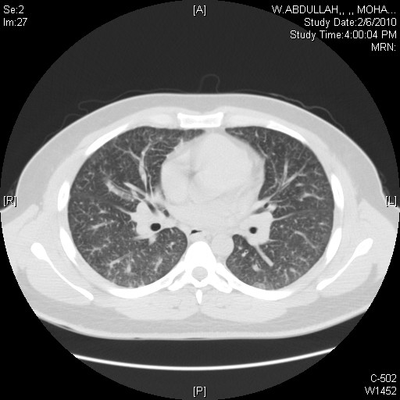

Slide 31
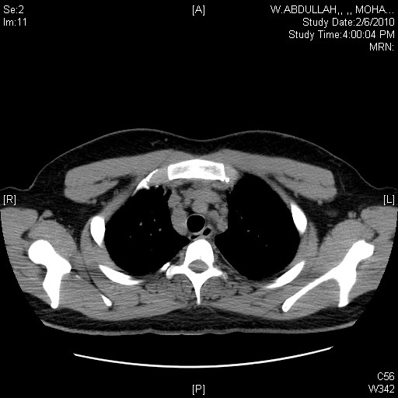

Slide 32
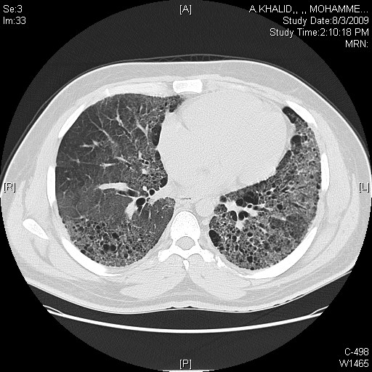

Slide 33
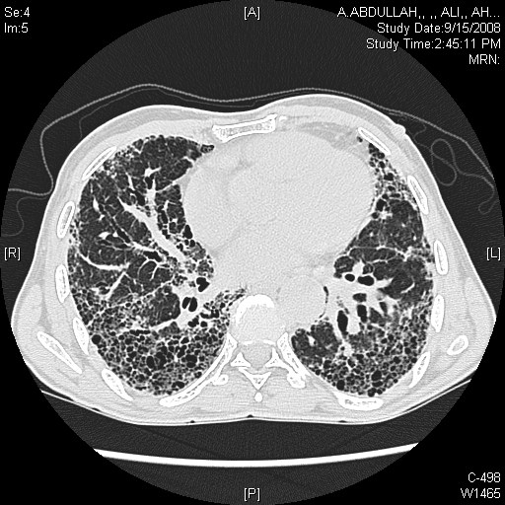

Slide 34
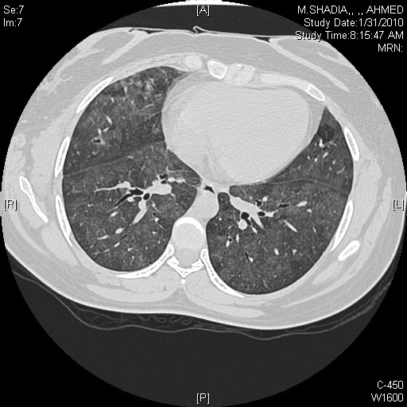

Slide 35
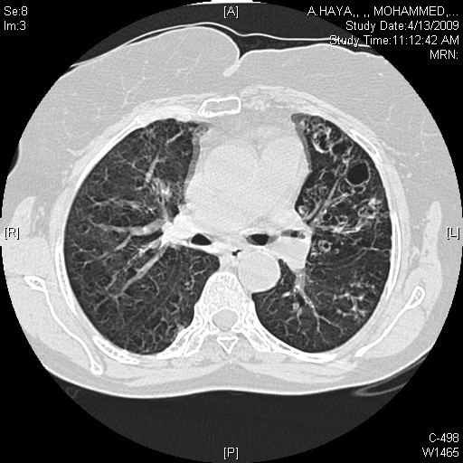

Slide 36
45 yrs old female with RT sided chest pain for 1 day
Notes:
Case of pe ask the student what else they need to know

Slide 37
ABG pH 7.32, PaCO2 28, PaO2 50, O2sat 88%
EKG sinus tachycardia
CXR normal
Spiral CT
V/Q scan

Slide 38
CT Angiography
Image data are acquired continuously as the tube and detector rotate within the gantry and the patient moves continuously through the gantry
Advantages
Critically ill patients
Children
Less volume of intravenous contrast
Permits greater processing of the raw data

Slide 39
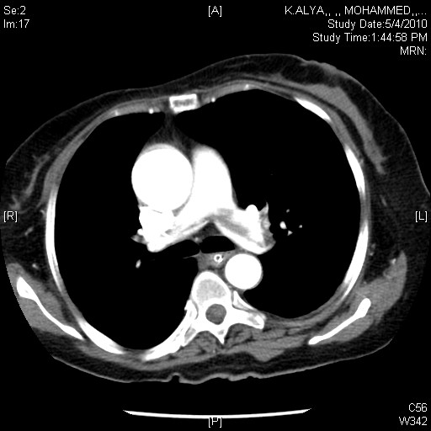
Notes:
PULMONARY EMBOLISM IN THE PULMONARY TRUNK

Slide 40
Lung Scans: V/Q
Technetium (Tc) 99 m radionuclide is tagged to macroaggregated albumin to make small radioactive particles
When Tc decays, it emits a gamma ray detected by the nuclear medicine gamma camera: a nuclear medicine image is formed by detection of many gamma rays

Slide 41
Lung scan: normal perfusion Q
When injected via periphral venous site, the first capillaries encountered are the pulmonary capillaries
If perfusion is present at the capillary level of the lungs, nuclear medicine perfusion image demonstrate activity in the periphery of the lungs

Slide 42
Lung scan: perfusion defect Q
If there is an obstructing vascular lesion in the pulmonary arterial circulation
blocked perfusion to the distal capillary level
nuclear medicine perfusion image demonstrate no activity in the periphery of the lungs

Slide 43
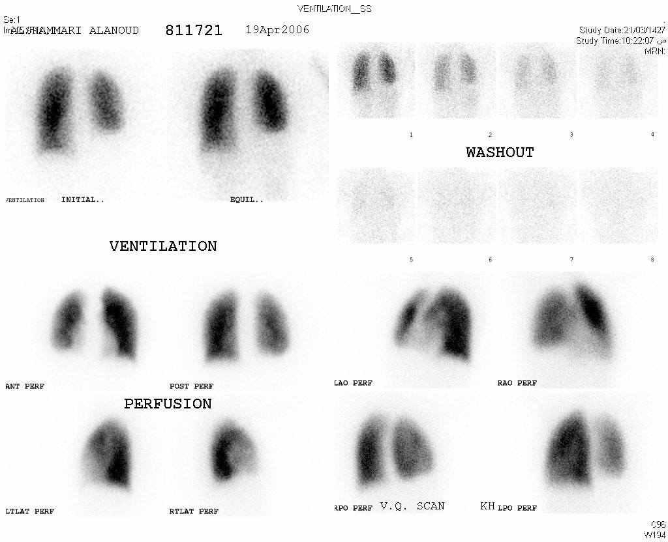
Notes:
Normal V/Q scan

Slide 44
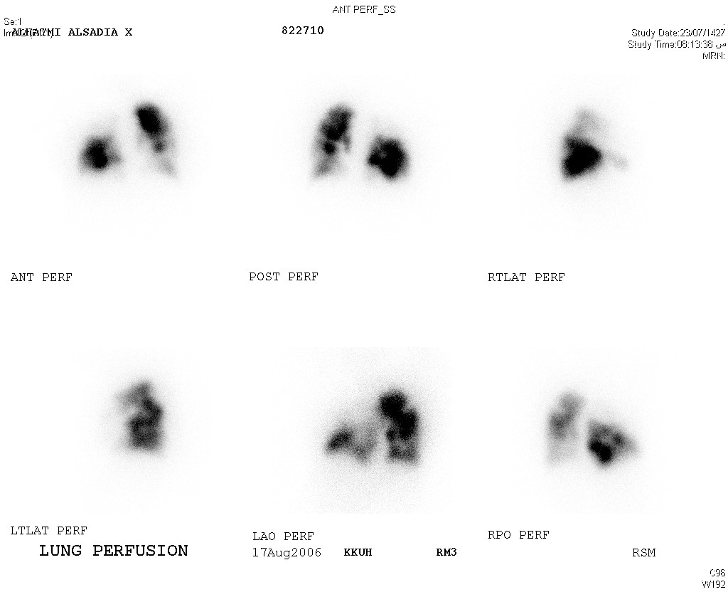
Notes:
PERFUSSION DEFECT PE

