Slide 1
Approach to Pleural Effusion
Dr Abdalla Elfateh Ibrahim
Consultant & Assisstant Professor
of Pulmonary Medicine
King Saud University

Slide 2
Definition
Anatomy of the pleura
Etiology & Pathophysiology
Types of pleural effusions
Clinical features
How to differentiate between exudates and transudates
Investigation
Treatment

Slide 3
Pleural effusions
Abnormal collection of fluid in the pleural space resulting from excess fluid production or decreased absorption

Slide 4
Pleural effusions
A common medical problem
is an indicator of an underlying
acute or chronic disease
- pulmonary or - nonpulmonary
with more than 50 recognized causes

Slide 6
Anatomy
The pleural space role in respiration
1- coupling the movement of the chest wall with that of the lungs in .
A- a relative vacuum in the space keeps the visceral and parietal pleurae in close proximity.
B- lubricant

Slide 7
Anatomy
Pleural fluid volume
0.13 mL/kg/B. w (approximately 1 ml)
Volume is maintained through the balance of
- hydrostatic
- oncotic pressure
- lymphatic drainage

Slide 8
Etiology
The etiologic spectrum of Pl.Ef is extensive
most pleural effusions are caused by
- congestive heart failure
- pneumonia
- malignancy
- or pulmonary embolism.

Slide 9
Mechanisms
Altered permeability of the pleural membranes
Reduction in intravascular oncotic pressure
Increased capillary hydrostatic pressure in the systemic and/or pulmonary circulation
Decreased lymphatic drainage or complete blockage, including thoracic duct obstruction or rupture

Slide 10
Increased capillary permeability or vascular disruption
(trauma, malignancy, inflammation, infection, pulmonary infarction, drug hypersensitivity, uremia, pancreatitis)
Reduction in intravascular oncotic pressure
(eg, hypoalbumiaemia ,cirrhosis)
Increased capillary hydrostatic pressure in the systemic and/or pulmonary circulation
( congestive heart failure, superior vena cava syndrome)
Decreased lymphatic drainage or complete blockage, including thoracic duct obstruction or rupture
( malignancy, trauma)

Slide 11
Types of pleural effusions
Transudates pleural fluid proteins < 30
OR
Exudates pleural fluid proteins >30

Slide 12
Causes of pleural effusion
Transudates
(usually bilateral effusion)
Very Common causes
Heart failure
Liver cirrhosis

Slide 13
Transudates
Less Common causes
Hypoalbuminaemia
Nephrotic syndrome
Peritoneal dialysis
Hypothyroidism
Mitral Stenosis
Myxedema
Constrictive pericarditis
Urinothorax – (due to obstructive uropathy)

Slide 14
Causes of pleural exudates
Common causes
(Usually unilateral effusion)
Parapneumonic effusions
Malignancy
( lung or breast , lymphoma, leukemia; less commonly, ovarian carcinoma, stomach, sarcomas, melanoma, mesothelioma )
Tuberculosis
Pulmonary embolism
Collagen-vascular conditions
(rheumatoid & systemic lupus erythematosus

Slide 15
Exudates
Less Common causes
Benign Asbestos-related effusion
Pancreatitis
Post-myocardial infarction
Post CABG Pericardial disease
Meigs syndrome
(benign pelvic neoplasm with associated ascites and p.effusion)
Ovarian hyperstimulation syndrome
Drug-induced pleural disease
Yellow nail syndrome
(yellow nails, lymphedema, pleural effusions)
Uremia
Chylothorax
(acute illness with elevated triglycerides in pleural fluid

Slide 16
Prognosis
Varies in accordance with the condition’s underlying etiology.
The most common associated malignancy in men is lung cancer
the most common associated malignancy in women is breast cancer
malignant pleural effusion is associated with a very poor prognosis

Slide 17
Morbidity and mortality
Related to
- cause
- stage of disease at the time of presentation
- biochemical findings in the pleural fluid
Parapneumonic effusion
- Early diagnosis and treatment have a lower rate of complications
-when treated promptly resolve without significant sequelae.
- untreated or inappropriately treated parapneumonic effusions may lead to
empyema, constrictive fibrosis, and sepsis

Slide 18
Clinical presentation
Symptoms
Asymptomatic
Breathlessness
Chest pain
Cough
Fever

Slide 19
Additional symptoms
May suggest the underlying disease process.
Example: lower limb oedema in heart failure
Night sweats, fever, hemoptysis, and weight loss should suggest TB
Hemoptysis also raises the possibility of malignancy

Slide 20
Clinical presentation
History
Infection, malignancy , risk of PE , heart failure etc.)
Drug history
An occupational history
Asbestos exposure

Slide 21
Physical Examination
Depend on the volume
Dullness to percussion
decreased tactile fremitus
Asymmetrical chest expansion
Mediastinal shift away from the effusion
Signs of associated disease
( chronic liver disease-heart failure-nephrotic syndrome -SLE-RA-Ca lung)

Slide 22
DIAGNOSIS
CXR
Pleural aspiration
CT scan
Chest Ultrasound
Pleural biopsy
Medical thoracoscopy
VAT (video assisted thoracoscopy)
Bronchoscopy

Slide 23
CXR

Slide 24
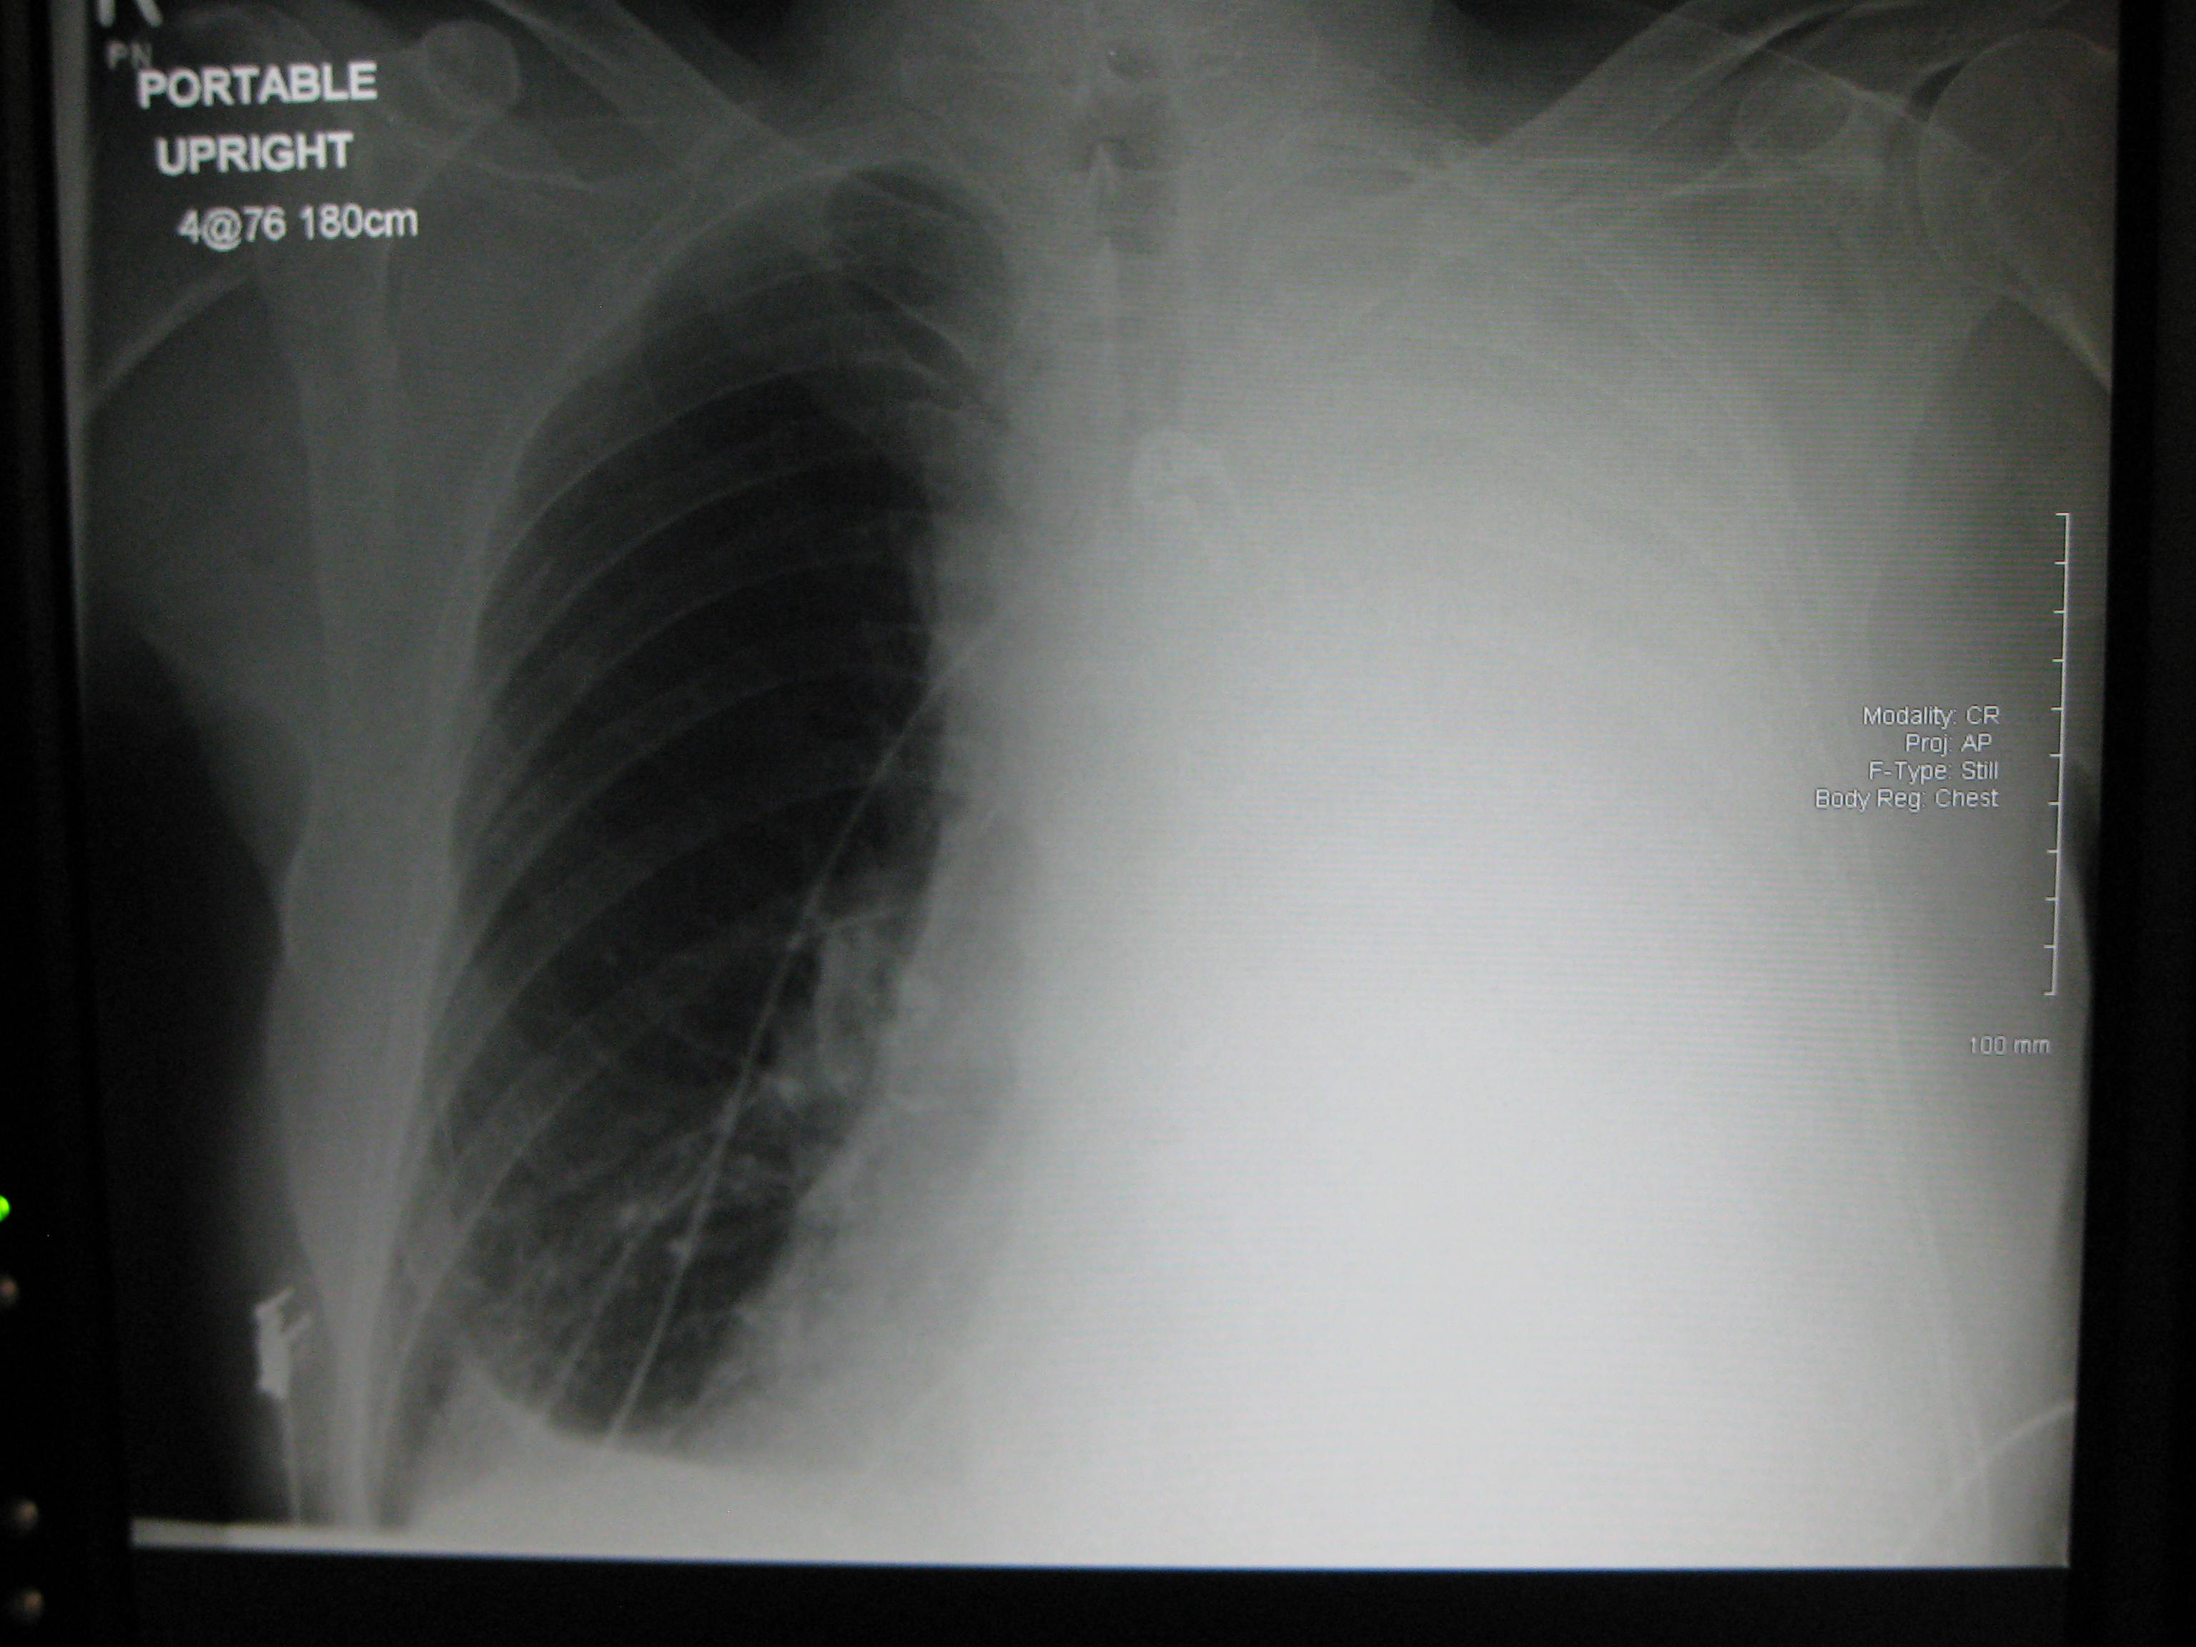

Slide 25
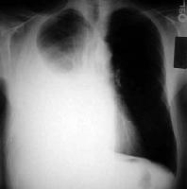

Slide 26
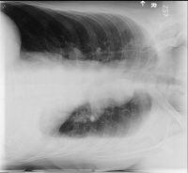
Left lateral decubitus film

Slide 27
Diagnostic Thoracentesis
Pleural aspiration
is a safe procedure in presence of sufficient fluid
Contraindications
- small volume of fluid
- bleeding diathesis or anticoagulation
- cutaneous disease over the puncture site
Complication
- pain at the puncture site
- Bleeding
- pneumothorax
- Empyema
- spleen/liver puncture.

Slide 28
Site of aspiration/us guided

Slide 29
Normal pleural fluid characteristics
Straw colour (yellow)
A pH of 7.60-7.64
Protein content of less than 2% (1-2 g/dL)
Fewer than 1000 white blood cells (WBCs) per cubic millimeter
Glucose content similar to that of plasma
Lactate dehydrogenase (LDH) less than 50% of plasma

Slide 30
LABORATORY
Biochemstry (5 ml)
PH, proteins ,glucose and LDH
send serum sample at the same time
Microbiology lab (20ml)
Gram stain + culture and sensitivity
TB –AFB &TB culture
- PCR for TB
Pathology lab (100ml or more)
Looking for malignant cells
Ask also for cell block(pleural clot)

Slide 31
Distinguish transudates from exudates
Exudative effusions might be suspected by :
( observing the gross characteristics of the fluid )
Frankly purulent fluid indicates an empyema
A milky fluid suggests a chylothorax (lymphatic obstruction)
Grossly bloody fluid
- trauma
- malignancy,
- postpericardiotomy syndrome
- asbestos-related effusion
(hematocrit of > 50% of the peripheral hematocrit defines a hemothorax)

Slide 32
Distinguish transudates from exudates
Laboratory testing
helps to distinguish pleural fluid transudates from
Using fluid protein content and LDH

Slide 33
Light`s criteria
The fluid is considered an exudate if any of the following applies
Ratio of pleural fluid to serum protein greater than 0.5 ( F. pr/pt. pr = 0.5)
Ratio of pleural fluid to serum LDH greater than 0.6 (f.LDH/Pt.LDH= 0.6)
Pleural fluid LDH greater than two thirds of the upper limits of normal serum value

Slide 34
Distinguishing Transudates From Exudates
Clinical judgment is required when pleural fluid test results fall near the cutoff points
Example
Heart failure on diuretics
pleural fluid levels of N-terminal pro-brain natriuretic peptide (NT-proBNP) are elevated in effusions due to congestive heart

Slide 35
Distinguishing Transudates From Exudates
serum - pleural protein = less than 3.1 g/dL
s albumin – pl. f. albumin = less than 1.2 g/dL

Slide 36
Pleural fluid pH
Correlated with pleural fluid glucose levels
Parapneumonic effusions
a low fluid pH level is more predictive of complicated effusions
fluid pH of less than 7.1-7.2 indicates the need for urgent drainage of the effusion

Slide 37
Pleural fluid glucose
A low pleural glucose (30-50 mg/dL) suggests
malignant effusion
tuberculous pleuritis
esophageal rupture
lupus pleuritis.
A very low pleural glucose (ie, < 30 mg/dL) suggest rheumatoid pleurisy or empyema.

Slide 38
Pleural Fluid Cell Count Differential
Fluid lymphocytosis (> 85%) suggests
-TB, lymphoma, sarcoidosis, rheumatoid , yellow nail syndrome, or chylothorax.
Fluid lymphocyte ( 50-70% ) suggest malignancy

Slide 39
TB pleural effusion
history of exposure
positive PPD
lymphocytic exudative effusions
Pleural fluid adenosine deaminase
Interferon-gamma test
PCR for TB

Slide 40
Imaging
CXR
Ultrasonography
Is very sensitive at dececting pleural fluid
Chest ultrasound is important for diagnosis
And guide aspiration and biopsy procedures
CT Scanning
Give detailed images
The contrast highlight different strctures

Slide 42
Biopsy
should be considered, especially if TB or malignancy is suggested
closed-needle p. biopsy is a blind technique
( bedside test)
Medical thoracoscopy has a higher diagnostic yield
Video assisted thoracoscopy

Slide 43
Treatment
Treatment of the underlying medical disorder
Parapneumonic effusions drainage
(1) frankly purulent fluid,
(2) a pleural fluid pH of less than 7.2
(3) loculated effusions
(4) bacteria on Gram stain or culture
Appropriate antibiotic treatment.

Slide 44
Therapeutic Thoracentesis
remove larger amounts of pleural fluid is used to alleviate dyspnea

Slide 45
Tuberculous pleuritis
typically is self-limited
Disappear after treatment of TB
Chylous effusions
usually managed by dietary and surgical proc.

Slide 46
Malignant pleural effusions
drain large, malignant PE to relieve dyspnea
pleurodesis for recurrent effusions
or placement of indwelling tunneled catheters.(eg, PleurX cathiter)

Slide 47
Pleurodesis
(also known as pleural sclerosis)
instilling an irritant into the pleural space to cause inflammatory changes that result in bridging fibrosis between the visceral and parietal pleural surfaces
Sclerosing agents
talc, doxycycline, bleomycin

Slide 49
Surgical treatment
Video-assisted thoracoscopy
to drain loculated pleural fluid
obliterate the pleural space.
Surgically implanted pleuroperitoneal shunts

