Slide 1
Gastrointestinal bleeding
Dr Nahla Azzam MRCP,FACP
Majid Almadi
MBBS, MSc (Clinical Epidemiology), FRCPC
Assistant professor of Medicine
King Saud University

Slide 2
Ms S
86-year-old woman
Physically active
Engages in numerous social activities, and attends a class in political science.
She presented to the emergency department after falling in her bathroom.
Almadi et al. JAMA 2011;306:2367-74.

Slide 3
Ms S
Had been feeling epigastric discomfort that was difficult to describe
It was episodic in nature and mild in intensity
There were no provocative or palliative factors.
A few hours prior to her fall she had been feeling lightheaded with some weakness.
Almadi et al. JAMA 2011;306:2367-74.

Slide 4
Ms S
When standing up she felt dizzy and fell to the ground but did not lose consciousness.
She was transported to the hospital by ambulance.
Almadi et al. JAMA 2011;306:2367-74.

Slide 5
Ms S
In 2008, she developed atrial fibrillation for which she was treated with warfarin.
Her medical history includes a hysterectomy for endometrial cancer in 1986 followed by radiation therapy.
Lumpectomy for breast cancer in 1998 with radiation therapy
Hypertension
Benign positional vertigo.
Almadi et al. JAMA 2011;306:2367-74.

Slide 6
Her current medications
Aspirin, 81 mg orally once daily
Extended-release diltiazem, 120mg orally once daily
Valsartan, 80 mg orally once daily
Vitamin D, 10 000 IU orally once daily
Warfarin, 7.5 mg orally once daily.
Almadi et al. JAMA 2011;306:2367-74.

Slide 7
Family Hx
Both of her parents had gastric ulcers.
Almadi et al. JAMA 2011;306:2367-74.

Slide 8
O/E
She was found to be diaphoretic
Pulse of 103/min and regular
Blood pressure of 108/68 mm Hg.
No orthostatic measurements were obtained on presentation.
Her abdominal examination revealed no abnormalities
But her rectal examination revealed melena.
Almadi et al. JAMA 2011;306:2367-74.

Slide 9
ECG
Normal sinus rhythm with a heart rate of 102/min.
Almadi et al. JAMA 2011;306:2367-74.

Slide 10
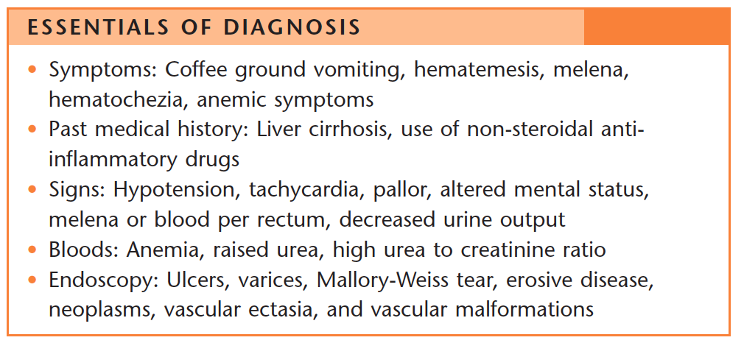

Slide 11
Epidemiology
48 to 160 cases per 100 000 adults per year
Mortality generally from 10% to 14%
Barkun et al. Ann Intern Med 2010;152:101-13.

Slide 12
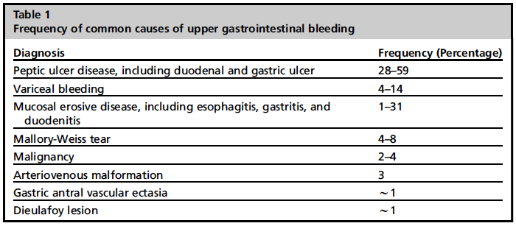
Causes of UGIB
Gibson et al. Gastrointest Endosc Clin N Am 2011;21:583-96.

Slide 13
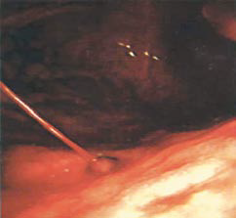
Spurting Blood
Gralnek et al. N Engl J Med 2008;359:928-37.
Notes:
High-risks lesions are those that spurt blood (Forrest grade IA, Panel A),
ooze blood (grade IB, Panel B), contain a nonbleeding visible vessel (grade IIA,
Panel C), or have an adherent clot (grade IIB, Panel D). Low-risk lesions are
those that have a flat, pigmented spot (grade IIC, Panel E) or a clean base
(grade III, Panel F).

Slide 14
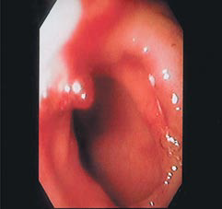
Non-bleeding Visible Vessel
Gralnek et al. N Engl J Med 2008;359:928-37.

Slide 15
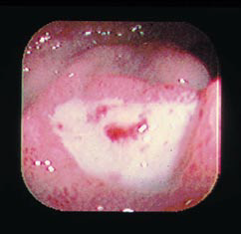
Flat, Pigmented Spot
Gralnek et al. N Engl J Med 2008;359:928-37.

Slide 16
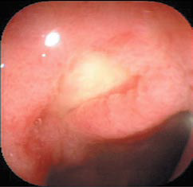
Clean Base
Gralnek et al. N Engl J Med 2008;359:928-37.

Slide 17
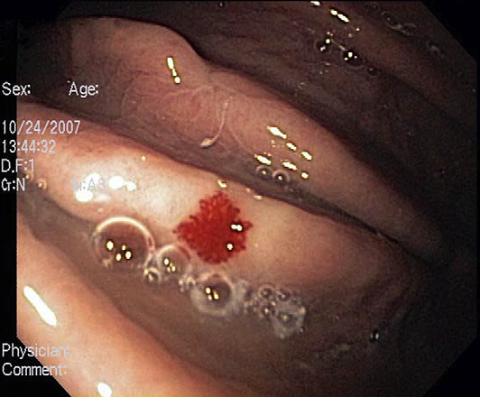
Acosta et al. Gastrointest Endosc Clin N Am 2011;21:555-66.
Notes:
Arteriovenous malformations.

Slide 18
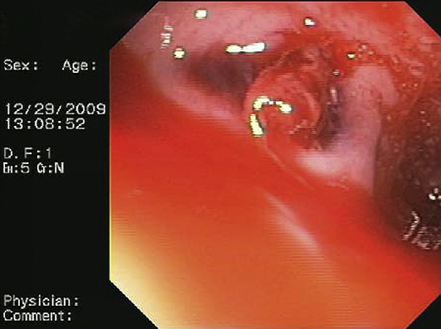
Acosta et al. Gastrointest Endosc Clin N Am 2011;21:555-66.
Notes:
Aortoesophageal fistula

Slide 19
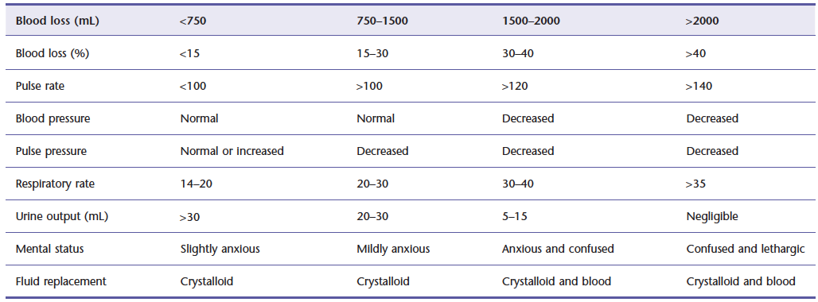
Hypovolemic shock: symptoms, signs and fluid replacement

Slide 20
Pre-endoscopic management

Slide 21
Risk stratification
Low vs. high risk
Early identification
Appropriate intervention
Minimizes morbidity and mortality
Barkun et al. Ann Intern Med 2010;152:101-13.

Slide 22
Scores

Slide 23
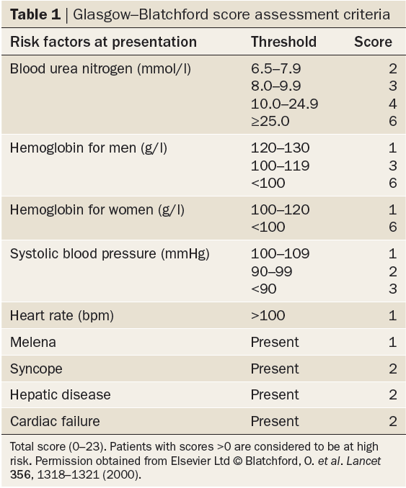
Urea
CBC
Physical
History
Bardou et al. Nat Rev Gastroenterol Hepatol 2012;9:97-104.
Notes:
Diagnosis and management of nonvariceal upper gastrointestinal bleeding

Slide 24
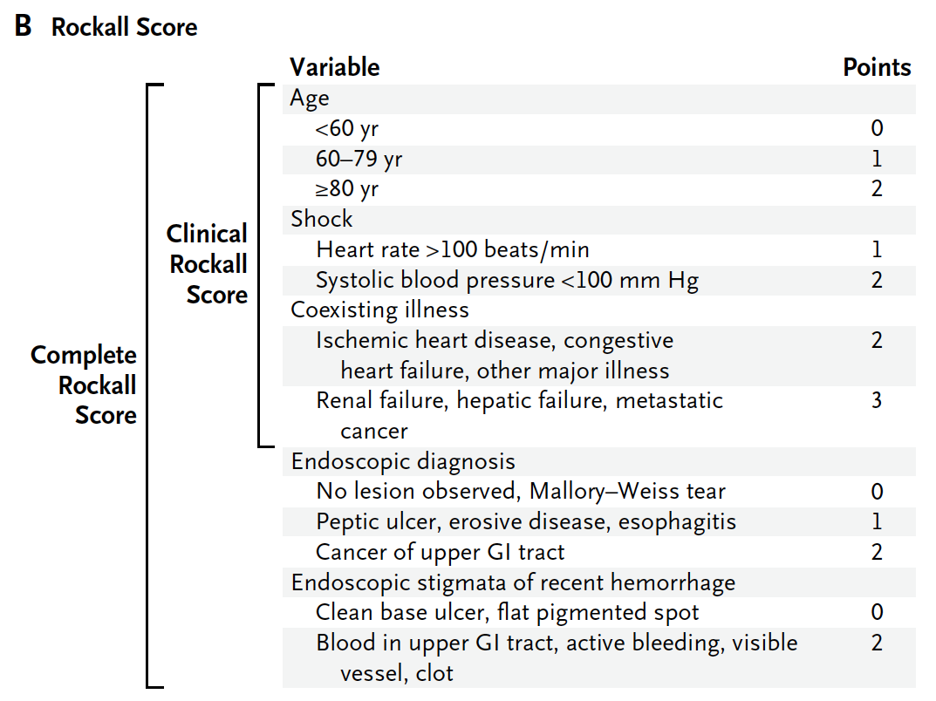
History
Physical
History
Hearnshaw et al. Aliment Pharmacol Ther 2010;32:215-24.
Notes:
Panel B
shows the Rockall score, with point values assigned for each of three clinical
variables (age and the presence of shock and coexisting illnesses) and
two endoscopic variables (diagnosis and stigmata of recent hemorrhage).
The complete Rockall score ranges from 0 to 11, with higher scores indicating
higher risk. Patients with a clinical Rockall score of 0 or a complete
Rockall score of 2 or less are considered to be at low risk for rebleeding
or death. Data are from Blatchford et al.16 and Rockall et al.17 GI denotes
gastrointestinal. To convert the values for blood urea nitrogen to milligrams
per deciliter, divide by 0.357.

Slide 25
Ms S
2 intravenous accesses established and she
Received crystalloids and was observed in a monitored setting.
Almadi et al. JAMA 2011;306:2367-74.

Slide 26
Laboratory investigations
Hemoglobin level 7.6 g/dL (compared with 13.7 g/dL a month prior to her presentation)
White blood cell count 9000/μL
Platelet count of 151,103/μL
INR was 3
Urea level 21 mmol/L (High)
Electrolyte, creatinine, and liver enzyme levels were otherwise normal.
Almadi et al. JAMA 2011;306:2367-74.

Slide 27
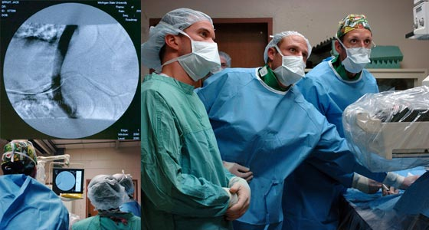
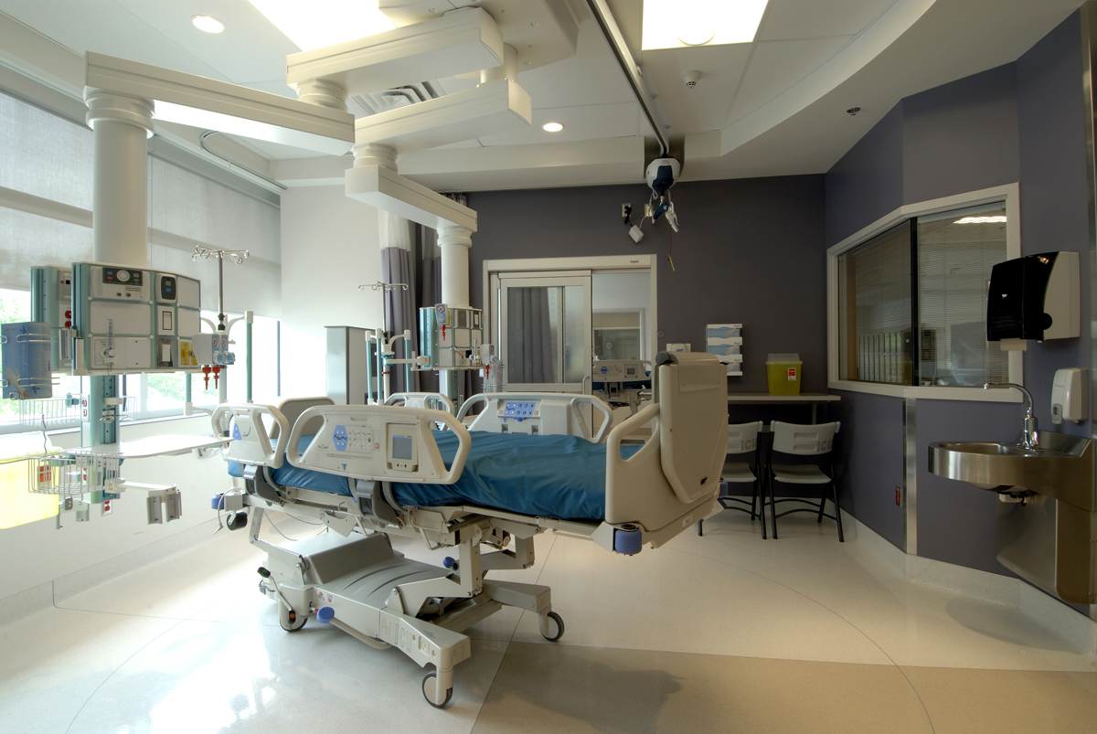
YOU ARE NOT ALONE
Gastroenterology
Interventional Rad.
Intensive Care
Surgery

Slide 28
IV Fluid Resuscitation

Slide 29
IV Fluid Resuscitation
Then

Slide 30
IV Fluid Resuscitation
Then

Slide 31
IV Fluid Resuscitation
Then

Slide 32
IV Fluid Resuscitation
Then

Slide 33
Blood Transfusion

Slide 34
Blood transfusions
Should be administered to a patient with a hemoglobin level of 70 g/L or less
Rarely indicated when the level is > 100 g/L
Almost always indicated when the level is < 60 g/L.
Target level of 70 to 90 g/L
Barkun et al. Ann Intern Med 2010;152:101-13.

Slide 35
Blood transfusions cont.
Based on underlying condition hemodynamic status, and markers of tissue hypoxia
Based on the patient’s risk for complications from inadequate oxygenation
Barkun et al. Ann Intern Med 2010;152:101-13.

Slide 36
Patients receiving anticoagulants
Correction of coagulopathy is recommended
Endoscopy should not be delayed for a high INR unless the INR is supratherapeutic
Barkun et al. Ann Intern Med 2010;152:101-13.

Slide 37
Pre-endoscopic pharmacological therapy

Slide 38
Preendoscopic PPIs
HAS NOT been shown to affect rebleeding, surgery, or mortality
HAS decreased the need for intervention
HAS a supportive cost-effectiveness analyses
HAS an excellent safety profile
This suggest that these agents may be useful
Barkun et al. Ann Intern Med 2010;152:101-13.

Slide 39
Preendoscopic PPI
May be even more beneficial in situations in which early endoscopy may be delayed or when available endoscopic expertise may be suboptimal
Barkun et al. Ann Intern Med 2010;152:101-13.

Slide 40
Ms S
Transfused with 2 units of packed red blood cells
Given 5 mg of vitamin K subcutaneously
Transfused with 1000 U of prothrombin complex concentrate (a mixture of clotting factors II, VII, IX, and X and proteins C and S). She was given 80 mg of pantoprazole intravenously as a bolus followed by an infusion of 8 mg/h while awaiting endoscopy

Slide 41
Endoscopic management

Slide 42
Timing and need for early endoscopy
Definition of early endoscopy
Ranges from 2 to 24 hours AFTER INITIAL PRESENTATION
May need to be delayed or deferred:
Active acute coronary syndromes
Suspected perforation
Barkun et al. Ann Intern Med 2010;152:101-13.

Slide 43
A VERY low Blatchford score
Can identify very low-risk patients
Unlikely to have high-risk stigmata
Unlikely benefit from endoscopic therapy
Can be safely managed as outpatients without the need for early endoscopy
HOWEVER, this remains controversial
Barkun et al. Ann Intern Med 2010;152:101-13.

Slide 44
Early endoscopy
Reductions in length of hospital stay in patients at low risk, high risk, and combined patient groups
Decreased need for surgery in elderly patients
Barkun et al. Ann Intern Med 2010;152:101-13.

Slide 45
Predictors of active bleeding
Fresh blood in the NGT
Hemodynamic instability
Hemoglobin level < 80 g/L
Leukocyte count >12 10⁹ cells/L
They need very early endoscopy (<12 hours)
Barkun et al. Ann Intern Med 2010;152:101-13.

Slide 46
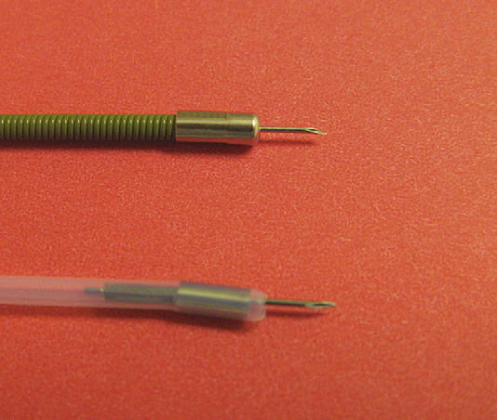
Notes:
Two different injectors. Top: US Endoscopy; bottom: American Endoscopy

Slide 47
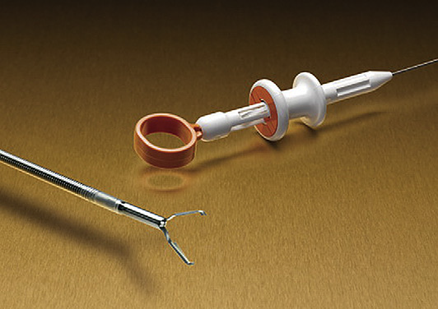
Kovacs et al. Gastrointest Endosc Clin N Am 2011;21:681-96.
Notes:
Hemoclip open (Boston Scientific).

Slide 48
Kovacs et al. Gastrointest Endosc Clin N Am 2011;21:681-96.
Notes:
Commercially available hemoclips. Left: Olympus America QuickClip 2; middle: Cook
Endoscopy TriClip; right: Boston Scientific Resolution Clip.

Slide 49
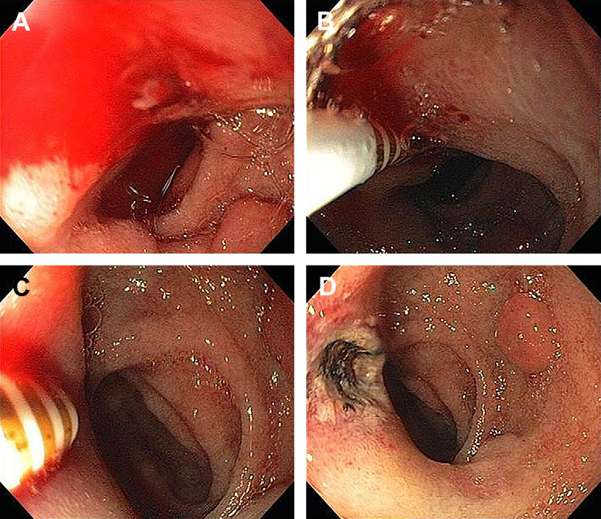
Kovacs et al. Gastrointest Endosc Clin N Am 2011;21:681-96.
Notes:
Combined epinephrine injection (B) and multipolar coagulation (C) therapy for
a bleeding duodenal ulcer (A). (D) Appearance after hemostasis

Slide 50
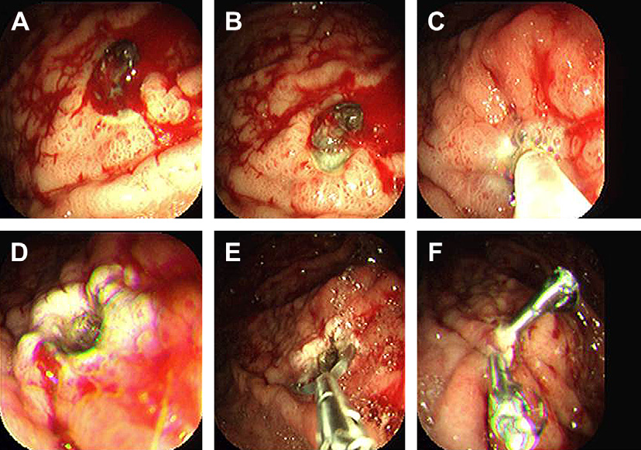
Kovacs et al. Gastrointest Endosc Clin N Am 2011;21:681-96.
Notes:
Combination therapy for a clot over a duodenal ulcer (A) with epinephrine injection
(B), cold guillotining (C), and multipolar coagulation (D, E). (F) Appearance after treatment.

Slide 51
Pharmacological therapy

Slide 52
PPIs
Compared to placebo or H2RAs with or WITHOUT endoscopic therapy PPIs reduced
Rebleeding
Surgery
NOT mortality
Barkun et al. Ann Intern Med 2010;152:101-13.

Slide 53
PPIs cont.
Compared to placebo or H2RAs with or WITH endoscopic therapy High dose PPIs reduced
Rebleeding
Surgery
Mortality
Barkun et al. Ann Intern Med 2010;152:101-13.

Slide 54
Hospitalizaton
It takes 72 hours for most high-risk lesions to become low-risk lesions AFTER endoscopic therapy
60% - 76% of patients who had rebleeding within 30 days AFTER endoscopic hemostasis PLUS high-dose PPI therapy did so within the first 72 hours
Barkun et al. Ann Intern Med 2010;152:101-13.

Slide 55
Admission to a monitored setting
For at least the first 24 hours on the basis of risk or clinical condition
Hemodynamic instability
Increasing age
Severe comorbidity
Active bleeding at endoscopy
Large ulcer size (>2 cm)
Barkun et al. Ann Intern Med 2010;152:101-13.

Slide 56
After discharge
Patients should be discharged with a prescription for a single daily-dose oral PPI for a duration as dictated by the underlying etiology.
Barkun et al. Ann Intern Med 2010;152:101-13.

Slide 57
Management of continued or recurrent bleeding

Slide 58
Percutaneous or transcatheter arterial embolization
Technical success range from 52% to 98%
Recurrent bleeding in about 10% to 20%
Complications include
Bowel ischemia
Secondary duodenal stenosis
Gastric, hepatic, and splenic infarction
A second attempt at endoscopic therapy remains the preferred strategy
Barkun et al. Ann Intern Med 2010;152:101-13.

Slide 59
Angiography
Where available, percutaneous embolization can be considered as an alternative to surgery for patients for whom endoscopic therapy has failed.
Barkun et al. Ann Intern Med 2010;152:101-13.

Slide 60
H pylori
Patients with bleeding peptic ulcers should be tested for H. pylori
Receive eradication therapy if present
Confirmation of eradication
Negative H. pylori diagnostic tests obtained in the acute setting should be repeated
Barkun et al. Ann Intern Med 2010;152:101-13.

Slide 61
Barkun et al. Ann Intern Med 2010;152:52-3, W-12.

Slide 62
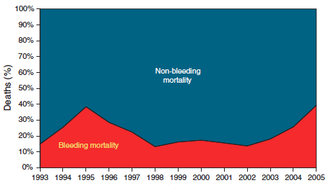
Incidences of bleeding-related and non-bleeding-related mortality
Sung et al. Am J Gastroenterol 2010;105:84-9.

Slide 63
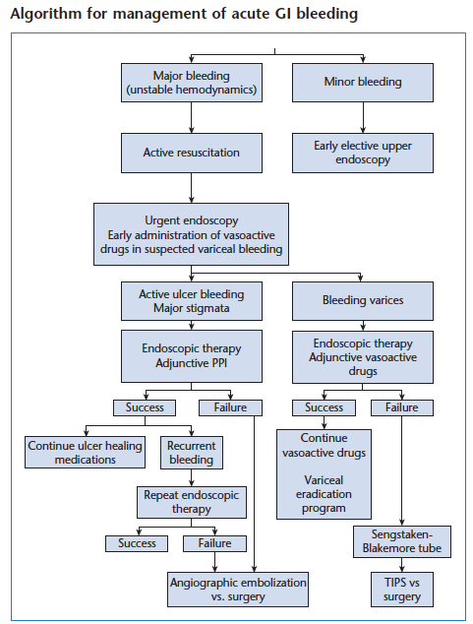

Slide 64
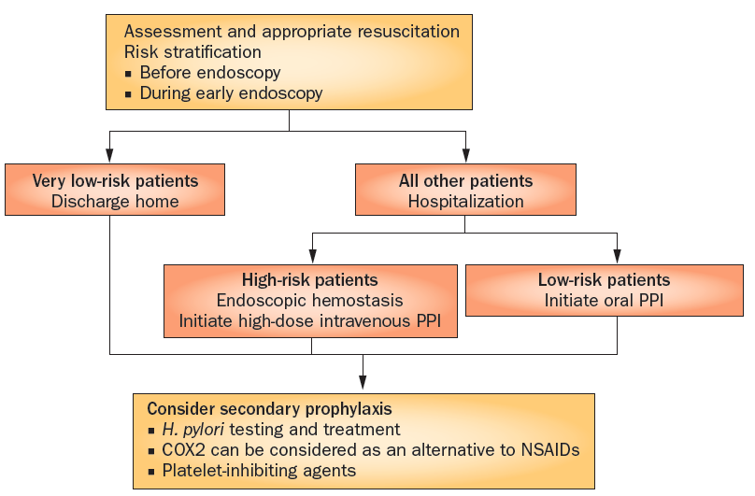
Bardou et al. Nat Rev Gastroenterol Hepatol 2012;9:97-104.
Notes:
Algorithm for optimal management of nonvariceal upper gastrointestinal bleeding. On presentation with UGIB, appropriate resuscitation should be carried out. Patients should be assessed and those at very low risk may be discharged. All other patients should be admitted as inpatients and categorized as low-risk or high-risk groups to determine treatment options. Oral PPI therapy can be adequate for low-risk patients but those at high risk should be treated with endoscopy and intravenous, high-dose PPI. All patients should be considered for secondary prophylaxis, including Helicobacter pylori testing and treatments, use of COX2 antagonists as an alternative to NSAIDs, and PPI for those taking low-dose aspirin. Abbreviations: COX2, cyclooxygenase 2 (also known as prostaglandin G/H synthetase 2); UGIB, upper gastrointestinal bleeding.

Slide 65
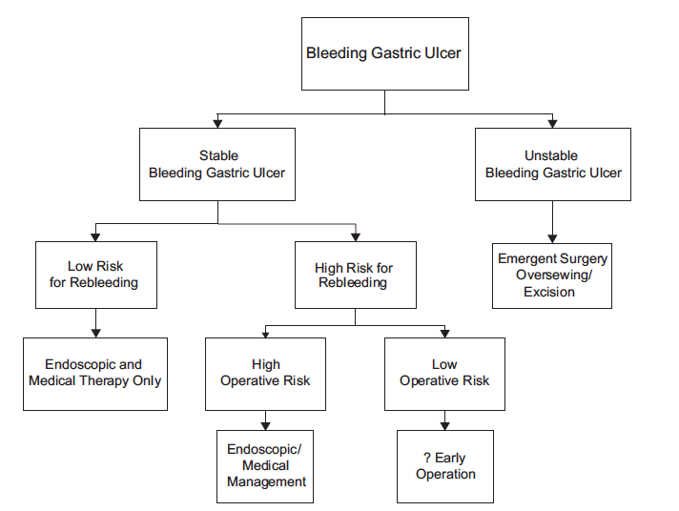
When to go to surgery?
Notes:
Management of Nonvariceal Upper Gastrointestinal Bleeding. Bingener, 2011

Slide 66
Conclusions
Resuscitation should be initiated prior to any diagnostic procedure
Gastrointestinal endoscopy allows visualization of the stigmata, accurate assessment of the level of risk and treatment of the underlying lesion
Intravenous PPI therapy after endoscopy is crucial to decrease the risk of cardiovascular complications and to prevent recurrence of bleeding
Helicobacter pylori testing should be performed in the acute setting
Bardou et al. Nat Rev Gastroenterol Hepatol 2012;9:97-104.
Notes:
Diagnosis and management of nonvariceal upper gastrointestinal bleeding

Slide 67
Thank you

