Slide 1
Complications of Liver Cirrhosis
Ayman Abdo
MD, AmBIM, FRCPC

Slide 2
Objectives
Understand the basic mechanisms of portal hypertension
Recognized the classic presentations of portal hypertension complications
Get an idea on the management of these complications

Slide 3
What is Liver Cirrhosis?
Diffuse fibrosis of the liver with nodule formation
Abnormal response of the liver to any chronic injury

Slide 4
Causes of Cirrhosis
Chronic viral hepatitis
Metabolic: hemochromatosis, Wilson dis, alfa-1-antitrypsin, NASH
Prolonged cholestasis (primary biliary cirrhosis, primary sclerosing cholangitis)
Autoimmune diseases (autoimmune hepatitis)
Drugs and toxins
Alcohol

Slide 5
Anatomy of the portal venous system

Slide 6
The Effect of The Liver Nodule

Slide 7
Mechanism of Portal HTN

Slide 8
Complications of Portal Hypertension

Slide 9
1. Varices

Slide 10
Collaterals

Slide 11
Varices
Esophagus
Gastric
Colo-rectal
Portal hypertensive gastropathy

Slide 12
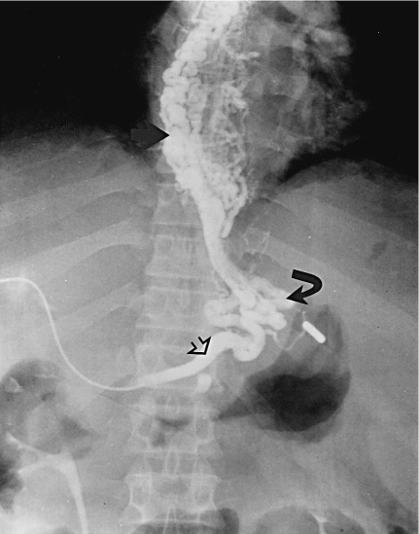

Slide 13
Varices Diagnosis
History : Hematemases, melena
Physical examination
Ultrasound abdomen
Endoscopy

Slide 14
Varices Management-General
ABC
2 IV Lines
Type and cross match
Resuscitation
IVF
Blood
Platelet transfusion (platelet <75,000)
Fresh frozen plasma (Correct Pt)

Slide 15
Varices Management-Specific
IV vasoconstrictors (Octreotide)
Endoscopic therapy
Banding
Sclerotherapy
Shunting
Surgical
TIPS

Slide 16
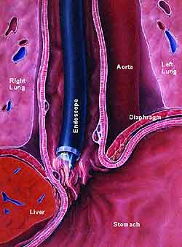
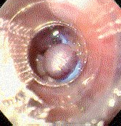
Variceal Banding

Slide 17
Types of Shunts
Surgical shunt
TIPS (Transjugular intrahepatic portosystemic shunt)

Slide 18
Varices Prevention
Treat underlying disease
Endoscopic banding protocol
B-blockers
Liver transplantation

Slide 19
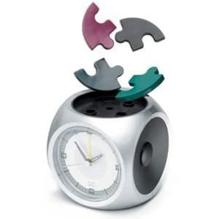

Slide 20
2. Ascites

Slide 21
Ascites
Definition: fluid in the peritonial cavity

Slide 22
Mechanism of Ascites

Slide 23
Causes of Ascites
Liver disease: cirrhosis
Right sided heart failure
Kidney disease (nephrotic syndrome)
Low albumin (malnutrition, bowel loss)
Peritonial infection (TB…)
Peritonial cancer

Slide 24
Presentation
History:
Increased abdominal girth
Increased wt
Physical exam:
Bulging flanks
Shifting dullness
Fluid wave

Slide 25
Diagnosis
Physical examination
Ultrasound
Ascitic tap
WBC (>250 PMN: SBP)
RBC
SAAG (serum albumin to ascitic fluid albumin gradient)
>11 mg/dl : portal hypertension
<11 mg/dl : Other

Slide 26
Portal hypertension
or heart failure
Peritonial disease
or kidney disease

Slide 27
Treatment-General
Treat the underlying disease
Salt restriction (<2gm/d)
Diuretics
Loop diuretic (Lasix)
Aldosterone inhibitor (Spironolactone)

Slide 28
Treatment-Resistant
Recurrent tapping
Peritoneal-venous shunt
TIPS
Liver transplantation

Slide 29
Spontaneous Bacterial Peritonitis
Infection of ascitic fluid
Usually gram negative (E.Coli)
Presentation variable
Mortality is high
Dx: ascitic tap = PMN>250
Treatment : third generation cephalosporin IV

Slide 30
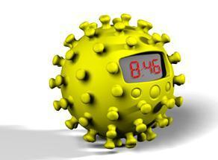

Slide 31
3. Hepatic Encephalopathy

Slide 32
Hepatic Encephalopathy
Reversible decrease in neurological function secondary to liver disease
Acute: seen with acute liver failure
Acute on chronic: established cirrhosis

Slide 33
Hepatic Encephalopathy Mechanism

Slide 34
Hepatic Encephalopathy Clinical features
Reversal of sleep pattern
Disturbed consciousness
Personality changes
Intellectual deterioration
Fetor hepaticus
Astrexis
Fluctuating

Slide 35
Flapping Tremor

Slide 37
Drawing Tests

Slide 38
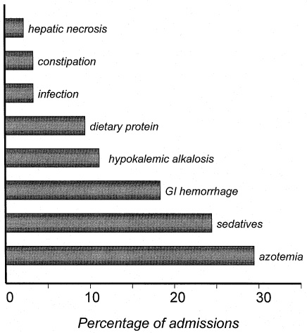
Hepatic Encephalopathy Exacerbating factors

Slide 39
Hepatic Encephalopathy Treatment
Identify and treat precipitation factor
Treat underlying liver disease
Normal protein diet
Antibiotics (Neomycin, metronidazole)
Lactolose
Transplantation

Slide 40
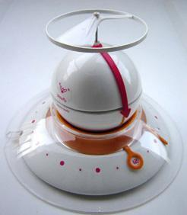

Slide 41
5. Hepatocellular Carcinoma
One of the most common cancers in Saudi Men
It develops in patients with cirrhosis usually
Detected by ultrasound and diagnosed by CT pr MRI
Poor prognosis
Multiple treatment modalities

Slide 42
Summary
Mechanical compression of blood flow plus hemodynamic changes leads to portal hypertension
Common complications of portal hypertension are:
Collateral formation (Varices)
Ascites
Hepatic encephalopathy

Slide 43
Summary
3. The most important step in variceal bleed management is resuscitation
4. The most important step in management of hepatic encephalopathy is the identification of the precipitating factor

