Slide 1
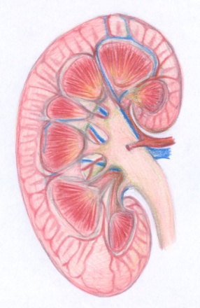
Acid base balance
Mohammed Al-Ghonaim, MBBS,FRCPC,FACP

Slide 2
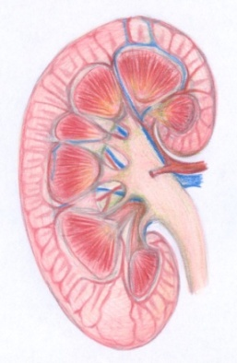
Objective
At the end of this tutorial you will be able to:
  State the normal value for PH,PCO2,HCO3
  - Understand the basic mechanism of acid base disturbance
  Interpret basic acid base disturbance
  List common differential diagnosis for different acid base disorder

Slide 3
Normal Values
Normal arterial blood pH = 7.35 – 7.45
P_{a}CO₂ = 35-45
Serum HCO₃⁻.= 22-26
Anion gap = 8-12

Slide 4
primary disturbance
Primary Disorder
Primary Disorder | Problem | pH | HCO₃ | P_{a}CO₂
Metabolic acidosis | gain of H⁺ or loss of HCO₃ | ↓ | ↓ | ↓
Metabolic alkalosis | gain of HCO₃ or loss of H⁺ | ↑ | ↑ | ↑
Respiratory acidosis | hypoventilation | ↓ | ↑ | ↑
Respiratory alkalosis | hyperventilation | ↑ | ↓ | ↓

Slide 5

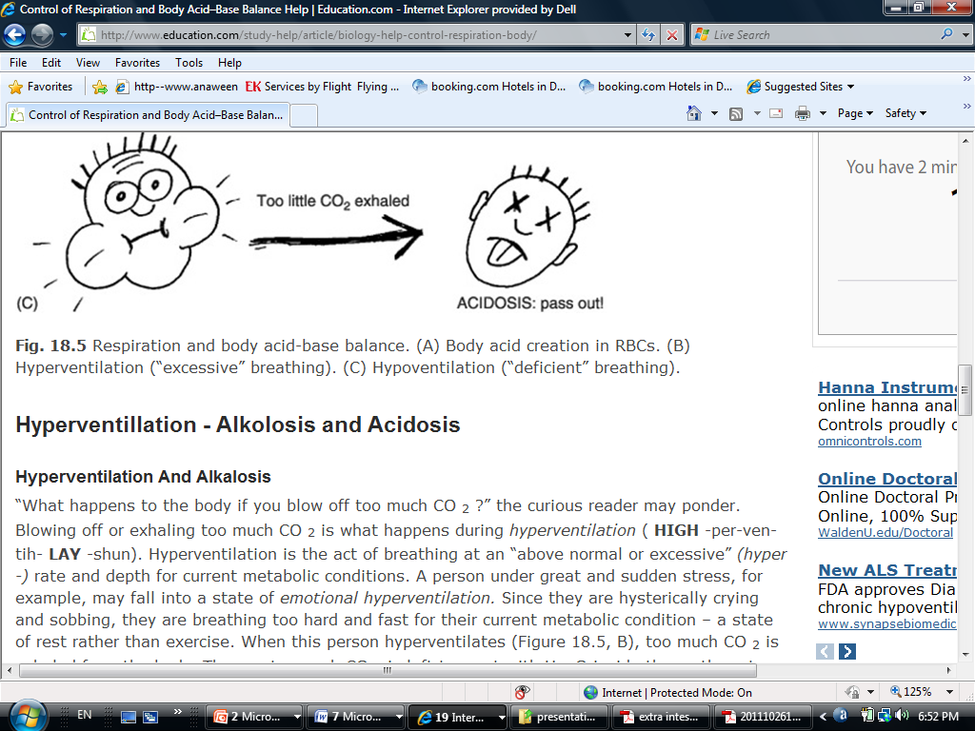
Respiratory acidosis

Slide 6



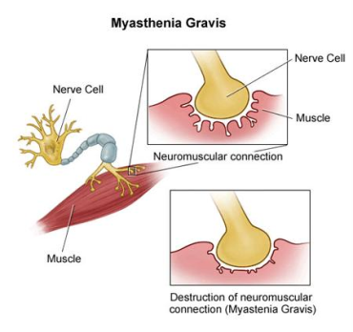
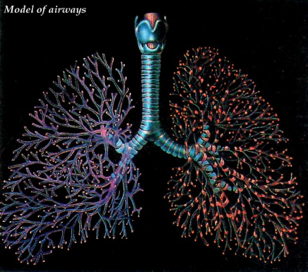
Respiratory acidosis
Primary mechanism: Hypoventilation
CNS
Peripheral nerve
Neuro muscular junction
Chest wall
Bronchial tree

Slide 7
Causes of acute respiratory acidosis:
  Respiratory pathophysiology - airway obstruction, severe pneumonia, chest trauma/pneumothorax
  Acute drug intoxication (narcotics, sedatives)
  Residual neuromuscular blockade
  CNS disease (head trauma)

Slide 8
Chronic Respiratory Acidosis
paCO₂ is elevated with a pH in the acceptable range
Renal mechanisms increase the excretion of H⁺ within 24 hours and may correct the resulting acidosis caused by chronic retention of CO₂ to a certain extent

Slide 9

Causes of chronic Respiratory Acidosis
  Chronic lung disease ( COPD)
  Neuromuscular disease
  Extreme obesity
  Chest wall deformity

Slide 10
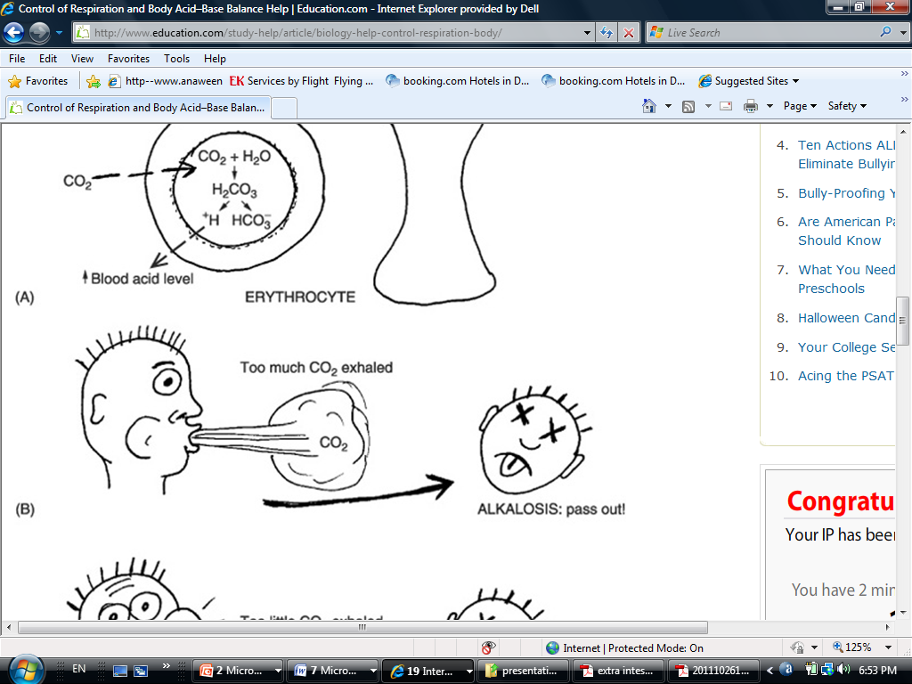
Respiratory alkalosis

Slide 11

Respiratory Alkalosis
  Pain
  Drugs
  Sepsis
  Fever
  Thyrotoxicosis
  Pregnancy
  Overaggressive mechanical ventilation
  Hepatic failure
  Anxiety
  Hypoxemia
  Restrictive lung disease
  Severe congestive heart failure
  Pulmonary emboli

Slide 12
Metabolic acidosis
Increase acid production
Decrease acid excretion
Loss of bicarbonate

Slide 13
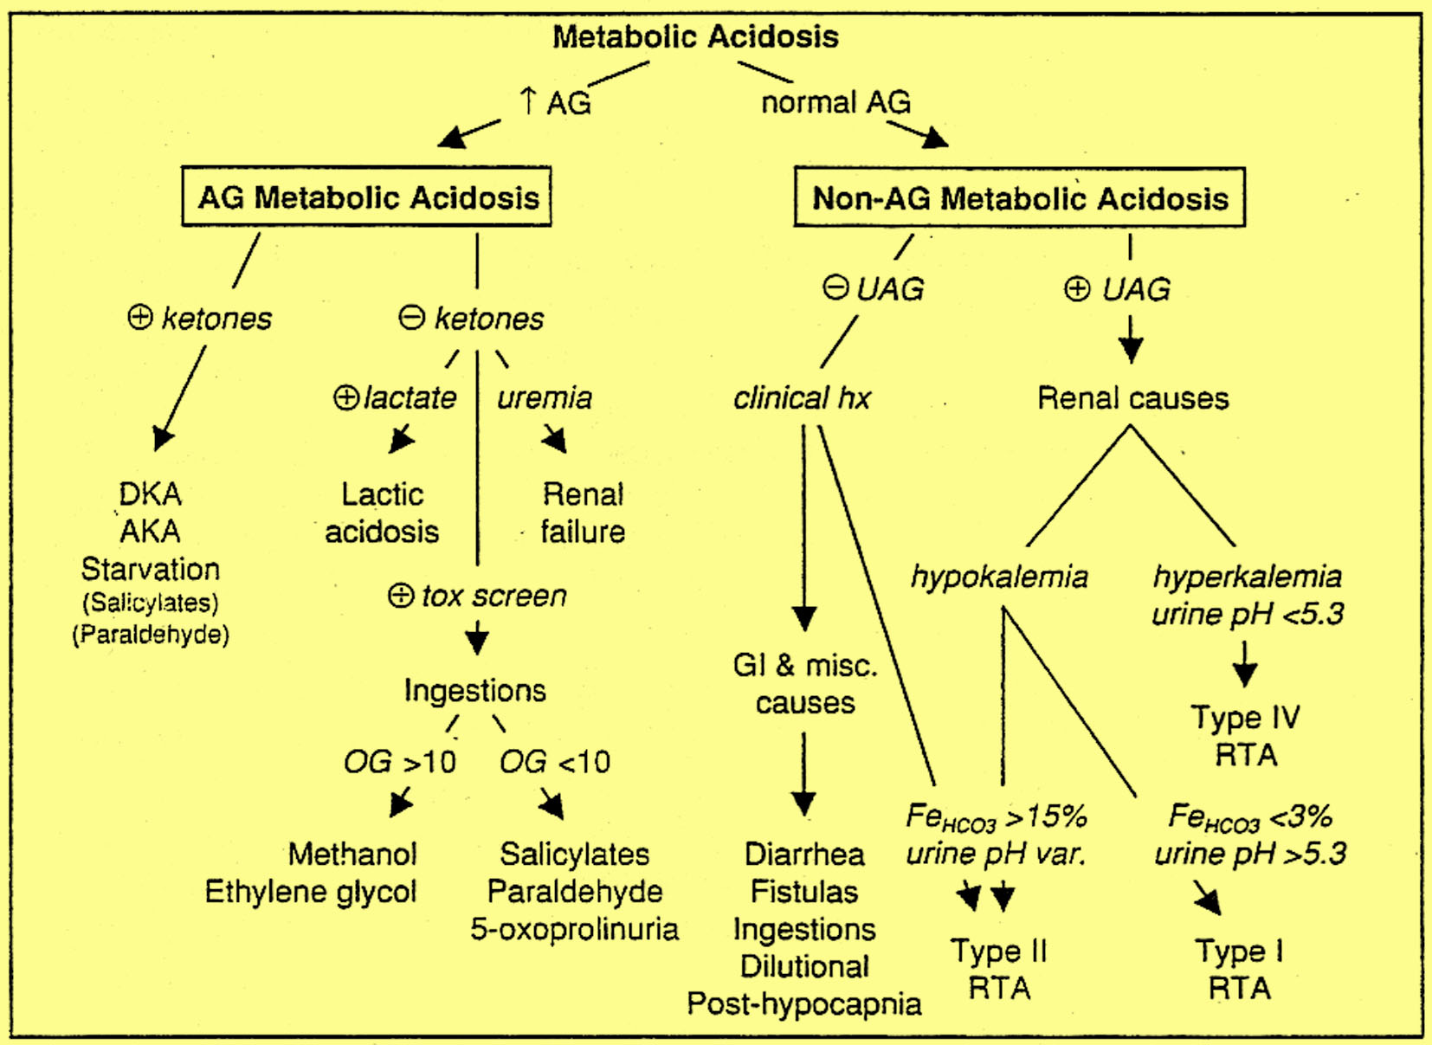

Slide 14
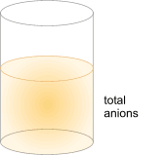
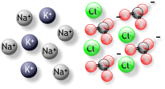
Metabolic acidosis
Anion gap = [Sodium] - ([Chloride] + [Bicarbonate]) Or
AG = [Na⁺] - ([Cl⁻] + [HCO₃⁻]).
OR
Anion gap = ([Na⁺] + [K⁺]) - ([Cl⁻] + [HCO₃⁻])
Anion gap = cations - anions

Slide 15
Increased anion gap metabolic acidosis
Methanol other alcohols, and ethylene glycol intoxication
Uremia (renal failure)
Lactic acidosis
Ethanol
Paraldehyde and other drugs
Aspirin
Ketones (starvation, alcoholic and diabetic ketoacidosis)

Slide 16
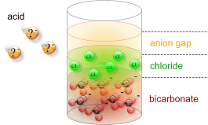
Anion Gap
High AG

Slide 17
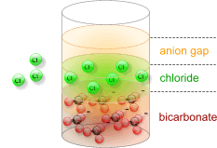
Anion Gap
Normal AG

Slide 18
Etiologies of AG Metabolic Acidosis
Diabetes mellitus, alcoholism, starvation | Ketoacidosis
Type A: impairment in tissue oxygenation, eg. Circulatory or Respiratory failure, sepsis, ischemic bowel, carbon monoxide Type B: no impairment in tissue oxygenation, eg. Malignancy, alcoholism, meds (metformin, NRTIs, salicylates) D-lactic acidosis: short bowel syndrome glc metab by colonic bacteria To D-lactate, which is absorbed; not detected by standard lactate assay | Lactic acidosis
Accumulation of organic anions such as phosphates, sulfates, etc. | Renal failure
Methanol: manifestations include blurred vision Ethylene glycol: manifestations include ∆MS, cardiopulmonary failure, calcium oxalate crystals and renal failure Paraldehyde Salicylates: metabolic acidosis (from lactate, ketones) + respiratory alkalosis due to stimulation of CNS respiratory center Acetaminophen: glutathione depletion accumulation of the Endogenous organic acid 5-oxoproline in susceptible host | Ingestions

Slide 19
Etiologies of Non-AG Metabolic Acidosis
GI losses of HCO₃ | Diarrhea, intestinal or pancreatic fistulas or drainage
RTAs | See section on renal tubular acidoses below
Early renal failure | Impaired generation of ammonia
Ingestions | Acetazolamide, sevelamer, cholestyramine, toluene
Dilutional | Due to rapid infusion of bicarbonate-free intravenous fluids
Post-hypocapnia | Respiratory alkalosis renal wasting of HCO₃ rapid correction Of resp. alk. Transient acidosis until HCO₃; regenerated
Ureteral diversion | Colonic CI⁻ /HCO₃⁻ exchange, ammonium reabsorption

Slide 20
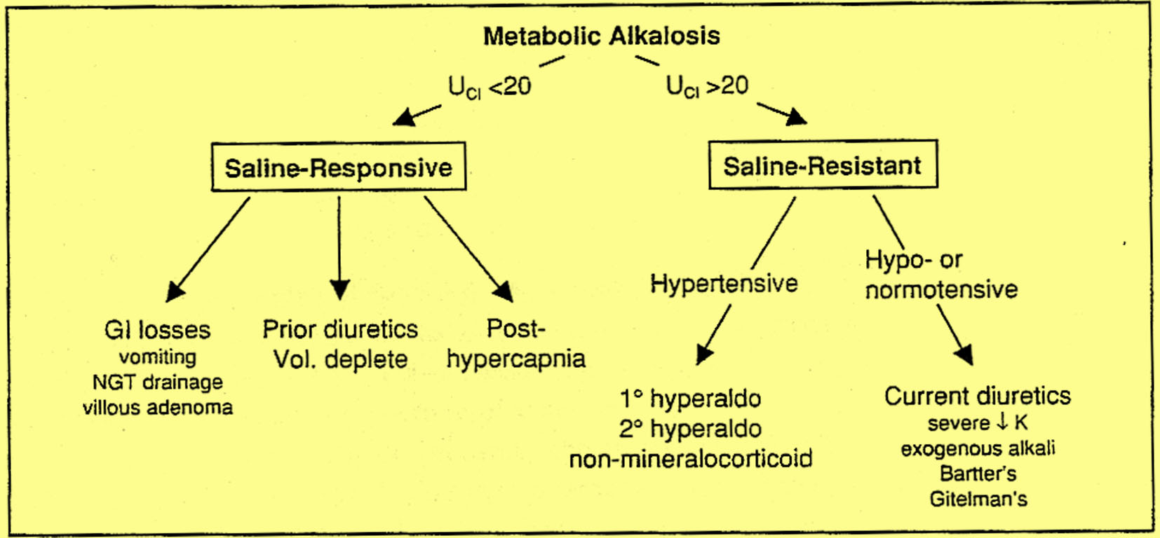
Metabolic alkalosis

Slide 21
Etiologies of Metabolic Alkalosis
Etiologies of Metabolic Alkalosis
Saline – responsive | GI loss of H⁺ : vomiting, NGT drainage, villous adenoma Diuretic use posthypercapina
Saline – resistant | Hypertensive (mineralocorticoid excess) 1⁰ hyperaldosteronism (eg. Conn's) 2⁰ hyperaldosteronism (eg, renovascular dis. Rennin-secreting tumor) Non-aldo (eg. Cushing's, Liddle's, exogenousmineralocorticoids) Normotensive Severe hypokalemia Exogenous alkali load Bartter's syndrome, Gitelman's syndrome

Slide 22
primary disturbance
Primary Disorder
Primary Disorder | Problem | pH | HCO₃ | P_{a}CO₂
Metabolic acidosis | gain of H⁺ or loss of HCO₃ | ↓ | ↓ | ↓
Metabolic alkalosis | gain of HCO₃ or loss of H⁺ | ↑ | ↑ | ↑
Respiratory acidosis | hypoventilation | ↓ | ↑ | ↑
Respiratory alkalosis | hyperventilation | ↑ | ↓ | ↓

Slide 23
Steps in Acid-Base Analysis
Step 1: Acidemic or Alkalemic?
Step 2: Is the primary disturbance respiratory or metabolic?
Step 3: Is the respiratory disturbance acute or chronic?
Step 4: For a metabolic acidosis, is there an increased anion gap?
Step 5: Are there other metabolic processes present in a patient with an increased anion gap metabolic acidosis?
Step 6: Is the respiratory system compensating adequately for a metabolic disturbance

Slide 24
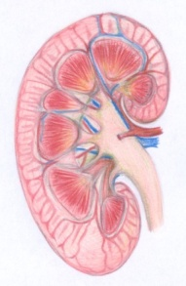
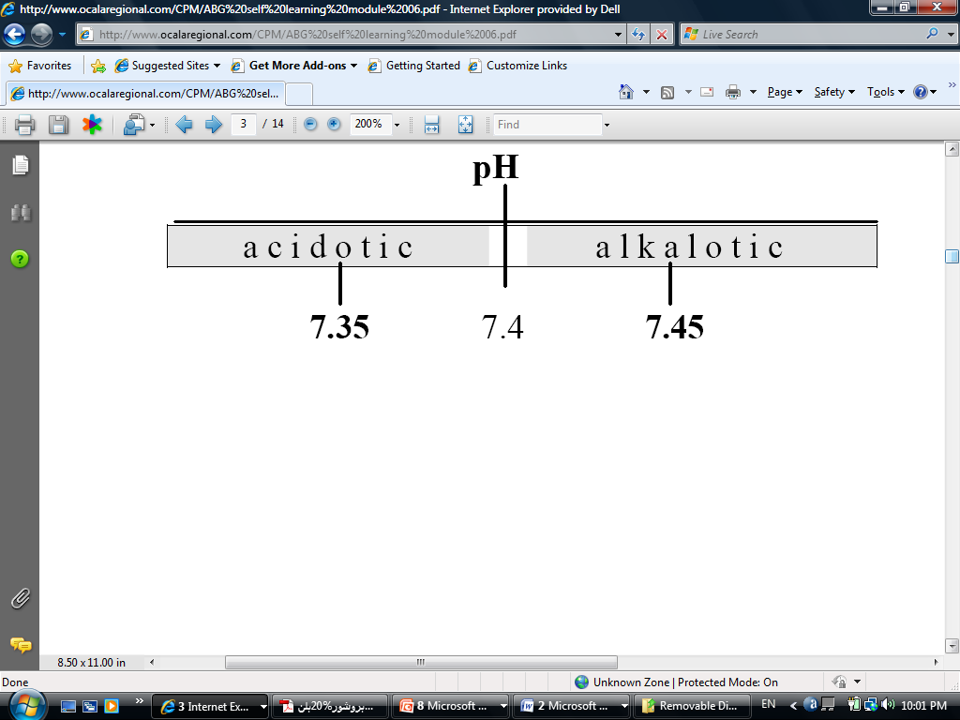
Step 1: Acidemic or Alkalemic?
The pH of the arterial blood gas measurement identifies the disorder as alkalemic or acidemic.
Normal arterial blood pH = 7.35 – 7.45
Acidemic: pH < 7.35
Alkalemic: pH > 7.45

Slide 25

Step 2: Is the primary disturbance respiratory or metabolic?
To determine whether the disturbance affects primarily
  The arterial P_{a}CO₂ or
  The serum HCO₃⁻.
Respiratory disturbances alter the arterial P_{a}CO₂ (normal value 35-45)
Metabolic disturbances alter the serum HCO₃⁻ (normal value 22-26)

Slide 26
Quiz?
1 | pH | pCO2 | HCO3 | Interpretation
2 | 7.41 | 40 | 24
3 | 7.5 | 42 | 35
4 | 6.72 | 40 | 5
5 | 7.26 | 63 | 25
1 | 7.52 | 18 | 25

Slide 27
Quiz?
1 | pH | pCO2 | HCO3 | Interpretation
2 | 7.41 | 40 | 24 | normal
3 | 7.5 | 42 | 35 | metabolic alkalosis
4 | 6.72 | 40 | 5 | metabolic acidosis
5 | 7.26 | 63 | 25 | respiratory acidosis
1 | 7.52 | 18 | 25 | respiratory alkalosis

Slide 28
Step 3: Is the respiratory disturbance acute or chronic?
Acute respiratory acidosis:
  HCO₃- increase by 1 mEq/l for every 10 mmHg increase in PaCO2
Chronic respiratory acidosis:
  HCO₃- increase by 3-3.5 mEq/l for every 10 mmHg increase in PaCO2
Acute respiratory alkalosis:
  HCO₃- decrease by 2 mEq/l for every 10 mmHg decrease in PaCO2
Chronic respiratory alkalosis:
  HCO₃- decrease by 4-5 mEq/l for every 10 mmHg decrease in PaCO2

Slide 29

Case study -1
pH =7.2, pCO2 = 60, HCO2 = 24.
What it is the primary problem? Compensation?
Differential diagnosis?
Treatment ?

Slide 30
Respiratory acidosis
Is it acute or chronic?
Note that the PH is abnormal
Note the HCO2 is with in normal
Remember:
Acute respiratory acidosis:
  HCO₃- increase by 1 mEq/l for every 10 mmHg increase in PaCO2
Chronic respiratory acidosis:
  HCO₃- increase by 3-3.5 mEq/l for every 10 mmHg increase in PaCO2

Slide 31
Case 2
What do you expect the ABG in the following patients to be:
24 years old male with acute SOB, and wheezes for 2days.
Past hx: Bronchial asthma
67 years old women, HTN,DMII, COPD presenting with cough and SOB

Slide 32
Case3
pH: 7.25
[HCO₃⁻]: 20 mEq/L
PaCO₂: 52 mmHg
What it is the primary problem? Compensation?
Differential diagnosis?

Slide 33

Case 4
pH: 7.32
[HCO₃⁻]: 19 mEq/L
PaCO₂: 55 mmHg
What it is the primary problem? Compensation?
Differential diagnosis?
What other investigation you want to do?

Slide 34
Step 4: For a metabolic acidosis, is there an increased anion gap?
Anion gap = [Sodium] - ([Chloride] + [Bicarbonate]) Or
AG = [Na⁺] - ([Cl⁻] + [HCO₃⁻]).
Normal AG 8-16
Serum Osmolality = (2 x (Na + K)) + (BUN ) + (glucose )

Slide 36
Step 5: Are there other metabolic processes present in a patient with an increased anion gap metabolic acidosis?

Slide 37
Step 6: Is the respiratory system compensating adequately for a metabolic disturbance
Metabolic acidosis:
  PCO2 decreases by 1 mmHg for every 1 mEq/l decrease in HCO3
Metabolic alkalosis:
  PCO2 increases by 0.6 mmHg for every 1 mEq/l increases in HCO3

Slide 38
Case 5
56 yo M with Hx of COPD is admitted with 1-wk Hx of dyspnea, productive cough and diarrhea
(Na) 125, (Cl) 103 , (BUN) 42, (Glucose) 100, (K) 3.5, (HCO3-) 10, (Creat) 1.4
ABG 7.14 pCO₂ 30 pO₂ 50
What is the predominant acid base disorder ?

Slide 39
Case 5 continue
What pCO2 is expected with normal respiratory compensation ? 40 – (1.2 * (24-10)) = 23.2, this is not full compensation b/c pCO2 is 30 – indicates an underlying primary respiratory acidosis, suggested by the Hx of COPD, dyspnea, and productive cough (lungs not able to appropriately compensate)
What is the Anion Gap ? 125 – (103+10) = 12 – normal AG ∴ etiology is either diarrhea or RTA – most likely diarrhea b/c of the history

Slide 40
Case 6
32 y/o male present w/ 2d Hx of intractable vomiting. ; pH 7.51, pCO₂ 41
Na132, Cl 90 32 K3.4 HCo2= 33 creatinine1.6
What is the predominant acid-base disorder? Alkalosis (Metabolic )

Slide 41
Case 6 continue
What pCO₂ is expected w/ normal respiratory compensation? = 40 + (32 – 24) * (~ 0.6 ⇔ 0.7) = 44.8 ⇔ 45.6 mmHg; since the measured pCO₂ < 44.8 ⇔ 45.6, there is also a primary respiratory alkalosis (inappropriate hyperventilation)
Tx: Isotonic saline to correct for volume depletion –

Slide 42
Case 7
A 58- year old man presents to the Emergency Department with abdominal pain and hypotension. Investigation reveal the following:
Na 140 K 4 Cl 90 HCO3 = 5 PH 6.8 PCO2 36 PO2 7
Analyze the acid-base disorder(s) seen in the patient.

Slide 43
primary disturbance
Primary Disorder
Primary Disorder | Problem | pH | HCO₃ | P_{a}CO₂
Metabolic acidosis | gain of H⁺ or loss of HCO₃ | ↓ | ↓ | ↓
Metabolic alkalosis | gain of HCO₃ or loss of H⁺ | ↑ | ↑ | ↑
Respiratory acidosis | hypoventilation | ↓ | ↑ | ↑
Respiratory alkalosis | hyperventilation | ↑ | ↓ | ↓

Slide 44
Summary
First, does the patient have an acidosis or an alkalosis
  Look at the pH
Second, what is the primary problem – metabolic or respiratory
  Look at the pCO₂
  If the pCO₂ change is in the opposite direction of the pH change, the primary problem is respiratory

Slide 45
Summary
Third, is there any compensation by the patient - do the calculations
  For a primary respiratory problem, is the pH change completely accounted for by the change in pCO₂
    if yes, then there is no metabolic compensation
    if not, then there is either partial compensation or concomitant metabolic problem

Slide 46
