Slide 1
Acute Coronary Syndrome
Dr. Hussam F. Al-Faleh
Associate Professor of Cardiac Sciences

Slide 2
Objectives
Pathophysiology of atherosclerosis.
Classification of ACS’s
Diagnostic workup and management
Common complications of ACS’s

Slide 3
Resources
Davidson or Kumar
Lecture

Slide 4
Why is this topic vital!
Number one killer
Almost 30% of hospital admission is cardiac related
You will be faced with this pathology regardless of your career path
You will likely know someone with CAD!

Slide 5
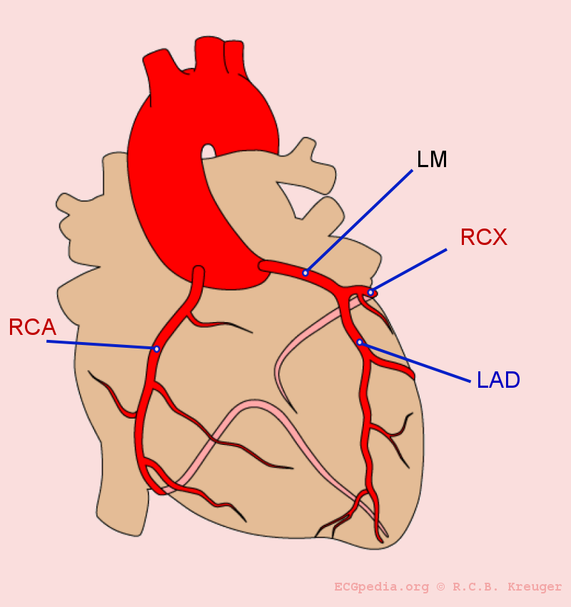
What are coronary arteries

Slide 6
Clinical Scenario

Slide 7
Clinical scenario
Saleh, 60yr old man
Owns a businessman
Smoker
Not on medications
No significant past medical history
3 years ago during a routine medical check up was found to have the following:

Slide 8

Saleh’s Profile
Physical Exam:
- BP of 150/90
( repeated 3 times)
Weight 90kg,Height 170 ( BMI=31)
Waist Circumference 115 cm
Lab investigations:
- FBS=9mmol/l
LDL= 4.5 mmol/l
HDL=0.7 mmol/l

Slide 9
Clinical scenario
Told that he had DM
Obese
Dyslipidemic
BP was high ( likely hypertensive if repeated on future occasions)
Strongly advised to change life style
Undergo another check up in 3 months times after dietary changes

Slide 10
What are the risk factors for CAD?

Slide 11
Risk factors
Age : males ≥45, females ≥55
Gender (Male gender)
DM
Dyslipidemia
HTN
Smoking
Family history of Premature CAD: males ≤55 females ≤65

Slide 12
Clinical scenario
Saleh, forgot or was careless !
3 yrs later, he started feeling occasional chest heaviness while rushing on the stairs. Radiated to both shoulders, and relived with rest.
He decided to go to his physician again….but after finishing off some business deals

Slide 13
What is happening with Saleh?

Slide 14
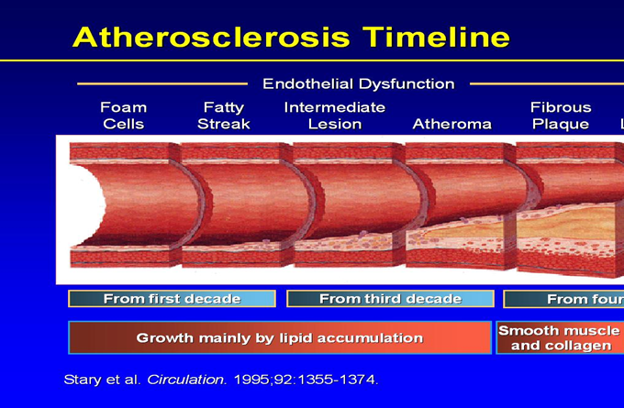
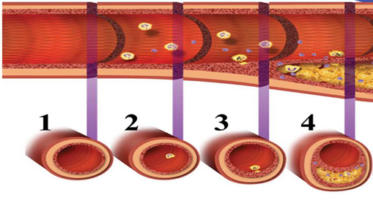

Slide 15
O2
Supply
Tissue
Demand

Slide 16
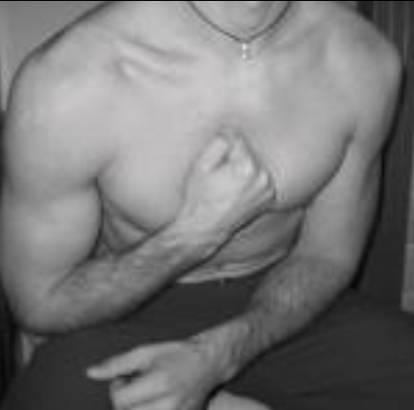
Back to Saleh
Delayed medical check up for 3 months!
Woke up at 5 AM with similar chest pain, however now at rest and severe.
Perfuse sweating and nausea
Called his son to take him to the ER
In ER
- HR 110bpm
- BP 180/100
- O2 Saturation 95% on RA
- PE was normal
Can you explain his clinical presentation?

Slide 17
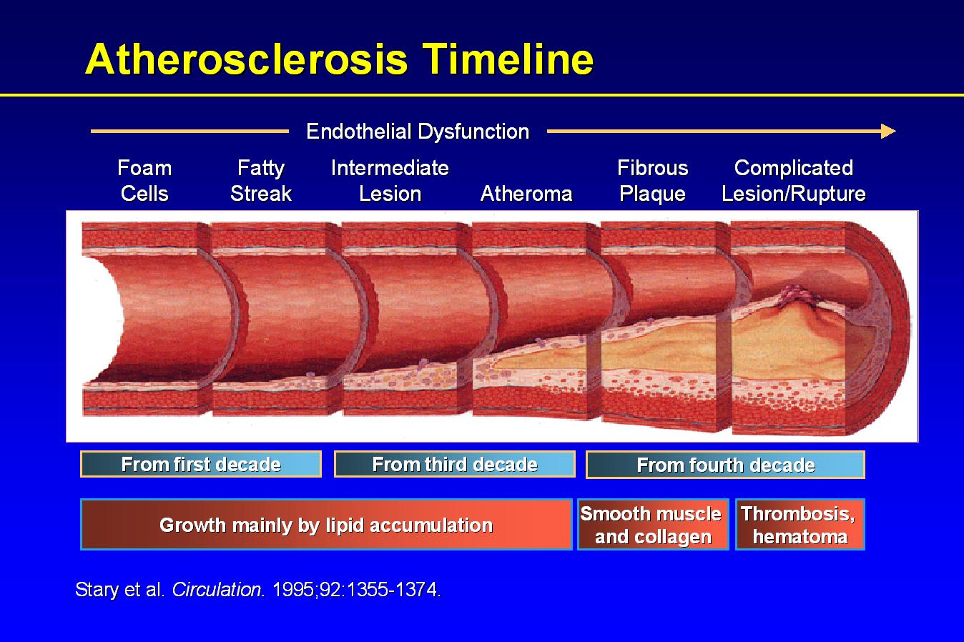
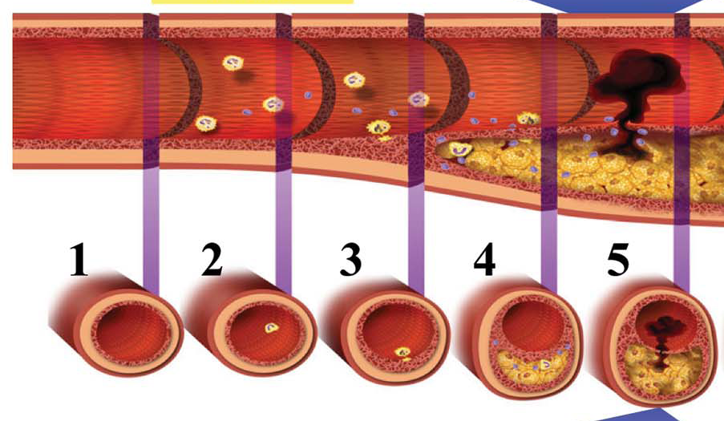

Slide 18
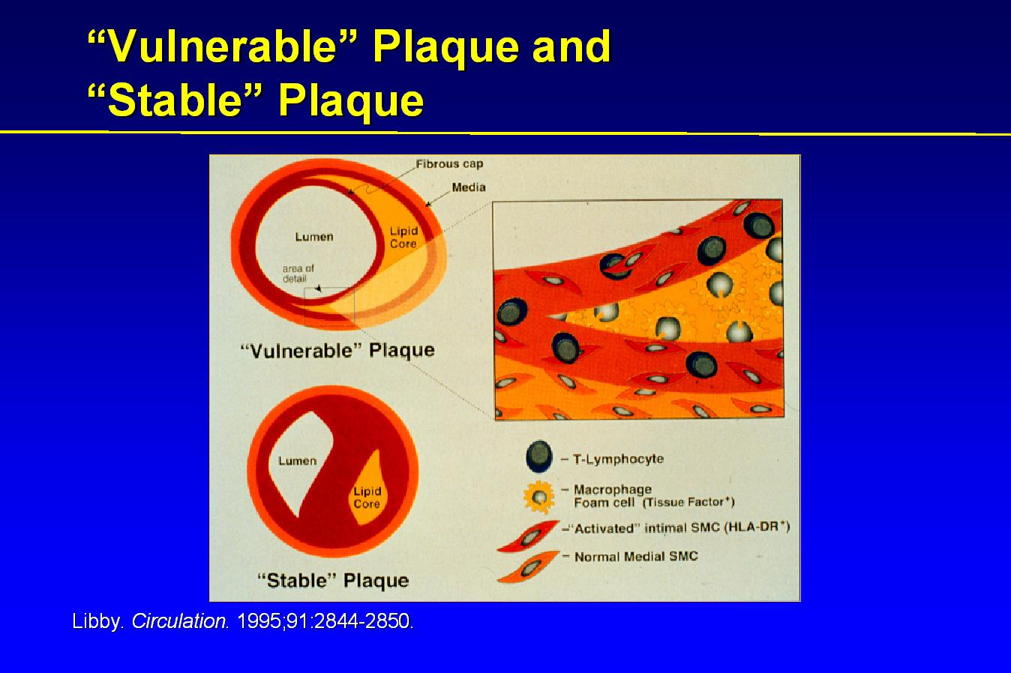
Secretion of
Matrex
metalloprotenases

Slide 19
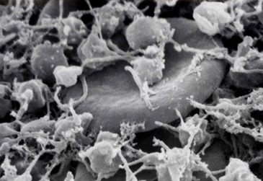

Slide 20
Investigations in ER

Slide 21
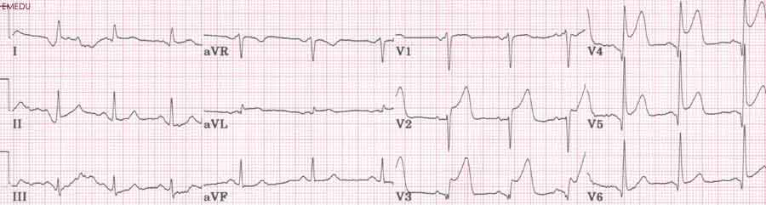
12 lead ECG

Slide 22
What is the diagnosis?

Slide 23
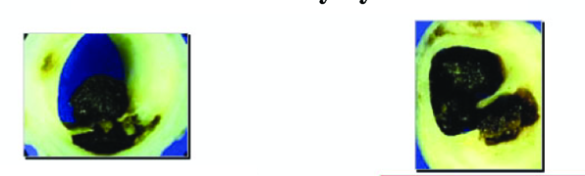


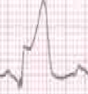

Acute Coronary Syndrome
OR
Unstable Angina
Non ST Elevation MI
(NSTEMI)
ST Elevation MI
(STEMI)
No Myocardial Necrosis
Myocardial Necrosis

Slide 24
What is Myocardial Infarction?

Slide 25
Third Universal Definition of MI
Typical rise in cardiac troponin T or I , CK-MB with at least one of the following:
1. Ischemic symptoms
2. Pathological Q wave on ECG
3. Ischemic ECG changes (e.g ST
elevation or depression, new LBBB)
4. Imaging evidence of new loss of
viable myocardium or a new WMA
5. Identification of an intracoronary thrombus by angiography or autopsy.
European Heart Journal , 2012

Slide 26
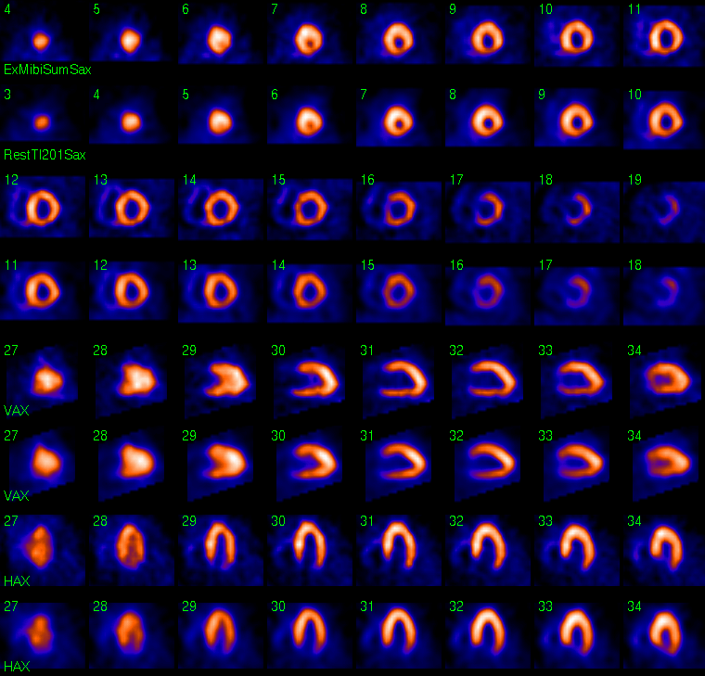
Nuclear imaging

Slide 27
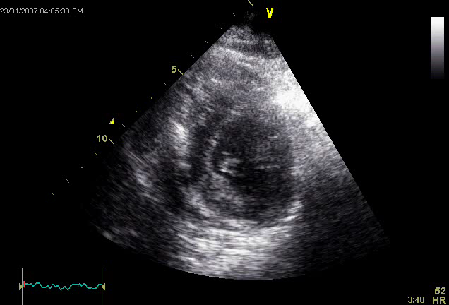

Slide 28
Markers for Myocardial Necrosis

Slide 29
Biochemical markers
MI causes release of certain enzymes and proteins into the blood stream.
Creatin Kinase (CK) is released from multiple organs such as the myocardium , skeletal muscles, and the brain.
The Iso-form CK-MB, is cardio-specific
Starts to rise 4-6 hrs after onset of ischemia, then falls within 48-72hrs.

Slide 30
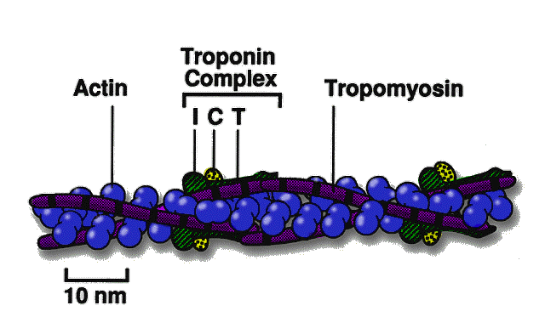
Biochemical markers
Cardiospecific proteins Troponin I, and T are the most sensitive & specific markers for myonecrosis.
Released with 4-6hrs, but can last upto 2 weeks.

Slide 31
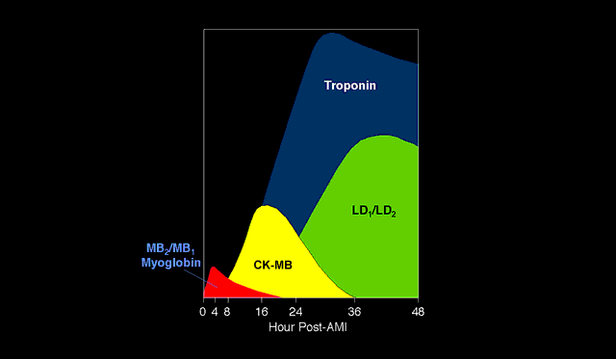
Relationship between onset of MI and
release of markers

Slide 32
Back to Saleh in ER
Management

Slide 33
Aims of therapy
Open Artery and Improve oxygen supply
1. Supplemental O2
2. Coronary vasodilators ( Nitroglycerine)
3. Antiplatelet agents
4. Reperfusion therapy
a. Fibrinolytic therapy
b. Primary Percutanous coronary intervention (PCI)
5. Antithrombotic agents

Slide 34
Aims of therapy
Reduce O2 demand
1. Beta blockers ( Propranolol, Metoprolol)
2. Analgesics ( Morphine)
Other medications
- ACE inhibitors( Enalapril, Lisinopril)
- Statin therapy

Slide 35
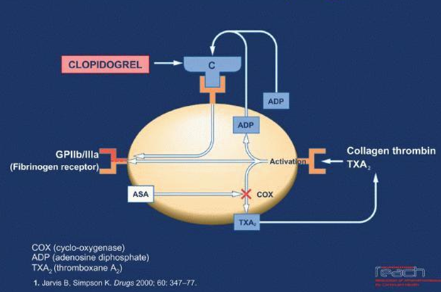
Antiplatelet Agents

Slide 36
Aspirin (ASA), and Clopedogel
ASA is Chewable 160 to 325 mg at presentation, then 75 to 325 mg daily.
Clopidogrel more potent than ASA and is combined with ASA
Both agents are powerful adjuncts to reperfusion therapy

Slide 37
Reperfusion therapy

Slide 38
Fibrinolytics
ONLY USED FOR STEMI ( NOT NSTEMI)
Reduces short and long term mortality
Should be given during a 12hr window, and given ASAP.
2 types of fibrinolytics:
1. Non Fibrin specific ( Streptokinase)
2. Fibrin specific

Slide 39
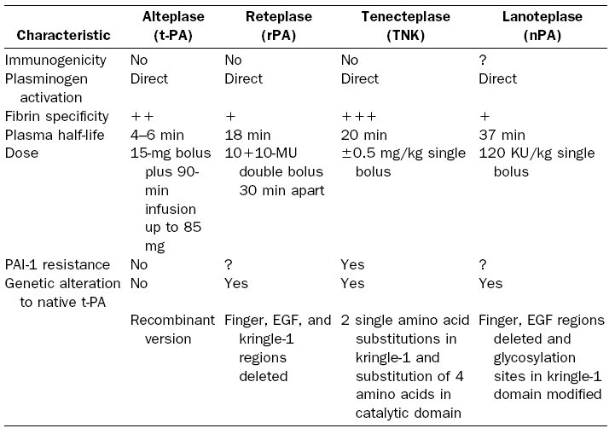
Fibrin specific agents

Slide 40
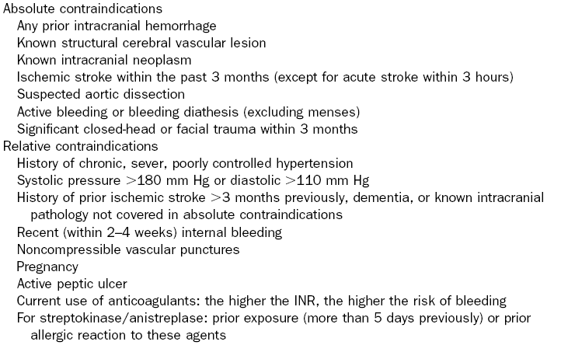

Slide 41
Primary PCI

Slide 42
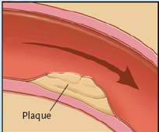
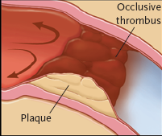
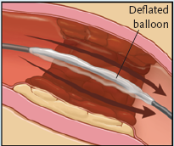
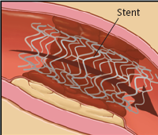
Adopted from N Eng J Med 2007

Slide 43
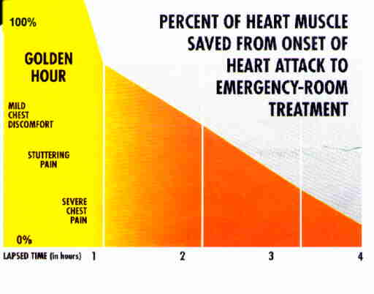

Slide 44
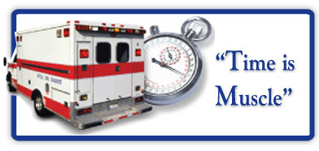

Door to needle time <30min
Door to balloon time <90min

Slide 45
Antithrombotics

Slide 46
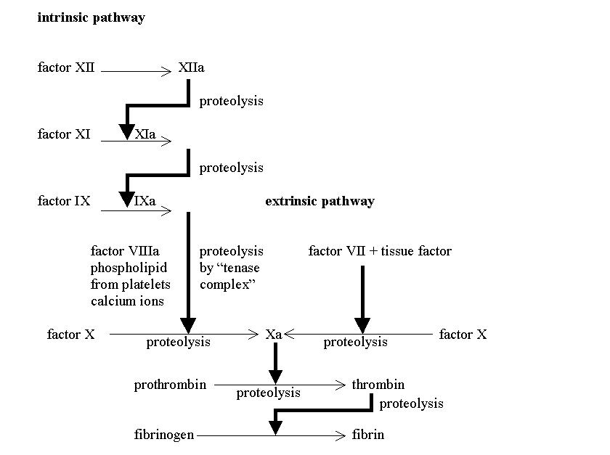
Heparin
Antithrombin III

Slide 47
Antithrombotics
Heparin
- Unfractionated
- Low molecular
Prevents further thrombosis and aids in insuring patency of the occluded artery.

Slide 48
Back to Saleh in ER
Was given chewable ASA
3 Sublingual Nitro tablets
He had no contraindications to fibrinolytic therapy
Just prior to receiving fibrinolytics , he lost consciousness ………

Slide 49
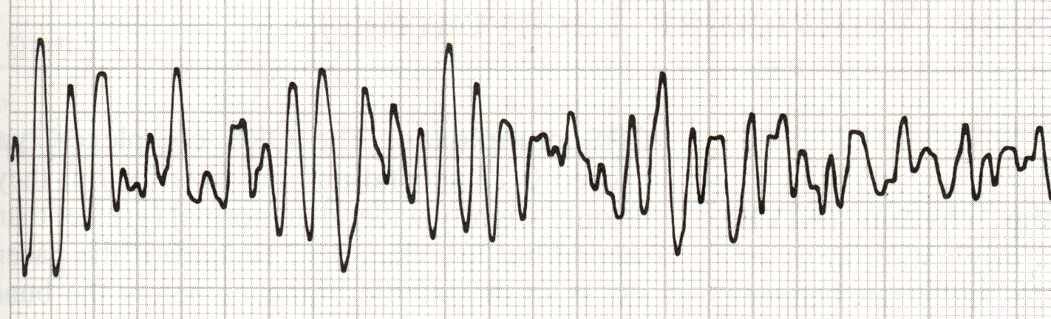
Ventricular Fibrillation

Slide 50
Defibrillator paddles immediately applied and 200J delivered managed to convert him to normal sinus rhythm
What other immediate complications may happen?

Slide 51
Complications of MI
Electrical ( Arrhythmia )
Heart failure (Pulmonary Edema)
Cardiogenic Shock
Mechanical complications ( usually occurs late after MI …days to weeks )

Slide 52
Complications of MI
Electrical complications:
1. Tachyarrhythmias
a. Ventricular:
- Ventricular Tachycardia
- Ventricular Fibrillation
b. Supraventricular:
- Atrial Fibrillation
2. Bradyarrhthmias
- 1st, 2nd, and 3ed degree AV blocks
- New LBBB, or RBBB

Slide 53
Mechanical complications:
1. Mitral regurgitation
- ( 2-7 days post MI)
- Caused by papillary muscle rupture.
2. Free LV wall rupture
- Rare
- 1st 24hr upto 2 weeks
3. Ventricular septal defect
- 1-3%
- Occurs with inferior and anterior MI

Slide 54
Pump failure
1. Heart failure
- Bad prognostic sign
- Reflects the size of the MI
- ACE inhibitors and diuretics is cornerstone
therapy.
2. Cardiogenic Shock
- Happens with major MI’s
- Carries high mortality ( >50% in 30 days)
- Should be rushed for cardiac cath and either
PCI or Coronary bypass grafting.

Slide 55
Summery
Plaque vulnerability is affected by an inflammatory process
Acute coronary syndromes is a spectrum and is classified according to markers of ST changes and Myocardial necrosis
In STEMI , time to reperfusion is critical in myocardial salvage ( time is muscle)

