Slide 1
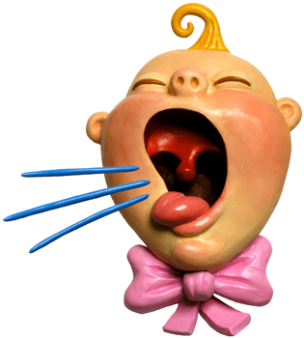
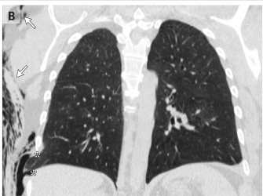
Cough
I’m Coughing my lungs up Doc.

Slide 2
Areas To Cover
Why do we Cough?
Classification and Causes of Cough
  Acute
  Sub acute
  Chronic
When and How to Investigate
Management
Case Study

Slide 3
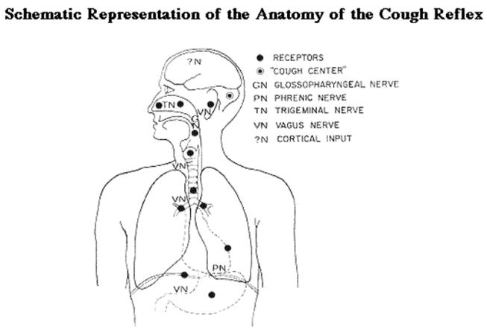
What is Cough?
‘A Cough is a forced expulsive manoeuvre, usually against a closed glottis and which is associated with a characteristic sound’

Slide 4
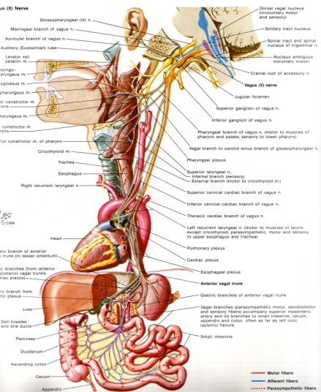
Cough Reflex: Afferent Pathway
Vagus nerve is major afferent pathway
Stimuli arise from:
  Ear
  Pharynx
  Larynx
  Lungs
  Tracheobronchial tree
  Heart
  Pericardium
  Esophagus

Slide 5
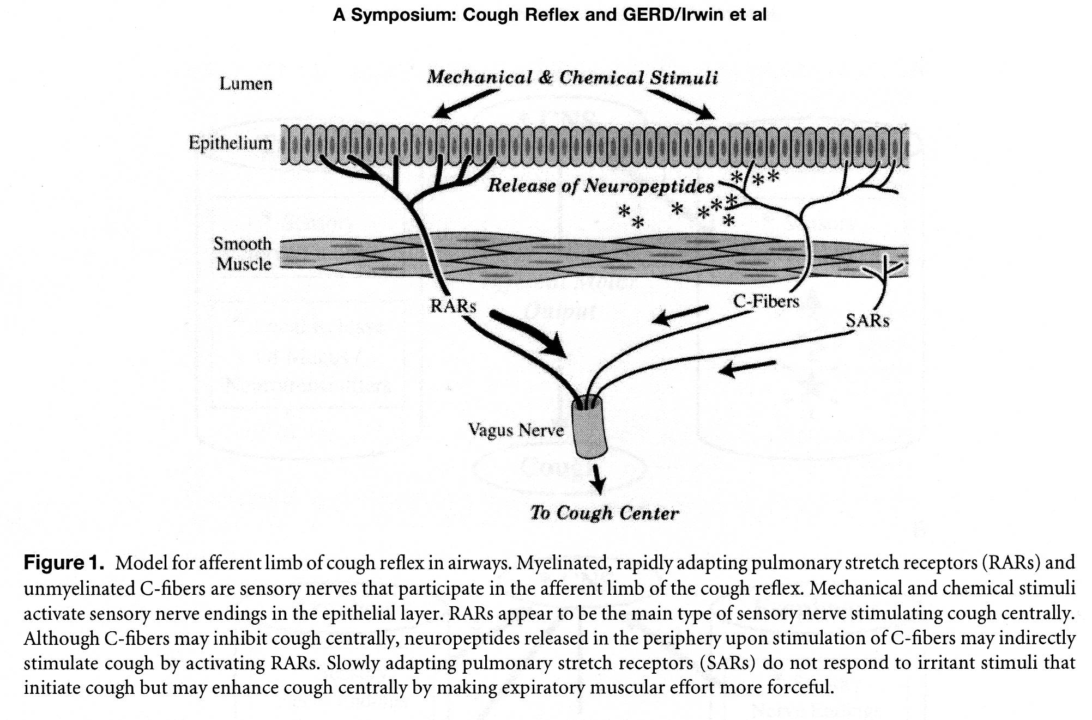
Cough Reflex: Afferent Pathway
Mechanical stimuli:
Chemical stimuli

Slide 6
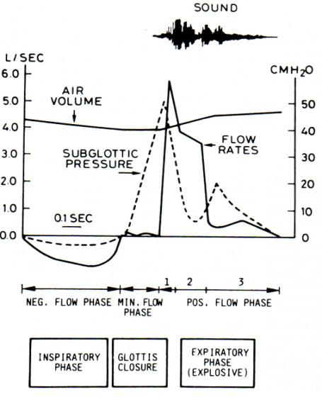
Efferent Pathway: 4 Phases
1. Inspiratory Phase
2. Compressive Phase
3. Expiratory Phase
4. Relaxation Phase

Slide 7
Cough
Vital protective mechanism
Four steps:
  inspiratory gasp
  Valsalva maneuver
  expiratory blast as cords abduct
  post-tussive prolonged inspiration
Notes:
Few things to note: Valsalva requires closed airway, therefore pt with trash or paralyzed cords can’t cough very well
Inspiratory muscles= diaphragm & accessories
Expiratory muscles= intercostals and abdominals
Expiratory blast requires functional exp muscles, C6 quad loose this ability and have much less effective cough
Exp blast can reach 500mph!

Slide 8
Cough: What’s it good for?
Attract attention
Signal displeasure
Protect the airway from pathogens, particulates, food, other foreign bodies
Clear the airways of accumulated secretions, particles

Slide 9
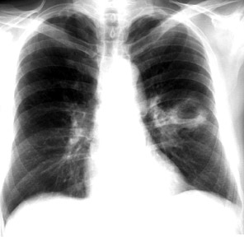
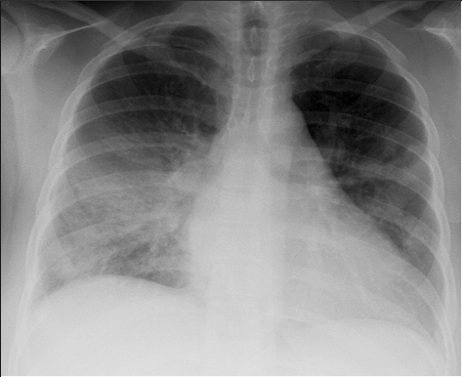
Impaired Cough: Consequences
Aspiration of oropharyngeal or stomach contents (bacteria, food, other)
Acute airway obstruction
Pneumonia
Lung abscess
Respiratory failure/ ARDS
Bronchiectasis
Pulmonary fibrosis

Slide 10
Cough. Complications
Intrathoracic pressure increases up to 300mmHg
Expiratory velocity reaches 500mph.
Helps to clear mucous
BUT can cause complications

Slide 11
COMPLICATIONS
headache
dizziness
musculoskeletal pain
syncope
urinary incontinence
Rib fracture
…….drives patient and everyone else crazy.

Slide 12
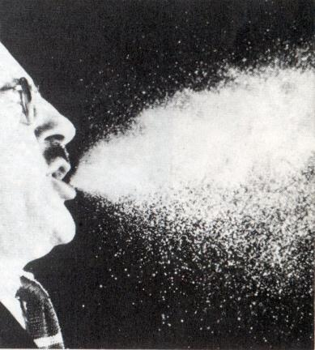
Cough: Public Health Concern

Slide 13
Classification of Cough
Three Categories of Cough
Acute Cough = < 3 Weeks Duration
Sub acute Cough = 3 – 8 Weeks Duration
Chronic Cough = > 8 Weeks Duration

Slide 14
Acute Cough

Slide 15
Acute Cough <3/52 Duration
Differential Diagnosis
Upper Respiratory Tract infections:
Viral syndromes, sinusitis viral / bacterial
URTI triggering exacerbations of Chronic Lung Disease e.g. Asthma/ COPD
Pneumonia
Left Ventricular Heart Failure
Foreign Body Aspiration

Slide 16
Acute Cough
Epidemiology
Symptomatic URTI
  2-5 per adults per year
  7-10 per child per year
40-50% will have cough
Self medication common -£24million per year
20% consult GP (2F:1M)
Most resolve within 2 weeks

Slide 17
Duration of Cough in URTI
Primary Care Setting
No antecedent or chronic lung disease
End of Week % Coughing
3 58
4 35
5 17
6 8
*Jones FJ and Stewart MA, Aust Family
Physician Vol. 31, No. 10, October 2002
Sub-acute Cough
-Post viral cough

Slide 18
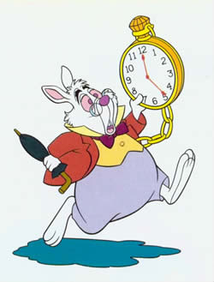
Managing Acute Cough
“Don’t just do something stand there.”
Alice in Wonderland

Slide 19
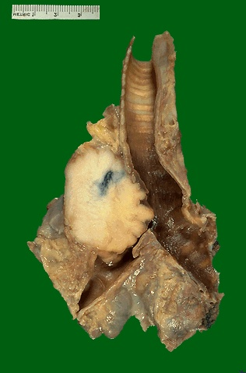
Managing Acute Cough
Identify High Risk groups
Acute Cough Can be 1st Indicator of Serious Disease
eg Lung ca, TB, Foreign Body, Allergy, Interstitial Lung disease
‘Chronic cough always preceded by acute cough’.

Slide 20
Red Flags in Acute Cough
Symptoms
Haemoptysis
Breathlessness
Fever
Chest Pain
Weight Loss
Signs
Tachypnoea
Cyanosis
Dull chest
Bronchial Breathing
Crackles
THINK pneumonia, lung cancer, LVF
GET a CHEST X-Ray

Slide 21
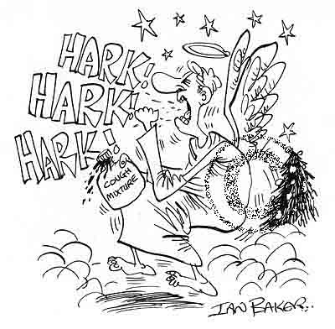
Treatment of Simple Acute Cough
Benign course -reassure
Cough can distress
Patients report OTC medication helpful
Voluntary cough suppression -linctuses/ drinks
Suppression of cough -dextromethorphan, menthol, sedating antihistamines & codeine

Slide 22
Which Anti-tussive?
Dextromorphan
eg Benilyn non-drowsy
1 meta-analysis
high dose 60mg
beware combinations eg paracetomol
Menthol
Steam inhalation. Effect on reflex short lived
Sedating Antihistamines
danger sleepy - nocturnal cough
Codeine or Pholcodeine
No better than dextromorphan
but more side-effects. Not recommended

Slide 23
Sub-Acute Cough

Slide 24
Sub-acute Cough 3-8 weeks
Likely Diagnoses
Post infectious
Bacterial Sinusitis
Asthma
Start of Chronic Cough
Don’t want to miss lung cancer
ACTIONS
Examine Chest
Chest X-Ray if signs or smoker
Measure of airflow obstruction
i.e. peak flow -one off
peak flow -serial
spirometry

Slide 25
Post Infectious Cough
A cough that begins with an acute
respiratory tract infection and is not
complicated* by pneumonia
*Not complicated = Normal lung exam and normal chest X-ray
Post Infectious cough will resolve without treatment
Cause = Postnasal drip or Tracheobronchitis

Slide 26
Chronic Cough

Slide 27
Case Study -CP 2007
60yr retd Nurse
Chest infection 2002 in Spain -mild SOB since
Chest infection 2006 -hospitalised for 4/7 antibiotics / steroids
SOB and dry cough since
No variation
4 lots of AB and steroids from GP plus tiotropium & oxis -no help for cough
Wt climbing
More SOB over 9/12
Ex-smoker 30 pack yrs
FEV1 0.97 43%
What else would you like to know?
What causes can you think of?

Slide 28
Chronic Cough
Epidemiology
Epidemiology difficult -acute vs chronic
Cullinan 1992 Respir Med 86:143-9
n=9077
16% coughed on >50% days of year
13% coughed sputum on >50% days of year
54% were smokers

Slide 29
Chronic Cough
Epidemiology
Associations with:
Smoking (dose related)
Pollutants (particulate PM₁₀) -occupation
Environmental irritants (e.g. cat dander)
Asthma
Reflux
Obesity
Irritable bowel syndrome
Female

Slide 30
Making the Diagnosis
Common Differentials
Lung Disease
-normal CXR
-abnormal CXR
Gastro
-Oesophageal
Reflux
Post-nasal Drip
-allergic rhinitis
-bacterial sinusitis
Non-structural
ACE-Inhibitors
Tobacco
Habit Cough

Slide 31
Chronic Cough
Investigating Chronic Cough
Purpose:
To exclude structural disease
To identify cause
How
History & Examination inc occupation
& Spirometry
ALWAYS GET A CHEST X-RAY
IN CHRONIC COUGH

Slide 32
Beware
Cough triggered by:
change in temperature
scent, sprays, aerosols and exercise
indicate
Increased cough reflex sensitivity
and Not just seen in Asthma.
Esp. GORD, infection and ACEI

Slide 33
ACE-Inhibitors and Chronic Cough
Incidence: 5-20%
Onset: one week to six months
Mechanism
Bradykinin or Substance P increase
Usually metabolized by ACE)
PGE2 accumulates and vagal stimulation.
Treatment: switch to Angiotensin II Receptor Blockers (ARBs)

Slide 34
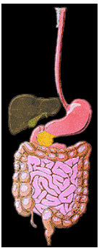
Gastro-oesophageal Reflux
GORD accounts alone or in combination for 10-40% of chronic cough
Two Mechanisms
a. Aspiration to larynx/ trachea
b. Acid in distal oesophagus stimulates vagus and cough reflex

Slide 35
Gastro-oesophageal Reflux Symptoms
Cough Features
Throat clearing
Worse at night / rising
On eating
Reflex hypersensitivity
CXR -normal or hiatus hernia
Spirometry normal
GI Symptoms
If Aspiration main mechanism
Heart burn
Waterbrash/ Sour taste
Regurgitation
Morning Hoarseness
If Vagal - NO GI symptoms

Slide 36
Gastro-oesophageal Reflux

Slide 37
Gastro-oesophageal Reflux
Investigation
Esophageal pH monitoring for 24 hours (+diary)
  95% sensitive and specific 95%
Ba swallow not sensitive enough
Endoscopy - may confirm but false -ve rate

Slide 38
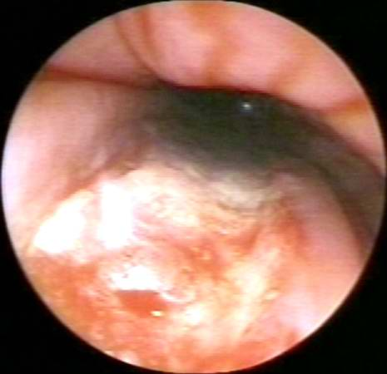
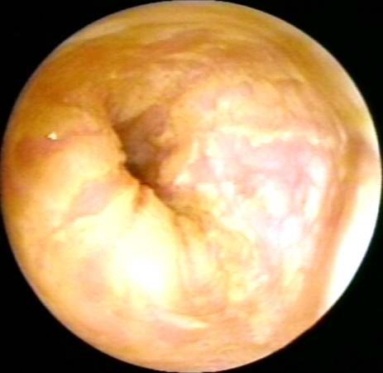
Endoscopy can show GORD, but cannot
confirm GORD as the cause of cough.
© Slice of Life and Suzanne S. Stensaas
GED
GED

Slide 39
Gastro-oesophageal Reflux
Treatment
Trial of Therapy
High dose twice daily PPI for min 8weeks
+ prokinetic e.g. domperidone or metoclopramide
Eliminate contributing drugs.
Baclofen rarely
Improves in 75-100% of cases

Slide 40
Post-Nasal Drip
Symptoms:
‘something dripping’
frequent throat clearing
nasal congestion / discharge
posture
Causes
Allergic rhinitis
Non-allergic rhinitis
Vasomotor rhinitis
Chronic bacterial sinusitis

Slide 41
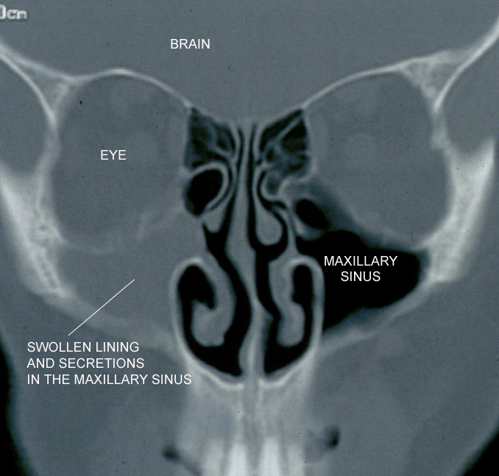
Post Nasal Drip Treatment
Options:
1. Exclude /treat infection
2. Nasal steroid for 8/52
3. Sedating antihistamines
4. Antileukotrienes eg montelukast
5. Saline lavage
6. ENT opinion

Slide 42
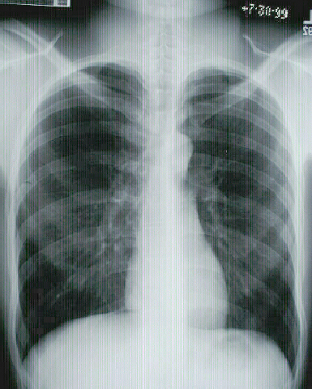
Lung Diseases inc Tobacco
Favouring Lung Disease
Shortness of breath
Wheeze
Sputum production
Haemoptysis
Chest signs eg crackles

Slide 43
Chest X-Ray and Differential of Cough
Normal CXR
Gastro-oesophageal reflux
Post-nasal Drip
Smokers cough/ Chronic Bronchitis
Asthma
COPD
Bronchiectasis
Foreign body
Abnormal CXR
Left ventricular failure
Lung cancer
Infection/ TB
Pulmonary fibrosis
Pleural effusion

Slide 44
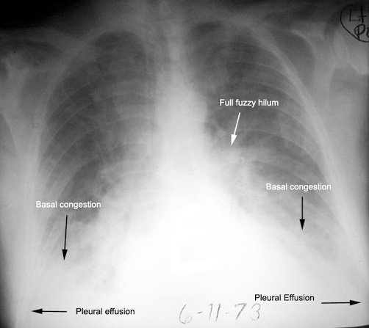
Left Ventricular Failure

Slide 45
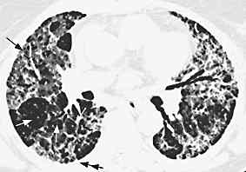

Idiopathic Pulmonary Fibrosis

Slide 46
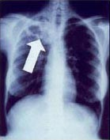
TB

Slide 47
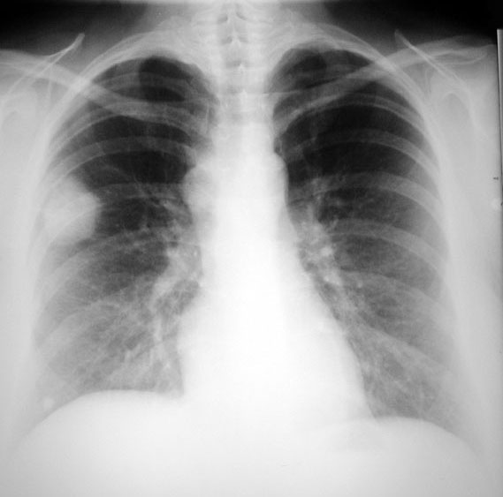
Lung Cancer

Slide 48
Chest X-Ray and Differential of Cough
Normal CXR
Gastro-oesophageal reflux
Post-nasal Drip
Smokers cough/ Chronic Bronchitis
Asthma
COPD
Bronchiectasis
Foreign body

Slide 49
A man presents to you with coughing
What would you like to know?

Slide 50
Cough
Onset?
Duration?
Character?
Nocturnal?
Precipitating factors?
Relieving factors?
Sputum?
Haemoptysis?
Association?

Slide 51
Cough
Onset?
Duration?
Character?
Nocturnal?
Precipitating factors?
Relieving factors?
Sputum?
Haemoptysis?
Association?
Recent or long standing (Chronic)

Slide 52
Cough
Onset?
Duration?
Character?
Nocturnal?
Precipitating factors?
Relieving factors?
Sputum?
Haemoptysis?
Association?
Recent or long standing (Chronic)

Slide 53
Cough
Onset?
Duration?
Character?
Nocturnal?
Precipitating factors?
Relieving factors?
Sputum?
Haemoptysis?
Association?
Chronicity
  Pertussis
  TB
  Foreign body
  Asthma
  Drugs
  Bronchiectasis
  ILD

Slide 54
Cough
Onset?
Duration?
Character?
Nocturnal?
Precipitating factors?
Relieving factors?
Sputum?
Haemoptysis?
Association?
Brassy?
Pressure on the trachea?

Slide 55
Cough
Onset?
Duration?
Character?
Nocturnal?
Precipitating factors?
Relieving factors?
Sputum?
Haemoptysis?
Association?
Change in character of a chronic cough should make you consider other pathology.

Slide 56
Cough
Onset?
Duration?
Character?
Nocturnal?
Precipitating factors?
Relieving factors?
Sputum?
Haemoptysis?
Association?
Asthma
Also Early morning

Slide 57
Cough
Onset?
Duration?
Character?
Nocturnal?
Precipitating factors?
Relieving factors?
Sputum?
Haemoptysis?
Association?
Usually in asthma
  Emotion
  Weather
    Wind
    Rain
    Cold
  Dust
  Allergies
  Exercise
  Drugs

Slide 58
Cough
Onset?
Duration?
Character?
Nocturnal?
Precipitating factors?
Relieving factors?
Sputum?
Haemoptysis?
Association?
Avoidance of precipitating factors!

Slide 59
Cough
Onset?
Duration?
Character?
Nocturnal?
Precipitating factors?
Relieving factors?
Sputum?
Haemoptysis?
Association?
Presence?
  Colour
  Volume
  Consistency
  Pattern
Consider
  Infections
  COPD
  CF
  Bronchiectatsis

Slide 60
Cough
Onset?
Duration?
Character?
Nocturnal?
Precipitating factors?
Relieving factors?
Sputum?
Haemoptysis?
Association?
Presence?
  Colour
  Volume
  Consistency
  Pattern
Will be covered elsewhere!

Slide 61
Cough
Onset?
Duration?
Character?
Nocturnal?
Precipitating factors?
Relieving factors?
Sputum?
Haemoptysis?
Association?
Breathlessness
Sputum
Chest pain
Wheeze
Hoarseness
Post nasal drip

Slide 62
CHRONIC COUGH
Useful pneumonic
G A S P S A N D C O U G H
Gastroesophageal reflux disease
Asthma
Smoking/chronic bronchitis
Post-infection
Sinusitis/post-nasal drip
Ace-inhibitor
Neoplasm/lower airway lesion
Diverticulum (esophageal)
Congestive heart failure
O uter ear
U pper airway obstruction
G I-airway fistula
Hypersensitivity/allergy

