Slide 1
Infective Endocarditis
DR. MOSTAFA ALSHAMIRI
ASSISTANT PROFESSOR
CONSULTANT CARDIOLOGIST
KING FAHED CARDIAC CENTER
KKUH october 2013

Slide 2
AGENDA
Definition
Path-physiology
The risk factors
Clinical features
Diagnosis
Treatment
Complication
Prevention

Slide 3
Definition :
Infection of endothelium surface of heart either of
1.Heart valves .
2.Septal defects.
3.Chordae tendinea .
4.A.V shunt.
It remains a life-threatening disease with significant mortality (about 20%) and morbidity.

Slide 4
Pathogenesis of IE-1
The IE is the net result of the complex interaction between the bloodstream pathogen with matrix molecules and platelets at sites of endocardial cell damage.

Slide 5
Pathogenesis of IE-2
Endothelial damage
Turbulent blood flow produced by certain types of congenital or acquired heart disease, such as flow from a high- to a low-pressure chamber or across a narrowed orifice, traumatizes the endothelium.
Formation of nonbacterial thrombotic endocarditis NBTE
Endothelial damage creates a predisposition for deposition of platelets and fibrin on the surface of the endothelium, which results in NBTE.
Bacteremia
Invasion of the bloodstream with a microbial species that has the pathogenic potential to colonize this site can then result in Proliferation of bacteria within a vegetation and form IE.

Slide 6
Pathogenesis of IE-3
Transient Bacteremia
Mucosal surfaces are populated by a dense endogenous microflora.
Trauma to a mucosal surface like
Gingiva around teeth,
Oropharynx,
GI tract,
Urethra,
Vagina,
This will releases many different microbial species transiently into the bloodstream which will leads to Transient bacteremia caused by organism e,g viridans group streptococci

Slide 7
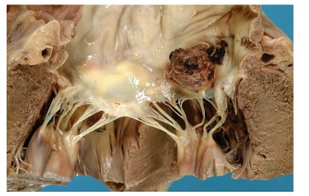
Pathogenesis: summery-1
Endothelial damage
1.High velocity jet
2.Flow from high pressure to low pressure chamber
3.Flow across narrow orifice of high velocity
Platelet-fibrin thrombi (Nonbacterial Thrombotic endocarditis)
Microorganism adherence (BTE)
Local vegetation
EXTENSON , Perivalvular ,Destructive valve, fistula and embolization.

Slide 8
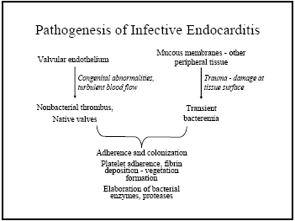
Pathogenesis: summery-2

Slide 9
Structural cardiac conditions that make adults and children at risk
Acquired valvular heart disease with stenosis or regurgitation
Valve replacement
Structural congenital heart disease
Hypertrophic cardio-myopathy
Previous infective endocarditis
Iv drug abuser.
Notes:
NOTES FOR PRESENTERS:
Key points to raise:
This guideline recommends that healthcare professionals should regard people with cardiac conditions listed on this slide as being at risk of developing infective endocarditis.
Structural congenital heart disease includes surgically corrected or palliated structural conditions, but excludes isolated atrial septal defect, fully repaired ventricular septal defect or fully repaired patent ductus arteriosus, and closure devices that are judged to be endothelialised.

Slide 10
Determining Risk
Cardiac conditions
Type of Procedure

Slide 11
Cardiac conditions predispose IE
Based on risk of progression to severe endocarditis with substantial morbidity and mortality Classified into :
HIGH risk - prophylaxis
MODERATE risk - prophylaxis
NEGLIGIBLE risk - no prophylaxis

Slide 12
Cardiac Conditions – High Risk¹
Prosthetic Valves (400x risk²)
Previous endocarditis
Congenital
Complex cyanotic dz (Tetralogy, Transposition, Single Vent)
Patent Ductus Arteriosus
VSD
Coarctation
Valvular:
Aortic Stenosis/ Aortic Regurg
Mitral Regurgitation
Mitral Stenosis with Regurg
Surgically constructed systemic pulmonary shunts or conduits
¹Durack, et al. NEJM 1995
²Steckleberg, et al. Inf Dis Clin N Amer 1993
Mod Risk per 1997 AHA guidelines

Slide 13
Cardiac Conditions - Moderate Risk¹
Valvular
MVP + regurgitation and/or thickened leaflets
pure Mitral Stenosis
TR/TS
Pulmonary Stenosis
Bicuspid AV/ Aortic Sclerosis
degenerative valve disease in Elderly
Asymmetric Septal Hypertrophy/HOCM
Surgically repaired intra-cardiac lesions without hemodynamic abnormality, < 6 months after surgery
1Durack, et al. NEJM 1995

Slide 14
Negligible Risk (no prophylaxis)
MVP no regurgitation
Physiologic/innocent murmur
Pacemaker/ICD
Isolated Secondum ASD
Previous CABG
Surgical repair ASD/VSD/PDA , no residua > 6mos after surgery

Slide 15
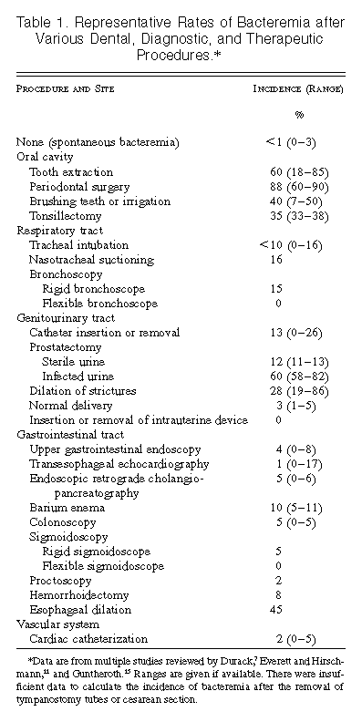
Procedures
Highest risk oral/dental
Int risk GU/Pulm
Low risk GI
¹Durack, et al. NEJM 1995

Slide 16
CLASSIFICATION
Type of lesion Native.
Prosthetic.
Onset & progress Acute.
Sub acute.
Acquire of infection Nosocomial .
Community.

Slide 17
ORIGINAL CLASSIFICATION (Prior to Antibiotic era)

Slide 18
Clinical Features-1
Onset usually within 2 weeks of infection
› Indolent course
-fever
- Malaise
- Fatigue
- Night sweats
- Anorexia
- Weight loss
› Explosive course
- CCF , murmur new onset or changing characters,
with severe systemic sepsis

Slide 19
Other Clinical Features-2
Spleno-megaly ~ 30%
Petechiae 20 - 40%
Conjunctivae
Buccal mucosa
palate
skin in supra-clavicular regions
Osler’s Nodes 10 - 25%
Splinter Haemorrhages 5 - 10%
Roth Spots ~ 5%
Musculoskeletal (arthritis)

Slide 20
Clinical features

Slide 21
Janeway lesions non tender

Slide 22
Splinter hg

Slide 23
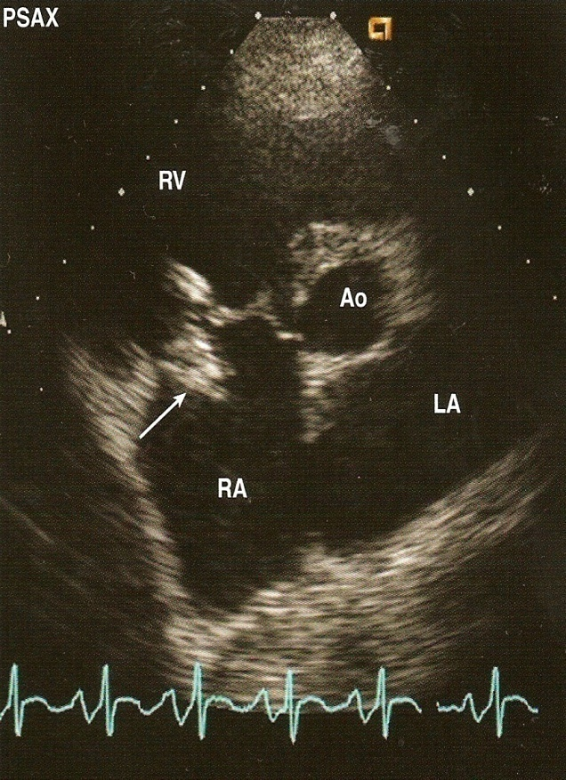
Diagnosis tests
C.B.C
ESR
Blood cultures
RFT
URINE
ECG
CXR
ECHO

Slide 24
TEE

Slide 25
Native Valve Endo-carditis Microbiology
›› Streptococci 50 - 70%
Viridans Streptococci (50% of all Strep)
›› Staphylococci ~ 25%
Mostly Coagulase +ve Staph. Aureus
Staph. Epidermidis
›› Enterococci ~ 10%
HACEK
Haemophilus species,
Actinobacillus
Actinomycetemcomitans,
Cardiobacterium hominis,
Eikenella,
Kingella

Slide 26
IE in IV Drug Abusers
Skin most predominant source of infection
70 - 100% of Rt. sided IE results in pneumonia and septic emboli
Microbiology
Staph aureus ~60%
Streptococci and Enterococci ~20%
Gram -ve bacilli ~10%
Fungi (Candida and Aspergillus ~5%

Slide 27
Prosthetic Valve Endocarditis Classification
Early ( < 60 days )
Reflects perioperative contamination
Incidence around 1%
Microbiology
Staph (45 - 50%)
Staph. Epiderm (~ 30%)
Staph. Aureus (~ 20%)
Gram -ve aerobes (~20%)
Fungi (~ 10%)
Strep and Entero (5-10%)
Late ( > 60 days)
After endothelialization
Incidence 0.2 -0.5 % / pt. year
Transient bacteraemia from dental, GI or GU
Microbiology
resembles native valve endocarditis

Slide 28
Modified Duke Criteria
Major Criteria
1.positive blood cultures
a. Typical organisms for 2 separated blood cultures
b. Persist positive blood cultures
c. Positive blood culture for coxella burniti
2.Evidence of Endocardial involvement
Positive Echocardiogram
Oscillating intra cardiac mass
Abscess
Dehiscence of prosthetic valve
New Valvular regurgitation
clinic inf disease 2000

Slide 29
Diagnostic (Duke) Criteria
Minor criteria
Predisposition (heart condition or IV drug use)
Fever of 100.4⁰F or higher
Vascular( Arterial emboli, septic pulmonary infarcts, intracranial hemorrhage, Osler, Janeway)
Immunologic phenomena( GN, Osler, Roth spots, Rheumatoid Factor)
Microbiologic or echocardiographic evidence not meeting major criteria

Slide 30
Diagnostic (Duke) Criteria
Definitive infective endocarditis
Pathologic criteria
Microorganisms or pathologic lesions: demonstrated by culture or histology in a vegetation, or in a vegetation that has embolized, or in an intracardiac abscess
Clinical criteria (as above)
Two major criteria, or
One major and three minor criteria, or
Five minor criteria

Slide 31
Diagnostic (Duke) Criteria
Possible infective endocarditis
findings consistent of IE that fall short of “definite”, but not “rejected”
Rejected
Firm alternate Dx for manifestation of IE
Resolution of manifestations of IE, with antibiotic therapy for ≤ 4 days
No pathologic evidence of IE at surgery or autopsy, after antibiotic therapy for ≤ 4 days

Slide 32
Treatment
Medical
Surgical

Slide 33
Principles of Medical Management
Sterilization of Vegetations with antibiotics
prolonged , high dose and bactericidal.
Acute onset:
blood culture and start treatment within three hours.
Sub acute onset ;
Blood culture then antibiotic can be started within three days.

Slide 34
Indications for Surgery Left sided native valve endocarditis
Valvular disruption leading to severe insufficiency and CCF
Extra valvar extension
Embolization of vegetations
Failure of medical management
Positive blood culture and systemic signs of infection after “adequate” antibiotic therapy
Resistant organisms
such as MRSA, Fungi , Pseudomonas
Echo detected vegetation > 1 cm ??

Slide 35
Complications-1
Congestive Cardiac Failure (Commonest complication)
Valve Destruction
Myocarditis
Coronary artery embolism and MI
Myocardial Abscesses
Neurological Manifestations (1/3 cases)
Major embolism to MCA territory ~25%
Mycotic Aneurysms 2 - 10%

Slide 37
Complications-2
Metastatic infections
Rt. Sided vegetations
Lung abscesses
Pyothorax / Pyo-pneumothorax
Lt. Sided vegetations
Pyogenic Meningitis
Splenic Abscesses
Pyelonephritis
Osteomyelitis
Renal impairment , Glomerulonephritis

Slide 38
Prevention

Slide 41
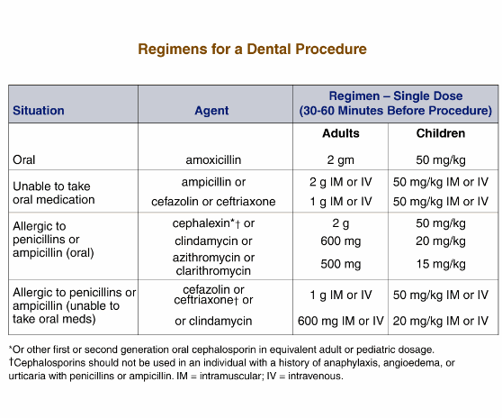

Slide 42
Treatment
Pre-antibiotic era - a death sentence
Antibiotic era
Microbiologic cure in majority of patient
Highly penicillin-susceptible Streptococcus viridans or bovis
Once-daily ceftriaxone for 4 wks
cure rate > 98%
Once-daily ceftriaxone 2 g for 2wks followed by oral amoxicillin qid for 2 wks

