Slide 1
Ali …. 65 years old
C/O exercise intolerance for 2 years

Slide 2
History of occasional wheeze
“slight cough for a while” “5 may be 10 years”
Morning sputum most of the time
Smoked on and off for 40 years / 1.5 packs
No clubbing
Wheeze and hyperinflation

Slide 3
FEV1 / FVC < 70 %
Diffusing capacity (DLco)
Kco reduced

Slide 4
Saleh 55 years
smoked 60 since age 16 Barrel-shaped Liver 6th space Cough, expectoration, SOB 2 years FEV1 44% FEF 19% RV%TLC 200%
FEV1 / FVC 60% Ventolin neb. 5mg----FEV1 INCREASED 140 ml (10%)

Slide 5
KCO 98% Allergic rhinitis and hypret. Turbinates SOB triggered strongly by dust and irritants
A trial of Symbicort for 3 weeks
FEV1 and FEF50 rose to 80%
FEV1 relapsed to 64% but recovered

Slide 6
D.D. with asthma
Age of onset
History of atopy
Eosinophilia and IgE
Bullae
Chronic respiratory failure
Diffusing capacity
Trial of inhaled corticosteroids

Slide 7
GOLD DEFINITION
(2001)
“Is a disease state characterized by airflow limitation
that is not fully reversible. The airflow limitation is
usually both progressive and associated with an
abnormal inflammatory response of the lungs to
noxious particles or gases”.

Slide 8
GOLD Definition (2007)
Incorporates the extrapulmonary manifestations
Muscle wasting
Cachexia
Cardiac deconditioning
Osteoporosis
Depression
Social isolation

Slide 9
DEFINITION OF CHRONIC BRONCHITIS
“Chronic or recurrent expectoration which is present
on most days for a minimum of 3 months a year for
at least 2 successive years”.

Slide 10
DEFINITION OF EMPHYSEMA
“Permanent destructive enlargement of airspaces
distal to the terminal bronchioles without obvious
fibrosis”.
Workshop of NHLBI

Slide 11
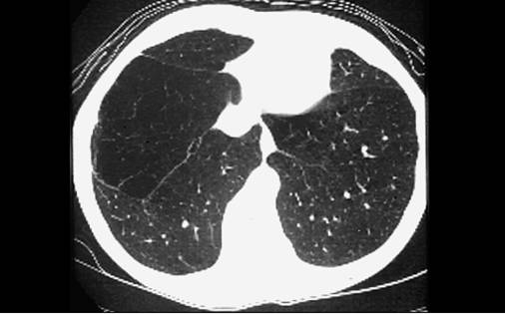

Slide 12
Low PaO2
Normal PaCO2
Low PaO2
High PaCO2
pH acidotic or low normal
HCO 3 raised

Slide 13
COMPLICATIONS
Respiratory failure
Cor pulmonale
Bacterial colonisation
Hemoptysis
Pneumothorax
Extrapulmonary

Slide 14
Summary of management
Bronchodilation ipratropium 40 to 80 µcg q 6 hourly
0r Combivent
Tiotropium 18 µcg q 24 hrs
Salmetrol 50 µcg q 12 hrs
Formoterol 9 µcg q 12 hrs
Influenzae vaccine yearly
Rehabilitation: Grade 3-5 S.O.B.
?? Nebulise higher doses of Salbutamol + Ipratropium
Spacer as effective
Inhaled corticosteroids for “frequent exacerbations”
500 µcg fluticasone HFA (Seretide)
800 µcg busesonide (Symbicort)
Rinse throat
Spacer
Mucolytics every winter
{

Slide 15
LONG –TERM REHABILITATION 1
Benefit independent of age, FEV₁,
exercise capacity, PaO₂
walk test 25-40%
6 minutes walk + 60 metres
Only modest rise VO₂ peak
Well being +

Slide 16
LONG –TERM REHABILITATION 2
2 supervised + 1 unsupervised session
As little as 6 weeks (Max. 12 weeks)
20-30 min
Anaerobic (cycle, brisk walking)
?? Strength exercises
Lower limbs > upper limbs
Respiratory muscles: no effect
60 – 85% peak performance
Benefit maintained 12-18 months without
formal maintenance regimen

Slide 17
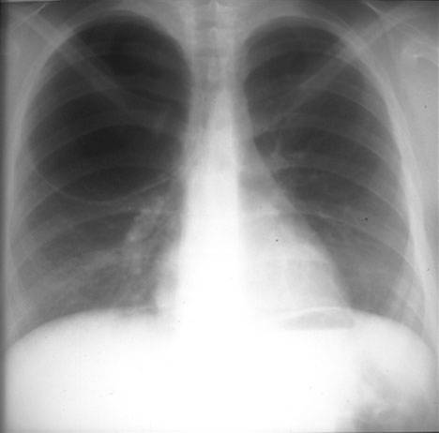

Slide 18
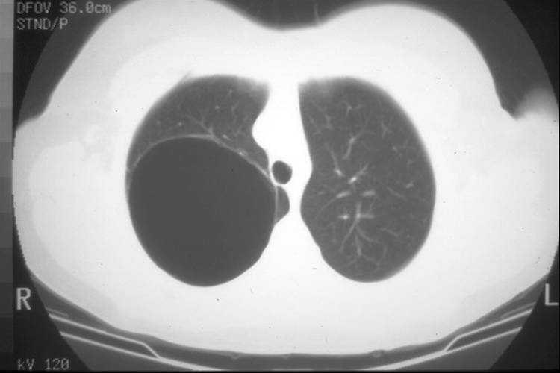

Slide 19
Bullectomy
FEV1 > 40%
PaO2, PaCO2 near normal
Normal V/Q scan in the surrounding lung

Slide 20
Lung volume reduction surgery LVRS
FEV1 and DLCO above 20%
Predominantly upper lobe emphysema

Slide 21
Exacerbations
Viral infection followed by bacterial activity
one third associated with virus
(rhinovirus or influenza)
bacterial colonisation
(20 to 30% during remissions)
(30 to 50% during exacerb.)
Haemophilus influenzae & parainfluenzae
Streptococcus pneumoniae
Branhamella catarrhalis
Bronchospasm
pollution or occupational
MINOR CAUSES
pneumonia
Lt or Rt cardiac failure
pneumothorax

Slide 22
Life-threatening exacerbations
Deterioration of consciousness
Marked distress
Paradoxical thoracoabdominal movement
Worsening ABGs in spite of oxygen and bronchodilators ( 50 – 70 – 7.3 )
Other comorbidities
Social support

Slide 23
MANAGEMENT OF EXACERBATIONS
Nebulize Ipratropium 250 ucg
Salbutamol 5 mg
O2 24% or 2 l / min
Prednisolone 40 mg daily ?
Antibiotics ?
Non-invasive ventilatory support ?

Slide 24
Antibiotics for exacerbations
Worsening of 2 out of 3 of the following :
shortness of breath
amount of sputum
purulency of sputum
Amoxycillin / clavunate
Cephalosporin (eg. Cefuroxime)
Quinolone ---Ciprofloxacin
---Levofloxacin
---Moxifloxacin (Avalox)

Slide 25
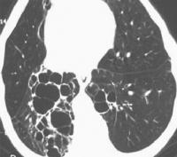

Slide 26
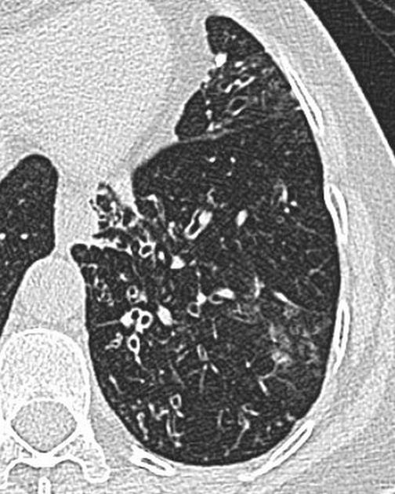

Slide 27
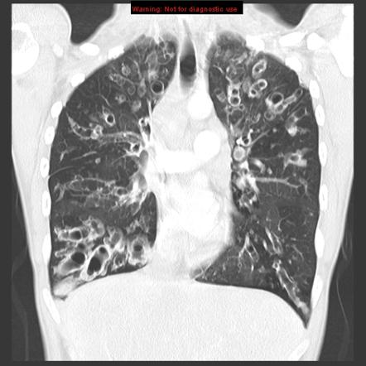

Slide 28
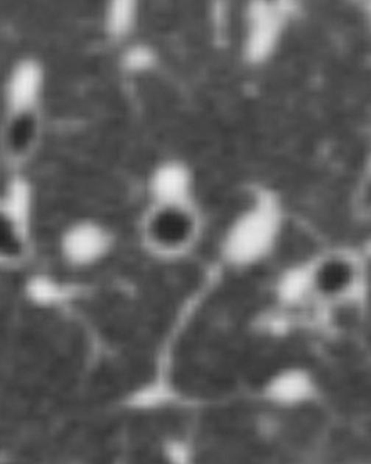

Slide 29
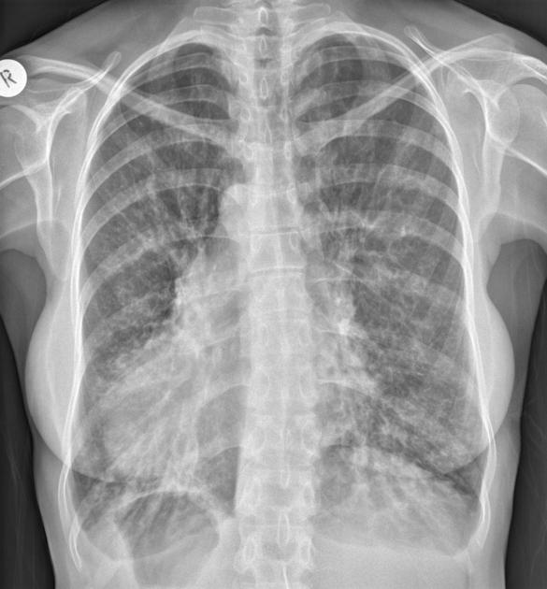

Slide 30
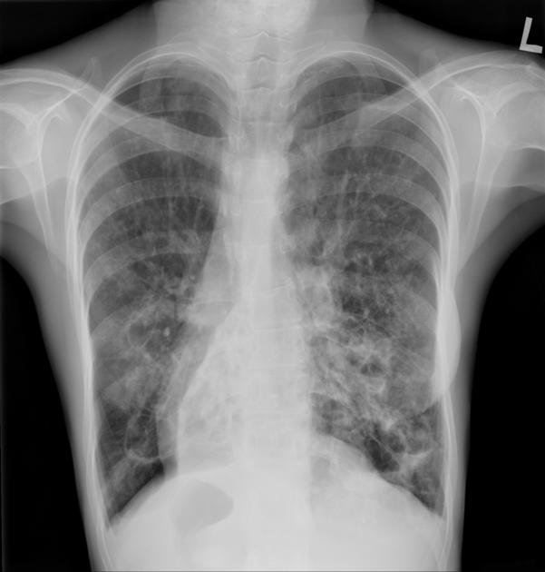

Slide 31
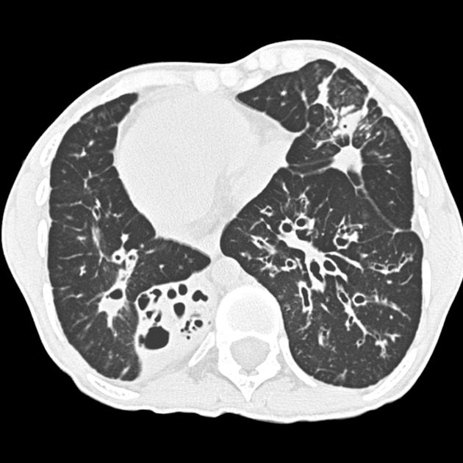

Slide 32
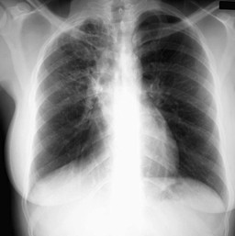

Slide 33
BRONCHIECTASIS
Permanent dilatation of the bronchi
Cough
Usually mucopurulent sputum
Hemoptysis is common
Clubbing uncommon
Wheeze similar to asthma and COPD
Crackles common

Slide 34
FB or adenoma
INFECTION
HYPOGAMMAGLOBULINEMIA
1RY CILIARY DYSKINESIA : sinusitis + male infertility
CYSTIC FIBROSIS

Slide 35
H. Influenzae
K.pneumoniae
S.pneumoniae
P.aeruginosa (associated with rapid decline of FEV1
S.aurius (cystic fibrosis)

Slide 36
Nebulized antibiotic therapy
Gentamycin or tobramycin
Twice daily

