Slide 1
Chronic diarrhea and malabsorption
Dr Khalid Alswat,
Associate Professor of medicine , consultant gastroenterologist

Slide 2
Diarrhea
Diarrhea is a common and usually transient symptom
Chronic diarrhea (liquid stools lasting more than four weeks) may occur in up to 5% of the population in any given year.
(weight of stool and frequency are not reliable)
Diarrhea is a symptom, not a disease and may occur in many different conditions

Slide 3
The gut absorbs most of the fluid that it secretes, and its motility provides a favorable milieu for water, electrolyte, and nutrient absorption
When infectious agents, toxins, or other noxious substances are present within the gut→ fluid secretion and motility are stimulated to expel the unwanted material, thereby producing diarrhea
Normal
Abnormal

Slide 4
This protective response is valuable acutely but, when chronic, is inappropriate and no longer serves an adaptive purpose
Epithelial and motor functions are altered in a coordinated fashion to produce diarrhea

Slide 5
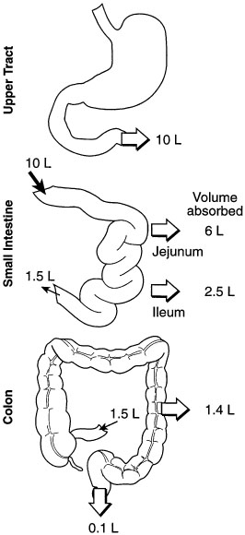
Fluid loads along the gastrointestinal tract

Slide 6
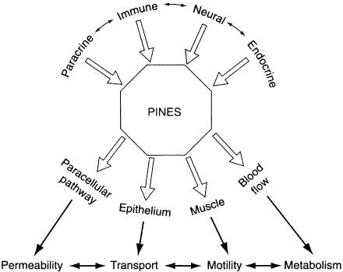
“PINES” regulatory system in the intestine

Slide 7
Classification
By time course (acute vs. chronic)
volume (large vs. small)
Pathophysiology (secretory vs. osmotic)
Stool characteristics (watery vs. fatty vs. inflammatory).
Epidemiology (epidemic vs. travel-related vs. immunosuppression-related)
no single scheme is perfect; the experienced physician uses all of these classifications to expedite patient care

Slide 8
Mechanism | Causes | Examples
Secretory diarrhea | Exogenous secretagogues | Enterotoxins (e.g., cholera)
 | Endogenous secretagogues | Neuroendocrine tumors (e.g., carcinoid syndrome)
 | Absence of ion transporter | Congenital chloridorrhea
 | Loss of surface area | Intestinal resection, diffuse mucosal disease
 | Intestinal ischemia | Chronic mesenteric ischemia
 | Rapid intestinal transit | Intestinal hurry following vagotomy
Osmotic diarrhea | Ingestion of a poorly absorbed agent | Magnesium ingestion
 | Loss of a nutrient transporter | Lactase deficiency

Slide 9
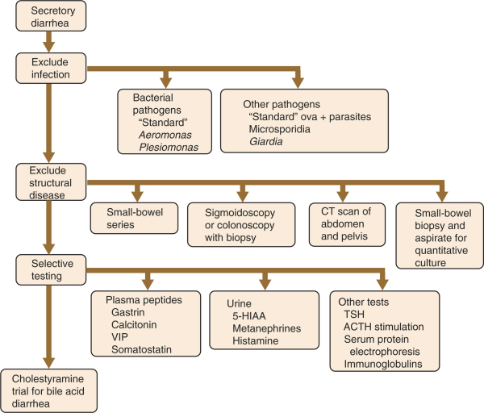
SECRETORY DIARRHEA
Laxative abuse (nonosmotic laxatives)
Post-cholecystectomy (from bile salts)
Congenital syndromes (chloridorrhea)
Bacterial toxins
Ileal bile acid malabsorption
Inflammatory bowel disease Ulcerative colitis Crohn's disease Microscopic (lymphocytic) colitis Collagenous colitis Vasculitis
Drugs and poisons
Disordered motility Postvagotomy diarrhea Postsympathectomy diarrhea Diabetic autonomic neuropathy Hyperthyroidism Irritable bowel syndrome
Neuroendocrine tumors Gastrinoma VIPoma Somatostatinoma Mastocytosis Carcinoid syndrome Medullary carcinoma of thyroid
Neoplasia Colon carcinoma Lymphoma

Slide 10
OSMOTIC DIARRHEA

Slide 11
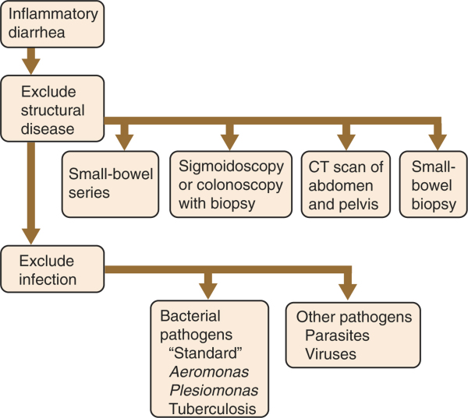
INFLAMMATORY DIARRHEA
Inflammatory bowel disease Ulcerative colitis Crohn's disease
Infectious diseases Pseudomembranous colitis Tuberculosis, yersinosis Amebiasis/other invasive parasites
Ischemic colitis
Radiation colitis
Neoplasia Colon cancer Lymphoma

Slide 12
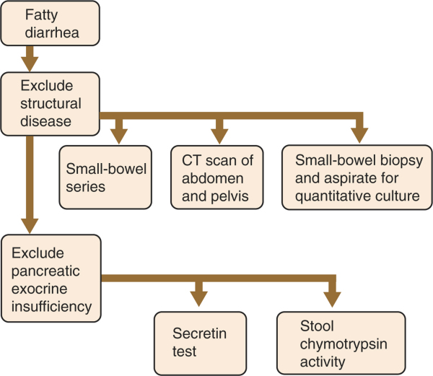
FATTY DIARRHEA
Fatty diarrhea
Malabsorption syndromes Mucosal diseases Short bowel syndrome Postresection diarrhea Small bowel
bacterial overgrowth Mesenteric ischemia
Maldigestion Pancreatic exocrine insufficiency Inadequate luminal bile acid

Slide 13
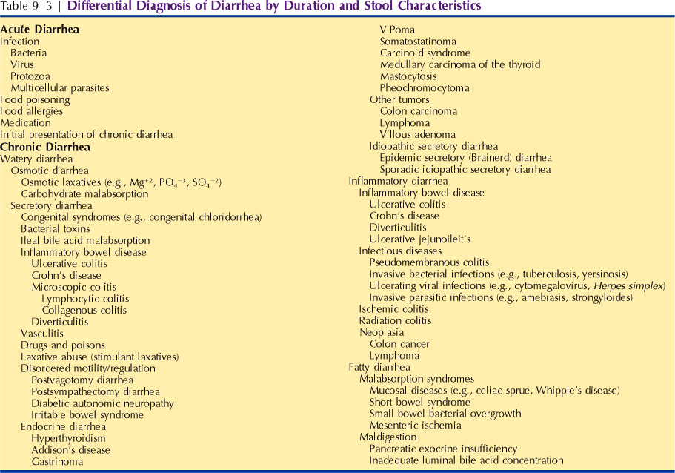

Slide 14
Most of acute diarrhea is due to infectious cause while chronic is due to noninfectious cause

Slide 15
Common causes of diarrhea
Chronic bacterial
Mycobacterial
Parasitic infections
Then
Functional disorders,
Malabsorption
Inflammatory bowel disease
Irritable bowel syndrome (IBS)
Inflammatory bowel disease (IBD)
Malabsorption syndromes (such as lactose intolerance and celiac disease)
Chronic infections (particularly in patients who are immunocompromised)
Developing countries
Developed countries

Slide 16
Approach to patient with diarrhea
History
Physical examination
Laboratory tests
Radiology
Endoscopy

Slide 17
History
What led the patient to complain of diarrhea? (eg, consistency or frequency of stools, the presence of urgency or fecal soiling)
Stool characteristics: (eg, greasy stools that float and are malodorous may suggest fat malabsorption while the presence of visible blood may suggest inflammatory bowel disease)
The volume of the diarrhea: (eg, voluminous watery diarrhea is more likely to be due to a disorder in the small bowel while small-volume frequent diarrhea is more likely to be due to disorders of the colon)
Duration of symptoms, nature of onset (sudden or gradual)
Weight loss, appetite
Occurrence of diarrhea during fasting or at night (suggesting a secretary diarrhea

Slide 18
History…
Systems review:The presence of systemic symptoms:(such as fevers, joint pains, mouth ulcers, eye redness)→ IBD, CTD, thyroid
Association of symptoms with specific food ingestion (such as dairy products or potential food allergens)
A history of recurrent bacterial infections (eg, sinusitis, pneumonia), which may indicate a primary immunoglobulin deficiency.
Epidemiological factors, such as travel before the onset of illness
Family history: IBD
Drug Hx: including over the counter mediation

Slide 19
Likely cause of diarrhea in certain epidemiologic classifications
Travelers: bacterial, protozoal, tropical sprue
Diabetics patients
AIDS patients infections,drugs
Hospitalized patients :drugs, infections, ischemia , C.D toxin

Slide 20
Physical examination
Rarely provides a specific diagnosis.
Findings suggestive of IBD (eg, mouth ulcers, a skin rash, episcleritis, an anal fissure or fistula, the presence of visible or occult blood on digital examination, abdominal masses or abdominal pain)
Evidence of malabsorption (wasting, physical signs of anemia, scars indicating prior abdominal surgery)
Lymphadenopathy (possibly suggesting HIV infection
Palpation of the thyroid and examination for exophthalmos and lid retraction may provide support for a diagnosis of hyperthyroidism

Slide 21
Investigations(essential in all)
CBC
ESR
Electrolytes
Total protein and albumin
TFT
Stool occult blood

Slide 22
Specific investigations
The history and physical examination may point toward a specific diagnosis for which testing may be indicated

Slide 23
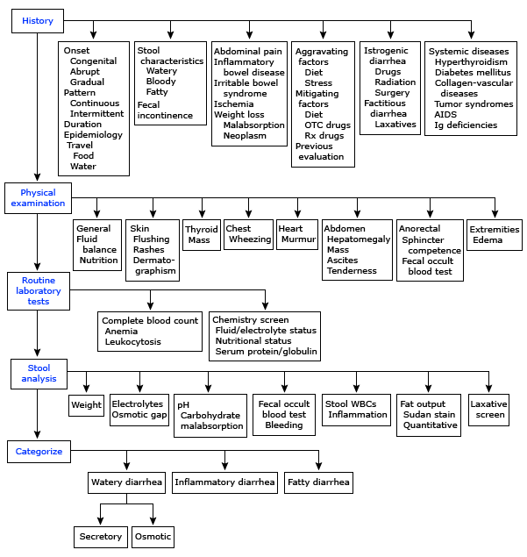

Slide 24
Cases:
Case 1: 30 y man with rt iliac fossa pain, diarrhea/ 5 months, wt loss
Case 2: 26 y female with female with bloody diarrhea/ 8 weeks
Case 3: 22 F with anemia only

Slide 25
Malabsorption

Slide 26
Phases of absorption
Luminal phase: dietary fats, proteins, and carbohydrates are hydrolyzed and solubilized by secreted digestive enzymes and bile.
Mucosal phase: relies on the integrity of the brush-border membrane of intestinal epithelial cells to transport digested products from the lumen into the cells.
Postabsorptive phase: nutrients are transported via lymphatics and portal circulation from epithelial cells to other parts of the body.

Slide 27
Causes of malabsorption
Luminal phase
Impaired nutrient hydrolysis
The most common cause is pancreatic insufficiency due to chronic pancreatitis, pancreatic resection, pancreatic cancer, or cystic fibrosis.
Inactivation of pancreatic enzymes by gastric hypersecretion, as seen in Zollinger-Ellison syndrome . .

Slide 28
Impaired micelle formation
Impaired micelle formation causes lead to fat malabsorption. This impairment is due to different reasons, including
(1) decreased bile salt synthesis from severe parenchymal liver disease (eg, cirrhosis);
(2) impaired bile secretion from biliary obstruction or cholestatic jaundice (eg, primary biliary cirrhosis, primary sclerosing cholangitis);
(3) impaired enterohepatic bile circulation, as seen in small bowel resection or regional enteritis;
(4) bile salt deconjugation due to small bowel bacterial overgrowth.
Luminal availability and processing
Luminal bacterial overgrowth can cause a decrease in the availability of substrates, including carbohydrates, proteins, and vitamins

Slide 29
Mucosal phase
Impaired brush-border hydrolase activity
Disaccharidase deficiency .
Lactase deficiency
Immunoglobulin A (IgA) deficiency

Slide 30
Impaired nutrient absorption
Acquired disorders are far more common and are caused by
(1) decreased absorptive surface area, as seen in intestinal resection
(2) damaged absorbing surface, as seen in celiac sprue, tropical sprue, giardiasis, Crohn disease, AIDS enteropathy, chemotherapy, or radiation therapy;
(3) infiltrating disease of the intestinal wall, such as lymphoma and amyloidosis

Slide 31
Postabsorptive phase:
Obstruction of the lymphatic system, both congenital (eg, intestinal lymphangiectasia)
Acquired (eg, Whipple diseases , lymphoma, tuberculosis),

Slide 32
Clinical presentation
History :
Diarrhea
Wt Loss
Steatorrhea , Flatulence and abdominal distention ,Edema, anemia,
Metabolic defects of bones

Slide 33
Physical
General
Patients may have orthostatic hypotension.
Signs of weight loss, muscle wasting, or both may be present.
Patients may have signs of loss of subcutaneous fat
Cheilosis, glossitis, or aphthous ulcers of the mouth.
Abdominal examination
The abdomen may be distended, and bowel sounds may be hyperactive.
Ascites may be present in severe hypoproteinemia

Slide 34
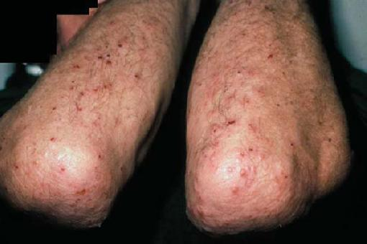
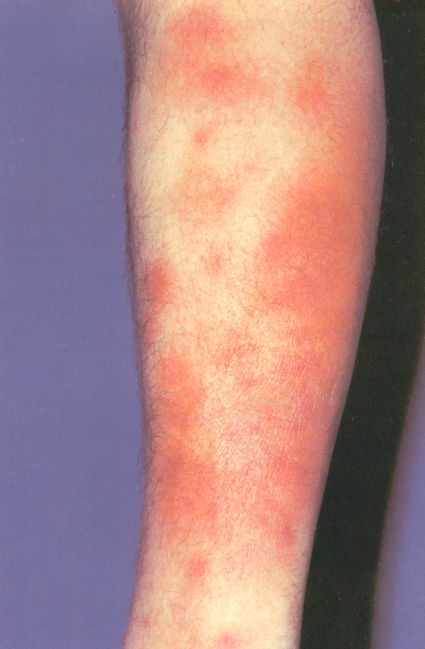
Dermatological manifestations
Pale skin
Neurological examination
Motor weakness, peripheral neuropathy, or ataxia may be present.
The Chvostek sign or the Trousseau sign may be evident due to hypocalcemia .

Slide 35
Lab Studies
Hematological tests
A CBC
Serum iron, vitamin B-12, and folate
Prothrombin time.
Electrolytes and chemistries
hypokalemia, hypocalcemia, hypomagnesemia, and metabolic acidosis.
Protein malabsorption may cause hypoproteinemia and hypoalbuminemia.
Fat malabsorption can lead to low serum levels of triglycerides, cholesterol
ESR which is elevated in Crohn disease and Whipple disease

Slide 36
Stool analysis
Stool pH may be assessed. Values of <5.6 are consistent with carbohydrate malabsorption
Stool C/S
Pus cell in the stool e.g IBD

Slide 37
Tests of fat malabsorption
For a quantitative measurement of fat absorption, a 72-hour fecal fat collection
Qualitative test Sudan III stain of stool,less reliable.

Slide 38
Stool --------- fat --------pancreatic, celiac
inflammatory ------------ IBD ,infection

Slide 40
Schilling test
Malabsorption of vitamin B-12 may occur as a consequence of deficiency of intrinsic factor (eg, pernicious anemia, gastric resection), pancreatic insufficiency, bacterial overgrowth, ileal resection, or disease.

Slide 41
3 STEPS SCHILLING TEST
1. Oral VIT B12
2. VIT B12 orally +intrinsic factor
3. VIT B12 orally +intrinsic factor+ oral antibiotics

Slide 42
Bacterial overgrowth
Bacterial overgrowth cause an early rise in breath hydrogen
JEUJENAL CULTURE
14c D–xylose breath test ,high sensitivity and specificity

Slide 43
Serology
No serologic tests are specific for malabsorption.
Serum Anti-TTG and antiendomysial antibodies can be used to help diagnose celiac sprue.
Serum IgA to rule out IgA deficiency
Determination of fecal elastase and chymotrypsin (2 proteases produced by the pancreas) can be used to try to distinguish between pancreatic causes and intestinal causes of malabsorption.

Slide 44
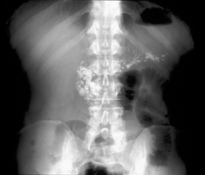
Imaging Studies
Plain abdominal x-ray film: Pancreatic calcifications are indicative of chronic pancreatitis.

Slide 45
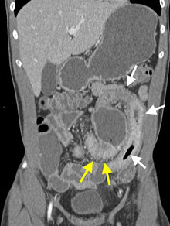
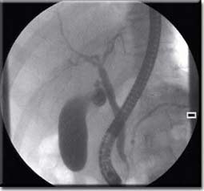
Small bowel barium studies.
CT scan of the abdomen:
(ERCP): pancreatitis

Slide 46
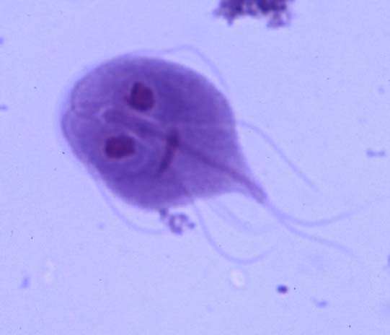
Endoscopy
Upper endoscopy with small bowel mucosal biopsy…. Examples
Celiac sprue,
Giardiasis
Crohn disease,
Whipple disease
Amyloidosis
Lymphoma.

Slide 48
Treatment of causative diseases
A gluten-free diet helps treat celiac disease.
Similarly, a lactose-free diet
Protease and lipase supplements are the therapy for pancreatic insufficiency.
Antibiotics are the therapy for bacterial overgrowth.
Corticosteroids, anti-inflammatory agents, such as mesalamine, and other therapies are used to treat CD

Slide 49
Nutritional support
Supplementing various minerals calcium, magnesium, iron, and vitamins
Caloric and protein replacement also is essential.
Medium-chain triglycerides can be used for lymphatic obstruction .
In severe intestinal disease, such as massive resection and extensive regional enteritis, parenteral nutrition may become necessary

