Slide 1
LYMPHOMA
EYAD ALSAEED , MBBS , FRCPC
CONSULTANT RADIATION ONCOLOGY
DEPARTMENT OF MEDICINE

Slide 2
WHO Classification of Hematological Neoplasms
Myeloid
Lymphoid
Histiocytic
Mast Cell
B cell neoplasms *
T cell neoplasms
Hodgkin’s lymphoma
* Includes plasma cell myeloma

Slide 3
Proposed WHO Classification of. Lymphoid Neoplasms - 1
B-Cell neoplasms
Precursor B-cell neoplasm
Precursor B-lymphoblastic leukemia/Iymphoma (precursor B-cell acute lymphoblastic leukemia)
Mature (peripheral) B-cell neoplasm*
B-cell chronic lymphocytic leukemia/small lymphocytic lymphoma
B-cell prolymphocytic leukemia
Lymphoplasmacytic lymphoma
Splenic marginal zone B-cell lymphoma (+/— villous lymphocytes)
Hairy cell leukemia
Plasma cell myeloma/plasmacytoma
Extranodal marginal zone B-cell lymphama of MALT type
Nodal marginal zone B-cell lymphoma (+1— monocytoid B cells)
Follicular lymphoma
Mantle-cell lymphoma
Diffuse large B-cell lymphama
Mediastinal large B-cell lymphoma
Primary effusion lymphoma
Burkitt’s lymphoma/Burlcitt cell leukemia

Slide 4
Proposed WHO Classification of. Lymphoid Neoplasms (cont’d)
T-cell and NK-cell neoplasms
Precursor T-cell neoplasm
Precursor T-lymnphoblastic lymphoma/leukemia (precursor T-cell acute lymphoblastic leukemia)
Mature (peripheral) T-cell neoplasms
T-cell prolymphocytic leukemia
T-cell granular lymphocytic leukemia
Aggressive NK-cell leukemia
Adult T-cell lymphoma/leukemia (HTLV1 +)
Extranodal NK/T-cell lymphoma, nasal type
Enteropathy-type T-cell lymphoma
Hepotosplenic gamma-delta T-cell lymphoma
Subcutaneous panniculitis-like T-cell lymphoma
Mycosis fungoides/Sezary syndrome
Anaplastic large-cell lymphoma, T/null cell, primary cutaneous type
Peripheral T-cell lymphoma, not otherwise characterized
Angioimmunoblastic T-celllymphoma
Amaplastic large-cell lymphoma, T/null cell, primary systemic type
Hodgkin’s lymphoma (Hodgkin’s disease)
Nodular lymphocyte-predominant Hodgkin’s )ymphoma
Classical Hodgkin’s lymphoma
Nodular sclerosis Hodgkin’s Iymphoma (grades 1 and 2)
Lymphocyte-rich classical Hodgkin’s lymphoma
Mixed cellularity Hodgkin’s lymphoma
Lymphocyte depletion Hodgkin’s lymphoma
NOTE: Only major categories are included. Subtypes and variants will be discussed in the WHO book² and are listed in Tables 7 through 16. Common entities are shown in boldface type.
Abbreviations: HTLV1 +, human T-cell leukemia virus; MALT, mucosa­-associated lymphoid tissue; NK, natural killer.
*B-and T-/NK-cell neoplasms are grouped according to major clinical presentations (predominantly disseminated/leukemic, primary extranodal, predominantly nodal).

Slide 5
Clinical Grouping of Lymphomas
Indolent
Aggressive
Highly aggressive

Slide 6
Clinical Grouping of Lymphomas
Indolent (≡ “low grade”)
Follicular lymphoma Grade 1,2 22%
Marginal zone lymphoma
Nodal 1%
Extranodal (MALT) 5%
Small lymphocytic lymphoma 6%
Lymphoplasmacytic* 1%
Approximate International Incidence
*association with Waldenstrom’s macroglobulinemia

Slide 7
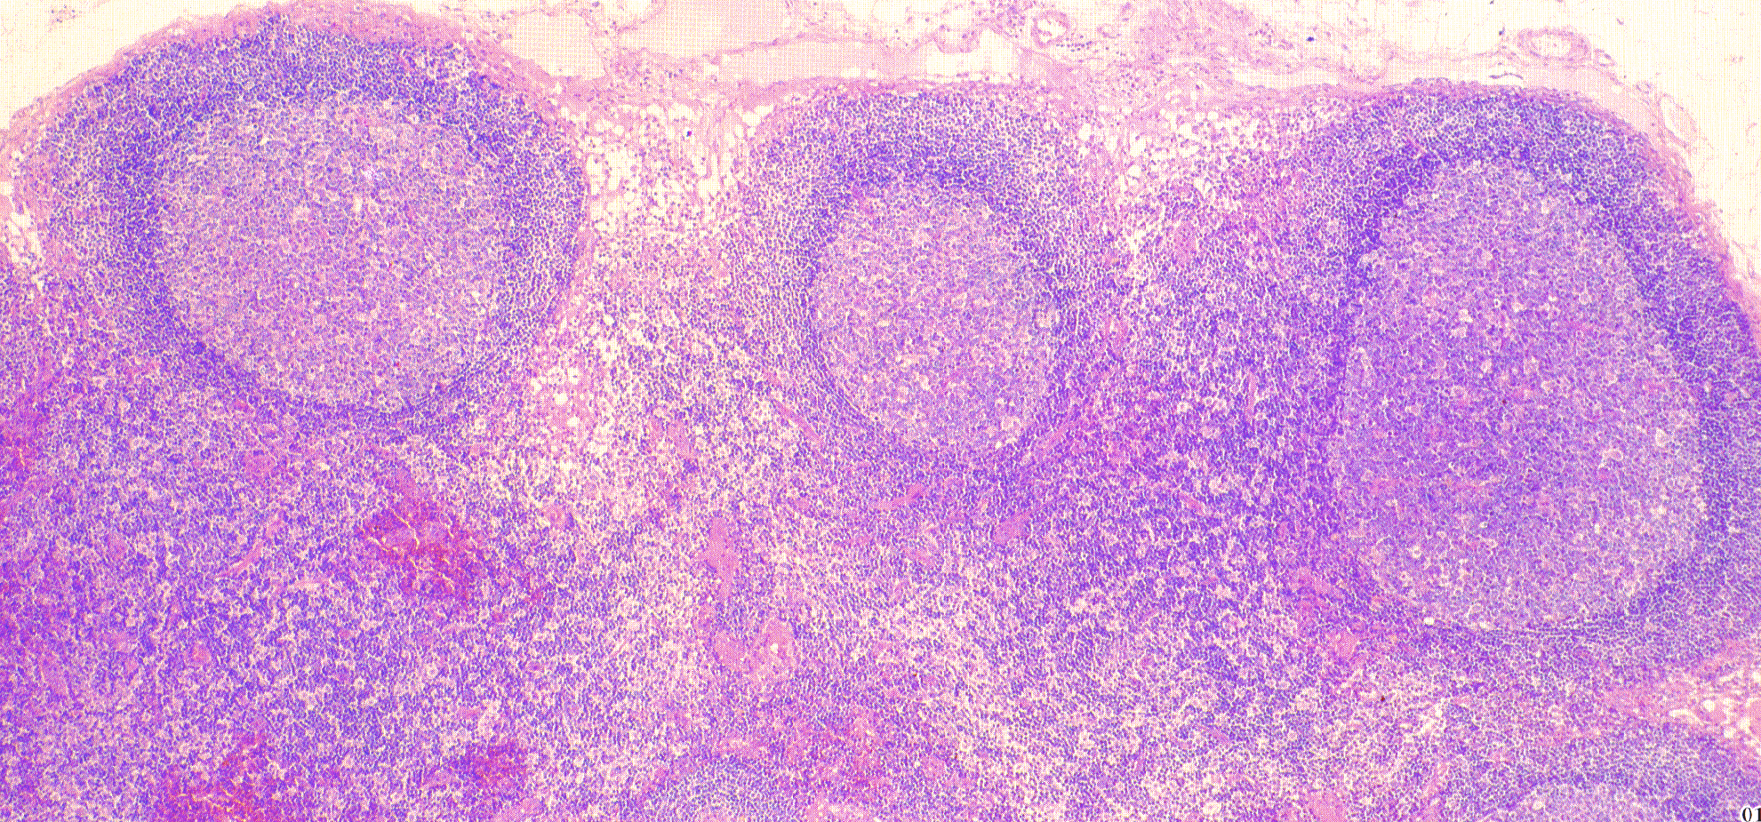
Normal Lymph Node
Notes:
Primary follicles are nodules consissting predominantly of small, mature, recirculating B lymphocytes.
Y. Yawata, Atlas of Blood Diseases, Martin Dunitz Ltd. 1996

Slide 8
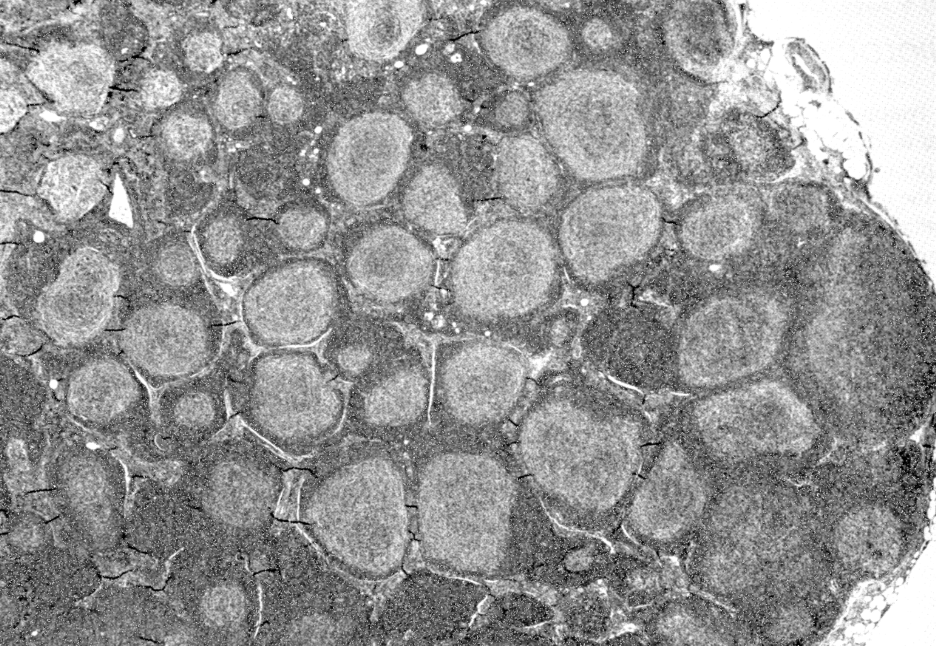
Follicular Lymphoma in a lymph node
Notes:
Follicular lymphoma showing replacement of normal nodal architecture by characteristic pattern of neoplastic lymphoid nodules.
Ioachim, Lymph Node Pathology. J.B. Lippincott 1994. Fig 51-1

Slide 9
Follicular Lymphoma
Grade 1
Grade 2
Grade 3
Number of Large cells
0 – 5 / hpf
6 - 15 / hpf
>15 / hpf
Little clinical difference between Grades 1 and 2
No difference in treatment of Grades 1 and 2

Slide 10
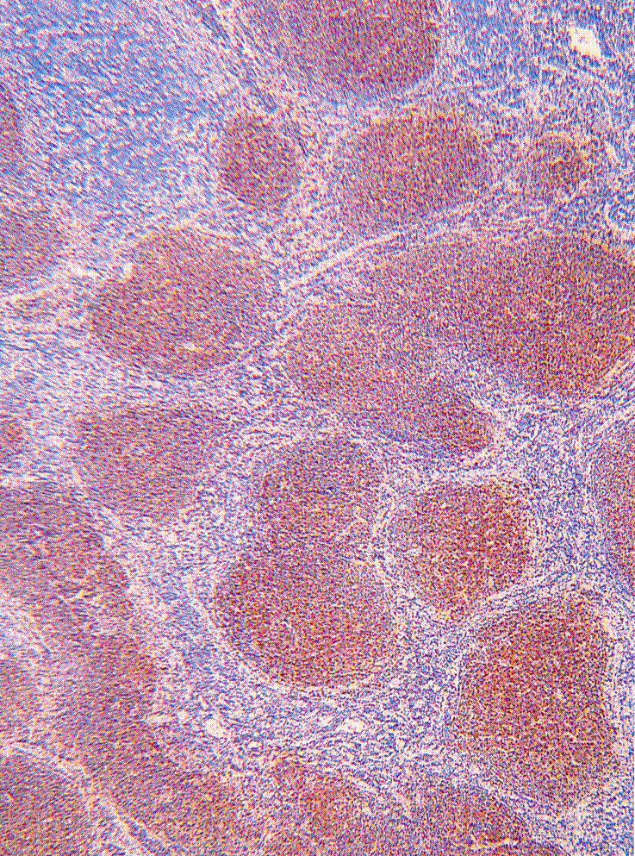
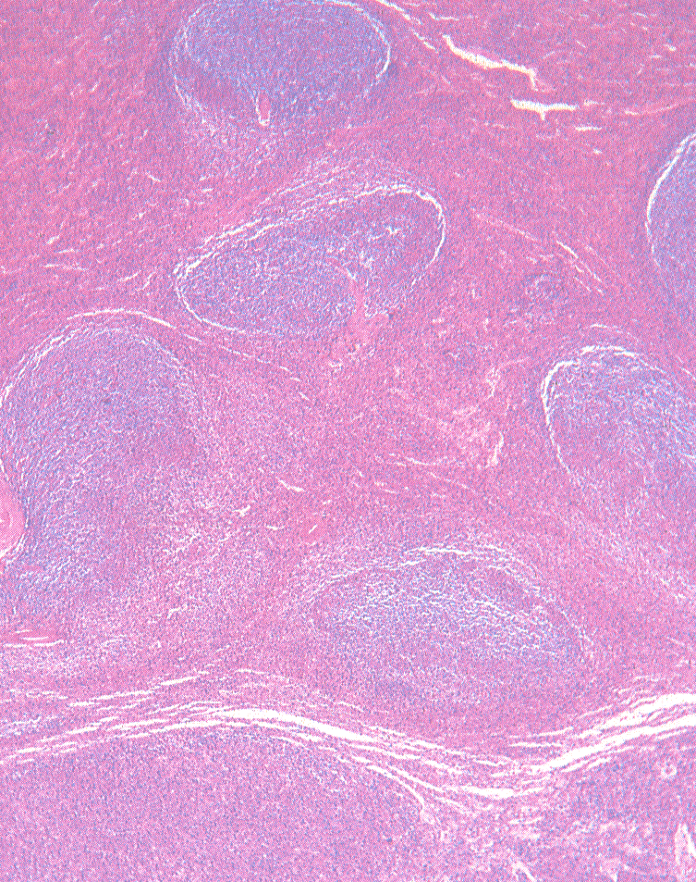
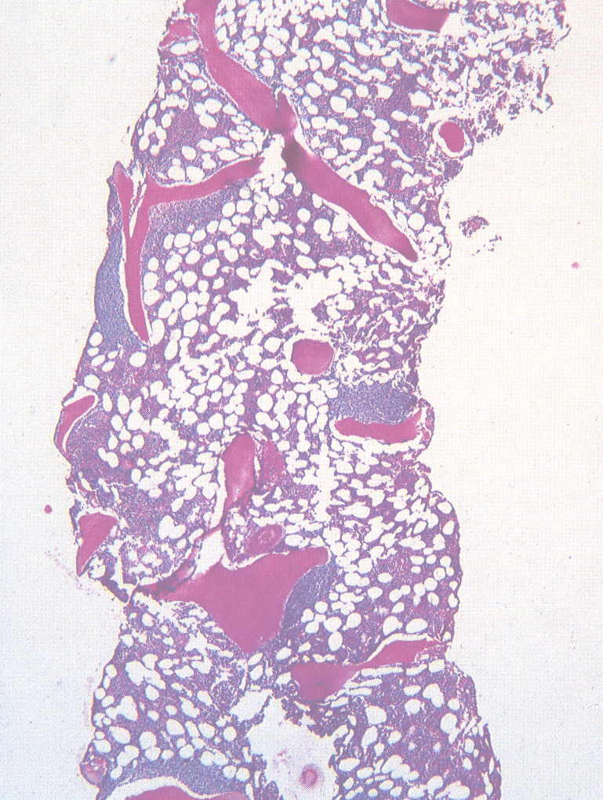
Follicular Lymphoma
Most patients have disseminated disease at diagnosis:
Lymph nodes, spleen, bone marrow
< 20 % Stage I at diagnosis
Lymph node
spleen
Bone marrow

Slide 11
Clinical Grouping of Lymphomas
Aggressive (≡ “intermediate grade”)
Diffuse large B-cell lymphoma 21%
Primary mediastinal large B cell lymphoma 2%
Anaplastic large T / null cell lymphoma 2%
Peripheral T cell lymphoma 6%
Extranodal NK / T cell lymphoma, nasal type
Follicular lymphoma Gd 3
Mantle cell lymphoma 6%
Approximate International Incidence

Slide 12
Clinical Grouping of Lymphomas
Highly Aggressive (≡ ”High grade”)
Lymphoblastic lymphoma 2%
Burkitts lymphoma 1%
Burkitt-like lymphoma 2%
Approximate International Incidence

Slide 13
Lymphoma – Staging System (Cotswold’s Meeting modification of Ann Arbour Classification
I Single lymph node region
(or lymphoid structure) *
II 2 or more lymph node regions
III Lymph node regions on both sides
of diaphragm
IV Extensive extranodal disease
(more extensive then “E”)

Slide 14
Lymphoma – Staging System Subscripts
A Asymptomatic
B Fever > 38º, recurrent
Night sweats drenching, recurrent
Weight loss > 10% body wt in 6 mos
X Bulky disease > 10 cm
or > 1/3 internal transverse diameter @ T5/6 on PA CXR
E Limited extranodal extension from adjacent nodal site

Slide 15
Lymphoma – Essential Staging Investigations
Biopsy – pathology review
History – B symptoms, PS
Physical Exam – nodes, liver, spleen, oropharynx
CBC
creatinine, liver function tests, LDH, calcium
Bone marrow aspiration & biopsy
CT neck, thorax, abdomen, pelvis

Slide 16
Additional Staging Investigations
PET or ⁶⁷Ga scan
CT / MRI of head & neck
Cytology of effusions, ascites
Endoscopy
Endoscopic U/S
MRI - CNS, bone, head & neck presentation
HIV
CSF cytology - testis, paranasal sinus, peri-orbital, paravertebral, CNS, epidural, stage IV with bone marrow involvement
for gastric lymphoma

Slide 17
International Prognostic Index for NHL
Age | > 60
Stage | 3, 4
PS | ECOG > 2
LDH | > normal
Extranodal | > 1 site
 | Number of Risk Factors | 5 yr OS*
Low Risk | 0-1 | 75%
Low-Intermediate | 2 | 51%
High-Intermediate | 3 | 43%
High Risk | 4-5 | 26%
*Diffuse large cell lymphoma

Slide 18
Indolent Lymphoma e.g. Follicular Gd 1/2, small lymphocytic, marginal zone
Limited Disease
( Stage 1A, 2A if 3 or less adjacent node regions)
IFRT* 30-35 Gy
Expect ~ 40% long term FFR
Alternate:
CMT
Observation. Treat when symptomatic.
* Involved Field Radiotherapy. Use 35 Gy for follicular. 30 Gy for SLL, marginal

Slide 19
Indolent Lymphoma e.g. Follicular Gd 1/2, small lymphocytic, marginal zone
Advanced Stage
( some Stage 2, Stage 3, 4 )
Palliative RT* for localized symptomatic disease
Palliative chemotherapy** for disseminated symptomatic disease
Observation only if low bulk, asymptomatic
Treat when symptomatic
* IFRT 15 – 20 Gy / 5
** CVP, chlorambucil

Slide 20
Aggressive Lymphoma (e.g. Diffuse large B cell)
Stage I, some Stage II
CHOP* x 3 + IFRT (35-45 Gy)**
Expect ~ 75% long term FFR
Stage III, IV, B symptoms, or bulky disease
CHOP* x 6-8
IFRT (35-45 Gy) to - sites of initial bulk
- residual disease (i.e. PR)
*or CHOP-R (see next slide)
** higher radiation dose if residual disease

Slide 21
Aggressive Lymphoma (e.g. Diffuse large B cell)
CHOP q 21 days
Cyclophosphamide
doxorubicin (formerly Hydroxydaunorubicin)
vincristine (“Oncovin”)
Prednisone (p.o. x 5 days)
CHOP-R x 8 → ~40 % ↑ 3 yr EFS, OS (vs. CHOP x 8)

Slide 22
Rituximab
Chimeric anti-CD20 mAb
Mouse variable region
Human constant region (I_{g}G₁)
Direct antitumor effects
Complement-mediated cytotoxicity
Antibody dependent cellular cytotoxicity
Synergistic activity with chemotherapy
CD20
B cell

Slide 23
Chemotherapy – Rituximab Combinations
CHOP – R
CHOP + rituximab (on day 1)
GELA study: elderly aggressive NHL . Improved EFS, OS at 3yrs with CHOP-R x 8 vs CHOP x 8.
MInT study: Interim results suggest superiority of CHOP-R over CHOP in younger (<60) patients.
CVP – R
Prolonged TTR in Indolent lymphoma. Probably not covered by most provincial plans

Slide 24
Extranodal Lymphoma
Same treatment as nodal lymphoma
Notable Exceptions:
Gastric MALT
Testis
CNS
Skin

Slide 25
MALT lymphoma
Stomach
Lung
Ocular adnexa
Thyroid
Salivary glands
Most localized ( Stage I, II )
History of chronic antigen stimulation
Autoimmune disease e.g. Sjogren’s, Hashimoto’s
H. pylori infection
Most low grade lymphomas at these sites are MALT type

Slide 26
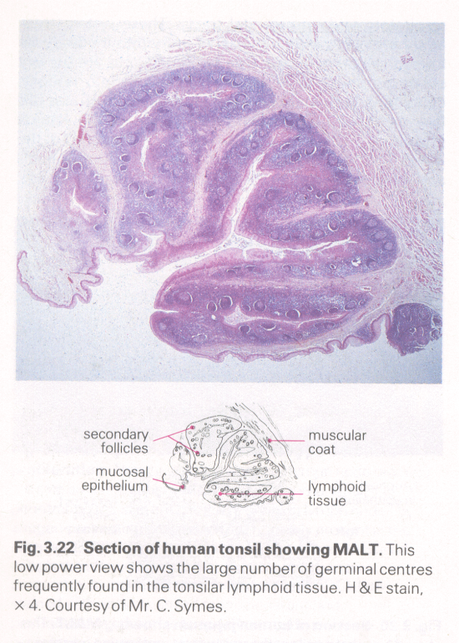
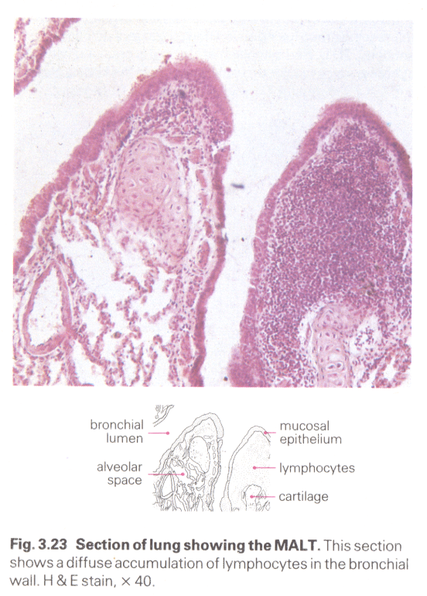
MALT lymphoma Extranodal marginal zone B cell lymphoma of MALT type
Presumed to arise in mucosa associated lymphoid tissue (MALT)
TONSIL
LUNG

Slide 27
Treatment of MALT lymphomas
Local treatment for Localized disease
radiotherapy
local / regional: 30 Gy / 20
surgery
antibiotics for gastric MALT lymphoma
cyclophosphamide / chlorambucil

Slide 28
Treatment of MALT lymphomas - 2
Disseminated disease
~ 30 % of cases
Treatment similar to
Stage III, IV follicular lymphomas

Slide 29
Gastric MALT Lymphoma
~ ½ of gastric lymphomas
association with:
chronic gastritis
helicobacter pylori infection
H. Pylori infection
Accumulation of MALT
Lymphoma arises in acquired MALT

Slide 30
Testis Lymphoma
usually aggressive histology
elderly patients, less tolerant of chemo
high risk relapse ∴ need aggressive Tx
High risk of:
extranodal relapse
contralateral testis relapse > 40% by 15yrs
CNS relapse > 30% 10yr actuarial risk

Slide 31
Testis Lymphoma - Treatment
All pts
Stage 2
3,4
Orchidectomy (diagnostic & therapeutic)
CHOP-R x 6
Scrotal radiation 30 Gy / 15
reduces risk testis recurrence to < 10%
involved field nodal RT
CNS chemoprophylaxis
intrathecal MTX

Slide 32
Lymphoma Follow-up
Hx, Px q3mo for 2 yrs, then q6mo to 5 yrs and then annually.
CBC, LDH
CT chest, abdo, pelvis q6mo to 5 yrs
TSH at least annually after neck irradiation
Breast cancer screening for women treated with chest radiation 10 yrs post RT

Slide 33
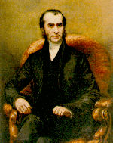
Hodgkin Lymphoma

Slide 34
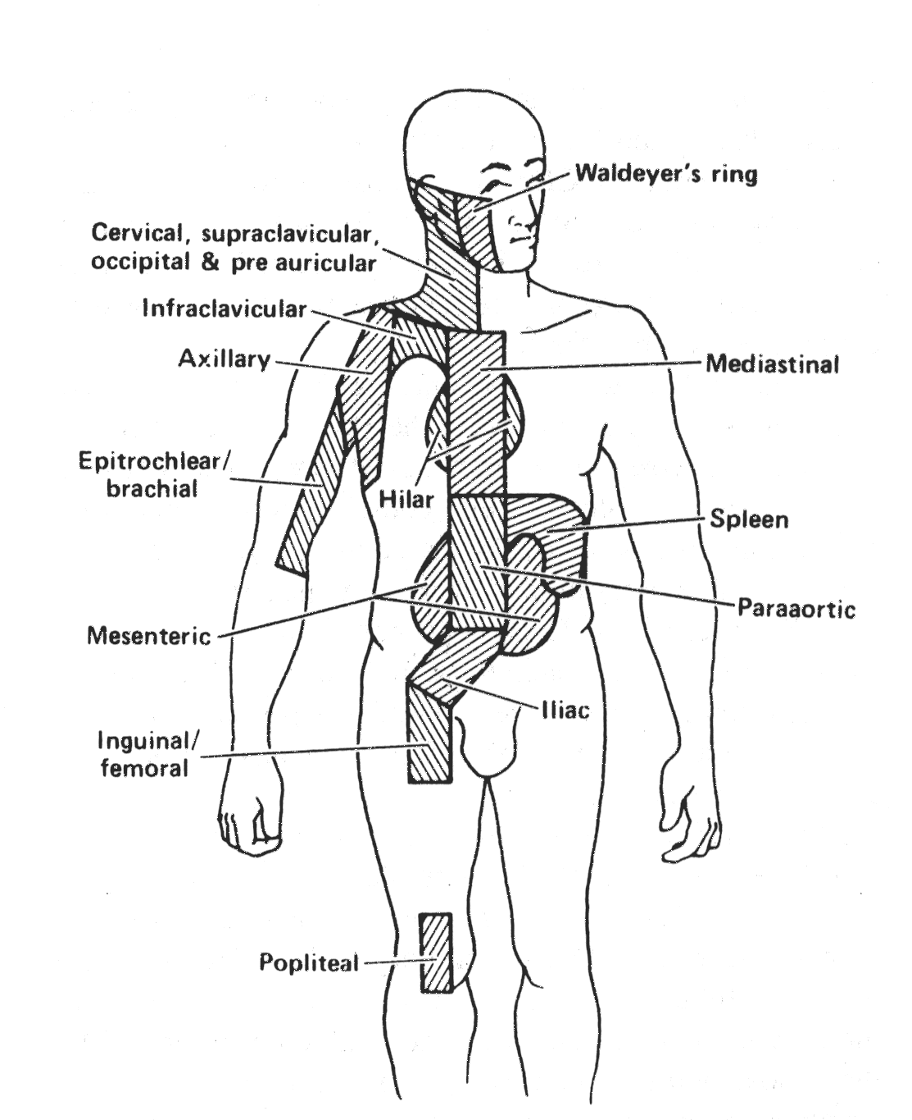

Slide 35
WHO Classification of Lymphoid Neoplasms
Hodgkin’s Lymphoma (≡ Hodgkin’s disease)
Nodular lymphocyte-predominant HL*
Classical HL
Nodular sclerosis HL
Lymphocyte-rich classical HL*
Mixed cellularity HL
Lymphocyte depletion HL
* formerly, both of these were classified as lymphocyte predominance Hodgkin’s Disease

Slide 36
Hodgkin’s Disease - Staging Investigations
Biopsy – pathology review
History – B symptoms, pruritis, alcohol pain, PS
Physical Exam – nodes, liver, spleen, oropharynx
CBC, ESR
creatinine, liver function tests, LDH, calcium, albumin
Bone marrow aspiration & biopsy
if abnormal CBC, Stage 2B or higher
CT thorax, abdomen, pelvis

Slide 37
Hodgkin’s Disease - Other Investigations
PET scan
⁶⁷Ga scan
Lymphangiogram – if expertise available, no PET
Pregnancy test
oophoropexy / semen cryopreservation
if chemotherapy or pelvic RT
Dental assessment – if oropharyngeal RT

Slide 38
Hodgkin’s Lymphoma
Early Stage
1A, 2A
Advanced
III, IV
Bulky Disease
B Symptoms

Slide 39
Hodgkin’s Lymphoma
Early Stage
1A, 2A
Advanced
III, IV
Bulky Disease
B Symptoms
FAVOURABLE*
1-3 sites
Age ≤ 40
ESR ≤ 50
NS, LRCHL
UNFAVOURABLE*
> 3 sites
Age > 40
ESR > 50
Mixed cellularity
*NCIC HD6 Study Criteria reflecting prognosis when treated with radiation only

Slide 40
Early Stage Hodgkin’s Lymphoma Favourable Prognosis
ABVD X 3 - 4
IFRT 30 Gy / 20
Fewer cycles ABVD may be adequate. GHSG HD10 study, in progress, compares ABVD x 2 vs. ABVD x 4
Lower radiation dose may be adequate. GHSG HD10 study and EORTC H9 study, in progress, compare IFRT 20 Gy with 30 Gy (HD10) and 36 Gy (H9)
Caution: late toxicity data awaited

Slide 41
Favourable Prognosis – Early Stage Hodgkin’s Lymphoma Some Other Treatment Options
STNI
ABVD x 2 + IFRT
ABVD x 6
historical gold standard
survival ≡ CMT
use if CTx containdicated
but: high risk late toxicity
as per BCCA guidelines
awaiting clinical trial results (GHSG HD10)
awaiting NCIC HD.6 results
Mantle + Para-aortic nodes,spleen 35 Gy/20

Slide 42
Early Stage Hodgkin’s Lymphoma Unfavourable Prognosis
ABVD X 4 - 6
IFRT 30 Gy / 20
NB: Overlap with favourable prognosis ESHL

Slide 43
Advanced Stage Hodgkin’s Lymphoma Stage 3, 4, B symptoms, bulky disease
ABVD X 6 – 8*
IFRT
sites of bulky disease
sites of residual disease (35 Gy / 20)
* ABVD until 2 cycles past maximum response

Slide 44
ABVD
doxorubicin (Adriamycin)
Bleomycin
Vinblastine
Dacarbazine
IV Days 1, 15

Slide 45
Very Favourable Prognosis Hodgkin’s Lymphoma
Stage 1A NLPHL*
Stage 1A high neck NS, LRCHL
→ IFRT 35 Gy / 20
*Nodular Lymphocyte Predominant HL
usually localized, peripheral nodal sites
good prognosis, but some late relapses (>10yr)

Slide 46
Hodgkin’s Lymphoma Rough Approximation of Prognosis
 | FFS | OS
Early | 80 – 90% | 85 – 95%
Advanced | 40 – 80%*
If RT only (STNI): Deaths from 2nd malignancy > deaths from Hodgkin’s disease by 15 – 20 yrs
* Depending on Hasenclever Prognostic Index: based on Age>45, male, Stage 4, albumin < 4, Hb < 10.5, WBC<600 or >15000

