Slide 1
Dyslipidemia
(Med-341)
Dr Anwar A Jammah, MD, FRCPC, FACP, CCD, ECNU.
Asst. Professor and Consultant
Medicine, Endocrinology
Department of Medicine, King Saud University

Slide 2
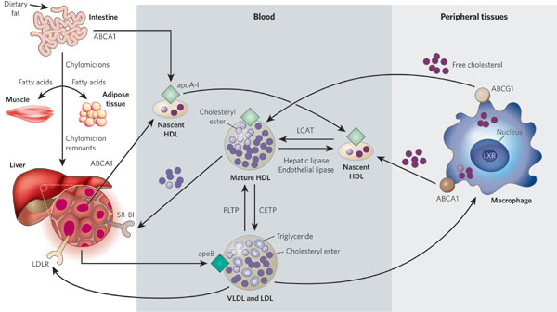
Lipid Transport
LPL/Apo C2
Rader DJ, Daugherty, A Nature 2008; 451:904-913
Notes:
Lipoprotein metabolism has a key role in atherogenesis. It involves the transport of lipids, particularly cholesterol and triglycerides, in the blood. The intestine absorbs dietary fat and packages it into chylomicrons (large triglyceride-rich lipoproteins), which are transported to peripheral tissues through the blood. In muscle and adipose tissues, the enzyme lipoprotein lipase breaks down chylomicrons, and fatty acids enter these tissues. The chylomicron remnants are subsequently taken up by the liver. The liver loads lipids onto apoB and secretes very-low-density lipoproteins (VLDLs), which undergo lipolysis by lipoprotein lipase to form low-density lipoproteins (LDLs). LDLs are then taken up by the liver through binding to the LDL receptor (LDLR), as well as through other pathways. By contrast, high-density lipoproteins (HDLs) are generated by the intestine and the liver through the secretion of lipid-free apoA-I. ApoA-I then recruits cholesterol from these organs through the actions of the transporter ABCA1, forming nascent HDLs, and this protects apoA-I from being rapidly degraded in the kidneys. In the peripheral tissues, nascent HDLs promote the efflux of cholesterol from tissues, including from macrophages, through the actions of ABCA1. Mature HDLs also promote this efflux but through the actions of ABCG1. (In macrophages, the nuclear receptor LXR upregulates the production of both ABCA1 and ABCG1.) The free (unesterified) cholesterol in nascent HDLs is esterified to cholesteryl ester by the enzyme lecithin cholesterol acyltransferase (LCAT), creating mature HDLs. The cholesterol in HDLs is returned to the liver both directly, through uptake by the receptor SR-BI, and indirectly, by transfer to LDLs and VLDLs through the cholesteryl ester transfer protein (CETP). The lipid content of HDLs is altered by the enzymes hepatic lipase and endothelial lipase and by the transfer proteins CETP and phospholipid transfer protein (PLTP), affecting HDL catabolism.

Slide 3
The story of lipids
Chylomicrons transport fats from the intestinal mucosa to the liver
In the liver, the chylomicrons release triglycerides and some cholesterol and become low-density lipoproteins (LDL).
LDL then carries fat and cholesterol to the body’s cells.
High-density lipoproteins (HDL) carry fat and cholesterol back to the liver for excretion.

Slide 4
The story of lipids (cont.)
When oxidized LDL cholesterol gets high, atheroma formation in the walls of arteries occurs, which causes atherosclerosis.
HDL cholesterol is able to go and remove cholesterol from the atheroma.
Atherogenic cholesterol → LDL, VLDL, IDL

Slide 5
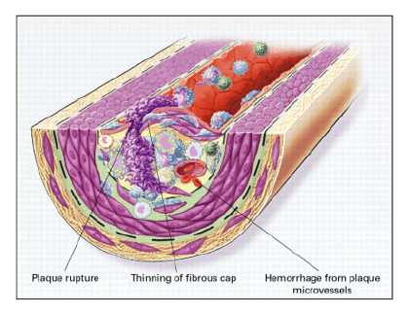
Atherosclerosis

Slide 6
Lipid Transport
LPL/Apo C2
Rader DJ, Daugherty, A Nature 2008; 451:904-913
Notes:
Lipoprotein metabolism has a key role in atherogenesis. It involves the transport of lipids, particularly cholesterol and triglycerides, in the blood. The intestine absorbs dietary fat and packages it into chylomicrons (large triglyceride-rich lipoproteins), which are transported to peripheral tissues through the blood. In muscle and adipose tissues, the enzyme lipoprotein lipase breaks down chylomicrons, and fatty acids enter these tissues. The chylomicron remnants are subsequently taken up by the liver. The liver loads lipids onto apoB and secretes very-low-density lipoproteins (VLDLs), which undergo lipolysis by lipoprotein lipase to form low-density lipoproteins (LDLs). LDLs are then taken up by the liver through binding to the LDL receptor (LDLR), as well as through other pathways. By contrast, high-density lipoproteins (HDLs) are generated by the intestine and the liver through the secretion of lipid-free apoA-I. ApoA-I then recruits cholesterol from these organs through the actions of the transporter ABCA1, forming nascent HDLs, and this protects apoA-I from being rapidly degraded in the kidneys. In the peripheral tissues, nascent HDLs promote the efflux of cholesterol from tissues, including from macrophages, through the actions of ABCA1. Mature HDLs also promote this efflux but through the actions of ABCG1. (In macrophages, the nuclear receptor LXR upregulates the production of both ABCA1 and ABCG1.) The free (unesterified) cholesterol in nascent HDLs is esterified to cholesteryl ester by the enzyme lecithin cholesterol acyltransferase (LCAT), creating mature HDLs. The cholesterol in HDLs is returned to the liver both directly, through uptake by the receptor SR-BI, and indirectly, by transfer to LDLs and VLDLs through the cholesteryl ester transfer protein (CETP). The lipid content of HDLs is altered by the enzymes hepatic lipase and endothelial lipase and by the transfer proteins CETP and phospholipid transfer protein (PLTP), affecting HDL catabolism.

Slide 7
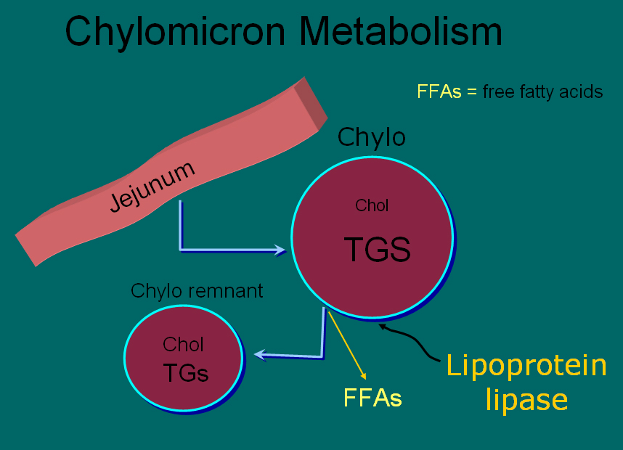
[ CLOSE WINDOW ]

Slide 8
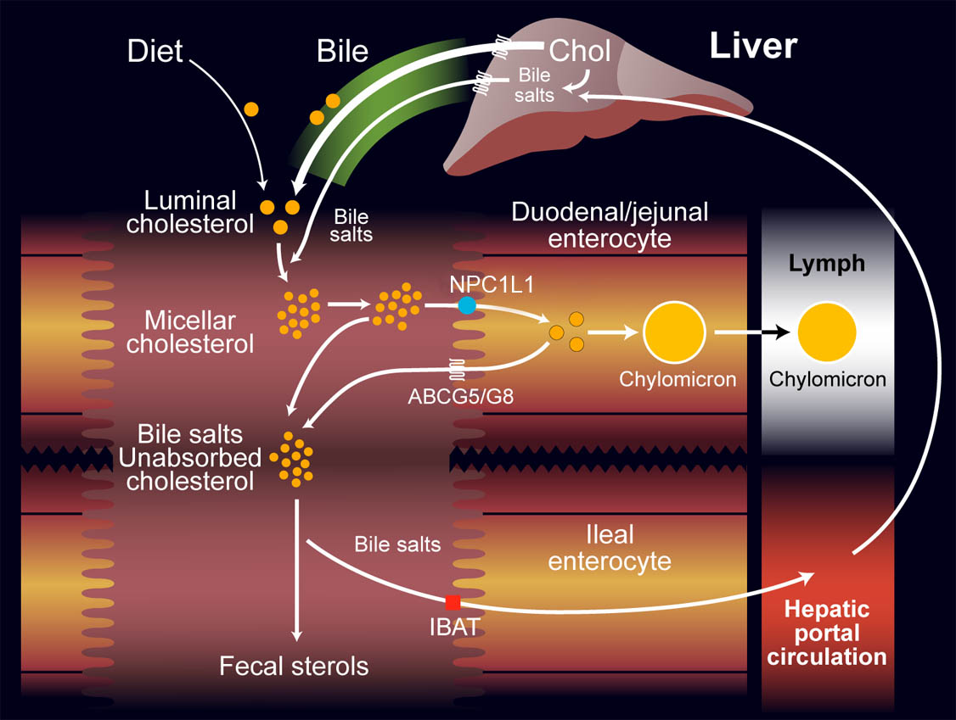
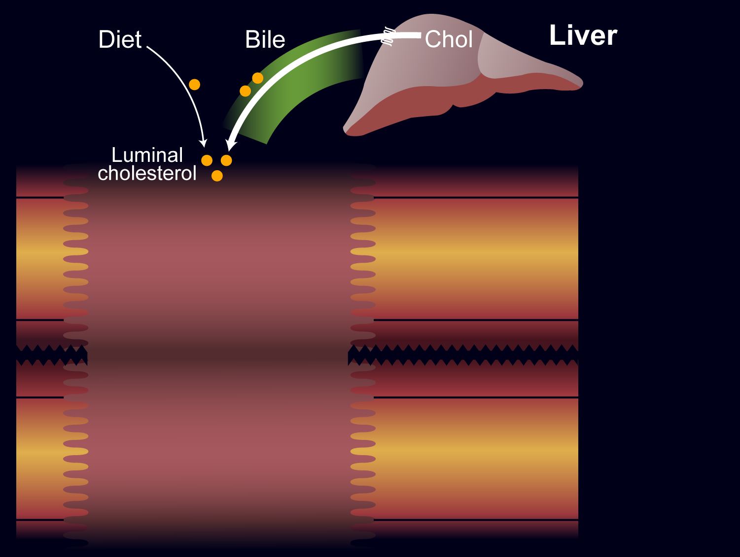
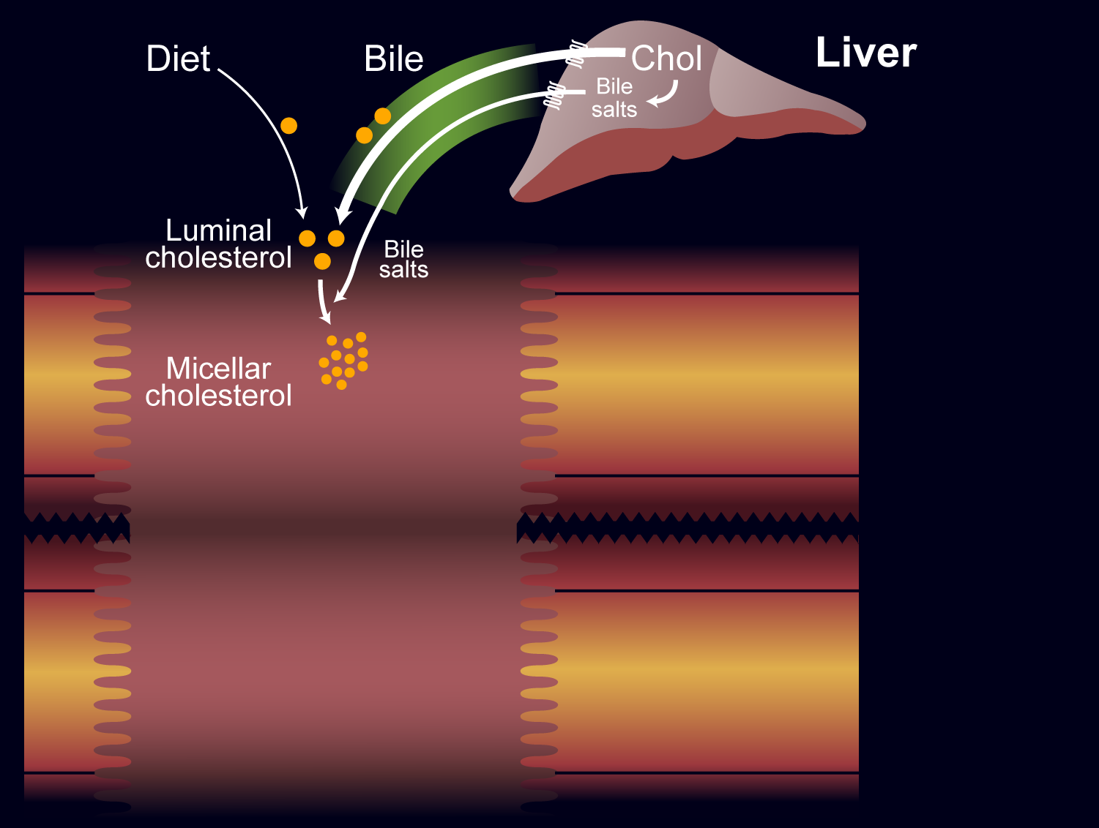
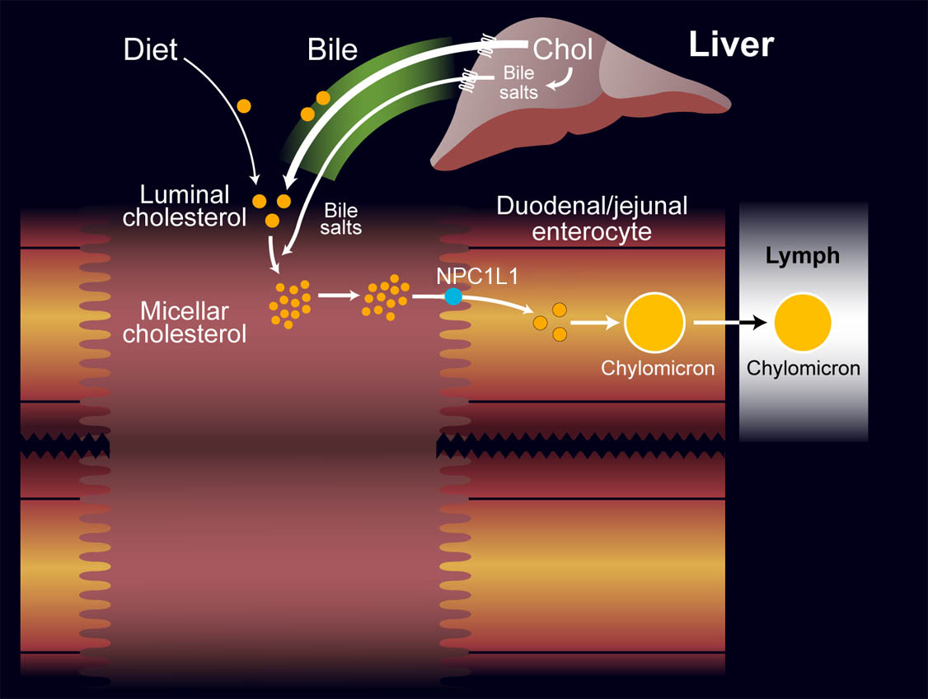
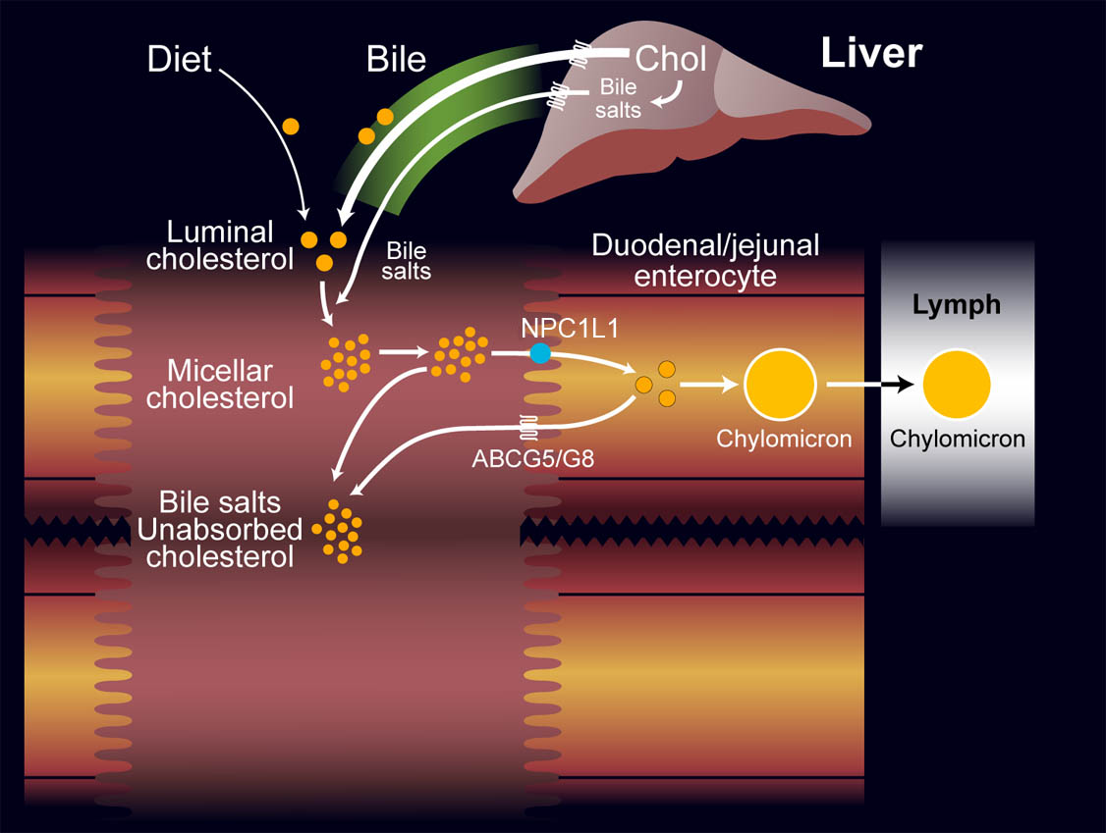
Notes:
Key Point:
Plasma cholesterol levels depend on the balance of cholesterol production and intestinal absorption.¹
Additional Background Information:
Cholesterol production: Approximately 10% of cholesterol is synthesized by the liver, which plays a role in regulating cholesterol balance. The other 90% is synthesized by other cells in the body.²
Intestinal cholesterol sources: Intestinal cholesterol is derived from bile (∼75%) and diet (∼25%).³
Absorption of intestinal cholesterol: On average, 50% of intestinal cholesterol is absorbed into the plasma.^{2,4}
After absorption from the intestine: Cholesterol is esterified and packaged into chylomicrons that circulate in the blood, ultimately reaching the liver.¹
Changes in intestinal cholesterol absorption affect blood cholesterol levels. Decreasing cholesterol absorption provides a key target for lipid-lowering therapy, especially when combined with statin therapy, which decreases hepatic cholesterol synthesis.³
References:
1. Shepherd J. The role of the exogenous pathway in hypercholesterolemia. Eur Heart J Suppl.
2001;3 (suppl E):E2–E5.
2. Dietschy JM. Theoretical considerations of what regulates low-density-lipoprotein and high-
density-lipoprotein cholesterol. Am J Clin Nutr. 1997;65(suppl):1581S–1589S.
3. Turley SD, Dietschy JM.The intestinal absorption of biliary and dietary cholesterol as a
drug target for lowering the plasma cholesterol level. Prev Cardiol. 2003;6:29–33,64.
4. Homan R, Krause BR. Established and emerging strategies for inhibition of cholesterol
absorption. Curr Pharm Design. 1997;3:29–44.

Slide 9
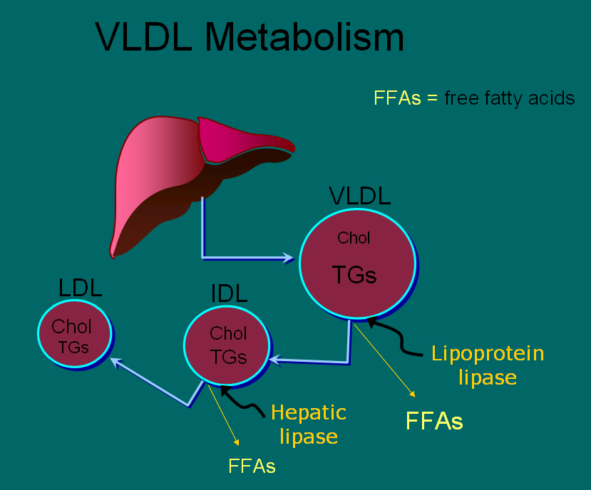
[ CLOSE WINDOW ]

Slide 10
Atherogenic Particles
MEASUREMENTS:
VLDL
VLDL_{R}
IDL
LDL
Small,
dense
LDL
TG-rich lipoproteins
Notes:
Atherogenic particles
Not only is LDL-C a risk factor for cardiovascular disease, but triglyceride-rich lipoproteins—very low density lipoprotein (VLDL), VLDL remnants, and intermediate-density lipoprotein (IDL)—may also increase the risk of heart disease. The NCEP ATP III uses non-HDL-C principally as a surrogate for these atherogenic particles.

Slide 11
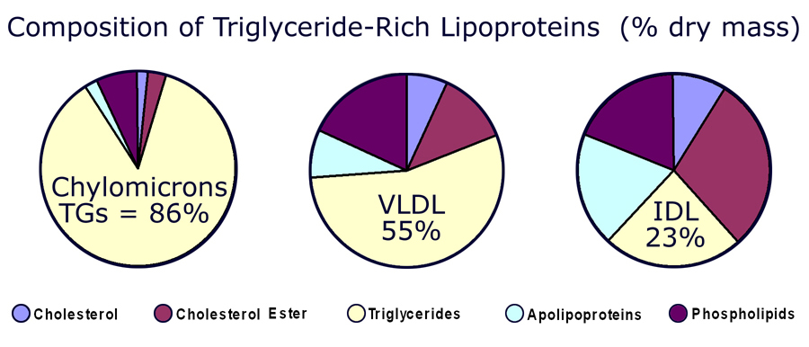
[ CLOSE WINDOW ]

Slide 12
HDL and Reverse Cholesterol Transport
Bile
A-I
A-I
FC
CE
LCAT
CE
FC
FC
CE
FC
SR-BI
Nascent
HDL
ABCA1
Liver
Macrophage
Mature
HDL
Notes:
HDL and reverse cholesterol transport
HDL is believed to protect against atherosclerosis at least in part through the process of reverse cholesterol transport, whereby excess free cholesterol (FC) is removed from cells in peripheral tissues, such as macrophages within the arterial wall, and returned to the liver for excretion in the bile. FC is generated in part by the hydrolysis of intracellular cholesteryl ester (CE) stores. Several key molecules play a role in reverse cholesterol transport, including ATP-binding cassette protein A1 (ABCA1), lecithin:cholesterol acyltransferase (LCAT), and scavenger receptor class-B, type I (SR-BI). Promotion of this pathway could in theory help reduce atherosclerosis.

Slide 13
Plasma lipoproteins
Type | Source | Major lipid | Apoproteins | ELFO | Athero-genicity
Chylomicrons | Gut | Dietary TGs | A-I, B-48, C-I, C-III, E | no mobility | – (pancreatitis)
VLDL | Liver | Endogenous TGs | B-100, E, C-II, C-III, | Pre-β | +
IDL | VLDL remnant | Ch esters, TGs | B-100, C-III, E | Slow pre- β | +
LDL | VLDL, IDL | Ch esters | B-100 | β | +++
HDL | Gut, liver | Ch esters, PLs | A-I, A-II, C-II, C-III, D, E | α | anti- atherogenic
Notes:
Fredrickson Classification of the Hyperlipidemias
Fredrickson phenotypes may be used to classify dyslipidemias on the basis of which lipoproteins are elevated. The Fredrickson classification system is not etiologic, does not distinguish between primary and secondary hyperlipidemias, and does not include HDL.
Reference:
Fredrickson DS, Lees RS. A system for phenotyping hyperlipoproteinemia. Circulation 1965;31:321-327.

Slide 14
Hereditary Causes of Hyperlipidemia
Familial Hypercholesterolemia
    Codominant genetic disorder, coccurs in heterozygous form
    Occurs in 1 in 500 individuals
    Mutation in LDL receptor, resulting in elevated levels of LDL at birth and throughout life
    High risk for atherosclerosis, tendon xanthomas (75% of patients), tuberous xanthomas and xanthelasmas of eyes.
Familial Combined Hyperlipidemia
    Autosomal dominant
    Increased secretions of VLDLs
Dysbetalipoproteinemia
    Affects 1 in 10,000
    Results in apo E2, a binding-defective form of apoE (which usually plays important role in catabolism of chylomicron and VLDL)
    Increased risk for atherosclerosis, peripheral vascular disease
    Tuberous xanthomas, striae palmaris

Slide 15
Fredrickson classification of hyperlipidemias
Phenotype | Lipoprotein(s) elevated | Plasma cholesterol | Plasma TGs | Athero-genicity | Rel. freq. | Treatment
I | Chylomicrons | Norm. to ↑ | ↑↑↑↑ | – pancreatitis | <1% | Diet control
IIa | LDL | ↑↑ | Norm. | +++ | 10% | Bile acid sequestrants, statins, niacin
IIb | LDL and VLDL | ↑↑ | ↑↑ | +++ | 40% | Statins, niacin, fibrates
III | IDL | ↑↑ | ↑↑↑ | +++ | <1% | Fibrates
IV | VLDL | Norm. to ↑ | ↑↑ | + | 45% | Niacin, fibrates
V | VLDL and chylomicrons | ↑ to ↑↑ | ↑↑↑↑ | + pancreatitis | 5% | Niacin, fibrates
Notes:
Fredrickson Classification of the Hyperlipidemias
Fredrickson phenotypes may be used to classify dyslipidemias on the basis of which lipoproteins are elevated. The Fredrickson classification system is not etiologic, does not distinguish between primary and secondary hyperlipidemias, and does not include HDL.
Reference:
Fredrickson DS, Lees RS. A system for phenotyping hyperlipoproteinemia. Circulation 1965;31:321-327.

Slide 16
Primary hypercholesterolemias
Disorder | Genetic defect | Inheritance | Prevalence | Clinical features
Familial hyper-cholesterolemia | LDL receptor | dominant | heteroz.:1/500 5% of MIs <60 yr homoz.: 1/1 million | premature CAD (ages 30–50) TC: 7-13 mM CAD before age 18 TC > 13 mM
Familial defective apo B-100 | apo B-100 | dominant | 1/700 | premature CAD TC: 7-13 mM
Polygenic hypercholesterolemia | multiple defects and mechanisms | variable | common 10% of MIs <60 yr | premature CAD TC: 6.5-9 mM
Familial hyper-alphalipoproteinemia | unknown | variable | rare | less CHD, longer life elevated HDL
Notes:
Fredrickson Classification of the Hyperlipidemias
Fredrickson phenotypes may be used to classify dyslipidemias on the basis of which lipoproteins are elevated. The Fredrickson classification system is not etiologic, does not distinguish between primary and secondary hyperlipidemias, and does not include HDL.
Reference:
Fredrickson DS, Lees RS. A system for phenotyping hyperlipoproteinemia. Circulation 1965;31:321-327.

Slide 17
Primary hypertriglyceridemias
Disorder | Genetic defect | Inheritance | Prevalence | Clinical features
LPL deficiency | endothelial LPL | recessive | rare 1/1 million | hepatosplenomegaly abd. cramps, pancreatitis TG: > 8.5 mM
Apo C-II deficiency | Apo C-II | recessive | rare 1/1 million | abd. cramps, pancreatitis TG: > 8.5 mM
Familial hyper-triglyceridemia | unknown enhanced hepatic TG-production | dominant | 1/100 | abd. cramps, pancreatitis TG: 2.3-6 mM
Notes:
Fredrickson Classification of the Hyperlipidemias
Fredrickson phenotypes may be used to classify dyslipidemias on the basis of which lipoproteins are elevated. The Fredrickson classification system is not etiologic, does not distinguish between primary and secondary hyperlipidemias, and does not include HDL.
Reference:
Fredrickson DS, Lees RS. A system for phenotyping hyperlipoproteinemia. Circulation 1965;31:321-327.

Slide 18
Primary mixed hyperlipidemias
Disorder | Genetic defect | Inheritance | Prevalence | Clinical features
Familial dysbeta-lipoproteinemia | Apo E high VLDL, chylo. | recessive rarely dominant | 1/5000 | premature CAD TC: 6.5 -13 mM TG: 2.8 – 5.6 mM
Familial combined | unknown high Apo B-100 | dominant | 1/50 – 1/100 15% of MIs <60 yr | premature CAD TC: 6.5 -13 mM TG: 2.8 – 8.5 mM
Notes:
Fredrickson Classification of the Hyperlipidemias
Fredrickson phenotypes may be used to classify dyslipidemias on the basis of which lipoproteins are elevated. The Fredrickson classification system is not etiologic, does not distinguish between primary and secondary hyperlipidemias, and does not include HDL.
Reference:
Fredrickson DS, Lees RS. A system for phenotyping hyperlipoproteinemia. Circulation 1965;31:321-327.

Slide 19
Dietary sources of Cholesterol
Type of Fat | Main Source | Effect on Cholesterol levels
Monounsaturated | Olives, olive oil, canola oil, peanut oil, cashews, almonds, peanuts and most other nuts; avocados | Lowers LDL, Raises HDL
Polyunsaturated | Corn, soybean, safflower and cottonseed oil; fish | Lowers LDL, Raises HDL
Saturated | Whole milk, butter, cheese, and ice cream; red meat; chocolate; coconuts, coconut milk, coconut oil , egg yolks, chicken skin | Raises both LDL and HDL
Trans | Most margarines; vegetable shortening; partially hydrogenated vegetable oil; deep-fried chips; many fast foods; most commercial baked goods | Raises LDL

Slide 20
Causes of Hyperlipidemia
Diet
Hypothyroidism
Nephrotic syndrome
Anorexia nervosa
Obstructive liver disease
Obesity
Diabetes mellitus
Pregnancy
Obstructive liver disease
Acute heaptitis
Systemic lupus erythematousus
AIDS (protease inhibitors)

Slide 21
Secondary hyperlipidemias
Disorder | VLDL | LDL | HDL | Mechanism
Diabetes mellitus | ↑ ↑ ↑ | ↑ | ↓ | VLDL production ↑, LPL ↓, altered LDL
Hypothyroidism | ↑ | ↑ ↑ ↑ | ↓ | LDL-rec.↓, LPL ↓
Obesity | ↑ ↑ | ↑ | ↓ | VLDL production ↑
Anorexia | - | ↑ ↑ | - | bile secretion ↓, LDL catab. ↓
Nephrotic sy | ↑ ↑ | ↑ ↑ ↑ | ↓ | Apo B-100 ↑ LPL ↓ LDL-rec. ↓
Uremia, dialysis | ↑ ↑ ↑ | - | ↓ | LPL ↓, HTGL ↓ (inhibitors ↑)
Pregnancy | ↑ ↑ | ↑ ↑ | ↑ | oestrogen ↑ VLDL production ↑, LPL ↓
Biliary obstruction PBC | - | - | ↓ | Lp-X ↑ ↑ no CAD; xanthomas
Alcohol | ↑ ↑ chylomicr. ↑ | - | ↑ | dep. on dose, diet, genetics

Slide 22
Checking lipids
Nonfasting lipid panel
    measures HDL and total cholesterol
Fasting lipid panel
    Measures HDL, total cholesterol and triglycerides
    LDL cholesterol is calculated:
      LDL cholesterol = total cholesterol – (HDL + triglycerides/5)

Slide 23
When to check lipid panel
Different Recommendations
  Adult Treatment Panel (ATP III) of the National Cholesterol Education Program (NCEP)
      Beginning at age 20: obtain a fasting (9 to 12 hour) serum lipid profile consisting of total cholesterol, LDL, HDL and triglycerides
      Repeat testing every 5 years for acceptable values

Slide 24
  United States Preventative Services Task Force
      Women aged 45 years and older, and men ages 35 years and older undergo screening with a total and HDL cholesterol every 5 years.
      If total cholesterol > 200 or HDL <40, then a fasting panel should be obtained
      Cholesterol screening should begin at 20 years in patients with a history of multiple cardiovascular risk factors, diabetes, or family history of either elevated cholesteral levels or premature cardiovascular disease.

Slide 25
Treatment Targets
LDL: To prevent coronary heart disease outcomes (myocardial infarction and coronary death)
Non LDL( TC/HDL): To prevent coronary heart disease outcomes (myocardial infarction and coronary death)
Triglyceride: To prevent pancreatitis and may be coronary heart disease outcomes (myocardial infarction and coronary death)

Slide 26
LDL and Non-LDL(HDL/TC)
Risk Assessment Tool for Estimating 10-year Risk of Developing Hard CHD (Myocardial Infarction and Coronary Death)
Framingham Heart Study to estimate 10-year risk for coronary heart disease outcomes
http://hp2010.nhlbihin.net/atpiii/CALCULATOR.asp?usertype=prof
  Age
  LDL-C
  T. Chol
  HDL-C
  Blood Pressure
  Diabetes
  Smoking

Slide 27
Adult Treatment Panel III Guidelines for Treatment of Hyperlipidemia
Risk Category | Begin Lifestyle Changes If: | Consider Drug Therapy If: | LDL Goal
High: CAD or CAD equivalents (10-yr risk > 20%) | LDL ≥ 2.58 mM | LDL ≥ 2.58 mM (drug optional if < 2.58 mM) | < 2.58 mM; < 1.8 mM optional
Moderate high: ≥ 2 risk factors with 10-yr risk 10 to 20%* | LDL ≥ 3.36 mM | LDL ≥ 3.36 mM | < 3.36 mM; < 2.58 mM optional
Moderate: ≥ 2 risk factors with 10-yr risk < 10%* | LDL ≥ 3.36 mM | LDL ≥ 4.13 mM | < 3.36 mM; < 2.58 mM optional
Lower: 0–1 risk factor | LDL ≥ 4.13 mM | LDL ≥ 4.91 mM (drug optional if 4.13–4.88 mM) | < 4.13 mM
*For 10-yr risk, see Framingham risk tables

Slide 28
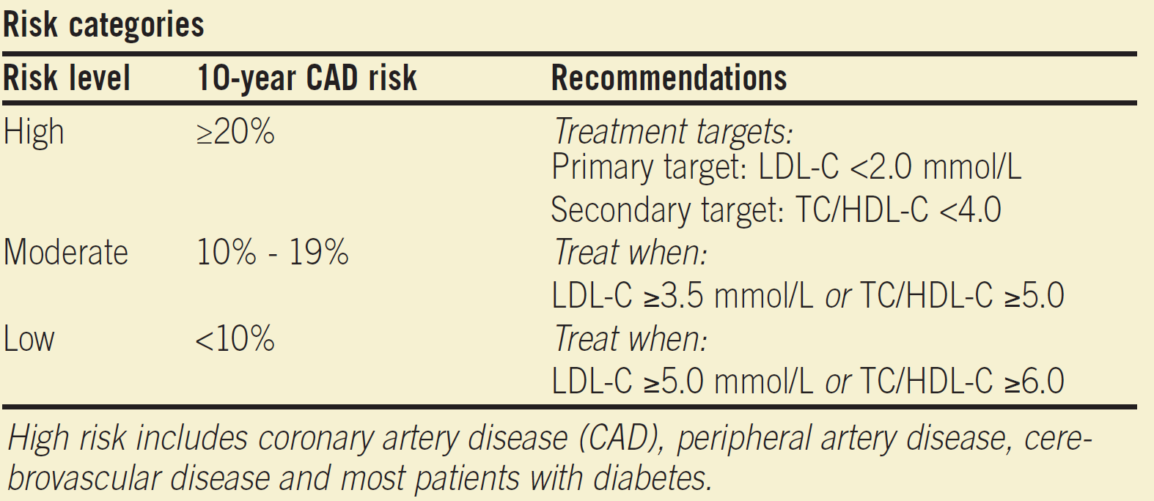
Canadian New Guideline

Slide 29
Treatment of Hyperlipidemia
Lifestyle modification
  Low-cholesterol diet
  Exercise

Slide 30
Medications for Hyperlipidemia
Drug Class | Agents | Effects (% change) | Side Effects
HMG CoA reductase inhibitors | Statins | ↓LDL (18-55),↑ HDL (5-15) ↓ Triglycerides (7-30) | Myopathy, increased liver enzymes
Cholesterol absorption inhibitor | Ezetimibe | ↓ LDL( 14-18), ↑ HDL (1-3) ↓Triglyceride (2) | Headache, GI distress
Nicotinic Acid |  | ↓LDL (15-30), ↑ HDL (15-35) ↓ Triglyceride (20-50) | Flushing, Hyperglycemia, Hyperuricemia, GI distress, hepatotoxicity
Fibric Acids | Gemfibrozil Fenofibrate | ↓LDL (5-20), ↑HDL (10-20) ↓Triglyceride (20-50) | Dyspepsia, gallstones, myopathy
Bile Acid sequestrants | Cholestyramine | ↓ LDL ↑ HDL No change in triglycerides | GI distress, constipation, decreased absorption of other drugs

Slide 31
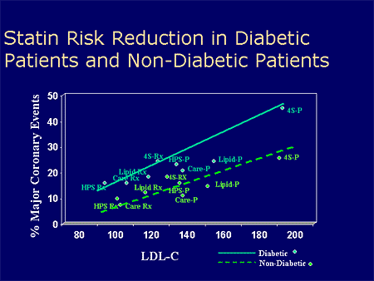
MI = myocardial infarction.
Adapted with permission from Robinson JG et al. J Am Coll Cardiol. 2005;46:1855–1862.
Notes:
Key Point¹:
This meta-regression analysis found that nonstatin (diet, bile acid sequestrants, and ileal bypass surgery) and statin interventions seemed to reduce CHD risk, consistent with a 1-to-1 relationship described by the National Cholesterol Education Program (NCEP).
Additional Background Information¹:
Results from a large number of studies with clinical events (eg, CHD, myocardial infarction [MI]) as end points showed that the risk for specific CHD events decreased as LDL-C decreased.
This relationship is strongly supported by the aggregate clinical trial evidence.
The figure shows the estimated change in the 5-year relative risk of nonfatal MI or CHD death associated with mean LDL-C reduction for the diet, bile acid sequestrant, surgery, and statin trials (dashed line) along with the 95% probability interval (dotted lines). The solid line has a slope of 1. The crude risk estimates from the individual studies are plotted along with their associated 95% confidence intervals.
MRC = Medical Research Council; LRC = Lipid Research Clinics; NHLBI = National Heart, Lung, and Blood Institute; POSCH = Program on the Surgical Control of the Hyperlipidemias; 4S = Scandinavian Simvastatin Survival Study; WOSCOPS = West of Scotland Coronary Prevention Study; CARE = Cholesterol and Recurrent Events study; LIPID = Long-Term Intervention with Pravastatin in Ischemic Disease; AF/TexCAPS = Air Force/Texas Coronary Atherosclerosis Prevention Study; HPS = Heart Protection Study; ALERT = Assessment of LEscol in Renal Transplantation; PROSPER = PROspective Study of Pravastatin in the Elderly at Risk; ASCOT-LLA = Anglo-Scandinavian Cardiac Outcomes Trial–Lipid Lowering Arm; CARDS = Collaborative Atorvastatin Diabetes Study.
Reference:
1. Robinson JG, Smith B, Maheshwari N, Schrott H. Pleiotropic effects of statins: benefit beyond cholesterol reduction? A meta-regression analysis. J Am Coll Cardiol. 2005;46:1855–1862.

Slide 32
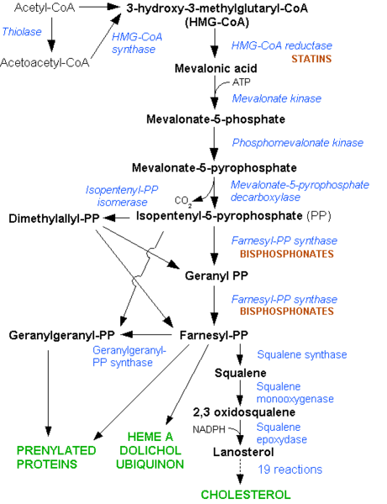

Slide 33
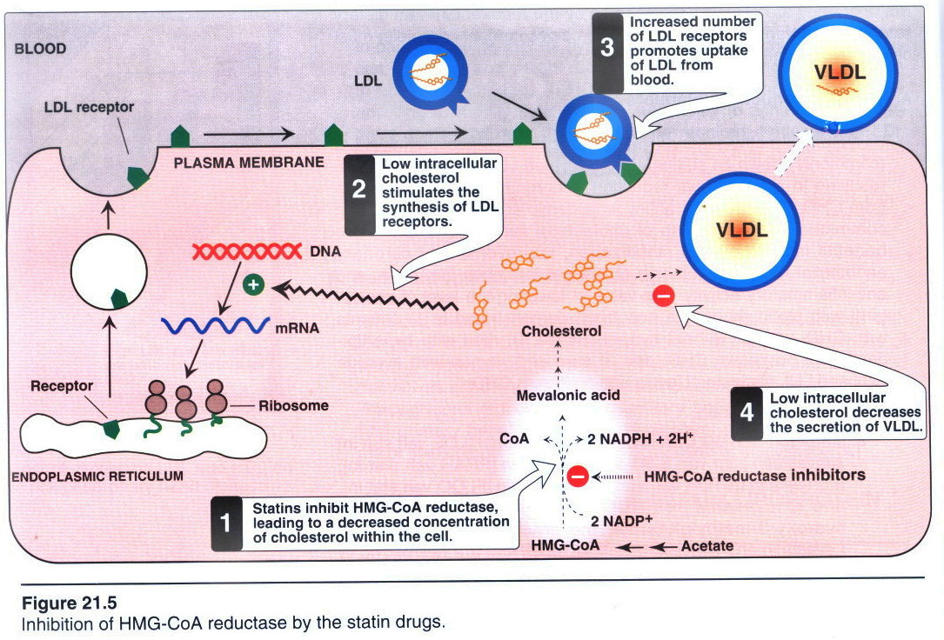

Slide 34
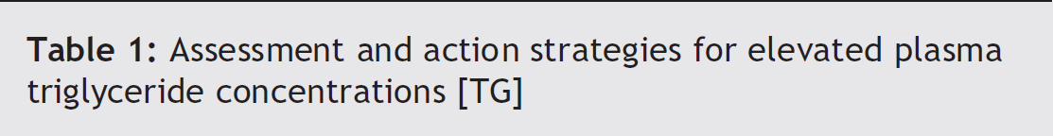
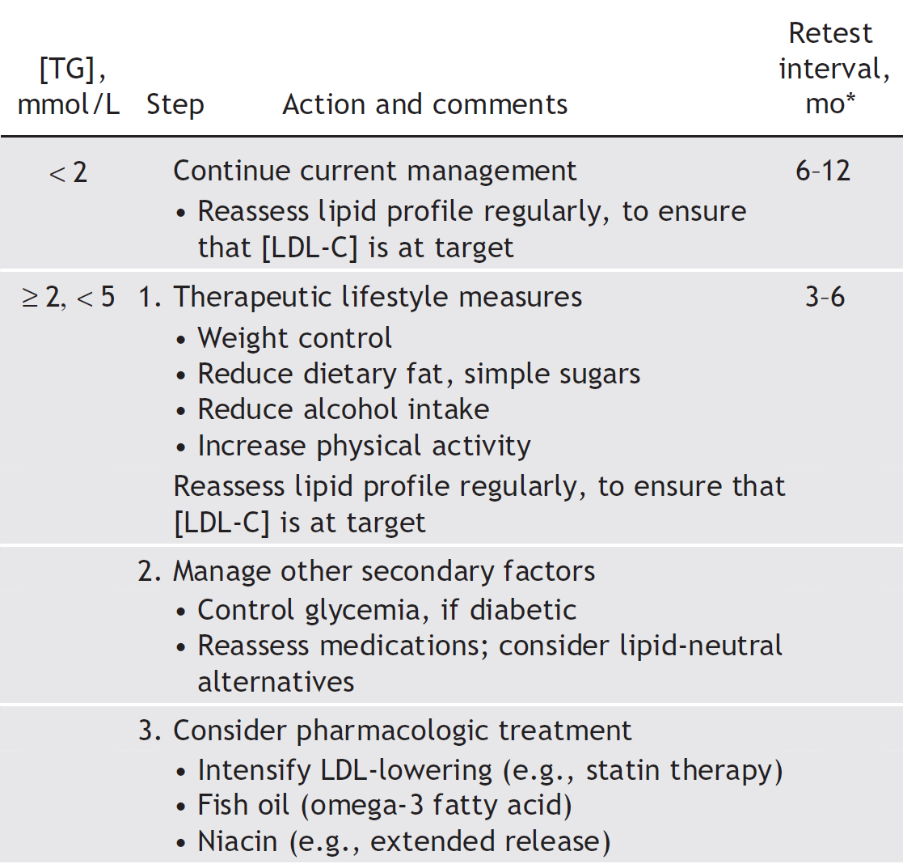

Slide 35
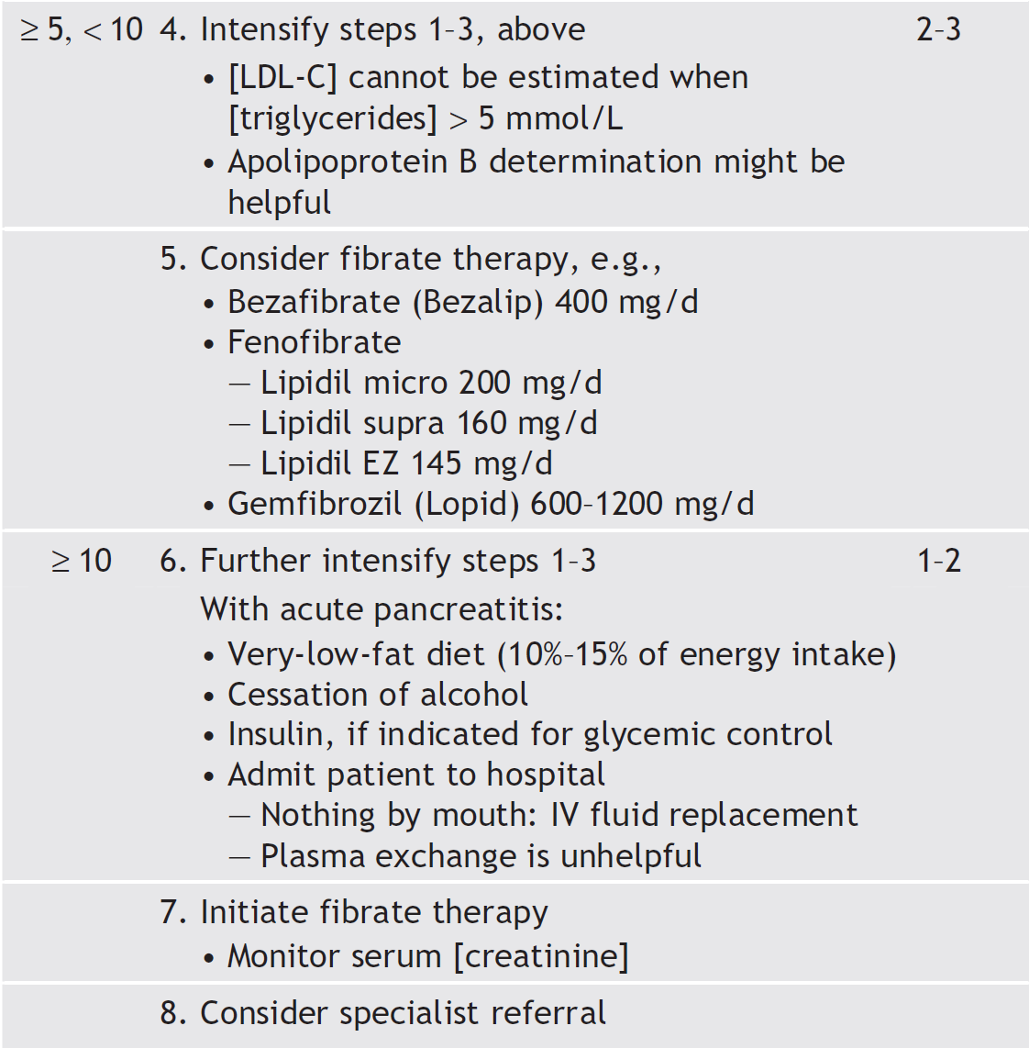
George Yuan, Khalid Z. Al-Shali, Robert A. Hegele
CMAJ • April 10, 2007 • 176(8)

Slide 36
THANK YOU ALL
drjammah@gmail.com
See you in 5th year MED-441 Course
Notes:
sd

